Slide 1
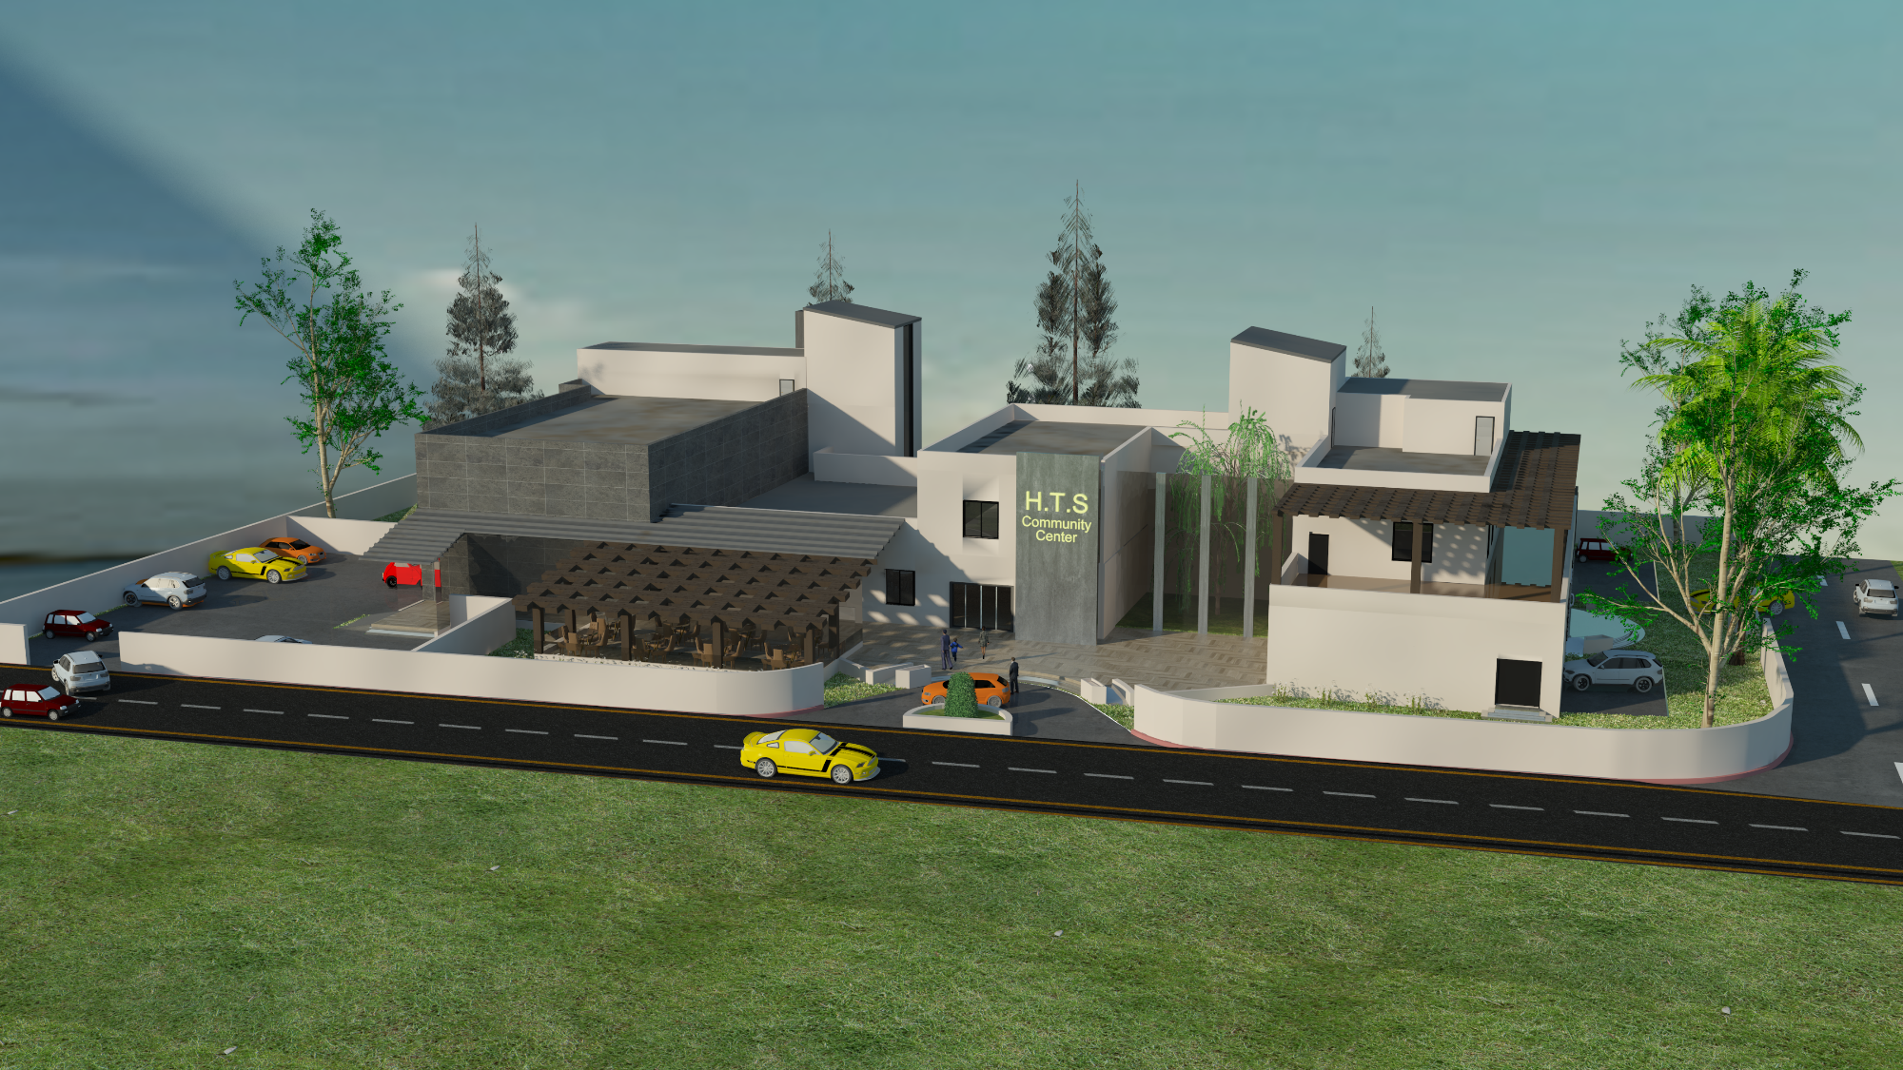

Graduation Project II
Hasan Abo Khalel
Talal Hijaze
Shafe Musleh
Community Center
Supervisor:
Dr. Hasan Mathar
Notes:
To use this title animation slide with a new image simply 1) move the top semi-transparent shape to the side, 2) delete placeholder image,
3) click on the picture icon to add a new picture, 4) Move semi-transparent shape back to original position, 5) Update text on slide.

Slide 2
Project Outline
Site Analysis
Architectural Design
Environmental Design
Structural Design
Mechanical Design
Electrical Design
Safety Design
Quantity Survey and Cost Estimate

Slide 3
1
Site Analysis

Slide 4
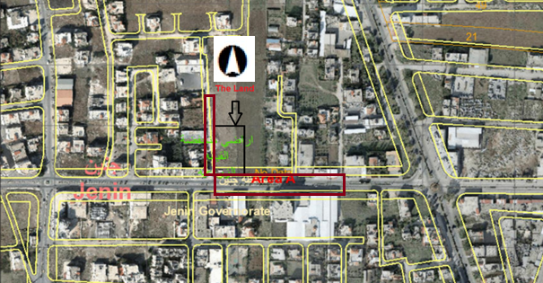
LOCATION

Slide 5
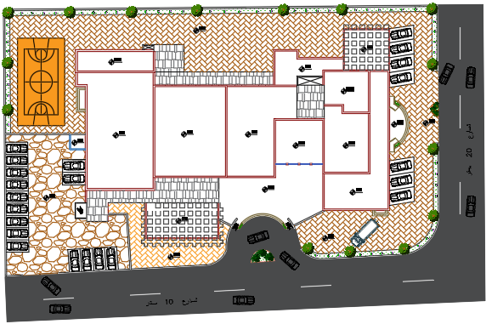
SITE PLAN

Slide 6
2
Architectural Design

Slide 7
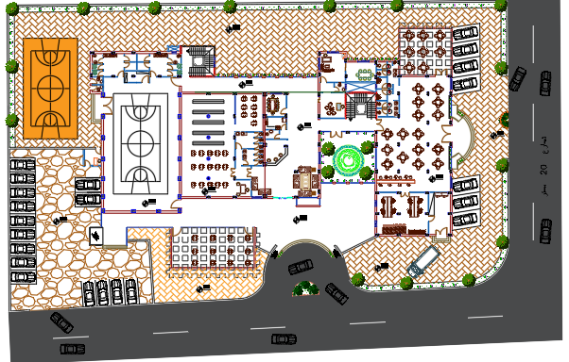
MASTER PLAN

Slide 8
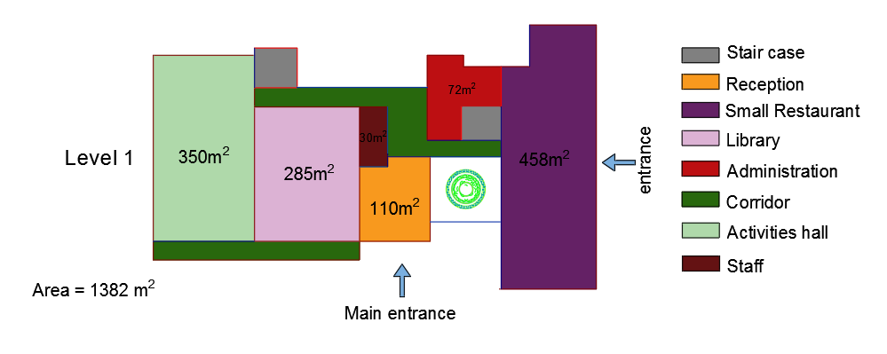
MASTER PLAN AREAS

Slide 9
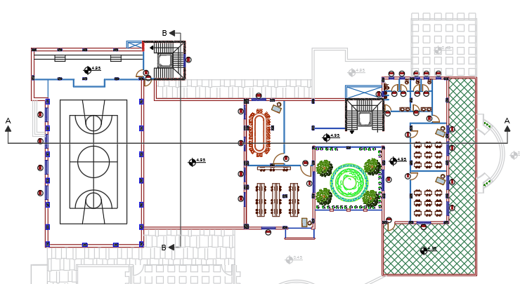
FIRST FLOOR

Slide 10
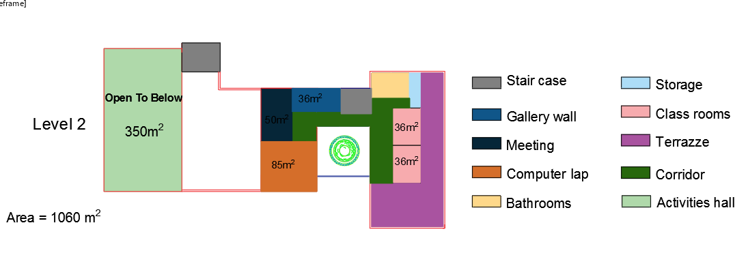
FIRST FLOOR AREAS

Slide 11
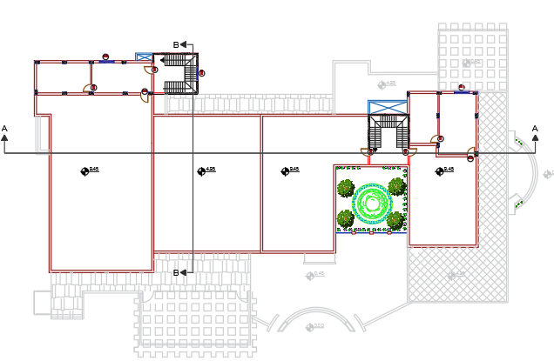
SECOND FLOOR

Slide 12
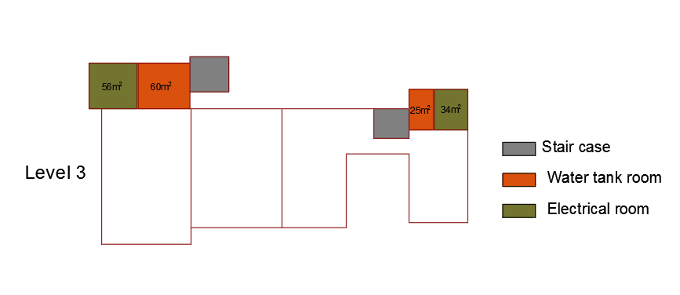
SECOND FLOOR AREAS

Slide 13
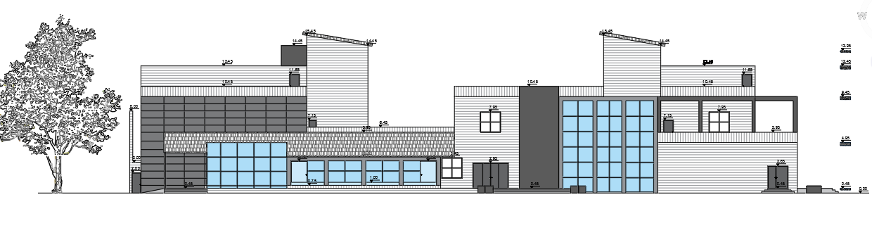
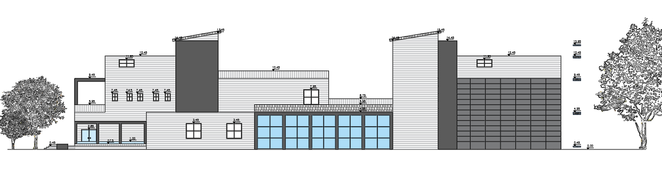
ELEVATIONS
West Elevation
East Elevation

Slide 14
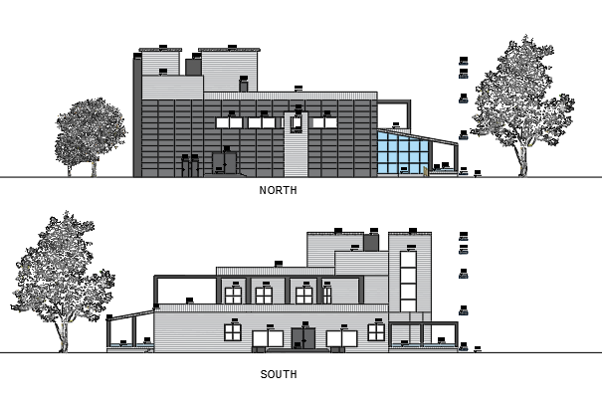
ELEVATIONS
North Elevation
South Elevation

Slide 15
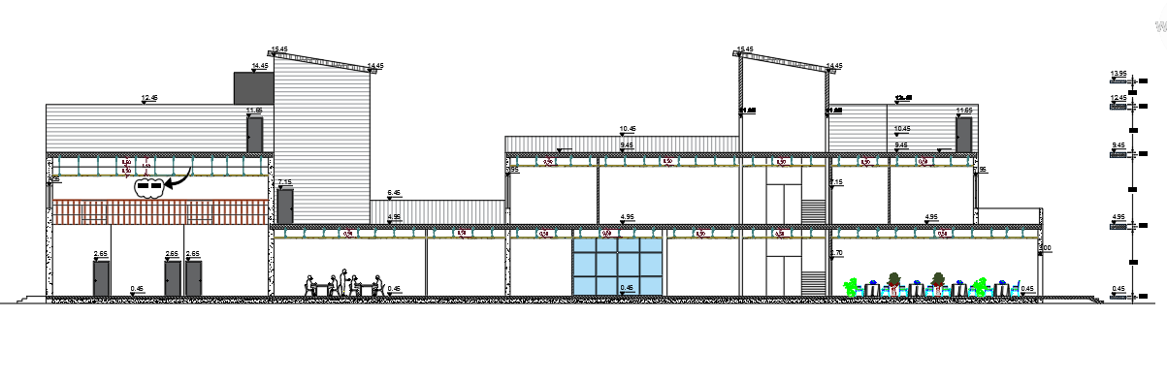
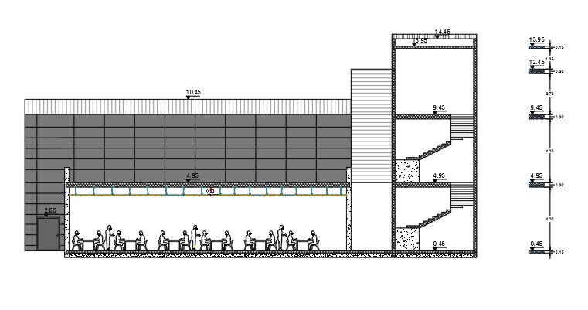
SECTIONS
Section A-A
Section B-B

Slide 16
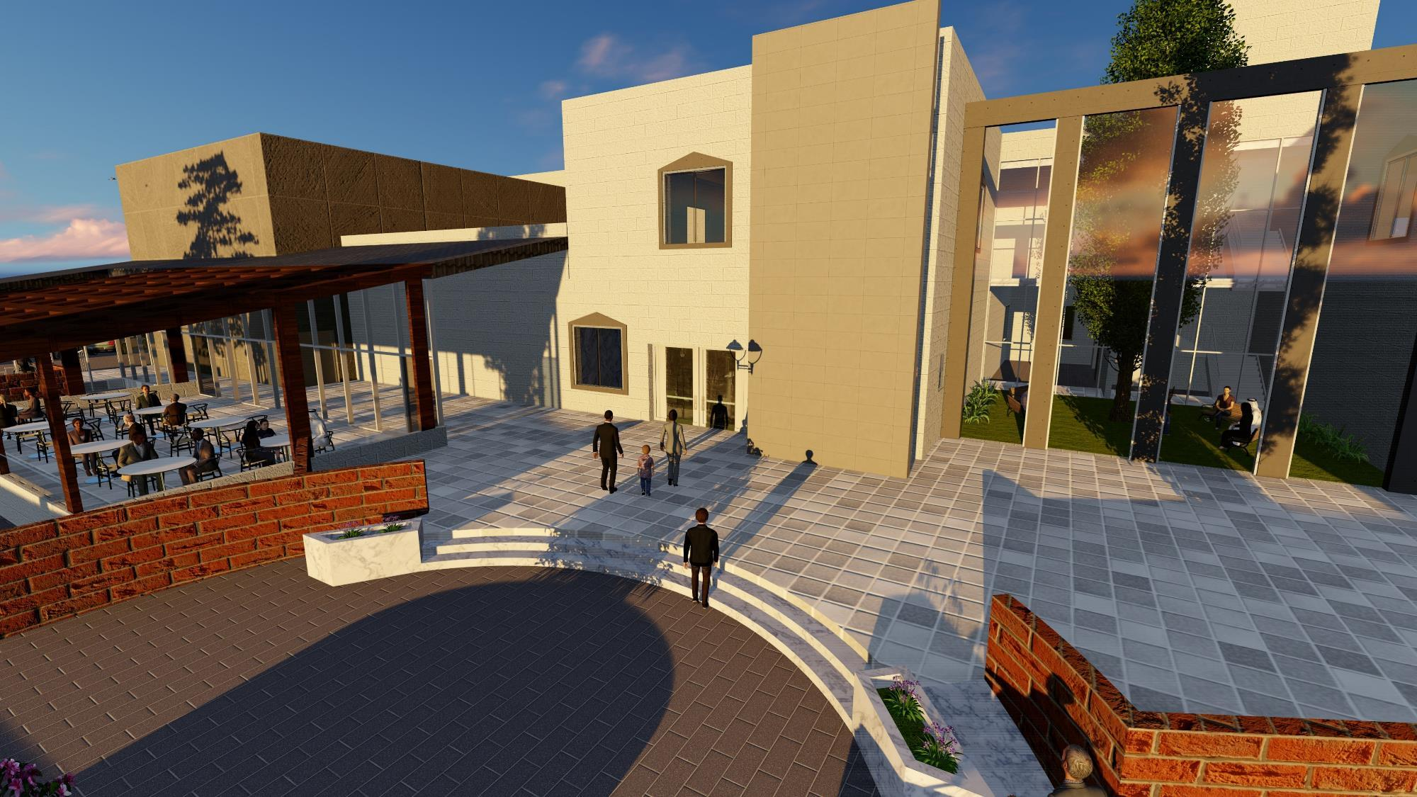

Slide 17
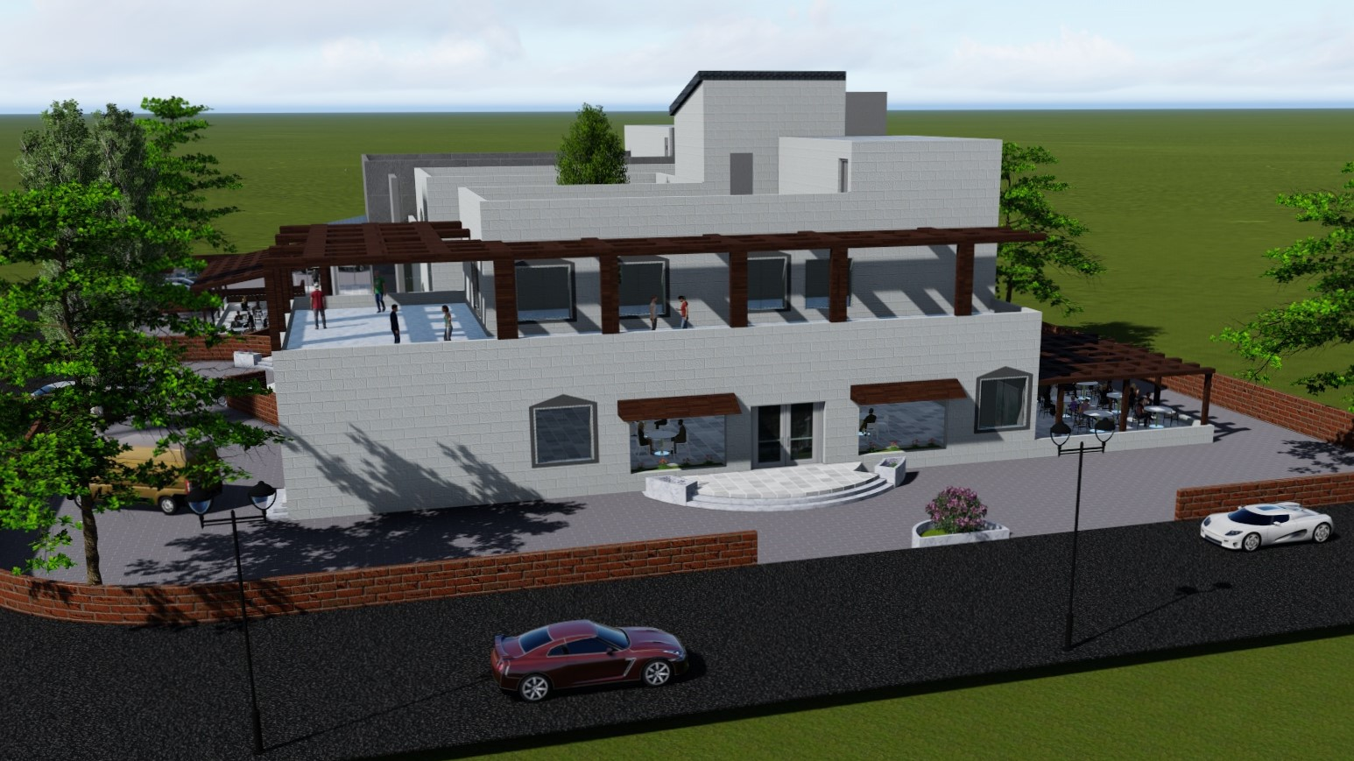
MASTER PLAN

Slide 18
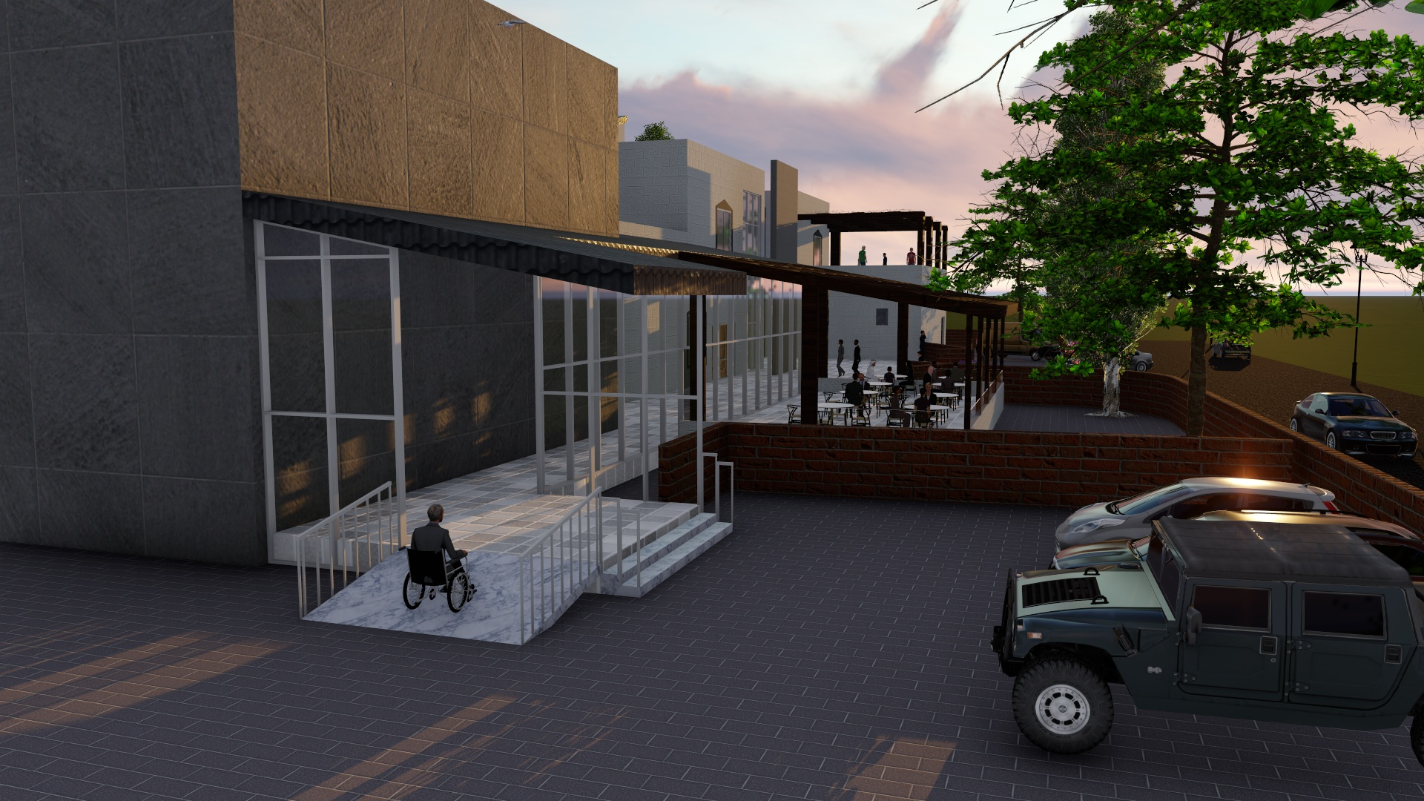

Slide 19
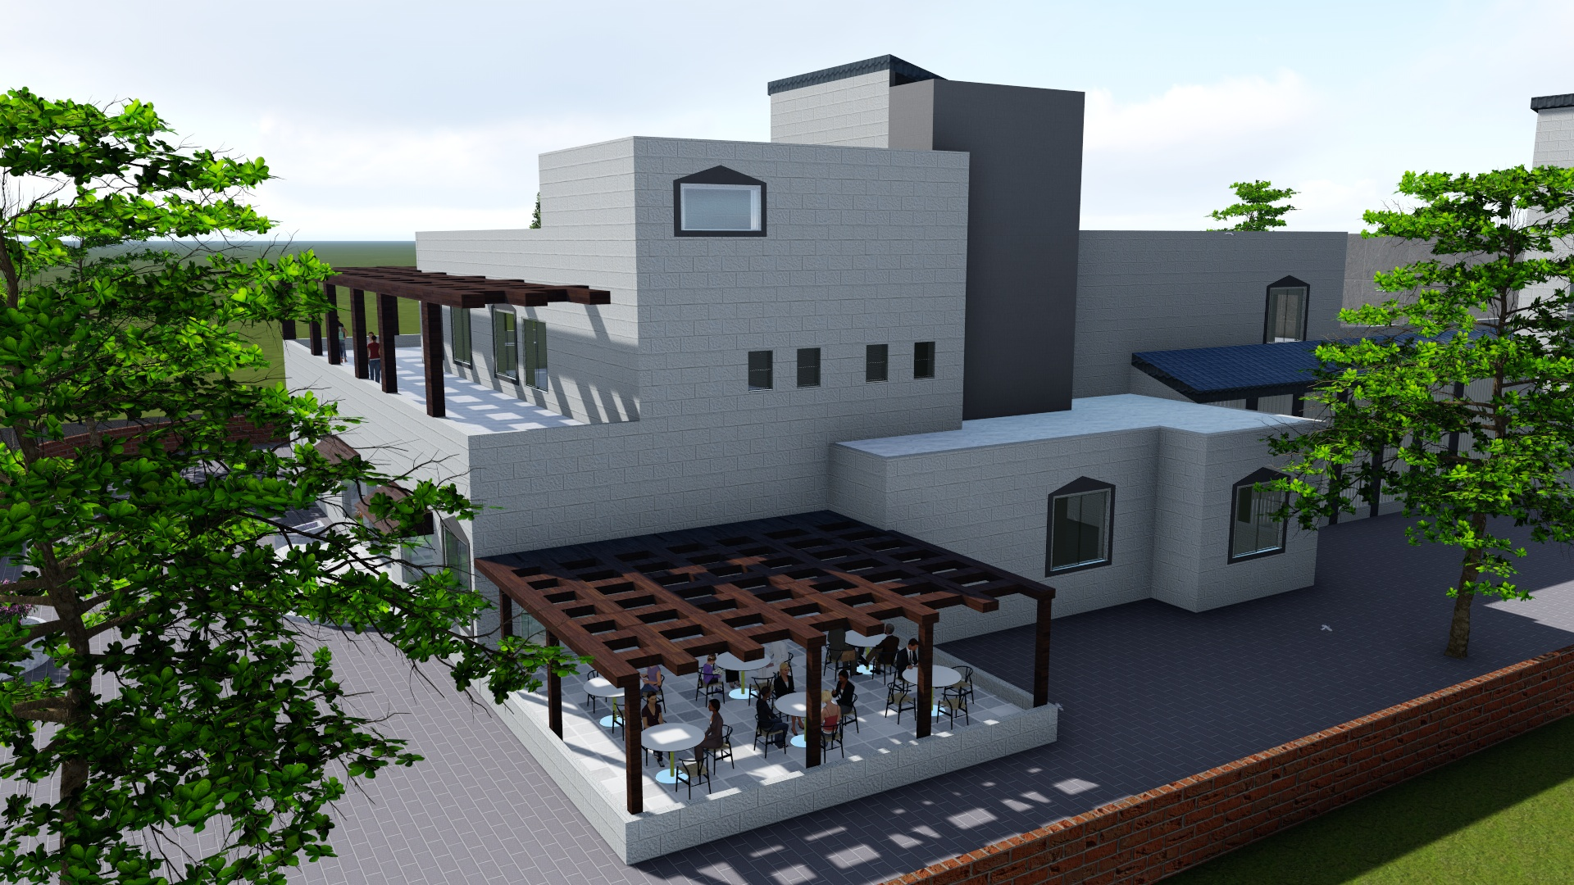
MASTER PLAN

Slide 20
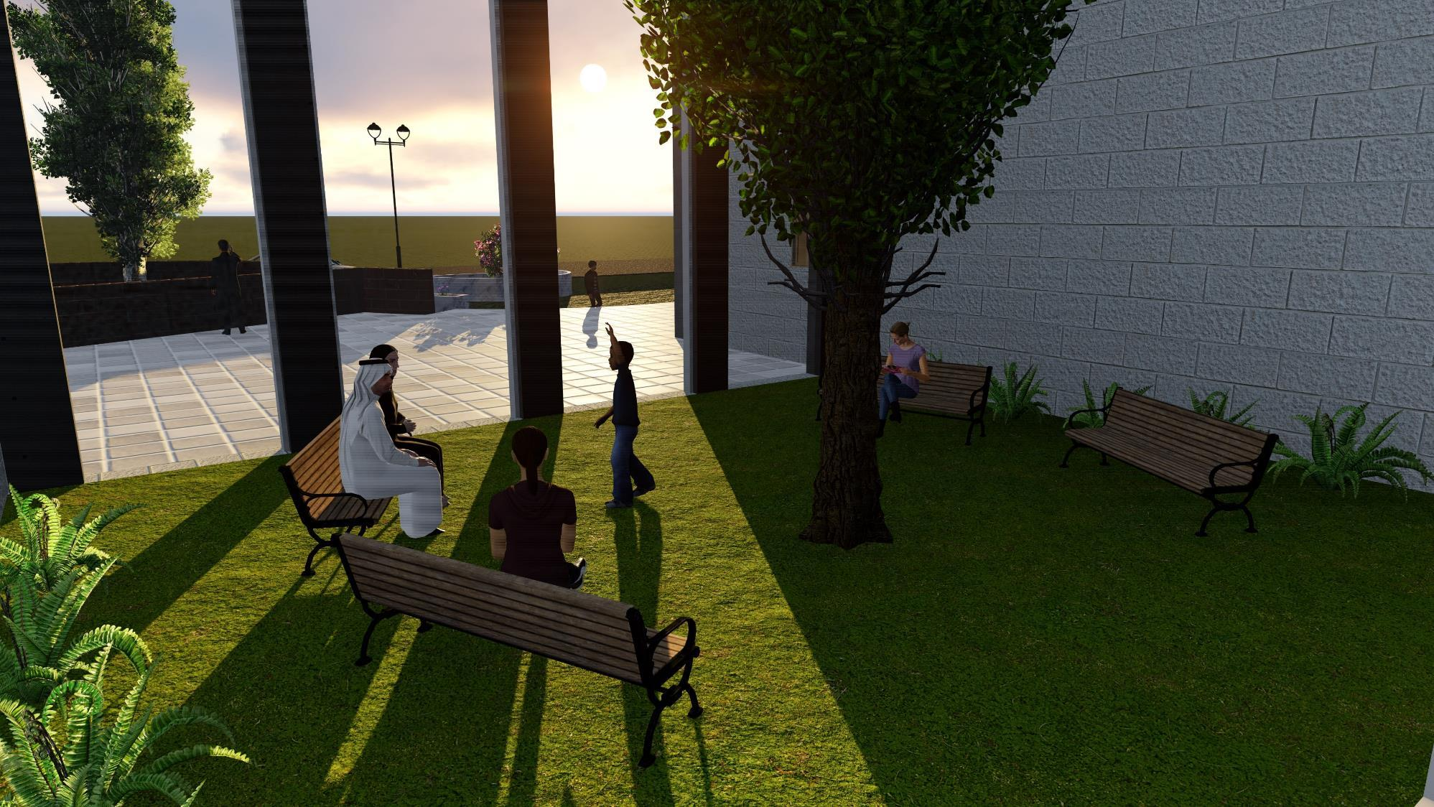
MASTER PLAN

Slide 21
3
Environmental Design

Slide 22
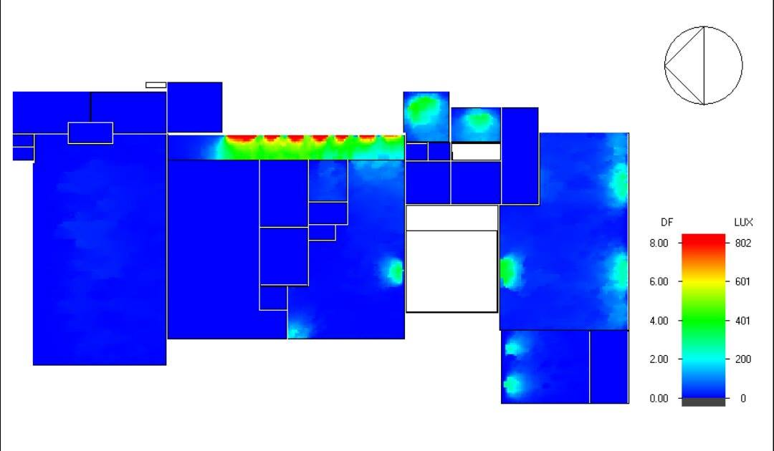
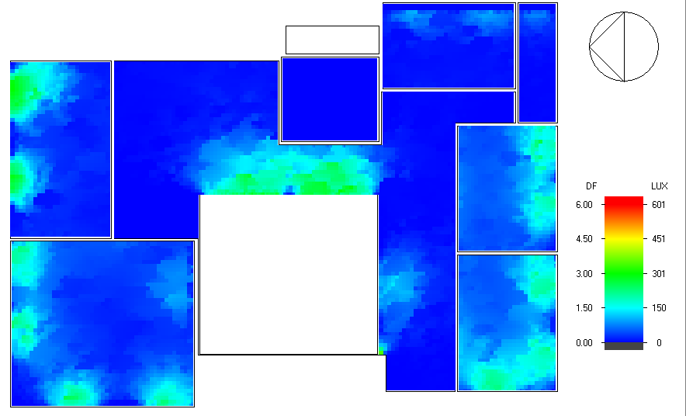
Daylight Factors
Ground Floor
First Floor

Slide 23
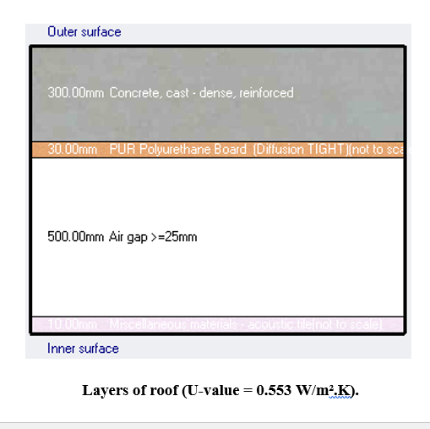
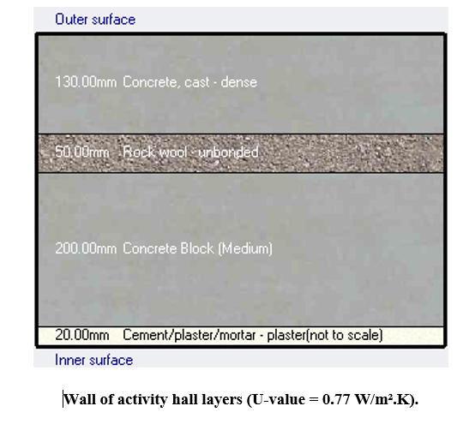
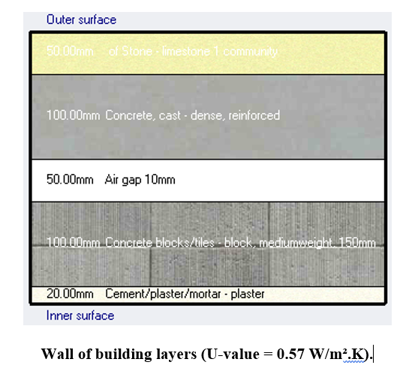
ENVELOP INSULATION
Detailing of Envelope Elements

Slide 24
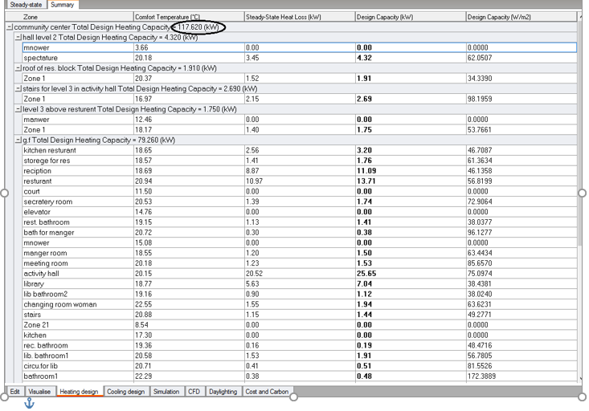
HEATING CAPACITY
Total heating load capacity = 117.62 kW

Slide 25
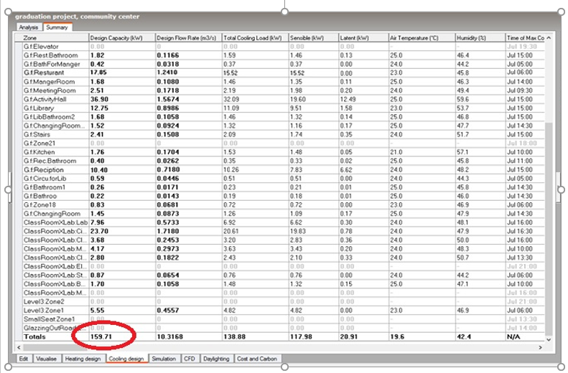
COOLING CAPACITY
Total cooling load capacity = 159.71 kW

Slide 26



ACOUSTICS
Absorption Coefficient for walls.
(Plaster)
Absorption Coefficient for ceiling.
(Acoustic tile suspended)
Absorption Coefficient for floor.
(Tile)

Slide 27
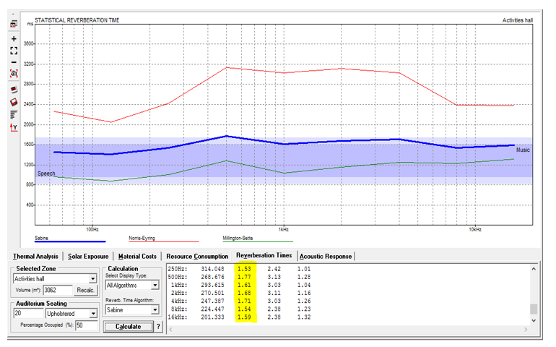
RT60
Activities hall
Range of RT60 for activities hall is from 1.6-2.1 seconds
RT60 =
1.77 at 500 HZ
1.61 at 1 KHZ

Slide 28
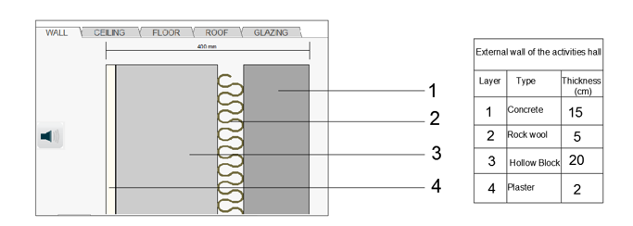
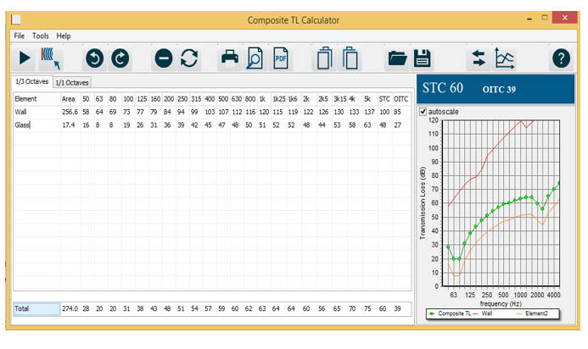
STC
Between Activities hall and the outside
STC = 60.00

Slide 29
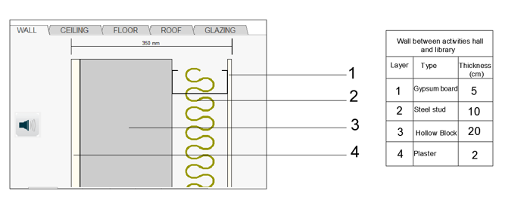
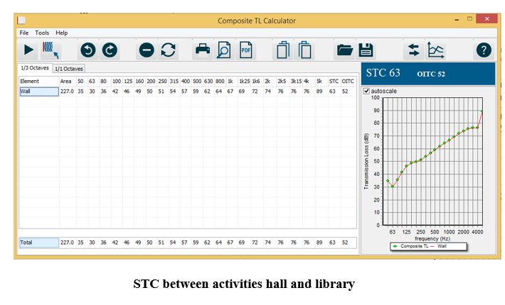
STC
Between Activities hall and Library
STC = 63.00

Slide 30
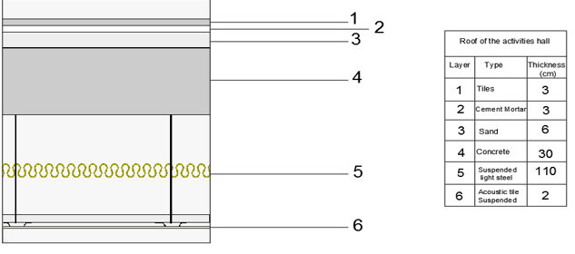
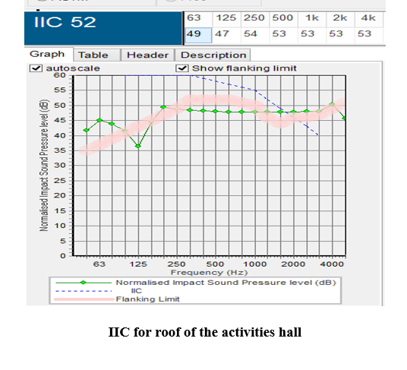
IIC
For Roof
IIC = 52.00

Slide 31
4
Structural Design

Slide 32
Design Codes
ACI -318-09 for reinforced concrete structural design.
UBC -97 for earthquake load computations.
ASCE for load computations.
The analysis and design were done using E-tabs program

Slide 33
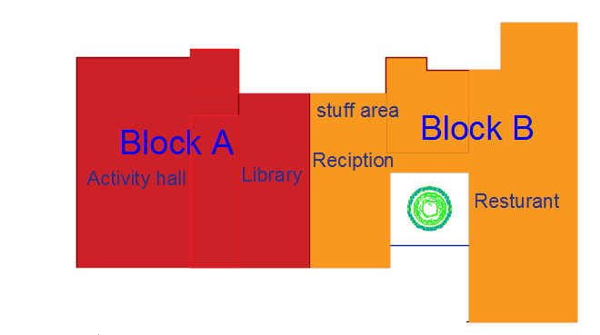
Structural Design
The project consists of two block separated by 5 cm structural joint.

Slide 34
Block A
Design Data:
Concrete F`c For slab, Beams, Columns, Shear walls and Footing = 28 MPa
Reinforcement steel: The yield strength of steel Fy= 420MPa.
Bearing Capacity For Soil 350 kN/m².

Slide 35
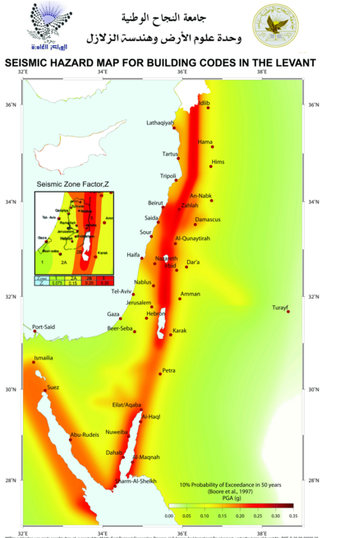
Seismic Design Data
Soil Type Sc
Location:
Jenin → Zone: 2B
→ Z = 0.2
Cv = 0.32
Ca =0.24
I =1
R = 5.5
In order to reach 90 % of mass participation we need 9 modes for UX and 8 mods for UY

Slide 36
Loads
Loads Used for Concrete blocks
Load type | Ground slab | First floor slab | second floor slab
Live | 4 KN/m² | 4 KN/m² | 4 KN/m²
SID | 3.5 KN/m² | 3.5 KN/m² | 3.5 KN/m²

Slide 37
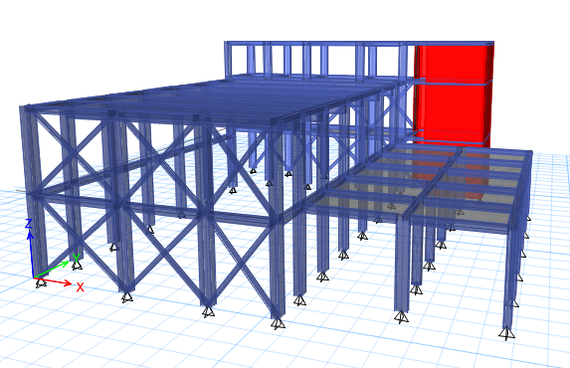
Structural Design
3D Structural Modeling For Block A

Slide 38
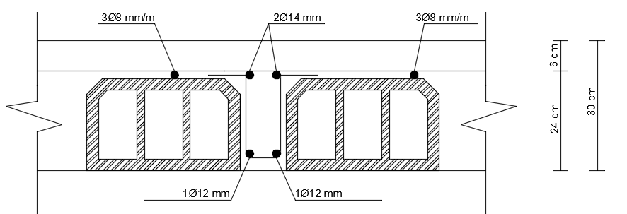
Structural Design
For Block A
Slabs
Structural system: One way ribbed slab withThickness = 30 cm .

Slide 39
Beams
Main beam
Column
Three types of column diminutions were used
Column 70x50 cm , circular column D=50cm
Column 60x30 cm
Secondary beam
Name of beam | Dimensions (mm)
B1 | 500*300
B2 | 500*300
B3 | 500*300
B6 | 900*600
Name of beam | Dimensions (mm)
B4 | 200*300
B5 | 400*300
b7 (ring beam) | 150*300

Slide 40
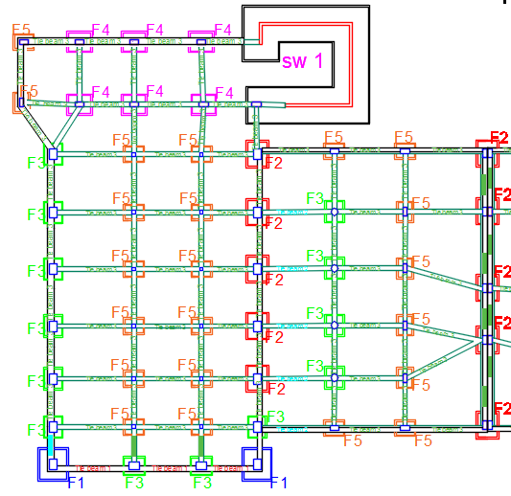
Foundation Design for the buildings
Using manual method we designed isolating
footing for the building
Footing type | Footing dimension mm | Depth (mm)
F1 | 2000*1800 | 450
F2 | 1600*1300 | 450
F3 | 1100*1300 | 450
F4 | 1500*1200 | 450
F5 | 1200*900 | 450
SW1 | B=2300 | 550

Slide 41
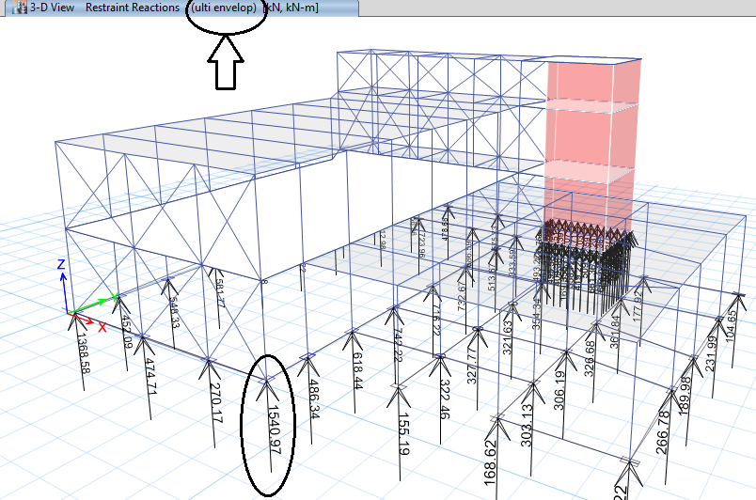
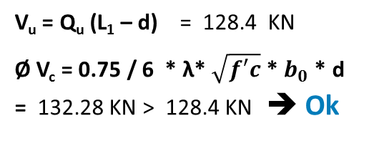
Footing checks:
check of thickness
V_{u} = Q_{u} (L₁ – d) = 128.4 KN
Ø V_{c} = 0.75 / 6 * λ* $\sqrt{f′c}$ * $b_{0}$ * d = 132.28 KN > 128.4 KN ➔ Ok
check of punching :
V_{u,punching} = p_{u} - A₁* Q_{U} , A₁ = (c₁ + d ) (c₂ + d )
= 1541 – (0.7 +0.35) (0.5 + 0.35 ) 428 = 1159 KN
Ø V_{c, punching} = 1760 KN > 1159 KN ➔ Ok

Slide 42
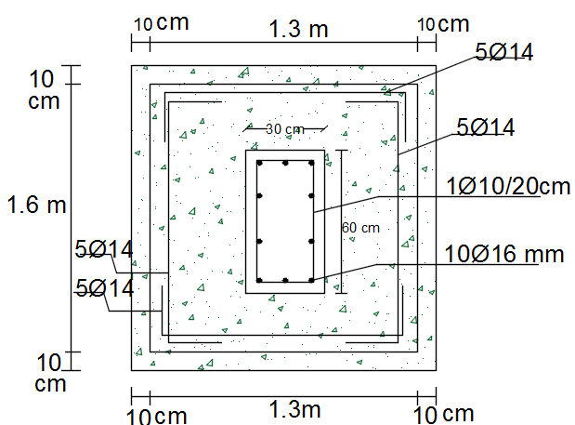
Footing Reinforcement
Footing type | Footing dimension mm | Depth (mm) | Reinforcement
F1 | 2000*1800 | 450 | 5Ø14
F2 | 1600*1300 | 450 | 5Ø14
F3 | 1100*1300 | 450 | 5Ø14
F4 | 1500*1200 | 450 | 4Ø16
F5 | 1200*900 | 450 | 5Ø14
SW1 | B=2300 | 550 | 4Ø25

Slide 43
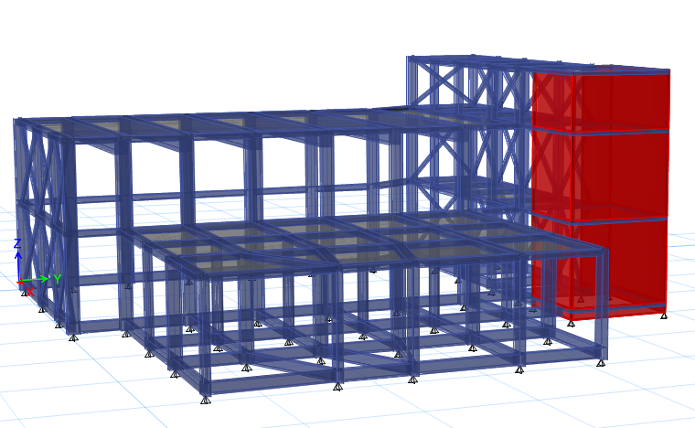
Tie Beam
Tie Beam Design for the buildings
3D Structural Modeling
For Block1 with tie beam
Load on Tie Beam
Uniform Load = own weight + wall
Own weight calculated by e-tabs
Wall weight = 7 KN/M² *Axial load = 0.1P

Slide 44
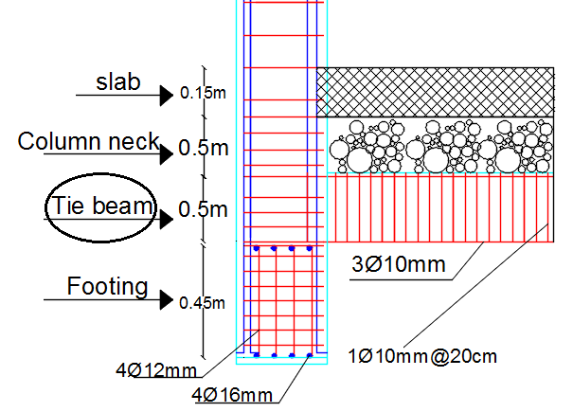
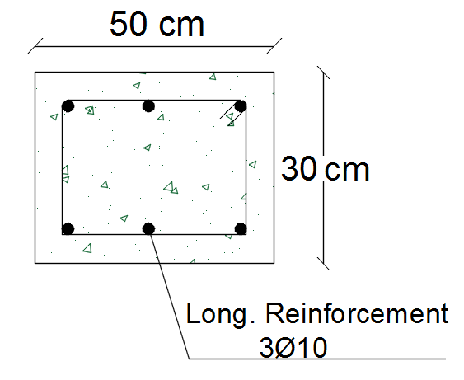
Tie Beam
Tie Beam Reinforcement:
NO. of Beam | Dimensions | top BARS | Bottom bars
B1 | 500*300 | 3Ø14 | 3Ø14
B2 | 500*300 | 3Ø12 | 3Ø12
B3 | 500*300 | 3Ø10 | 3Ø10
Section in tie beam3

Slide 45
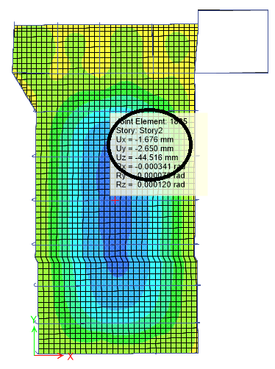
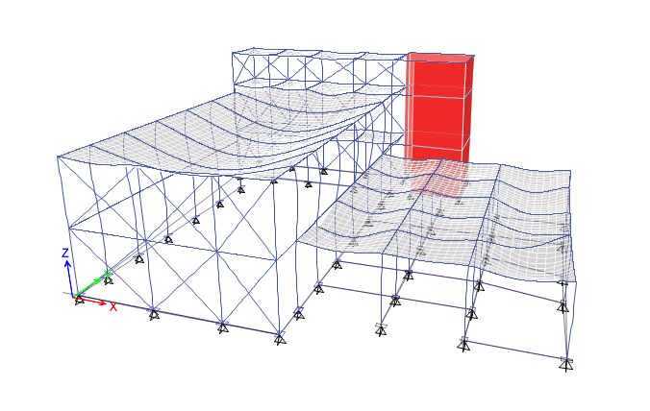
Checks
Max deflection in the model = 44.5 mm
Max allowable deflection in slab = L / 240
Max allowable deflection = 13.5 / 240 = 56 mm
➔ Ok
compatibility ok

Slide 46
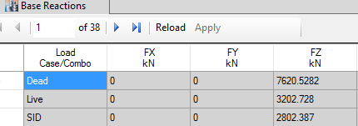
Checks
Load | ETABS-Results(KN) | Manual Results (KN) | Error
Dead Load | 7620.5282 | 7527 | 1.20%
Live Load | 3202.728 | 3203.12 | 0.01%
SID Load | 2802.387 | 2803.73 | 0.01%
Equilibrium Check
Error = ( ( Manual – ETABS Load ) / Manual Load ) X 100%

Slide 47
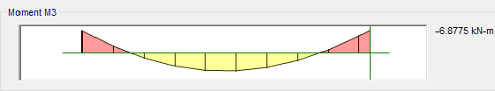
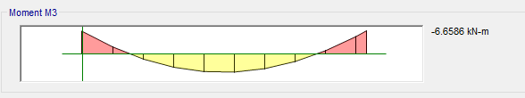
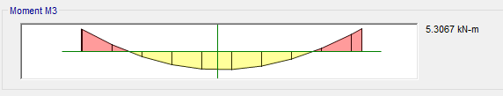
Checks
Internal Forces Check
From E-tab M = (M1+M2)/2 + M3
(6.6+6.8)/2+5.3 = 12
By hand M = W L² / 8 = 4* 5 ² / 8 = 12.5 ➔ ok

Slide 48

Seismic
Base shear (V) for seismic design
Manual calculation for ( V ) = 2230.89 KN.
From Etabs :
V by hand calculation > v by e-tabs V _{max} > v_{x-direction}
V_{max} > v_{y- direction}
The Check is OK

Slide 49

Seismic
Building period check
T=C*H^{0.75}
T= (0.0488 * (12)^{0.75})*1.4 = 0.435 sec
The period in E-tab is less than allowance
The Check is OK

Slide 50

Checks
Lateral building drift
According to UBC97 MAX. Drift should not exceeds 0.025 the story height for structure having period less than 0.7 sec.
4.5 * 0.025 = 11.25 mm
By take the maximum displacement in the building and the center of diaphragm
Δ m = 0.7 * R* δ
Where δ: is the drift difference between stories , Δm: structure drift.
R: reduction factor.
δ = 1.796-0 = 1.796
Δm = 0.7 * 5.5 * 1.796
Δm = 6.9 mm Δm < 6.9 mm
11.25 mm > 6.9 mm ➔ Drift is OK

Slide 51

Block A
Ribbed Slab Reinforcements in y– Direction For Block A:

Slide 52
Structural Design
Beams Reinforcements
NO. of Beam | Dimensions mm |  | Top BARS mm² |  | Bent |  | Bottom bars mm² | Stirrups
B1 | 500*300 |  | 5Ø16 |  | 2Ø16 |  | 4Ø16 | Ø10/15cm
B2 | 500*300 |  | 6Ø20 |  | 3Ø20 |  | 5Ø20 | 1Ø10/15cm
B3 | 500*300 |  | 5Ø20 |  | 2Ø20 |  | 4Ø20 | 2Ø8/15cm
B4 | 200*300 |  | 2Ø12 |  |  |  | 3Ø12 | 1Ø10/15cm
B5 | 400*300 |  | 4Ø12 |  |  |  | 4Ø12 | 2Ø8/15cm
B6 | 900*600 |  | 7Ø20 |  | 4Ø20 |  | 4Ø20 | 1Ø10/10cm
b7 (ring beam) | 150*300 |  | 2Ø10 |  |  |  | 2Ø10 | 1Ø8/15cm

Slide 53


Beams
Reinforcements

Slide 54




Columns
Reinforcements

Slide 55



Shear walls
Reinforcements

Slide 56

Stairs
Reinforcements

Slide 57
5
Mechanical Design

Slide 58



HVAC

Slide 59

HVAC
VRF System
 | Volumetric flow rate (m3/s) | # of diffusers
Activities hall | 1.567 | 9
Restaurant | 1.241 | 7
Reception | 0.737 | 4
Library | 0.898 | 6

Slide 60

Water Supply
Water consumption of community center = 20 g per person
The community center is used 12 hours in a day, so the consumption of the community center which is used by nearly 70 persons 20*70 = 1400 g
The consumption of water per day = 1400 g * 0.5 day= 700 g per day.
= 2660 liter per day
Assume that there is 3 day with no water supply from municipality.
We use 6 water tanks with 1.5 cube for each one.

Slide 61

Drainage
Septic tank is used to collect sewer, then we pump waste to the main sewerage network

Slide 62

Storm Water
For storm water, we designed a water tank to collect storm water with volume = 36 m³.
We used this storm water for trees.

Slide 63
6
Electrical Design

Slide 64

Lighting Design
Artificial Lighting Design

Slide 65


Lighting Design
Artificial Lighting Design

Slide 66



Lighting Design
Artificial Lighting Design

Slide 67


Lighting Design
Artificial Lighting Design

Slide 68


Lighting Design
Artificial Lighting Design

Slide 69


Lighting Design
Artificial Lighting Design

Slide 70

Lighting Design
Electricity Calculations
Lighting distribution in ground floor.

Slide 71

Sockets Design
Electricity Calculations
Sockets distribution in the first floor.

Slide 72


Control Panel
Electrical control panel system

Slide 73
7
Safety Design

Slide 74

Safety Design

Slide 75

Safety Design

Slide 76


Safety Design
Fire alarm device
Hose and extinguishers cabinet

Slide 77
8
Quantity Survey & Cost Estimate

Slide 78
Quantity Survey & Cost Estimate
B.O.Q.
Total Project Cost = 1,600,810.0 $ = 6,403,240.0 NIS.
Total Cost per m2 = 615.7 $ /m2 .

Slide 79

Thank You ☺
Notes:
To use this title animation slide with a new image simply 1) move the top semi-transparent shape to the side, 2) delete placeholder image,
3) click on the picture icon to add a new picture, 4) Move semi-transparent shape back to original position, 5) Update text on slide.

