Slide 1

Faculty of Engineering & Information Technology
Civil Engineering Department
Graduation Project
Conceptual design of Al-Malaqi dam at Faria
Prepared by:
Saleh Melhem; Bashar Najjar
Under the direction of
Dr. Isam Jardaneh
A graduation project submitted to Civil Engineering Department in partial fulfillment of the requirement for the degree of B.Sc in Civil Engineering

Slide 2
Chapter Five
Dams in Palestine
5.1 Introduction
In Palestine, there are a group of dams that were constructed for various purposes. Some of these dams were intended to recharge groundwater and wells, while others were intended to collect rainwater behind them to use for irrigating crops after the end of the winter instead of useless leakage of rainwater.
But unfortunately, the dams in Palestine did not serve the purpose for which they were created after a heavy rainy season, the dams built in Palestine are supposed to overflow, but this did not happen the water barely lasts a week or two behind the dam and quickly seeps into the ground without benefit. This is all due to negligence and lack of Follow-up and lack of good planning

Slide 3
Dams in Palestine
The dams in Palestine are:
Beit Rosh Dam.
Bani Naim Dam.
Al Faraa Dam.
Al Awja Dams.

Slide 4
Dams in Palestine
5.2 Beit Rosh Dams
This dam was constructed in the city of Hebron in the village of Beit al-Rush al-Fawqa with funding from the Arab Authority for Agricultural Investment and Development. The dam expands to about 220,000 cubic meters of rainwater, but the water quickly evaporates and is swallowed by the ground as a result of cracks in the ground, even though it is the largest dam in Palestine and reaches the area of land on which the dam is built is 50 dunums. The dam serves about 1,000 dunums of agricultural land surrounding the dam. The dam works to increase agricultural work and provide new types of crops.

Slide 5
Dams in Palestine
5.3 Bani Naim Dam
This dam was constructed in the city of Hebron in the village of Masafer Bani Naim this dam was constructed to find a radical solution to the problem of water shortage in the summer. This dam can accommodate about 100,000 cubic meters of rainwater, which would support the agricultural and livestock sector in the region.

Slide 6
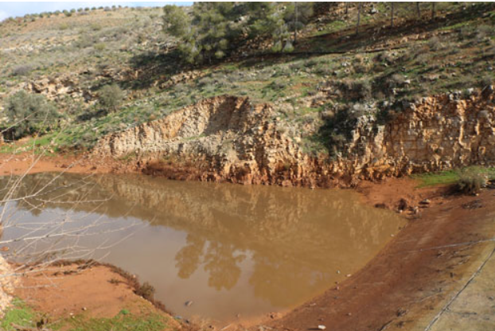
Dams in Palestine
5.4 Al Farea Dam
This dam was constructed in Tubas Governorate in the village of Wadi Al-Fara’a it is considered the first dam constructed in Palestine its primary goal was to collect rainwater to replenish the underground reserve, but on the contrary, the dam turned into a water swamp due to rainwater mixing with sewage water due to a leakage. Wastewater flows through the cracks in the dam and mixes with rainwater

Slide 7
Dams in Palestine
5.5 Al Awja Dam
This dam was constructed in the Al-Auja area in Jericho Governorate, with a storage capacity of 700,000 cubic meters this dam will contribute to improving biodiversity in the Jordan Valley area, as well as improving the vital water reserve in addition, it was established to develop the management of natural resources in a sustainable manner and to develop agricultural water sources and organize their optimal use the idea of constructing the dam is due to the drought that has afflicted the region since 2000, which in turn affected the amount of water and the decline in agricultural area, and also because of Israeli control over water sources in the region and preventing Palestinians from benefiting from them. Hence came the idea of constructing the Al-Auja Dam, which will be used by the people of Al-Auja and the Jordan Valley, since this area constitutes the Palestinian food basket, and with the presence of the dam, the agricultural season will be extended to at least two months, and the dam’s floor area is about 150 dunums.

Slide 8
Chapter Six
General Aspects of Earth Fill Dams Design
6.1 Introduction
This chapter summarizes the main aspects of earth fill dams design components, including, core, shell, top width, slopes,
Components of Earth Fill Dams
The dam consists of a group of different elements, and each of these elements must be designed appropriately in order to ensure the safety of the dam and its design in the correct manner and in accordance with the engineering specifications. In this part of the project, we will talk about each of these elements.

Slide 9
General Aspects of Earth Fill Dams Design
6.2 Top Width of Earth Fill Dams
The top width or crest width of dam should be sufficient to withstand seismic forces and wave action. The seepage line should be within the dam width when the reservoir is full. The top width of a dam is decided based on the height of dam. Following are the formula for top width for different heights of dams.
For vary low dam:
W = H/5 + 3
For dams lower than 30 m
W = 0.55(H)1/2 + H/5
For dams higher than 30 m
W = 1.65(H + 1.5)1/3
W=Z/5+10
Where:
Z: height of dams in foot
W: Top width of dams in foot

Slide 10
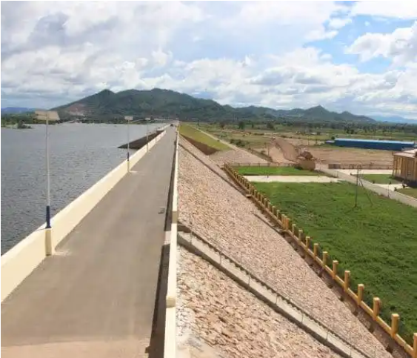
General Aspects of Earth Fill Dams Design
Top Width of Earth Fill Dams
Figure 6.1 Top Width of Dams

Slide 11
General Aspects of Earth Fill Dams Design
6.3 Central Core of Earth Fill Dams
Central core of dam is made of impervious materials and it acts as a barrier against seepage flow of water through dam. The shear strength of core materials should be less than that of embankment materials. Sometimes there is chance of seepage occurrence due to capillary action of water to prevent this, the height of central core should be minimum 1 m more than the maximum reservoir level and its thickness should not less than 50% of maximum head of water. Different types of soils classified based on gradation and their suitability for core construction is tabulated below.

Slide 12
General Aspects of Earth Fill Dams Design
Central Core of Earth Fill Dams
Table 6.1: Type of soil and Suitability for core construction
Type of Soile | Suitability
Very well graded mixtures of sand, gravel and fines of which 15% of material (D85) are coarser than 50 mm and 50% of material (D50) are coarser than 6 mm. | Very Good
Well graded mixture of sand, gravel and clayey fine, D85 coarser than 25 mm. Fines consisting of inorganic clay (clay with plastic index > 12) or high plastic tough clay (clay with plastic index > 20). | Good
Fairly well graded, gravelly, medium to coarse sand with cohesion less fines, D85 coarser than 19 mm, D50 between 0.5 to 3 mm. Clay of medium plasticity (clay with plastic index > 12) | Fair
Clay of low plasticity with little coarse fraction. Plastic index between 5 to 8, liquid limit > 25 Silts of medium to high plasticity with little coarse fraction having plastic index greater than 10. | Poor

Slide 13
General Aspects of Earth Fill Dams Design
6.4 Outer Shell of Earth Fill Dams
Outer shell also called as casing and its function is to protect the central core of dam. It covers the upstream and downstream slopes and is made of pervious soil. The slope maintained on both sides of dam is decided based on the type of soil used.

Slide 14
General Aspects of Earth Fill Dams Design
Outer Shell of Earth Fill Dams
Table 6.2: Upstream and Downstream slops of shell
Type of soil | Upstream Slope (H: V) | Downstream Slope (H: V)
Homogeneous well graded | 2.5:1 | 2:1
Homogeneous course silt | 3:1 | 2.5:1
Homogeneous silty clay (H < 15 m) | 2.5:1 | 2:1
Homogeneous silty clay (H > 15 m) | 3:1 | 2.5:1
Sand with clay core | 3:1 | 2.5:1

Slide 15
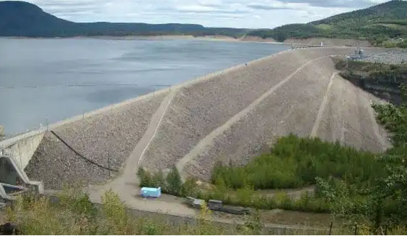
General Aspects of Earth Fill Dams Design
6.5 Berms of Earth Fill Dams
Berms are provided in earth fill dams to perform following functions.
1.To observe the conditions of slope protection.
2.For maintenance and repair works purposes.
Berms are provided on downstream side with a width of 1 - 2 m and at a height interval of 10 to 15 m.
Figure 6.2: Berms of Earth Fill Dams

Slide 16
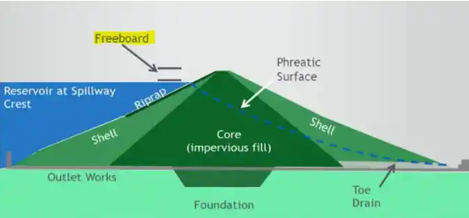
General Aspects of Earth Fill Dams Design
6.6Free Board of Earth Fill Dams
Freeboard is the vertical distance between the crest of dam to the water level surface. If the vertical distance is measured from normal pool level to the top of dam, then it is called as Normal freeboard. If it is taken from maximum reservoir level to the top of dam then it is known as minimum freeboard. The distance between normal and minimum freeboards is called surcharge head. For any type of dam, adequate freeboard must be provided to prevent over-topping.
Figure 6.3: Freeboard of earth fill dams

Slide 17
General Aspects of Earth Fill Dams Design
Free Board of Earth Fill Dams
Table 6.3: Minimum value of freeboard
Type of Spillway | Height of Dam | Minimum Freeboard
Uncontrolled spillway | For all heights | 2 – 3 m
Controlled Spillway | Up to 60 m | 2.5 m
Controlled Spillway | More than 60 m | 3 m

Slide 18
General Aspects of Earth Fill Dams Design
6.7 Cut off Trench of Earth fill Dams
The seepage loss of water through foundation and abutment of earth dam can be prevented by cutoff trench. Subsurface erosion affected by the piping action can also be prevented by providing cutoff trench. Following are guidelines to be considered while designing cutoff trench for earth fill dam.
Following are guidelines to be considered while designing cutoff trench for earth fill dam.
The center line of cutoff should be within the base of impervious central core.
Bottom width of cutoff trench should be at least 4 m.
Back fill material used for cutoff trench should same as the material used for impervious core.
The positive cutoff should be provided at least to a depth of 0.4 m into continuous impervious sub-stratum.
If there is a weathered rock stratum or rock formation with cracks and joints is found then cutoff trench should be terminated.

Slide 19
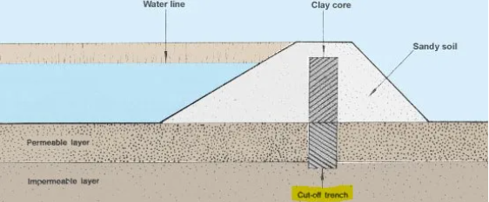
General Aspects of Earth Fill Dams Design
Cut off Trench of Earth fill Dams
Figure 6.4: Cut-off trench of earth fill dams

Slide 20
General Aspects of Earth Fill Dams Design
6.8 Slope Protection of Earth Fill Dams
Both upstream and downstream side of earth dam are subjected to different type of problems and to prevent this slope protection is required upstream slope of dam is always subjected to wave action by water and deterioration of dam may occur. To prevent this, 300 mm rock rip-rap layer is provided using stone boulders or hand packed stones it is constructed over 150 mm filter layer downstream slope of dam may damage due to severe rains or during floods the cheap and best method to protect the slope on downstream side is by planting grass on it then the water will easily slip away from the surface.

Slide 21
General Aspects of Earth Fill Dams Design
6.9 Spillway in dams
Spillways are structures that either form part of a dam, or are found just beside one. They are used, when a reservoir is full, to pass floodwater safely, and in a controlled way, over a dam, around it or through it. Here are some of the different types you may see:
1)Overflow spillways.
2)Side Channel spillways.
3)Shaft spillways.
Spillways are not the only outlets for reservoir water. Other outlets are built into the dam or away from it to let water out for a number of uses. These are some of the different types of outlets:
1)Outlet towers.
2)Compensation water.
3)Scour.

Slide 22
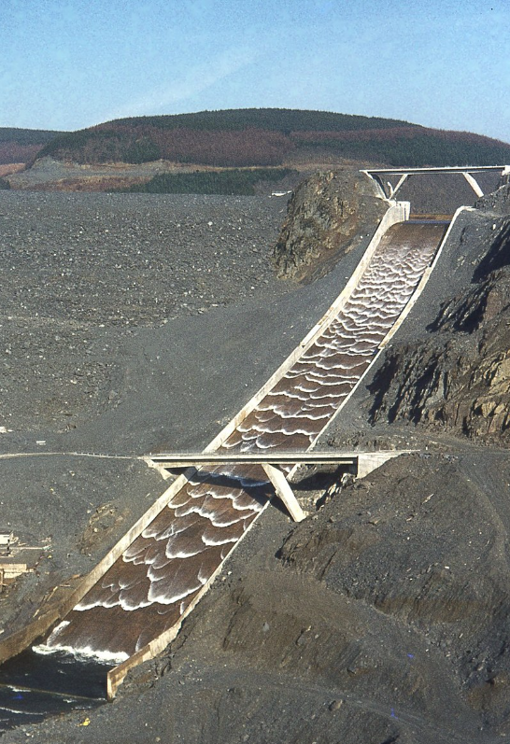
General Aspects of Earth Fill Dams Design
Spillway in dams
Figure 6.5: Spillway in dams

Slide 23
General Aspects of Earth Fill Dams Design
6.10 Drainage systems in Earth Fill Dams
Two type of drainage systems are required for the earth dams and they are:
Internal Drainage System
Surface Drainage System
Internal Drainage System: Internal drainage system is provided for the safe disposal of seepage water the filter material generally used in this system is sand, gravel. The seepage water is disposed through

Slide 24
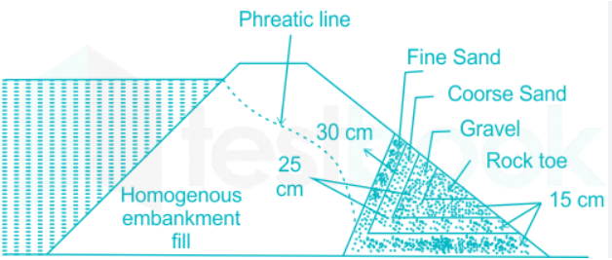
General Aspects of Earth Fill Dams Design
Drainage systems in Earth Fill Dams
Internal Drainage System
Rock Toe: in this arrangement stone size which varying from 15cm to 20cm is arranged in the downstream toe end of the dams which consist of fine sand, Corse sand, and gravel as shown in the figure below
Figure 6.6: Rock toe internal drainage system

Slide 25
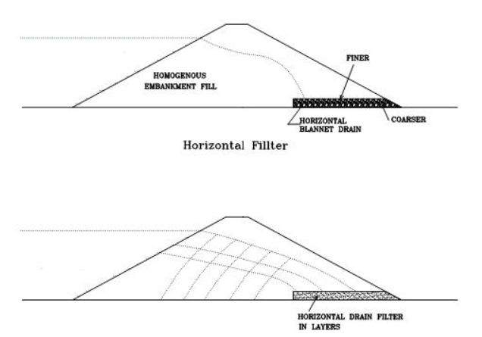
General Aspects of Earth Fill Dams Design
Drainage systems in Earth Fill Dams
Internal Drainage System
Horizontal filter: Horizontal filter extends from downstream side of the dam to inside at a distance of 25% to 100% from toe to center line of the dam as shown in the figure below
Figure6.7: Horizontal Filter

Slide 26
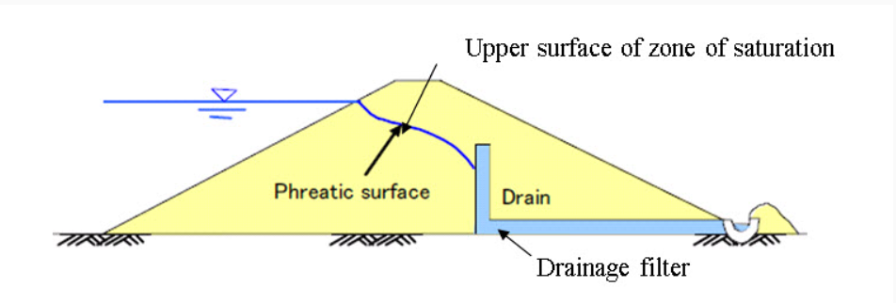
General Aspects of Earth Fill Dams Design
Drainage systems in Earth Fill Dams
Internal Drainage System
Chimney Drain: A vertical filter is placed along with the horizontal filter, which carries out the seeping water effectively, as shown in the figure below, this arrangement is termed as chimney drain.
Figure 6.8: Chimney Drain

Slide 27
General Aspects of Earth Fill Dams Design
Drainage systems in Earth Fill Dams
Surface Drainage Systems: Surface drainage system is provided to drain the rainwater from the surface of dam in this system, 30 cm deep trapezoidal shaped open drains are provided on the sloped surface of earth dam at the junction of berms.

Slide 28
General Aspects of Earth Fill Dams Design
6.11 Soil Materials of Earth Fill Dams
Soil Materials of Core
We decide to use Silty Clay soil in construction the core, this type of soil is present in the Fara Basin, and therefore we do not need to bring soil to build the core from another place.
Silty clay soil is a type of soil that contains a significant amount of fine particles, including clay and silt. It is characterized by its smooth, slippery texture when wet, and it can become hard and compacted when dry. Silty clay soil has properties of both clay and silt soils, and its characteristics can vary depending on the specific ratios of clay, silt, and sand present.

Slide 29
General Aspects of Earth Fill Dams Design
Soil Materials of Earth Fill Dams
Soil Materials of Core
Key features of silty clay soil include:
Particle Size: Silty clay soil contains fine particles, with clay particles being smaller than silt particles. The fine texture contributes to its ability to hold water.
Water Retention: One of the notable characteristics of silty clay soil is its high water retention capacity. It can hold water for an extended period, making it potentially fertile but also prone to drainage issues and compaction.
Fertility: Silty clay soil is often fertile because of its ability to retain nutrients. However, its fertility can be affected by factors such as organic matter content and drainage.
Compaction: When wet, silty clay soil can become easily compacted, reducing its porosity and making it difficult for air and water to penetrate. This can impact plant root growth and lead to poor drainage.

Slide 30
General Aspects of Earth Fill Dams Design
Soil Materials of Earth Fill Dams
Soil Materials of Core
Workability: Silty clay soil can have good workability when it's at the right moisture level. However, it can become challenging to work with when too wet or too dry.
It's important to note that the specific properties of silty clay soil can vary widely depending on the location and environmental conditions. Soil testing is recommended to understand the soil's characteristics and determine appropriate amendments for specific agricultural or gardening purposes.

Slide 31
General Aspects of Earth Fill Dams Design
Soil Materials of Earth Fill Dams
Soil Materials of Core
The following table shows the results of examining a soil sample taken from an area close to where the dam was constructed
Table 6.4: results of testing silty clay soil sample
Test | Result
Liquid Limit (L.L) | 58.48%
Plastic Limit (P.L) | 38.67%
Plasticity Index (P.I) | 19.81
Percent Passing Sive No.200 | 92.23%
AASHTO Classification | A-7-5
Optimum Moisture Content (O.M.C) | 22.40%
Maximum Dry Density (M.D.D) | 1.675 gm/cm3

Slide 32
General Aspects of Earth Fill Dams Design
Soil Materials of Earth Fill Dams
Soil Materials of Core
Specifications of silty clay soil
1.Permeability (Test Method ASTM D-5084) = 1 x 10-6 cm/sec
2. Plasticity Index of Soils (Test Method ASTM D-4318) = Not less than 15%
3. Liquid Limit of Soils (Test Method ASTM D-4318) = Not less than 30%
4. Soil Particles Passing the No. 200 Sieve (Test Method ASTM D-422) = Not less than 70%
5. Maximum particle size = 2 inches.

Slide 33
General Aspects of Earth Fill Dams Design
Soil Materials of Earth Fill Dams
Soil Materials of Core
The following table shows the results of the soil sample examination and the specific specifications for each examination.
Table 6.5: Summary of testing result and specification
Test | Result | Specification | Good/not good
Liquid Limit (L.L) | 58.48% | Not less than 30% | Good
Plasticity Index (P.I) | 19.81 | Not less than 15% | Good
Percent Passing Sieve No.200 | 92.23% | Not less than 70% | Good

Slide 34
General Aspects of Earth Fill Dams Design
Soil Materials of Earth Fill Dams
Soil Materials of Shell
We decide to use Granular soil (Alluvial Soil) in construction the core, this type of soil is present in the Fara Basin, and therefore we do not need to bring soil to build the core from another place.
Granular soil is a type of soil that is characterized by the presence of granules or grains. These granules are larger than the particles found in clay or silt soils, and they provide the soil with specific engineering and agricultural properties. Granular soils are classified based on the size of their particles and can include sandy soils, loamy soils, and gravelly soils

Slide 35
General Aspects of Earth Fill Dams Design
Soil Materials of Earth Fill Dams
Soil Materials of Shell
Here are some key characteristics of granular soil:
Particle Size: Granular soils consist of relatively large particles, such as sand, gravel, and sometimes silt. The size of the particles can vary, but they are generally larger than those found in cohesive soils like clay or silt.
Permeability: Granular soils typically have high permeability, allowing water to move through the soil easily. This property makes them well-draining and less prone to waterlogging.
Drainage: Due to their high permeability, granular soils are less likely to retain water, and they provide good drainage. This makes them suitable for construction projects and foundations where drainage is important.
Compaction: Granular soils generally do not compact as much as clay soils. They are more resistant to compaction, which can be beneficial in certain engineering applications.

Slide 36
General Aspects of Earth Fill Dams Design
Soil Materials of Earth Fill Dams
Soil Materials of Shell
Strength: Granular soils tend to have good load-bearing capacity, making them suitable for construction projects where a stable foundation is crucial.
Workability: Granular soils are usually easy to work with, especially when they are well-graded and have a balanced mix of sand and gravel. This makes them suitable for landscaping and gardening.
Understanding the specific characteristics of granular soil in a particular location is essential for various applications, including construction, agriculture, and landscaping. Soil testing and analysis can provide valuable information about the composition and properties of the soil, guiding appropriate land use and management practices.

Slide 37
General Aspects of Earth Fill Dams Design
Soil Materials of Earth Fill Dams
Soil Materials of Shell
The following table shows the results of examining a soil sample taken from an area close to where the dam was constructed and their specifications
Table 6.6: Specifications and results of testing granular soil sample
Test | Result | Specifications
Liquid Limit (L.L) | 17.76% | 25(max)
Plastic Limit (P.L) | 17.43% | ………………..
Plasticity Index (P.I) | 0.33 | (2-6)
Percent Passing Sive No.200 | 7.28% | 5-10(5-13compacted)
Optimum Moisture Content (O.M.C) | 6.40% | ……………………
Maximum Dry Density (M.D.D) | 2.21gm/cm3 | 2.1(Min)

Slide 38
General Aspects of Earth Fill Dams Design
6.12 Properties of Al-Malaqi Dam Suggested Site
In addition to the hydrological characteristics that we mentioned in the first section of our graduation project, there are many other characteristics of the dam site, and therefore these characteristics are what guided us in choosing the dam site.
These characteristics are:
Lands are owned the government.
Water of both Wadi Al-Bathan and Wadi Al-Fara’a are joined together at this proposed site.
Soil surrounding the site may by used as backfill materials for both the core and the shell.
Shoulders of the dam are rock so that is very stable.
The foundation is of limestone bedrock which considered good foundation for the dam.

Slide 39
General Aspects of Earth Fill Dams Design
6.13 Foundations of Earth Fill Dam
A site investigation should be conducted prior to construction so as to investigate the nature of the foundation by knowing the actual foundation condition at site, the earth dam can then be designed according to it a dam foundation is said to be adequate if it is capable of providing a stable support for the embankment under all condition of saturation and loading and that it provide enough resistance to seepage to avoid excessive loss of water dam foundation can be generally classified into three types namely foundations of rock, foundations of coarse-grained material and foundation of fine-grained material these foundations may need to be treated to stabilize any weakness as well as to reduce seepage for instance, coarse-grained, pervious foundations present no difficulties in the matter of settlement or stability whereas a fine-grained, weak foundation is subject to settlement or displacement usually present no problem in seepage rock foundation on the other hand must be checked for erosive leakage and excessive uplift pressure. If such conditions exist, grouting to the foundation must be considered.

Slide 40
General Aspects of Earth Fill Dams Design
6.14 Earth fill dam dimensions and slops
The dimension and slops for the Al-Malaqi dam is shown in figure(6.9) below, it is worth mentioning that:
Basic height of the dam is 47 meters, and free board is assuming 3 meters, so the total height of the dam is 50 meters, this height represents the depth of the dam from the top to the bottom of the lake behind the dam.
Top width of dame according to the following equation W = 1.65(H + 1.5)^{1/3}
W= 1.65*(50+1.5)^{1/3}
W= 4.4 m
W= Z/5 +10
W=164.04/5 +10
W= 42.80foot =13.04m
Take large value of W, so assume W= 15m.
.

Slide 41
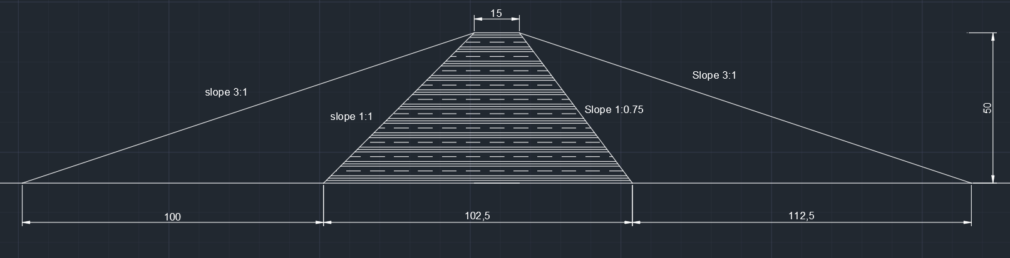
General Aspects of Earth Fill Dams Design
Earth fill dam dimensions and slops
Slopes of the components of the proposed dam are found after checking the factor of safety using software GeoStudio are also shown in figure (6.10). It is found out that the slope of the shells is 3horizontal: 1 vertical for both upstream and downstream, for the slope of the core of the upstream it is found out to be 1 horizontal: 1 vertical, while for slope of the core downstream it is found about 1 horizontal: 0.75 vertical.
Figure 6.9: Dam Dimensions

Slide 42
General Aspects of Earth Fill Dams Design
6.15 Slope Stability Analysis
Slope stability analysis is done using software called GeoStudio, this software is the leading slope stability software product for computing the factor of safety of earth and rock slopes.
The software can be used to analyze almost any slope stability in geotechnical and civil engineering projects, and it can model almost any stability problem, including natural earth and rock slopes, sloping excavations, earth embankments, and many more.
The main purpose of this software in this project is to determine the minimum factor of safety for the critical slip surface.
The minimum required factor of safety for earth fill dams are as shown below in table 6.7
Table 6.7 Minimum required factor of safety
Analysis Condition | Minimum Required Factor of Safety | Slope
End of construction | 1.3 | Upstream and Downstream
Long-tearm | 1.5 | Downstream
Maximum surcharge pool | 1.4 | Downstream
Rapid drawdown | 1.1-1.3 | Upstream

Slide 43
General Aspects of Earth Fill Dams Design
Slope Stability Analysis
Several slope stability analyses were performed to determine the most suitable dimensions for the proposed dim.
Table 6.8 below summaries the results found that will be used to analyze and check slope stability of the proposed earth dam of this project.
Table 6.8 Summary of result to be used in the software GeoStudio for slope stability analysis
Soil Property | Silty Clay for Core | Alluvial Soil for Shells
Unit weight KN/m³ | 18.5 | 23
Cohesion KN/m² | 50 | 0
Angle of internal friction | 0 | 28

Slide 44
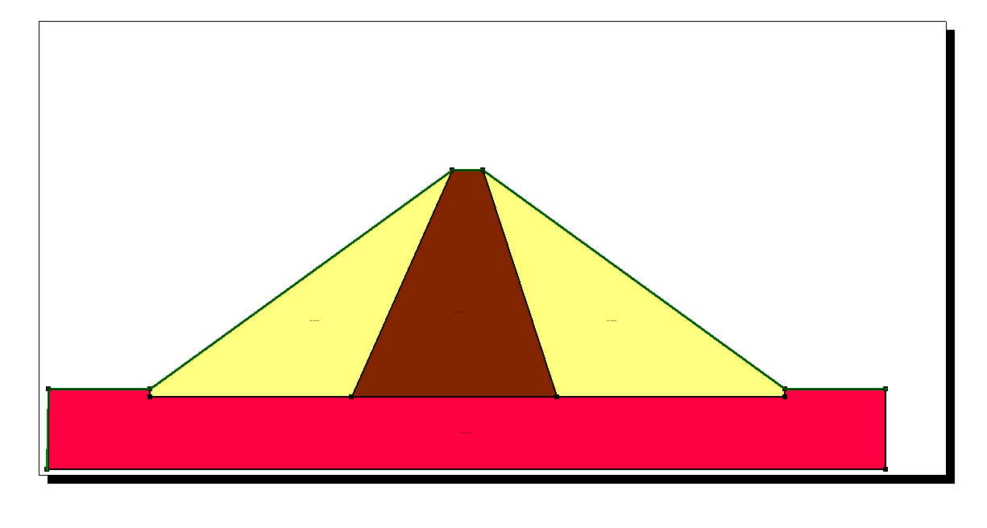
General Aspects of Earth Fill Dams Design
Slope Stability Analysis
Figure 6.10: Dam in GeoStudio

Slide 45
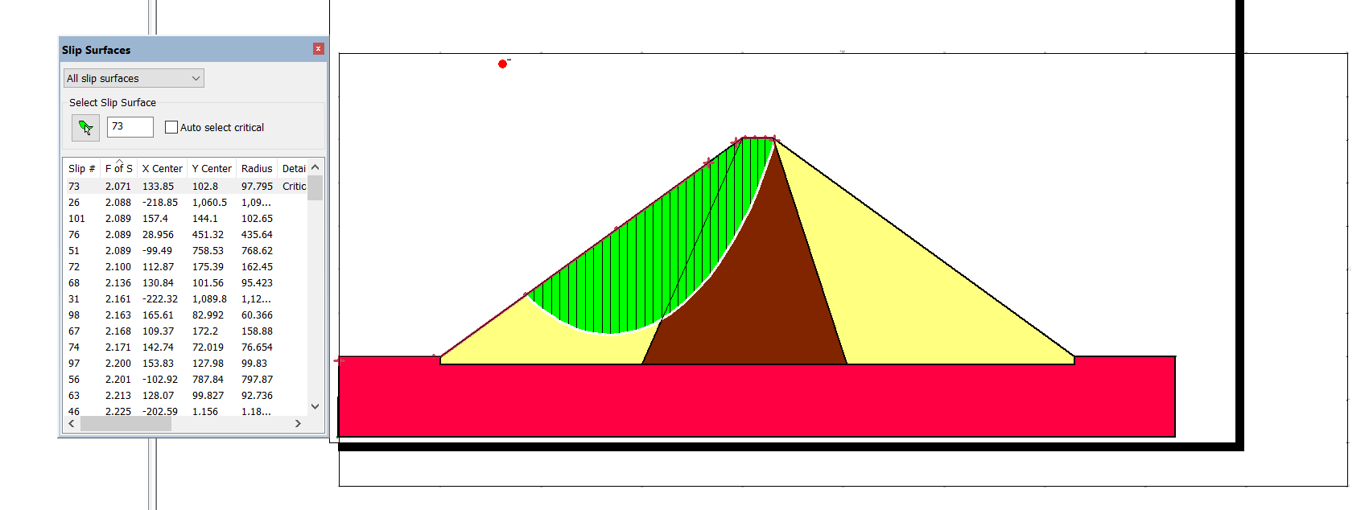
General Aspects of Earth Fill Dams Design
Slope Stability Analysis
6.14.1 Slope stability analysis at the end of the construction
The factor of safety for slope stability analysis at the end of construction was found to be equal for upstream (2.07) and for downstream (2.23). Figure 6.10 And 6.11 Shows the critical slip surface and its factor of safety for both upstream and downstream.
Figure 6.11: critical slip surface and factor of safety for upstream (end of construction)

Slide 46
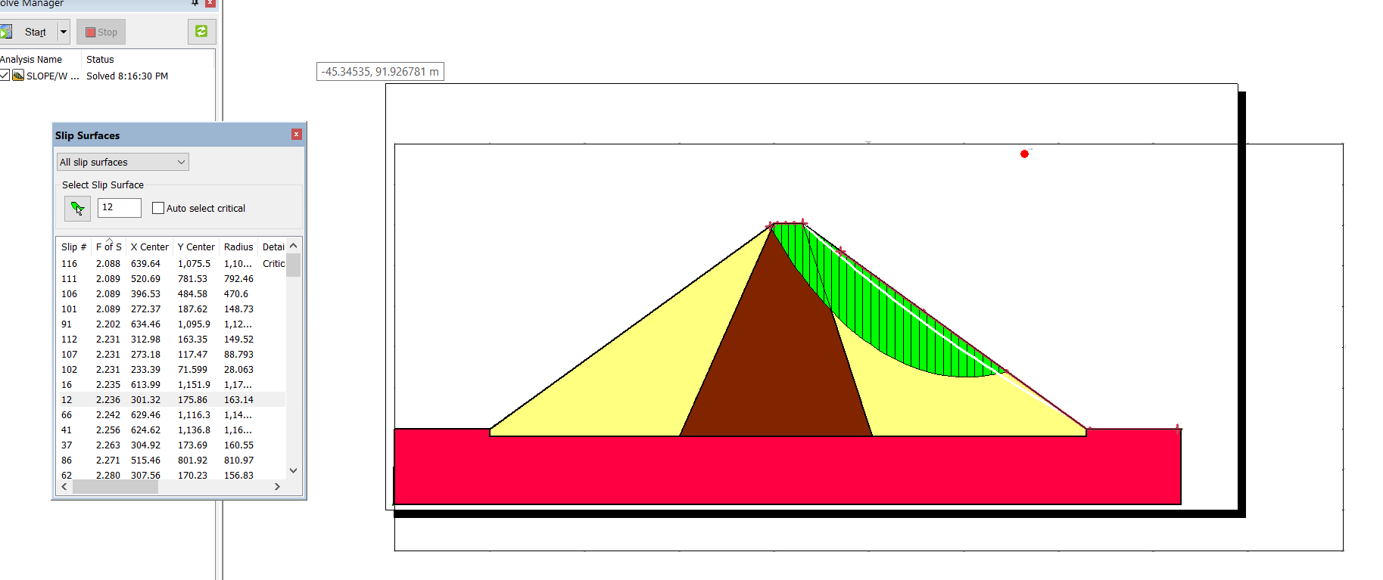
General Aspects of Earth Fill Dams Design
Slope Stability Analysis
Slope stability analysis at the end of the construction
Figure 6.12: critical slip surface and factor of safety for downstream (end of construction)

Slide 47
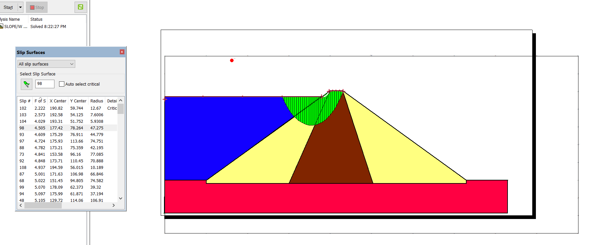
General Aspects of Earth Fill Dams Design
Slope Stability Analysis
    Slope stability analysis for long term
The factor of safety for slope stability analysis at long term steady state was found to be equal for upstream (4.50) and for downstream (2.23). Figure 6.12 And 6.13 Shows the critical slip surface and its factor of safety for both upstream and downstream.
Figure 6.13: critical slip surface and factor of safety for upstream (long term)

Slide 48
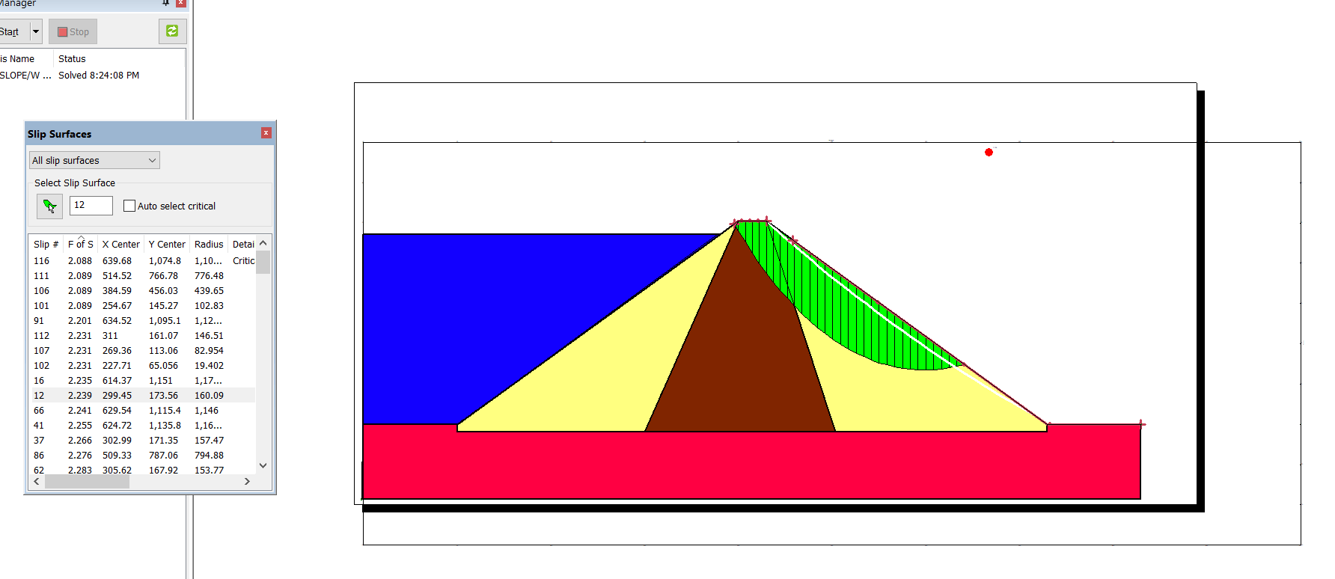
General Aspects of Earth Fill Dams Design
Slope Stability Analysis
Slope stability analysis for long term
Figure 6.14: critical slip surface and factor of safety for downstream (long term)

Slide 49
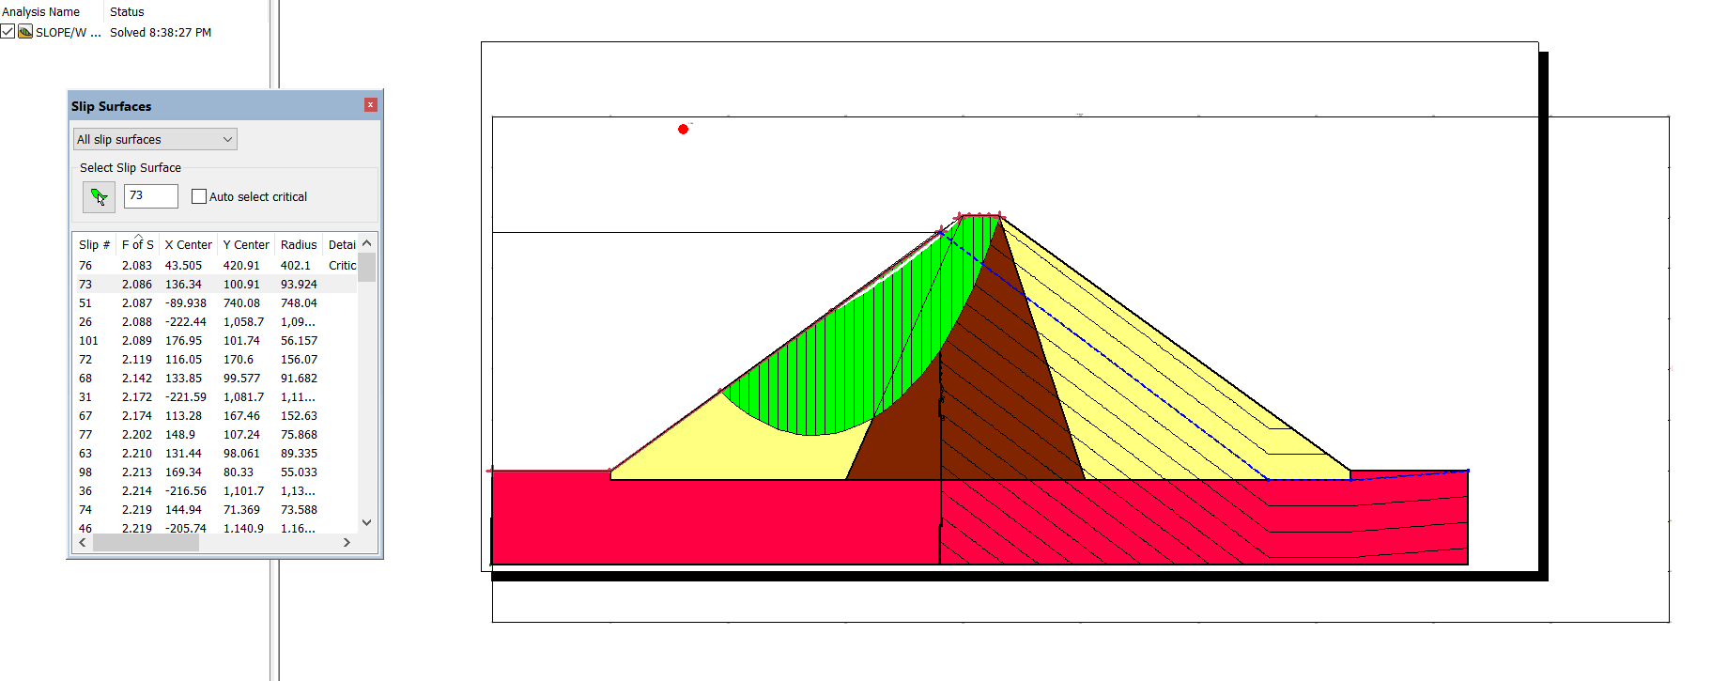
General Aspects of Earth Fill Dams Design
Slope Stability Analysis
    Slope stability analysis for rapid drawdown
The factor of safety for slope stability analysis for rapid drawdown was found to be equal for upstream (2.08) and for downstream (1.80). Figure 6.15 And 6.16 Shows the critical slip surface and its factor of safety for both upstream and downstream.
Figure 6.15: critical slip surface and factor of safety for upstream (rapid drawdown)

Slide 50
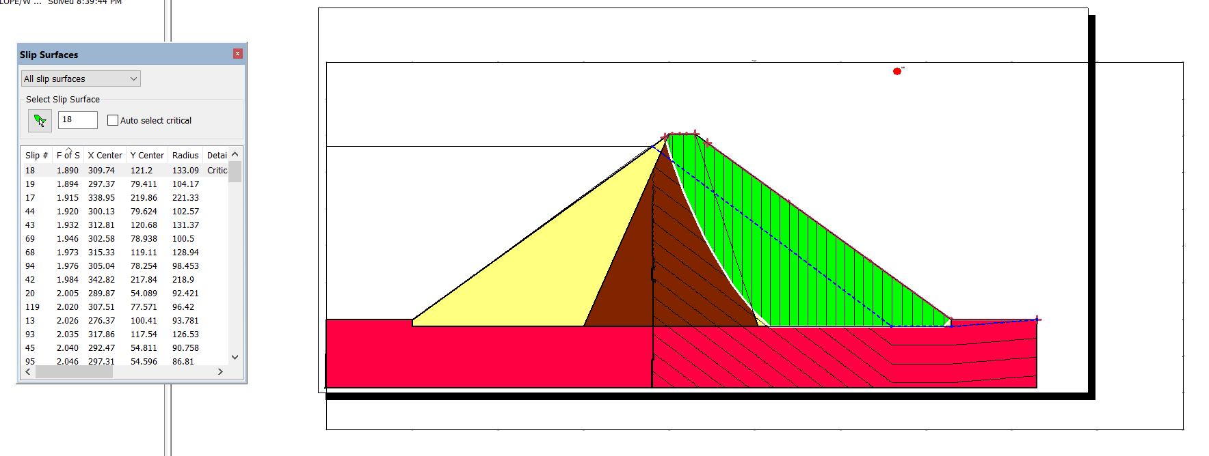
General Aspects of Earth Fill Dams Design
Slope Stability Analysis
Slope stability analysis for rapid drawdown
Figure 6.16: critical slip surface and factor of safety for downstream (rapid drawdown

Slide 51
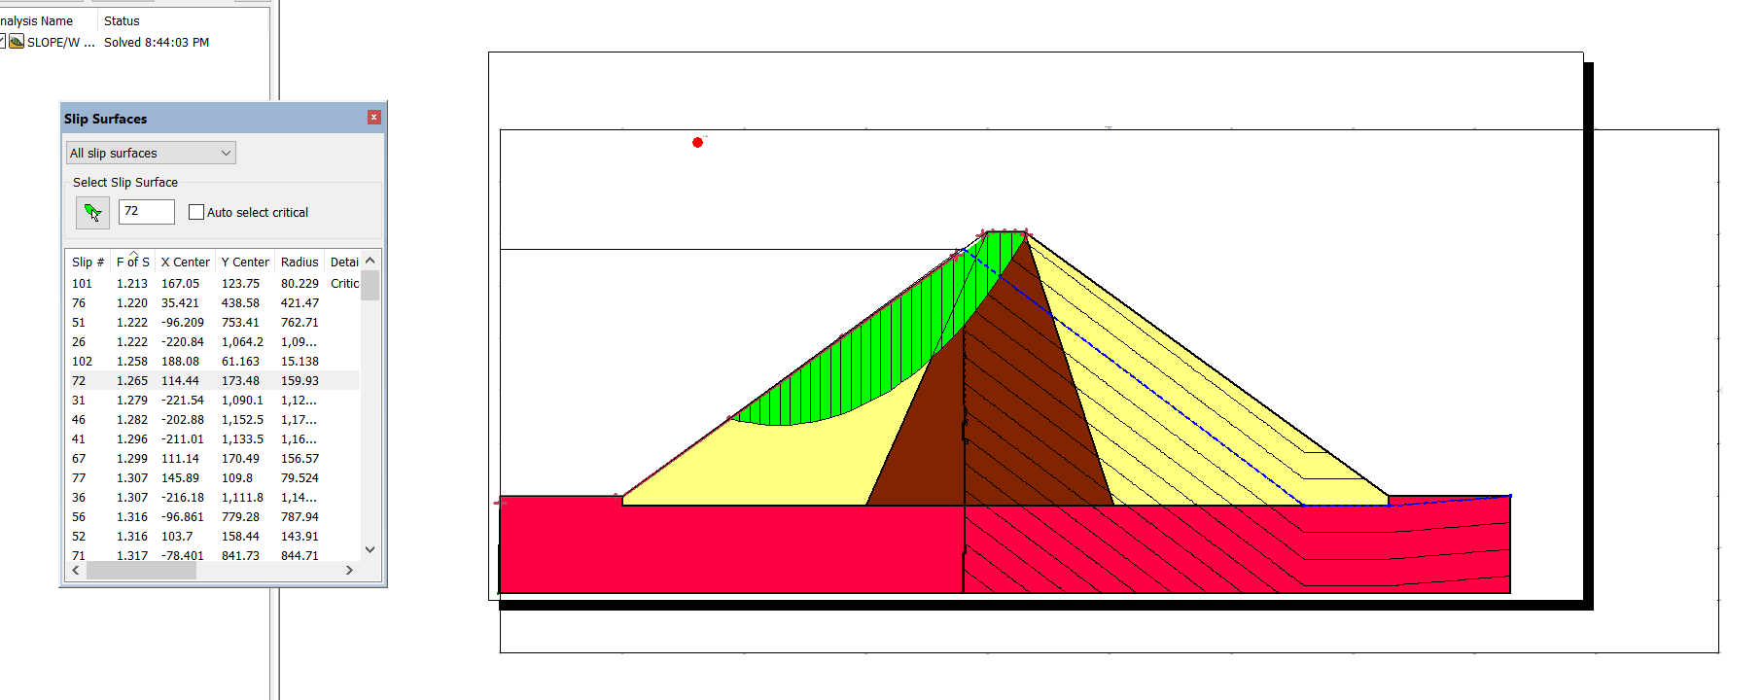
General Aspects of Earth Fill Dams Design
Slope Stability Analysis
    slope stability analysis for rapid draw dawn and earthquake
the factor of safety for slope stability analysis for rapid draw dawn and earthquake was found to be equal for upstream (1.26) and for downstream (1.13). Figure 6.17 And 6.18 Shows the critical slip surface and its factor of safety for both upstream and downstream.
Figure 6.17: critical slip surface and factor of safety for upstream (rapid draw dawn and earthquake)

Slide 52
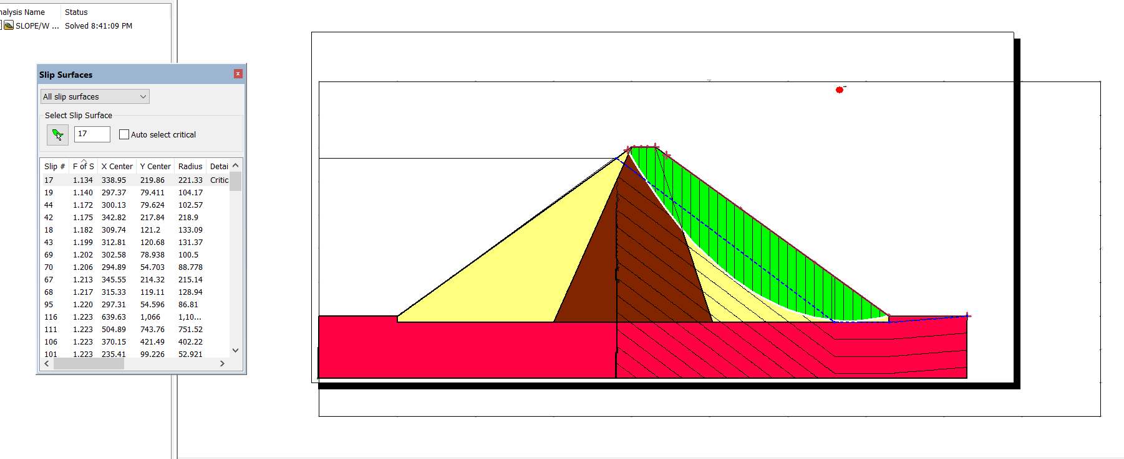
General Aspects of Earth Fill Dams Design
Slope Stability Analysis slope stability analysis for rapid draw dawn and earthquake
Figure 6.18: critical slip surface and factor of safety for downstream (rapid draw dawn and earthquake)

Slide 53
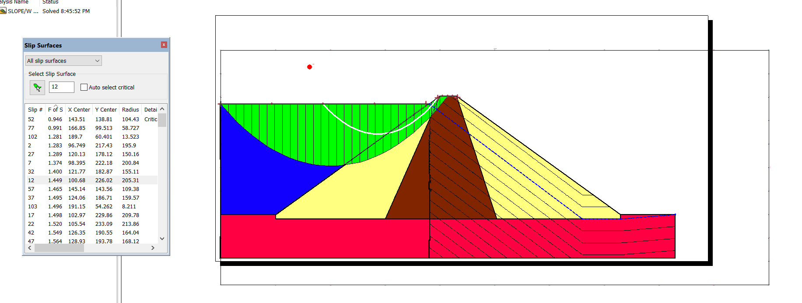
General Aspects of Earth Fill Dams Design
Slope Stability Analysis
    Slope stability analysis for earthquake
The factor of safety for slope stability analysis for earthquake was found to be equal for upstream (1.40) and for downstream (1.21), that when the horizontal acceleration (g=0.2). Figure 6.19 And 6.20 Shows the critical slip surface and its factor of safety for both upstream and downstream.
Figure 6.19: critical slip surface and factor of safety for upstream (earthquake)

Slide 54
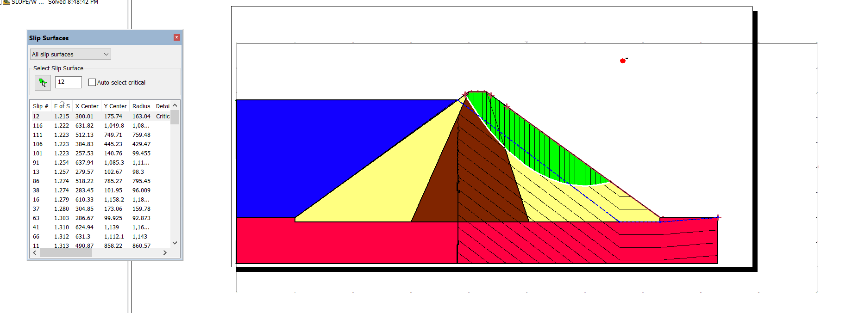
General Aspects of Earth Fill Dams Design
Slope Stability Analysis
Slope stability analysis for earthquake
Figure 6.20: critical slip surface and factor of safety for downstream (earthquake)

Slide 55
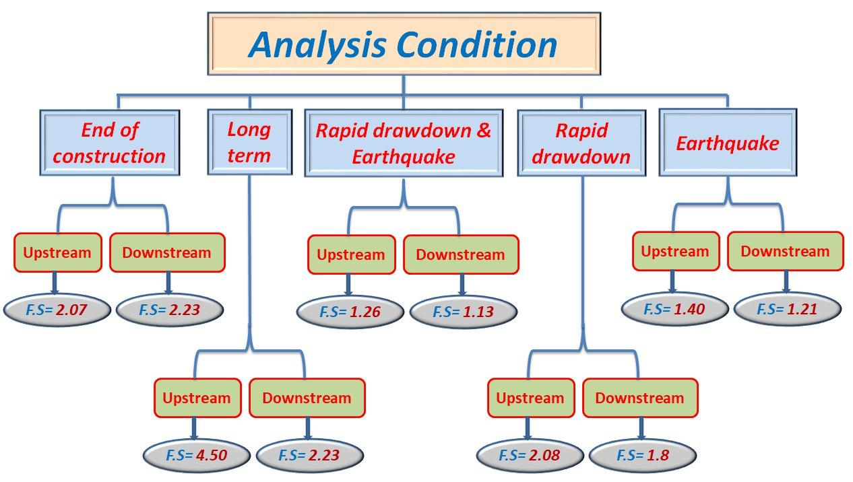
General Aspects of Earth Fill Dams Design
Slope Stability Analysis
Summary
Figure 6.21: Summary of the factor of safety

