Slide 1

Energy Audit for Engineers Association Building - Nablus.
An-Najah National University
P R E P A R E D B Y : H A S H E M G H A N E M
M A H M O U D I S M A I E L Y A S I N Y A S I N
S U P E R V I S O R :
D R . M O H A M M A D A L S A Y E D

Slide 2
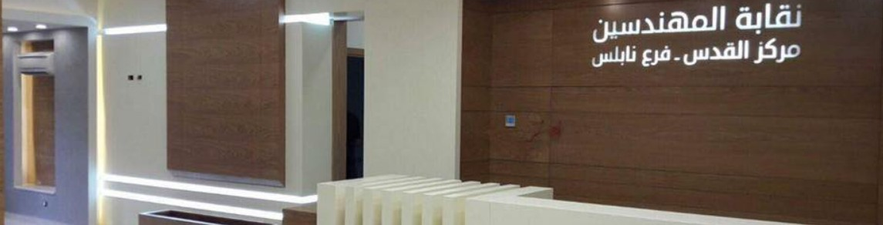
Agenda
1
Introduction
4
Results and Discussion
Softwares Used
Conclusion Recommendations
2
5
3
methodology
1

Slide 3

Introduction
Preview of Project 1
Objectives
The current status of the EAB
2

Slide 4


Preview of Project 1
Analyzed the building's electrical bills
Examined the lighting systems Reviewed the architectural plans
3

Slide 5
Objectives
1
Modifying the lighting system inside the Association
2
Study the HVAC system and find savings opportunities for the system
3
Design a solar system for the Association
4

Slide 6



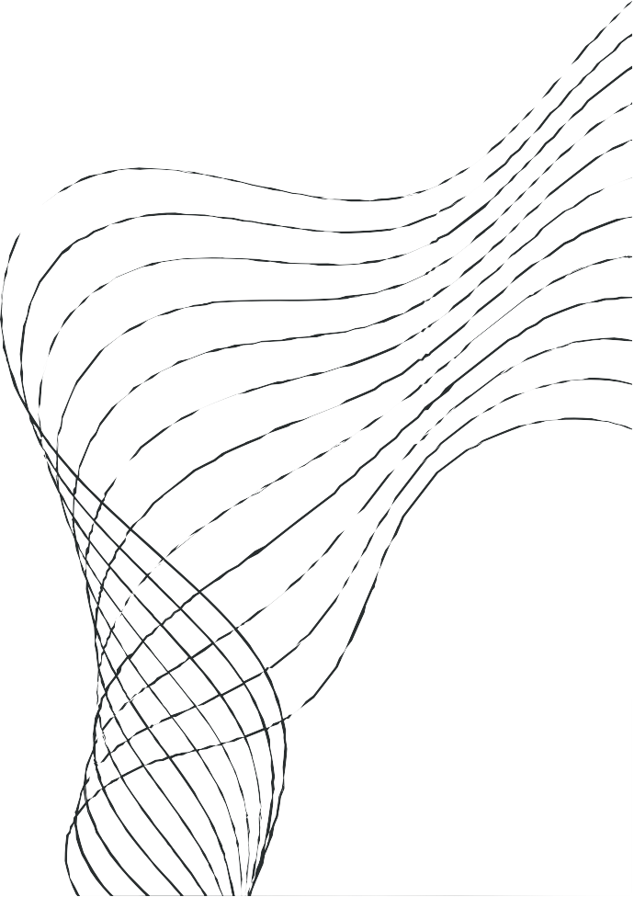
Softwares Used
HAP
(Hourly Analysis Program)
AutoCAD
PVsyst
5

Slide 7
Methodology
01 Study the EAB behaviour and its energy bills
Using the HAP program to simulate the building’s energy bill and assume different case scenarios to study how the energy bills diffrentiate for each scenario
02
Using the PVsyst program to design a solar cell system (on-grid and hybrid) and decide which of these systems is economically mo feasible.
03

Slide 8
Results and Discussion

Slide 9
E A B O P E R A T I N G A T
N O R M A L C O N D I T I O N S
Air System 3.3%
Electric Equipment 18.6%
Lights 32.8%
Heating 8%
Cooling 37.3%
Total
kWh/year
36,568
Total Cost
NIS/year
24,757

Slide 10
E A B O P E R A T I N G A T F U L L L O A D
Air System 2.5%
Electric Equipment 21.9%
Lights 36.7%
Cooling 33.4%
Heating 5.4%
Total
kWh/year
54,964
Total Cost
NIS/year
37,211

Slide 11
E A B O P E R A T I N G A T T = 2 3 ⁰ C
Air System 1.7%
Electric Equipment 21.5%
Lights 37.8%
Cooling 29.8%
Total
kWh/year
31,680
Total Cost
NIS/year
21,448
Heating 9.2%

Slide 12
F O R N O H V A C I N A P R I L A N D
N O V E M B E R
Air System 1.8%
Electric Equipment 22.7%
Lights 34.4%
Cooling 31.3%
Heating 9.8%
Total
kWh/year
29,977
Total Cost
NIS/year
20,295

Slide 13
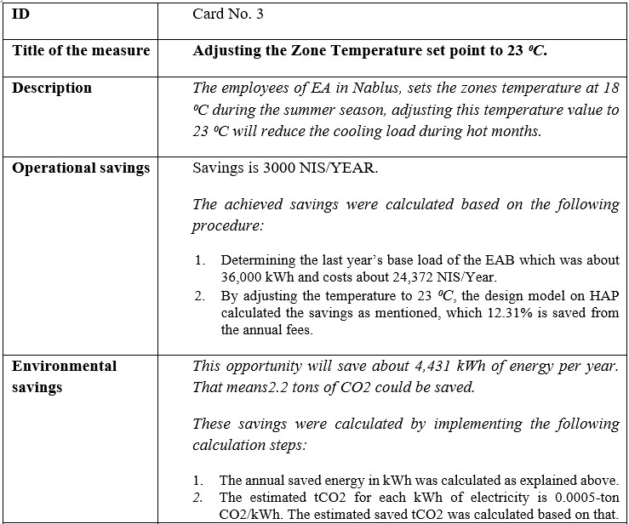
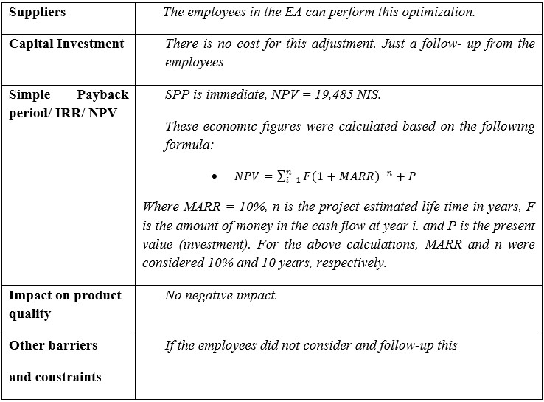


Slide 14
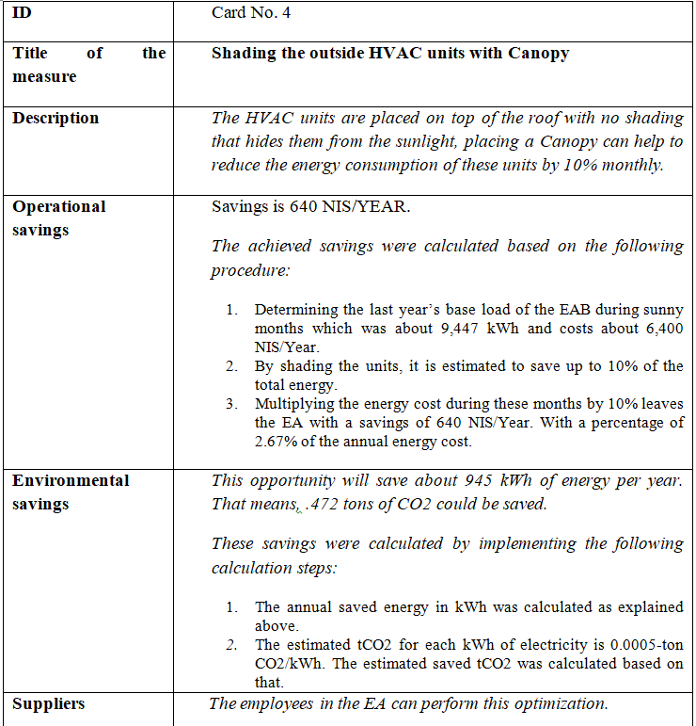
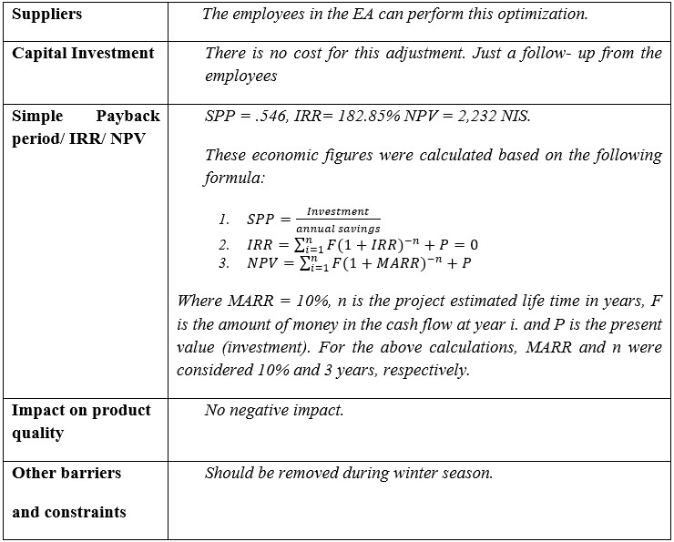

13

Slide 15
Solar System
Grid-Connected (On-Grid) System
Off-Grid Systems Hybrid Systems

Slide 16
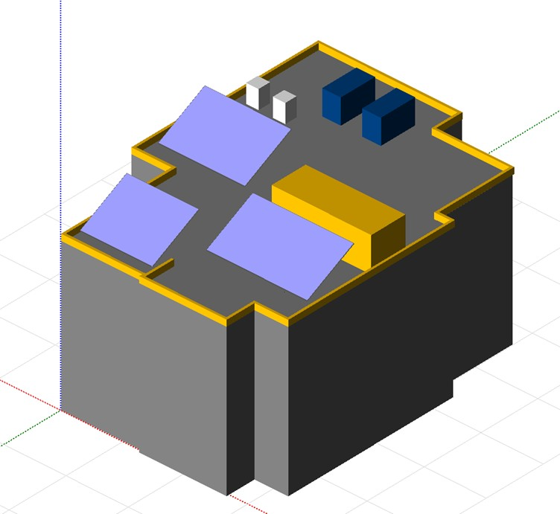
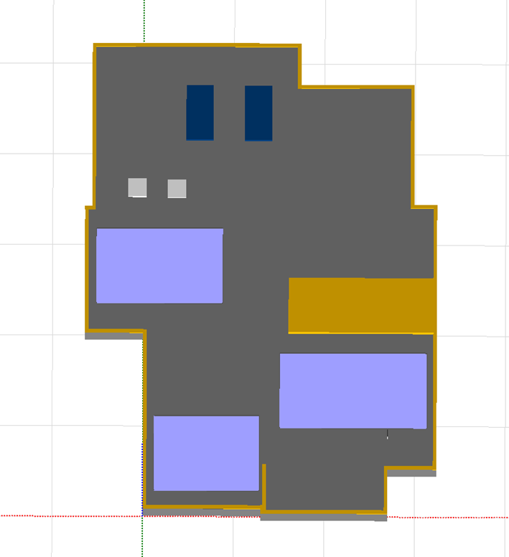

Slide 17
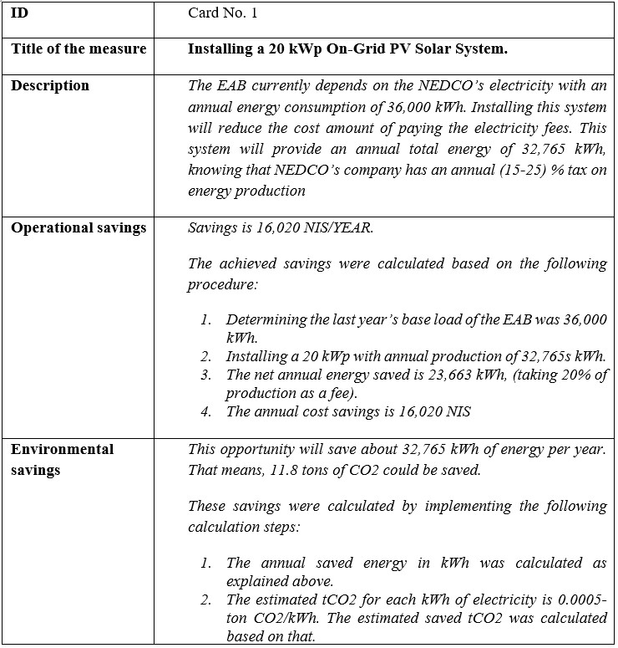
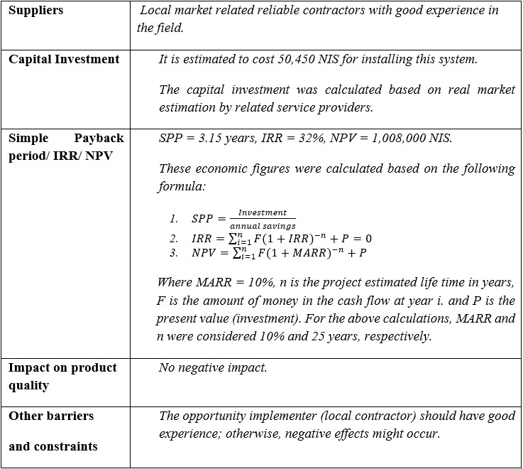

16

Slide 18
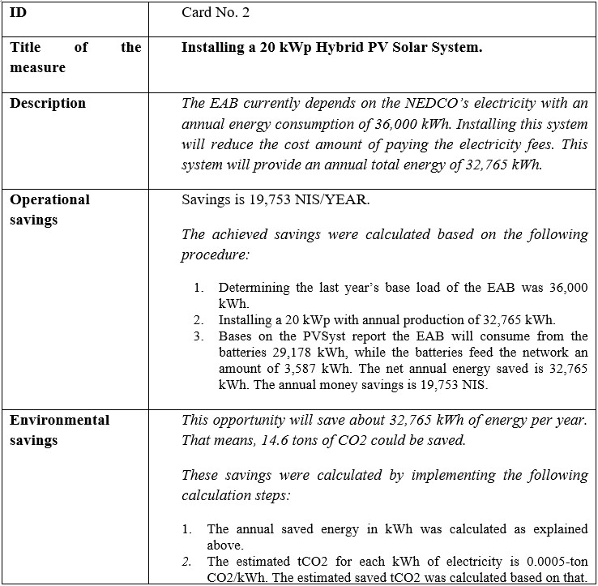
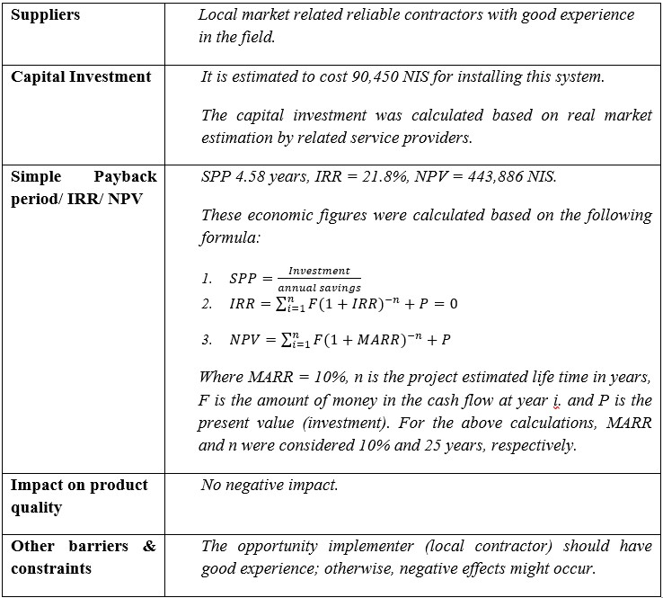
17

Slide 19
Conclusion
and
Recommendations
18

Slide 20
Our Savings
15%
12.31%
Savings Percentage of optimizing the Temperature
12.31%
2.67%
Savings Percentage of installing a Canopy
2.67%
Total Savings Percentages
15%

Slide 21

1.The building is not running on full capacity.
4. On-Grid solar system proved to be more feasible and suitable for the EAB.
The lighting system should be fixed.
Turning off the HVAC units in April and November and setting the Temperature at 23, will decrease the EAB’s energy bill by about 15%.
5.If the recommendation were taken into consideration, the energy bill decrease by about 20% of their last bill.

Slide 22







THANKS FROM OUR TEAM
Mahmoud Ismael
Energy Engineer
Yasin Yasin
Energy Engineer
Hashem Ghanem
Energy Engineer

