Slide 1

An- Najah National University
Faculty of Engineering & Information Technology.
Building Engineering Department.
Graduation project (2)
.
Redesign of Municipal Development and Lending Fund Building in Ramallah.
Prepared By:
Amro Jawabreh
Masa Sunallah
Rasha Ismail
Supervisor: Eng. Moayad Salhab

Slide 2
1
2
3
4
5
6
TABLE OF CONTENTS
Introduction
Architectural Aspects
Environmental Aspects
Structural Aspects
Eloctro-Mechanical Aspects
Quantity Surveying and Cost Estimation

Slide 3
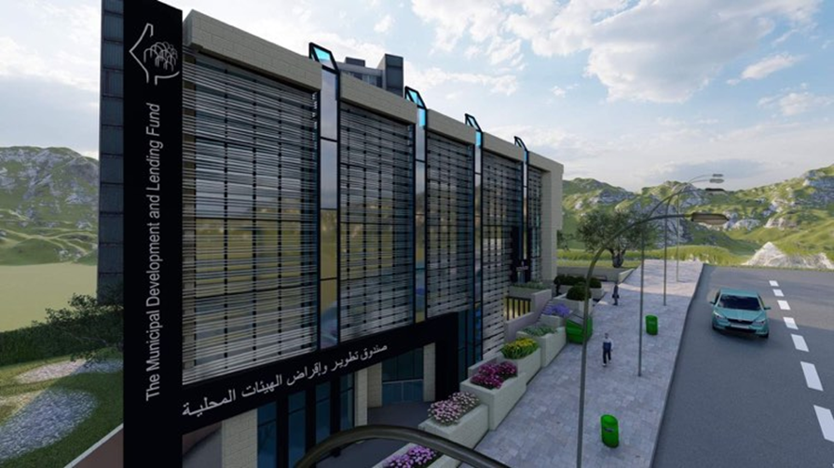
Introduction
1
This project is a building of the Municipal Development and Lending Fund located in the city of Ramallah. It is a Palestinian institution with financial and administrative independence. It was established in 2005 by the Palestinian government to be the main and preferred channel to support the development and reform process for local authorities.

Slide 4
  Objectives
This project aims to modify the Development Trust Fund in order to achieve an attractive architectural design and achieve comfort for employees and customers, and we will conduct a complete environmental analysis of the building, as we seek in our design to make the building more efficient.

Slide 5
Methodology
Site analysis
Structural Aspect
Architectural Aspects
Eloctro-Mechanical Aspects
Quantity Surveying and Cost Estimation
Environmental Aspect

Slide 6

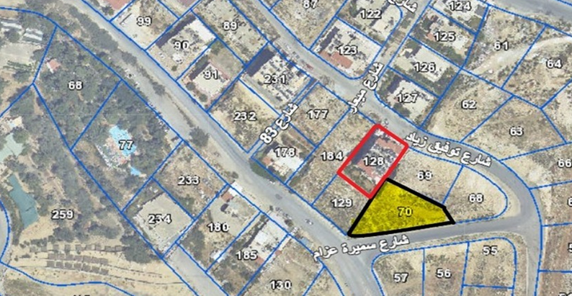
Site Analysis
Site Location
Facilities & surrounding
The plot of land for the project is located in the city of Ramallah, west of the main Al-Ersal Street, at the intersection of two secondary streets (Samira Azzam and Ein Semaan Street).
There is also one adjacent apartment building next to it.

Slide 7
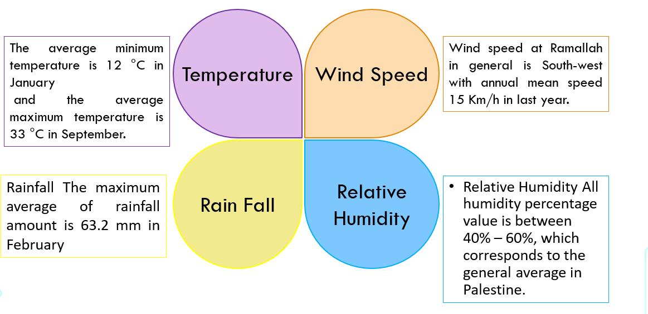
Climate

Slide 8
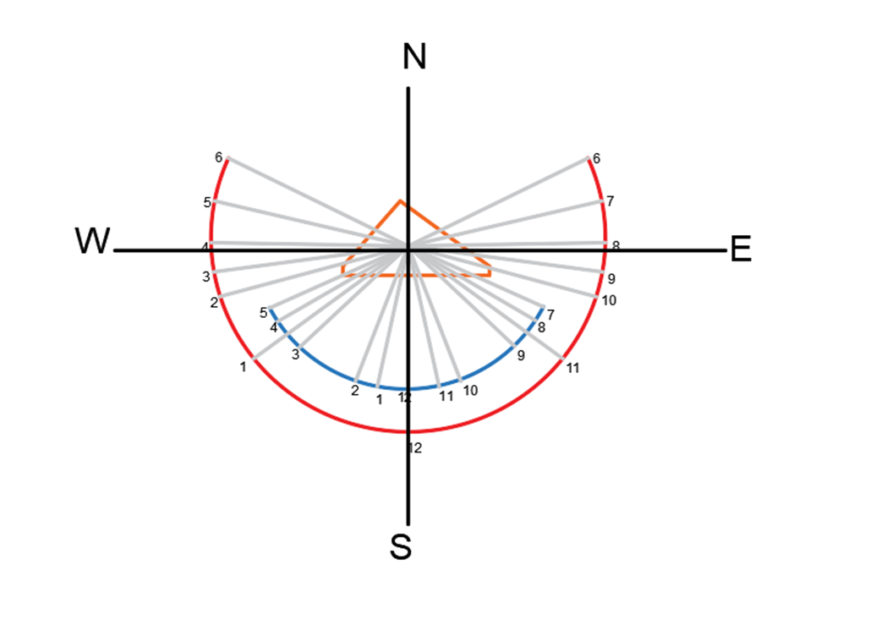

Sun path and wind direction

Slide 9
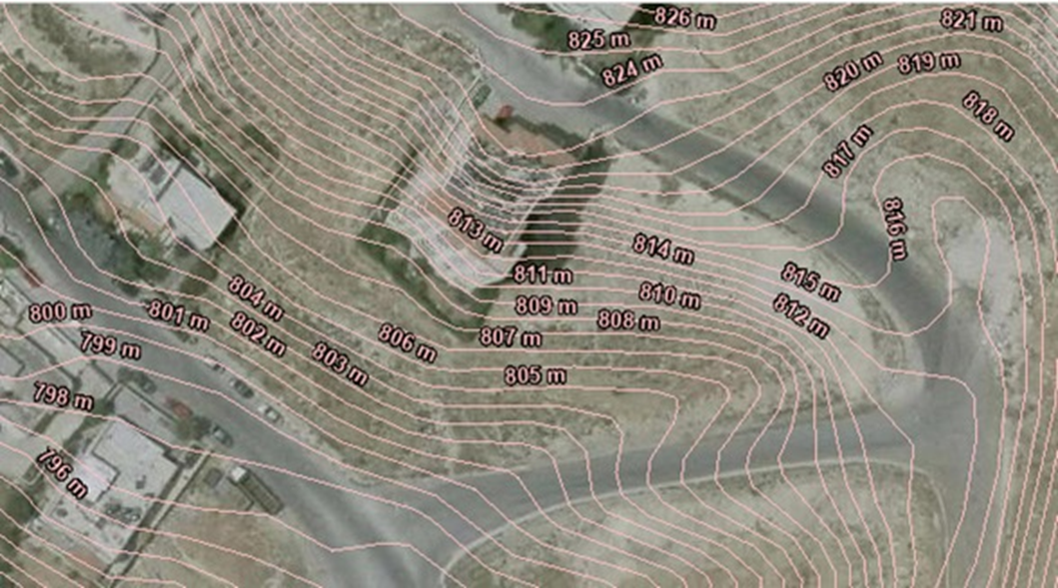
Topography and contour
In order to the sloped land, the stairs and ramp was designed. The level difference between the highest and lowest point is around 7 meters, reference level (0.00 m) while the subsequent at level )+7.00 m).

Slide 10

2
Architectural Aspects
Plans Before and after modification.
Elevation.
3D from Lumion

Slide 11
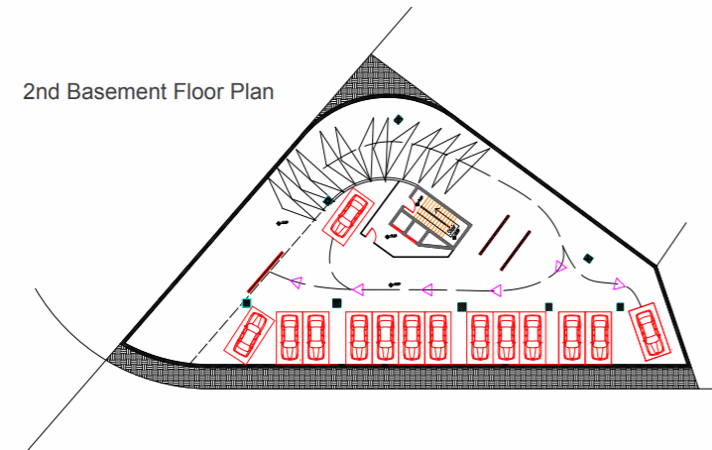
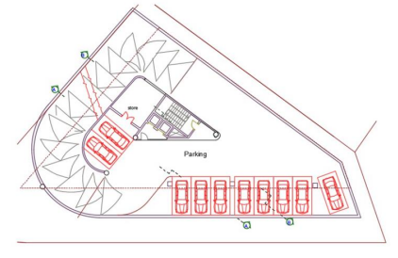

Second Basement Before and After modification
2
Before modification
After modification

Slide 12
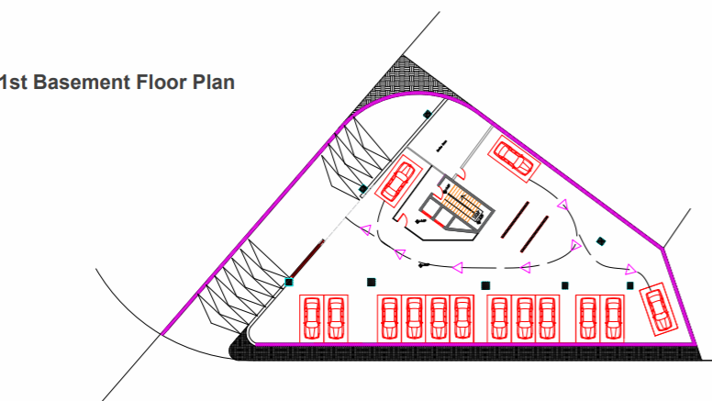
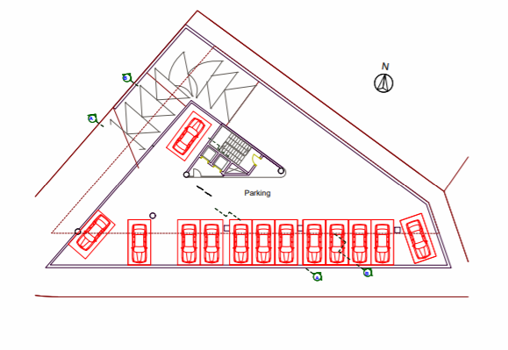
First Basement Before and After modification
Before modification
After modification

Slide 13
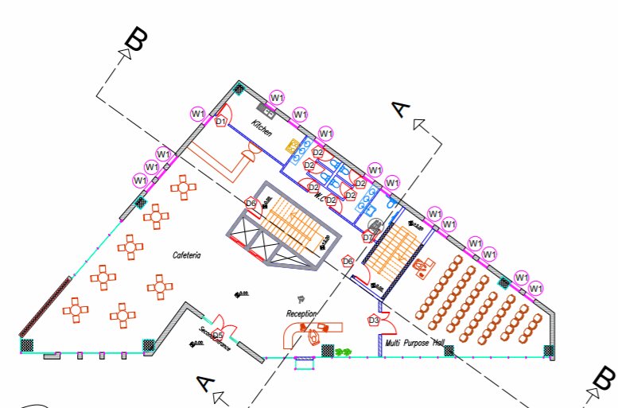
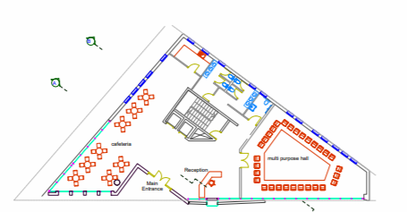
Ground Floor Before and After modification
Before modification
After modification

Slide 14
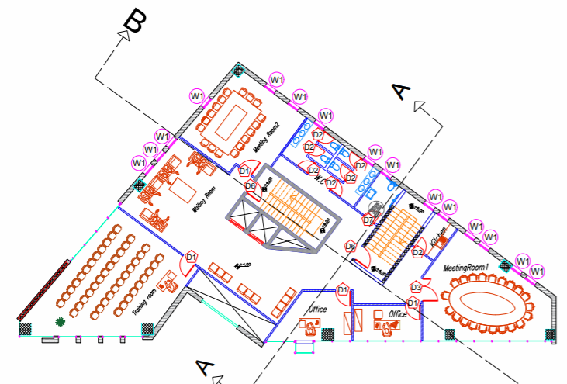
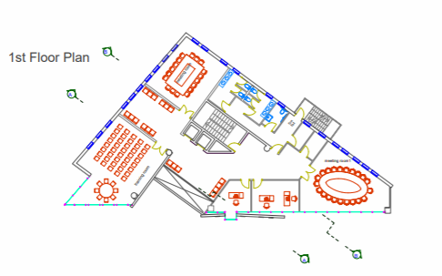
First Floor Before and After modification
Before modification
After modification

Slide 15
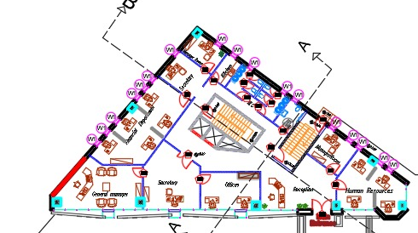
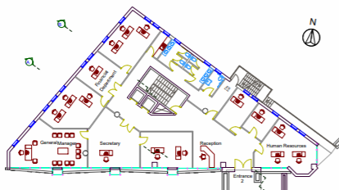
Second Floor Before and After modification
Before modification
After modification

Slide 16
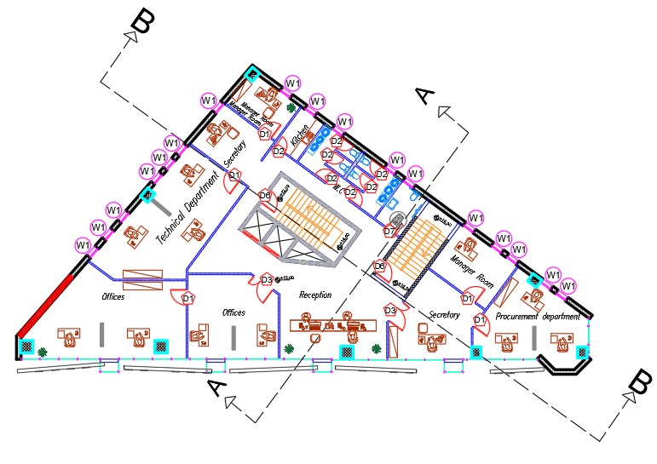
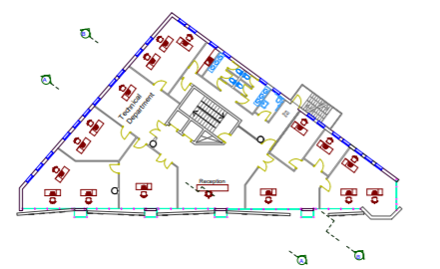
(Third – Fifth ) Floor Before and After modification
Before modification
After modification

Slide 17
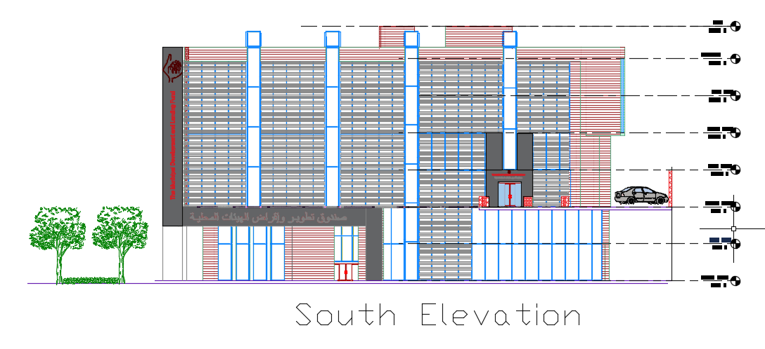
ELEVATIONS

Slide 18


Slide 19
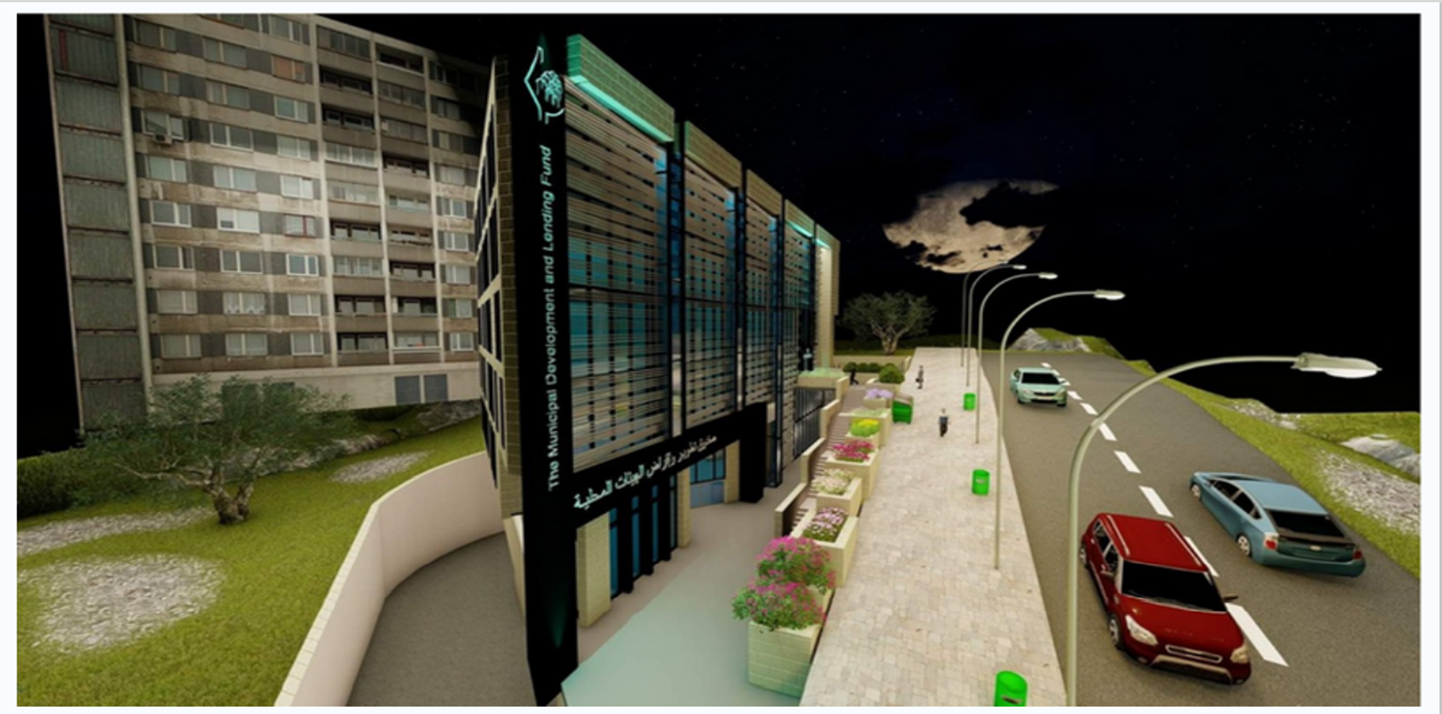

Slide 20

3
Enviromental Aspects
Daylight Factor
Heating and cooling Load
Shading Analysis

Slide 21
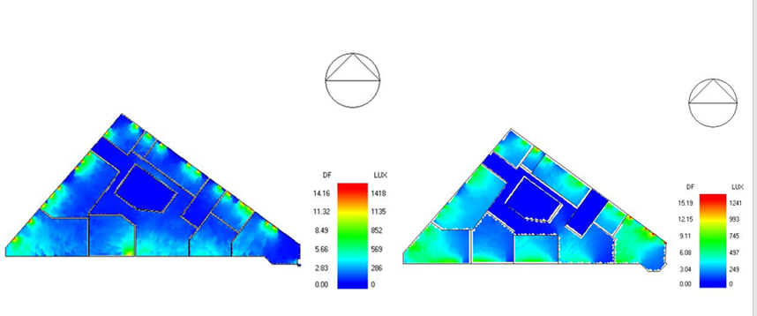
Daylight Factor
As shown in the picture above, the values of daylight are acceptable

Slide 22
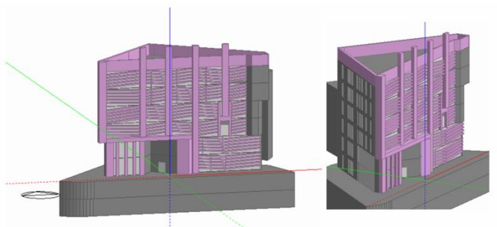
Heating and cooling Load
Heating Load
the total design heating capacity = 140.94 kw
Cooling Load
the total design cooling capacity for the building equal 166 KW.

Slide 23
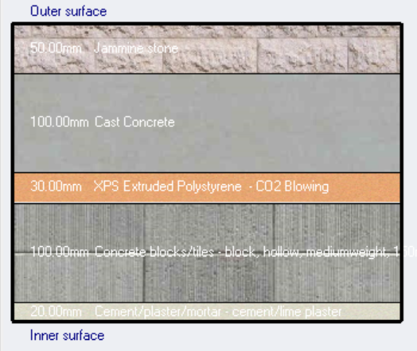
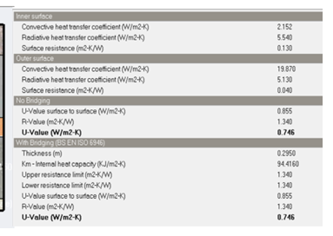
Thermal modification on exterior wall:

Slide 24
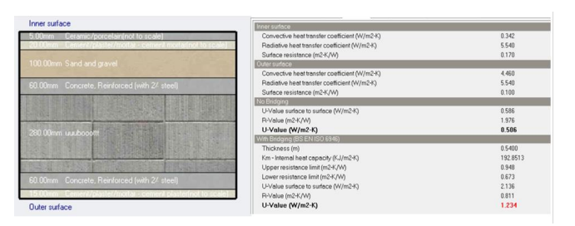
Thermal modification on internal floor

Slide 25
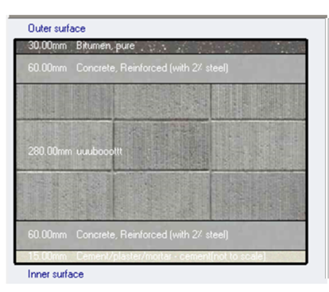
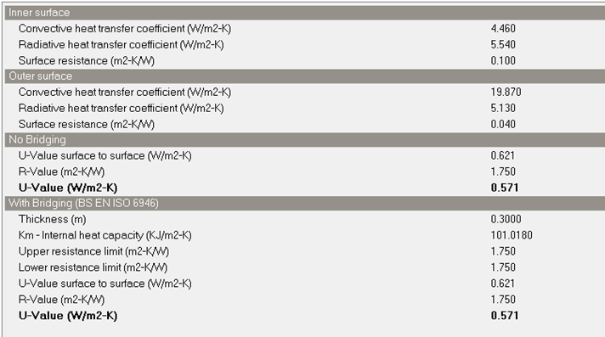
Thermal modification on Roof

Slide 26
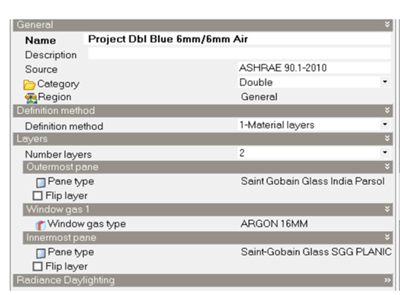
Thermal modification on glazing

Slide 27
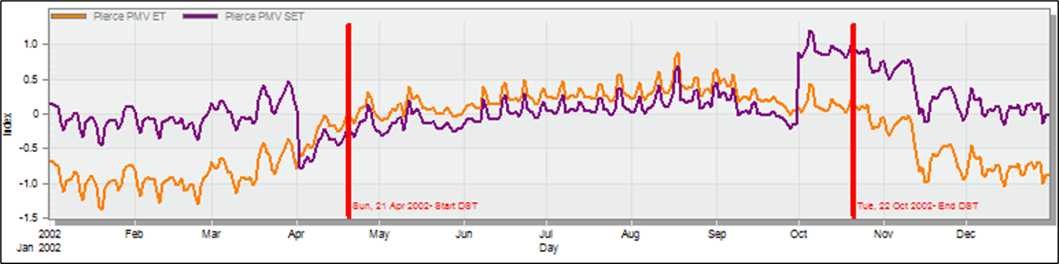
Design Builder Simulation Result
Simulations provide valuable information on annual energy consumption. Data also helps
to identify the number of hours and other uncomfortable results. According to Pierce PMV
Set, a building will achieve comfort when the PMV ranges from -0.7 to 0.7, as shown in the figure.

Slide 28
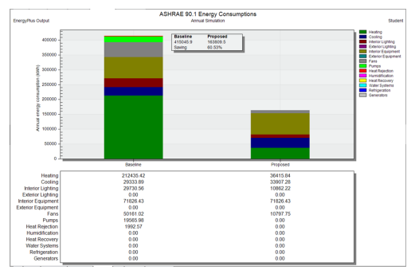
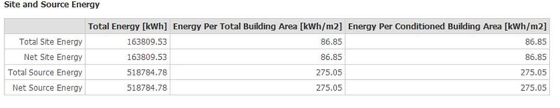
Design Builder Simulation Result
"The table above show the total site energy consumed per meter square which is equal 86.85 and the standard requirements from energy portfolio manager standard for mixed use property is 207, so it is acceptable
Energy Baseline Comparison
As the figure above shows, the Percentage of saving equal 60.53%, so the design is
good.

Slide 29
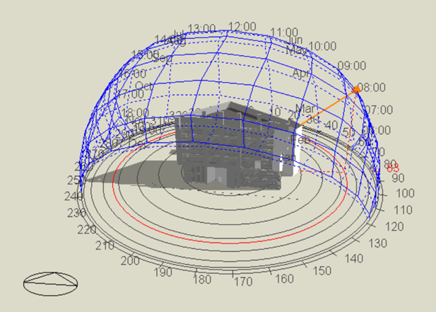
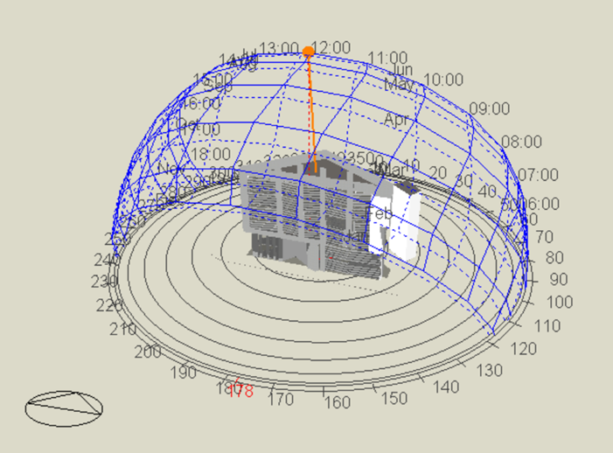
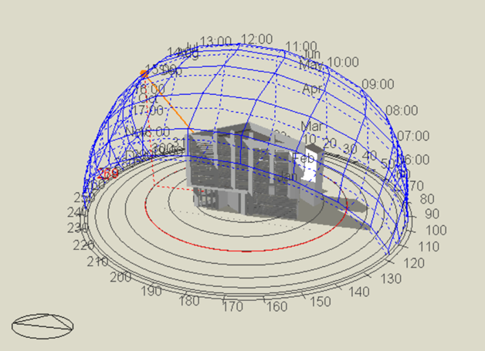
Shading Analysis
in Summer 21-june
8:00 AM
12:00 PM
3:00 PM

Slide 30
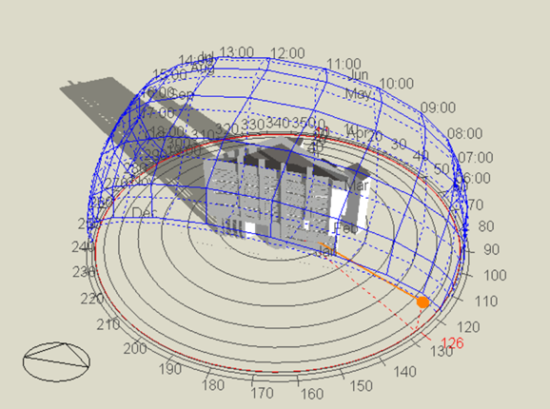
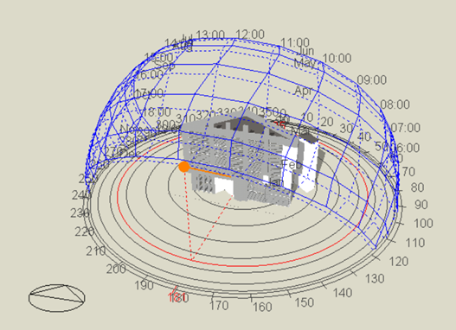
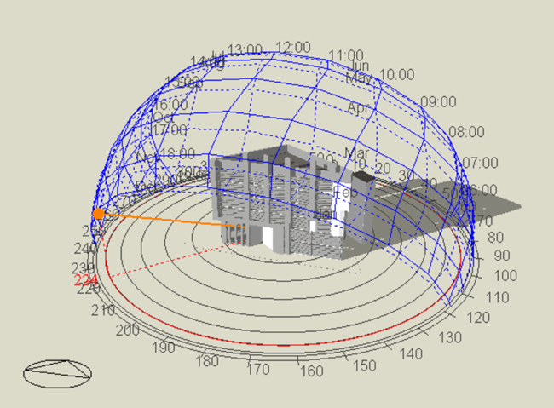
Shading Analysis
in Winter 21-December
8:00 AM
12:00 PM
3:00 PM

Slide 31
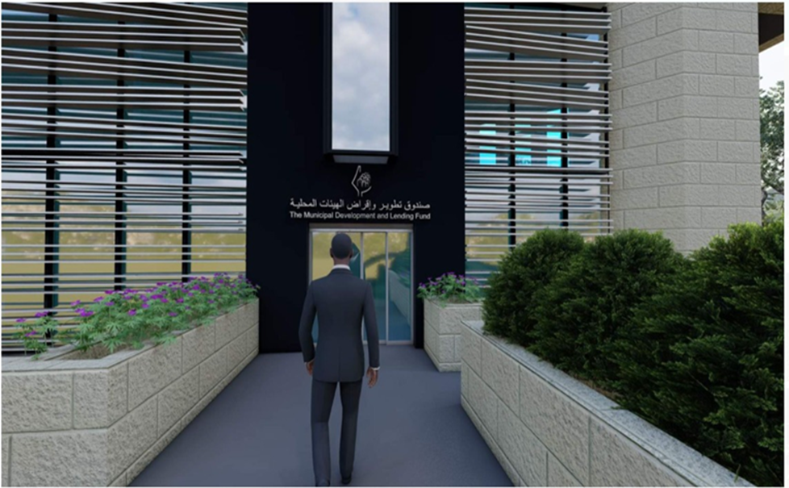
environmental treatments
From an environmental aspect, our project originally had louvers in the south (front) elevation .

Slide 32
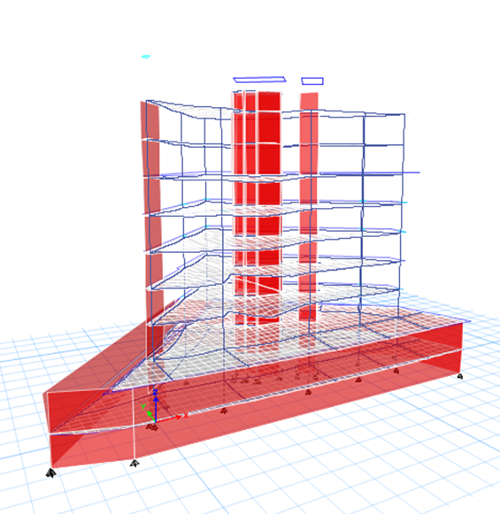
Structural Aspects
3
Structural System
Structural Checks
Seismic Design
Seismic Checks
Design & Details

Slide 33
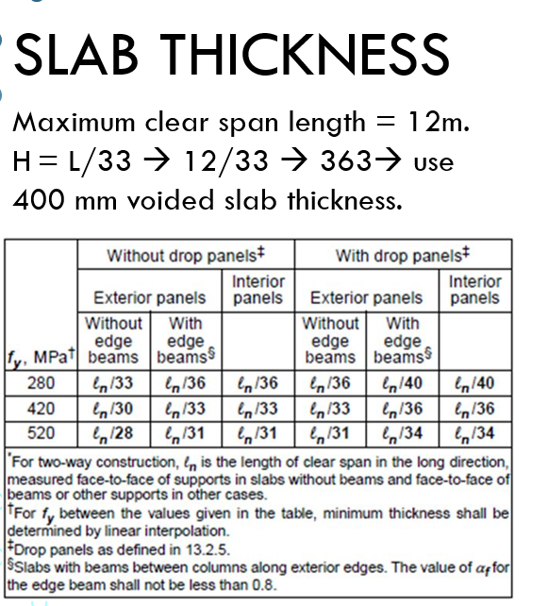
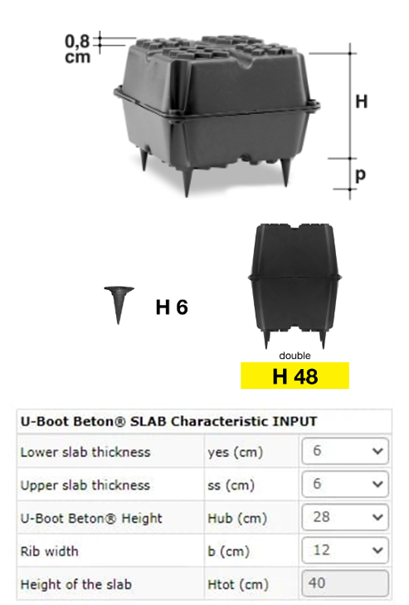
Slab thickness

Slide 34
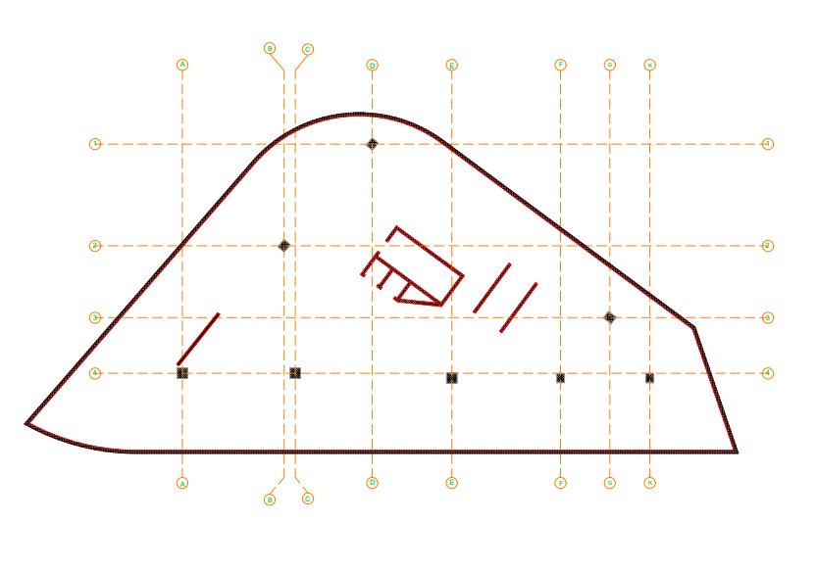
Structural System
Centre of Column

Slide 35
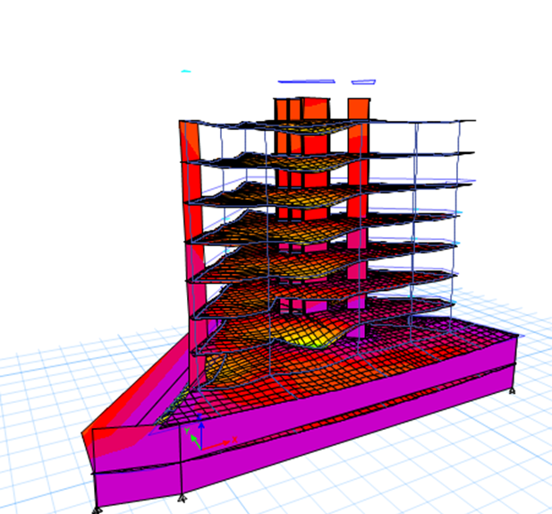
Structural Checks
Compatibility Check
All structural elements of the building move with each other, and this indicates that the compatibility Check is acceptable

Slide 36
Structural Checks
Equilibrium Check
In the Equilibrium Check, the value resulting from the error rate is 1.1% of the dead load, and this value is less than 5% --> The Equilibrium Check is acceptable
Load | etabs | manual | % Error
Dead | 53161.3939 | 52914.9 | 0.00%
Live | 21125.5396 | 21106.008 | 0.00%
SID | 23933.9657 | 24191.4 | 1.1%

Slide 37
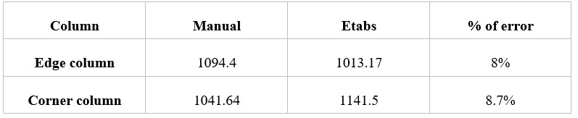
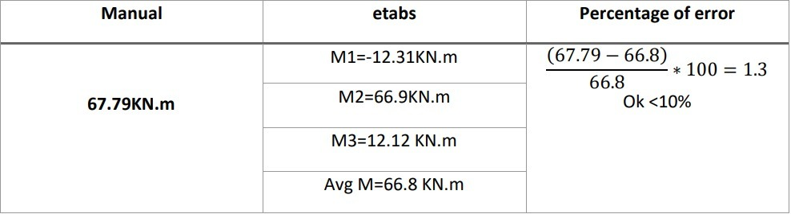
Structural Checks
Stress-Strain Check – Columns
Stress-Strain Check – Slab
Check is acceptable

Slide 38
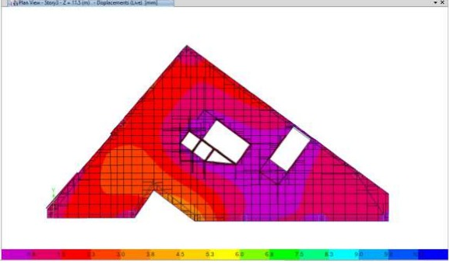
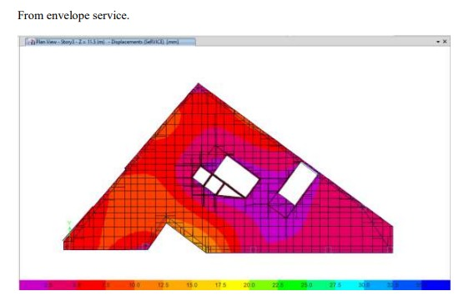
Structural Checks
Deflection check from live load for slab:
Immediate deflection
Deflection limitation= 𝐿/ 360 = 12 /360 = 33mm.
Max Deflection from etabs for slab = 4.4mm.Check is ok.
Long term deflection.
Limit = short long for span /240= 6800/240=28.3mmCheck is ok.

Slide 39
Seismic Design
Seismic Design
Seismic zone: the seismic zone is 2A and the Z is →0.15.
The soil profile is SC , bearing capacity = 400 kg/cm3.
Force Reduction Factor→ R =5.5 (Building Frame System-Shear wall)
Importance factor I=1.25.
Acceleration seismic load coefficient Ca=0.18.
seismic coefficient Cv=0.25.

Slide 40
Seismic Design
Check Name | ETABs results | Allowable limit/Manual limit | Check status
Period check | 1.2 | 1.1 | ok
Modal participating ratio | 94 – X 97 – Y | >90 | ok
Base shear | 4658.17 | 4658.19 | ok
Drift check | ΔMX=51 | < 80 | ok

Slide 41
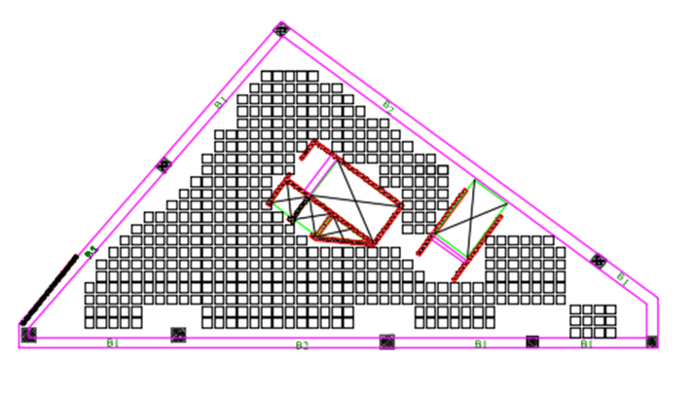
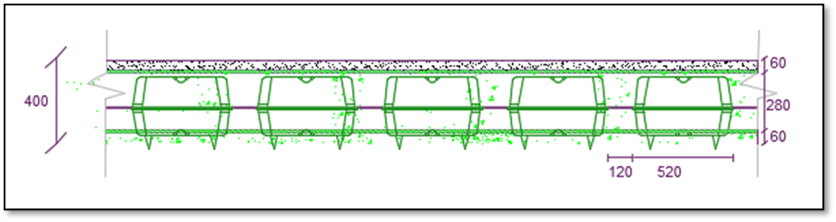
Design & Details
Slab Design
U-Boot plan
Section in slab

Slide 42
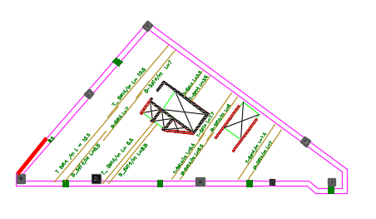
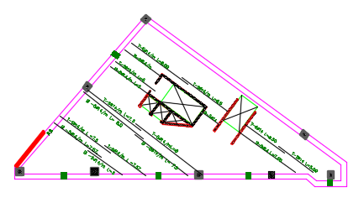
Design & Detailing
Slab Design

Slide 43

Design & Detailing
slab detailing
Section in slab

Slide 44
Design & Detailing
Column design & detailing
Column | length | width | AS (mm2 ) | No.of bars
edge column | 800 | 800 | 6400 | 24 Ø20
corner column | 600 | 700 | 4500 | 16 Ø20

Slide 45



Design & Detailing
Column design & detailing

Slide 46


Design & Detailing
Shear wall design & detailing

Slide 47


Design & Detailing
Beam design & detailing

Slide 48

Design & Detailing
Stairs design & detailing

Slide 49

Design & Detailing
Ramp design & detailing

Slide 50

Design & Detailing
Mat Foundation design & detailing

Slide 51


Design & Detailing
Isolated footing Design

Slide 52


Design & Detailing
Water Tank Design & detailing

Slide 53

Design & Detailing
    Basement wall Design & detailing

Slide 54


Design & Detailing
Tie Beam design & detailing

Slide 55





04
Electro-Mechanical Aspects
HVAC System
Water Supply and Drainage
Artificial Lighting
Acoustical Design
Power Design system
Fire Fighting System

Slide 56
HVAC System
VRF System has been considered.
HVAC System Used Components:
Fan Coil Unit.
Ducts.
Diffusers.
Cassette unit.

Slide 57


HVAC System
Design cooling Capacity = 166 KW
Total heating Capacity = 140.94KW
Total Design Flowrate = 18.1097$m^{3}/s$
Air Handling Unit Catalogue

Slide 58


HVAC System
Outdoor unit
The selected outdoor units are from
AIRSTAGE company type J-IVL with 22.4 KW.
Indoor unit
Fan coil unit from Daikin company.

Slide 59

HVAC System
Diffuser unit
Diffuser unit from Air Master Emirates Company
60×60 cm diffuser will be used for all spaces.

Slide 60


HAVC System
Duct sizer tool will be used to calculate the diameter of all ducts.
To calculate the size of the main duct and Branches as shown (A-B), the airflow (407.9 L/s) and the velocity (5 m/s) are needed and duct sizer software will calculate the head loss and the equivalent diameter as shown in the figure.
Then all branches diameter was calculated
based on the constant head loss theory
and duct sizer software will calculate

Slide 61


HAVC System
Indoor unit
also Since The cooling load for all offices is between 1-5 KW, the FXZQ-A Fully flat cassette (Ductless) from Daikin company. (Each office space contains 1 to 2 cassette units only)

Slide 62


Cassette unit ,Diffuser and duct distribution

Slide 63


Water Supply and Drainage
The hot water source was relied on the electric boiler. Installation for each floor 2 electric boilers 50 L For Each from CATA company

Slide 64


Water Supply and Drainage
Drainage System Sample Plans

Slide 65

Water Supply and Drainage
Rainwater in Drainage System

Slide 66

Artificial Lighting
DIALux has been used for Space Analysis and Design.
1- meeting room
2- manager room
3-traning room
4- Reception
5- cafeteria
6- office

Slide 67

Artificial Lighting
For training design: Type of luminaire has been used:

Slide 68




Artificial Lighting

Slide 69

Artificial Lighting
Lighting Plans

Slide 70


Acoustical Design
Standard of RT60(Reverberation time ).
Standard of STC (Sound transmission class).

Slide 71
Acoustical Design
Ecotect had been used for RT60 analysis
Space | RT60 (sec)
Office | (0.6-0.8)
Manager room | (0.6-0.8)
Meeting room | (0.7-0.9)
Training room | (0.7-0.9)
Multi-purpose hall | (1.2 -1.9)

Slide 72


Acoustical Design
Insul had been used to designed layer of wall and floor
STC For external Wall
STC For internal Wall

Slide 73

Acoustical Design
Insul has been used to designed layer of wall and slab
    STC ( Sound transmission class) For external and internal Wall
IIC (Impact Isolation class) for floor
STC & IIC | Value from standard | Value from INSUL
STC for external wall | $≥$50 | 78
STC for glass wall | $≥$40 | 45
STC for internal wall | $≥$50 | 51
IIC for floor | $≥$ 40 | 110

Slide 74


Power Design
Socket Distribution Plans

Slide 75

Power Design
Distribution Boards

Slide 76


Power Design
Low voltage Design
Designed the low voltage circuits such as internet or TV line.

Slide 77




Fire Fighting System
Used Fire-fighting System
Sprinkler System
Fire Hose Stations
Fire alarm System
Dry Stand Pipe
Fire-fighting Signs
fire extinguishers

Slide 78


Fire Fighting System
Fire-fighting Symbols
Six Floor Fire-Fighting Plan

Slide 79
Quantity Surveying & Cost Estimations
5
In this section, we detailed the activities and quantities needed to set up our project, and we calculated all the necessary quantities and created a Bill of quantity table. The cost includes materials cost, labor costs, and equipment costs.

Slide 80
Cost Estimation
Working items | Total Cost (NIS)
Structural Work | 3470000
Finishes | 3850000
Electrical Work | 250000
Mechanical and HVAC | 1010000
Firefighting | 65000
Lumpsum | 80000
The total cost of the project ≈ 9 M NIS.
The unit cost of the project ≈ 2300 NIS/m2
.

Slide 81
Thank you for listening

