Slide 1
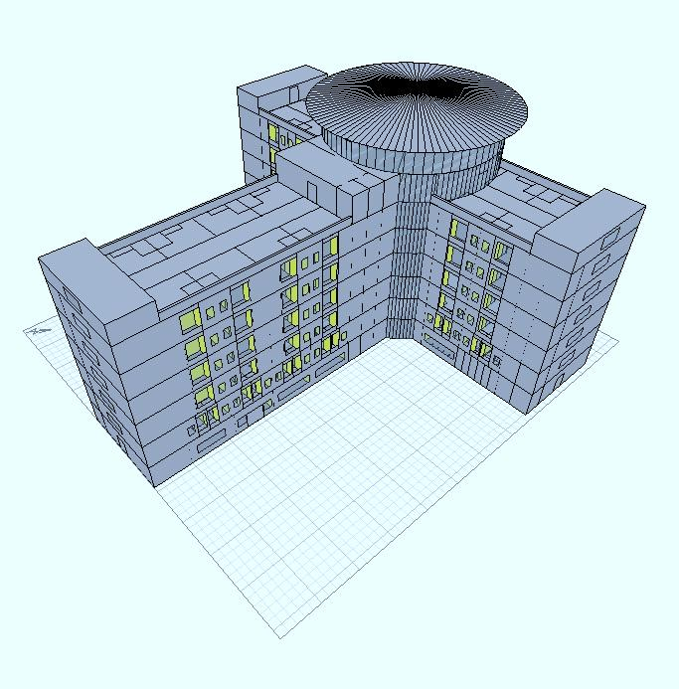

An-Najah National University
Faculty of Engineering
Building Engineering Department
Graduation Project – 2
Integrated Design for Hotel with Revolving Restaurant
Prepared By:
Alaa Jamal Sabri
Ahmad Monir Je’an
Ali Maher Abu Khalil
Project supervisor:
Dr. Mutasim F. Ba’ba
2012 - 2013

Slide 2
Outline:
Site of the project
Architectural Design
Environmental Design.
Structural and Seismic Design
Electrical Design
Mechanical Design
Safety Design
Conclusion.

Slide 3
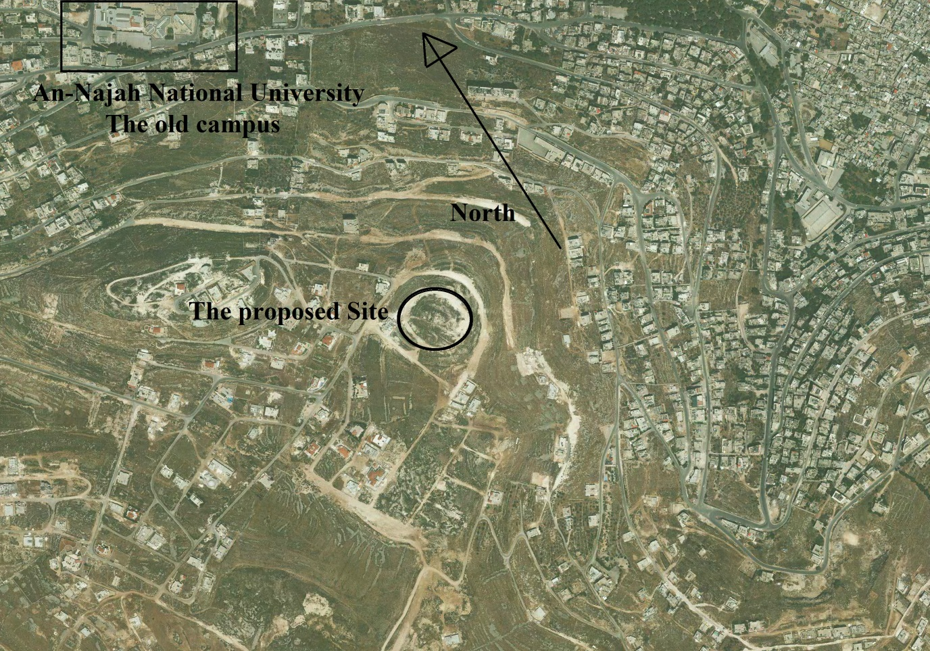
Site of the project:
Location and Site: Area = 7770 square meter.

Slide 4
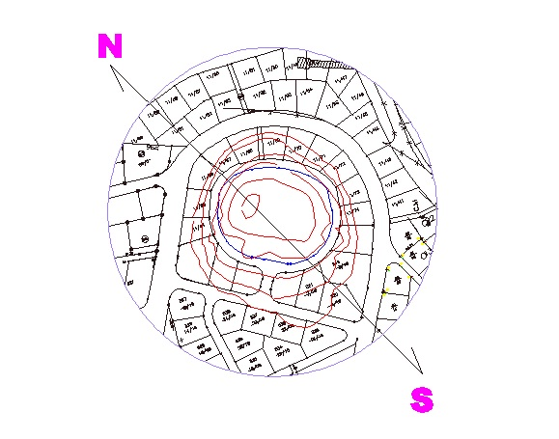
Site of the project:
Location and Site:

Slide 5
Architectural Design

Slide 6
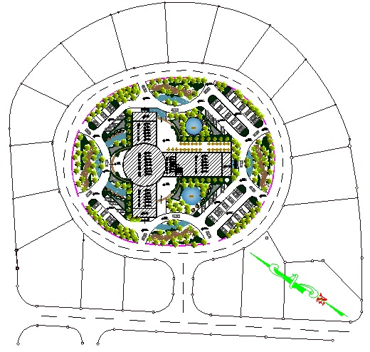
The Site Plan for the project:

Slide 7
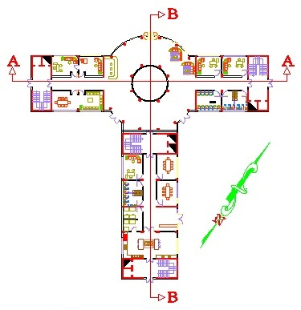
Ground Floor (Area = 1278.5 square meter):

Slide 8
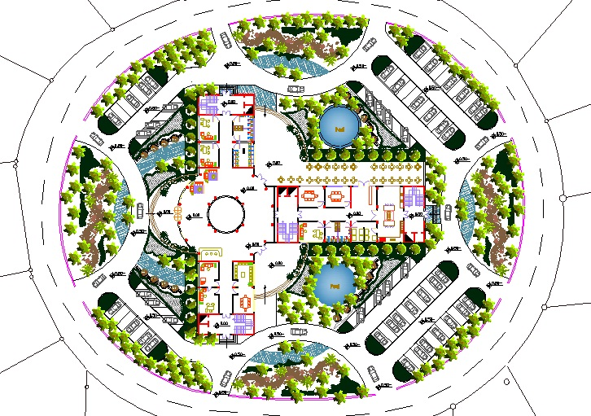
Ground Floor and the landscape:

Slide 9
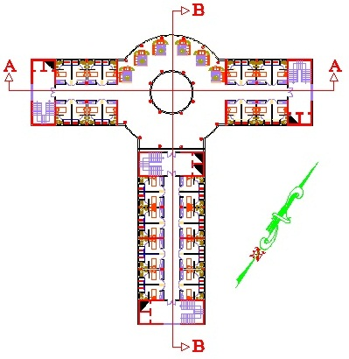
First Floor (Area = 1278.5 square meter):

Slide 10
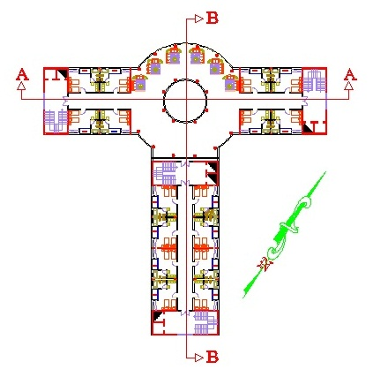
Second Floor (Area = 1278.5 square meter):

Slide 11
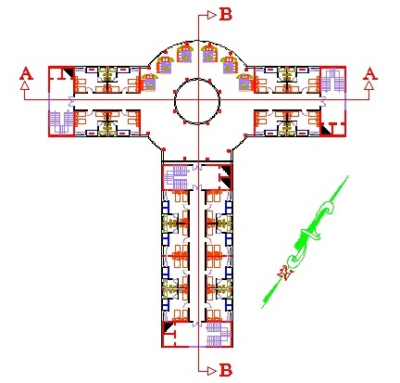
Third Floor (Area = 1278.5 square meter):

Slide 12
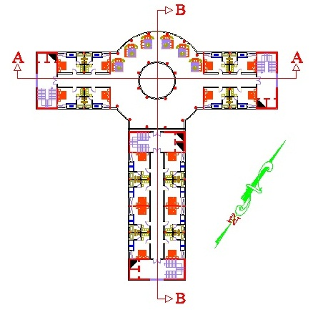
Fourth Floor (Area = 1278.5 square meter):

Slide 13
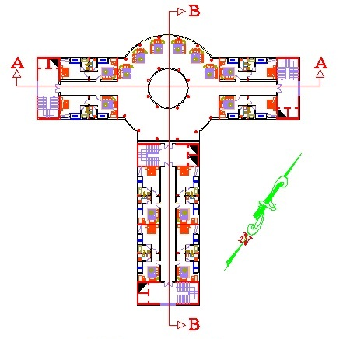
Fifth Floor (Area = 1278.5 square meter):

Slide 14
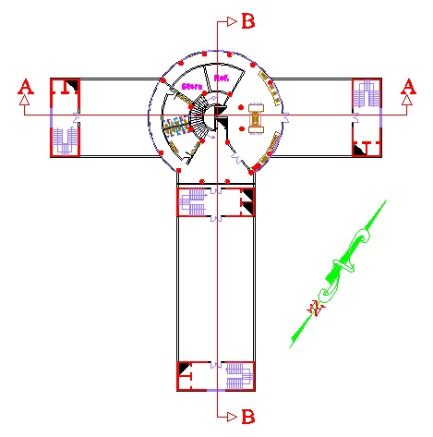
Sixth Floor (Area = 466 square meter):

Slide 15
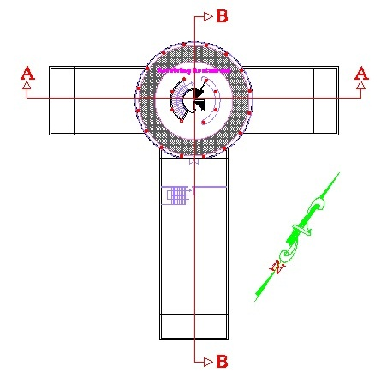
Seventh Floor (Area = 390.5 square meter):

Slide 16
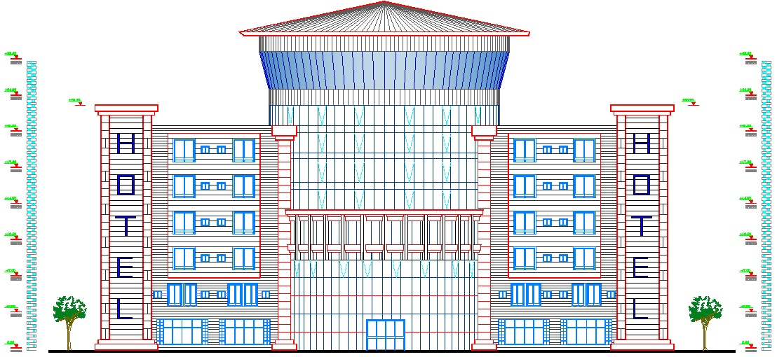
North Elevation:

Slide 17
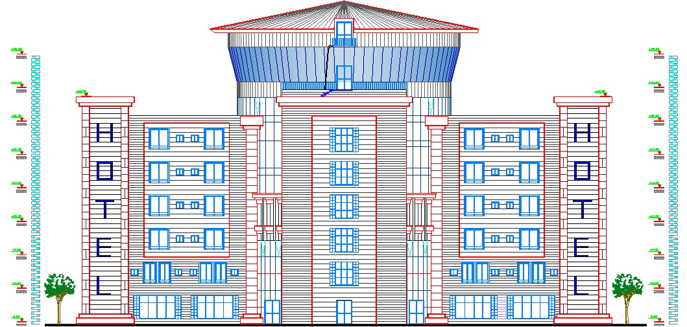
South Elevation:

Slide 18
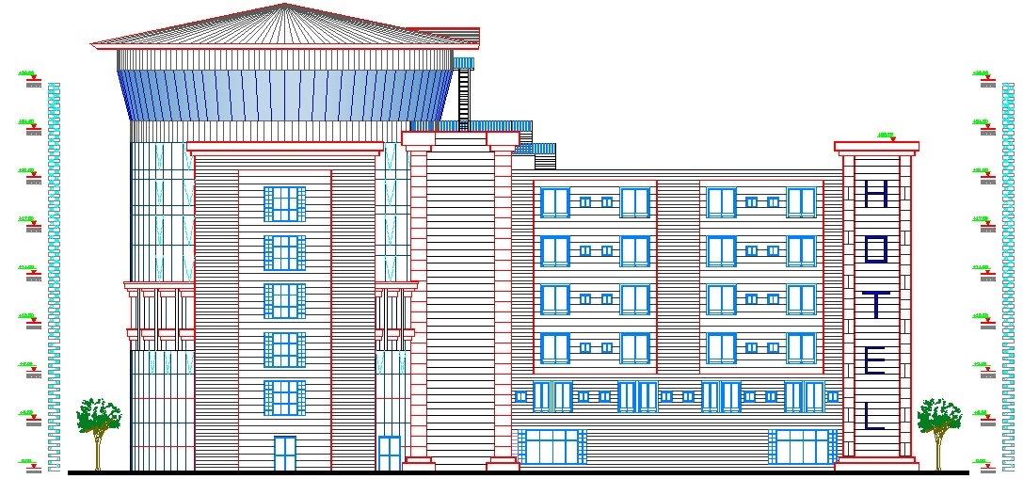
West Elevation:

Slide 19
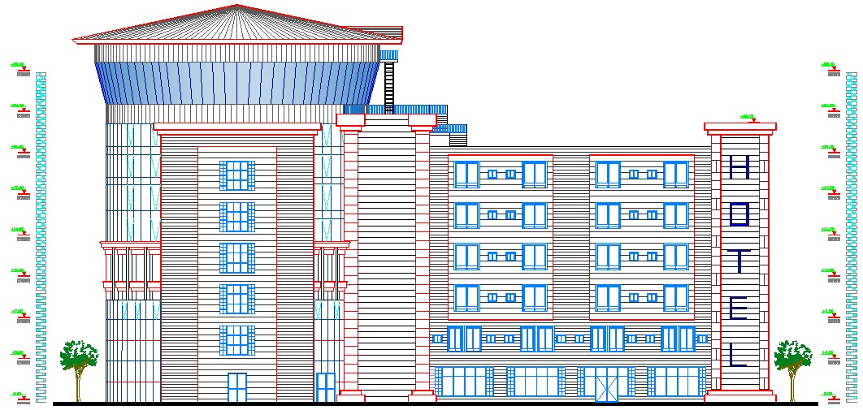
East Elevation:

Slide 20
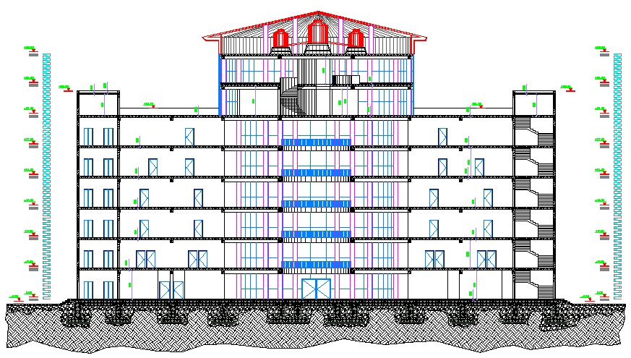
Section A-A:

Slide 21
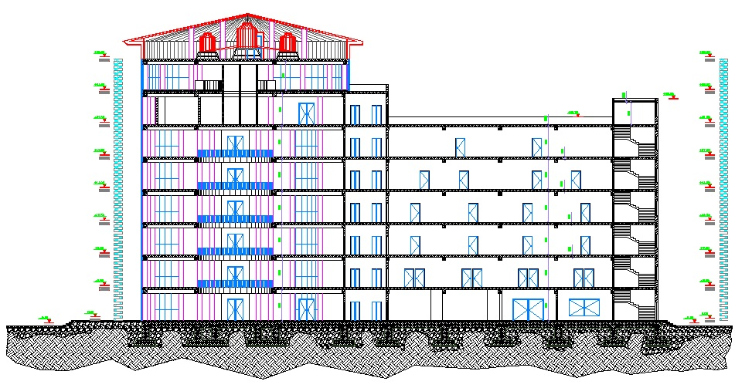
Section B-B:

Slide 22
Environmental Design

Slide 23
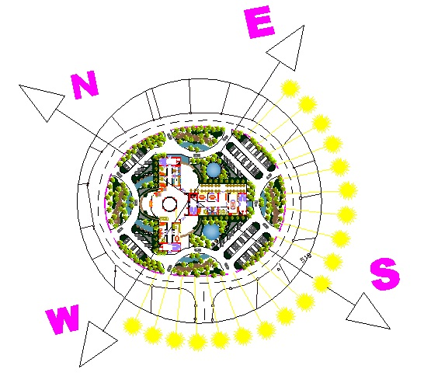
Orientation of the building:

Slide 24
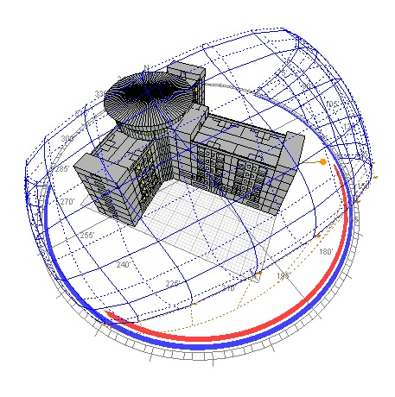
:Ecotect Program

Slide 25
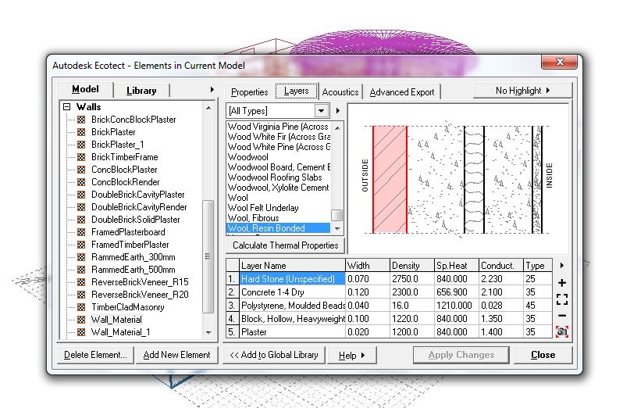
:layers for external walls (U = 0.560 W/m².k.)
Conduct. | Width | Layer Name
2.23 | 7 cm | Hard Stone
2.1 | 12 cm | Concrete
0.028 | 4 cm | Polystyrene
1.35 | 10 cm | H.C.B
1.4 | 2 cm | Plaster

Slide 26
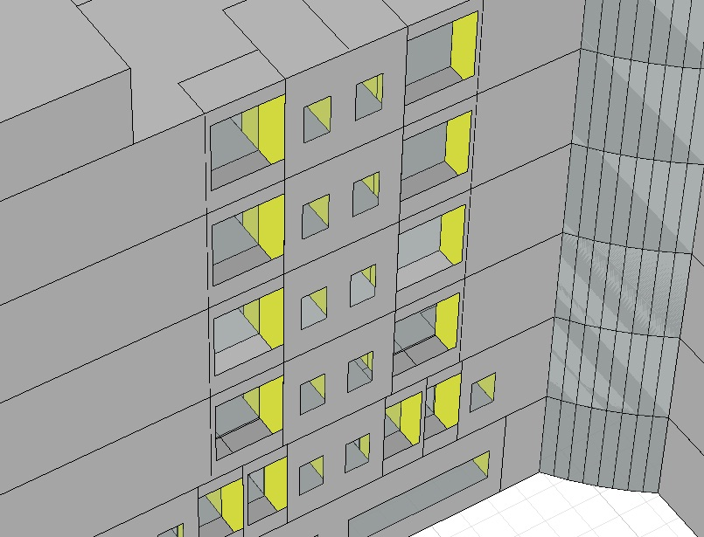
South wall
(Recessed windows with U = 2.260 W/m².k. ):

Slide 27
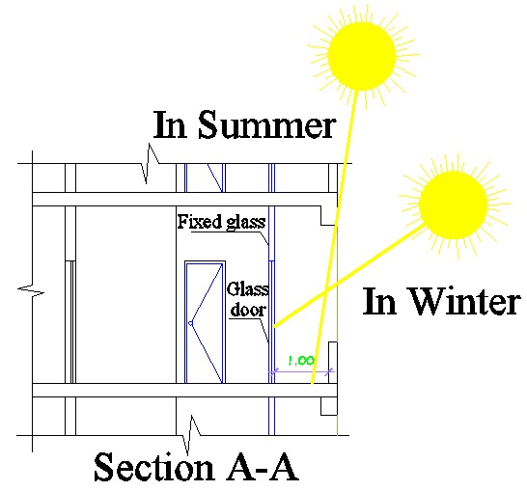
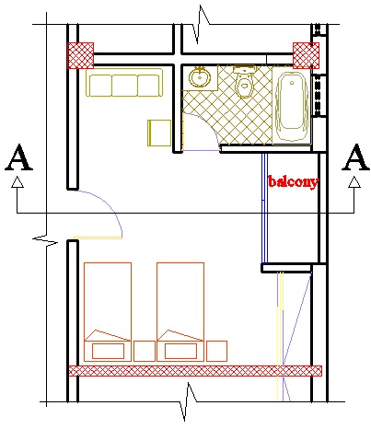
South wall (Recessed windows):

Slide 28
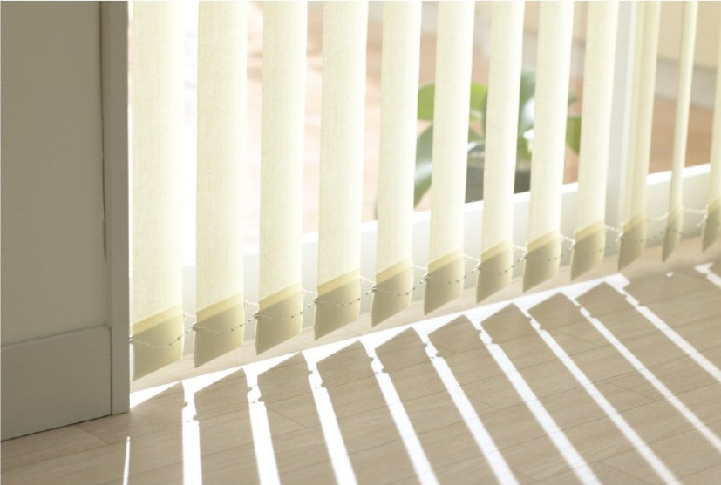
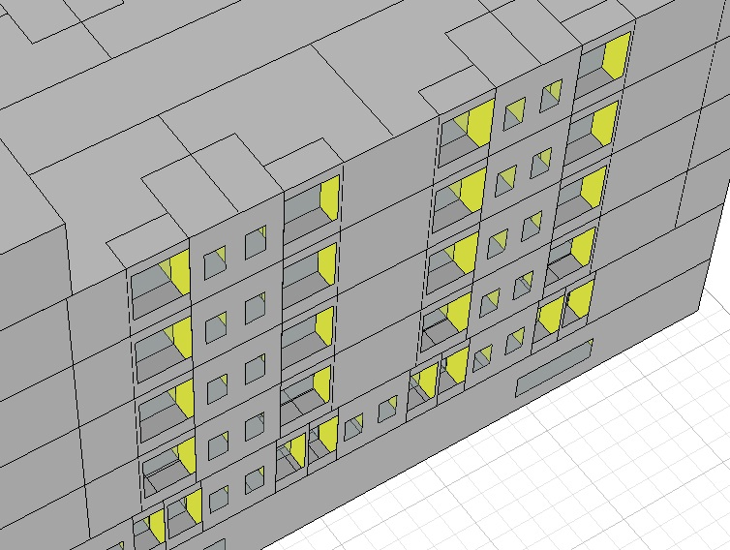
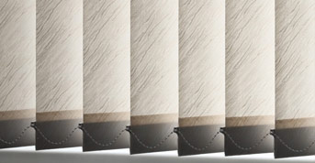
West and East walls
(Recessed windows and internal vertical shutters)

Slide 29
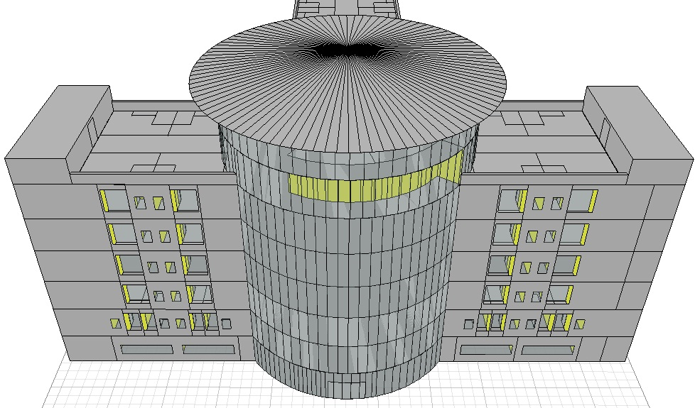
North wall (Double skin facade)

Slide 30
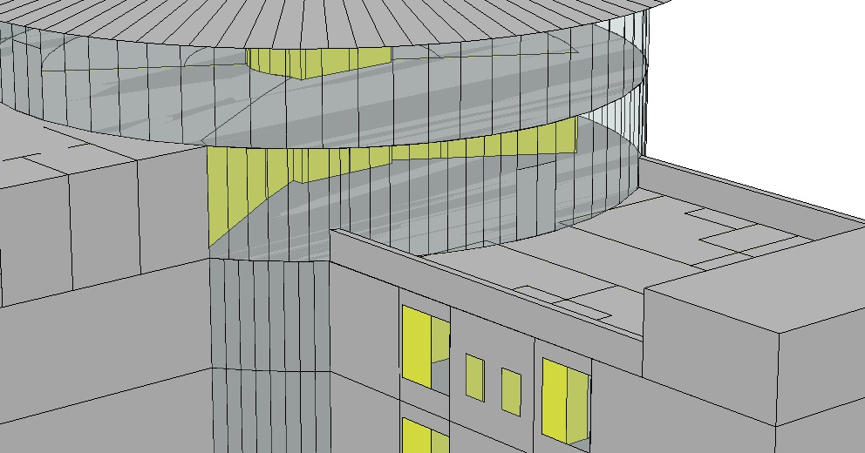
Sixth floor – Kitchen:
(Double skin facade, Internal shutters and Horizontal shading)

Slide 31
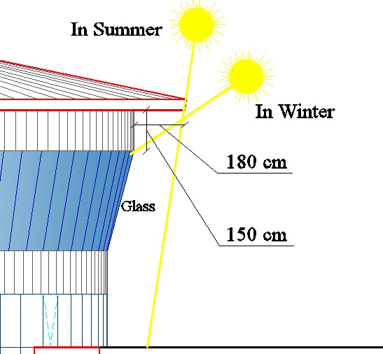
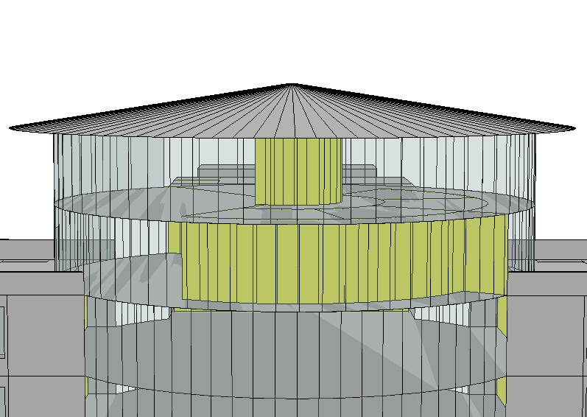
Seventh floor – Revolving Restaurant:
(Double skin facade and horizontal shading)

Slide 32
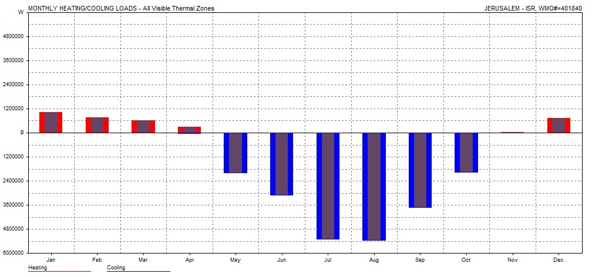
Thermal calculations:
Total (Heating and Cooling) load per meter = 64605 Wh = 64.6 KWh
The acceptable range from 30 to 80 KWh

Slide 33
Acoustical Design (Walls):
Bedroom to Bedroom (STC = 52 required):
Wall type one: Hollow cement block 20 cm thickness:
Wall type two: Shear walls 25 cm thickness:
STC | Layers
48 | 8-in. Dense hollow block
Plus 4 | Add plaster to both sides
52 | Total
STC | Layers
53 | 10-in. Solid concrete
Plus 4 | Add plaster to both sides
57 | Total

Slide 34
Acoustical Design (Walls):
Corridor to Bedroom (STC = 52 required):
Wall layers: Hollow cement block 20 cm thickness:
Furring strips, lath and plaster to both sides
STC | Layers
48 | 8-in. Dense hollow block
Plus 10 | Add furring strips, lath and plaster to both sides
58 | Total

Slide 35
Structural and Seismic Design

Slide 36
Design Codes
Structural Design
The American Concrete Institute code ACI 318-08.
The seismic design according to UBC-97.
The analysis and design were done using SAP2000 program.

Slide 37
* Design data :
1. Concrete compressive strength :
f’c =24 MPa for slabs.
f’c =28MPa for beams, shear walls, columns and footings.
2.Yielding strength of steel
The yield strength of steel Fy= 420MPa
3. Bearing capacity of soil
the bearing capacity of soil = 350 KN/m²

Slide 38
Structural system:
One way ribbed slab with drop beams
Thickness of slab:
The longest span(one end continues) = 430 cm.
The thickness of slab (h) = Ln/18.5 = 430/18.5 = 23 cm
The thickness of slab (h) = 25 cm

Slide 39
Beams dimension
columns dimension
Footings dimension
Dimension (mm) | Type
350*600 | Main beams
300*400 | Secondary beams
Type | Dimension (mm)
Square Columns | 500*500
Circular Columns | 700 mm diameter
Type | Dimension (cm)
Isolated Footing | 240*240*600
Combined Footing | 190*550*520
Wall Footing | 230*580*500

Slide 40
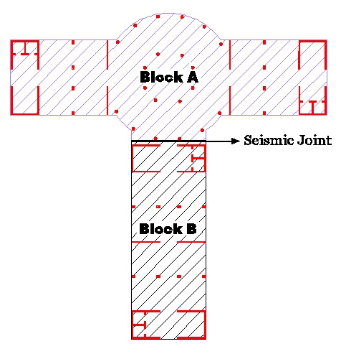
The distribution of columns and shear walls in the building:

Slide 41
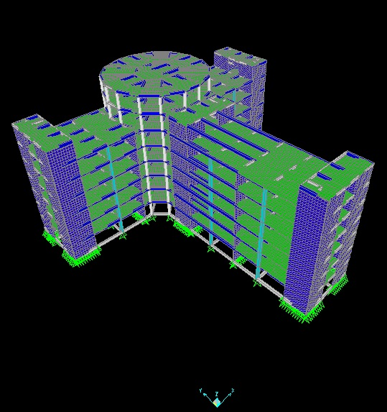
3D Modeling from SAP2000 Program:

Slide 42
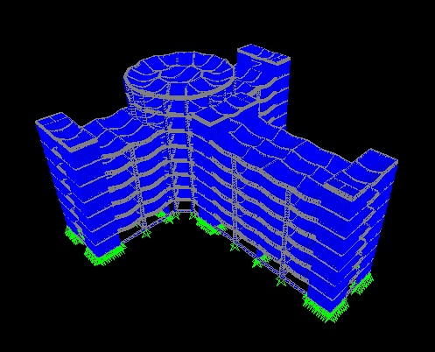
Check Model: Compatibility check

Slide 43
Equilibrium checks:
Error% | SAP | Manual
2.60 % | 91472 | 89023 | Dead load + S.I.D.L
1.10 % | 23208 | 23470 | Live load

Slide 44
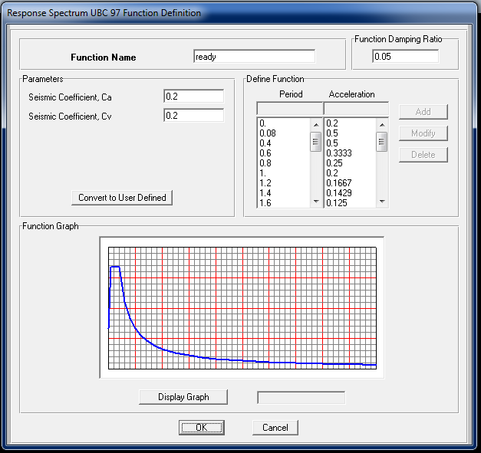
Seismic design using Response Spectrum – UBC 97:
W = 91472 KN
Soil type SB
I = 1
R = 4.5
C_{v} = 0.20
C_{a} = 0.20
T = 0.594 sec.
V = 686.05 KN

Slide 45
Natural Period (T) for the building:
T(sec)
0.65 | From SAP
0.594 | Manual

Slide 46
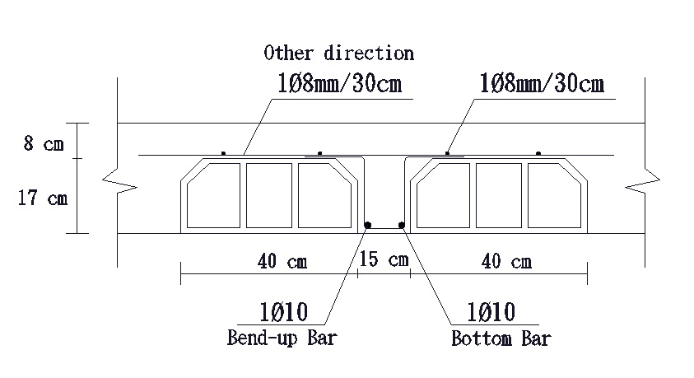
:Structural System Design
    1. Slab design:

Slide 47
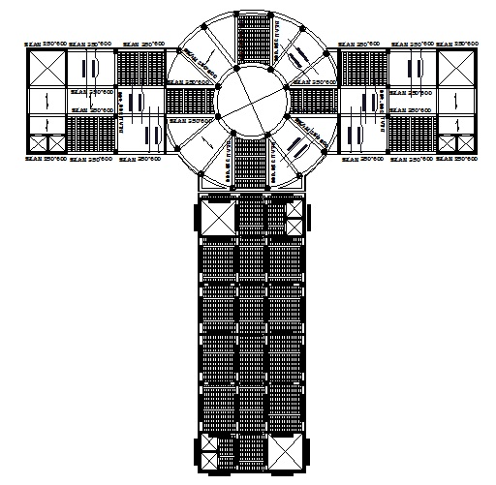
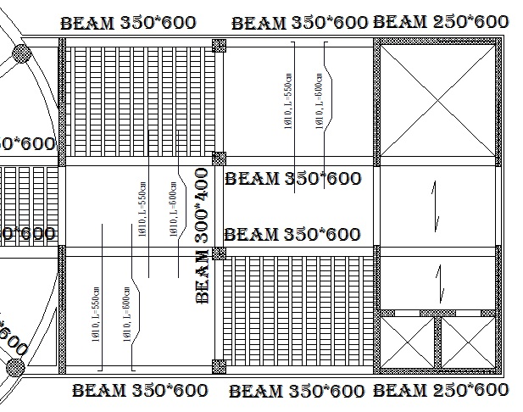
    1. Slab design:

Slide 48
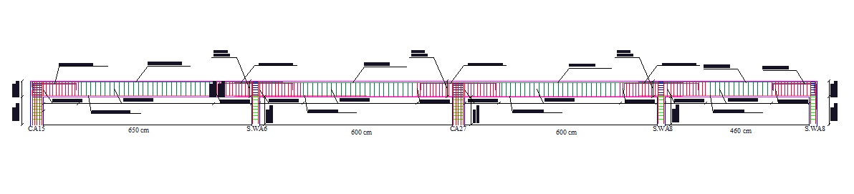
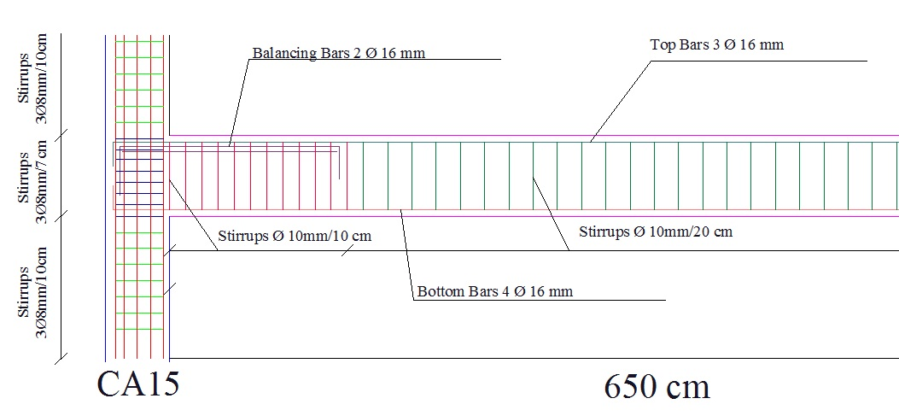
    2. Main Beam Design:

Slide 49
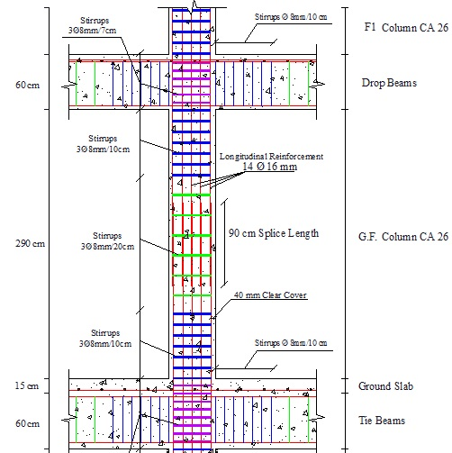
    3. Columns Design (Square Column):

Slide 50
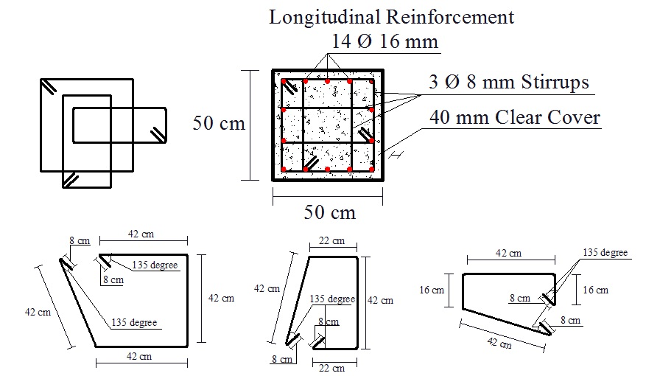
    3. Columns Design (Square Column):

Slide 51
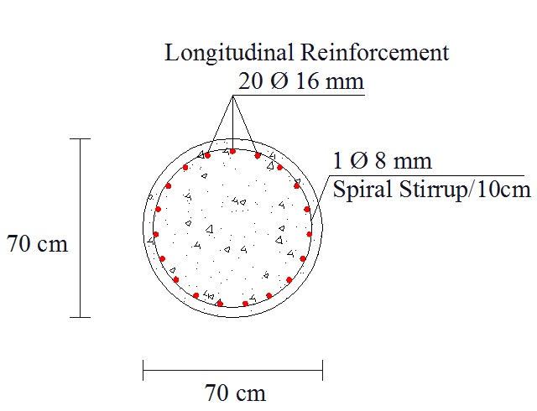
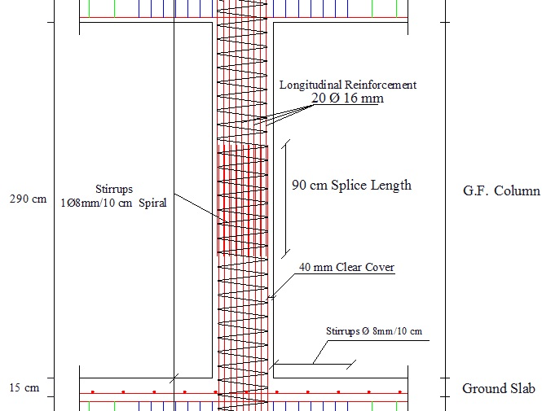
    3. Columns Design (Circular Column):

Slide 52
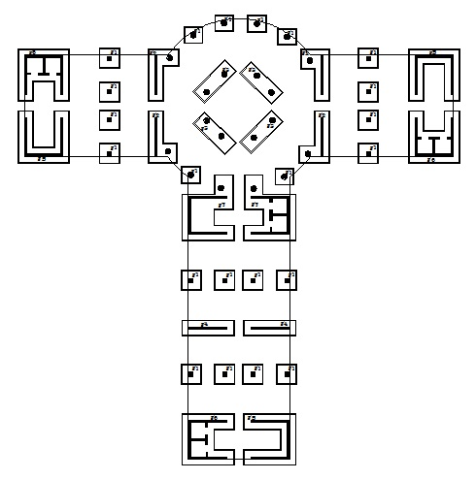
    4. Footings Design:

Slide 53
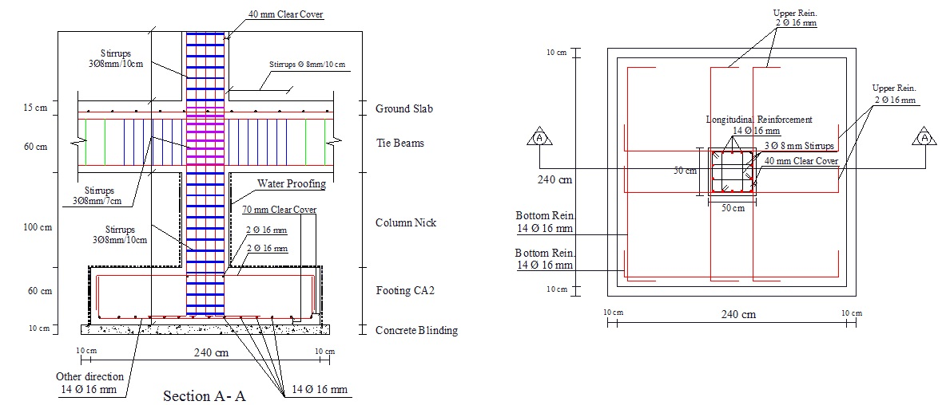
    4. Footings Design (Isolated Footing):

Slide 54
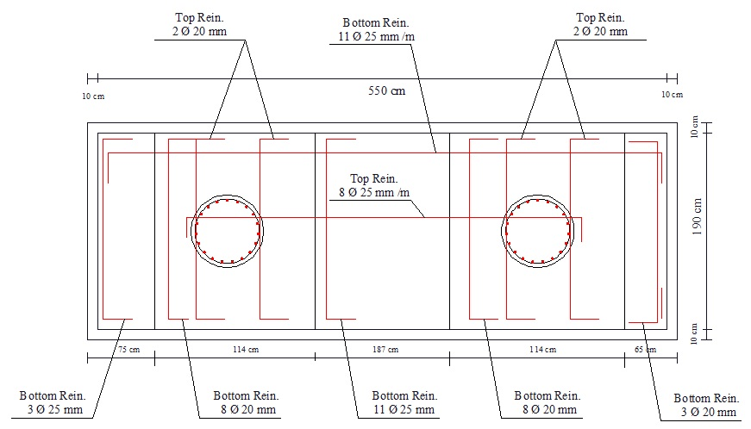
    4. Footings Design (Combined Footing):

Slide 55
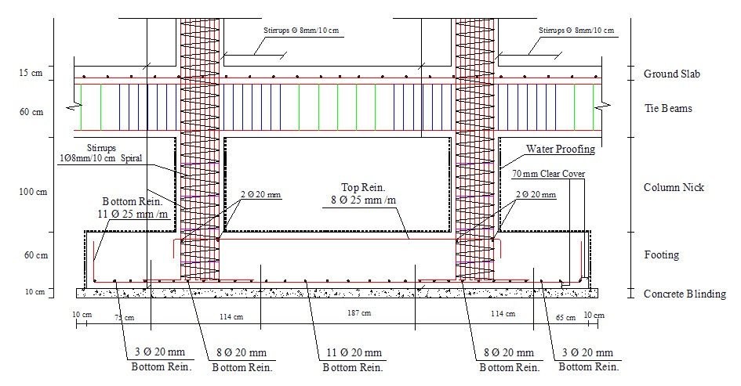
    4. Footings Design (Combined Footing):

Slide 56

    4. Footings Design (Wall Footing):

Slide 57

    4. Footings Design (Wall Footing):

Slide 58

    5. Shear Walls Design:

Slide 59

    5. Reinforcement details around openings:

Slide 60

    6. Stair Design:

Slide 61

Electrical
Design

Slide 62




Revolving Restaurant
E avg =257 lux

Slide 63


Bedroom:
E avg =247 lux

Slide 64


Distribution of lighting and sockets for bedrooms:

Slide 65
Mechanical
Design

Slide 66
General
Mechanical design of a building involves many aspects including:
1. Water Supply System.
2. Drainage System Design.
3. Vertical Transportation (Elevators).
4. Revolving Restaurant.

Slide 67

    Water Supply System:
** Large-size Underground water tank :
Capacity = 150 cubic meter.
** Small nine water tanks on the roof above the revolving restaurant:
Capacity = 10 cubic meter.
** Pump between the underground tank and the small tanks on the roof

Slide 68

    1-Water Supply System:

Slide 69

    1-Water Supply System:
    (The sixth floor-Kitchen and water closets):

Slide 70
1-Water Supply System:
We've divided the building into four zones and we compute the sizes of the pipes for main vertical feeder, main horizontal feeder and branches for each zone.
Zone A: Number of Fixture units= 188, and water demand = 65 gpm
Zone B: Number of Fixture units= 136, and water demand = 53 gpm
Zone C: Number of Fixture units= 188, and water demand = 65 gpm
Zone D: Number of Fixture units= 152, and water demand = 57 gpm
Each zone Provide water to special parts of the building that shown in the plans.

Slide 71

    1-Water Supply System:
    (The second floor to the fifth floor water supply layout):

Slide 72
1-Water Supply System:
Calculations :
Water demand (gpm) | Number of F.U | Type of supply control | Main feeder
65 | 188 | Flush Tank | Zone A
53 | 136 | Flush Tank | Zone B
65 | 188 | Flush Tank | Zone C
57 | 152 | Flush Tank | Zone D
** Pipes diameters for zone A:
Main vertical feeder (Galvanized Steel) (2 inch).
Main horizontal feeder (PVC)(1.25 inch) for ground floor.
Branches (PVC)( ¾ inch) for ground floor.

Slide 73
1-Water Supply System:
Hot Water supply:
** In the hot water supply system we will use boilers, and it is located near the small water tanks on the roof above revolving restaurant.
** Hot water pipes diameters will be the same of the cold water pipes diameters used.

Slide 74
2- Drainage System Design:
To try making the building environmentally-friendly building, the drainage system was divided into two types:
** Black water: To public sewage network.
** Gray water: For irrigation.

Slide 75

2- Drainage System Design:

Slide 76
2- Drainage System Design (Pipes diameters):
** The vertical stack pipe diameter = 4 inch.
** horizontal pipes from laundry, kitchen sink and bathtub up to the floor drain diameter = 2 inch @ ¼ inch per foot slope.
** Horizontal pipe from floor drain to the vertical stack diameter = 4 inch @ 1/8 inch per foot slope.

Slide 77
2- Drainage System Design (Pipes diameters):
** horizontal pipe from lavatory to the vertical stack diameter = 4 inch @ 1/8 inch per foot slope.
** The diameter of vent = 4 inch, and it is raising 4 foot above slab.
** The main drain pipes (underground pipes) diameter = 6 inch @ 1% slope.

Slide 78
3- Vertical transportation (Elevators):
** The required elevators for the hotel after making the calculations are:
1-) Two motor driven elevators:
Capacity = 2000 lb., and speed = 250 fpm.
2-) One special motor driven elevator for revolving restaurant:
Capacity = 2000 lb., and speed = 250 fpm.
3-) One special motor driven elevator for hotel services.
4-) One left between the sixth floor (Kitchen) and the seventh floor (Revolving Restaurant) for special needs people.
5-) One left for things and foods between kitchen and revolving restaurant.

Slide 79

4- Revolving Restaurant:
The mechanism of revolving for the restaurant is (Just the external cylinder of the ground circular slab of restaurant will rotate) as shown in the figures below:

Slide 80


4- Revolving Restaurant:
Stationary elements and rotational elements:

Slide 81


4- Revolving Restaurant:
Photos illustrate mechanism of revolving:

Slide 82


4- Revolving Restaurant:
Photos illustrate mechanism of revolving:

Slide 83


4- Revolving Restaurant:
Photos illustrate mechanism of revolving:

Slide 84

4- Revolving Restaurant:
Photos illustrate mechanism of revolving:

Slide 85
Safety
Design

Slide 86

Safety Signs used and distributed in the hotel:

Slide 87






Safety Signs used and distributed in the hotel:
Right Exit
Left Exit
Exit
Output stairs
Danger Electricity
Do not use elevators

Slide 88






Safety Signs used and distributed in the hotel:
Safe area
Fire Exit
Assembly point
First aid
Emergency Lights
Manual fire alarm

Slide 89



Safety Signs used and distributed in the hotel:
(Fire Protection system):
Fire hoses
Extinguishers
Smoke detectors

Slide 90

Safety Signs used and distributed in the hotel:

Slide 91
Conclusion:
** Gives a wonderful view and be one of the important architectural attractions and encourages local and foreign tourism in Nablus city.
** Very simple structural system and very good seismic design.
** We try to make Hotel environmentally-friendly by dividing the drainage system into two types: Black water and Gray water.
** The method of construction and the cost for the project approximately as any typical building because revolving parts are interior and small.
**We try to make integrated design for the project so it is executable.

Slide 92
Thank you

