Slide 1
Assessment of the Building Management company at Nablus City and Feasibility Study
Aseel Yassin
Diaa Qalalweh
Khalid Zahran
Sabah Hindi
Tariq Mashaeikh

Slide 2
Outline
Introduction.
Literature Review
Methodology
Results and Analysis
Discussion
Conclusions and Recommendations

Slide 3
Introduction
Problem Statement
  According to the PCBS, Nablus recorded the highest number of building licenses in the West Bank with 581 issued for residential buildings during the third quarter of 2016.
  The problem is that the buildings’ committee or person in charge doesn't provide the residents with the needed services

Slide 4
`

Slide 5
Project
Objectives
1
Assessment for the existing building management in Nablus city considering different region.
2
Discuss the problem associated with buildings analyze
3
Measure how people are willing to react and support such company
4
5
Feasibility study for a proposal company provide different services to help in reduce such problem
Enhance the capabilities of the team as industrial engineers in the analysis of the problems and the preparation of feasibility studies

Slide 6
Literature Review

Slide 7
Methodology
Market Study
Meeting key stakeholder of the Real Estate Industry
Design and revision of the Survey.
Technical Study
Location and area of office
Equipment and material needed
Financial Study
Calculate financial study indicators:
Pilot Study
Field work
SPSS program
Collect all the initial costs to know the investment cost
Determine all periodic expenses to know the operational cost
Determine revenues and establish the income statement.
Net present value
Rate of return (ROR)
Payback period
Breakeven point
Sensitivity analysis

Slide 8
Market Study

Slide 9
Stakeholder survey and results
هل يوجد لجنة او شخص مسؤول عن العمارة؟
ما هي قيمة المبلغ الدفوع شهريا؟
كيف يتم اختيار لجنة العمارة؟
هل يوجد شركة مسؤولة عن صيانة المصعد؟
هل يوجد في عقد البيع او الاستئجار بنود تنص بالتزامات نحو اللجنة او الشخص المسؤول؟
هل تؤيد وجود شركة تقدم كافة الخدمات للسكان ؟
There is a committee responsible for the services in the building that they own
The amount of money that is being paid is whether 100 NIS or anything that the residents are willing to pay
The committee s chosen by doing elections or volunteering
They all agreed that there is a company for the elevator maintenance
Some of the stakeholders include terms about the committee and some do not
They all agreed and showed their willingness to support our company

Slide 10
Summary of problems from the Stakeholders of the Real Estate Industry
The stakeholders assured that they provide a full year covered for the elevator maintenance, and they have a meeting for the residents after they sell most of the apartments to set a committee that is responsible for providing the residents with the services needed but the problem is that these committee are not followed up by any one.

Slide 11
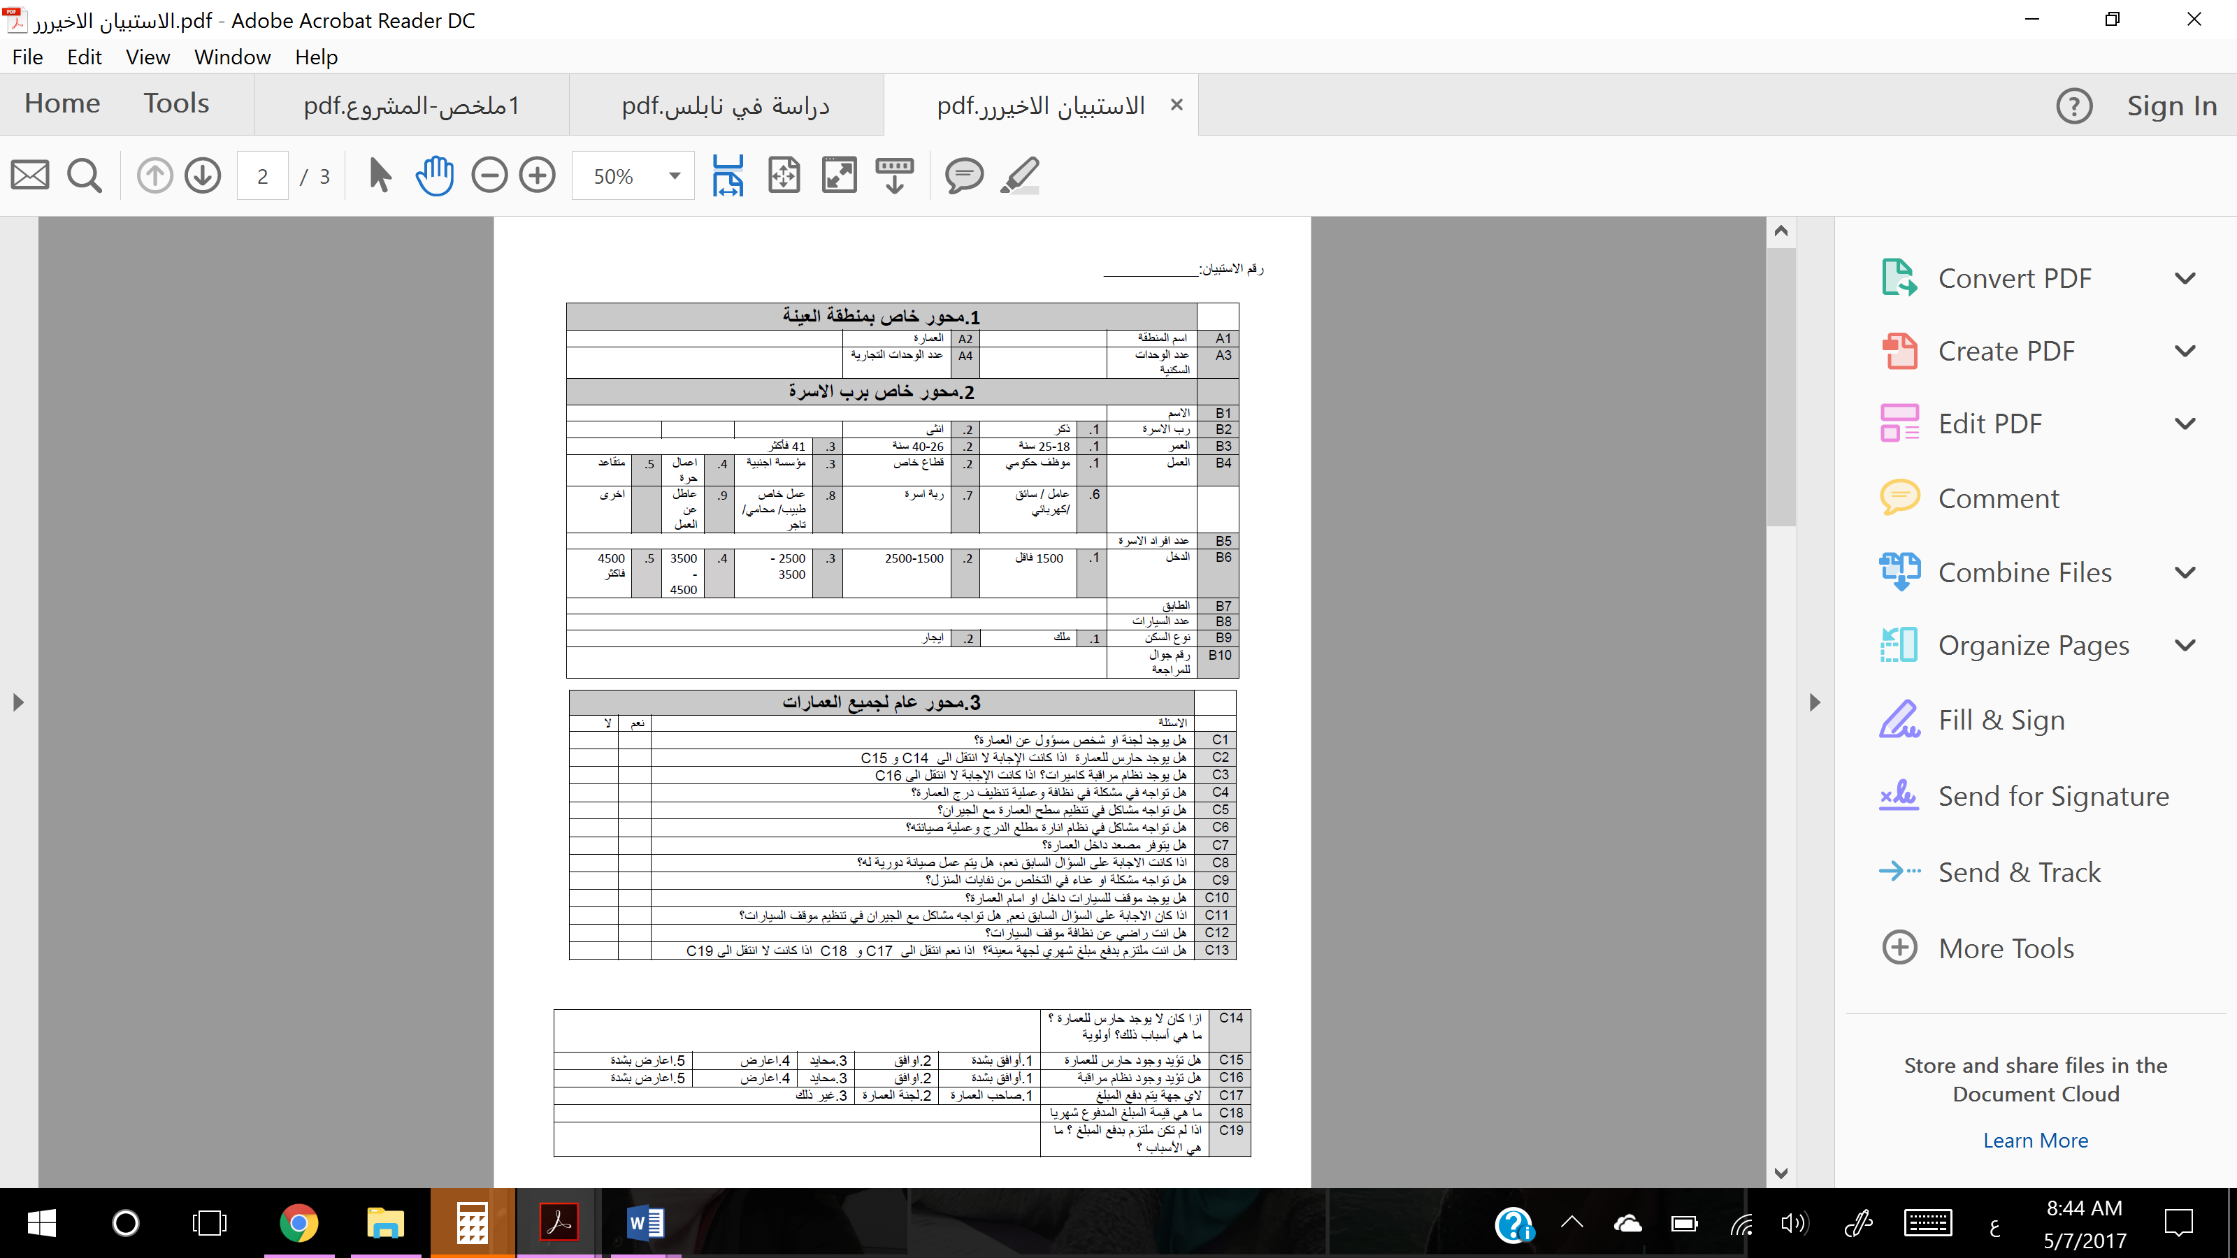
Residential Survey and Results

Slide 13
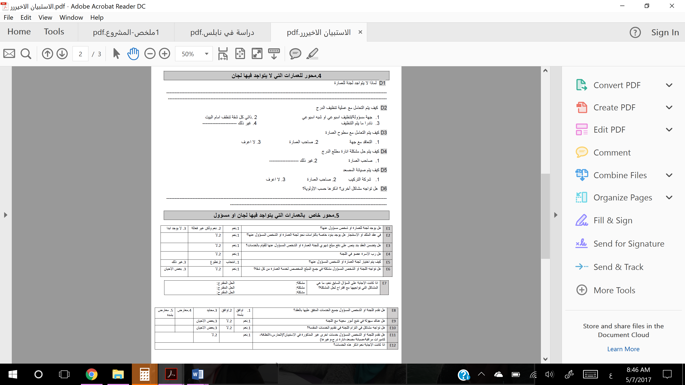

Slide 15
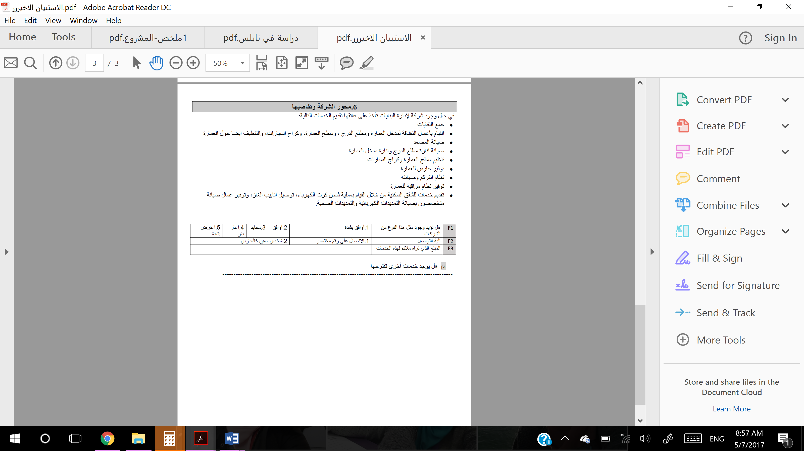

Slide 16
لا | نعم | السؤال
11% | 89% | هل يوجد لجنة او شخص مسؤول عن العمارة؟
69% | 31% | هل يوجد حارس للعمارة
75% | 25% | هل يوجد نظام مراقبة كاميرات؟
55% | 45% | هل تواجه في مشكلة في نظافة وعملية تنظيف درج العمارة؟
80% | 20% | هل تواجه مشاكل في تنظيم سطح العمارة مع الجيران
64% | 36% | هل تواجه مشاكل في نظام انارة مطلع الدرج وعملية صيانته؟
26% | 74% | هل يتوفر مصعد داخل العمارة؟
12% | 88% | هل يتم عمل صيانة دورية له؟
84% | 16% | هل تواجه مشكلة او عناء في التخلص من نفايات المنزل؟
34% | 66% | هل يوجد موقف للسيارات داخل او امام العمارة؟
71% | 29% | هل تواجه مشاكل مع الجيران في تنظيم موقف السيارات؟
39% | 61% | هل انت راضي عن نظافة موقف السيارات
17% | 83% | هل انت ملتزم بدفع مبلغ شهري لجهة معينة؟
57% | 43% | في عقد الملك او االاستئجار هل يوجد بنود خاصة بالتزامات نحو لجنة العمارة او الشخص المسؤول عنها؟
67% | 33% | هل يتضمن العقد بند ينص على دفع مبلغ شهري للجنة العمارة او الشخص المسؤول عنها للقيام بالخدمات؟
Survey results for the main problem

Slide 17
Results cont.
المبلغ الذي تراه ملائم لهذه الخدمات
Mean | 127.82
Std. Deviation | 75.006
قيمة المبلغ المدفوع شهريا
Mean | 74.00
Std. Deviation | 33.222

Slide 19
Crosstabulation analysis
وجود لجنة او شخص مسؤول عن العمارة * وجود حارس للعمارة Crosstabulation
 |  | وجود حارس للعمارة
 |  | نعم | لا
وجود لجنة او شخص مسؤول عن العمارة | نعم | 33.6% | 66.4%
 | لا | 6.2% | 93.8%
وجود حارس للعمارة *تأييد وجود حارس للعمارة Crosstabulation
 |  | تأييد وجود حارس للعمارة
 |  | اوافق بشدة | اوافق | محايد | معارض | اعارض بشدة
وجود حارس للعمارة | لا | 47.1% | 38.5% | 4.8% | 8.7% | 1.0%

Slide 20
وجود لجنة او شخص مسؤول عن العمارة * وجود نظام مراقبة كاميرات Crosstabulation
 |  | وجود نظام مراقبة كاميرات
 |  | نعم | لا
وجود لجنة او شخص مسؤول عن العمارة | نعم | 26.5% | 73.5%
 | لا | 31.2% | 68.8%
وجود نظام مراقبة كاميرات * تأييد وجود نظام مراقبة كاميرات Crosstabulation
 |  | تأييد وجود نظام مراقبة كاميرات
 |  | اوافق بشدة | اوافق | محايد | اعارض
وجود نظام مراقبة كاميرات | لا | 61.0% | 27.6% | 8.6% | 2.9%

Slide 21
Summary of problems in the buildings from the householders point of view
The shorten in providing services from the current committees even though residents do pay their monthly amount of money
Not all the apartments are occupied to pay the money which is needed to provide such services and led to that shorten
Committees should have some clear strategies to deal with the unoccupied apartments in order to distribute the money fairly among the residents and other strategies to deal with any resident that is not commitment to pay
Other householders showed their complains about not having an effective committee or not having one at all

Slide 22
Technical Study

Slide 23
Services
Guarding
Delivery
Camera system
Electrical maintenance
Sanitary maintenance
Elevator maintenance

Slide 24
Demand
Demand | Service
80 building | Guarding
1200 per month | Delivery
54 system | Camera system
50 order per month | Electrical maintenance
50 order per month | Sanitary maintenance
60 building | Elevator maintenance

Slide 25
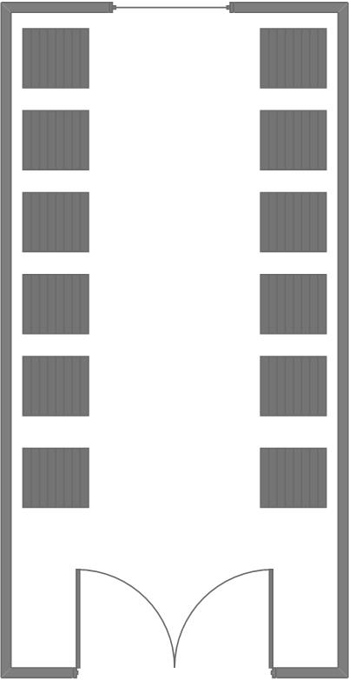
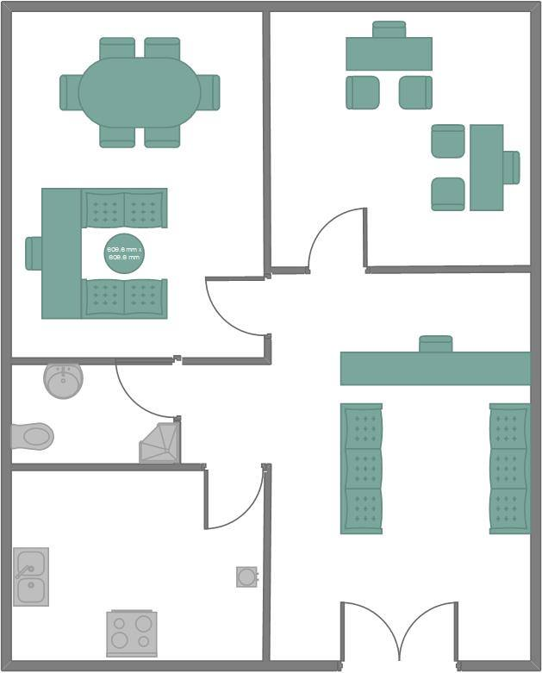
Office and store Layout
Area (m²) | item
80 | Office
50 | Store

Slide 26
Summary for technical study
Category | cost
Total establishment/capital cost | 271,026
Total salaries | 1,766,950
Total deprecation | 14,845
Company administrative cost | 20,760

Slide 27
services cost
Variable cost | Fixed cost (yearly) | service
20500 (yearly) | 230575 | Guarding
1 (per order) | 88900 | Delivery
900(per system) | 0 | Camera system
Out sourcing (10% for each maintenance) |  | Electrical maintenance
Out sourcing (10% for each maintenance) |  | Sanitary maintenance
3420 | 0 | Elevator maintenance

Slide 28
Service Price
Price (NIS) | Service
2000 per month | Guarding
7.5 per order | Delivery
1000 per system | Camera system
Each order on average is 100 NIS. 10%*100 = 10 NIS / order | Electrical maintenance
Each order on average is 100 NIS. 10%*100 = 10 NIS / order | Sanitary maintenance
3610 | Elevator maintenance

Slide 29
Sales | service | price | number | total per year
 | Guard | 2000 | 80 | 1920000
 | Delivery | 7.5 | 1200 | 108000
 | Camera system | 1000 | 54 | 54000
 | Electrical maintenance | 10 | 50 | 6000
 | Sanitary extension maintenance | 10 | 50 | 6000
 | elevator maintenance | 300 | 60 | 216000
 |  |  | Total | 2,310,000
variable cost | service | cost | number | Total per year
 | Guard | 1708.33 | 80 | 1639996.8
 | Delivery | 1 | 1200 | 14400
 | Camera system | 900 | 54 | 48600
 | Electrical maintenance | 0 | 50 | 0
 | Sanitary extension maintenance | 0 | 50 | 0
 | elevator maintenance | 285 | 60 | 205200
 |  |  | Total | 1,908,196.8
Gross profit | 401,803.2
fixed cost | service |  | cost
 | Guard |  | 230575
 | Delivery |  | 88900
 | Camera system |  | 0
 | Electrical maintenance |  | 0
 | Sanitary extension maintenance |  | 0
 | elevator maintenance |  | 0
 | Total |  | 319475
Net profit | 82,328.2
Net profit after taxes | 65,862.4
Income
statement

Slide 30
Financial Study
Breakeven point
Net present value
Rate of return
Payback period
Sensitivity analysis

Slide 31
Break Even point
Break even point | Service
66 building per year | Guarding
38 order per day (1140 per month) | Delivery

Slide 32
category | year
 | 0 | 1 | 2 | 3 | 4 | 5
initial investment | 271026 | 0 | 0 | 0 | 0 | 30000
running cost | 0 | 2227672 | 2655671 | 4056669 | 4056669 | 4980617
income | 0 | 2310000 | 2832880 | 4523120 | 4523120 | 5638626
net profit | 0 | 82328.2 | 177209 | 466451.4 | 466451.4 | 658009
20% taxes | 0 | 16465.64 | 35441.8 | 93290.28 | 93290.28 | 131601.8
profit after taxes | 0 | 65862.56 | 141767.2 | 373161.1 | 373161.1 | 526407.2
net cash flow | -271,026 | 65,862.56 | 141,767.2 | 373,161.1 | 373,161.1 | 496,407.2
category | year
 | 6 | 7 | 8 | 9 | 10 | 11
initial investment | 0 | 0 | 0 | 0 | 118450 | 0
running cost | 4980617 | 6135725 | 6135725 | 6135725 | 6135725 | 6135725
income | 5638626 | 7033086 | 7033086 | 7033086 | 7033086 | 7033086
net profit | 658009 | 897361 | 897361 | 897361 | 897361 | 897361
20% taxes | 131601.8 | 179472.2 | 179472.2 | 179472.2 | 179472.2 | 179472.2
profit after taxes | 526407.2 | 717888.8 | 717888.8 | 717888.8 | 717888.8 | 717888.8
net cash flow | 526,407.2 | 717,888.8 | 717,888.8 | 717,888.8 | 599,438.8 | 717,888.8
category | year
 | 12 | 13 | 14 | 15
initial investment | 0 | 0 | 0 | 30000
running cost | 6135725 | 6135725 | 6135725 | 6135725
income | 7033086 | 7033086 | 7033086 | 7033086
net profit | 897361 | 897361 | 897361 | 897361
20% taxes | 179472.2 | 179472.2 | 179472.2 | 179472.2
profit after taxes | 717888.8 | 717888.8 | 717888.8 | 717888.8
net cash flow | 717,888.8 | 717,888.8 | 717,888.8 | 687,888.8
Cash flow
table

Slide 33
Cash flow diagram
ROR = 76%
NPV = 4,540,315

Slide 34
Pay back period
Net cash flow | Cumulative
-271026 | -271026
65862.56 | -205163.4
141767.2 | -63396.24
373161.12 | 309764.9
Payback period (year) | 2.16989
Payback period (months) | 26.03868
By using
Conventional
method

Slide 35
Sensitivity analysis
Scenario | Changes
Best case scenario (Case 1) | 15% increase on net cash flow
Worst case scenario (Case 2) | 20% decrease on net cash flow

Slide 36
Category | year
 | 0 | 1 | 2 | 3 | 4 | 5
initial investment | 271026 | 0 | 0 | 0 | 0 | 30000
running cost | 0 | 2227672 | 2655671 | 4056669 | 4056669 | 4980617
income | 0 | 2310000 | 2832880 | 4523120 | 4523120 | 5638626
net profit | 0 | 82328.2 | 177209 | 466451.4 | 466451.4 | 658009
20% taxes | 0 | 16465.64 | 35441.8 | 93290.28 | 93290.28 | 131601.8
profit after taxes | 0 | 65862.56 | 141767.2 | 373161.1 | 373161.1 | 526407.2
net cash flow | -271026 | 65,862.56 | 141,767.2 | 373,161.1 | 373,161.1 | 496,407.2
Case 1 (+15%) | -271026 | 75,741.94 | 163,032.28 | 429,135.29 | 429,135.29 | 570,868.28
Case 2 (-20%) | -271026 | 52,690.05 | 113,413.76 | 298,528.90 | 298,528.90 | 397,125.76
category | year
 | 6 | 7 | 8 | 9 | 10 | 11
initial investment | 0 | 0 | 0 | 0 | 118450 | 0
running cost | 4980617 | 6135725 | 6135725 | 6135725 | 6135725 | 6135725
income | 5638626 | 7033086 | 7033086 | 7033086 | 7033086 | 7033086
net profit | 658009 | 897361 | 897361 | 897361 | 897361 | 897361
20% taxes | 131601.8 | 179472.2 | 179472.2 | 179472.2 | 179472.2 | 179472.2
profit after taxes | 526407.2 | 717888.8 | 717888.8 | 717888.8 | 717888.8 | 717888.8
net cash flow | 52,6407.2 | 717,888.8 | 717,888.8 | 717,888.8 | 599,438.8 | 717,888.8
Case 1 (+15%) | 605,368.28 | 825,572.12 | 825,572.12 | 825,572.12 | 689,354.62 | 825,572.12
Case 2 (-20%) | 421,125.76 | 574,311.04 | 574,311.04 | 574,311.04 | 479,551.04 | 574,311.04
category | year
 | 12 | 13 | 14 | 15
initial investment | 0 | 0 | 0 | 30000
running cost | 6135725 | 6135725 | 6135725 | 6135725
income | 7033086 | 7033086 | 7033086 | 7033086
net profit | 897361 | 897361 | 897361 | 897361
20% taxes | 179472.2 | 179472.2 | 179472.2 | 179472.2
profit after taxes | 717888.8 | 717888.8 | 717888.8 | 717888.8
net cash flow | 717888.8 | 717,888.8 | 717,888.8 | 687,888.8
Case 1 (+15%) | 825,572.12 | 825,572.12 | 825,572.12 | 791,072.12
Case 2 (-20%) | 574,311.04 | 574,311.04 | 574,311.04 | 550,311.04
Cash Flow table

Slide 37
Cash flow for Case 1 (+15%)

Slide 38
Cash flow for Case 2 (-20%)

Slide 39
Rate of return
Case | ROR
Natural case | 76%
Case 1 (+15%) | 82%
Case 2 (-20%) | 66%

Slide 40
Pay back period
net cash flow | cumulative
-271026 | -271026
75741.94 | -195284.06
163032.28 | -32251.78
429135.29 | 396883.51
payback period (years) | 2.0751553
net cash flow | cumulative
-271026 | -271026
52690.05 | -218335.95
113413.76 | -104922.19
298528.90 | 193606.70
Payback period (years) | 2.3514641
Case | Payback period (years)
Natural case | 2.16989
Case 1 (+15%) | 2.0751553
Case 2 (-20%) | 2.3514641
Case 1
Case 2
Summary

Slide 41
Conclusion
According to the research results it was clear that Nablus city is facing a lot issues regarding building management and there is a good potential for success for the company that will be established
Even though that 90% of the residential that was covered during the research had committee there was shortening in most of the services such as providing janitors, security cameras, or the neatness and cleanliness of the stairs.

Slide 42
The existence of this kind of companies will help developing Nablus city
After studying the market, we found from technical and financial analysis that establishing this kind of companies is feasible and profitable.

Slide 43
The need to commercialize the company with the help of stakeholders to help raise the awareness about the need for such company.
Company should enter new markets in new cities and expand locally
The company should always improve the services with good quality and low cost.
Recommendations

