Slide 1

Design and structural Analysis of Golden Tree Hotel
Prepared By
Nabela Jamal Odeh
Nadeen Suliman Abo Sroor
Rana Mohammad zubaidi
Submitted to : Dr. Imad Al Qasem

Slide 2
Outline:
Introduction.
3D modeling .
Seismic design.
Design and Detailing .

Slide 3
INTRODUCTION

Slide 4
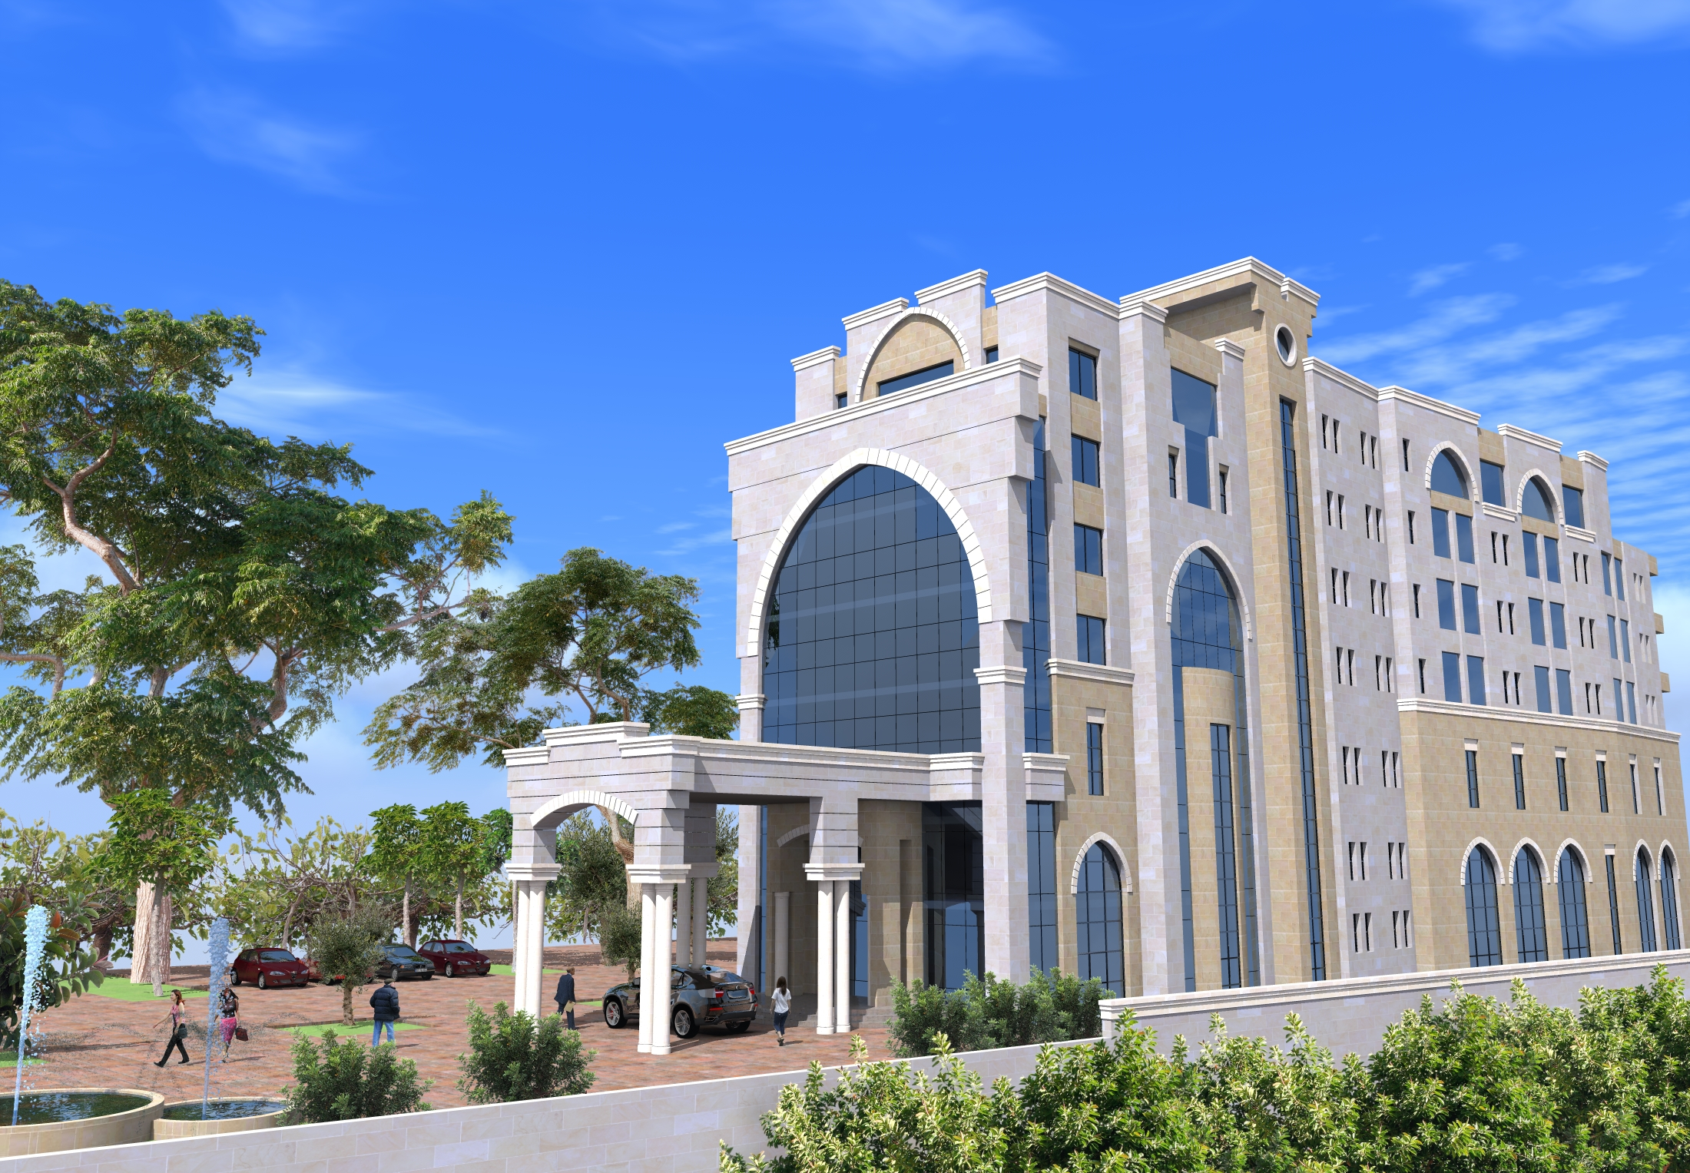
Golden Tree Hotel

Slide 5
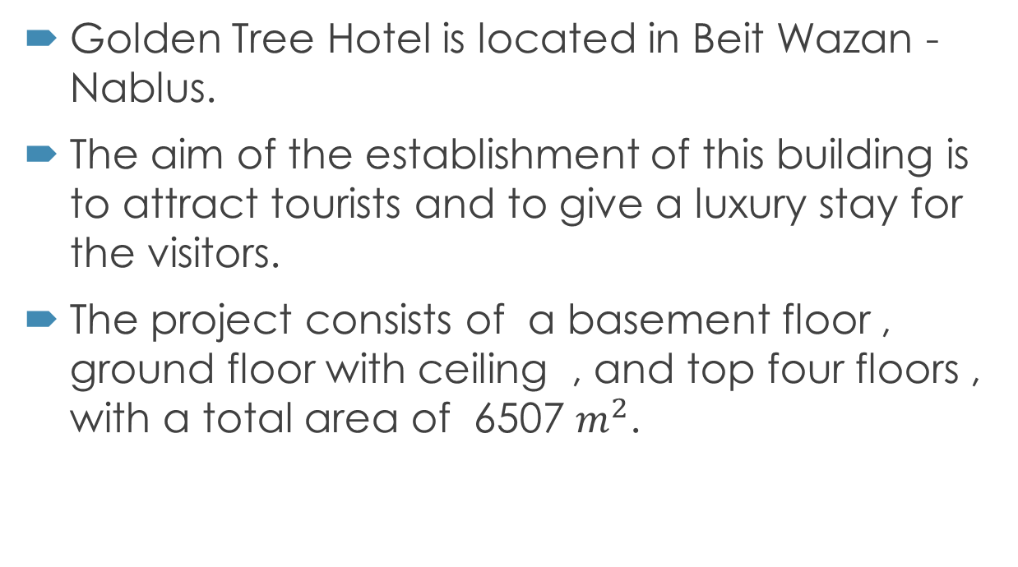
Project Description
Golden Tree Hotel is located in Beit Wazan -Nablus.
The aim of the establishment of this building is to attract tourists and to give a luxury stay for the visitors.
The project consists of a basement floor , ground floor with ceiling , and top four floors , with a total area of 6507 $m^{2}$.

Slide 6
Golden Tree Hotel
Floor | Area (m²) | Height (m) | Use of floor
Basement | 1532 | 4.75 | Swimming pools ,Stores and other services
Ground | 863 | 3.25 | Reception room ,Kitchen and cafeteria
Ceiling | 660 | 2.75 | Cafeteria
First | 863 | 3.25 | Wedding hall
Second | 863 | 3.25 | Bedrooms
Third | 863 | 3.25 | Bedrooms
Fourth | 863 | 3.25 | Bedrooms
 |  | 19
 | 6507
Total Area
.

Slide 7
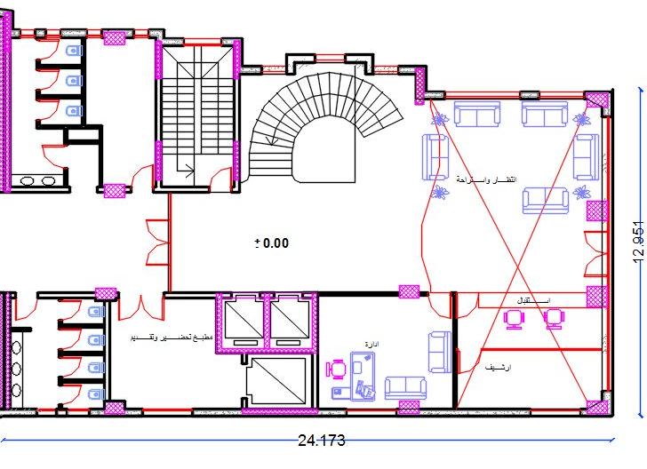
Ground Floor in Block 1 :

Slide 8
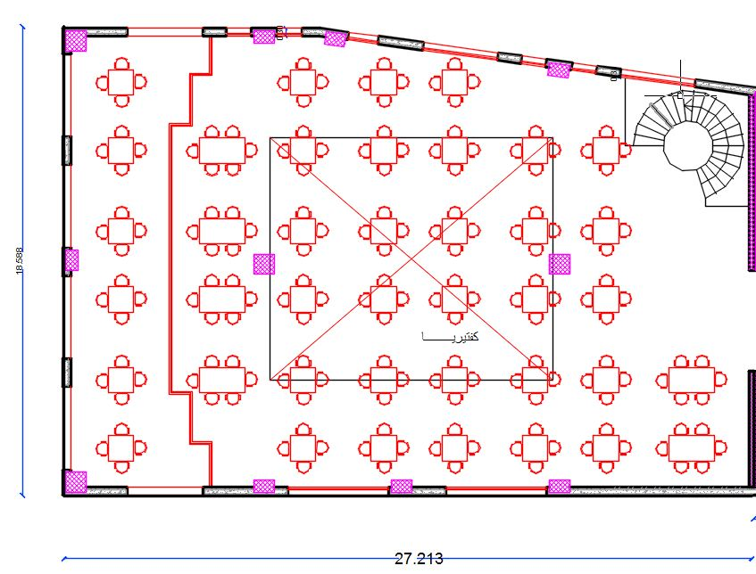
Ground Floor in Block 2:

Slide 9
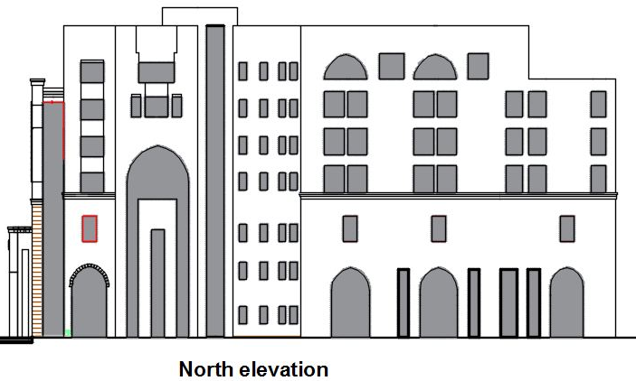
Elevations

Slide 10
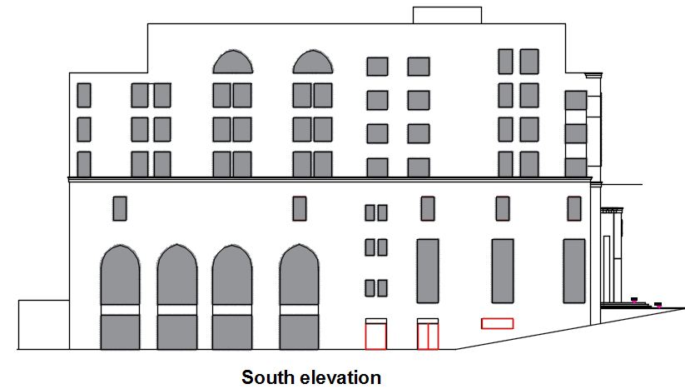
Elevations

Slide 11
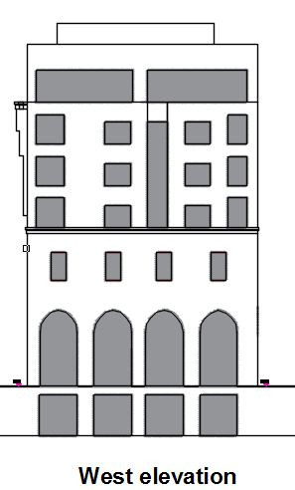
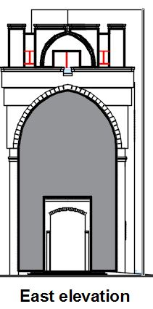
Elevations

Slide 12
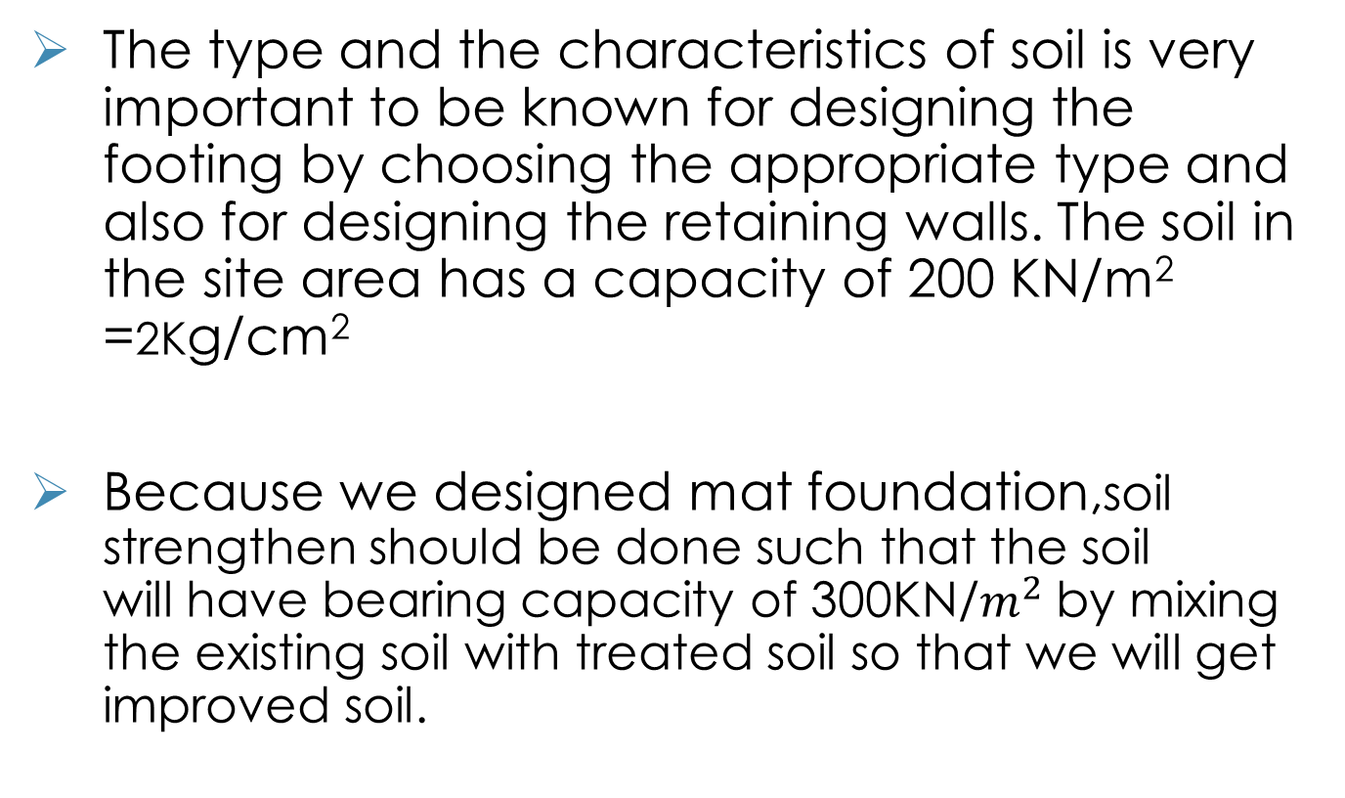
Soil Properties
The type and the characteristics of soil is very important to be known for designing the footing by choosing the appropriate type and also for designing the retaining walls. The soil in the site area has a capacity of 200 KN/m² =2Kg/cm²
Because we designed mat foundation,soil strengthen should be done such that the soil will have bearing capacity of 300KN/$m^{2}$ by mixing the existing soil with treated soil so that we will get improved soil.

Slide 13
Materials
Structural materials
Concrete :-
Value | Property
30 Mpa | Compressive strength of concrete ( f'c) for columns
24Mpa | Compressive strength of concrete ( f'c) for beams and slab
23.025*10³Mpa | Modulus of elasticity (Ec)
23 KN/m³ | Unit weight of plain concrete
25 KN/m³ | Unit weight of reinforced concrete

Slide 14
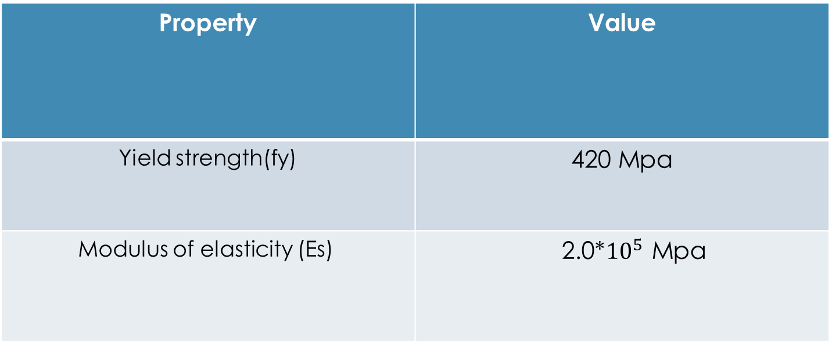
Materials
Reinforcing Steel :-
Property | Value
Yield strength(fy) | 420 Mpa
Modulus of elasticity (Es) | 2.0*${10}^{5 }$Mpa

Slide 15
Codes
ACI 318-11
(American Concrete Institute): building code requirements of structural concrete and commentary.
UBC-97
(Uniform Building code) used in seismic design

Slide 16
LOADS
Loads
Lateral
* Gravity *
Dead
Live
Superimposed
Seismic

Slide 17
A load combination results when more than one load type acts on the structure .The following are equations for load combination taken fromACI318-11
Load combinations
U =1.4D............................................................... ACI318-11, equation (9-1)
U = 1.2D + 1.6L +0.5(Lr or S or R) .................. ACI318-11, equation (9-12)
U = 1.2D +1.6(Lr or S or R) + (1.0L or 0.5W) .. ACI318-11, equation (9-3)
U = 1.2D + 1.0W + 1.0L +0.5(Lr or S or R) ....... ACI318-11, equation (9-4)
U = 1.2D +1.0E + 1.0L + 0.2S............................. ACI318-11, equation (9-5)
U =0.9D + 1.0W.................................................. ACI318-11, equation (9-6)
U = 0.9D + 1.0E................................................... .ACI318-11, equation (9-7)

Slide 18
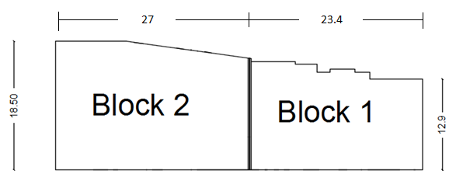
Preliminary design
The building consists of two blocks as shown in figure one .
Figure 1: The two blocks of the building(m)

Slide 19
Slab Design
Block 1 :
Structural system : one way solid slab
Thickness of slab & roof slab : 280 mm
  Block 2 :
Structural system : two way solid slab
Thickness of slab : 200 mm
Thickness of roof slab : 250 mm

Slide 20
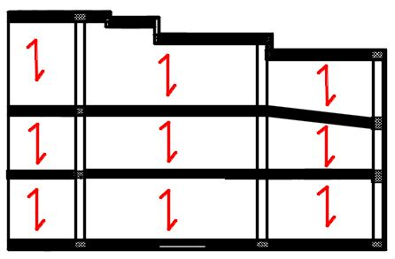
One Way solid slab in block 1

Slide 21
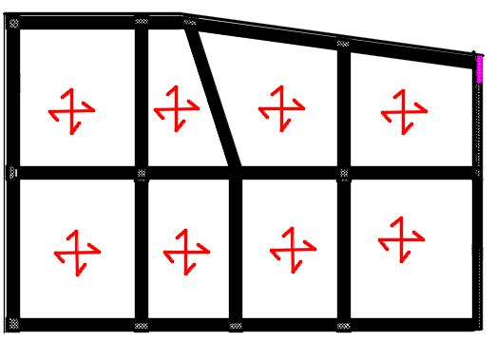
Two Way solid slab in block 2

Slide 22
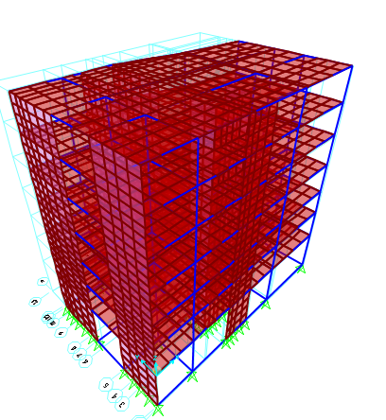
3D STRUCTURAL ANALYSIS for block 1

Slide 23
Modifiers for each element in block1&block2
Element | Modifiers
Column | 0.7
Beam | 0.35
Slab | 0.25
Shear wall | 0.35

Slide 24
Verifications of structural analysis
Compatibility of structural model
Equilibrium
Stress Strain relationship (internal equilibrium)
Deflection

Slide 25
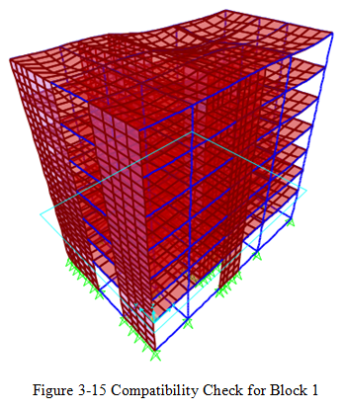
Compatibility of structural model(block1)
Time Period = 1.08 sec

Slide 26

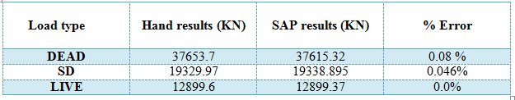
Equilibrium check in block 1
Results from sap

Slide 27

1. Moments slab
Stress Strain relationship in block 1
Hand calculations :
$M= \frac{5×{4.6}^{2}}{8}=13.225 KN.m$
By using SAP:
M₁ = 7 KN.m ,M₂ = 5.5 KN.m ,M₃ = 7 KN.m
$M= \frac{M_{1}+ M_{2}}{2}+ M_{3}$
$M= \frac{7+ 7}{2}+ 5.5=12.5 KN.m$
% error =$5.5\%$< 10 % (OK)

Slide 28
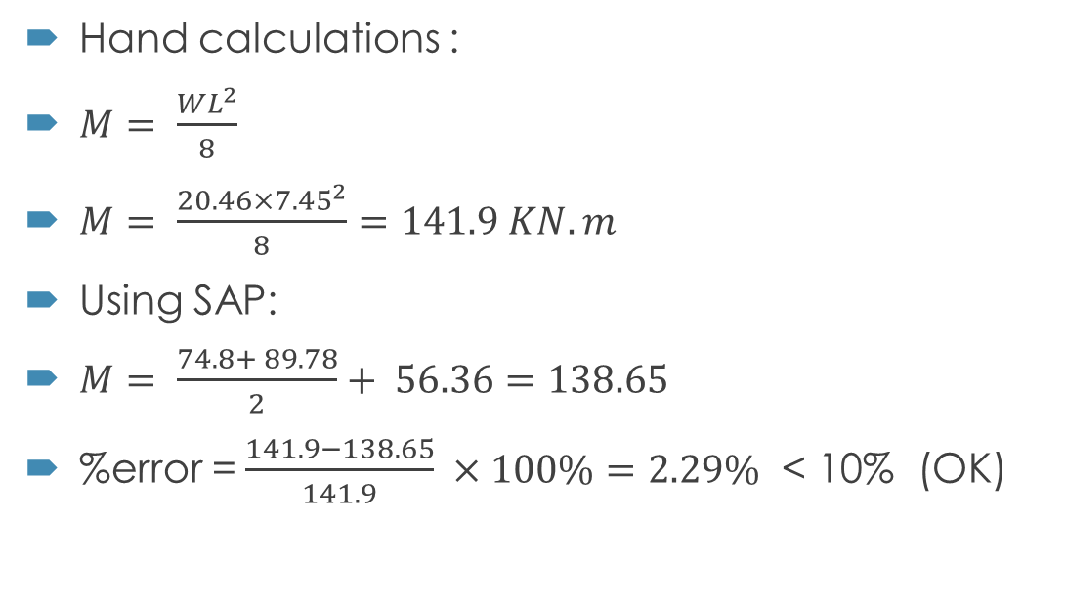
2.Beams moments
Hand calculations :
$M= \frac{WL^{2}}{8}$
$M= \frac{20.46×{7.45}^{2}}{8}=141.9 KN.m$
Using SAP:
$M= \frac{74.8+ 89.78}{2}+ 56.36=138.65$
%error =$\frac{141.9−138.65}{141.9} ×100\%=2.29\%$< 10% (OK)

Slide 29
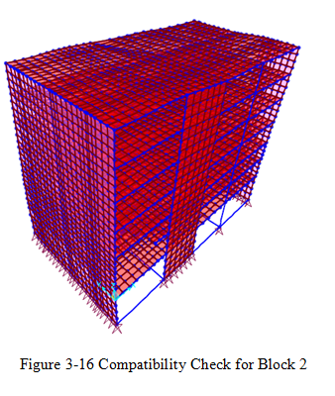
Compatibility of structural model for block 2
Time Period = 1.06 sec

Slide 30

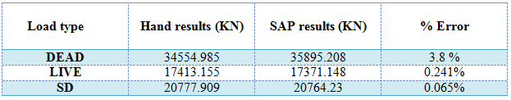
Equilibrium check in block 2
Results from sap

Slide 31

1. Moments slab in x-direction
Stress Strain relationship in block 2
Hand calculations :
$M= \frac{WL{L_{n}}^{2}}{8}$
$M= \frac{5×8.825×{6.65}^{2}}{8}=243.9 KN.m$
Using SAP :
$M= \frac{132+ 131.77}{2}+ 119.45=250.95 KN.m$
%error =$\frac{243.9−250.9}{250.9} ×100\%=3\%$< 10% (OK)

Slide 32

2. Moments slab in y-direction
Stress Strain relationship in block 2
Hand calculations :
$M= \frac{WL{L_{n}}^{2}}{8}$
$M= \frac{5×5.85×8^{2}}{8}=234 KN.m$
Using SAP;
$M= \frac{233+ 25.7}{2}+ 92.7=222.05 KN.m$
%error =$\frac{234−222.05}{234} ×100\%=5\%$< 10% (OK)

Slide 33
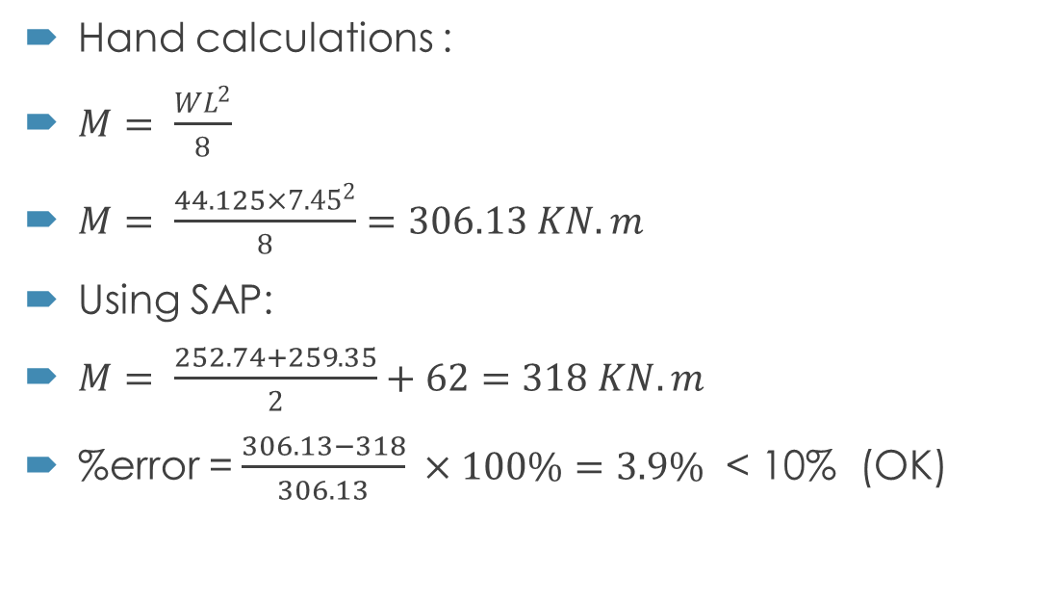
3.Beams moments
Hand calculations :
$M= \frac{WL^{2}}{8}$
$M= \frac{44.125×{7.45}^{2}}{8}=306.13 KN.m$
Using SAP:
$M= \frac{252.74+259.35}{2}+62=318 KN.m$
%error =$\frac{306.13−318}{306.13} ×100\%=3.9\%$< 10% (OK)

Slide 34
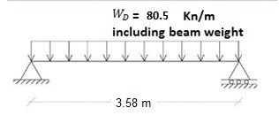
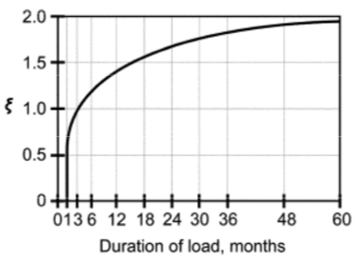
Check Deflection
Block 1 :
WD = 80.525KN/m , W(D+L ) = 176.275 KN/m , W(D+LS) = 128.4 KN/m
∆ D = 0.206 mm , ∆(D+L )= 0.45 mm , ∆ L= 0.244 , ∆ Lt = 0.904 mm
Compare deflection with ACI allowable values :
L/180 = 19 mm > ∆ L = 0.244 mm (OK)
L/360 = 9.95 mm > ∆ L = 0.244 mm (OK)
For slab :
Using SAP :
Average deflection of the points = 0.0053m
∆ L = L/480 = 0.025 > 0.0053 m (OK)

Slide 35
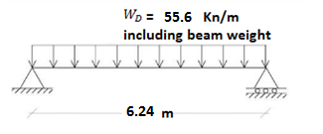
check Deflection
Block 2 :
WD = 55.6 KN/m , W(D+L ) = 122.15 KN/m, W(D+LS) = 88.87 KN/m
∆ (D+L )= 5.6 mm , ∆ D = 1.9 mm , ∆ L = 3.7 mm, ∆ Lt = 16.7 mm
Compare deflection with ACI allowable values :
L/180 = 34.66 mm > ∆ L = 9 mm (OK)
L/360 = 17.33 mm > ∆ L = 9 mm (OK)
Slab :
Using SAP :
Average deflection of the points = 0.01206 m
∆ L = L/480 = 0.018 m >0.01206 (OK)

Slide 36
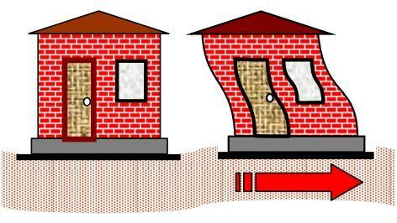
Seismic Design

Slide 37
Seismic Design
Design according to UBC-97 code.
Soil profile type: soft rock
Zone factor: By using Palestine seismic map the zone factor Z for Nablus city is 2B thus, Z=0.2
Seismic coefficients: Ca and Cv
Ca =0.20 Table 16-Q in UBC
Cv = 0.20 Table 16-R in UBC

Slide 38
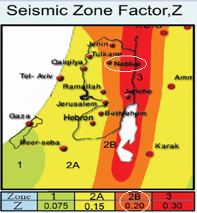

Slide 39
Seismic Design
Importance factor [I]: I=1

Slide 40
Seismic Design
Response modification factor R=5.5

Slide 41
Using response spectrum to determine the design base shear

Slide 42
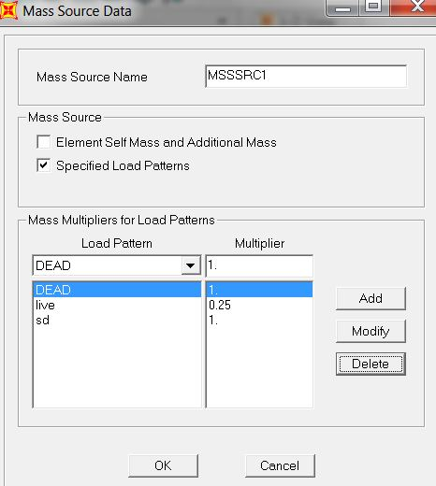
Define mass source

Slide 43
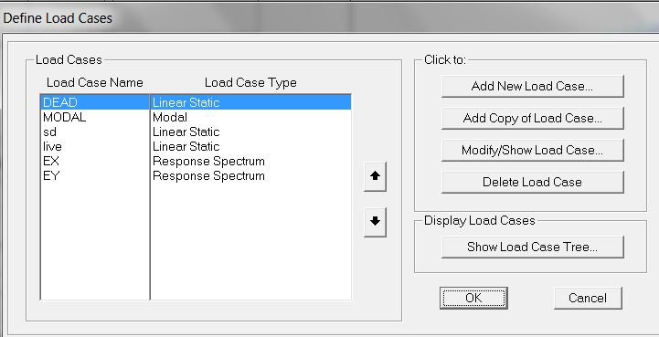
Load cases definition

Slide 44
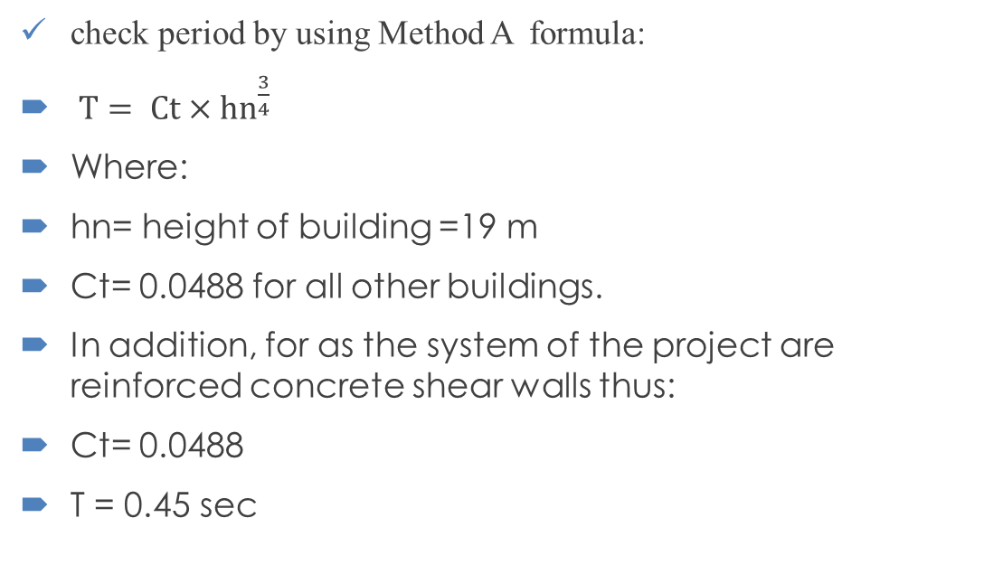
Verification for Earth Quake
1. Check Period
check period by using Method A formula:
$T= Ct×{hn}^{\frac{3}{4}}$
Where:
hn= height of building =19 m
Ct= 0.0488 for all other buildings.
In addition, for as the system of the project are reinforced concrete shear walls thus:
Ct= 0.0488
T = 0.45 sec

Slide 45
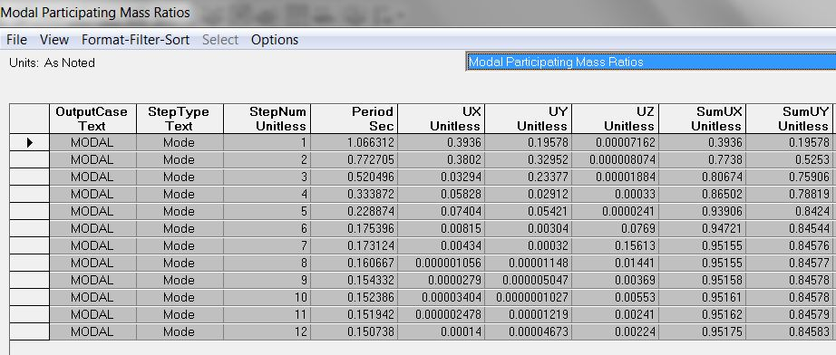
Verification for Earth Quake
Period from SAP

Slide 46
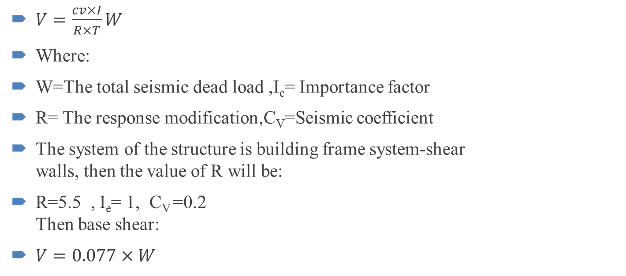
Base shear Calculations
$V=\frac{cv×I}{R×T}W$
Where:
W=The total seismic dead load ,I_{e}= Importance factor
R= The response modification,C_{V}=Seismic coefficient
The system of the structure is building frame system-shear walls, then the value of R will be:
R=5.5 , I_{e}= 1, C_{V} =0.2 Then base shear:
$V=0.077×W$

Slide 47
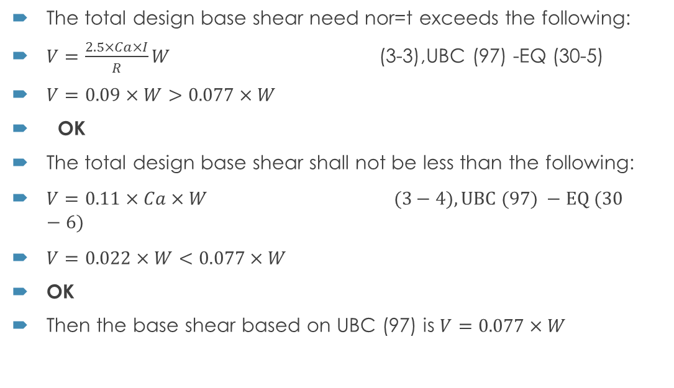
Base shear Calculations
a

Slide 48
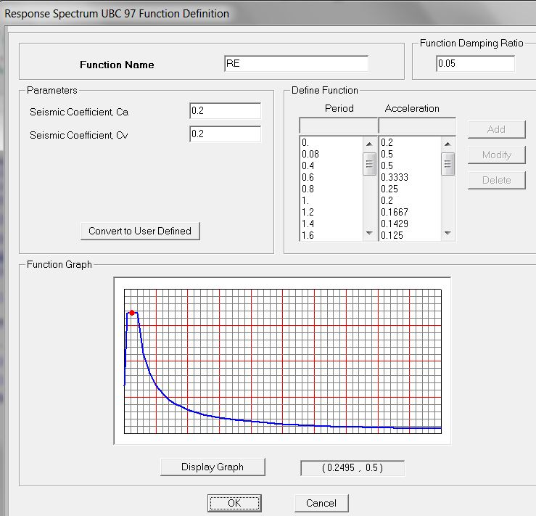
Response spectrum definition

Slide 49
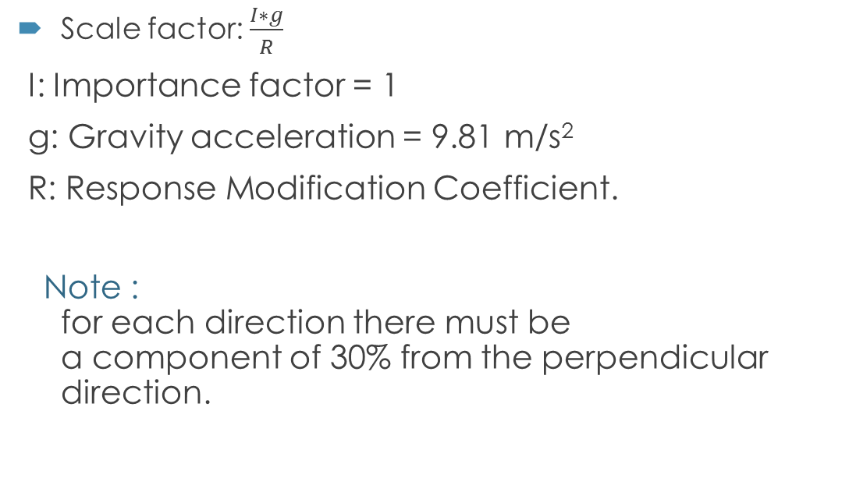
Definition of Response Spectrum Function
Scale factor: $\frac{I∗g}{R}$
I: Importance factor = 1
g: Gravity acceleration = 9.81 m/s²
R: Response Modification Coefficient.
Note :
for each direction there must be
a component of 30% from the perpendicular direction.

Slide 50
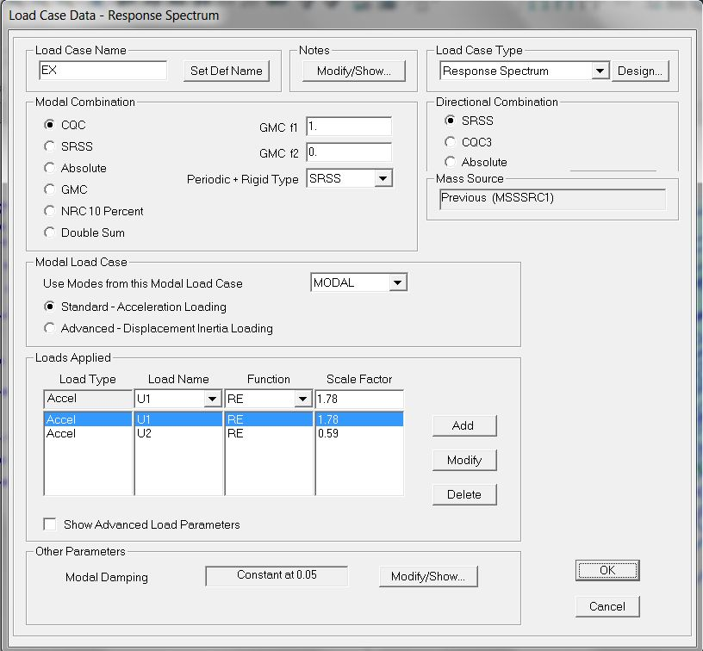
Scale Factor

Slide 51
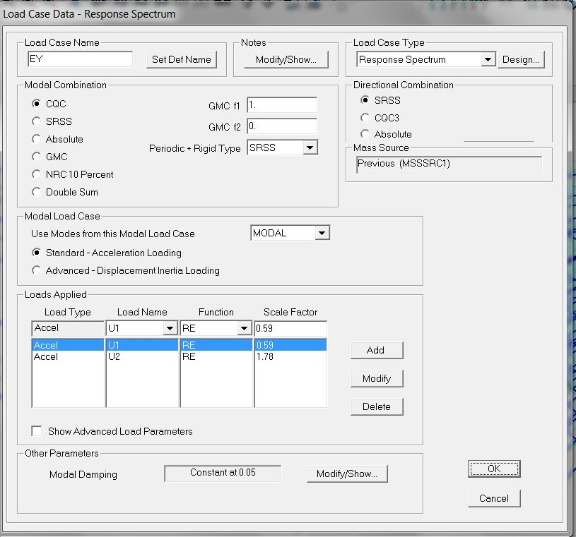
Scale Factor

Slide 52
Design and detailing
Structural elements:
Slab
Beams
Shear wall
Columns
Footing

Slide 53

Slab Design and Detailing
Block 1 :
One way solid slab
Slab thickness :
h = L/24 = 6.115/24 = 0.254 m , try h =280 mm , take d=240 mm.
Loads on slab :
Slab weight = 7KN/m2
W_{SD}= 5.285KN/m2
Wu= 1.2D + 1.6L = 22.742KN/m2
Check for shear :
= 146.9
Vu = 72 KN
φVc > Vu ( OK )

Slide 54
Slab Design and Detailing
Reinforcement :
Bottom Steel :
Mu = 65.68 KN.m , ρ = 0.0031
As = ρ * b * d = 0.0031 * 1000 * 240 = 744 mm2
Use 7Φ12 mm/m
Top Steel :
Mu = 69.73 KN.m , ρ = 0.0033
As = ρ * b * d = 0.0033 * 1000 * 240 = 792 mm2
Use 7Φ12 mm/m

Slide 55
Slab Design and Detailing
Roof Slab :
Bottom Steel :
Mu = 69.07 KN.m , ρ = 0.0032
As = ρ * b * d = 0.0032 * 1000 * 240 = 768 mm2
Use 7Φ12 mm/m
Top Steel :
Mu = 72.95 KN.m , ρ = 0.0034
As = ρ * b * d = 0.0034 * 1000 * 240 = 816mm2
Use 8Φ12 mm/m

Slide 56
Slab Design and Detailing
Block 2 :
Two way solid slab
Slab thickness :
L/B = 1.133 < 2 ( ok )
Ln ₁ = 4.86 m , Ln₂ = 7.25 m
assume αfm> 2:
try h = 200 mm
Check αfm :
αf₁ = 8.39
αf₂ = 4.23
αf₃ = 5.78
αf₄ = 10.02
Average αfm> 2 ( ok )

Slide 57
Slab Design and Detailing
Loads on Slab :
Slab weight = 5 KN/m²
W_{SD} = 5.258 KN/m² , W_{L} = 5 KN/m²
Check for shear :
Vu = 81.16 KN
ᴓVc = 98 KN > Vu ( OK )

Slide 58
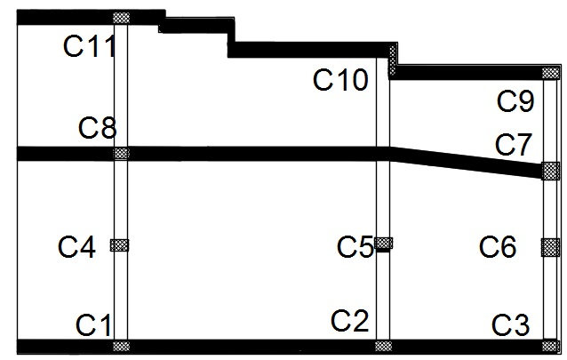
Columns Design and Detailing
Block 1 :

Slide 59
Columns Design and Detailing
Columns grouping :
Group number | Column number | Axial force range (KN)
1 | C1,C2, C4,C3,C8,C9,C11, C6 | 2000-4200
2 | C7 | 4200-6100
3 | C5,C10 | 6100-8000

Slide 60



Columns Design and Detailing
Check slenderness for the critical column (C10 )in block 1 :
For compression braced members :
ῳ_{A}= 0 , ῳ_{B}= 12 , K=0.58
L_{U}: Unbaked length of the column
L = 4.75 m
r: Radius of gyration for cross section of column.
r = 0.4041
M1 = 166.86 KN.m , M2 = - 295.16 KN.m
≤
14 ≤ 40.77 So the column is short

Slide 61
Columns Design and Detailing
Columns Design :
Column number C10 from group 3 will be taken as a sample.
For computing gross area of column, assume
Where Pu = 7943 KN
φPn = (5-2),ACI-318-11 (10-2)
0.65*0.8 * = 7943 KN
Take Column dimensions are (650*900) mm
Ag = 585000 mm²
substituting Ag in equation (5-2) gives : As = 7127.8 mm2
For stirrup, use 1φ10/250 mm

Slide 62
Columns Design and Detailing
Ties (mm) | Reinforceme-nt | As | Ag | Dimensions (mm) | Pu (kN) | Critical column # | Group #
1Ф10/290 | 18Ф18 | 4503.3 | 400000 | 500x800 | 4022.6 | C4 | 1
1Ф10/260 | 18Ф16 | 3574.3 | 400000 | 500x800 | 4214 | C7 | 2
1Ф10/260 | 18Ф16 | 3412.4 | 585000 | 650*900 | 7918.6 | C10 | 3

Slide 63
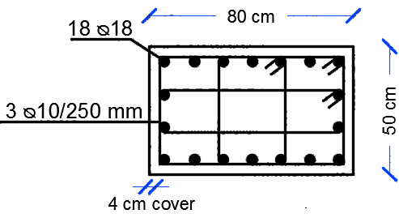
Columns Design and Detailing
Columns Details for Block 1 :
Group 1 :

Slide 64
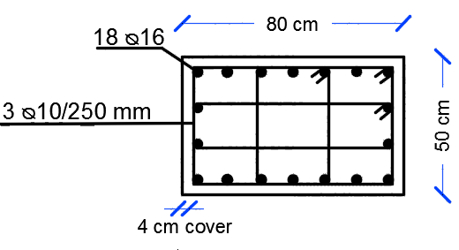
Columns Design and Detailing
Group 2 :

Slide 65
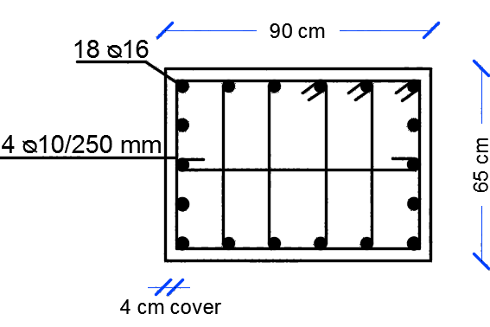
Columns Design and Detailing
Group 3 :

Slide 66
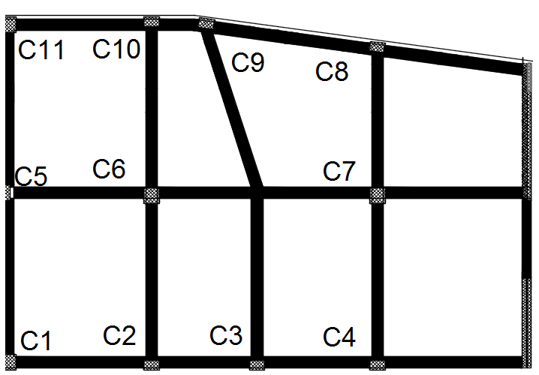
Columns Design and Detailing
Block 2 :

Slide 67
Columns Design and Detailing
Axial force range (kN) | Column number | Group number
1000-5000 | C1,C2,C3,C5,C10,C11 | 1
5000-10000 | C4,C8, C9 | 2
10000-14110 | C6,C7 | 3

Slide 68


Columns Design and Detailing
Check slenderness for the critical column ( C7) in block 2 :
For compression braced members :
ῳ_{A}= 0 , ῳ_{B}= 5.1 , K=0.68
L_{U}: Unbaked length of the column
L = 4.75 m
r: Radius of gyration for cross section of column.
r = 0.2309
M1 = 79.87 KN.m , M2 = 256.59 KN.m
≤
6.81 ≤ 37.73 So the column is short

Slide 69
Columns Design and Detailing
Columns Design :
Column number C10 from group 1 will be taken as a sample.
For computing gross area of column, assume
Where Pu = 4715.5 KN
φPn = 0.65*0.8 * = 4715.5 KN
Take Column dimensions are (500*800) mm
Ag = 400000 mm²
substituting Ag in equation (5-2) gives : As = 1140.2 mm2
For stirrup, use 1φ10/200 mm

Slide 70
Columns Design and Detailing
Ties (mm) | Reinforc-ement | As | Ag | Dimensions (mm) | Pu (kN) | Critical column # | Group #
3Ф10/200 | 8Ф14 | 1140.2 | 400000 | 500x800 | 4715.5 | C10 | 1
4Ф10/250 | 12Ф18 | 5158.4 | 540000 | 600*900 | 7745.8 | C8 | 2
8Ф10/250 | 36Ф16 | 7172.8 | 1020000 | 1700*600 | 14101.3 | C7 | 3

Slide 71
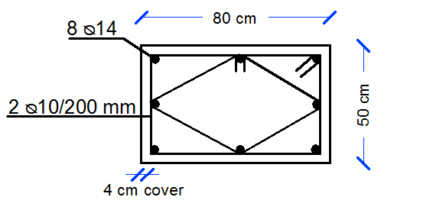
Columns Design and Detailing
Columns Details for Block 2 :
Group 1 :

Slide 72
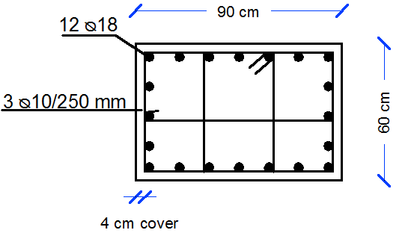
Columns Design and Detailing
Group 2 :

Slide 73
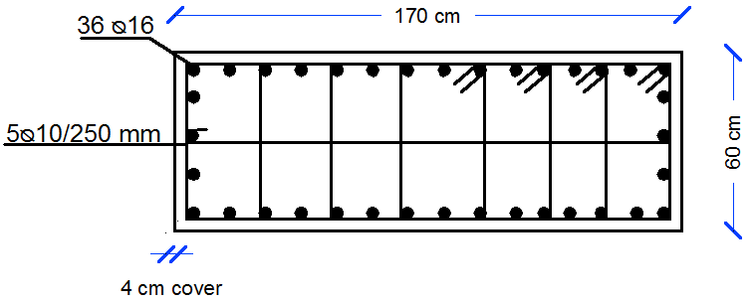
Columns Design and Detailing
Group 3 :

Slide 74
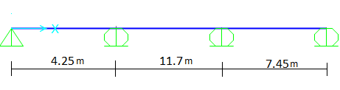
Beams Design and Detailing
Beam design in block 1 :
After trying different dimensions, the preliminary dimensions are
( h:900 mm , w: 600mm )
V_{c} = 421.3 KN
Vu= 724.2KN
Vu > ØVc So need Shear reinforcement
VS= 544.3 KN
Vsmax = 1685.25 KN
Vsmin = 180.6 KN
Vsmax >VS > Vsmin
S= 100 mm

Slide 75
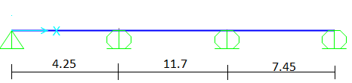
Beams Design and Detailing
Beam design in block 1 Roof :
After trying different dimensions, the preliminary dimensions are ( h:900 mm , w: 600mm )
V_{c} = 421.3 KN
Vu= 937.9KN
Vu > ØVc So need Shear reinforcement
VS= 429.2 KN
Vsmax = 1685.25 KN
Vsmin = 180.6 KN
Vsmax >VS > Vsmin
S= 100 mm

Slide 76
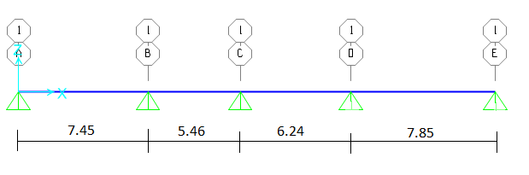

Beams Design and Detailing
Beam design in block 2 :
After trying different dimensions, the preliminary dimensions are ( h:700 mm , w: 600mm )
V_{c} = 323.33 KN
Vu=145.3 KN
Vn=193.74 KN
Vu > ØVc So need Shear reinforcement
So use minimum Shear reinforcement
Vsmin =138.6 KN
S= 200 mm

Slide 77
Beams Design and Detailing
Beam design in block 2 Roof :
After trying different dimensions, the preliminary dimensions are ( h:700 mm , w: 600mm )
V_{c} = 323.33 KN
Vu= 224.24 KN
Vu > ØVc So need Shear reinforcement
Vn= 229 KN
So use minimum Shear reinforcement
VS min = 138.6 KN
S= 200 mm

Slide 78
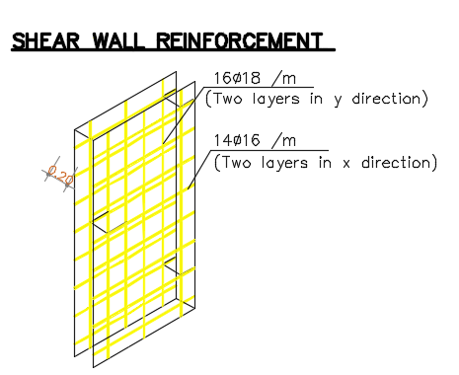
Shear Wall Design and Detailing

Slide 79

Stairs

Slide 80
Mat Foundation Design and Detailing For Block 1
We make soil strengthen such that the soil will have bearing capacity of 300KN/ m^2 by mixing the existing soil with treated soil so that we will get improved soil.
Thickness assumed :140 mm
Punching shear check for block 1
ØV_{c} = 8598 KN
Vu= 8461 KN
Vu < ØVc

Slide 81
Mat Foundation Design and Detailing For Block 2
We make soil strengthen such that the soil will have bearing capacity of 300KN/ m^2 by mixing the existing soil with treated soil so that we will get improved soil.
Thickness assumed :130 mm
Punching shear check for block 2
ØV_{c} = 16685 KN
Vu=14363 KN
Vu < ØVc

Slide 82


