Slide 1

Solar Power Refrigerator
Prepared by : Saadi Jamous
Ameen Qassi
Supervised by : Dr. Kamel Subhi

Slide 2
Outlines:
Overview
Design
Solar Panel
Battery
Inverter circuit
Step-up Transformer
Refrigerator motor
Feasibility Study
Conclusion

Slide 3
Overview:
Our project consists of five parts:
Solar Panel.
Battery.
Inverter.
Transformer.
Refrigerator motor.

Slide 4
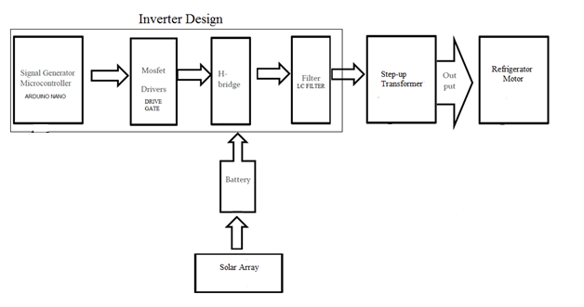
Design:

Slide 5
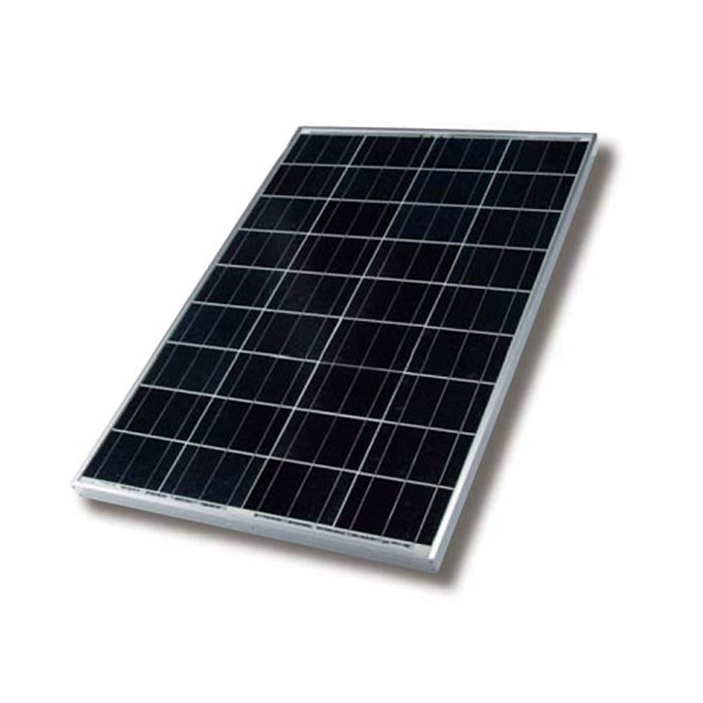
Solar Panel:
Solar panel gives current = P/I = 53W/12V = 4.42A.

Slide 6
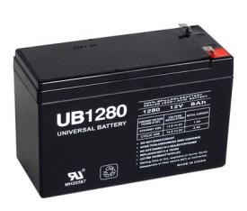

Battery:
Battery Specifications:
12VDC
Capacity = 7.2Amp.hour.
Charging time = = an hour and 37.8 minutes.

Slide 7
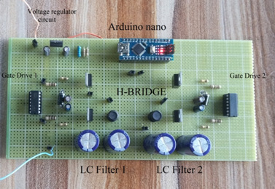
Inverter Circuit:
The inverter consists of:
Arduino Nano.
Drive Gates.
H-bridge.
LC Filters.

Slide 8
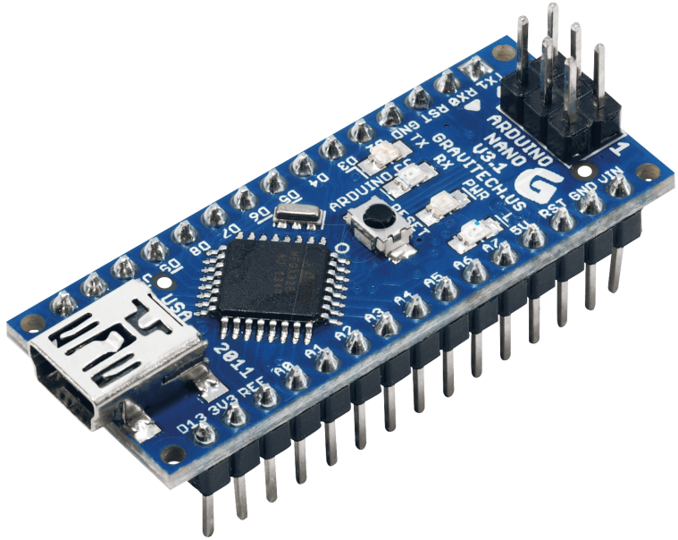
Arduino Nano:

Slide 9
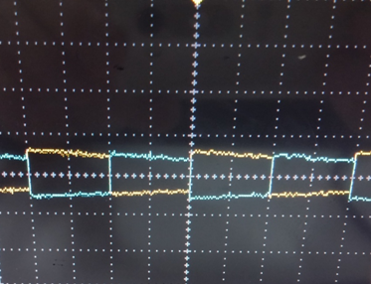
Arduino Output:

Slide 10
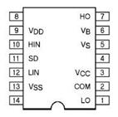
Drive Gates:
IR2110.

Slide 11
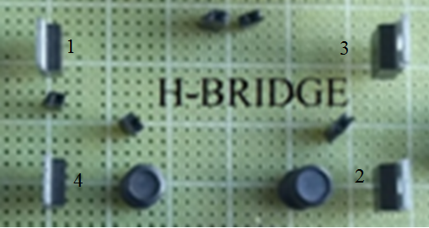
H-bridge:

Slide 12
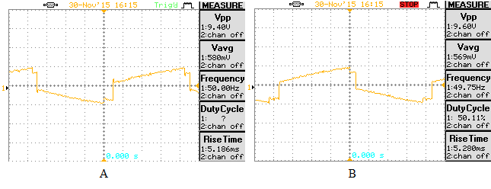
H-bridge output:

Slide 13
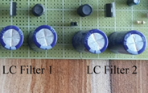
LC Filters:

Slide 14
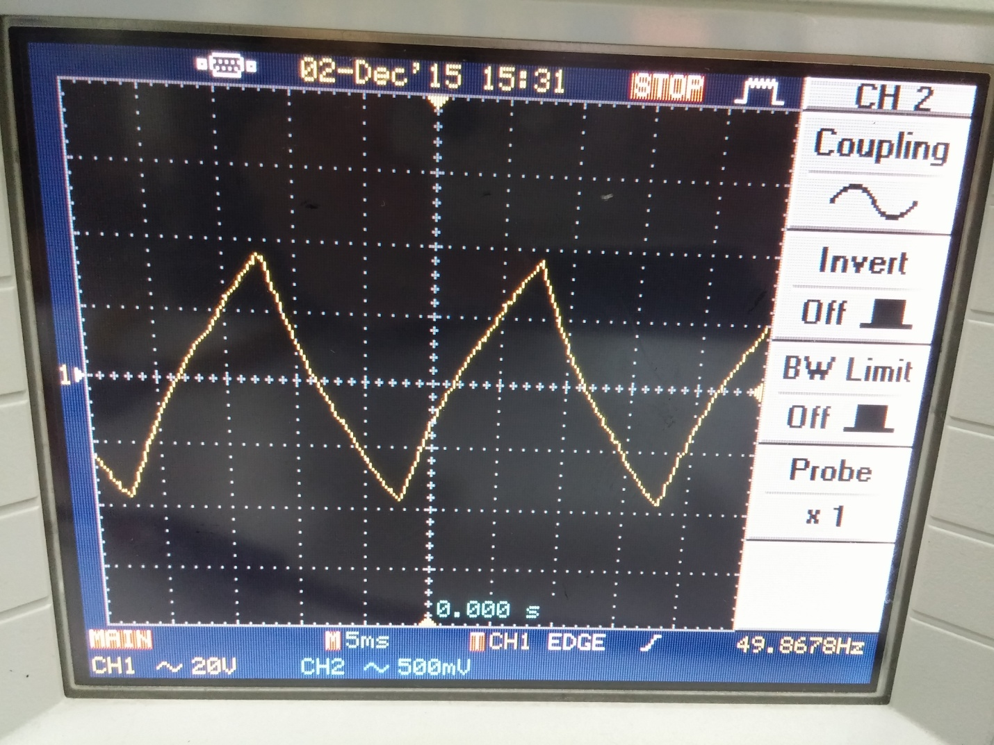
LC Filters Output (Inverter output):

Slide 15
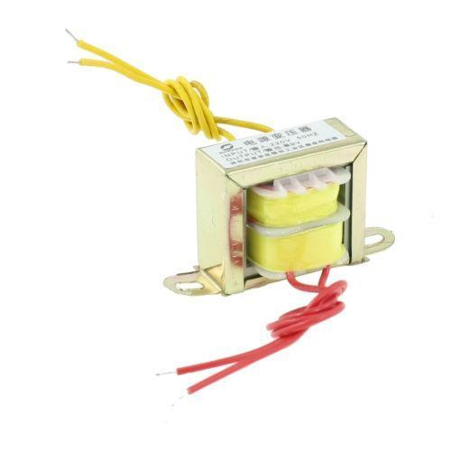
Step-up Transformer:

Slide 16
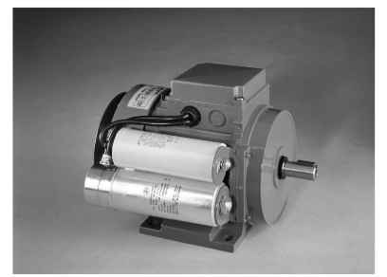

Refrigerator Motor:
I = P/V = = 0.318A = 318mA.

Slide 17
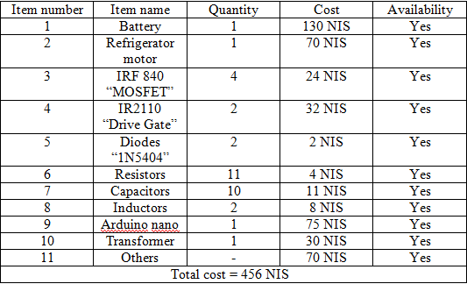
Feasibility Study:
Availability of the items in the Palestinian market.

Slide 18
Strengths and Weaknesses of our product:
Strengths:
Availability of all of the items at the Palestinian market.
New product idea at Palestinian market which provides a large market share.
Anyone can carry the refrigerator for his journey.
Weaknesses:
If we want to apply it in the market we need to do some modifications on the hardware part, and it will be more complex sometimes.

Slide 19
Conclusion:
At the end of our project we learned how to design a small solar system which is consisting of four parts: Solar Panel, Battery, Inverter and load.

Slide 20


