Slide 1


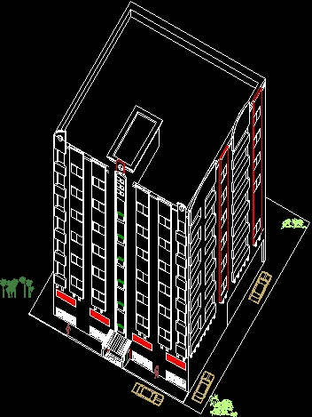
Multi Story Housing
Prepared By
Ehab Hamza Khzemieh
Hamza Abdullah Wahdan
Mohammad Jaber Salim
Mohammad Nadim Dawwas
Under The Supervision Of :
ENG . Amt Tuffaha

Slide 2

Abstract :
Chapter 1: Architectural Design
An-Najah National University
Building Engineering
This project is Re-design of a multi-storey buildings in Almeria Housing in the city of Nablus in and Use of a lightweight concrete materials instead of the normal
brick .
Graduation Project
The final analysis and design of building is done using a three dimensional (3D) structural model by the structural analysis and design software sap2000.

Slide 3
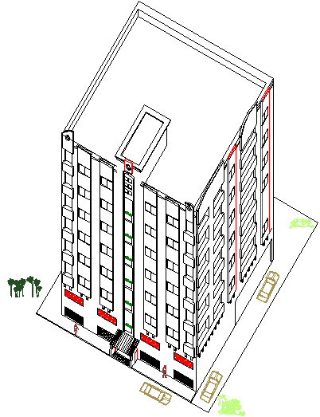
3D Picture of the building
Chapter 1: Architectural Design
An-Najah National University
Building Engineering
Graduation Project

Slide 4
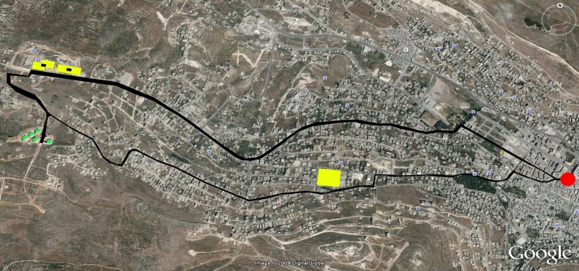
Project Location.
Chapter 1: Architectural Design
An-Najah National University
Building Engineering
Graduation Project
موقع الاسكان
مركز المدينة
الحرم الجامعي الجديد
الحرم الجامعي القديم

Slide 5
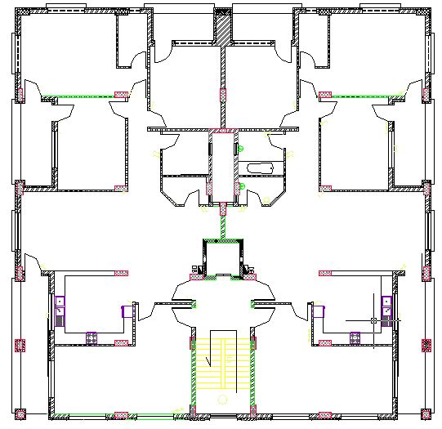
Architectural view
Chapter 1: Architectural Design
An-Najah National University
Total used Area : 900 m²
The area distributed to 7 floors and include parking.
Each floor area is about 500 m² & Each floor is divided into two apartments area per apartment almost 250 m²
Building Engineering
Graduation Project

Slide 6
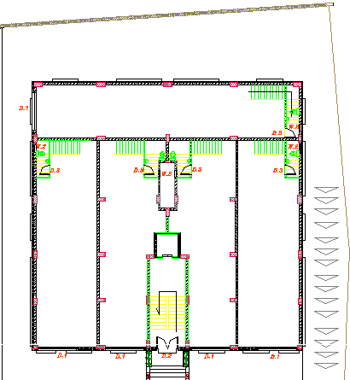
Ground floor
Chapter 1: Architectural Design
An-Najah National University
Building Engineering
Graduation Project

Slide 7
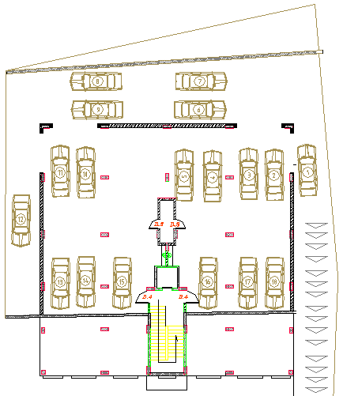
Parking :
Chapter 1: Architectural Design
An-Najah National University
Building Engineering
Graduation Project

Slide 8
First Floor to seven are the same
Chapter 1: Architectural Design
An-Najah National University
Building Engineering
Graduation Project

Slide 9
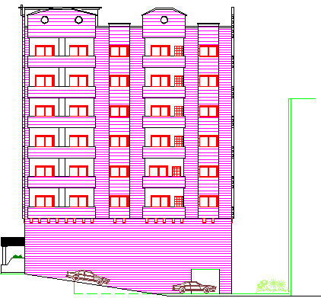
Elevations :
North
Elevation
Chapter 1: Architectural Design
An-Najah National University
Building Engineering
Graduation Project

Slide 10
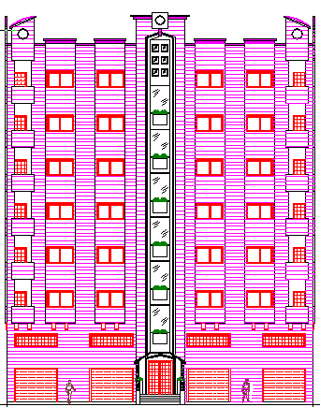
East Elevation
Chapter 1: Architectural Design
An-Najah National University
Building Engineering
Graduation Project

Slide 11
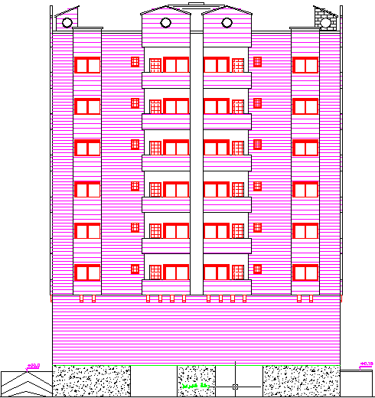
West Elevation
Chapter 1: Architectural Design
An-Najah National University
Building Engineering
Graduation Project

Slide 12
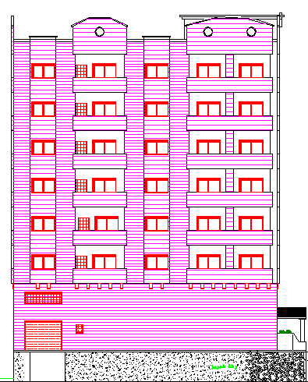
South Elevation
Chapter 1: Architectural Design
An-Najah National University
Building Engineering
Graduation Project

Slide 13
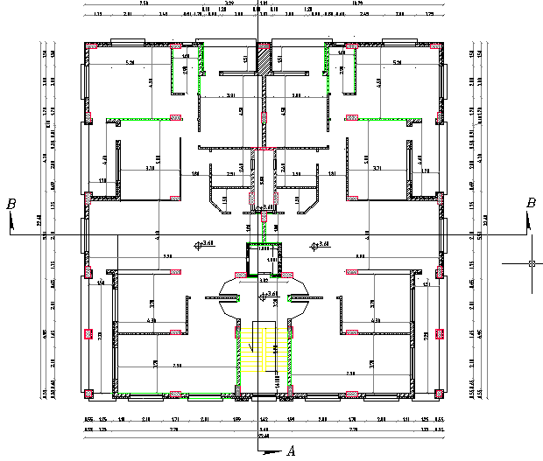
Sections
Chapter 1: Architectural Design
An-Najah National University
Building Engineering
Graduation Project

Slide 14
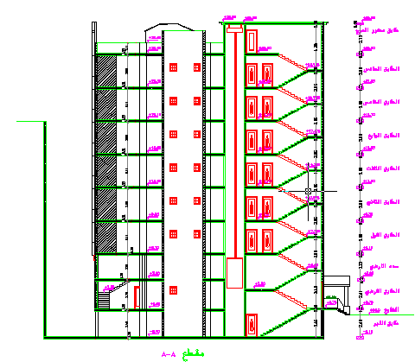
Section A-A
Chapter 1: Architectural Design
An-Najah National University
Building Engineering
Graduation Project

Slide 15
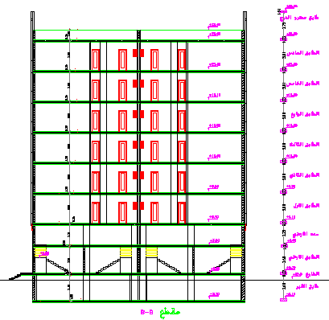
Section B-B
Chapter 1: Architectural Design
An-Najah National University
Building Engineering
Graduation Project

Slide 16
Chapter 2: Environmental System
An-Najah National University
In this chapter we have to simulate the building by using Ecotect to give an indication about how much this building is energy efficient.
This chapter includes the building orientation on the land to collect the largest amount of solar gain in winter and the minimum solar gain in summer.
We also provide shading for the windows on just East direction In line with the sun path at different times of the year, Because the other directions have an automatic shading due to the presence of balconies.
Building Engineering
Graduation Project

Slide 17
Solar Shading
Chapter 2: Environmental System
An-Najah National University
Building Engineering
In its simplest form, solar shading is any device which excludes sunshine from a building, like a curtain.
Solar shading is an effective energy saver all year round. In summer it can cut the amount of heat enter a building and in winter it can decrease heat loss.
Graduation Project

Slide 18
In summer:
Chapter 2: Environmental System
An-Najah National University
During the day in summer, solar shading will help to keep heat out of the building, which can dramatically cut the need for air condition. In the evening, we can open the windows to allow the building to flush any heat build-up, again reducing the need for air condition
Building Engineering
Graduation Project

Slide 19
In winter:
Chapter 2: Environmental System
An-Najah National University
In winter, solar shadings will remain open to let free solar energy into the building during the day, to reduce energy requirements for heating. When the sun has set, these will close, to reduce heat loss and thus continue to save on the energy required for heating.
Building Engineering
Graduation Project

Slide 20
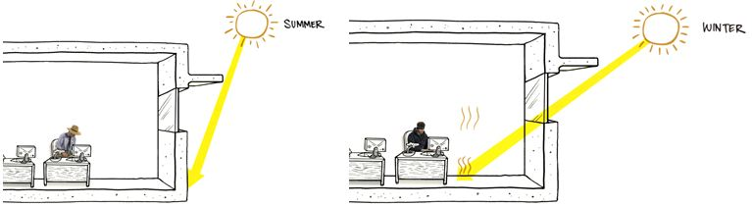
Systems of Solar Shading
Chapter 2: Environmental System
An-Najah National University
Building Engineering
Graduation Project

Slide 21
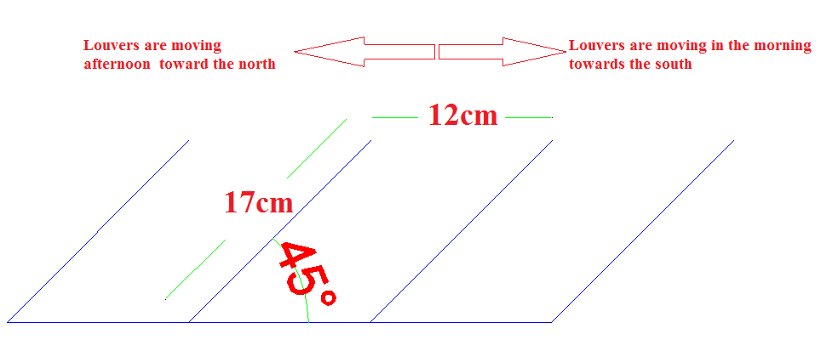
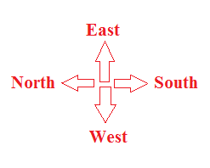
Shading for East elevation
Chapter 2: Environmental System
An-Najah National University
Automatic vertical moveable shutters were used in east windows to prevent the sun rays enter the office and residential rooms, it moves in 45 degrees to the north in the winter and 45 degrees to the south in the summer depending on the sun movement, assume the spacing between shutters = 12cm , so the length of each shutter = 17cm
The dimension of the shutter as in the diagram
Building Engineering
Graduation Project

Slide 22
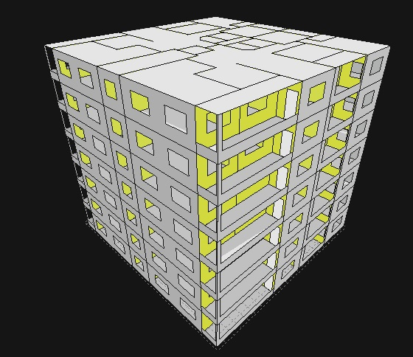
Chapter 2: Environmental System
An-Najah National University
Building Engineering
Graduation Project
THE SHAPE OF THE BUILDING ON ECOTECT

Slide 23
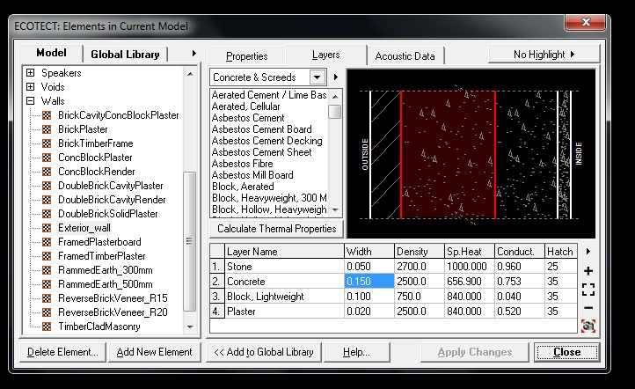
This program was used to analysis the daylight, the direct solar gain, and the heating and cooling loads for the building..
The main steps done before reaching to the results are:
Chapter 2: Environmental System
An-Najah National University
First: Insert the building in the program.
Second: Define the material of walls, floors, roofs and partitions. It was as follows:
The external wall included
Building Engineering
Graduation Project

Slide 24
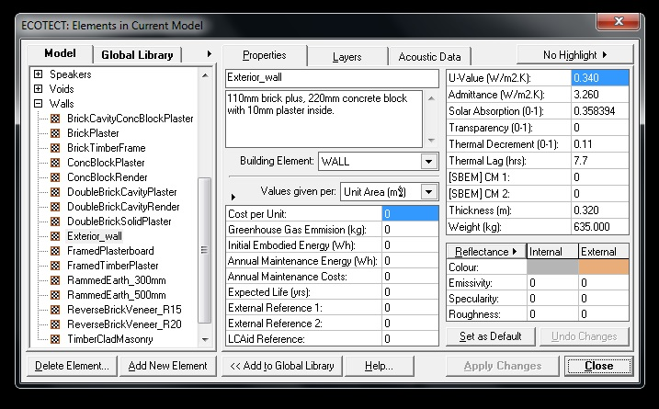
Chapter 2: Environmental System
An-Najah National University
Total U-value by ECOTECT = 0.34W/m2.k.
Building Engineering
Graduation Project

Slide 25
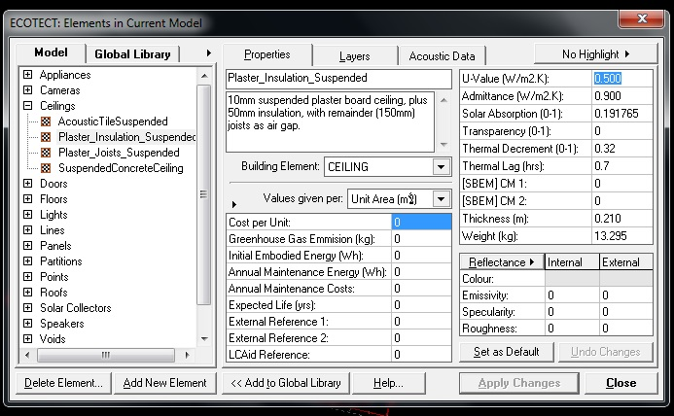
Chapter 2: Environmental System
An-Najah National University
Total U-value by ECOTECT for ceiling = 0.5 W/m2.k.
Building Engineering
Graduation Project

Slide 26
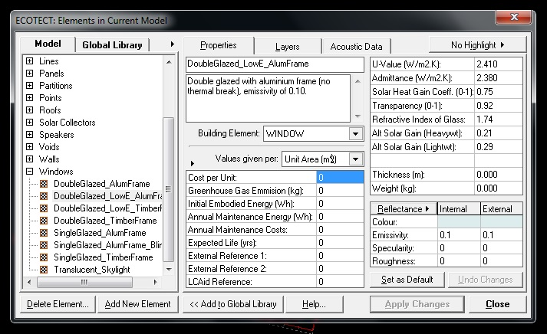
Chapter 2: Environmental System
An-Najah National University
Total U-value by ECOTECT for windows = 2.41 W/m2.k.
Building Engineering
Graduation Project

Slide 27
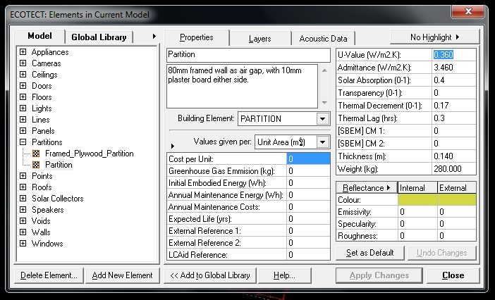
Chapter 2: Environmental System
An-Najah National University
Total U-value by ECOTECT for partition = 0.63 W/m2.k.
Building Engineering
Graduation Project

Slide 28
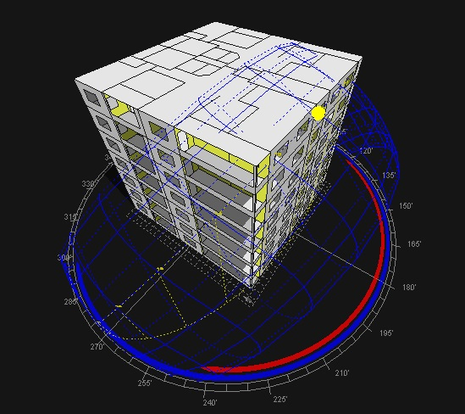
THE SUN PATH
Chapter 2: Environmental System
An-Najah National University
Building Engineering
Graduation Project

Slide 29
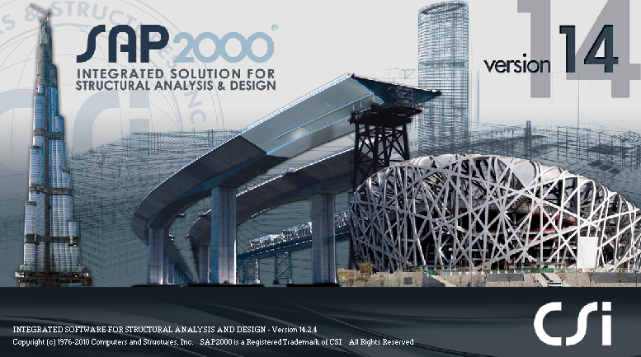
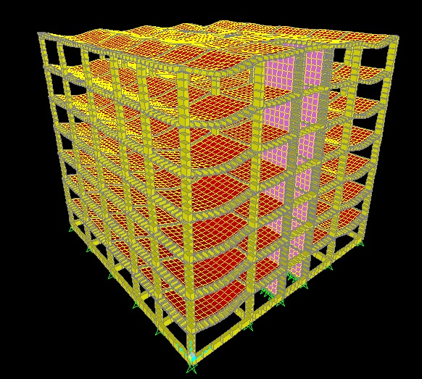
Chapter 3: Structural Design
An-Najah National University
The structural design was made by SAP program
3D modeling
Building Engineering
Graduation Project

Slide 30
Chapter 3: Structural Design
An-Najah National University
Design Codes:
The structural design will be according to :
1) the American Concrete Institute code ACI 318-08 .
2) the seismic design according to UBC-97
Building Engineering
Design will include the following elements :
1) slab ( one way rib slab).
2) beam .
3) column .
4) shear wall.
5) footing.
Graduation Project

Slide 31
Chapter 3: Structural Design
An-Najah National University
Design data
Compressive strength of concrete (f\c)
Building Engineering
beams
shear walls
columns
slabs
footing
250 kg/cm2
2. Yielding strength of steel (fy)
steel for flexure , fy = 4200kg/cm2
Graduation Project
3. Bearing capacity of soil= q=3.5kg/cm2
4. Density of light weight cement block =750kg/cm3
5-Density of concrete block =1200kg/cm3

Slide 32
Chapter 3: Structural Design
An-Najah National University
Preliminary dimensions
Slab thickness= 25 cm
Beam dimension
Main beam internal→ (70*25) cm
Secondary beam internal→ (60*25) cm
External beam→ (60*25) cm
Tie beam→ (60*30) cm
Column dimension
Column dimensions were taken from plans
Column 1→ (60*30) cm
Column2→ (30*60) cm
Building Engineering
Graduation Project

Slide 33
Chapter 3: Structural Design
An-Najah National University
Loads
Superimposed dead load= 2.5 KN/m²
Live load =3 KN/m²
Building Engineering
Graduation Project
SAP MODEL

Slide 34
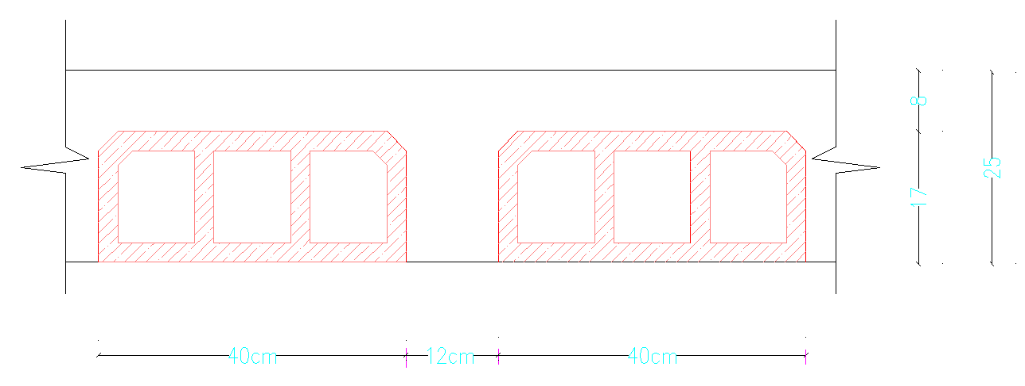
Chapter 3: Structural Design
An-Najah National University
Design
Building Engineering
Slab design
Slabs are designed as one way ribbed slab with thickness =25cm
Graduation Project

Slide 35
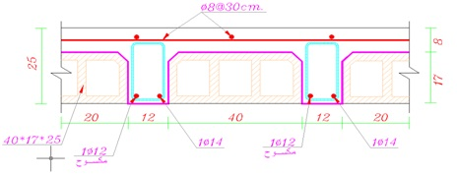
structural design
Flexural design for slab
Light weight cement block
Wu (L.W.C) = 1256 kg/m2
Ast = 2.2 cm2 use 2Ф12
Concrete Block
Wu (C.B) = 1328 kg/m2
Ast= 2.5 cm2 use 1Ф14&1Ф12

Slide 36
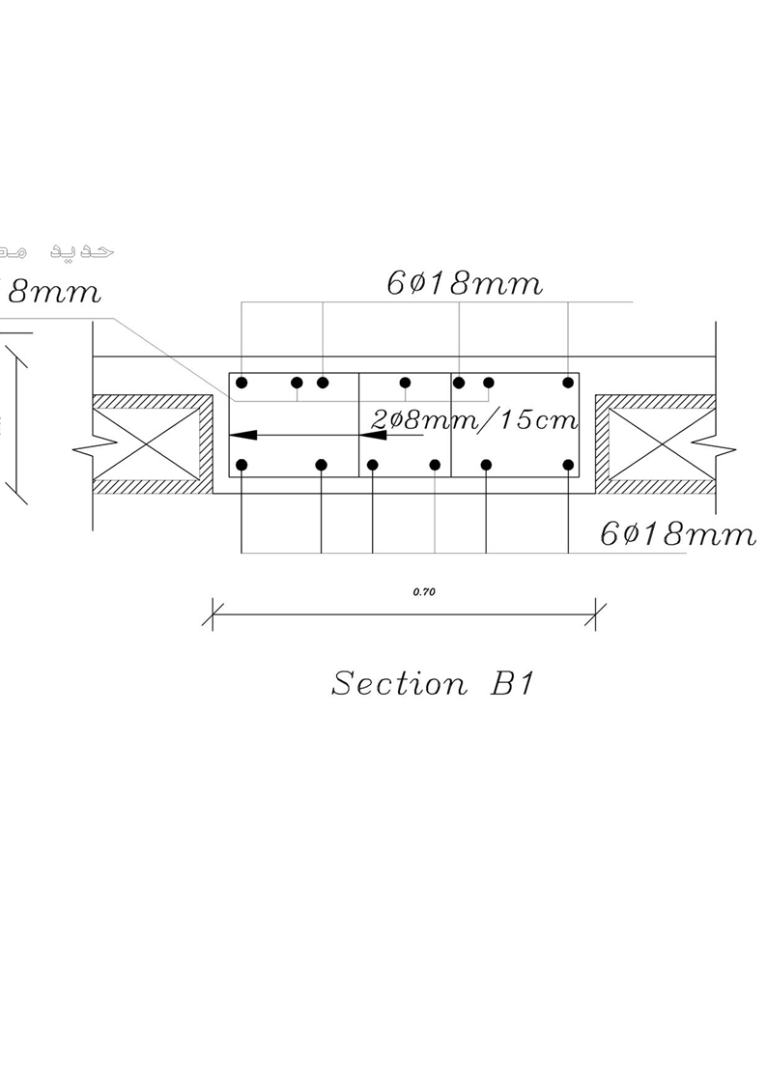
structural design
Beams design
Light weight cement block
Wu use (L.W.C) =6554kg/m
Ast = 19 cm2 , use 8Ф18 in the top
Ast = 20cm use 9Ф18 in the bottom
Concrete Block
Wu use (C.B) =6900kg/m
Ast = 30cm ,use 12Ф18 in the top
Ast = 20cm use 9Ф18 in the bottom

Slide 37
Chapter 3: Structural Design
An-Najah National University
column design
Building Engineering
Light weight cement block
As =127cm2 , use 12ɸ16mm
Concrete Block
As =228.3cm2 , use 14ɸ16mm
footing design
Type of footing ISOLATED
Graduation Project
use 8Ф18/m in both direction
use 8Ф20/m in both direction

Slide 38
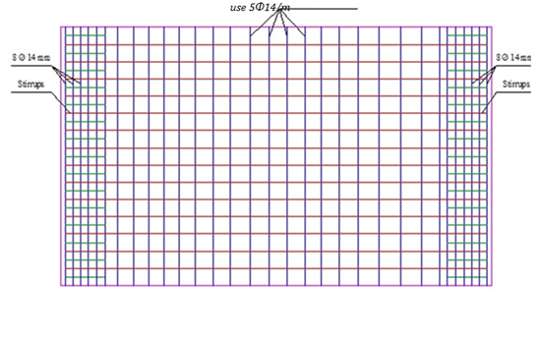
Chapter 3: Structural Design
An-Najah National University
Shear wall design
use 5Ф14/m in long direction
Building Engineering
Graduation Project

Slide 39
Chapter 3: Structural Design
An-Najah National University
Checks for SAP model
Compatibility check
Building Engineering
Graduation Project

Slide 40
Chapter 3: Structural Design
An-Najah National University
Studying the difference cost of blocks and steel for using normal concrete block and light weight cement blocks
Building Engineering
Total cost of concrete block = 47100.375
Total cost of L.W.C block = 79177.5 $
Difference of cost = 79177.5-47100.375=32077.125 $
Total price steel saved $ =2479.7+2371.8+550.4 = 10356$
Graduation Project
10356 $ saved in steel is less than 32077.125 $ over cost using L.W.C
So it is not economical to use L .W.C

Slide 41
Chapter 3: Structural Design
An-Najah National University
Positive to use light weight cement
Building Engineering
Reduce the amount of steel in the building leads to reduce the price of steel .
Considered the best when we design buildings on weak soil.
Considered the best when we design building , resistant to .earthquakes
Graduation Project
Faster in the implementation of construction because they are in the templates ready and ride with each other easily and .quickly

Slide 42

Chapter 4: Electrical Design
An-Najah National University
LIGHTING
DIALUX software was used to design the lighting system
Building Engineering
Artificial lighting
Emergency lighting
Natural lighting
Graduation Project
Multi Story Housing

Slide 43
Chapter 4: Electrical Design
An-Najah National University
Lighting design
Natural lighting
All of illuminance value are reduced to the half to take into account the natural lighting
Building Engineering
For artificial lighting
Graduation Project
Technical values for design :
1. illuminance value(Lx)
2. Work plane
Type of room | Luminance at work plan(lux)
غرفة نوم | 500
مطبخ | 300
صالة معيشة | 300
غرفة ضيوف | 300
w.c | 150
Function | Height
Offices | Desktop-75cm
Corridors | 150cm
Multi Story Housing

Slide 44
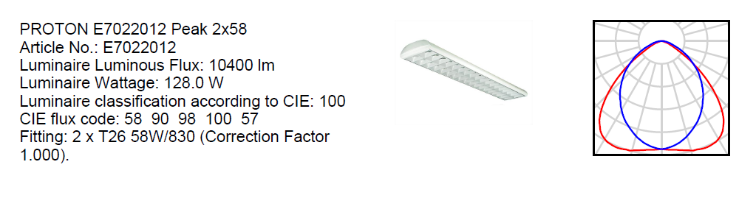
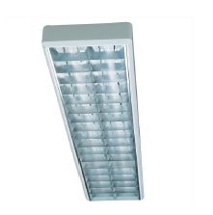
Chapter 4: Electrical Design
An-Najah National University
Lighting design
Artificial lighting
Building Engineering
    Types of Lamps are used in our building floors:
Graduation Project
Florescent lamps
BEGA 5127 2 TC-D 26W

Slide 45
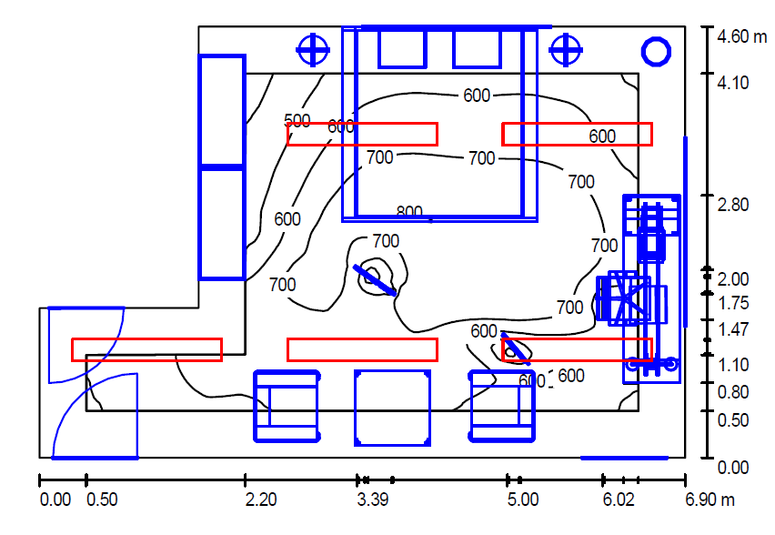
Chapter 4: Electrical Design
An-Najah National University
Lighting design
Artificial lighting
Building Engineering
SAMPLE:. Bedroom
Laminar distributed
Illumenance =500 lux
Work plane =75cm
DIAL 11 R2600/158
Florescent Lamps used
Graduation Project

Slide 46
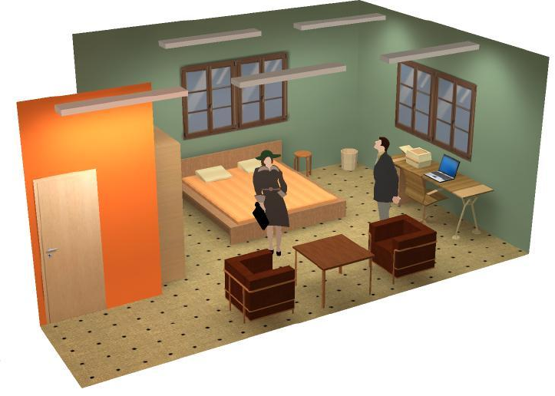
Chapter 4: Electrical Design
An-Najah National University
Lighting design
Artificial lighting
Building Engineering
SAMPLE:. Bedroom
Graduation Project
Distribution laminar in Bedroom

Slide 47
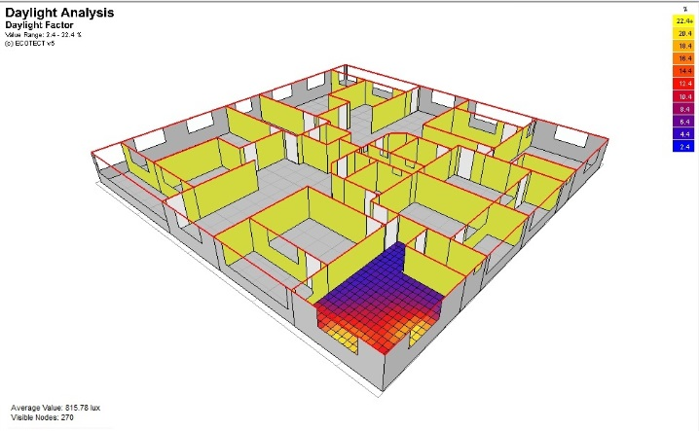
Chapter 4: Electrical Design
An-Najah National University
Lighting design
Artificial lighting
Average illuminances[lx] = 815.78 lux
Building Engineering
SAMPLE:. Bedroom
Graduation Project
Average Value : 9.06% 815.78 lux

Slide 48
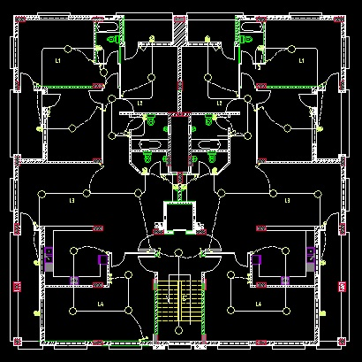
Chapter 4: Electrical Design
An-Najah National University
The plan of lighting in residential building
Building Engineering
Graduation Project

Slide 49
Chapter 5: Mechanical Design
An-Najah National University
Elevator design
Fire fighting & Emergency stairs
Sanitation system
Building Engineering
Graduation Project

Slide 50
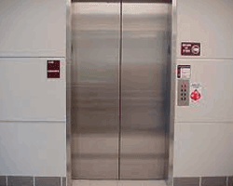
Chapter 5: Mechanical Design
An-Najah National University
A-Elevator design system
Building Engineering
The design consists two things:
The type of the elevator
The number of the elevator
Graduation Project
The type of the elevators
(2500Ib/200ft/min) Elevator

Slide 51
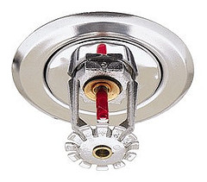
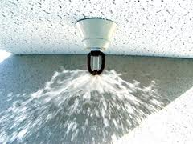
Chapter 5: Mechanical Design
Chapter 5: Mechanical Design
An-Najah National University
An-Najah National University
B. Fire fighting & Emergency stairs
Building Engineering
Fire alarm system and fire protection system were designed for the building, since Saving lives is a primary consideration in the event of fire within buildings
Fire system automatic warning: There are many regulations, but the best automatic system for buildings is disabled Sprinkler Systems
Graduation Project

Slide 52
Chapter 5: Mechanical Design
An-Najah National University
C. Sanitation system
Clean water
Grey water
Black water
Rain water
Building Engineering
Graduation Project

Slide 53
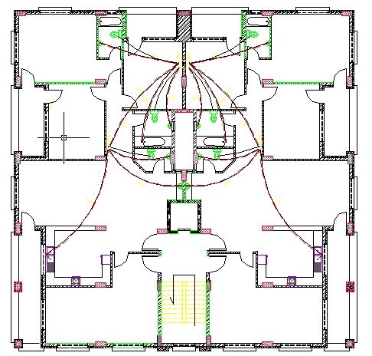
Chapter 5: Mechanical Design
An-Najah National University
Sanitation system
Clean water
Building Engineering
Feed water to buildings divided into
two main sections:
cold water supply.
hot water.
(Gravity down feed system).
Graduation Project
مخطط تمديدات المياه للطوابق السكنية

Slide 54
Chapter 5: Mechanical Design
An-Najah National University
Sanitation system
Drainage Systems.
Building Engineering
Black water :WCS & kitchen sink
Grey water : lavatory
diameters of the pipes =4” (for stack)
Vent :to maintain the air pressure inside the drainage network
Graduation Project

Slide 55
Chapter 5: Mechanical Design
An-Najah National University
HVAC system
Information for design
Building Engineering
Parameters | Winter | Summer
T_{in} | 22 C° | 24 C°
T_{out} | 6C° | 35 C°
Φ_{in} | 50 % | 65 %
Φ_{out} | 70 % | 65 %
W_{in} | 8.2 (g/Kg dry air) | 12.1(g/Kg dry air)
W_{out} | 4.7(g/Kg dry air) | 21(g/Kg dry air)
T_{un.} | 15.15 C° | 30.46 C°
T_{ground} | 13.3 C° | 38.7 C°
Graduation Project

Slide 56
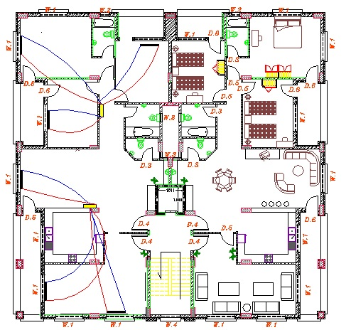
Chapter 5: Mechanical Design
An-Najah National University
Distribution Radiator in left apartment
Building Engineering
Graduation Project

Slide 57
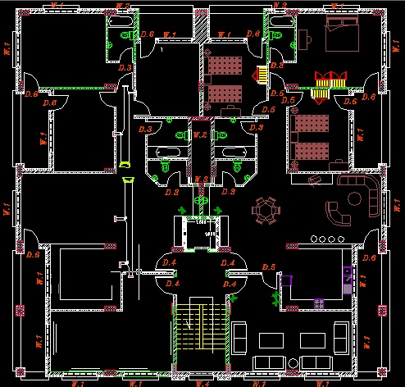
Chapter 5: Mechanical Design
An-Najah National University
Distribution ducts and diffusers in left apartment
Building Engineering
Graduation Project

Slide 58
Chapter 5: Mechanical Design
An-Najah National University
Analysis the Building on ECOTECT Program
Building Engineering
Graduation Project

Slide 59
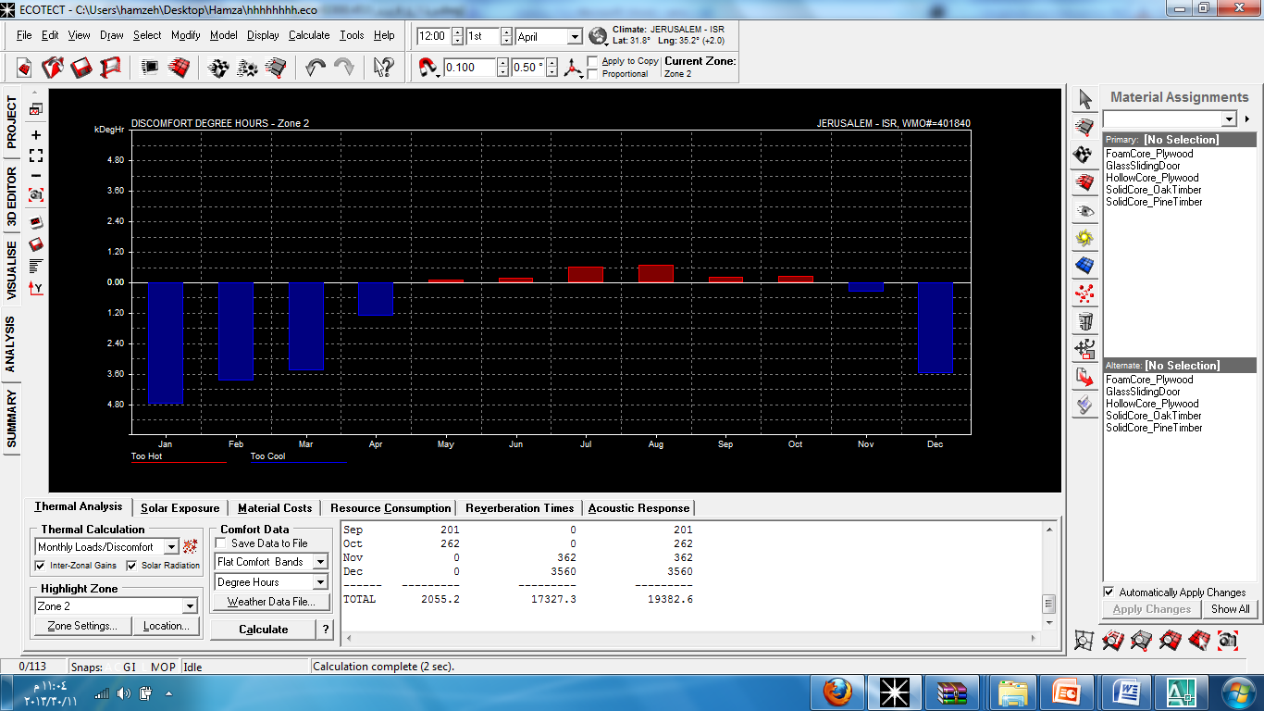
Chapter 5: Mechanical Design
An-Najah National University
The analysis was done for sample areas and the results the heating and cooling .
Building Engineering
Graduation Project

Slide 60
Chapter 5: Mechanical Design
An-Najah National University
Heating and cooling Results:
 | TOO HOT | TOO COOL | TOTAL
MONTH | (DegHrs) | (DegHrs) | (DegHrs)
Jan | 0 | 4763 | 4763
Feb | 0 | 3862 | 3862
Mar | 0 | 3454 | 3454
Apr | 0 | 1323 | 1323
May | 107 | 4 | 111
Jun | 173 | 0 | 173
Jul | 603 | 0 | 603
Aug | 709 | 0 | 709
Sep | 201 | 0 | 201
Oct | 262 | 0 | 262
Nov | 0 | 362 | 362
Dec | 0 | 3560 | 3560
Total | 2055.2 | 17327.3 | 19382.6
Building Engineering
Area of floor = 506 square meter
Total heating and cooling load per one square meter = 19382.6 / 506 = 38.3 whr
30 < 38.3 < 80 good
Graduation Project

Slide 61
Chapter 5: Mechanical Design
An-Najah National University
Equipments
Building Engineering
we select chiller model: APA_55_1S
WE SLECT FAN model GCC12
we select boiler model: FM500
Graduation Project

Slide 62


