Slide 1

An-Najah National University Faculty of Engineering and IT
-Mechanical Engineering Department
Prepared by:
Emam Omar
Hamzah Odeh
ALi Jaara
Supervised by:
Dr : Luqman Herzaallah
June 2 02 5

Slide 2
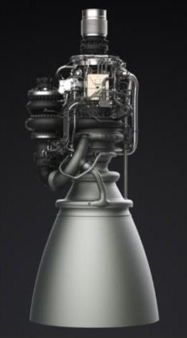
Investigation and Comparative Study of Three Regenerative Cooling Models for the Raptor Engine Bell Nozzle

Slide 3
Review
Methodology Result Conclusion Future Work
Outline
1
2
3
4
5
6
Acknowledgement

Slide 4
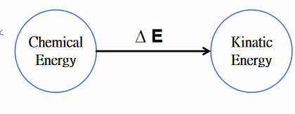
Review - Introduction
Rocket Nozzle
Working Principle
Main Challenges
Cooling
Thrust enhancement
Nozzle Manufacturing

Slide 5
Review - Literature Review
Cooling Types
Film cooling
Main Parameters Effects
Slot Hight
Injection Angle
Blowing Ratio
Regenerative cooling
Ribs
Channel Shape
Aspect Ratio

Slide 6
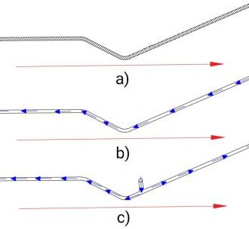
Review - Purpose
Comparative and analysis between three models .
Model 1 : no cooling channel .
Model 2: a typical cooling channel.
Model 3: cooling channel with modification (change the position of the coolant inlet ).

Slide 7
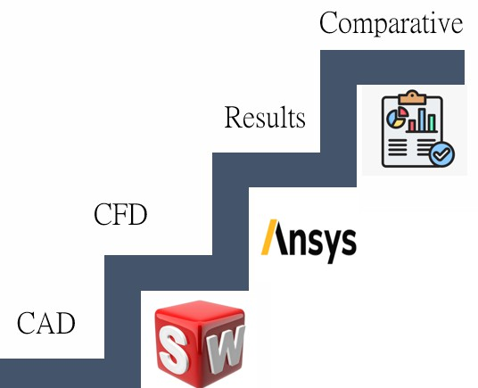
Methodology
Geometry of raptor engine
Geometry of the models
Mesh Generation
Boundary Conditions and setup

Slide 8
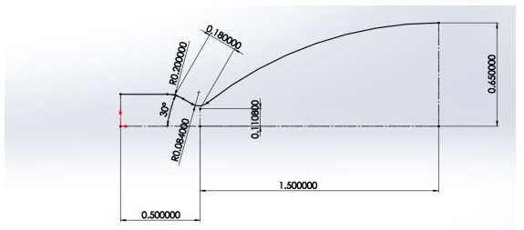
Methodology
Geometry of raptor engine

Slide 9
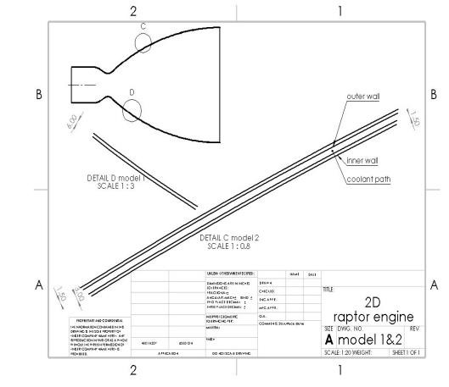
Methodology
Geometry of the models-model 1 &2

Slide 10
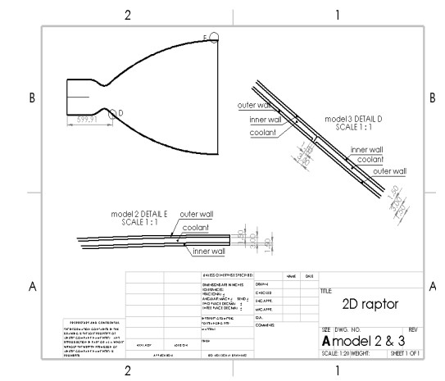
Methodology
Geometry of the models-model 2&3

Slide 11
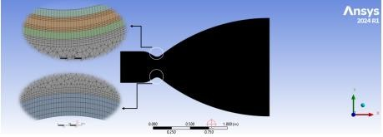
Methodology
Mesh generation – Model 1 &2
Edge sizing 1mm
Body sizing 4mm
Multizone-all quad
Tetra – triangle
Inflation

Slide 12
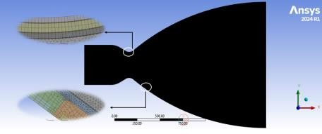
Methodology
Mesh generation – Model 2 &3
Edge sizing 1mm &0.5mm
Body sizing 4mm
Multizone-all quad
Tetra – triangle
Inflation

Slide 13
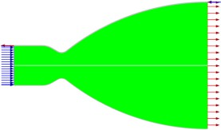
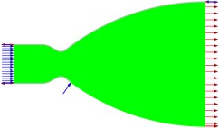
Methodology
Boundary Conditions and setup-controlled variable
Steady state solution
Density base solver
Turbulence model: SST K-W
Ideal gas Sutherland viscosity
Energy equation activated
Second order hybrid initialization
Residual value 1e^-6
Iteration 5000

Slide 14


Methodology
Boundary Conditions and setup-material selection
Solid parts: walls
Fluid parts: coolant

Slide 15
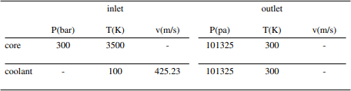
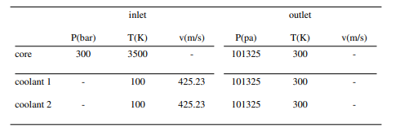
Methodology
Boundary Conditions and setup-initial condition
Model 1&2
Model 2&3

Slide 16
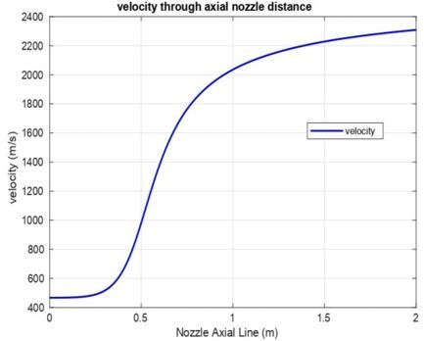
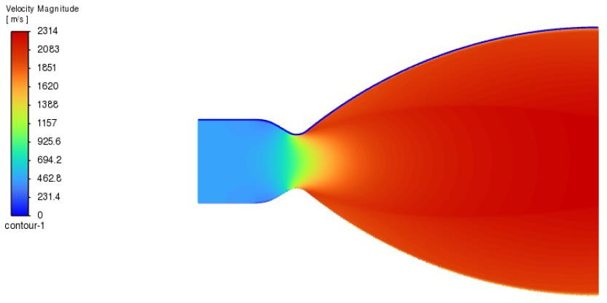
Result
Flow characteristics- Velocity

Slide 17
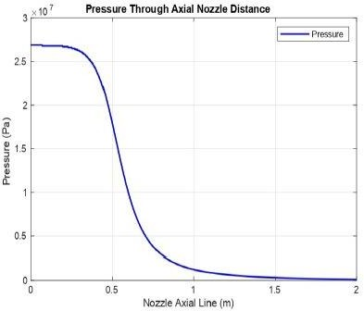
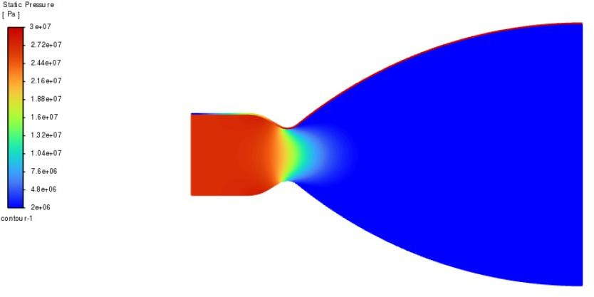
Result
Flow characteristics- Pressure

Slide 18
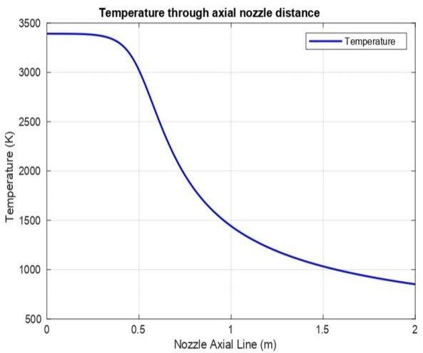
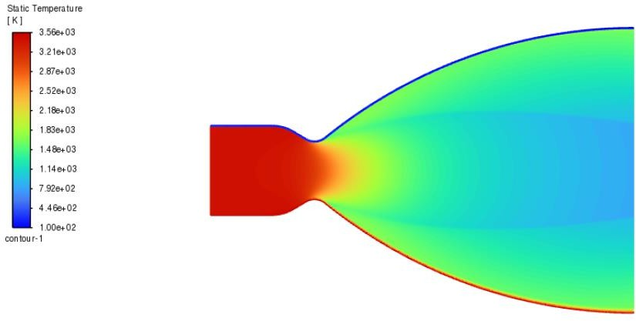
Result
Flow characteristics- Temperature

Slide 19
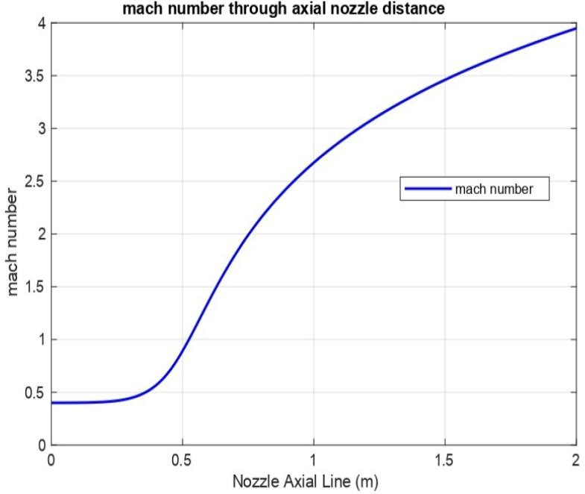
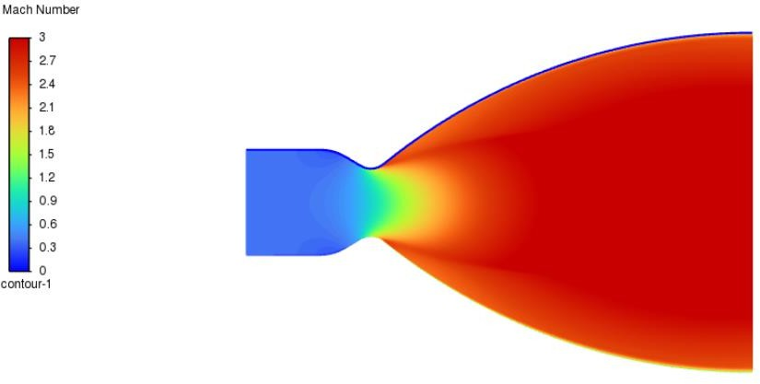
Result
Flow characteristics- Mach number

Slide 20
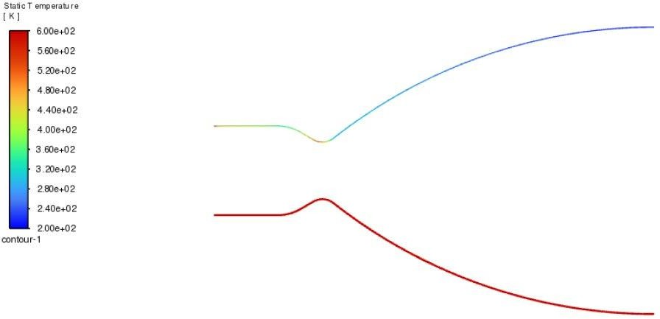
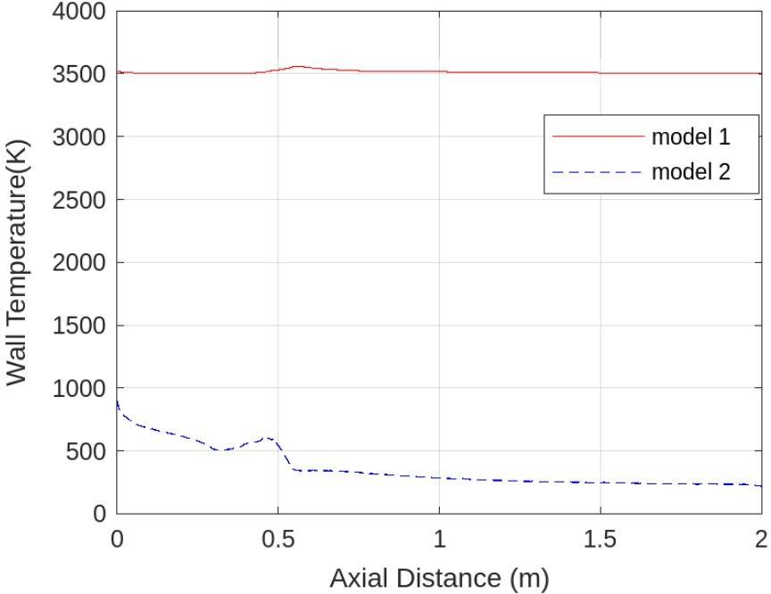
Result
Thermal analysis and heat transfer- model 1&2

Slide 21
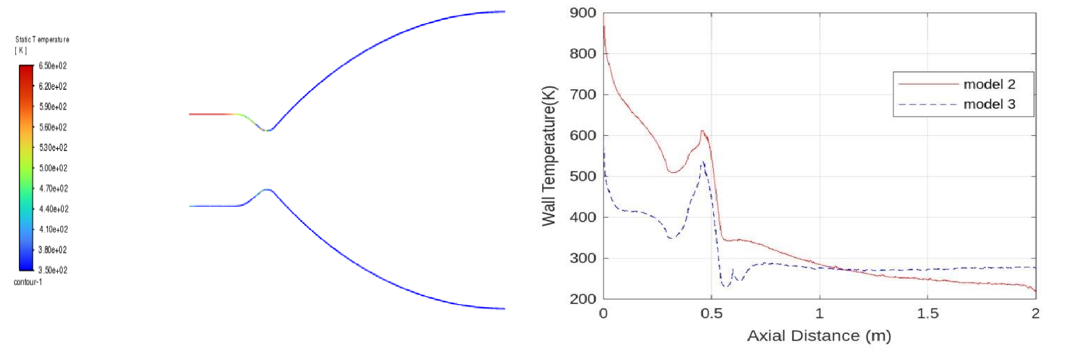
Result
Thermal analysis and heat transfer- model 2&3

Slide 22
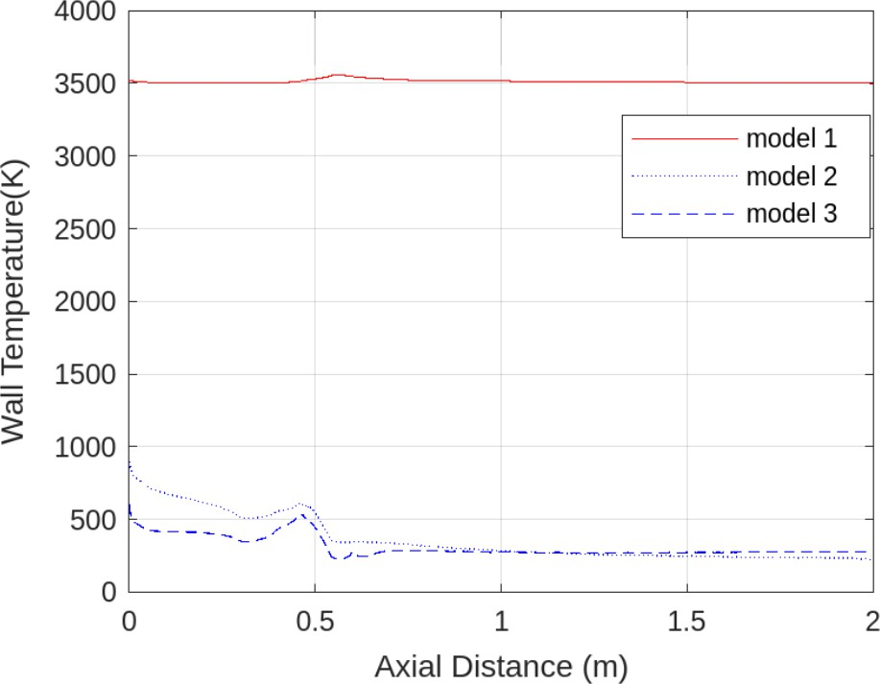
Result
Thermal analysis and heat transfer- all models

Slide 23
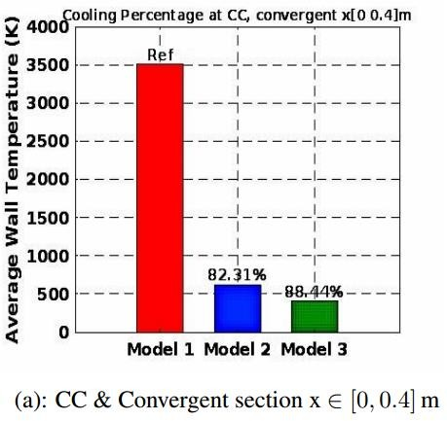
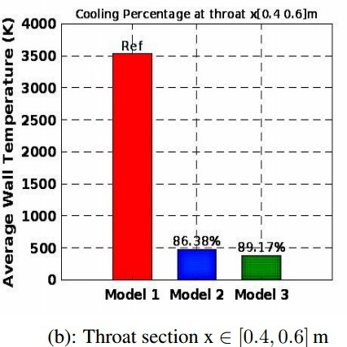
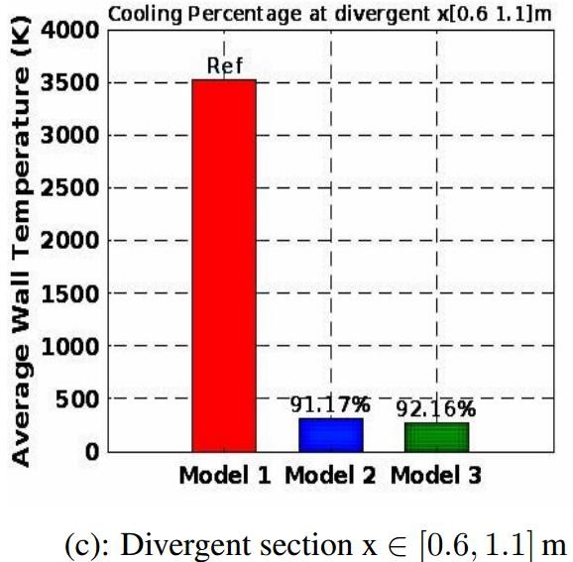
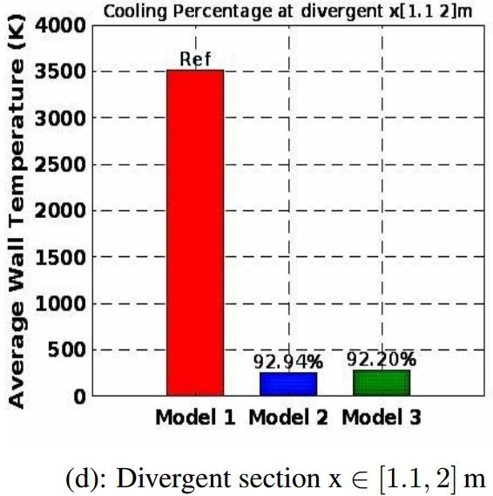
CONCLUSION
Average nozzle wall temperature at different sections showing the cooling percentage.

Slide 24

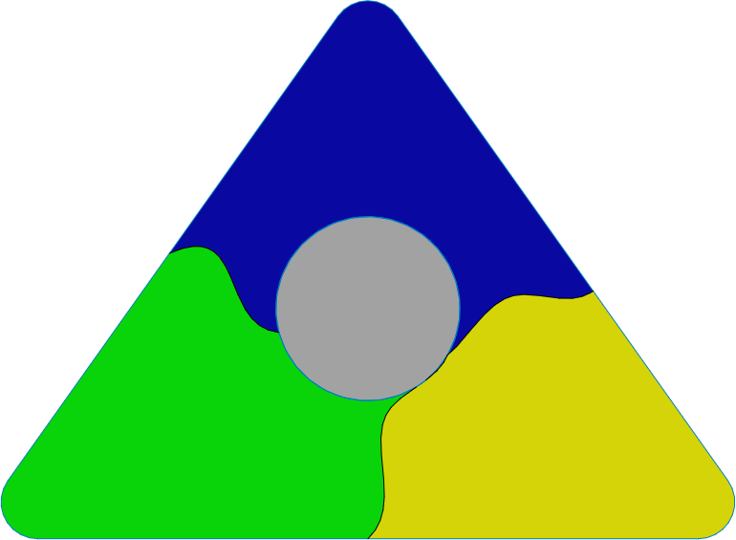
Future work
Several locations of coolant inlet
Future Work
Further improve the quality of the mesh
Channel Enhancements with Ribs

Slide 25


Slide 26


