Slide 1



COLLEGE OF ENGINEERING & INFORMATION TECHNOLOGY
DEPARTMENT OF MANAGEMENT INFORMATION SYSTEMS
AL-SULTAN FURNITURE

Slide 2

Website and E-Marketing for AL-SULTAN FURNITURE
TEAM WORK:
SHAHD SAIF
ROAA ALSHAIKH
SUPERVISED BY:
DR.MAHER ABO BAKER

Slide 3

CONTENT
01
INTRODUCTION
02
PROBLEMS
03
SOLUTION
04
E- MARKETING
05
WEBSITE

Slide 4
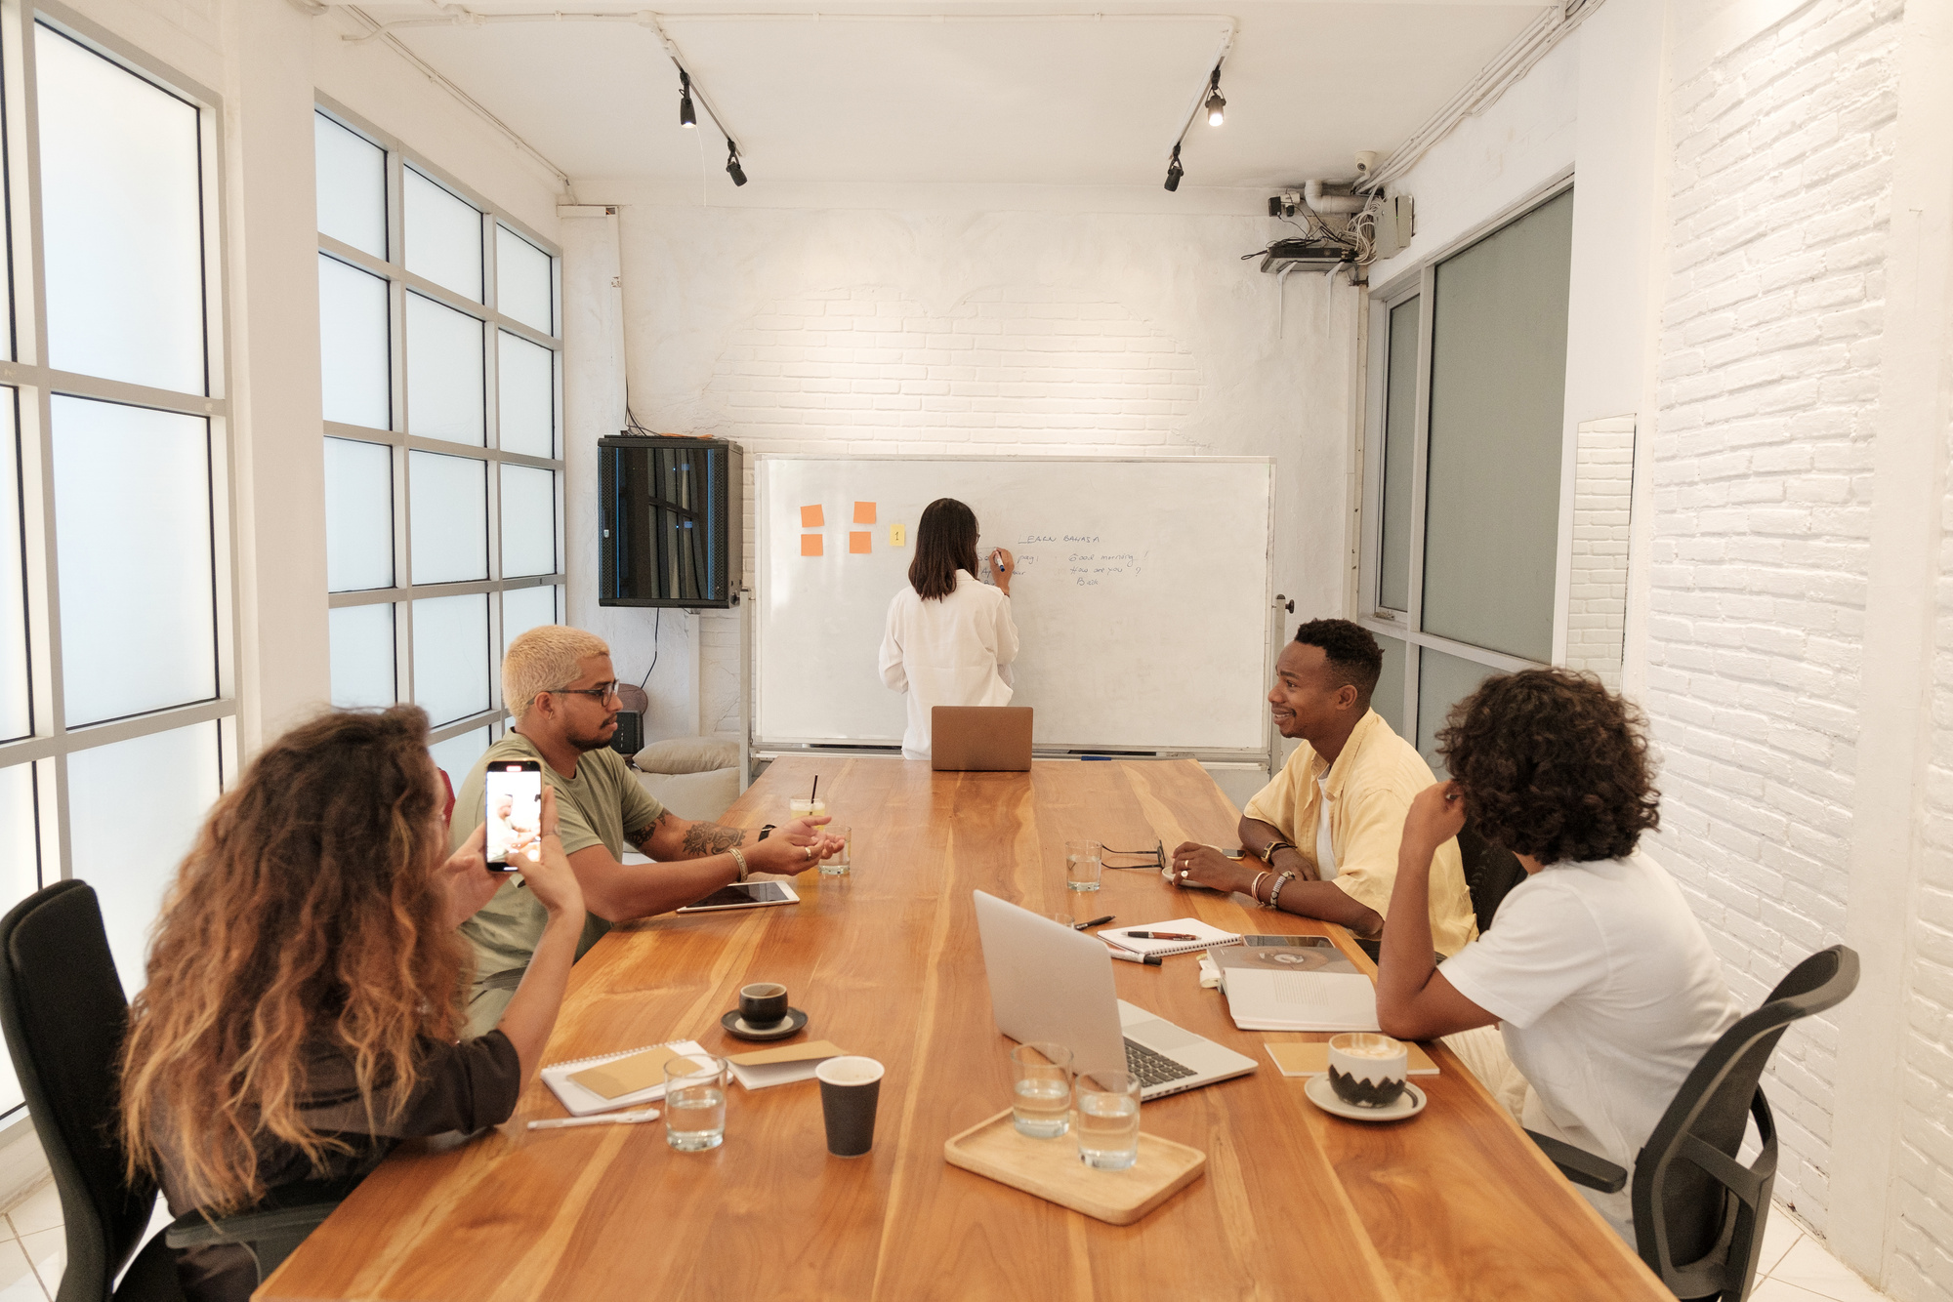


ABOUT AL-SULTAN
In its early beginnings, established in 2010 AD, the business specialized solely in sofa upholstery. Over time, it expanded to open its own showroom showcasing all products, including household essentials and furniture, in addition to upholstery. It also offers customization and product manufacturing services according to customer requests. The business is now managed by Qusai Al-Akhras, and the showroom is located at 17 Betonia Street in Ramallah.

Slide 5



VALUES
Mission
  We strive to deliver a delightful shopping experience through high-quality products and excellent customer service, aiming for customer satisfaction and building lasting trust.
  .
Vision
  Our goal is to be the top choice for customers seeking high-quality, unique home products.

Slide 6


PROBLEMS
1
2
3
Sales decline due to weather and political conditions, which reduces customers visiting the store.
Lack of interaction on social media due to lack of funding and ads not reaching a large number of customers.
Inability to display all products, in addition to the lack of analysis and data.

Slide 7
SOLUTIONS
1
2
3
Create a website on WordPress to display products.
Collect and analyze data on products, orders, inventory and customers
Increase engagement on social media through targeted marketing and advertising.

Slide 8




TECHNOLOGY USED
SOCIAL MEDIA PLATFORMS
WORDPRESS

Slide 9

E-MARKETING STRATEGIES AND IMPLEMENTATION OF SOCIAL MEDIA:

Slide 10
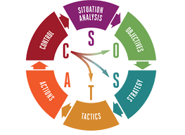
E-marketing
SOSTAC plan

Slide 11

TOOLS WE USED TO ANALYZE FACEBOOK& Instagram PAGES:
  Fanpage Karma
  Zoho
  Buffer
  Agorapulse

Slide 12
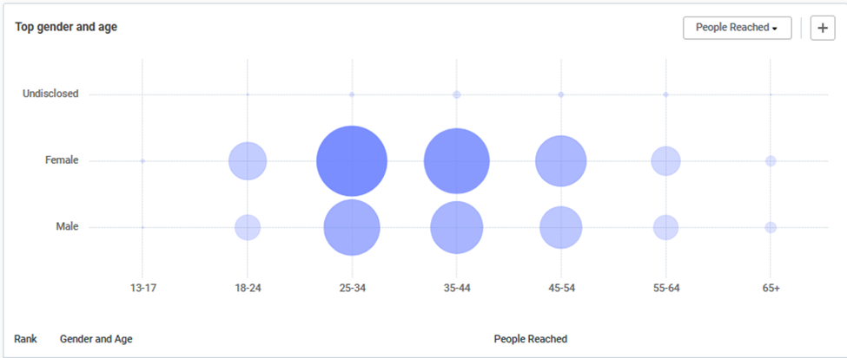
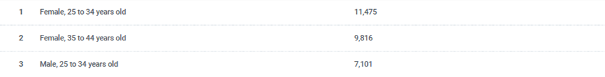
ANALYSING SOCIAL MEDIA PAGES AGE & GANDER ANALYSIS

Slide 13

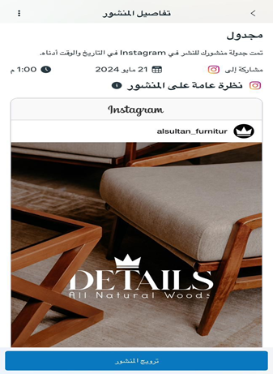
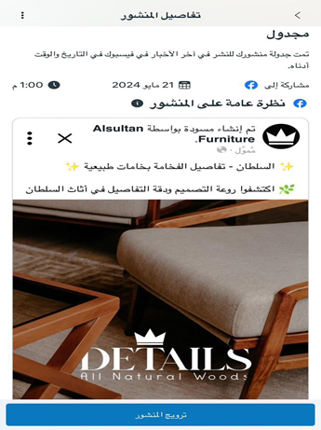
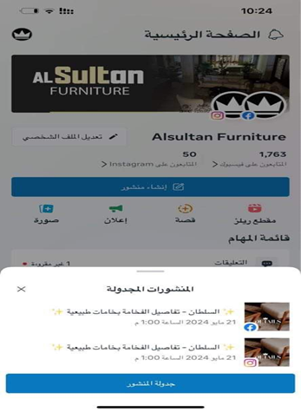
POSTING SCHEDULING

Slide 14

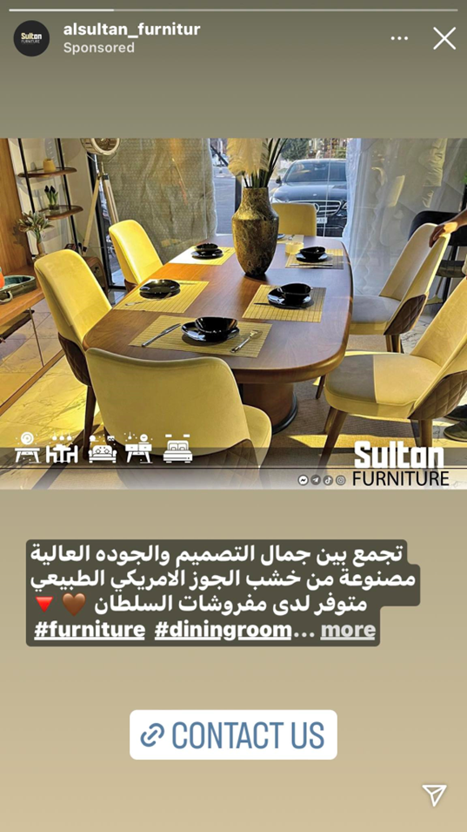
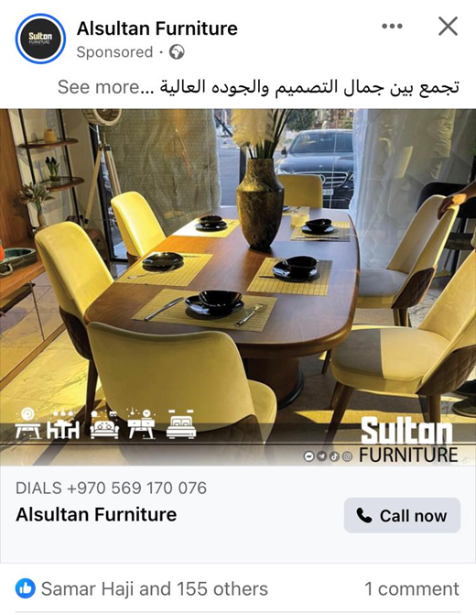
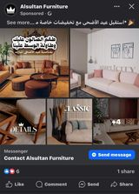
PAID ADVERTISEMENTS

Slide 15

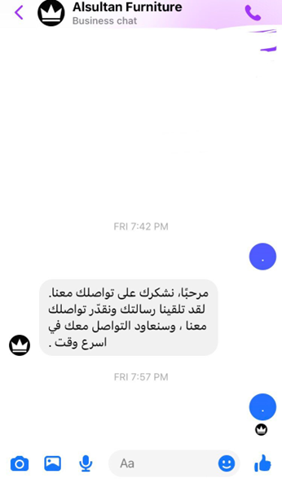
AUTOMATED REPLY

Slide 16


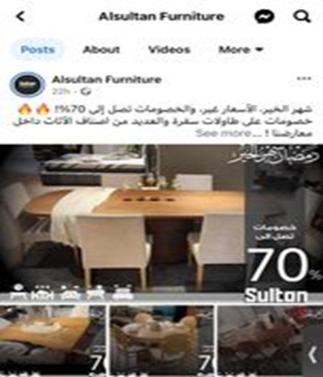
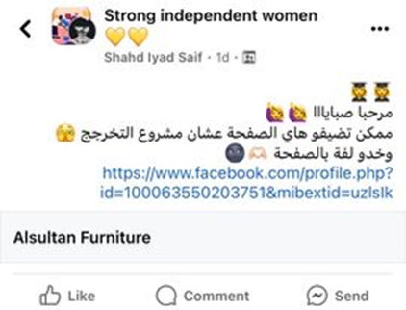

MAKE OFFER
POST IN FACEBOOK GROUPS

Slide 17
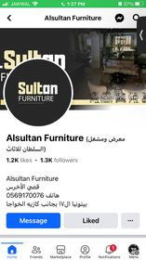
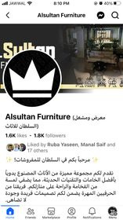
BEFORE
AFTER

Slide 18
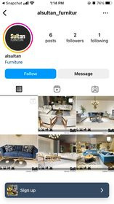
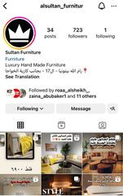
BEFORE
AFTER

Slide 19


THANK'S FOR WATCHING

