Slide 1



SMART TAXI MANAGEMENT & BOOKING SYSTEM
TAXIGO

Slide 2


Why?
1
2
3
Lack of real-time taxi management in Palestine
Need for secure, user-friendly transportation platform
Enable better driver assignment and user safety

Slide 3

Main Idea
TaxiGo is a smart and user-friendly ride-booking platform designed to connect users with nearby drivers efficiently. The system supports multiple roles — users, drivers, managers, and admins — each with tailored interfaces and tools. With real-time trip management, clear role separation, and secure account handling, TaxiGo aims to make transportation more organized, accessible, and reliable for everyone involved.

Slide 4



IDES & FRONTEND TECHNOLOGY
android studio
VS Code
Flutter

Slide 5



BACKEND TECKNOLOGY
Node.js with Express.js
MongoDB
Soket.io

Slide 6




DEPLOYMENT & UTILITIES & SERVICES TECKNOLOGY
Render
Postman
Cloudinary
Flutter

Slide 7







SYSTEM ROLES
Admin
User
Driver
Manager

Slide 8



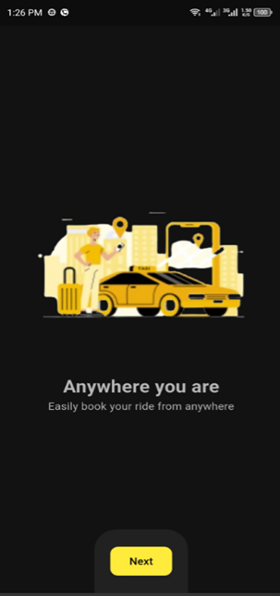
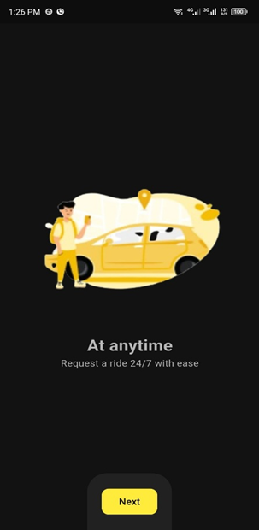
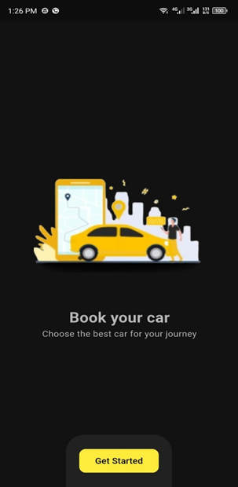



Welcome Page
"Provides a brief introduction and smooth entry into the
app experience."
Further elaborate on the channel.
Further elaborate on the channel.
Further elaborate on the channel.

Slide 9
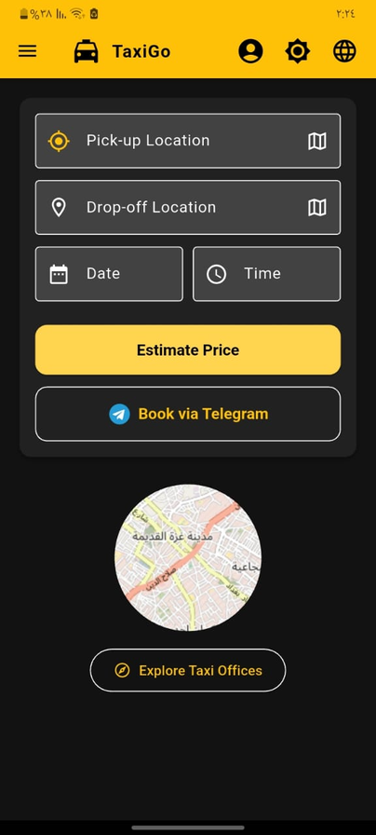
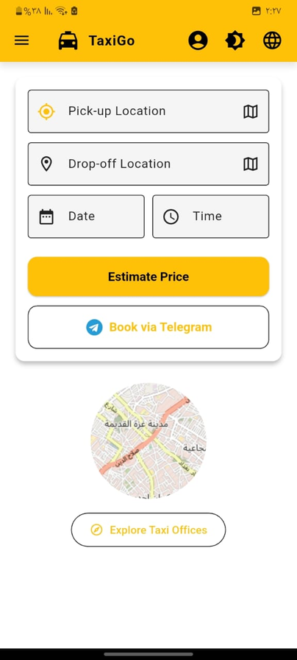
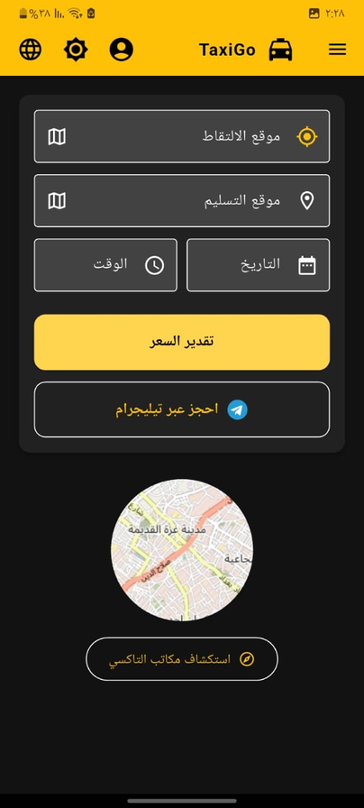
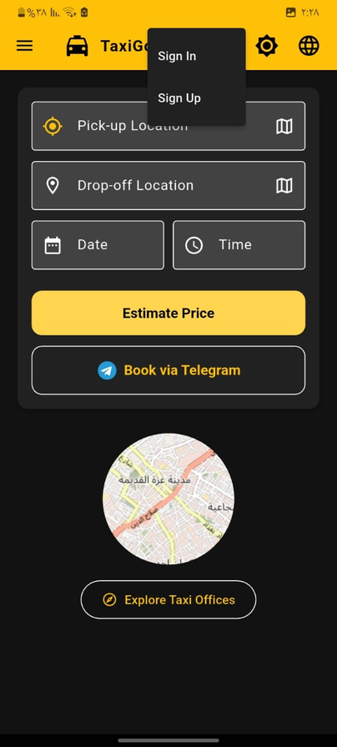
Home Page
"Showcases key features and invites users to
explore or join the platform."
Further elaborate on the channel.
Further elaborate on the channel.
Further elaborate on the channel.

Slide 10
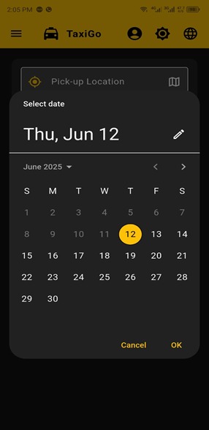
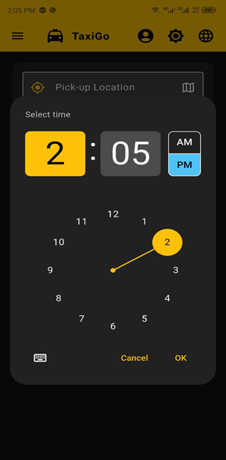
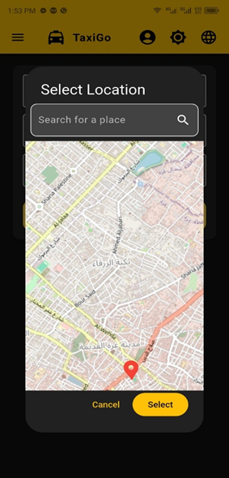

Trip Price Estimation Feature
Further elaborate on the channel.
Further elaborate on the channel.

Slide 11
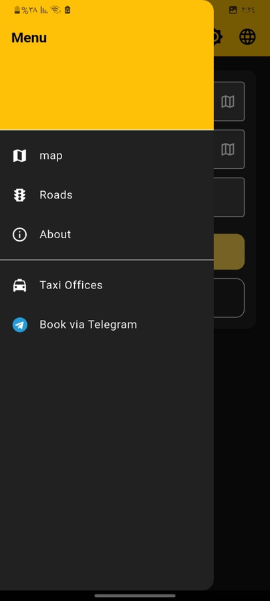
Side Menu

Slide 12
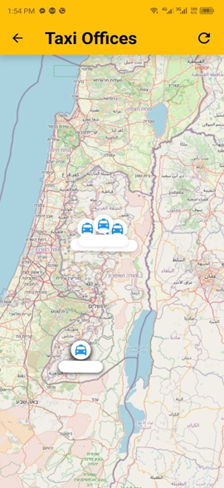
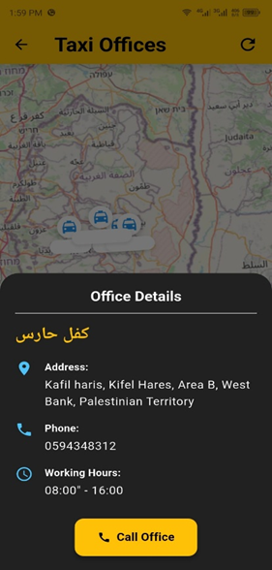
View Taxi Offices on the Map
Further elaborate on the channel.
Further elaborate on the channel.

Slide 13
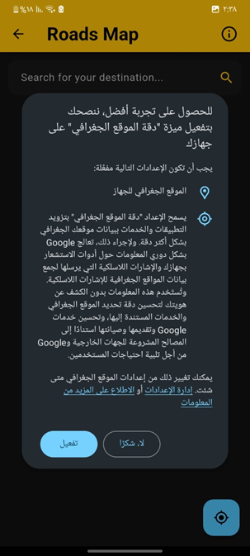
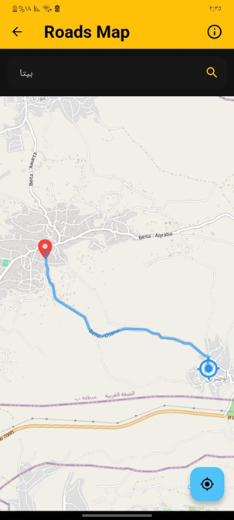
Map Page
"Allows visitors to explore routes from their current
location to any desired destination."

Slide 14
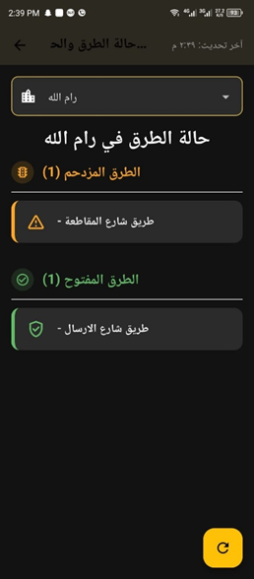
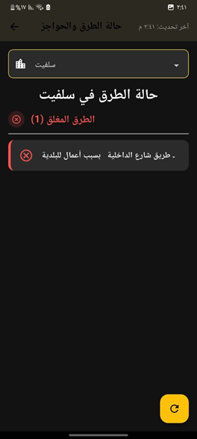
Roads Page
The "Roads" page shows real-time road conditions in major Palestinian cities, automatically analyzed using Gemini AI to help visitors plan safe and informed routes.

Slide 15
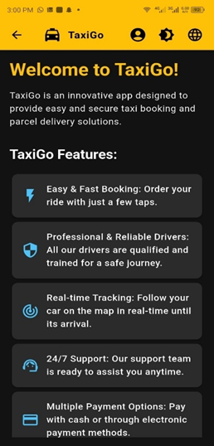
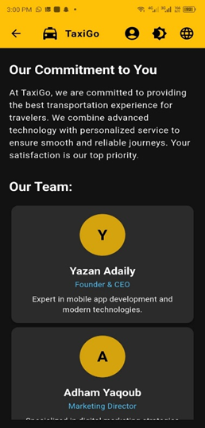
About Page
The "About" page briefly introduces the TaxiGo project,
its goals, and the team behind it.

Slide 16
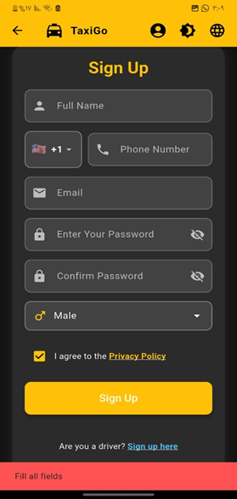
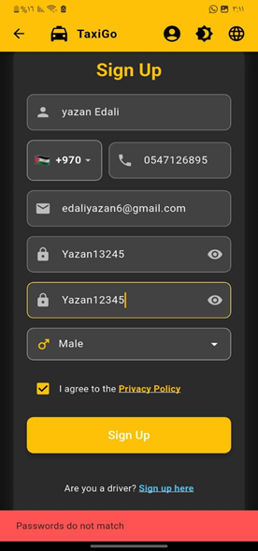
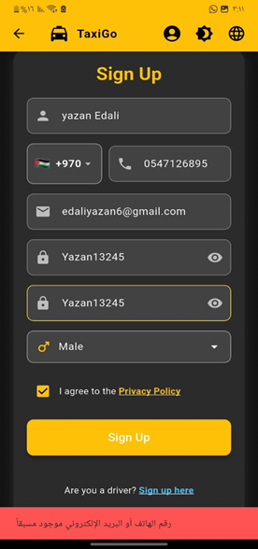
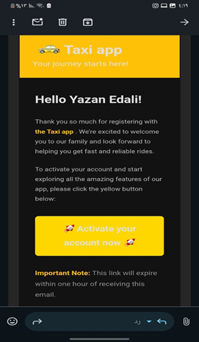
User Registration Page
The user registration page lets new users sign up with basic details and requires email verification for account activation. It includes separate links for driver registration and existing user login.

Slide 17
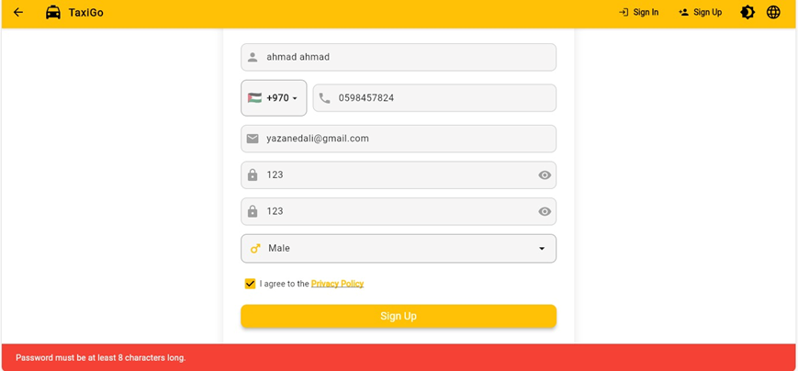
User Registration Page
validate Password Strength
Password must be at least 8 characters long.

Slide 18
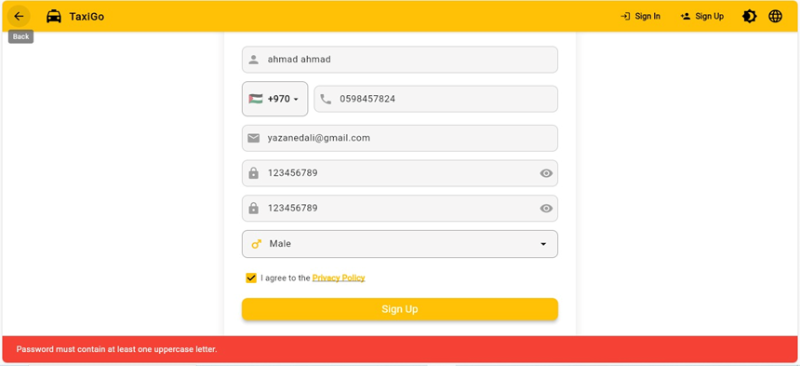
User Registration Page
validate Password Strength
Password must contain at least one uppercase letter

Slide 19
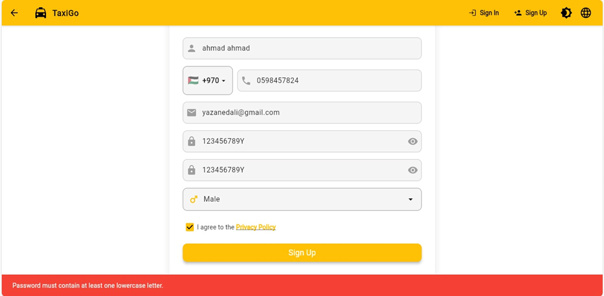
User Registration Page
validate Password Strength
Password must contain at least one lowercase letter.

Slide 20
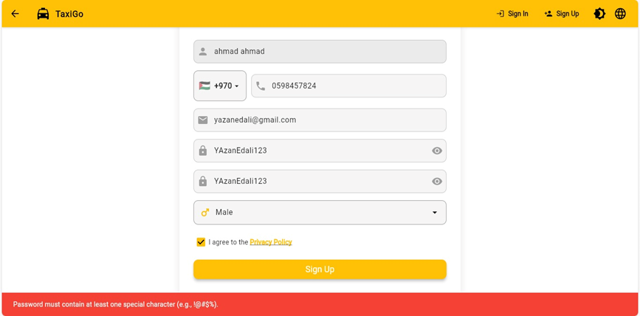
User Registration Page
validate Password Strength
Password must contain at least one special character (e.g., !@#\$%)

Slide 21
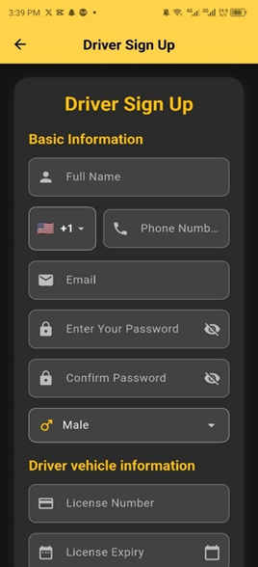
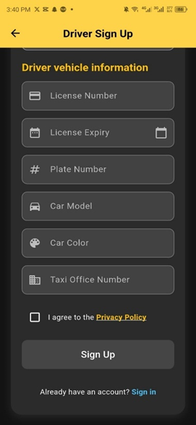
Driver Registration Page
The Driver Sign Up page collects both personal and vehicle-related information, including a valid Taxi Office ID, ensuring drivers are linked to registered offices. Email verification is required to activate the account

Slide 22
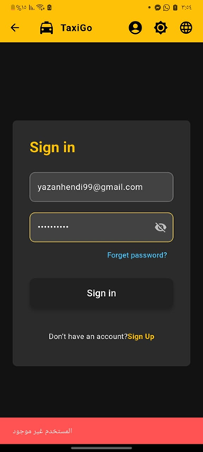
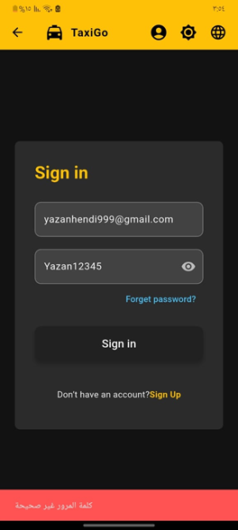

Sign in
The Sign In page allows all user types to log in using their email and password. Upon successful login, the system updates the isLogged field to manage session activity and enhance security.

Slide 23
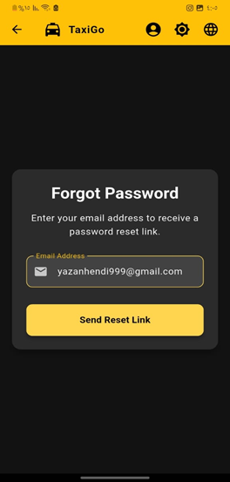
Forgot Password
The "Forgot Password" feature sends a reset link to the user's email, allowing secure password recovery. The link is valid for one-time use only to ensure account safety.

Slide 24
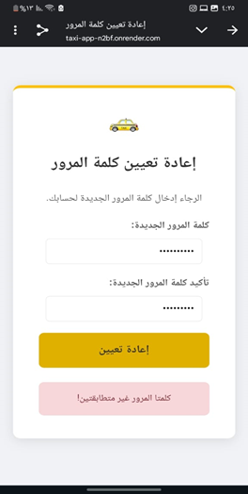
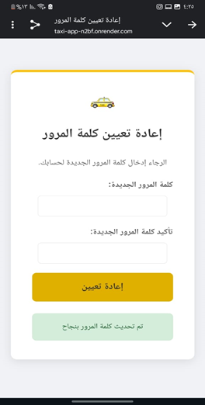
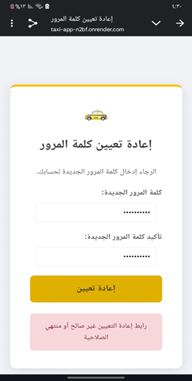
Forgot Password
continue

Slide 25
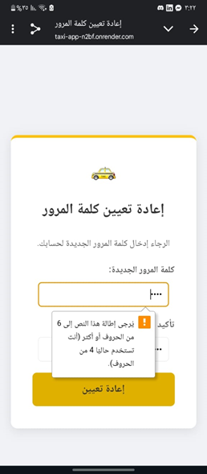
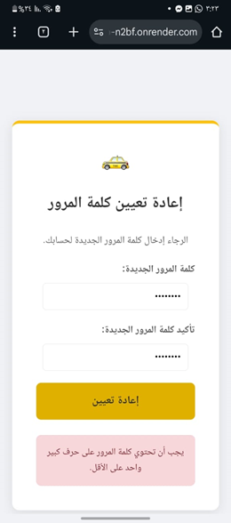
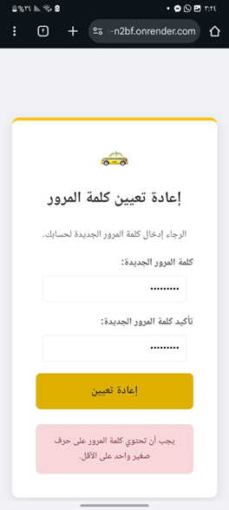
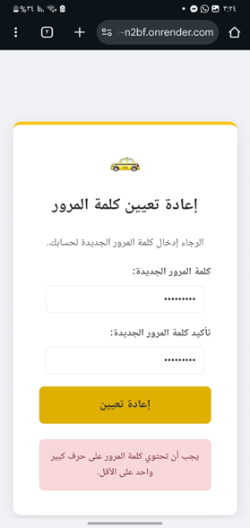
Forgot Password
validate Password

Slide 26
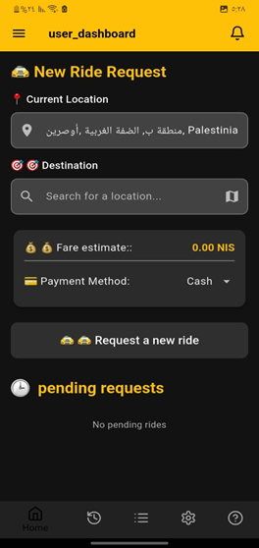
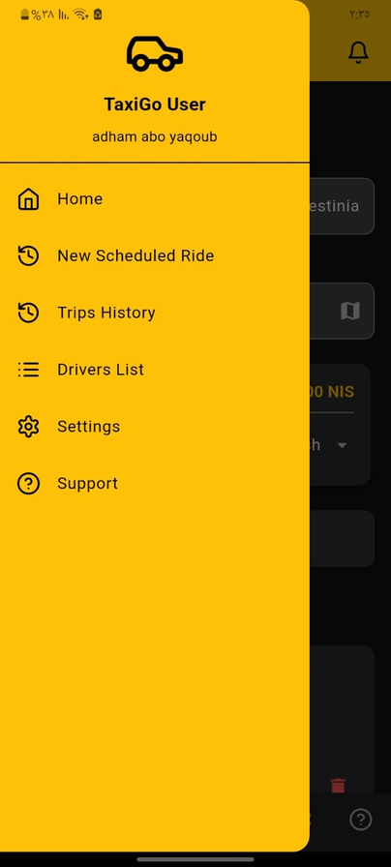
User interface

Slide 27
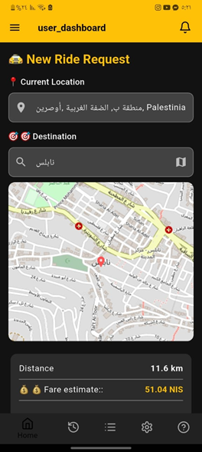
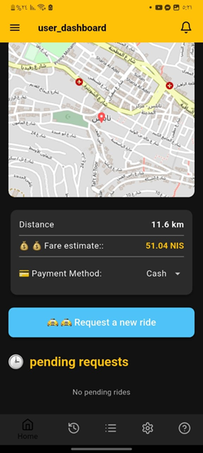
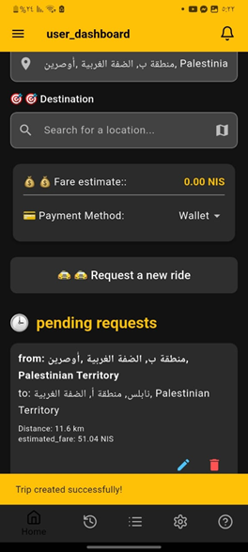
User interface - Home page

Slide 28
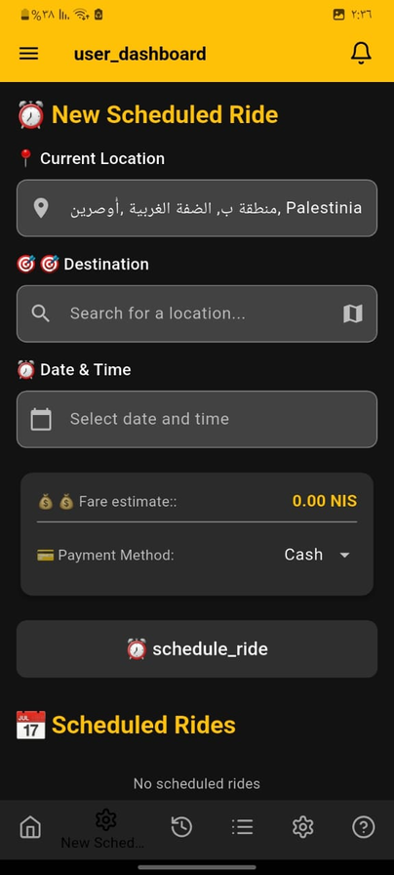
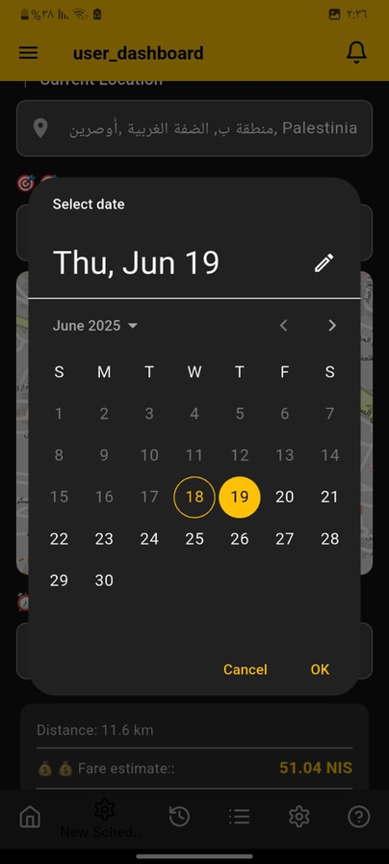
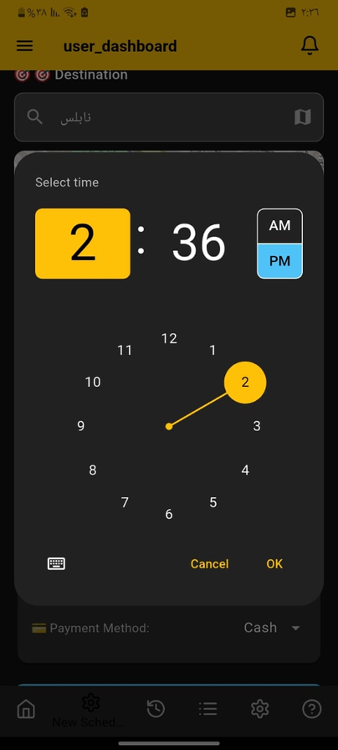
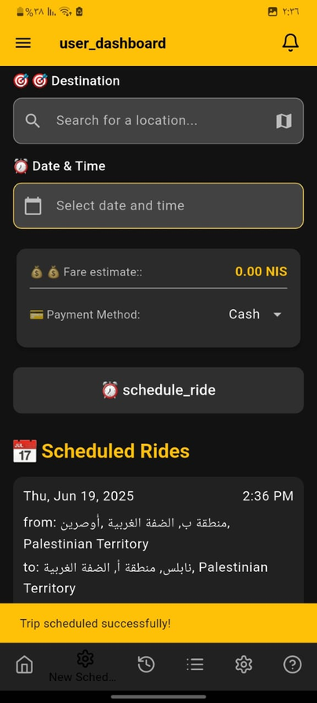
User interface - Scheduled trip

Slide 29
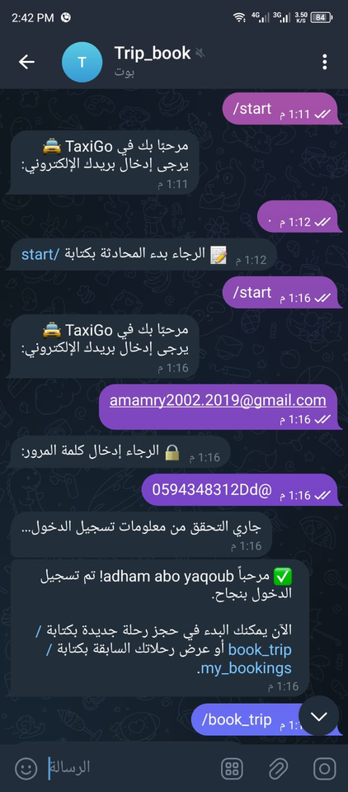
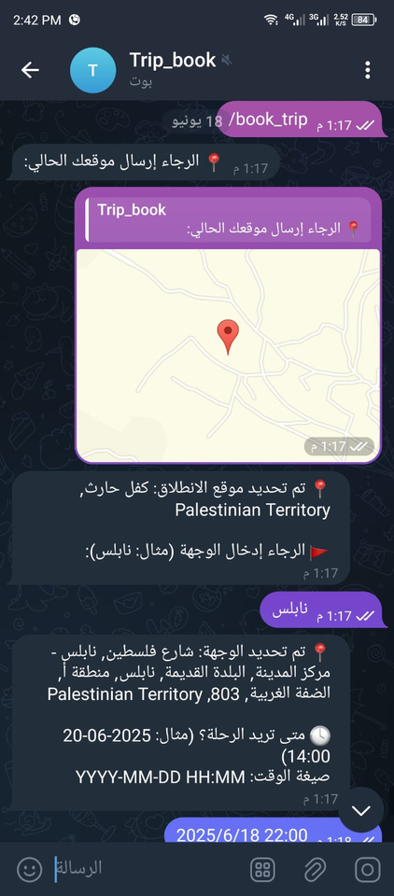


book trip via telegram

Slide 30


Trip History Page
Mobile
Web

Slide 31


Trip History Page-pop up
Mobile
Web

Slide 32


Driver List Page
Mobile
Web

Slide 33



Settings Page

Slide 34


Settings Page
Change Password

Slide 35

Settings Page
Change Password
Password must be at least 8 characters long.

Slide 36

Settings Page
Change Password
Password must contain at least one uppercase letter.

Slide 37

Settings Page
Change Password
Password must contain at least one lowercase letter.

Slide 38

Settings Page
Change Password
Password must contain at least one special character (e.g., !@#\$%).

Slide 39


Settings Page
Edit Profile

Slide 40

Settings Page
The Logout updates isLogged to false in the database, securely ending the session and preventing unauthorized access.

Slide 41



Support Page
Edit Profile

Slide 42



Notifications
The notification system sends real-time alerts about trip status updates (accepted, rejected, started, completed) and tracks unread/read status for better user experience and organization.

Slide 43


Driver
Home Page

Slide 44



Driver
Trip Requset

Slide 45



Driver
Trip accepted

Slide 46



Driver
Driver Trip

Slide 47


Driver
Earning

Slide 48



Driver
Setting
Edit profile
Change Password

Slide 49



Driver
Chatting in mobile

Slide 50


Driver
Chatting in Web

Slide 51



Manager
Home Page

Slide 52


Manager
Manager Driver:

Slide 53


Manager
View Driver Details

Slide 54



Manager
Add New Driver
Managers can easily add new drivers by filling out a simple form with driver and vehicle details.

Slide 55



Manager-Chat
The manager chat page enables real-time messaging with assigned drivers using WebSocket, with instant notifications and full chat history for efficient coordination.

Slide 56


Manager
Settings Page
Change Pasword

Slide 57
Manager
Settings Page
Change Pasword

Slide 58


Admin interface

Slide 59

Admin interface
In WEB:

Slide 60

Admin interface
Home Page

Slide 61



Admin interface
Drivers Page

Slide 62

Admin interface
Drivers Page

Slide 63

Admin interface
Drivers Detalis

Slide 64


Admin interface
Users Page

Slide 65

Admin interface
UsersPage

Slide 66

Admin interface
User details

Slide 67



Admin interface
Trip Management:

Slide 68

Admin interface
Trip Management:

Slide 69

Admin interface
Trip Management - Pop up

Slide 70

Admin interface
Settings page:

Slide 71


Admin interface
Taxi Offices page

Slide 72


Admin interface
Add New Taxi Offices

Slide 73

Admin interface
Add New Taxi Offices

Slide 74



Admin interface
Add New Taxi Offices
This is the message I received by email:

Slide 75

Admin interface
Taxi Offices page

Slide 76

Admin interface
Taxi Offices page-Pop up

Slide 77

Admin interface
Add New Taxi Offices

Slide 78

Admin interface
Add New Taxi Offices

Slide 79



Challenges
  Learning new tools (Dart & Flutter)
  Render deployment slowness
  Switched from Google Maps to OpenRouteService

Slide 80

Future Work
  In-App Payments: Add secure online payment options like Stripe.
  Group chat, voice, call & image sharing
  Integrating AI algorithms for driver verification and trip predictions.

Slide 81
Thank you!

