Slide 1
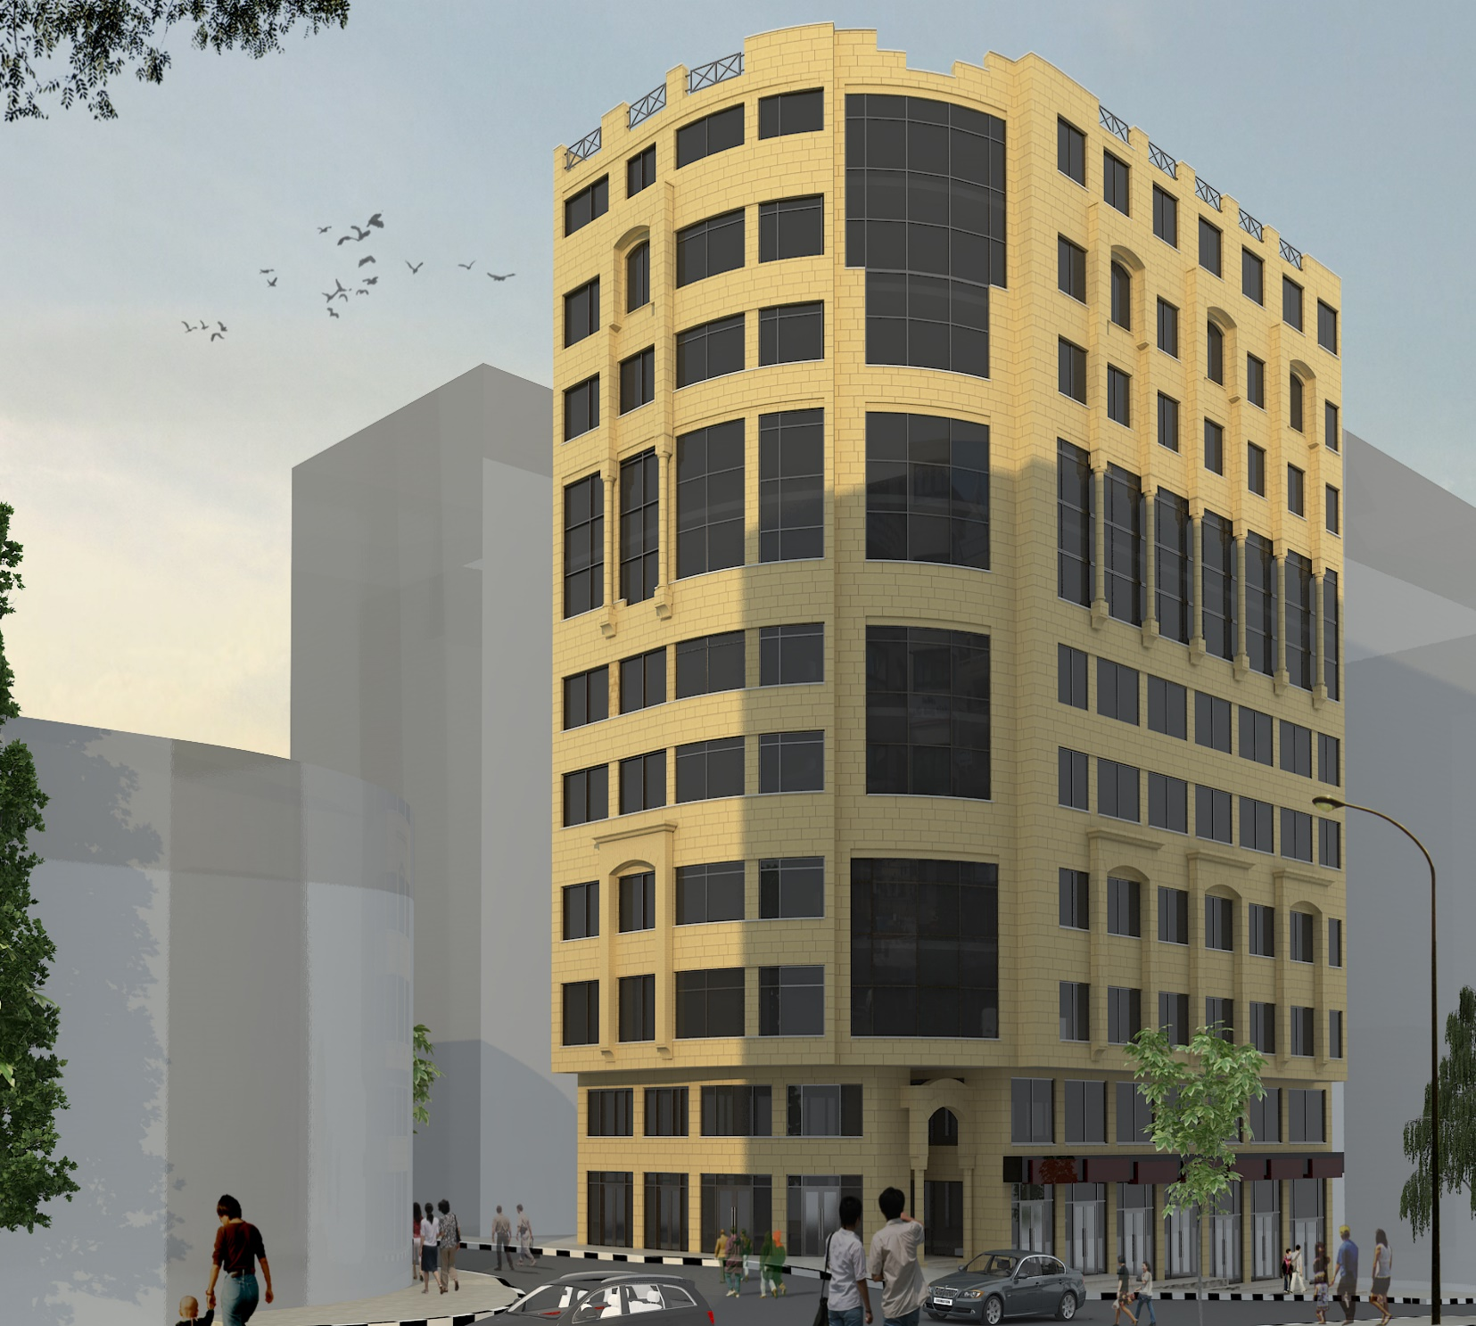
Structural design of Al-Awqaf building
Prepared by:
Hamza Isleem
Rajaa’ Sabra
Mohammed Robo’
Sa’ad Kittaneh
Under supervision of:
Eng. Abdelhakeem Jawhari

Slide 2
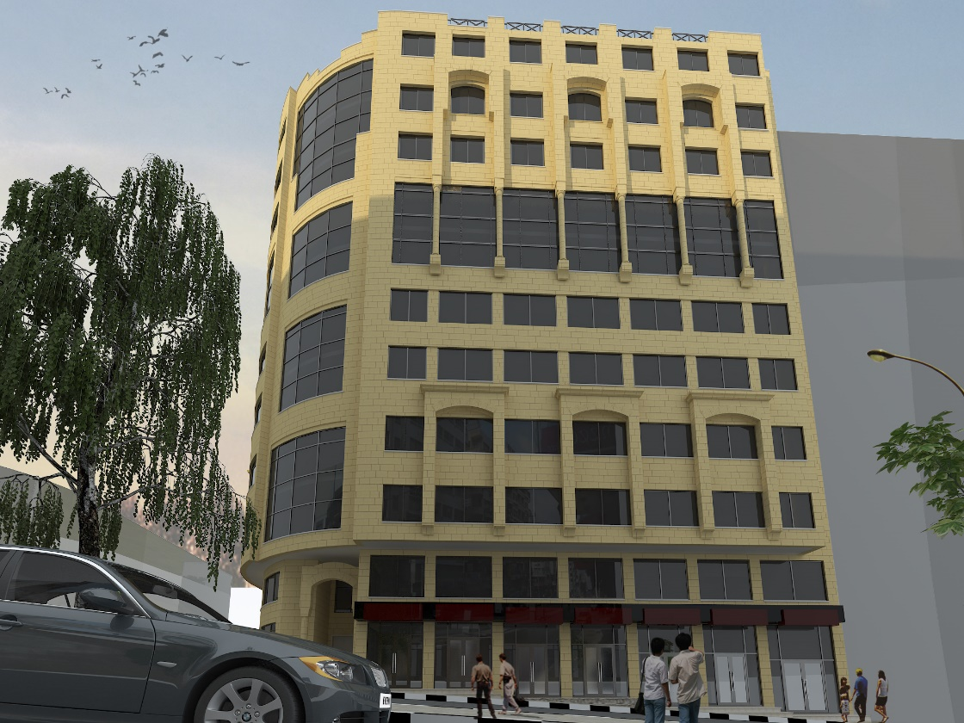
Outline
Architectural review
Structural view
Model checks
Design & detailing
Conclusion

Slide 3
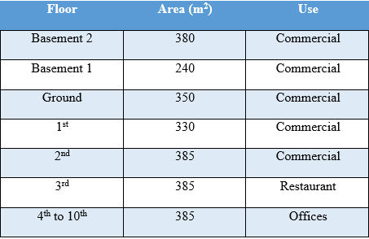

Slide 4
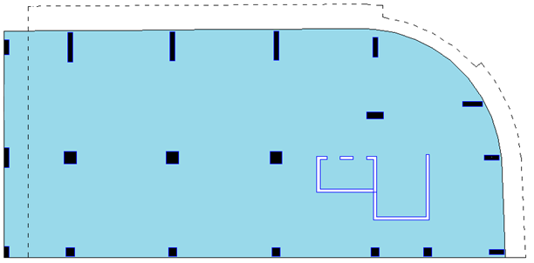
Ground floor

Slide 5
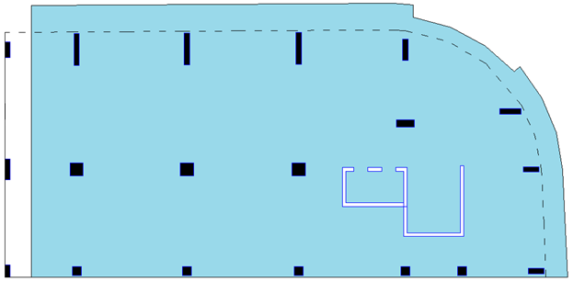
Upper floors

Slide 6
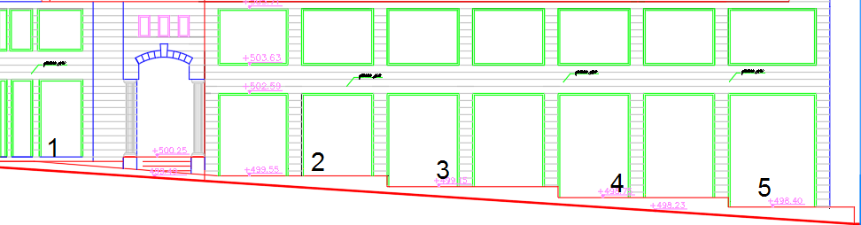
Ground floor & street slope

Slide 7
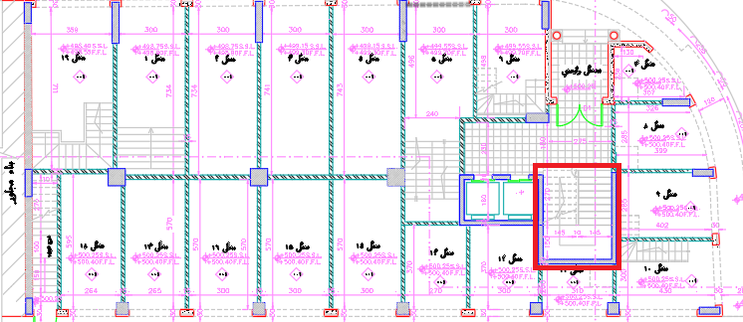
The stair was in the direction shown:

Slide 8
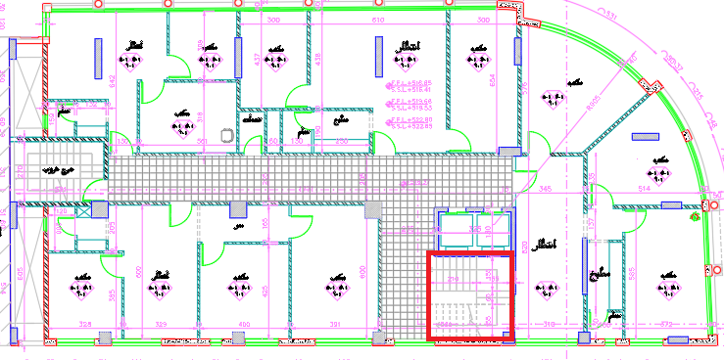
Then it’s suddenly changed direction:

Slide 9
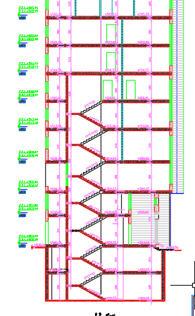
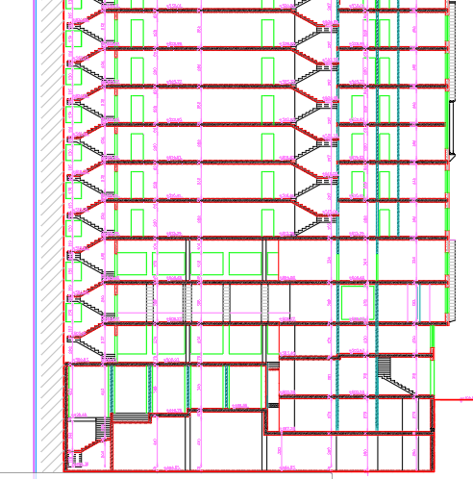
Then

Slide 10
Soil properties
The soil bearing capacity=150KN/m2,
But…

Slide 11
Structural View

Slide 12
Codes and standards
- ACI 318-14
-ASCE-7 (2010)
- IBC 2012
- UBC 97

Slide 13
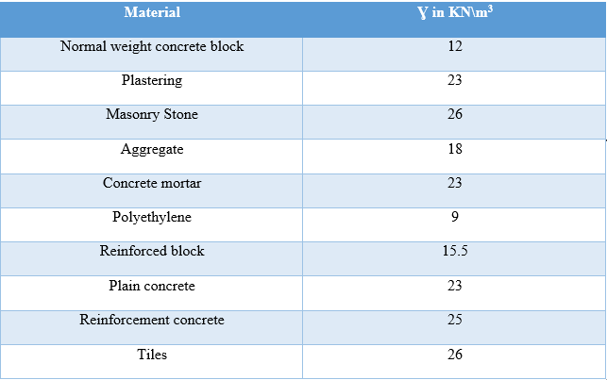
Materials unit weight

Slide 14
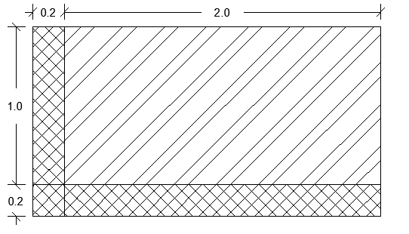
Why $γ$=15.5 for partition block?

Slide 15
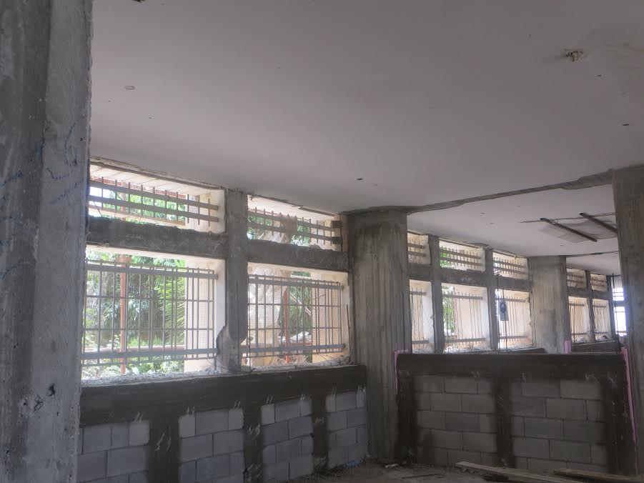
Internal Partitions

Slide 16
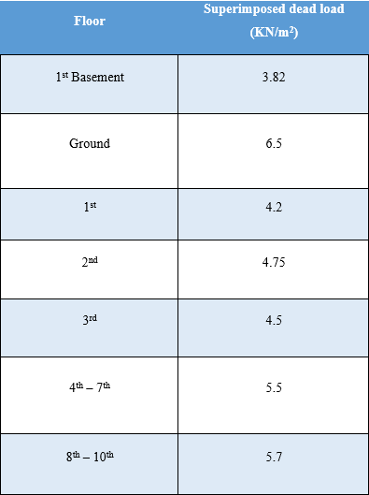
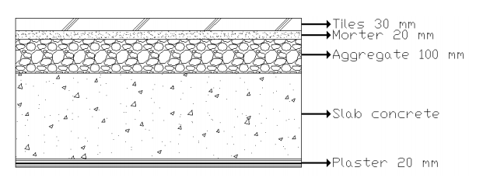
Super Imposed dead load

Slide 17
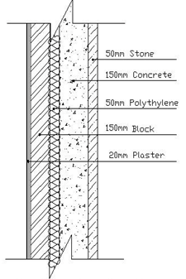
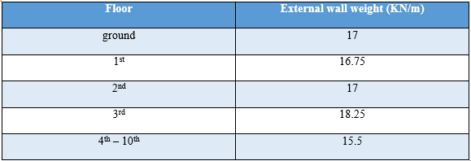
External “masonry” wall

Slide 18
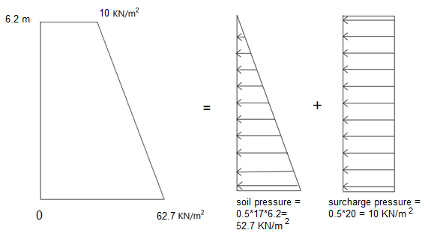
Soil load

Slide 19
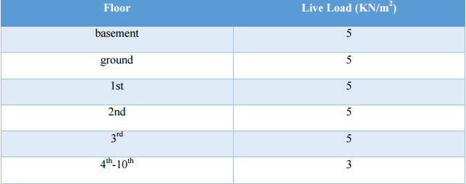
Live load
The live load was distributed according to the use of the floor from codes

Slide 20
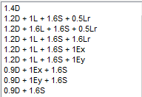
Load Combinations

Slide 21
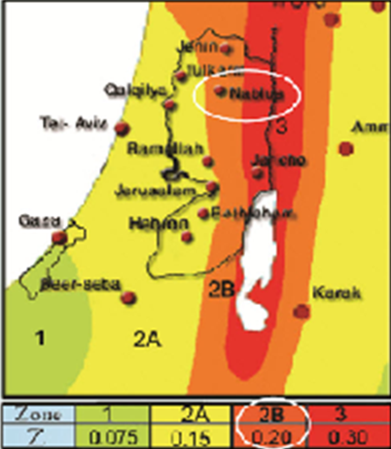
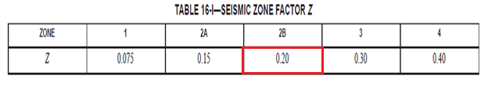
Lateral loads “IBC”
Ss = 2.5 * 0.2 = 0.5
S₁ = 1.25 * 0.2 = 0.25

Slide 22
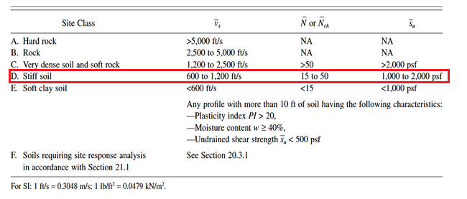
Site class
The soil profile type is D

Slide 23
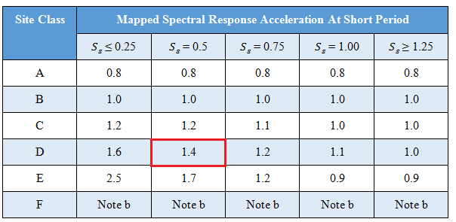
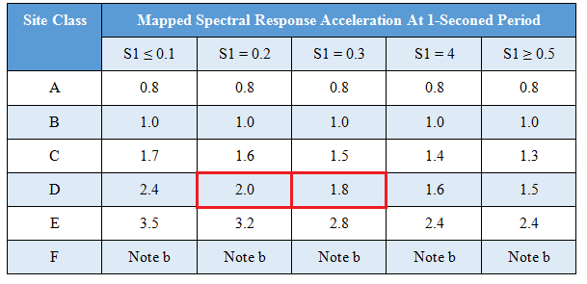
Fa & Fv

Slide 24
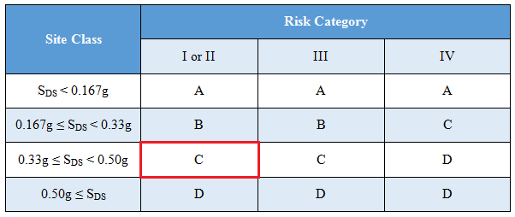
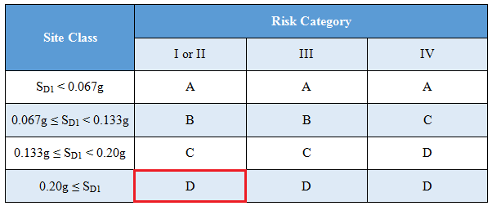
Seismic design category
S_{DS} = 0.7
S_{D1} = 0.475
So, SDC of this project is D

Slide 25
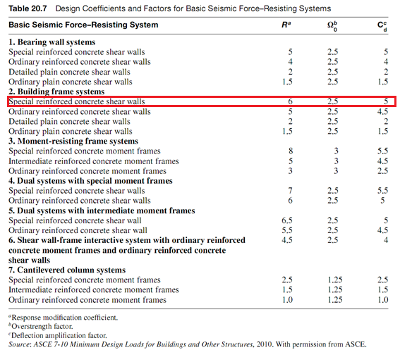
Lateral loads “IBC”

Slide 26
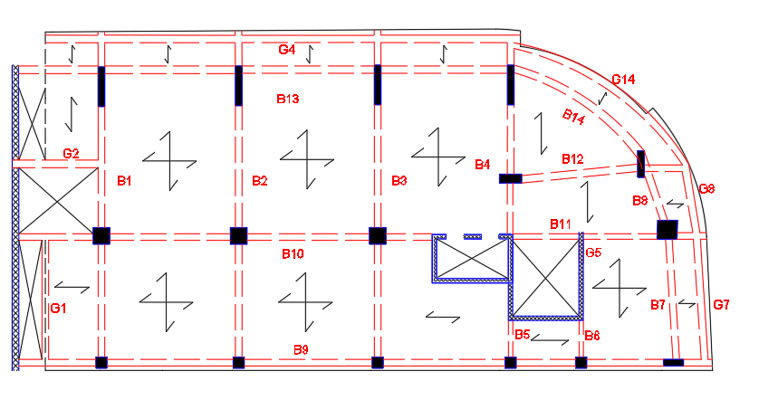
Beams Layout & slabs directions
Drop beams (250x500) and (300x600)

Slide 27
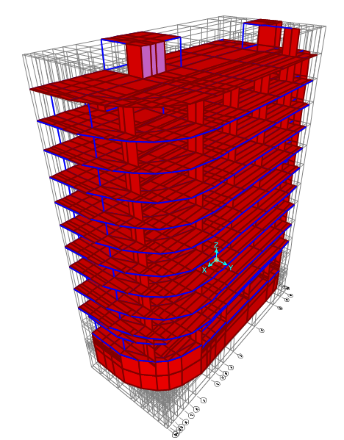
3D Model using SAP2000

Slide 28
Checks
Compatibility
Equilibrium
Stress-strain
Period
Base shear
Ductility

Slide 29
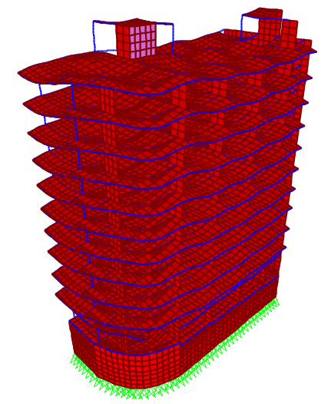
Compatibility

Slide 30
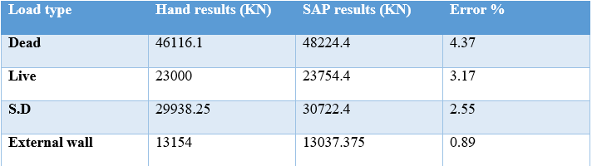
Equilibrium

Slide 31
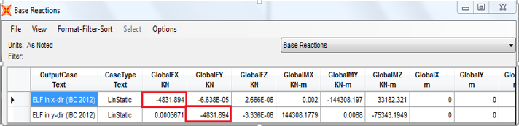
Base shear IBC
By hand: W = 89208.35 KN
So, V = Cs * W = 0.0528 * 89208.35 = 4710.2 KN
Error= 2.52%

Slide 32
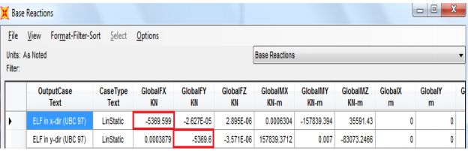
Base shear UBC
By hand, V = 5232 KN
Error= 2.56%

Slide 33
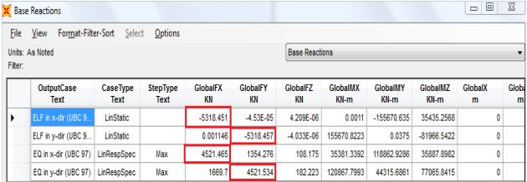
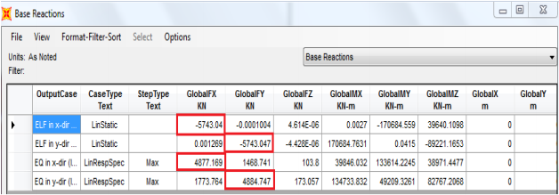
Base shear comparison, UBC or IBC?
UBC
IBC

Slide 34
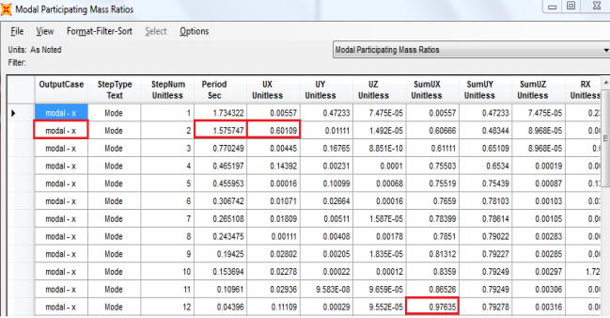
Period and modal mass participation
By hand: Tx=1.5 s
By Sap: Tx=1.57 s
Error= 4.8%

Slide 35
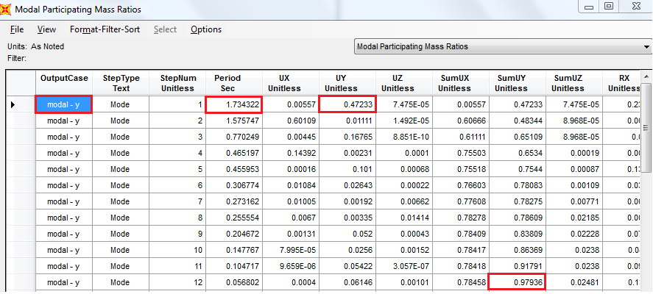
Period and modal mass participation

Slide 36
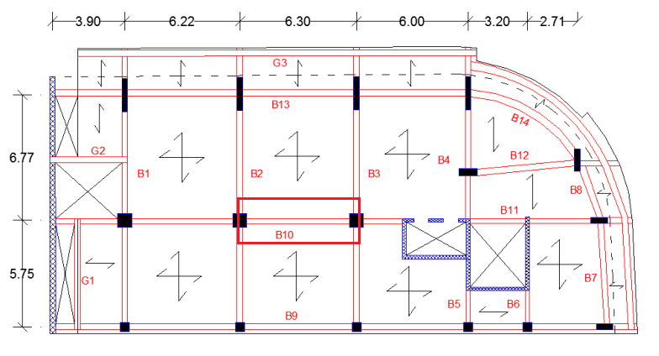
Stress-Strain relationship
The errors were 0 % as shown in the report

Slide 37
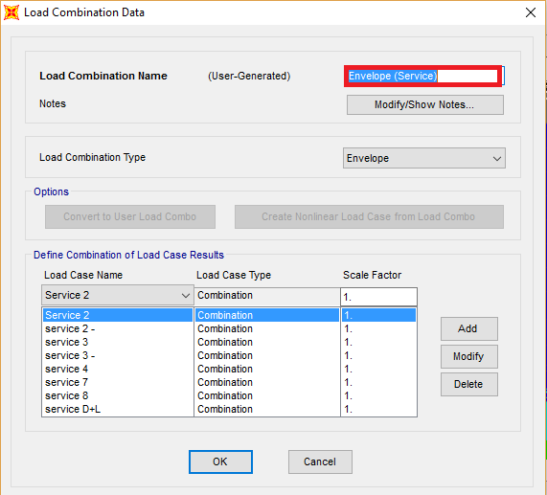
Ductility ”check story drift”

Slide 38
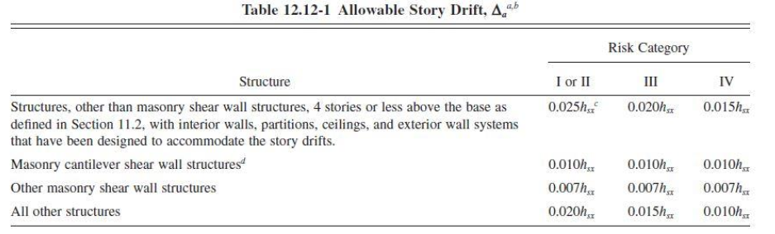

Ductility ”check story drift”
Limit= 0.02*3.1= 0.062 m= 62mm

Slide 39
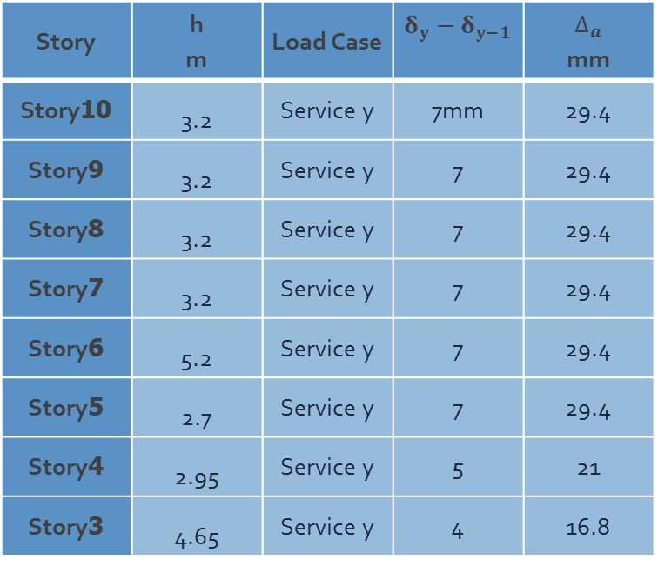
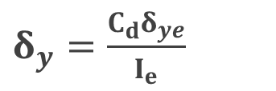


Ductility ”check story drift”
Story | h m | Load Case | $δ_{y}−δ_{y−1}$ | $$∆_{a}$$ mm
Story10 | 3.2 | Service y | 7mm | 29.4
Story9 | 3.2 | Service y | 7 | 29.4
Story8 | 3.2 | Service y | 7 | 29.4
Story7 | 3.2 | Service y | 7 | 29.4
Story6 | 5.2 | Service y | 7 | 29.4
Story5 | 2.7 | Service y | 7 | 29.4
Story4 | 2.95 | Service y | 5 | 21
Story3 | 4.65 | Service y | 4 | 16.8
$δ_{y}=\frac{C_{d}δ_{ye}}{I_{e}}$
Or by UBC = 0.7R*$∆_{a}$
$δ_{y}$ is less than allowable story drift, $∆_{a}$ = Ok
Story2 | 2.95 | Service y | 4 | 16.8
Story1 | 4.65 | Service y | 3 | 12.6

Slide 40
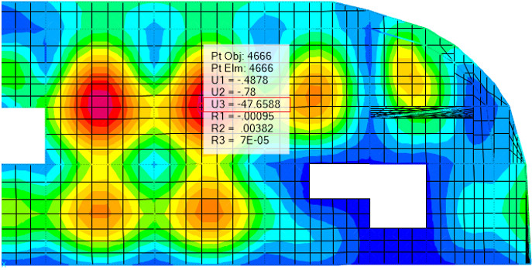
Long term deflection & Shear checks

Slide 41
Design

Slide 42
Slabs
Solid slabs were used in the floors (Basement to 3rd)
Ribbed slabs were used in the floors (4th to 10th)
Solid slab was used in the roof floor
Solid: 18 cm both one way and two way
ribbed: 25 cm both one way and two way

Slide 43

Design of slabs
Solid slabs:
Minimum steel = $4∅12$
It can resist 25.8 KN.m/m moment
So, for all panels have moment 25.8 or less, $4∅12$/m will be used

Slide 44
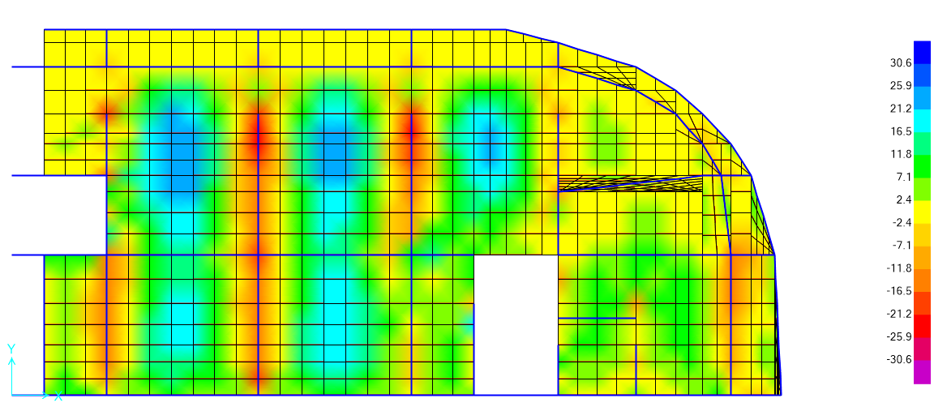
Design of slabs

Slide 45

Design of slabs
Ribbed slabs:
Minimum steel = $2∅12$
It can carry 16.8 KN.m/rib moment
So, for all panels have moment 16.8 or less, $2∅12$/m will be used

Slide 46
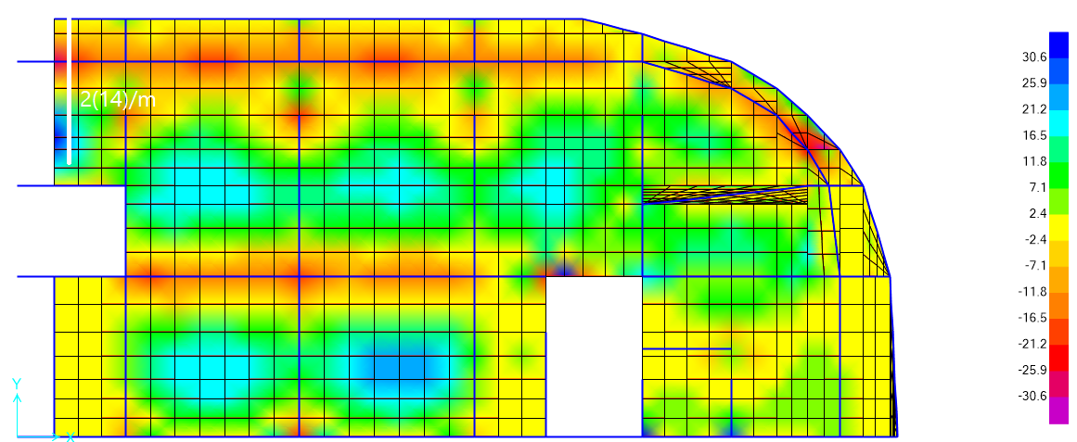
Design of slabs

Slide 47
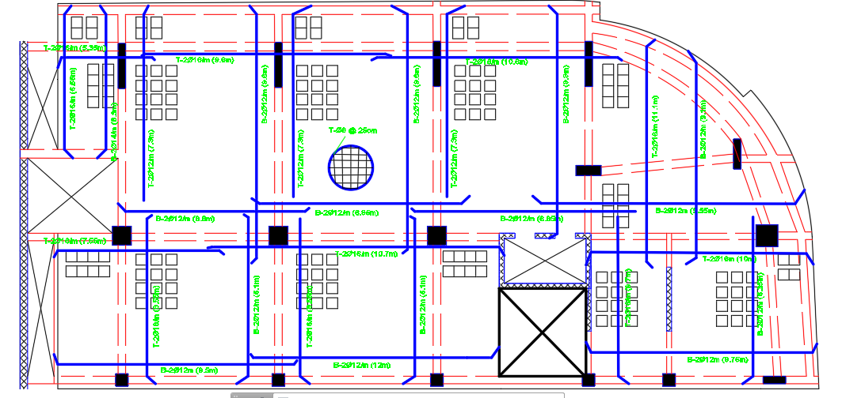
Ribbed slabs reinforcement

Slide 48


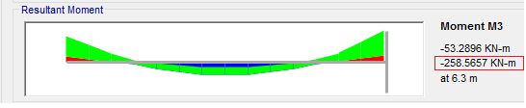
Design of Beams for flexure

Slide 49


Design of Beams for flexure
The error between sap design results
and hand calculations was ZERO

Slide 50

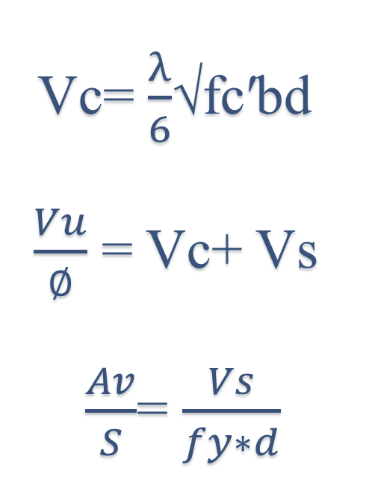
Design of Beams
for shear
Vc= $\frac{λ}{6}$√fc′bd
$\frac{Vu}{∅}$ = Vc+ Vs
$\frac{Av}{S}$= $\frac{Vs}{fy∗d}$
Error= ZERO %

Slide 51
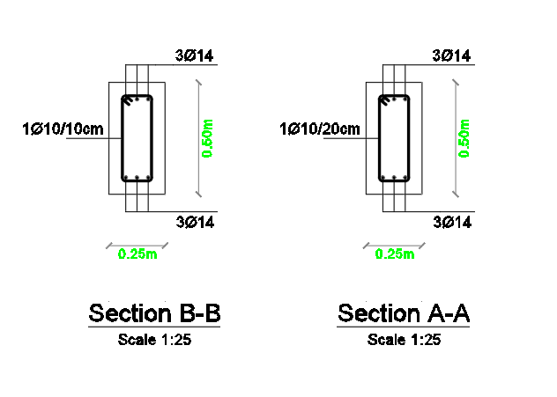
Design of Beams

Slide 52


Design of Columns

Slide 53

Design of shear walls

Slide 54


Slide 55


Slide 56

Design of shear walls

Slide 57

Stair Design

