Slide 1

An-Najah National University
Faculty of Engineering
Braille Printer
Prepared by :
Rbee waheeb
Supervisor:
Dr. Nidal Farahat
May- 2014

Slide 2
Content:
Introduction.
  General Description.
Mechanical Components .
Electrical Components .
Types of Solar Trackers.
Control System .
  Discussion & Conclusion .

Slide 3
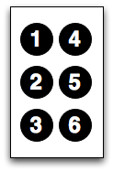
Introduction
Braille history .
  Braille symbols .

Slide 4
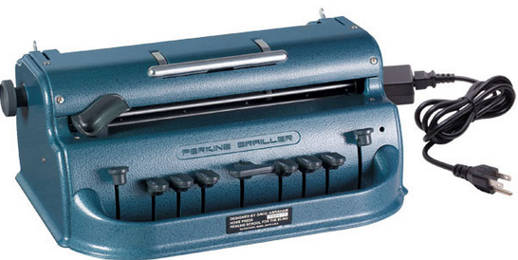
Tools used in Braille writing
Plastic Braille Panel:
b. Pocket Roller:
c. Braille pen :
d. Perkins manual printer

Slide 5
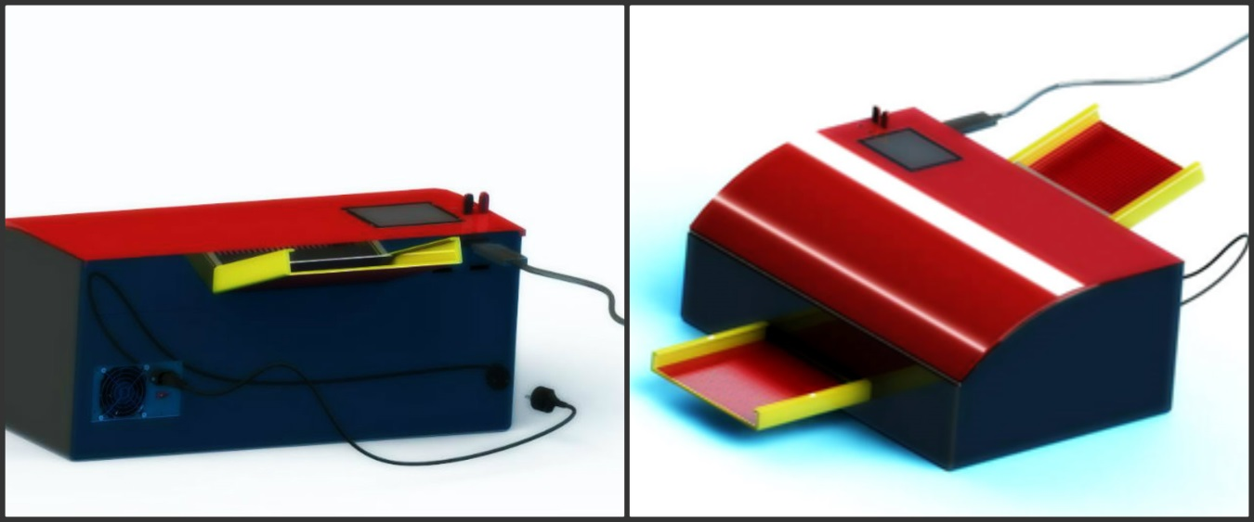
Mechanical components
Housing and paper feeder

Slide 6
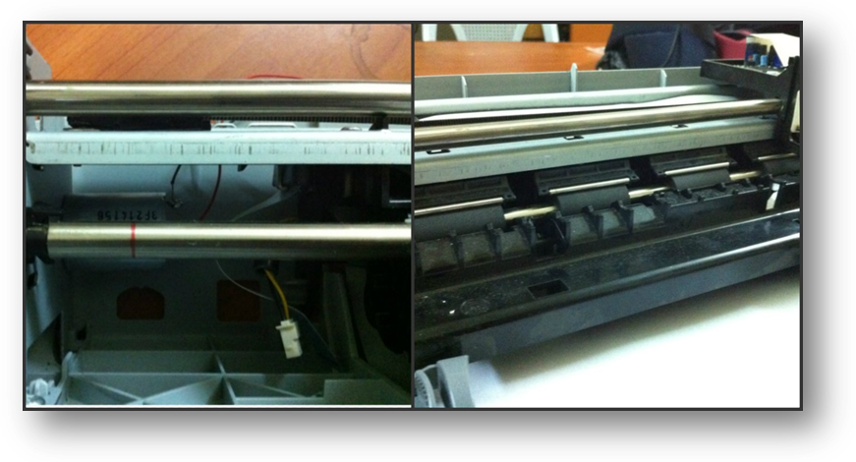
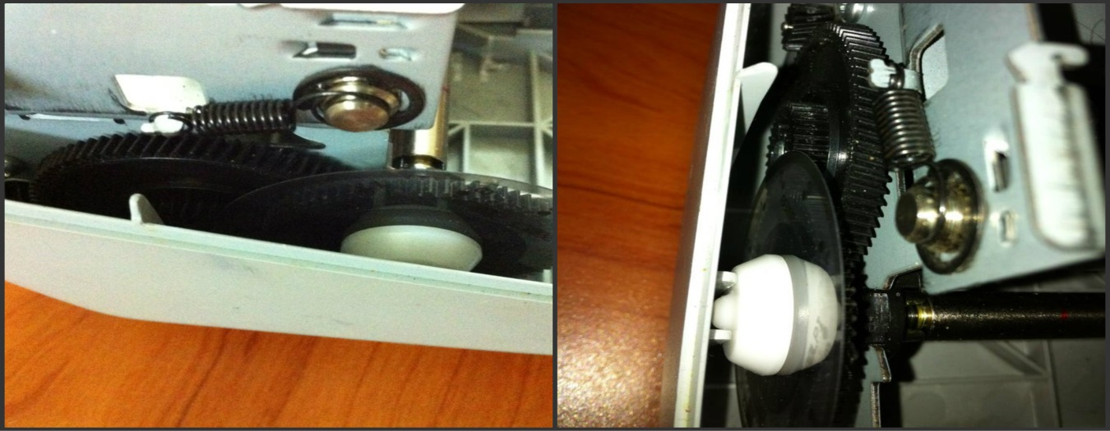
Rods
Gears

Slide 7
Electrical components
Universal Serial Bus (USB) Controller.
Touch screen.
Sensors.
Stepper and DC motors

Slide 8
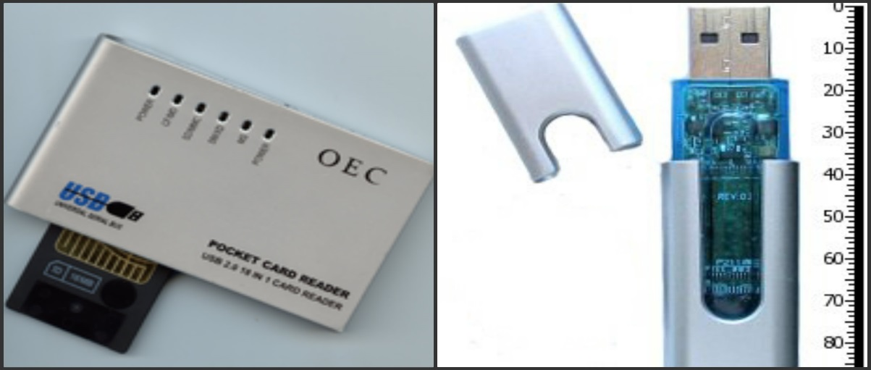
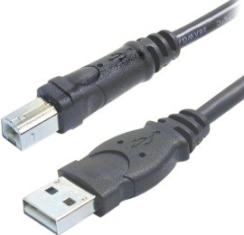
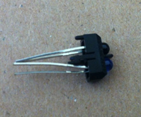

Slide 9
Control system
Controlling Device
Is an advanced microcontroller designed to make using electronics in projects more accessible by taking inputs from a variety of switches or sensors and controlling the physical outputs, using a specific programming language. In our project we are used Raspberry Pi, because it is the most practical controller
Get started with Raspberry Pi

Slide 10
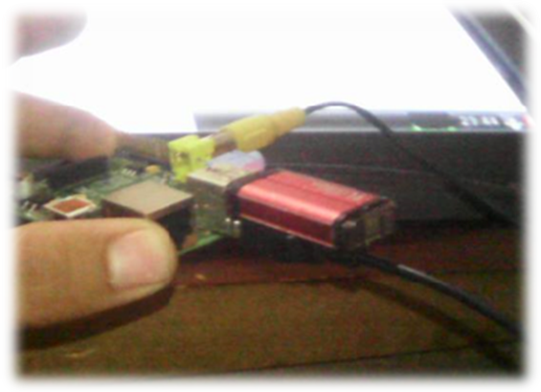
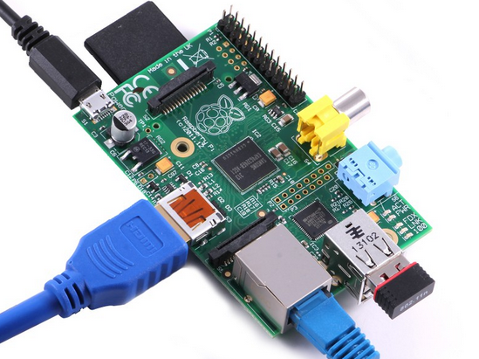

Slide 11
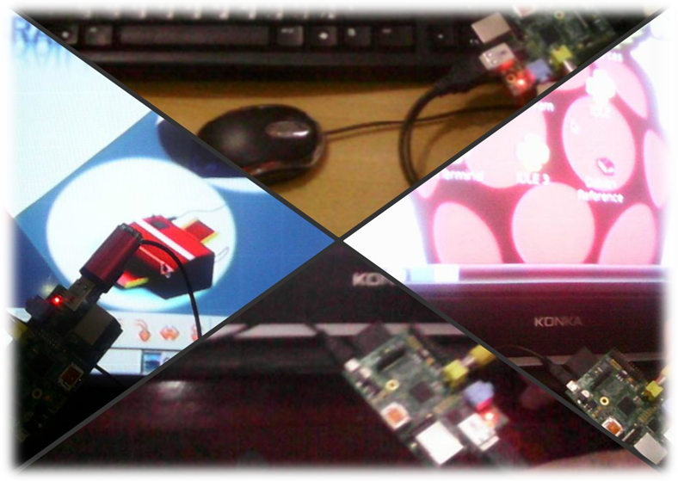
Raspberry Pi with serial connections:

Slide 12
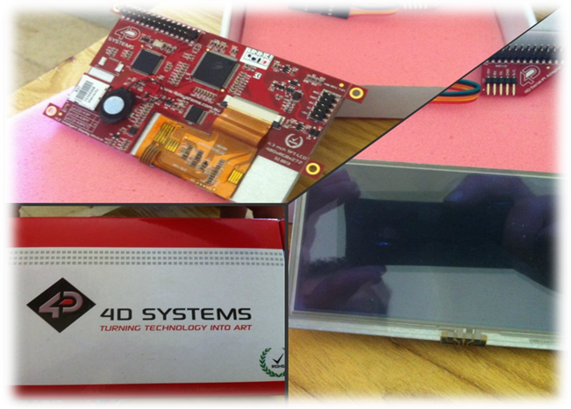
Raspberry Pi with Touch Screen:

Slide 13
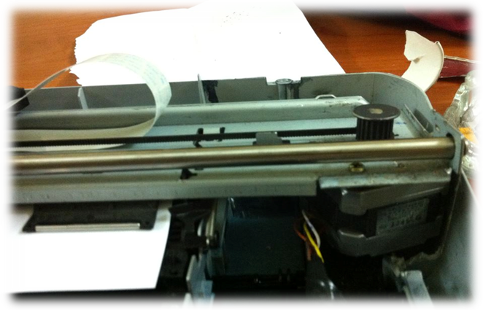
Printer with Motors:
One stepper motor is connected to the Raspberry Pi board, for controlling the movement of solenoid, and one DC motor for controlling the movement of paper.

Slide 14
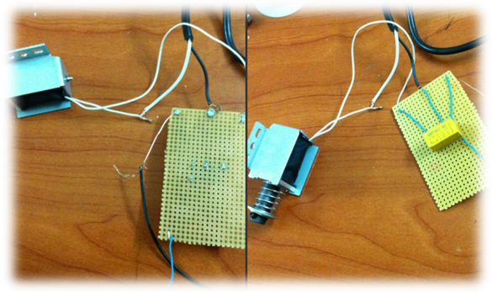
  Relay with Solenoid :
  When the software convert the files that will be printed to the Braille alphabets, they will be saved in a matrix of ones and zeroes, this matrix will send to the solenoid if the Raspberry Pi send zero, solenoid will not strike and if it send one the solenoid will strike to print a specific letter in Braille.

Slide 15
  Code in python
# get started with Raspberry Pi
import RPi.GPIO as GPIO
from time import sleep
from os.path import abspath, exists
GPIO.setmode(GPIO.BOARD)
GPIO.setmode(GPIO.BCM)
# Raspberry Pi bins connecting Dc motor
Motor1A = 16
Motor1B = 18
Motor1E = 22
# Raspberry Pi bins connecting Stepper motor
coil_A_1_pin = 17
coil_A_2_pin = 4
coil_B_1_pin = 10
coil_B_2_pin = 25
# Raspberry Pi bin connecting solenoid
soillnoid_pin = 26

Slide 16
# read lines until finish reading the file if exists(f_path): with open(filename) as f: counter=0 n=3 m=22 while True: c = f.read(1) counter=counter+1 if not c: print "End of file" break print "Read a character:", c

Slide 17
Discussion & Conclusion
Recognize the problem
The main problem that forces us to construct this project is the Difficulties for blind people to get information which increases their suffering in their studies and daily lives.

Slide 18
Advantages of Braille Printer:
1. Flexible, contains touch screen, enables instant printing using USB, SD card
2. You can add a mouse and keyboard easily
3. No need for setup programs
4. Deals with all documents(PDF, TXT, WORD)
5. Enable the connection between several devices
6. Enable the connection of Bluetooth and internet

Slide 19
Conclusion
In this project we made a plan of Braille printer that does not need any extra program that will be installed in computer and receive data from flash memories and computers too, the printer enable receiving files (Pdf ,text, and document) and convert it to Braille language by convert each letter or character to a specific movement of stepper motor

Slide 20
further study
In the future, we will work to make the printer smaller and easy for any person to get it.
We can also make the printing process more fast that will print a whole document such as the ordinary printer prints

Slide 21
Cost
This project is cost about 600 JD, Due to the prices of the components available in the market.

Slide 22
Thank You

