Slide 1
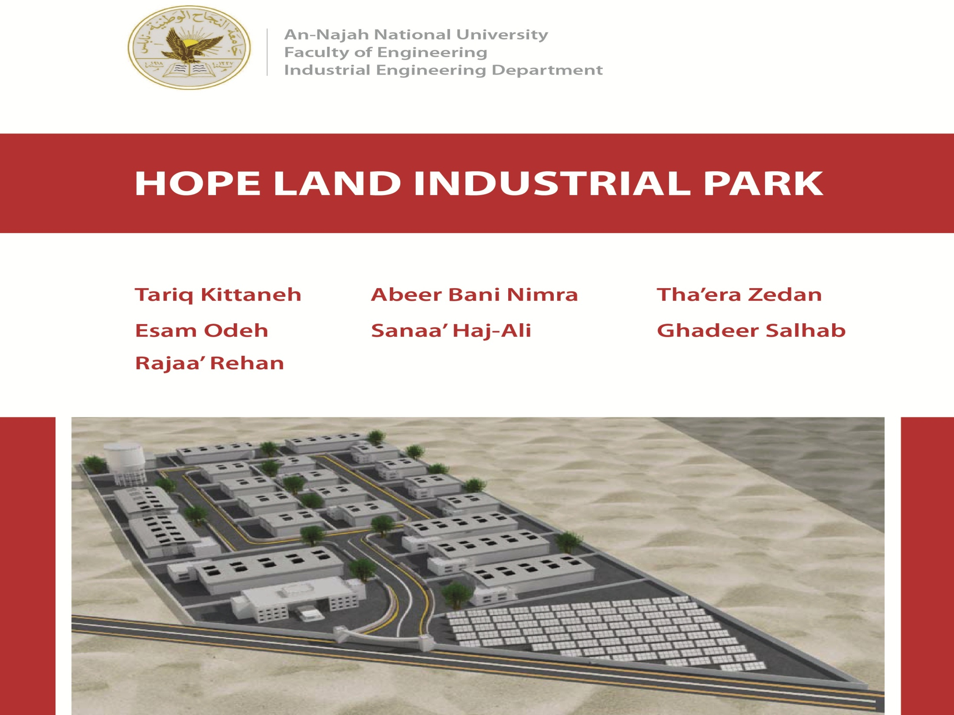


Slide 2
Contents
Objectives
Project Justifications & Economy Analysis
Site & Location Analysis
Introduction
Infrastructure Planning
Layout Planning
Recommendations

Slide 3
Objetives
Study and planning for the establishment of an industrial zone in the northern West Bank.
Studding the economic impact for the establishment of an industrial zone in this region.
Determine the best site for the establishment of an industrial zone in the northern West Bank
Infrastructure planning and Layout Planning for the site.

Slide 4

introduction

Slide 5
Definition of industrial park
Integration of different functions of research, production, education that take place in the particular industrial area.

Slide 6
Impact of Industrial Parks
Support employment growth.
Utilization and provision of infrastructure .
Provide convenient access for regional residents to industrial goods and services.

Slide 7
Impact of Industrial Parks
Encourage the clustering of industrial activities according to the principles of industrial .
Encourage the design and construction of industrial and commercial buildings.
Make provision for manufacturing, warehouse and transport land uses requiring large land.

Slide 8
Factors affecting the industrial areas
Physical Cost Factors
Proximity to raw material .
Human-based Cost Factors
Labor force characteristics:
Wages expected.
Training.
Benefits.
Availability.
Land .
Energy.

Slide 9
Government Policies Influence
Transportation.
Political occupation
Tax .
Environmental factor
Pollution.
Earthquake.

Slide 10
industrial Park in Palestine
Manufacturing industry
Extractive Industries
Traditional Industry
Palestinians Industries

Slide 11
Palestinian Industry Classification
Food industry, beverages and tobacco
Clothing and leather
The timber industry
Paper products
Chemical products
Manufacturing Nonmetallic
Metal products industry

Slide 12
Manufacturing Industry Sector:
Manufacturing industry refers to those industries which involve in the manufacturing and processing of items and indulge in either creation of new commodities or in value addition.
Th'era

Slide 13
development of the industrial sector
Building a modern and comprehensive marketing system
development of agricultural areas
The importance of manufacturing industry sector.
Development of national products
Improving the financial situation
Palestinian economy independency
Th'era

Slide 14
Characteristics of the Palestinian Industrial Sector
absence of diversity in industrial structure
The small size of industrial facilities
Low level of scientific workers.
Low participation of women in industrial activity.
Poor performance on exports.
absence of a clear weakness of the strategic planning and management
Raja’ Rehan

Slide 15
Palestinian industrial zones.
Industrial zone in Nablus
Industrial zone in Tulkarem
Industrial zone in Tarkomiah.
The industrial zone of Beitunia.
Bethlehem Industrial Park.
Jericho Agro-Industrial Park
Jenin Industrial Estate.
Gaza Industrial Estate.
Raja’ Rehan

Slide 16
Industrial Parks Studied
Jericho Agro-Industrial Park
( JAIP )
Hope land industrial park
(HLIP )
Raja’ Rehan

Slide 17
Confectioneries and sweets
Animal feeds industry
Dairies and milk products.
The Palestinian Processed Food Sector
Oils and ghee.
Meat processing.
Canned food.
Beverage soft drinks
Pasta and other grains products.
Snacks.
Raja’ Rehan

Slide 18
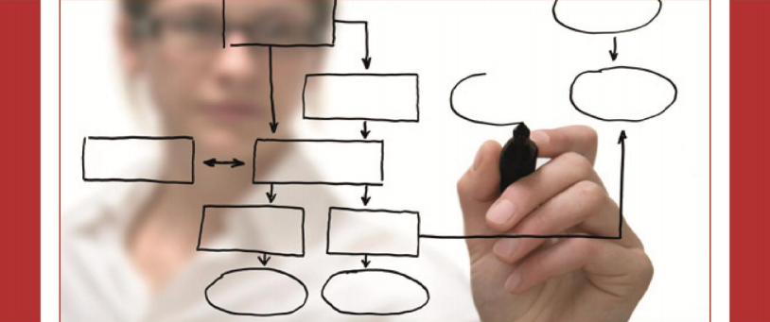
Methodology

Slide 19
Raja’ Rehan

Slide 20

HLIP Justification

Slide 21
Developing the National Economy
Increased income
Reduce unemployment
Increase the added value
promoting trade and creating job opportunities
Ghadeer Salhab

Slide 22
The creation of a national economy is far from Israel
Developing the agricultural sector
Increase the level of export of raw materials and products
Eliminate the restrictions on the agricultural development sector
Introduction the new technology
Improvement in agriculture
Promotion of agro-industry and enhancement of export competitiveness
Israeli policy
Ghadeer Salhab

Slide 23
HLIP Row Material
Main Row Material
field crops
fruit trees
Vegetables
The northern west bank raw material cannot cover production volume of HLIP so we need to Adapted from raw material from outside northern region.
Ghadeer Salhab

Slide 24
HLIP estimated to locate near row material resources
Higher quality goods
Lower cost transport
Improved handling
Improved market performance
Increase the added value
Ghadeer Salhab

Slide 25
Industry
In HLIP
Mining and business dealing with fresh vegetables and fruits (5%). quarrying
food processing industries (90%).
supporting services such as packaging and ice making industries(5%).
Ghadeer Salhab

Slide 26
The employment effect of HLIP
The Agro-industrial Park is expected to create about 7300 additional jobs in Palestine.
Direct and indirect employment in the Agro-industrial Park is expected to reduce the number unemployment ratio by 0.9%.
And outside the Agro-industrial Park is estimated to be USD 12.5million and USD 2.9 million per annum, respectively
Ghadeer Salhab

Slide 27
Technology in the Agro Industrial Park
Grinding Machines
Wash machines
Peeling machines
Packaging Machines
Drying machines
Filling Machines
Ghadeer Salhab

Slide 28

Economic outlook

Slide 29
Effect of HLIP on West Bank
Support the agriculture sector
Creating employment
Attracting foreign investment
Technology transfer
Develop the competitiveness of products
Support Palestinian economy
Sanaa Ali

Slide 30
Support the agriculture sector
Production volume of agriculture sector in Palestine is 414204 ton/year for 2006/2007
Production volume for HLIP was estimated to be 437600 ton/year
Sanaa Ali

Slide 31
Employment
HLHP is expected to offer about 7828 additional employment.
23.6% unemployed persons in west bank
23% unemployed persons.
Sanaa Ali

Slide 32
Attracting foreign investment
Attracting foreign investment

Slide 33
Examples of factors encouraging investment:
The availability of a broad package of tax breaks
Provide the infrastructure
Appropriate administrative structure
Government of qualified staff and collaborator.
International guarantees for investments.
Sanaa Ali

Slide 35
Technology transfer
Grinding machine
Packaging machine
Wash machine
Peeling machine
Cutting machine
drying machine
filling machine

Slide 36
Develop the competitiveness of products
transfer of modern technology
through improvement of the Palestinian’s fresh and processed products to achieve competitiveness in the export market.

Slide 37
Target Market for the Future

Slide 38
Support Palestinian economy
Value of Output within HLIP is 177.5 m USD/year
The added value generated from HLIP=113.5 m USD/year
Sanaa Ali

Slide 39
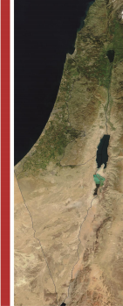
Site Analysis

Slide 40
Factors of Industrial Location Parks

Slide 41
Transportation
Climate
Labor
Factors
Tax Structure
Raw Material
Government Attitude
Markets
Utilities
Industrial site
Esam Odeh

Slide 42
Criteria for Site selection:
External Criteria.
Internal Criteria.

Slide 43
Accessibility (people and goods)
Infrastructure availability
Raw Material
External Criteria
Labors
End user market orientation
Functional relationship and integration
National development policy context
Environmental impacts
Security concerns

Slide 44
Suitability of terrain – slope, shape, configuration
Initial and long-term availability of services
Site area and potential for expansion
Internal Criteria
Land ownership and availability
Environmental impacts

Slide 45
Identification of Sites
Identify our study scope(West Bank northern).
Agro-Industrial Park(suggestion).
Suggestions from PIEFZA.
Studying maps.
Studying previous work.
Suggestions from Ministries.
Meetings with several experts in this field.

Slide 46
Location | Name | Symbol
South of Jericho | JAIP | S1
West of Nablus | Der Sharaf | S2
South of Tulkarm | Al Kafriyat | S3
North of Tubas | Tubas | S4
North of Tulkarm | Sha’rawia | S5
South of Jenin | Sanour | S6

Slide 47
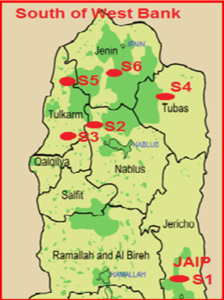

Slide 48
Suitability of terrain – slope, shape, configuration
End user market orientation
Functional relationship and integration
5
5
5
Site area and potential for expansion
JAIP
(S1)
Infrastructure availability
5
5
Land ownership and availability
Accessibility
5
4
5.19
Environmental impacts
Environmental impacts
4
5
Security concerns
Labor Force
5
3
Initial and long-term availability of services
5
National
development
policy context
Raw Material
5
5
Esam Odeh

Slide 49
Suitability of terrain – slope, shape, configuration
End user market orientation
Functional relationship and integration
5
4
5
Site area and potential for expansion
Der Sharaf
(S2)
Infrastructure availability
5
5
Land ownership and availability
Accessibility
5
5
5.28
Environmental impacts
Environmental impacts
5
4
Security concerns
Labor Force
5
5
Initial and long-term availability of services
4
National
development
policy context
Raw Material
5
4
Esam Odeh

Slide 50
Suitability of terrain – slope, shape, configuration
End user market orientation
Functional relationship and integration
3
4
5
Site area and potential for expansion
Alkafreyat
(S3)
Infrastructure availability
5
4
Land ownership and availability
Accessibility
3
5
4.38
Environmental impacts
Environmental impacts
3
4
Security concerns
Labor Force
5
4
Initial and long-term availability of services
4
National
development
policy context
Raw Material
4
3
Esam Odeh

Slide 51
Suitability of terrain – slope, shape, configuration
End user market orientation
Functional relationship and integration
5
4
3
Site area and potential for expansion
Tubas
(S4)
Infrastructure availability
4
5
Land ownership and availability
Accessibility
4
4
4.58
Environmental impacts
Environmental impacts
4
4
Security concerns
Labor Force
5
4
Initial and long-term availability of services
4
National
development
policy context
Raw Material
5
3

Slide 52
Suitability of terrain – slope, shape, configuration
End user market orientation
Functional relationship and integration
3
3
4
Site area and potential for expansion
Sha’rawia
(S5)
Infrastructure availability
4
5
Land ownership and availability
Accessibility
4
3
4.26
Environmental impacts
Environmental impacts
3
4
Security concerns
Labor Force
5
4
Initial and long-term availability of services
4
National
development
policy context
Raw Material
5
4

Slide 53
Total Score | WEIGHTED AVERAGES |  | Sites
 | Internal Criteria | External Criteria
5.19 | 2.38 | 2.81 | JAIP (S1)
5.28 | 2.43 | 2.85 | Der Sharaf (S2)
4.38 | 2.07 | 2.31 | Al Kafriyat (S3)
4.58 | 2.12 | 2.46 | Tubas (S4)
4.26 | 1.76 | 2.5 | Sha’rawia (S5)
4.02 | 1.88 | 2.14 | Sanour (S6)

Slide 54
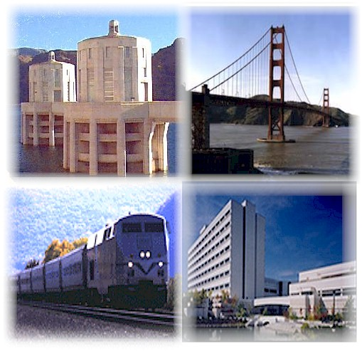
Infrastructure
Abeer Bani Nimra

Slide 55
Table of Contents
1
2
Infrastructure and Layout Planning of JAIP(Case Study)
3
HLIP Infrastructure Planning
Introduction
Abeer Bani Nimra

Slide 56

Introduction
Definition of Infrastructure
Local Infrastructure in Palestine
Standard Infrastructure in Palestine

Slide 57
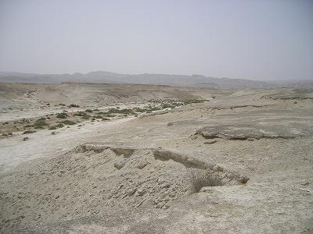
Infrastructure and Layout Planning of JAIP(Case Study)
Abeer Bani Nimra

Slide 58
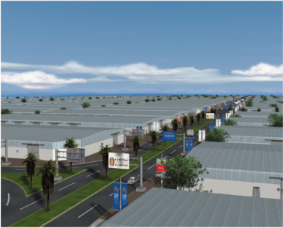
HLIP Infrastructure Planning
Abeer Bani Nimra

Slide 59
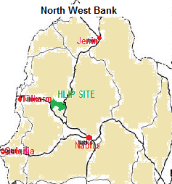
HLIP Site
Abeer Bani Nimra

Slide 60
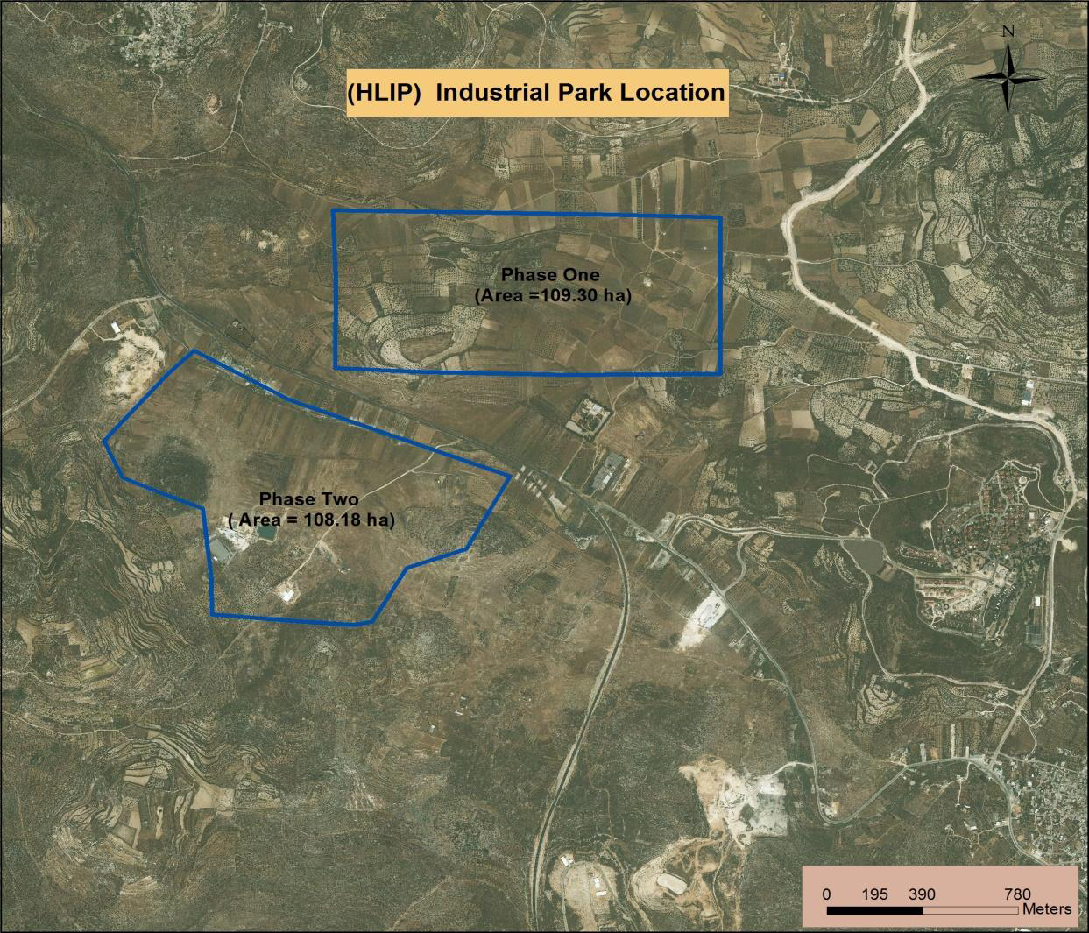
Project Phases & Land Segments Land Ownership
Abeer Bani Nimra

Slide 61
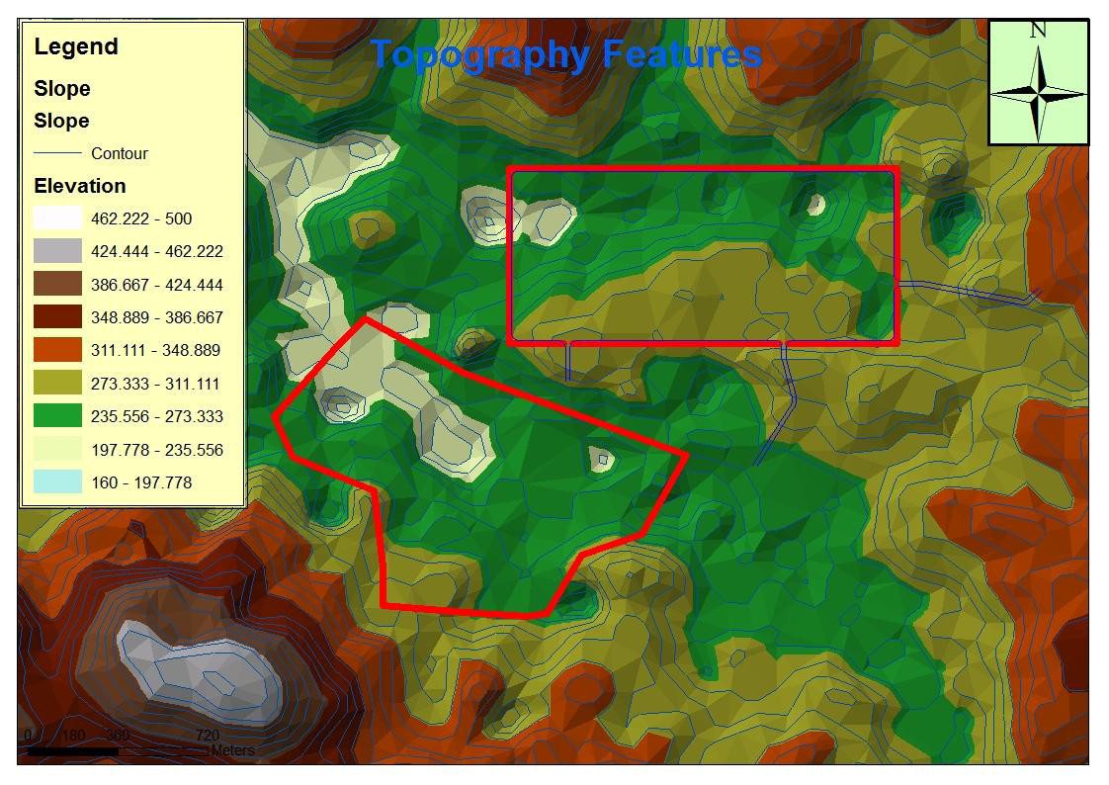
1.2 Topography and Geology and Climate

Slide 62
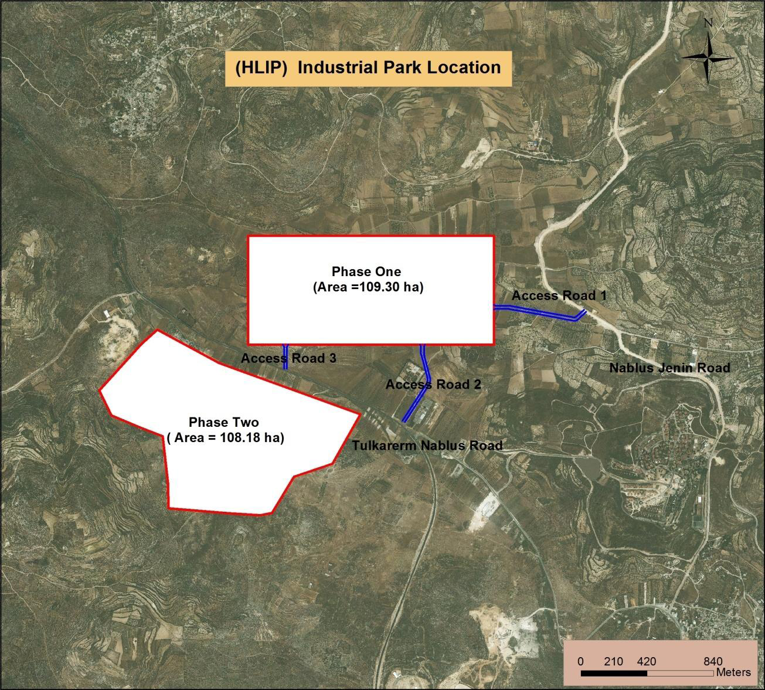
1.4 Accessibility
Abeer Bani Nimra

Slide 63

Number of Employees of factories = Floor area x 200 person/ha = 5465 person
Total Number of Employees in HLIP =
7828 person
Production Volume = No. of employees x 80ton/ person/ year = 437200 ton /year
Abeer Bani Nimra

Slide 64
HLIP Infrastructure
Off-site Infrastructure
On-site Infrastructure
Abeer Bani Nimra

Slide 65
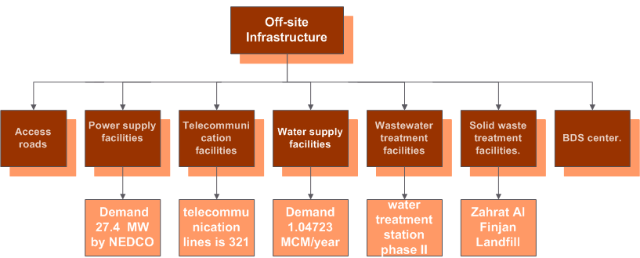

Slide 66
Bus stations & storage areas
Land Reclamation
Internal roads
Bus stations & storage areas
Sewage channel
Distribution and storage areas
On-site
Infrastructure
Power distribution facilities
Buildings
Banks and financial institutions
Telecommunication distribution
facilities
QD & BDS centers
Security facilities
Wastewater collection facilities
Water distribution facilities

Slide 67
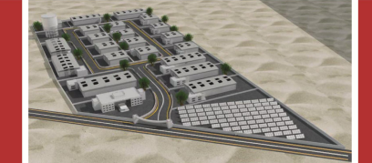
Layout Planning

Slide 68
Layout Planning
Layout Planning: Identify the best distribution of the site items with the best utilization of the land.
Good picture project
Land Utilization
Facilitation of traffic flow
Effective Configuration
Tariq Kittaneh

Slide 69
Layout Planning processes
Land Use Area
Layout Item
(On-Site Items)
Layout Criteria
Distribution and Arrangement of Items
Ranking
&
Results
Layout Plan
Tariq Kittaneh

Slide 70
Layout Planning Criteria
Percentage of Each Factory Categories
0.22
Availability of entrances & exists
0.1
Locations of main exits
0.20
Density of green areas
0.05
Distribution of services.
0.15
Mobility between related items
0.15
Configuration of factories inside sections.
0.08
Locations of workers dorms.
0.05
Tariq Kittaneh

Slide 71
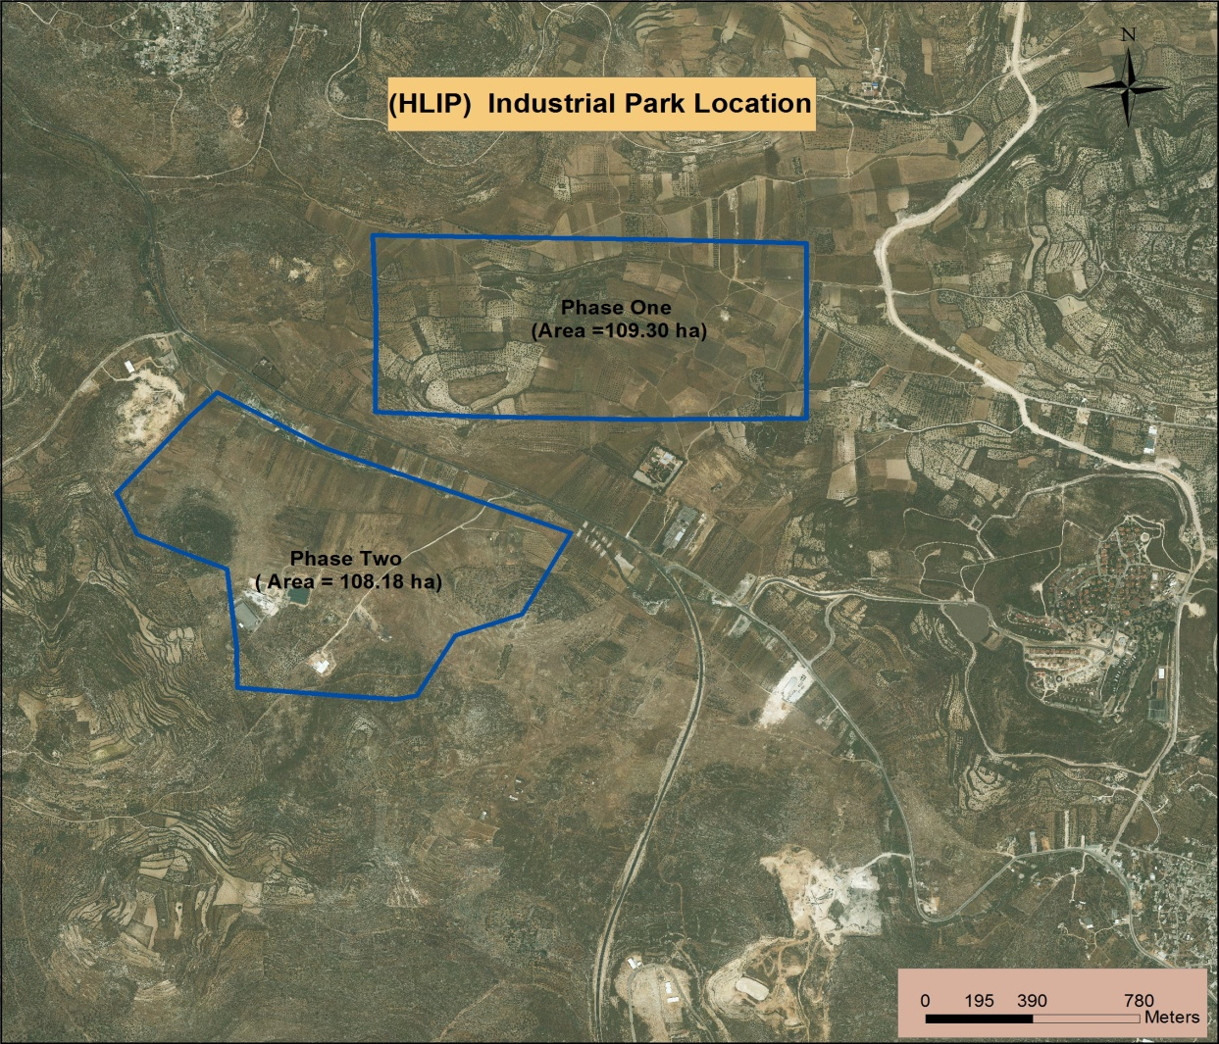
Site Area
1093 Donom
Factories
Office Building
Distribution Area
Green Area
Storage Area
marketing centers
Common Utility
Park Area
Police & Health
Bus Station
Parking
Internal Road
Banks
Others
Tariq Kittaneh

Slide 73
Industries Area

Slide 74
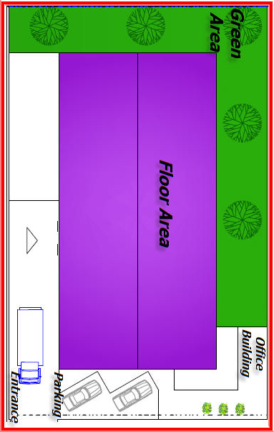
Factories buildings
A
1 Donom
B
2 Donom
C
3 Donom
D
4 Donom
E
5 Donom
Tariq Kittaneh

Slide 75
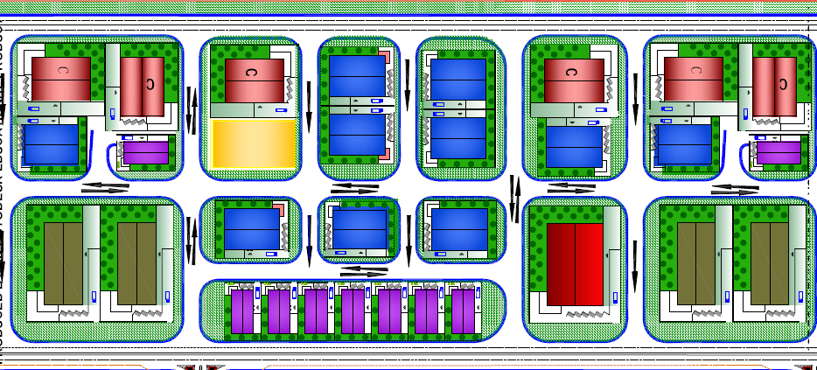
Factory blocks configuration inside a section

Slide 76
Central services area

Slide 77
Central Area
Administration
BDS Center
QD Center
Distribution
Mosque
Marketing Centers
Police & Civil Defense
Park Area
Bus Station & Parking
Tariq Kittaneh

Slide 78
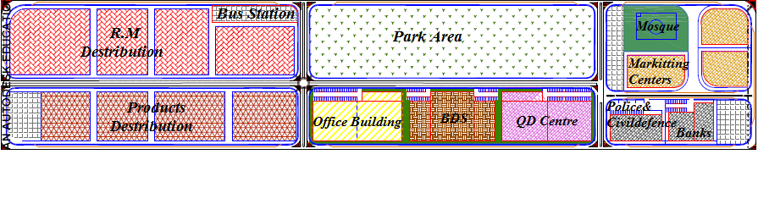
Central Area Plan
Tariq Kittaneh

Slide 79
Internal Roads
Tariq Kittaneh

Slide 80
Final Layout Plan

Slide 81
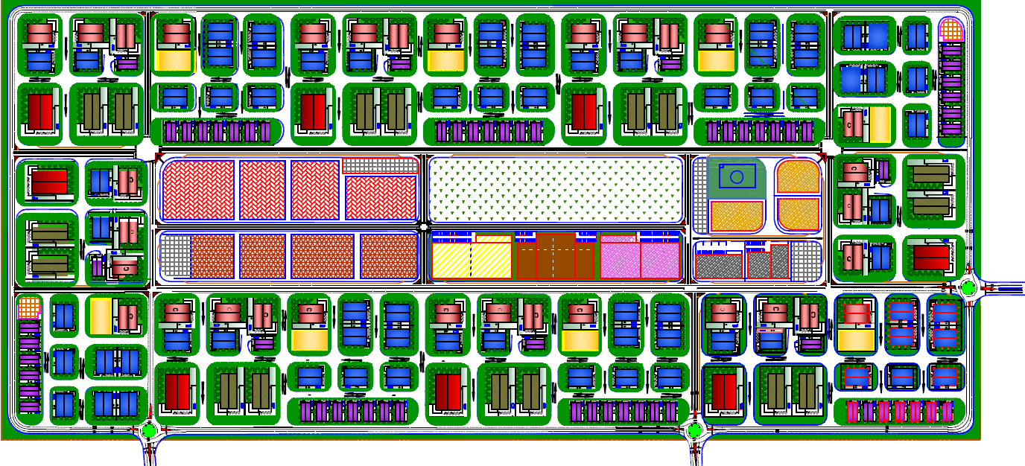

Slide 82

Ranking & Results
Criteria | Weight | Score | Compound Score
Mobility between related items. | 0.15 | 4 | 0.6
Availability of Entrances & Exists for the Factories | 0.1 | 4.5 | 0.45
Percentage of Each Factory Categories. | 0.22 | 3.8 | 0.836
Distribution of Services & Amenities | 0.15 | 3.5 | 0.7
Density of Green Areas | 0.05 | 4 | 0.4
Locations of Workers dorms. | 0.05 | 3.6 | 0.18
Locations of Main Exits. | 0.20 | 3.4 | 0.17
Configuration of Factories Inside Sections. | 0.08 | 4.4 | 0.352
Total | 1 |  | 3.823

Slide 83

Recommendations

Slide 84
Local markets should be encouraged to support the local products.
Develop programs aiming to motivated Palestinian manufacturers to apply Quality Control Standards and Quality Systems.
Work to facilitate the export of Palestinian products on international markets
The development of the Palestinian industrial sector, and increased efforts to establish industrial cities to create a strong and effective national economy.
Provide programs to encourage investment and facilitate the work procedures and laws at the national industries, and reduce taxes on national products.
Tariq Kittaneh

Slide 85
Not to uproot olive trees when implementing such projects.
The development of strategic planning to resist the growth of Jewish settlements in Palestinian areas.
Concern for the exploitation of natural resources available.
The development of the agricultural sector through the development of industries.
Tariq Kittaneh

Slide 86
Thank you for
listening

