Slide 1
New Approach of Implementing STBC Technique for MIMO system and MIMO-OFDM Channel Estimation
Prepared by: Duaa Waleed
Rawya Deriah
Walaa Hammoudeh
Supervisor: Dr. Yousef Dama

Slide 2
Outline
OFDM Channel estimation
  LS and MMSE
MIMO-OFDM channel estimation
  Weiner and Orthogonal Training Sequence
QO-STBC and DHSTBC over OFDM for four, eight and sixteen transmitter antenna

Slide 3
Channel Estimation
It provides information about distortion of the transmission signal when it propagates through the channel.
Types of Channel Estimation
Non-Data-Aided
Data-Aided

Slide 4
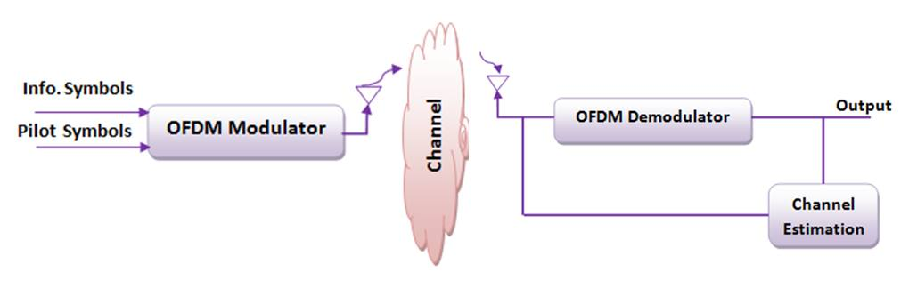
OFDM channel estimation

Slide 5
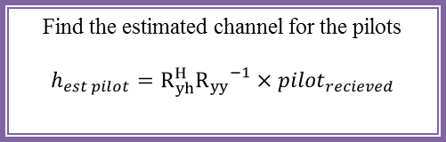
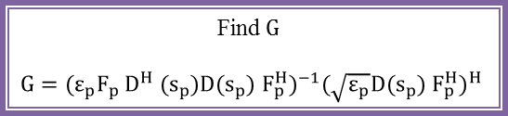
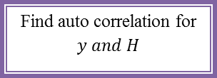
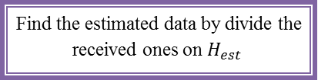
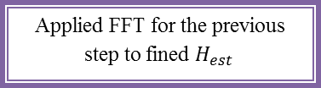
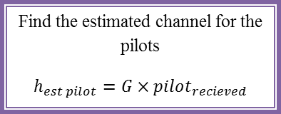
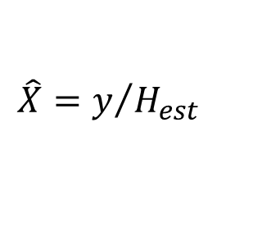
MMSE Estimator
LS Estimator
Channel Estimation
Find the noise variance
Find$G$
$$G={(ε_{p}F_{p }D^{H} (s_{p}){D(s_{p}) F}_{p}^{H})}^{−1}{(\sqrt{ε_{p}}{D(s_{p}) F}_{p}^{H})}^{H}$$
Find auto correlation for $y and H$
Find the estimated channel for the pilots
$$h_{est pilot}=G×pilot_{recieved}$$
Find cross correlation
Applied FFT for the previous step to fined $H_{est }$
Find the estimated channel for the pilots
$$h_{est pilot}=R_{yh}^{H}{R_{yy}}^{−1}×pilot_{recieved}$$
$$\hat{X}=y/{H_{est}}$$
Find the estimated data by divide the received ones on $H_{est }$
To be Count.

Slide 6
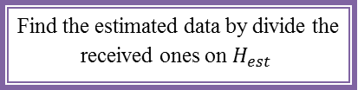

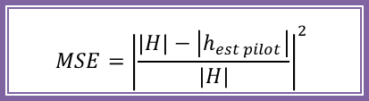
Find the estimated data by divide the received ones on $H_{est }$
$$MSE={\left|\frac{H_{est }}{H}\right|}^{2}$$
$$MSE={\left|\frac{\left|H\right|−\left|h_{est pilot}\right|}{\left|H\right|}\right|}^{2}$$
End

Slide 7
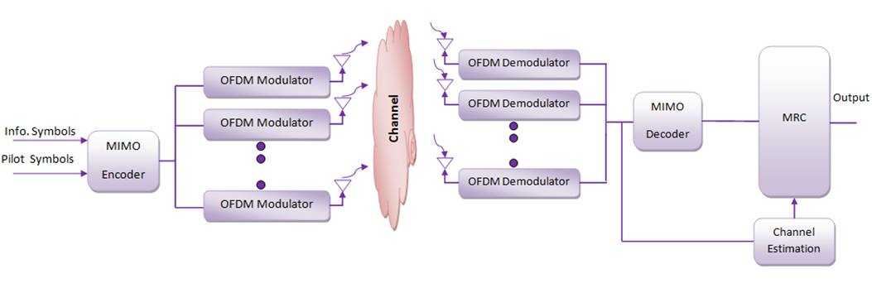
MIMO-OFDM Channel estimation

Slide 8
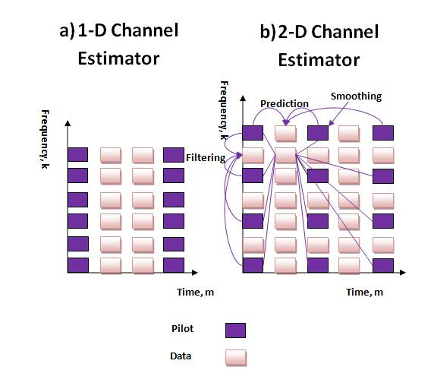
1-D and 2-D channel estimation.

Slide 9
Methods for Channel Estimation In MIMO-OFDM
Channel Estimation
Wiener channel estimation
Orthogonal training sequence

Slide 10
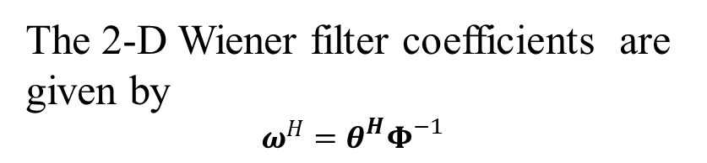
Wiener
Generate some random data and pilots
Find the auto correlation matrix
Stack the pilots indices down the frequency index first then across time index
Initial channel estimate at the pilot symbol
Calculate wiener filter coefficients
FFT for the Channel Gain
Calculate the channel estimate at the data location
Add noise to the received symbols
The 2-D Wiener filter coefficients are given by
$$ω^{H}=θ^{H}Φ^{−1}$$
Find the correlation matrix

Slide 11
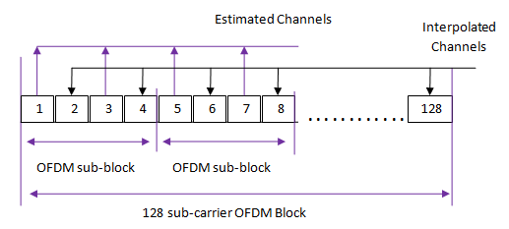
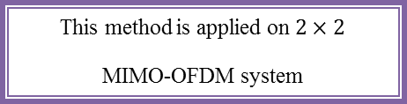
Orthogonal training sequence
This method is applied on $2×2$
MIMO-OFDM system
Estimate channel at each orthogonal training symbol indices
Generate the data, then split the data into two antennas
Interpolation to estimate the channel at data indices
OFDM modulation
OFDM Demodulation
Generate orthogonal training sequence, sort them in odd indices, and in even indices put the data
Receive data and orthogonal training sequence at receiver side

Slide 12
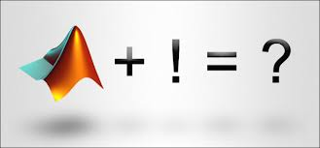
Result of Channel Estimation

Slide 13
OFDM Channel Estimation

Slide 14
Wiener Filter Channel Estimation

Slide 15
Orthogonal Training Sequence
Channel Estimation

Slide 16
Orthogonal Training Sequence
Channel Estimation

Slide 17
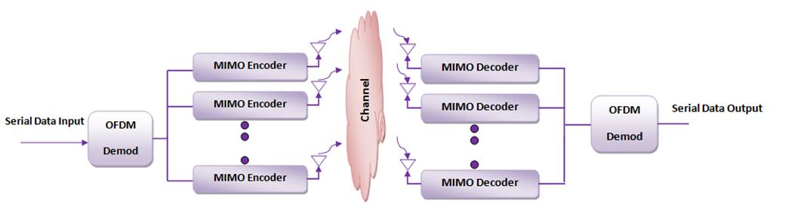
QO-STBC and DHSTBC

Slide 18
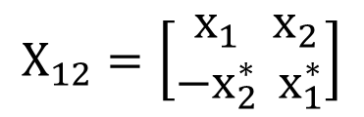

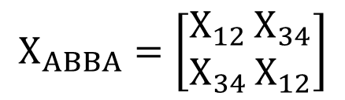
QO-STBC over OFDM for 4,8and 16 transmitter antennas
The encoding matrix for two (2 × 2) Alamouti codes are
$X_{34}=\left[\begin{aligned}x_{3} \\ {−x}_{4}^{∗}\end{aligned}\right.\left.\begin{aligned}x_{4} \\ { x}_{3}^{∗}\end{aligned}\right]$
to form
$$X_{12}=\left[\begin{aligned}x_{1} \\ {−x}_{2}^{∗}\end{aligned}\right.\left.\begin{aligned}x_{2} \\ { x}_{1}^{∗}\end{aligned}\right]$$
$$X_{ABBA}=\left[\begin{aligned}X_{12} \\ X_{34}\end{aligned}\right.\left.\begin{aligned}X_{34} \\ X_{12}\end{aligned}\right]$$

Slide 19
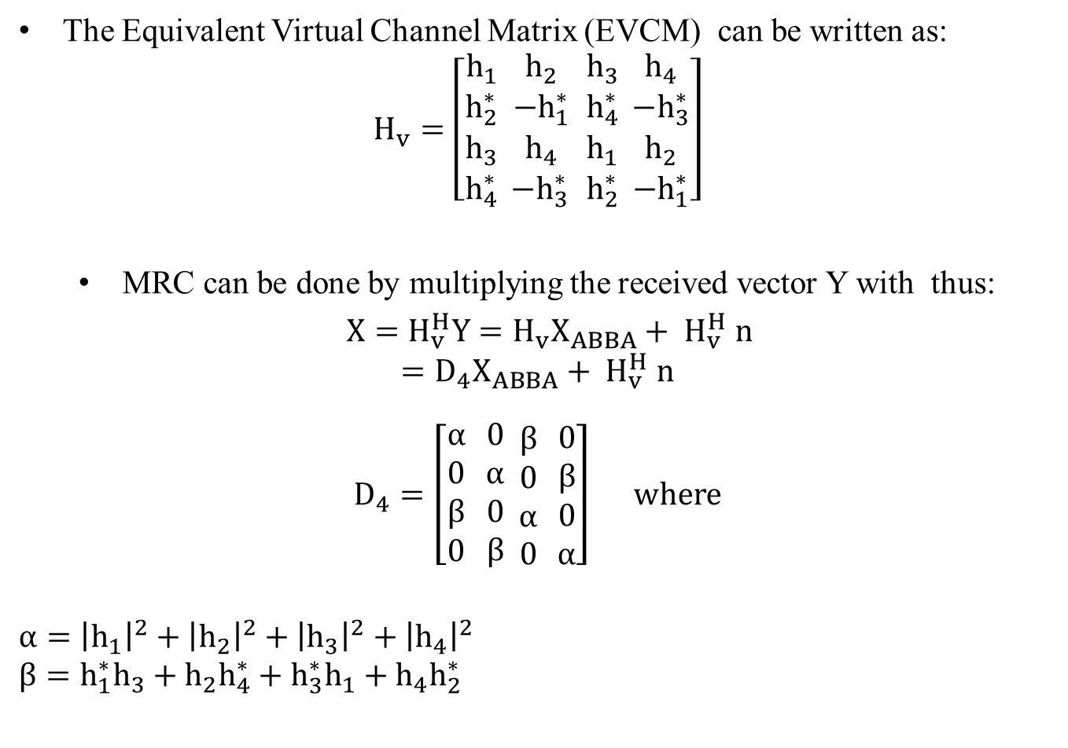
QO-STBC over OFDM, Cont…
The Equivalent Virtual Channel Matrix (EVCM) can be written as:
$$H_{v}=\left[\begin{aligned}h_{1} \\ h_{2}^{∗} \\ h_{3} \\ h_{4}^{∗}\end{aligned}\right. \begin{aligned}h_{2} \\ {−h}_{1}^{∗} \\ h_{4} \\ {−h}_{3}^{∗ }\end{aligned} \begin{aligned}h_{3} \\ h_{4}^{∗} \\ h_{1} \\ h_{2}^{∗}\end{aligned} \left.\begin{aligned}h_{4} \\ {−h}_{3}^{∗} \\ h_{2} \\ −h_{1}^{∗}\end{aligned}\right]$$
MRC can be done by multiplying the received vector Y with thus:
$X=H_{v}^{H}Y=H_{v}X_{ABBA}+ H_{v}^{H} n$
$$=D_{4}X_{ABBA}+ H_{v}^{H} n$$
$D_{4}=\left[\begin{aligned}α \\ 0 \\ β \\ 0\end{aligned} \right.\begin{aligned}0 \\ α \\ 0 \\ β\end{aligned} \begin{aligned}β \\ 0 \\ α \\ 0\end{aligned}\left. \begin{aligned}0 \\ β \\ 0 \\ α\end{aligned}\right]$ where
$$α={\left|h_{1}\right|}^{2}+{\left|h_{2}\right|}^{2}+{\left|h_{3}\right|}^{2}+{\left|h_{4}\right|}^{2}$$
$$β=h_{1}^{∗}h_{3}+{h_{2}h}_{4}^{∗}+h_{3}^{∗}h_{1}+{h_{4}h}_{2}^{∗}$$

Slide 20
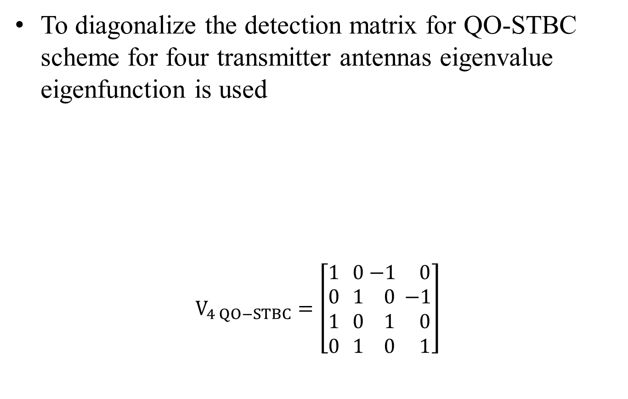
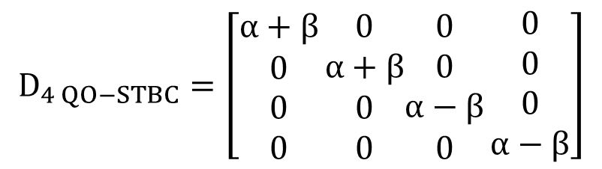
QO-STBC over OFDM, Cont…
To diagonalize the detection matrix for QO-STBC scheme for four transmitter antennas eigenvalue eigenfunction is used
$$V_{4 QO−STBC}=\left[\begin{aligned}1 \\ 0 \\ 1 \\ 0\end{aligned}\right. \begin{aligned}0 \\ 1 \\ 0 \\ 1\end{aligned} \begin{aligned}−1 \\ 0 \\ 1 \\ 0\end{aligned} \left.\begin{aligned} 0 \\ −1 \\ 0 \\ 1\end{aligned}\right]$$
$$D_{4 QO−STBC}=\left[\begin{aligned}α+β \\ 0 \\ 0 \\ 0\end{aligned}\right.\begin{aligned}0 \\ α+β \\ 0 \\ 0\end{aligned}\begin{aligned}0 \\ 0 \\ α−β \\ 0\end{aligned}\left.\begin{aligned}0 \\ 0 \\ 0 \\ α−β\end{aligned}\right]$$

Slide 21
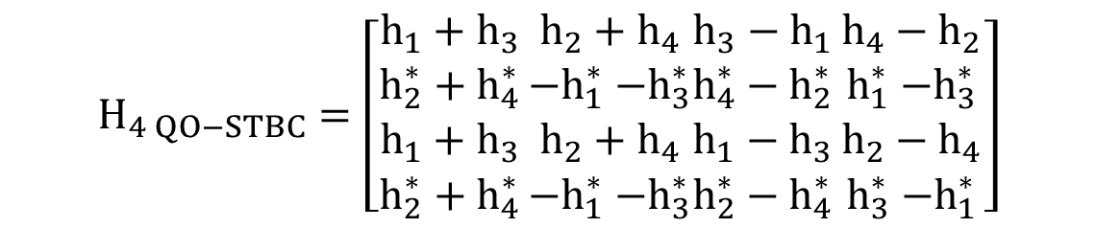
QO-STBC over OFDM, Cont…
A new channel matrix can be defined as:
$$H_{4 QO−STBC}=H_{v}V_{4 QO−STBC}$$
$$H_{4 QO−STBC}=\left[\begin{aligned}h_{1}+h_{3} \\ h_{2}^{∗}+h_{4}^{∗} \\ h_{1}+h_{3} \\ h_{2}^{∗}+h_{4}^{∗}\end{aligned}\right.\begin{aligned}h_{2}+h_{4} \\ {−h}_{1}^{∗}{−h}_{3}^{∗} \\ h_{2}+h_{4} \\ {−h}_{1}^{∗}{−h}_{3}^{∗}\end{aligned}\begin{aligned}h_{3}−h_{1} \\ h_{4}^{∗}−h_{2}^{∗} \\ h_{1}−h_{3} \\ h_{2}^{∗}−h_{4}^{∗}\end{aligned}\left.\begin{aligned}h_{4}−h_{2} \\ h_{1}^{∗}{−h}_{3}^{∗} \\ h_{2}−h_{4} \\ h_{3}^{∗}{−h}_{1}^{∗}\end{aligned}\right]$$

Slide 22


DHSTBC over OFDM for 4,8 and 16 Transmit Antennas
The transmitted symbols are sorted to form a cyclic matrices which are $S_{4}$ , $S_{8}$ and $S_{16}$
The Hadamard matix of order four
$$S_{12}=\left[\begin{aligned}s_{1} \\ s_{2}\end{aligned}\right.\left. \begin{aligned}s_{2} \\ s_{1}\end{aligned}\right] { S}_{34}=\left[\begin{aligned}s_{3} \\ s_{4}\end{aligned}\right.\left. \begin{aligned}s_{4} \\ s_{3}\end{aligned}\right] S_{5}=\left[\begin{matrix}S_{56} & S_{78} \\ S_{78} & S_{56}\end{matrix}\right]$$
$S_{4}=\left[\begin{matrix}S_{12} & S_{34} \\ S_{34} & S_{12}\end{matrix}\right]$ $S_{8}=\left[\begin{matrix}S_{4} & S_{5} \\ S_{5} & S_{4}\end{matrix}\right]$
$$H_{4}=\left[\begin{aligned}1 \\ 1 \\ 1 \\ 1\end{aligned}\right.\begin{aligned}1 \\ −1 \\ 1 \\ −1\end{aligned}\begin{aligned}1 \\ 1 \\ −1 \\ −1\end{aligned}\left.\begin{aligned} 1 \\ −1 \\ −1 \\ 1\end{aligned}\right]$$

Slide 23

The resultant matrix is a DHSTBC over OFDM and hence, the overall expression is given by
$$X=H.S$$
$$X_{4}=\left[\begin{aligned}s_{1}+s_{2}+s_{3}+s_{4} \\ s_{1}−s_{2}+s_{3}−s_{4} \\ s_{1}+s_{2}−s_{3}−s_{4} \\ s_{1}−s_{2}−s_{3}+s_{4}\end{aligned}\right.\begin{aligned}s_{1}+s_{2}+s_{3}+s_{4} \\ s_{2}−s_{1}+s_{4}−s_{3} \\ s_{1}+s_{2}−s_{3}−s_{4} \\ s_{2}−s_{1}−s_{4}+s_{3}\end{aligned}\begin{aligned}s_{1}+s_{2}+s_{3}+s_{4} \\ s_{1}−s_{2}+s_{3}−s_{4} \\ s_{3}+s_{4}−s_{1}−s_{2} \\ s_{2}−s_{1}−s_{4}+s_{3}\end{aligned}\left.\begin{aligned}s_{1}+s_{2}+s_{3}+s_{4} \\ s_{2}−s_{1}+s_{4}−s_{3} \\ s_{3}+s_{4}−s_{1}−s_{2} \\ s_{1}−s_{2}−s_{3}+s_4\end{aligned}\right]$$
$$X_{4}X_{4}^{H}$$
$$=\left[\begin{aligned}4(x_{1}+x_{2}+x_{3}+x_{4}) \\ 0 \\ 0 \\ 0\end{aligned}\right.\begin{aligned}0 \\ 4(x_{1}−x_{2}+x_{3}−x_{4}) \\ 0 \\ 0\end{aligned}\begin{aligned}0 \\ 0 \\ 4(x_{1}+x_{2}−x_{3}−x_{4}) \\ 0\end{aligned}\left.\begin{aligned}0 \\ 0 \\ 0 \\ 4(x_{1}−x_{2}−x_{3}+x_{4})\end{aligned}\right]$$

Slide 24
Result for QOSTBC and DHSTBC over OFDM

Slide 25
QO-STBC for 4,8 and 16 transmitter antennas

Slide 26
DHSTBC for 4,8 and 16 transmitter antennas

Slide 27
DHSTBC , QO-STBC and Real STBC Comparison

Slide 28
QO-STBC with different modulation scheme

Slide 29
DHSTBC with different modulation scheme

Slide 30
w | s
T | o
The use of channel estimation is more practical than assumes the channel response known at the receiver
New approaches of implementing STBC technique for 8 and 16 transmit antenna have been done for the first time
Increasing the number of antennas
Computational complexity
Modernity of this topic in wireless communication world
Blind channel estimation was ambiguous to work on
Improve the Quality of Service
Used in most of the wireless communication systems

Slide 31
Recommendation for Future Works
Implement a noise cancellation method as a feature inside the presented techniques in this project
Move toward new methods which guarantee more error reduction
Go through blind and semi-blind techniques

Slide 32

Questions are Guaranteed in Life Answers aren't

Slide 33


