Slide 1
I Follow You
Person-Tracking Robot System
Presented by: Supervisor:
Hammam Najem Dr.Hanaal Abu Zant
Asem Ishtayah

Slide 2
Overview
Introduction
Motivation
Tracking Technologies
Design
Tools And Components
Process
Future Works
References

Slide 3
Introduction
I Follow You is a robot that can hold your stuffs and follow you wherever you go.
It’s can operate on unstructured environment.

Slide 4
Motivation
It’s hard to drag all your stuffs when you traveling, shopping, or walking to long distances.
It’s expensive to rent somebody to carry your bags.
It’s easy to lose your bag when you are shopping.

Slide 5
Tracking Technologies
Vision-Based Approach tracks a person with special features by a camera.
Non-Vision-Based Approach use many rangefinder sensors to locate the nearest object.
Intelligent Space Approach use several sensors located on the environment to determine person and robot locations .
I Follow You can operate with no need of unique dress, no need to be most nearest one, no need pre prepared environment.

Slide 6
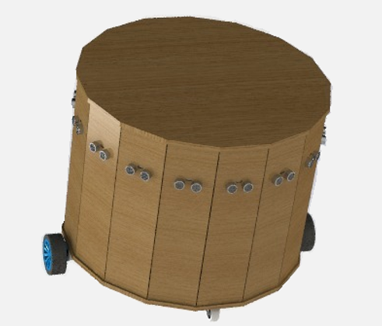
Design
Tow ultrasonic sensors will mounted on top of the robot for ultrasonic-positioning system.
16 Ultrasonic sensors arranged around the robot for obstacles avoidance system.

Slide 7

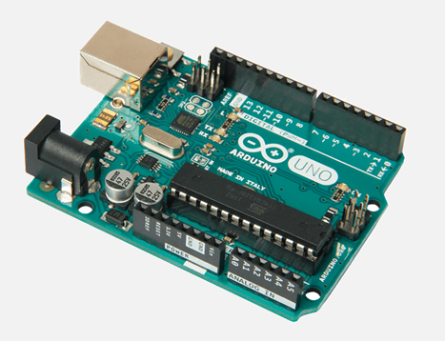
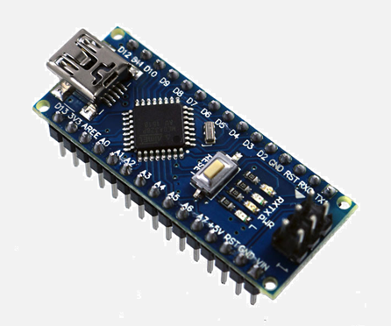
Tools and Components
Tools: Arduino IDE
Controllers: Arduino Uno/Nano
Arduino Uno
Arduino Nano
For control receiver and sensors.
For control sender.

Slide 8
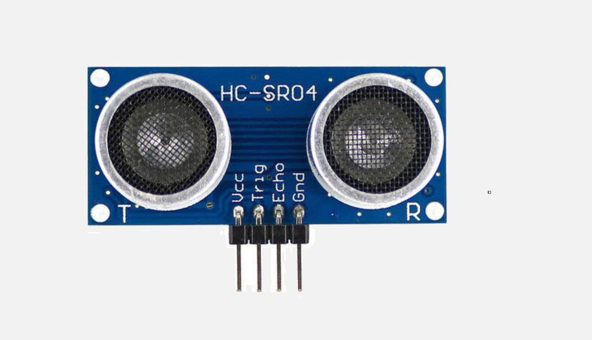
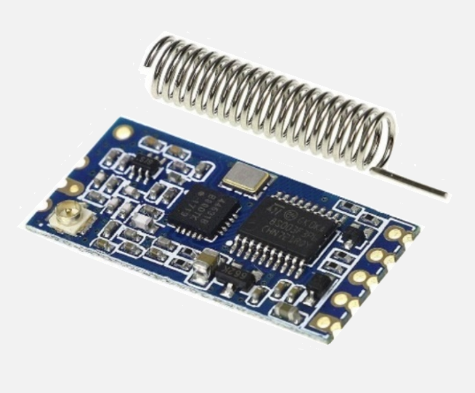
Sensors
HC-12 Wireless module
Used in positioning system
Used in synching between sender and receiver
and obstacle avoidance system.
and send data to each other.

Slide 9
Process
Ultrasonic Positioning System.
Obstacles Avoidance System.
Alarm System.

Slide 10
Ultrasonic Positioning System
Ultrasonic sender & receiver.
Need of synchronization.
Determine the Distance.
Determine the Direction (angle).

Slide 11
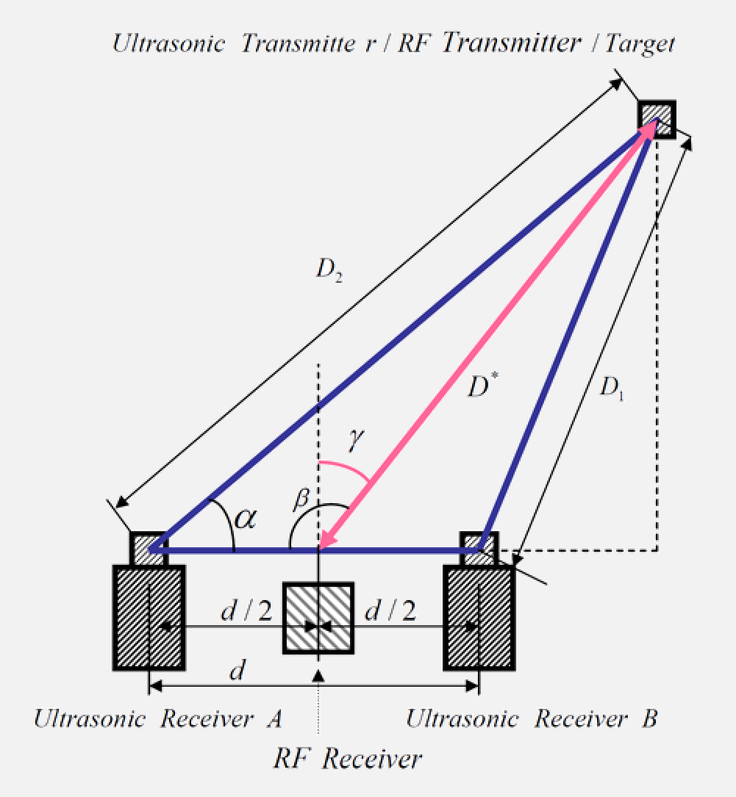
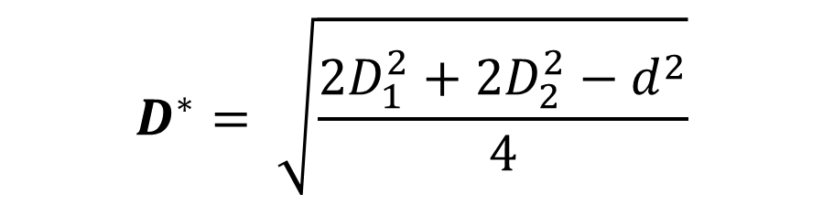
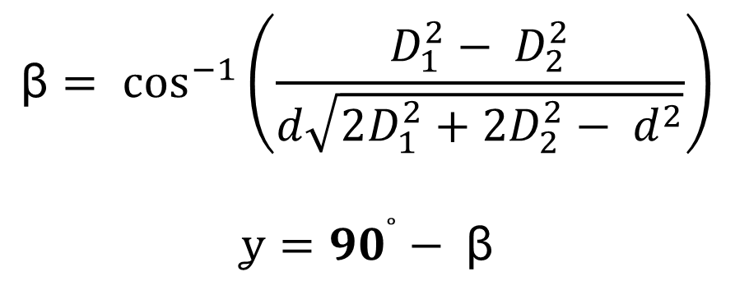
Ultrasonic Positioning System
$$D^{∗}= \sqrt{\frac{{2D}_{1}^{2}+2D_{2}^{2}−d^{2}}{4}}$$
$$ꞵ= \cos^{−1}\left(\frac{D_{1}^{2}− D_{2}^{2}}{d\sqrt{2D_{1}^{2}+2D_{2}^{2}− d^{2}}}\right)$$
$$ỿ={90}^{˚}− ꞵ$$

Slide 12
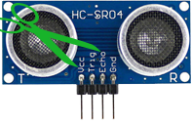
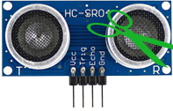
Need of synchronization
Receiver
Transmitter

Slide 13
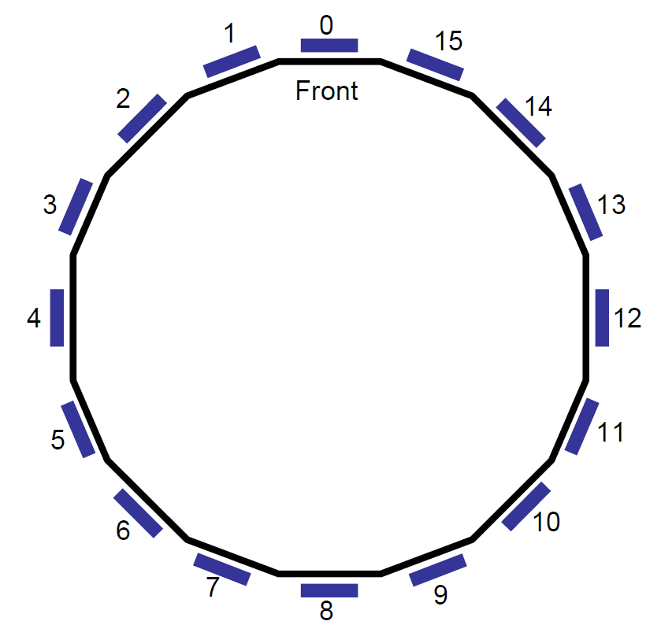
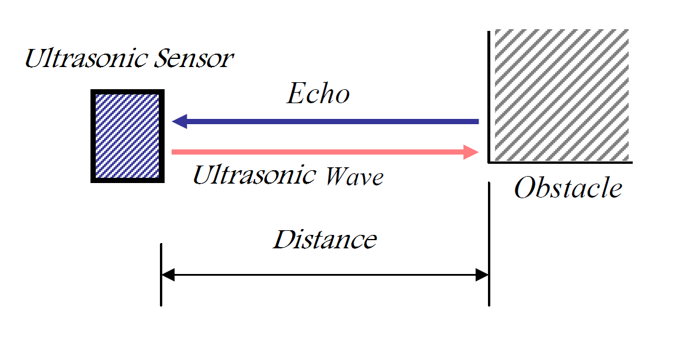
Obstacles Avoidance System

Slide 14
Alarm System

Slide 15
Future Works
GPS can be added for more security issues.
Mobile app can be created to receive alarms, notifications, robot current distance, etc.
Computer vision can help robot to avoid other types of obstacles such as holes, curvature roads, etc.
Artificial Intelligence can help robot to choose how to determine the shortest path of to the person and to avoid faced obstacle.

Slide 16
References
12V 60RPM 25mm High Torque DC Gear Motor Kit with 65mm Plastic wheel. (n.d.). Retrieved from technolob: http://technolab.ps/#!/items/details/492
ARDUINO NANO. (n.d.). Retrieved from Arduino Nano | Arduino Official Store: https://store.arduino.cc/usa/arduino-nano
Arduino Uno Rev3. (n.d.). Retrieved from Arduino Uno Rev3 | Arduino Official Store: https://store.arduino.cc/usa/arduino-uno-rev3
HC-12 Wireless Serial Port Module. (n.d.). Retrieved from Amazon.com: HiLetgo HC-12 433Mhz SI4463/SI4438 Wireless Serial Port Module 1000M Replace Bluetooth with Antenna: https://www.amazon.com/HiLetgo-Wireless-Replace-Bluetooth-Antenna/dp/B01MYTE1XR
HC-SR04 Ranging Detector Mod Distance Sensor. (n.d.). Retrieved from Amazon.com: SainSmart HC-SR04 Ranging Detector Mod Distance Sensor (Blue): https://www.amazon.com/SainSmart-HC-SR04-Ranging-Detector-Distance/dp/B004U8TOE6

Slide 17
Hung-Kwan. (2004, july). The Implementation of a Person Tracking Mobile Robot.
Kazuyuki Morioka, & Joo-Ho Lee. (2004, February). Human-Following Mobile Robot in a Distributed Intelligent Sensor Network.
Luo, R. C., Chang, N. W., & Lin, S. C. (2009). Human tracking and following using sensor fusion approach for mobile assistive companion robot. (pp. 2235-2240). Annual Conference of IEEE Industrial Electronics.
Morioka, K., & Lee, J. H. (2002, October). Physical agent for human following in intelligent sensor network. pp. 1234-1239.
Ohya, A., & Nagumo, Y. (2002, October). Intelligent escort robot moving together with human-methods for human position recognition.
Raspberry Pi 3 Model B Board. (n.d.). Retrieved from Amazon.com: Raspberry Pi 3 Model B Board: Computers & Accessories: https://www.amazon.com/Raspberry-Pi-MS-004-00000024-Model-Board/dp/B01LPLPBS8
Rf Transmitter and Receiver. (n.d.). Retrieved from Amazon.com: SMAKN 433Mhz Rf Transmitter and Receiver Link Kit for Arduino/Arm/McU: Computers & Accessories: https://www.amazon.com/SMAKN%C2%AE-433Mhz-Transmitter-Receiver-Arduino/dp/B00M2CUALS

Slide 18
The End
Thanks for Watching !
Like and Subscribe Please !!

