Slide 1
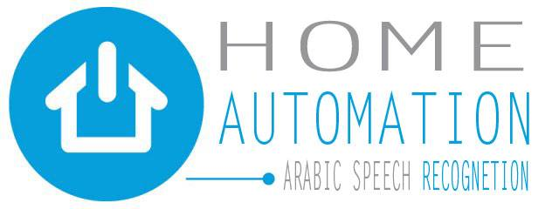
Stand alone system

Slide 2
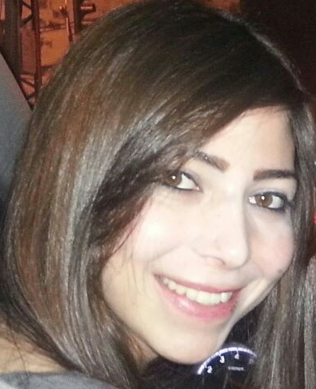

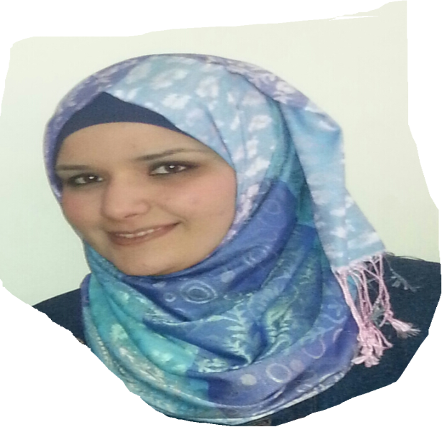
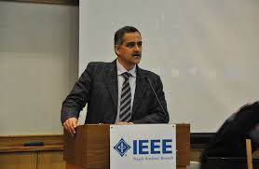
Team members
Kifah Harb
Besan Jamous
Ammera Fattouh
Dr Allam Mousa

Slide 3
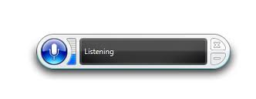
PC dependent

Slide 4
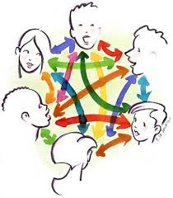
Speech recognition

Slide 5
Problems
Dependency on computer
High error percentage
Doesn’t support Arabic language
Low security

Slide 6

What To Do?

Slide 7
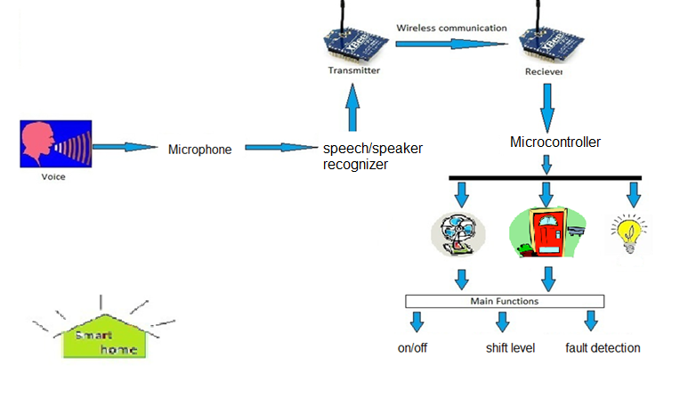
Stand Alone Arabic Voice recognition
Notes:
Hardware solution , standalone recognizer
That recognize Arabic speaker voice
For controlling Home devices
Connected to the Zigbee network

Slide 8
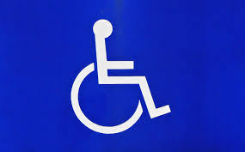




Features
Suit disable
Feedback
Wireless
Security
Arabic speaker

Slide 9
Methodology:
Stand alone recognizer
With shield
network
Mechanical system
Without shield
Data analysis

Slide 10
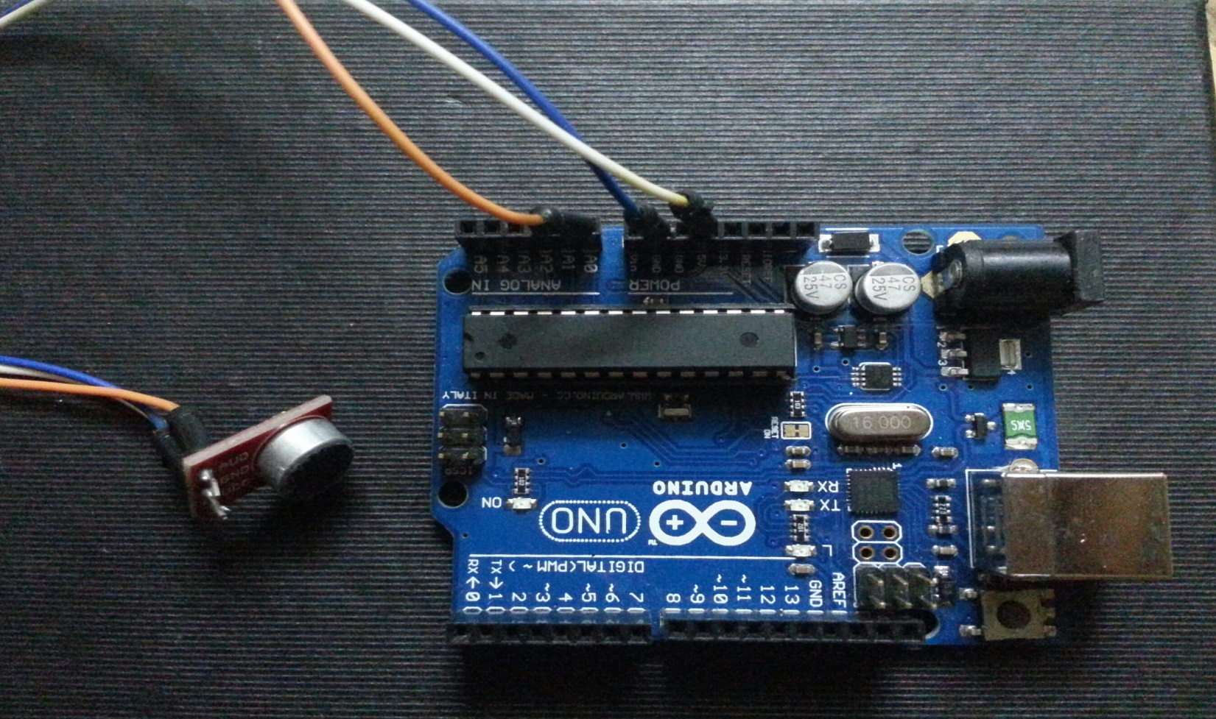
Stage # one:
Arduino without shield recognizer

Slide 11
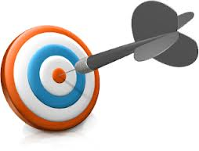
Goal.

Slide 12
Arduino without shield recognizer
f(x)
User
$$\frac{\sum{|}\frac{df(x)}{dx}|}{\sum{|f\left(x\right)|}}$$
(∑1▒| (𝑑𝑓(𝑥))/𝑑𝑥|)/(∑1▒〖|𝑓(𝑥)|〗)
System
Record the signal power
System

Slide 13
Speech divided to three basic types of phonemes:
Vowels (o ,a ,e ,i) ➔low frequency
Fricatives (s, z ,f) ➔high frequency
Plosives (p , b) ➔high frequency

Slide 14
Creating the recognizer:
The first step
Measuring the volume of the microphone for our system.
Measuring each phonetic threshold.
ee = e = i ➔ econstant
a = o =r = l ➔ aconstant
z = v = w ➔ vconstant
s = sh = ch ➔ shconstant
f ➔ fconstant

Slide 15
Demo 1

Slide 16
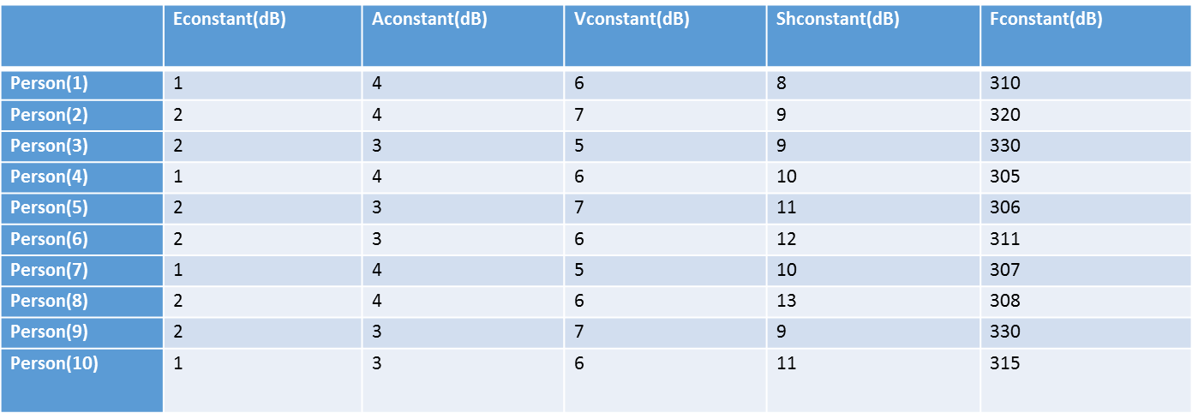
The second step
we measured the threshold average for each phonetic taken from 10 different people:

Slide 17
Strength and weakness in the design.
It can be used to make speaker recognition by creating vocabulary to the user and measure each phonetic power.
The system is only able to differentiate between fricatives and voiced fricatives (like f and s).

Slide 18
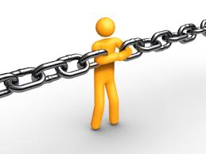
Constrains.
Notes:
Few( limited one )

Slide 19
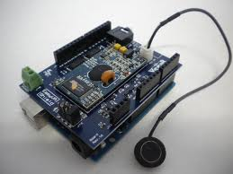
Stage # two:
Arduino with shield recognizer.

Slide 20

Goal.
Increase the performance of the system.

Slide 21
The approach
Preparing the system :
Record the voice
Signal processing
Save properties on data base

Slide 22
Recognition
Detect the signal
Fetch its properties
Compare and take decision

Slide 23
demo4

Slide 24
analysis
Trial and success:
percentage of success trials for two users
 | Command #1(open door) | Command #2(افتح الباب)
User #1 | 30% | 45%
User #2 | 25% | 50%

Slide 25
Acceptable Confidence Level.
Minimum Audio Level.
Audio Level Activated Period.

Slide 26
percentage of success for advanced trials for two users
 | Command #1(open door) | Command #2(افتح الباب)
User #1 | 65% | 80%
User #2 | 70% | 78%

Slide 27
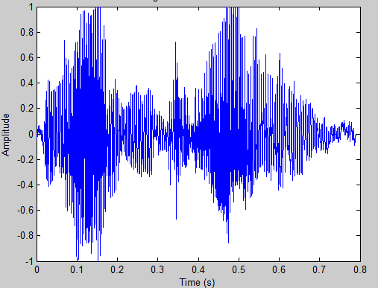
waveform with time of "led on" in quit environment

Slide 28
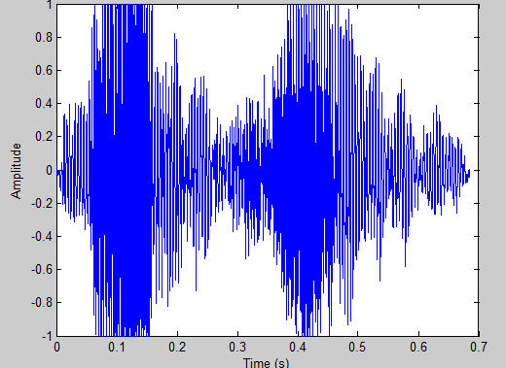
waveform with time of "led on" in noisy environment

Slide 29
Constrains.

Slide 30
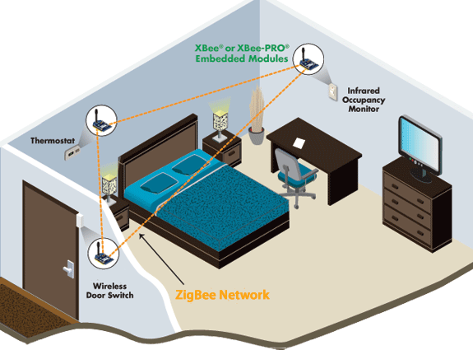
Stage # three: Zigbee network.

Slide 31
goal
Optimum wireless connection.

Slide 32
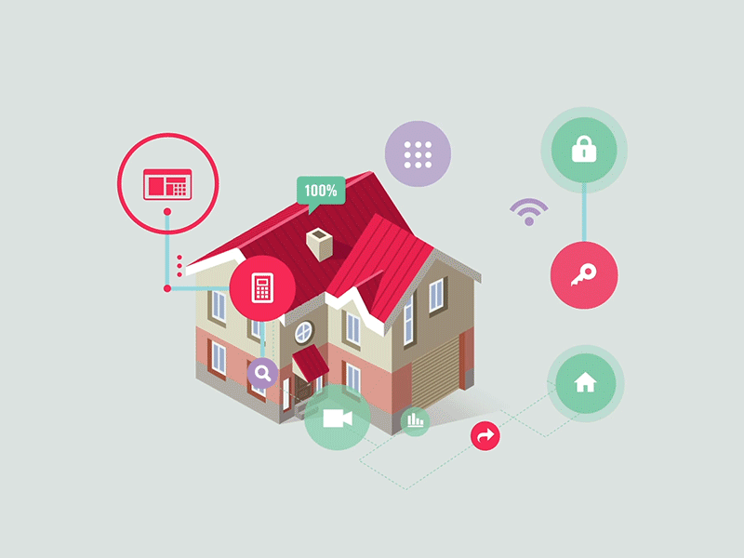
Stage # four: Controlling.

Slide 33
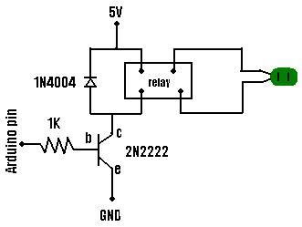
Step # one: control AC devices.
Control light.
Arduino controls a power 4400 times its own power.

Slide 34
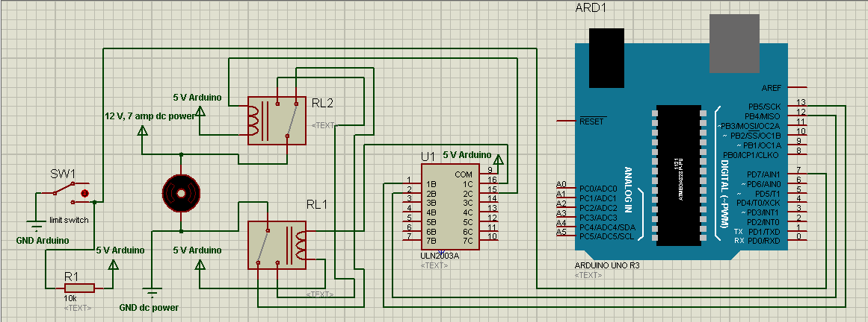
Step # two: Control mechinecal devices.
DC motors.

Slide 35
demo

Slide 36
Constrains.

Slide 37


Slide 38
Business model.

Slide 39
The expected costs of recognizer.
 | Standalone recognizer | Standalone recognizer with zigbee | Network
Prototype Cost | 80 $ | 126 $ | 76*n
Final production cost | 10-13 $ | 21 $ | 13*n
Selling cost | 30 $ | 63 $ | 39*n $

