Slide 1
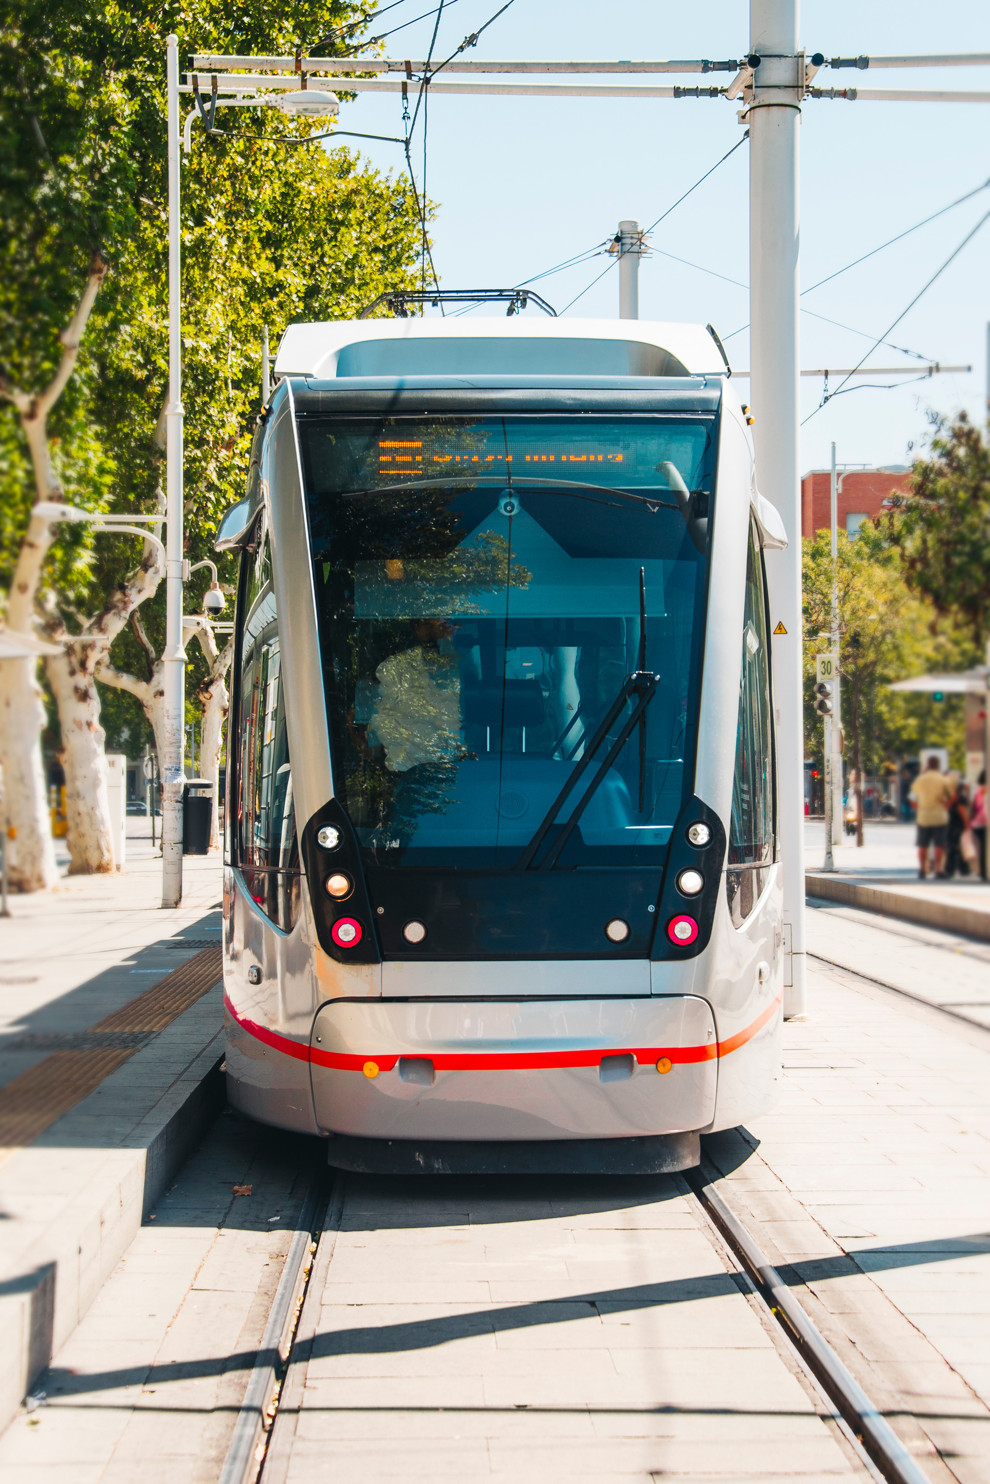

STUDY AND DESIGN OF
NABLUS TRAM
DESIGNED BY :
HUSAM SALAMEH
ABDULRAHMAN RAWAJBEH
UNDER THE SUPERVISION OF PROF. SAMEER ABU-EISHEH

Slide 2
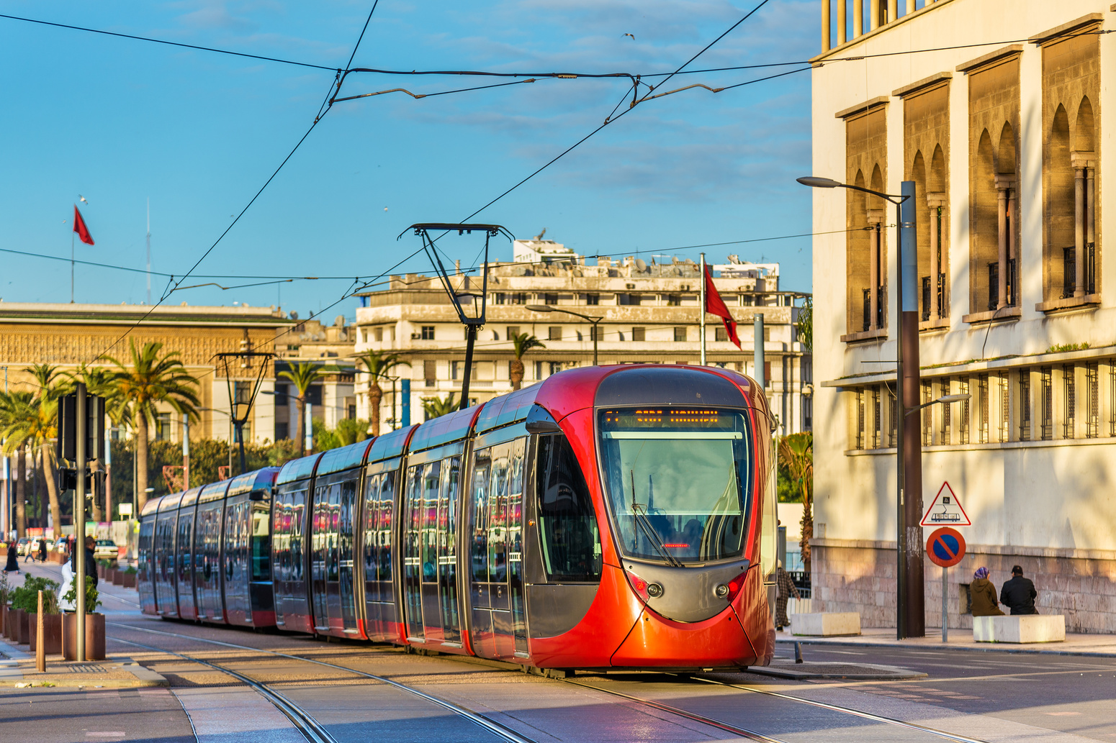
01
INTRODUCTION, DATA COLLECTION, AND ANALYSIS
1.1 Nablus City Background.
1.2 Problems and Challenges.
1.3 Objectives.
1.4 Methodology.
1.5 Public Transportation Terminals
1.6 Data Analysis

Slide 3
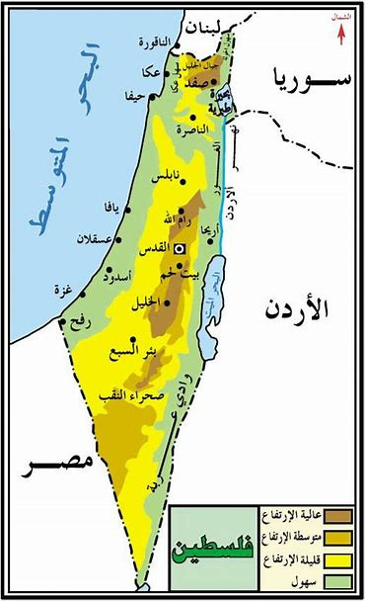
BACKGROUND
  An important city in Palestine.
  Set between two mountains, Ibal (941m AMSL), and Girzim (881m AMSL).
  It was laid on the Hijaz Railway.
  Nablus Governorate contains 64 villages and 3 refugee camps.
  The population of Nablus Governorate is 415,606.

Slide 4

1.2
Problems and Challenges
1.2.1 Delay
1.2.2 Congestion
1.2.3 Pollution
1.2.4 Terminals Problems
1.2.5 Safety

Slide 5
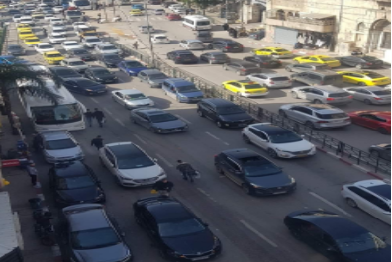
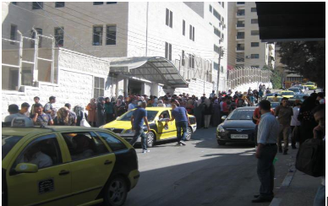

Slide 6
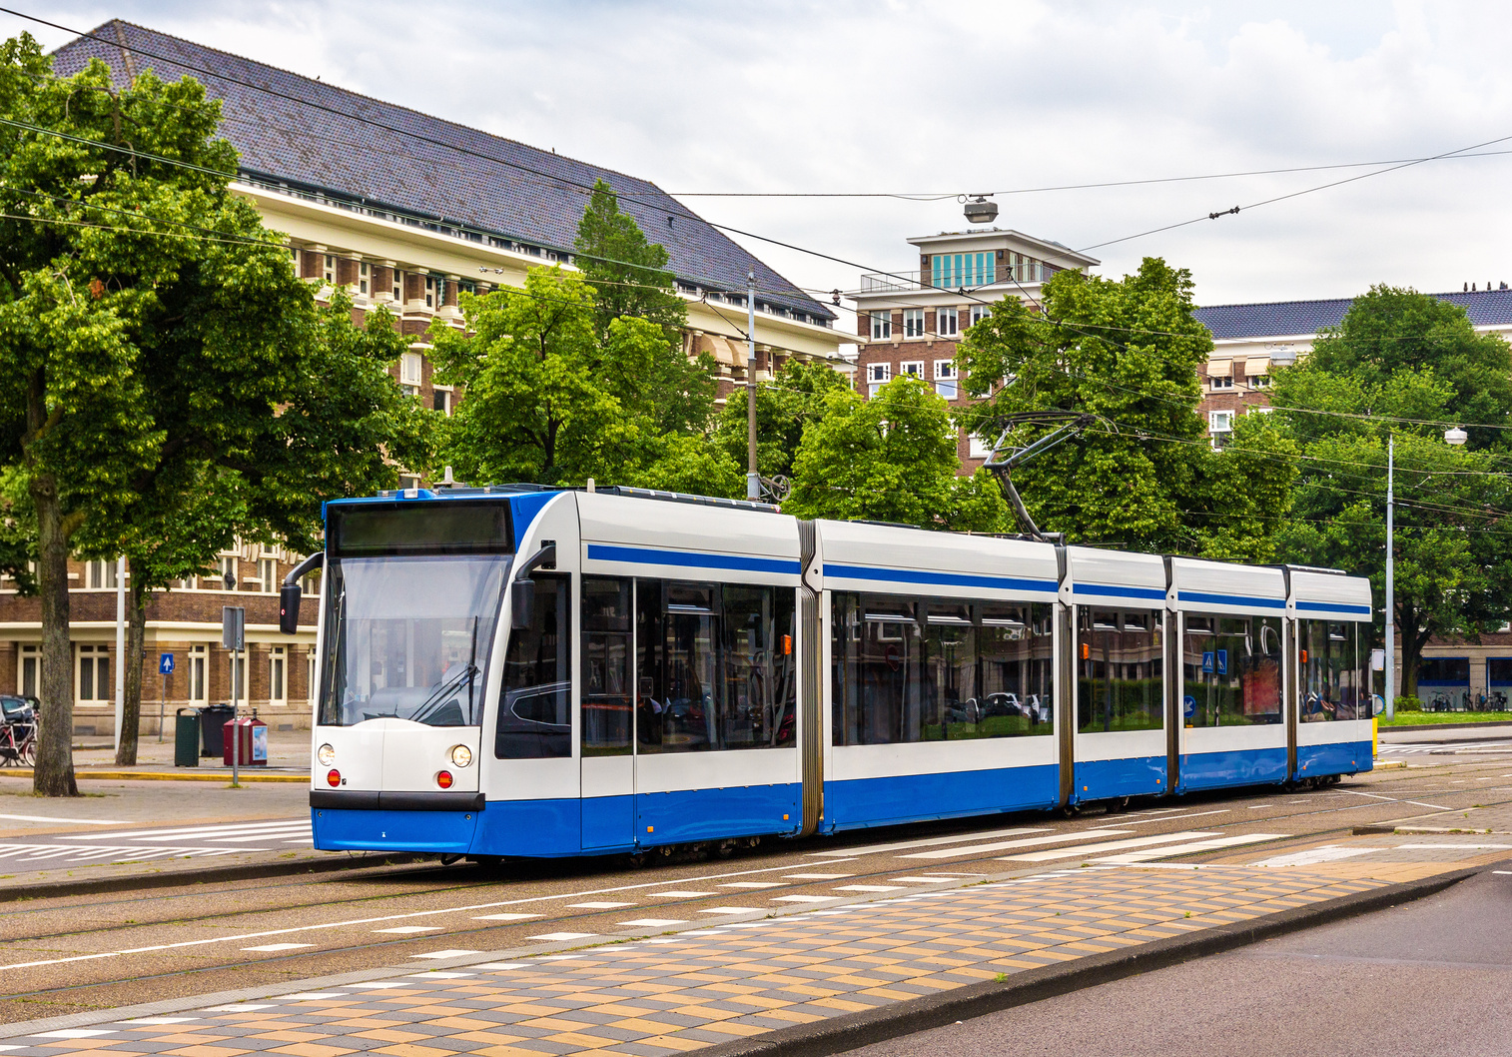
1.3 EXPECTED OUTCOMES
1.3.1 Overcome traffic congestion
1.3.2 Improve Safety
1.3.3 Reduce Delay
1.3.4 Protect the Environment
1.3.5 Efficient Transportation System
1.3.6 Reduce Dependence on Private Cars.

Slide 7

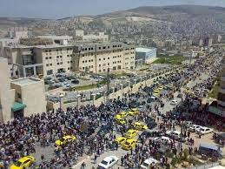
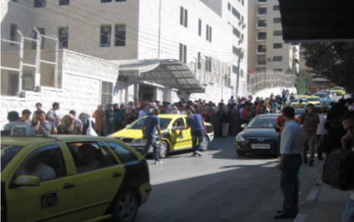

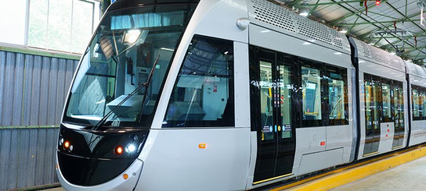
1.4
DATA COLLECTION
In this project there are 5 types of studies were applied to get out the needed data and information
  Demand Study
  Travelers Preference Study
  Frequency Study
  Forecasting Traffic Study
  Occupancy Rate Study
  Dwell Time and Headway Study

Slide 8
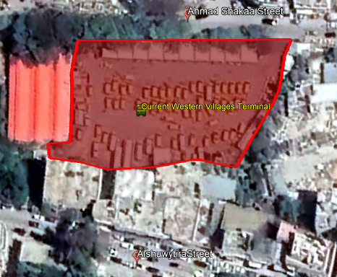
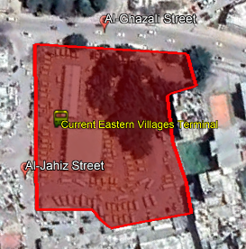
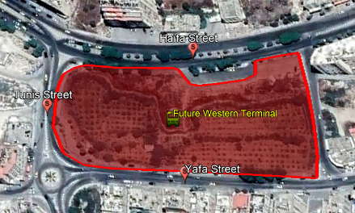
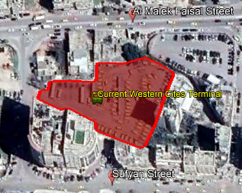
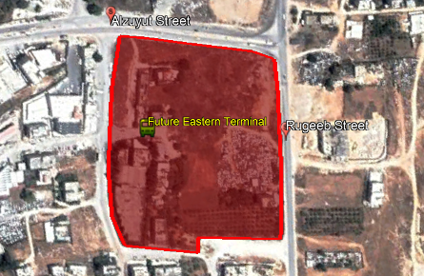
1.5 Public Transportation Terminals

Slide 9
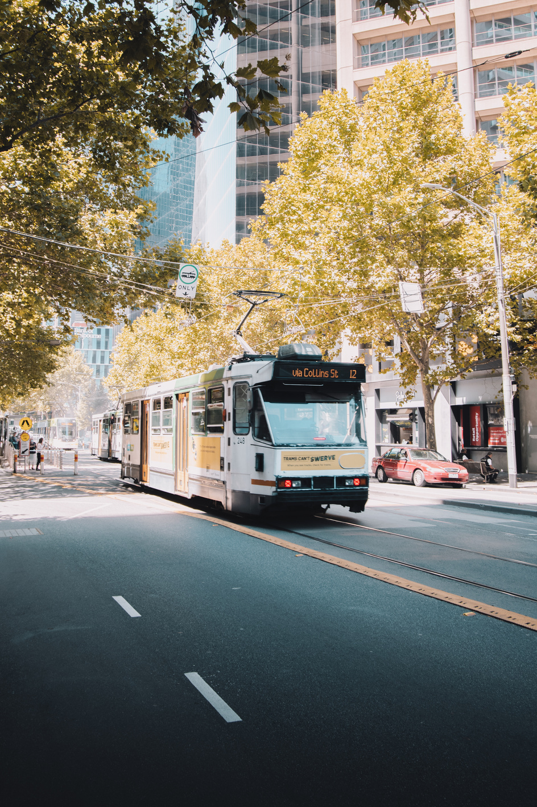
1.6
DATA ANALYSIS
1.6.1 Passenger Load and Scenarios
1.6.2 Current and Suggested Public
Transportation Solutions.
1.6.3 BRT vs. Tram

Slide 10
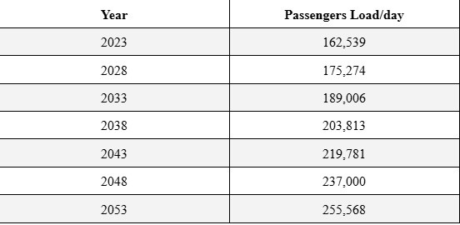
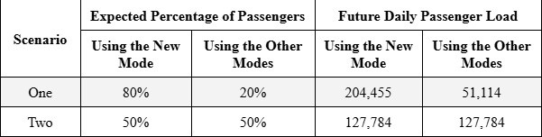
1.6.1 Passenger Load and Scenarios

Slide 11
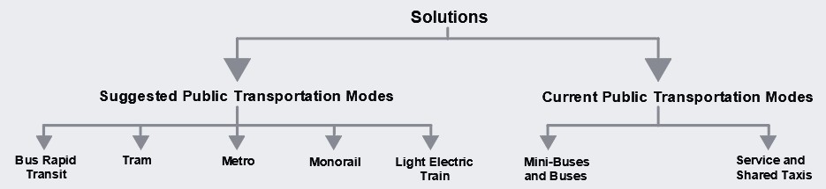
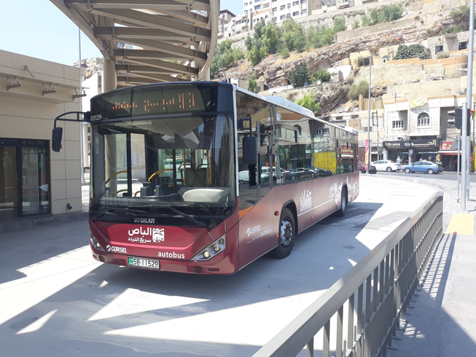

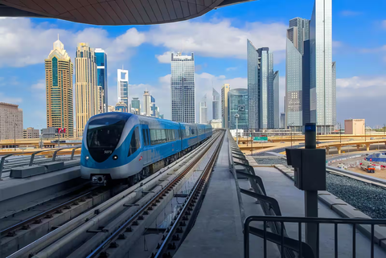
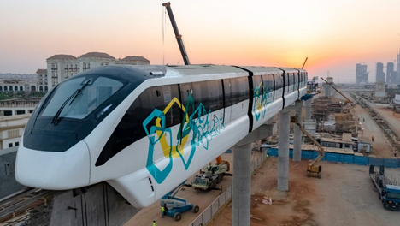
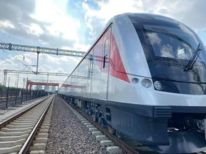
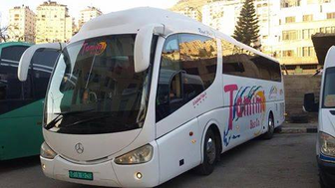
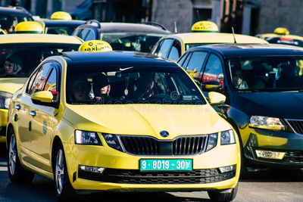
1.6.2 Current and Suggested Public Transportation Solutions

Slide 12
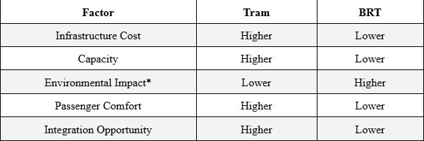
1.6.3 BRT vs. Tram

Slide 13
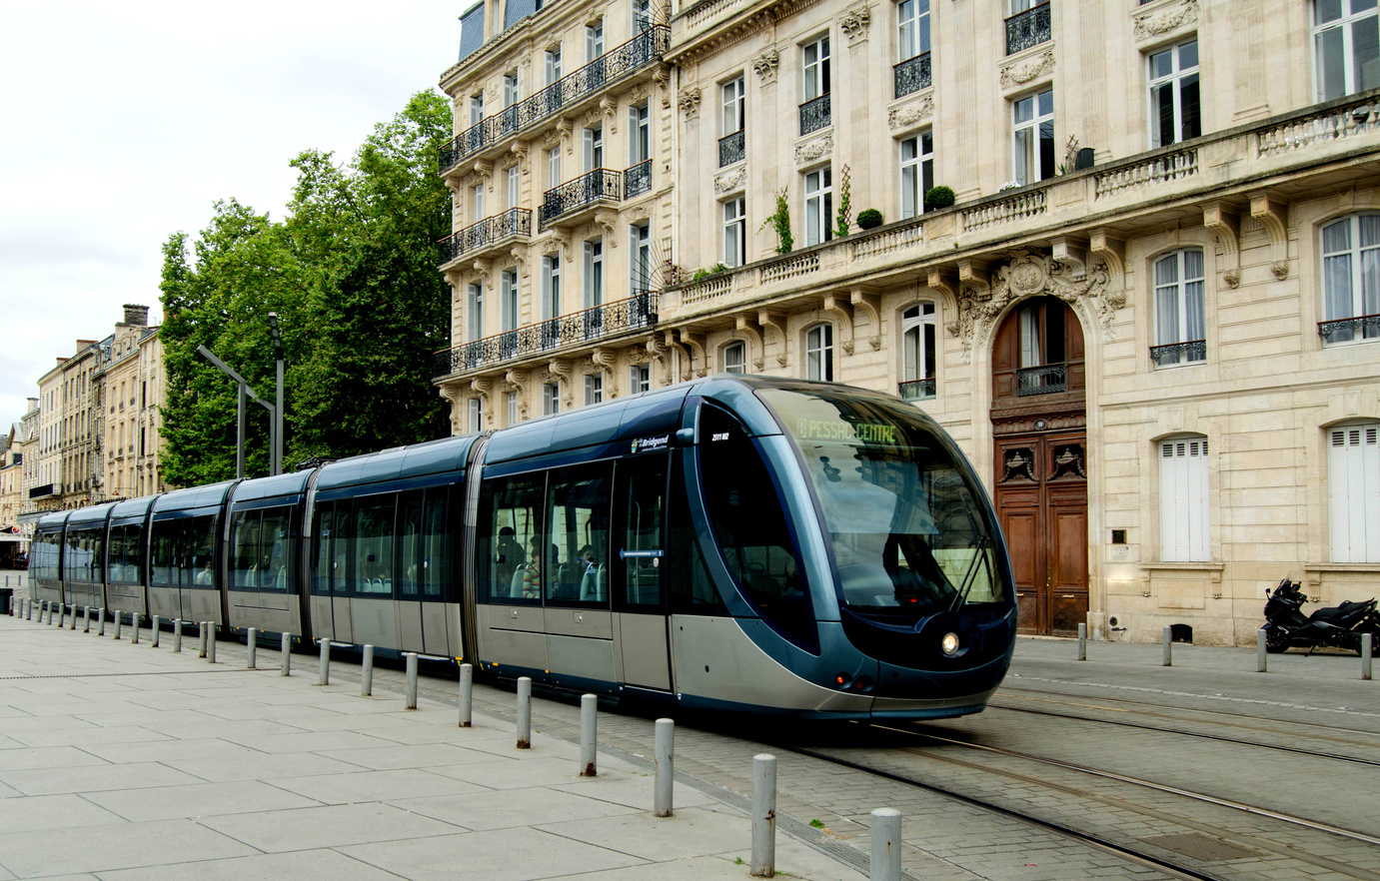
02
TRAMWAY
2.1 Introduction
2.2 Tramway Advantages
2.3 Tramway Standards and Specifications
2.4 Tramway Depots
2.5 Nablus Tramway Design

Slide 14
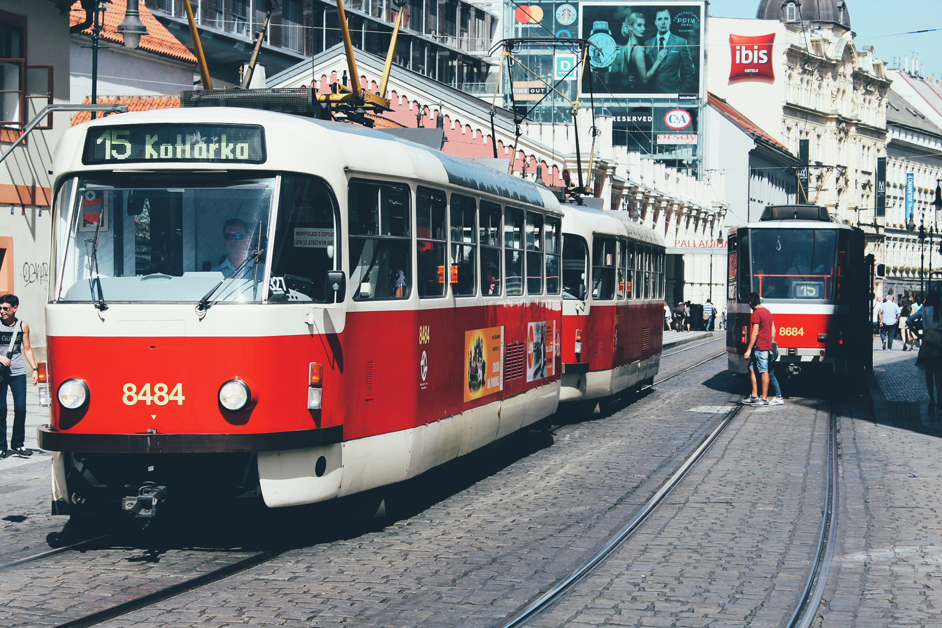
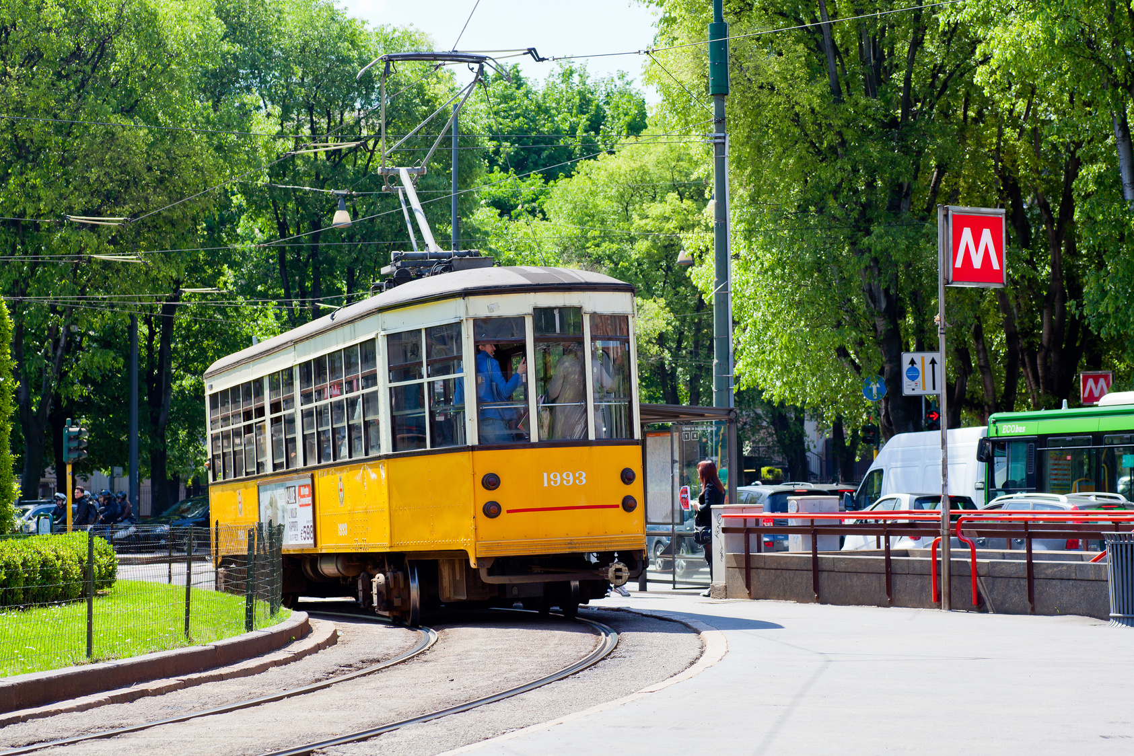
2.1 Introduction
  The Tramway is one of the rail transportation modes.
  Consists of a vehicle or more that operates on a specific lane.
  Usually, implement it is on the street level.

Slide 15
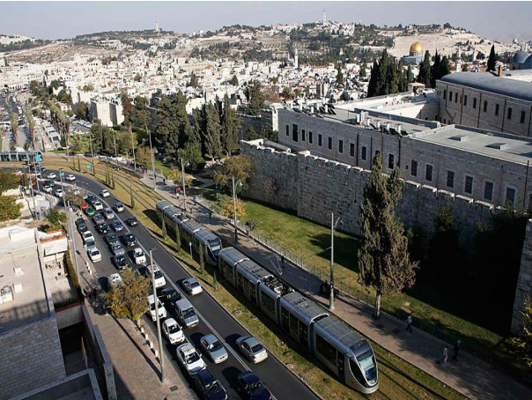

Slide 16
2.2 Tramway Main Advantages
  High capacity of the tramway vehicle..
  The multiplicity of tram vehicles for the same route at the same time.
  Strong safety records, compared to other transportation modes.
  Integration with other transportation modes.
  More flexible in emergencies.

Slide 17
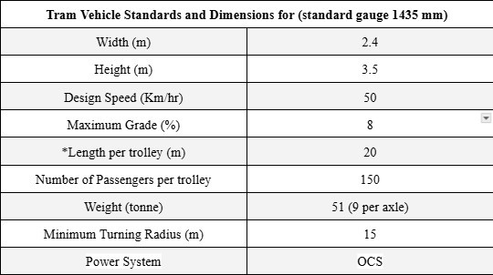
2.3 Tramway Standards and Specifications

Slide 18
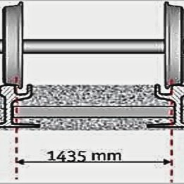
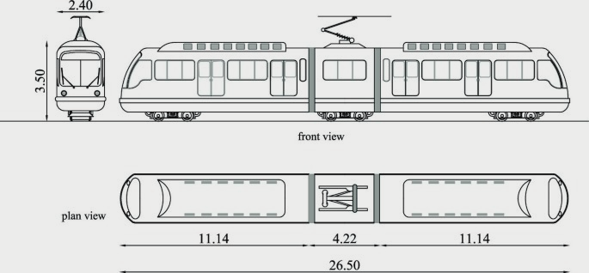
2.3 Tramway Standards and Specifications

Slide 19
2.4 Tramway Depots
  The facility where trains are parked, serviced,
  maintained, and sometimes assembled or disassembled.
  It has tracks, workshops, storage areas, and facilities for
  refueling, cleaning, washing, and repairing trains.
  It's a crucial part of the railway infrastructure.

Slide 20
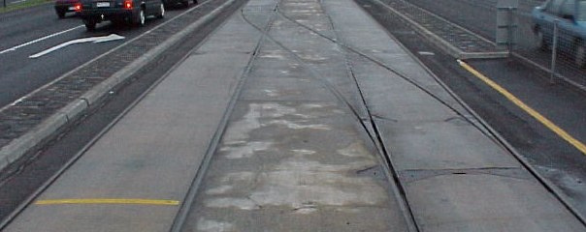
2.5 Tramway Turnout
There are two types of turnouts that were used in this project:
  Origin-Destination Turnout
  Emergency Turnout

Slide 21


2.6
NABLUS TRAMWAY DESIGN
  2.6.1 Nablus Tramway Routes and Stations
  2.6.2 Cross Sections
  2.6.3 Horizontal and Vertical Alignments
  2.6.4 System Schedule

Slide 22
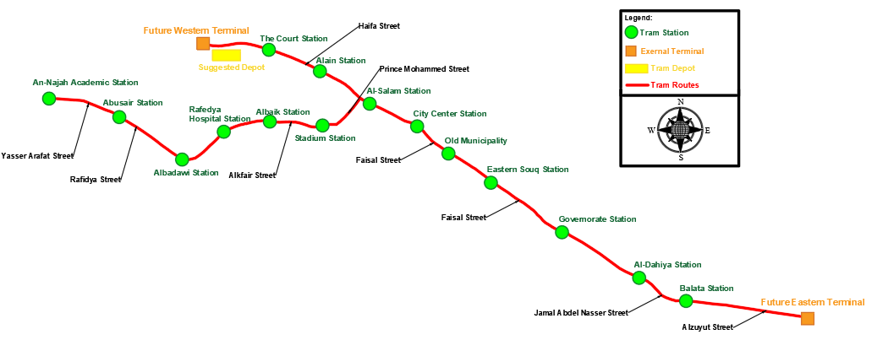
Single Line Digram for Nablus Tramway
Routes and Stations

Slide 23
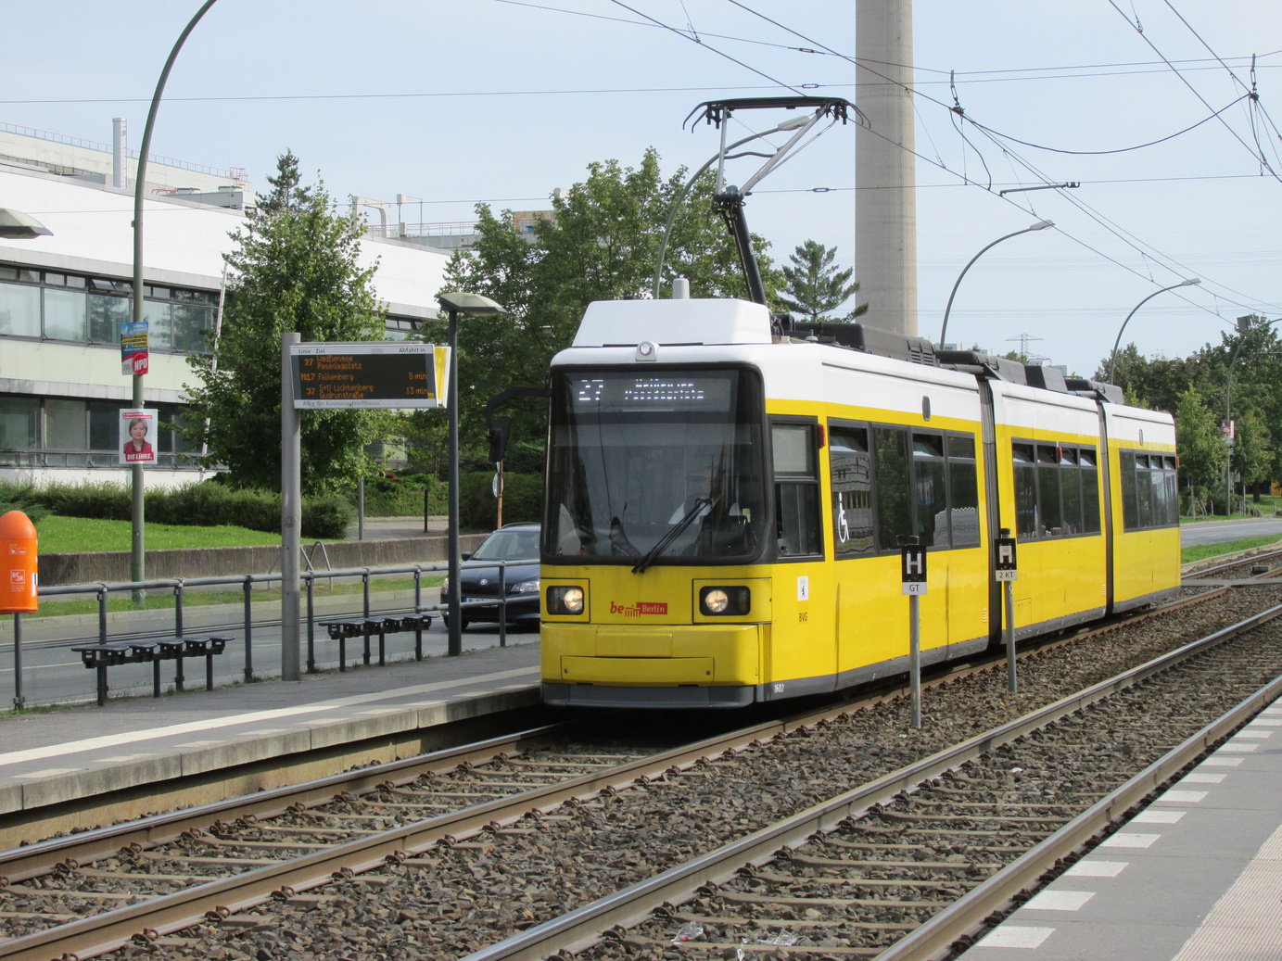
2.6.2
Cross Sections

Slide 24
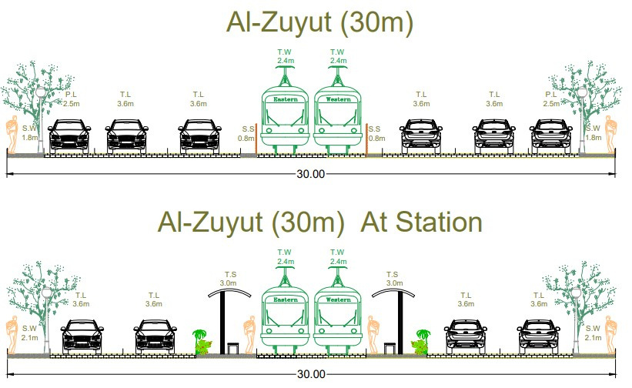

Slide 25
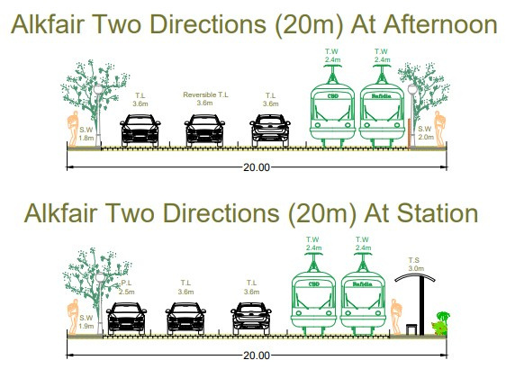

Slide 26
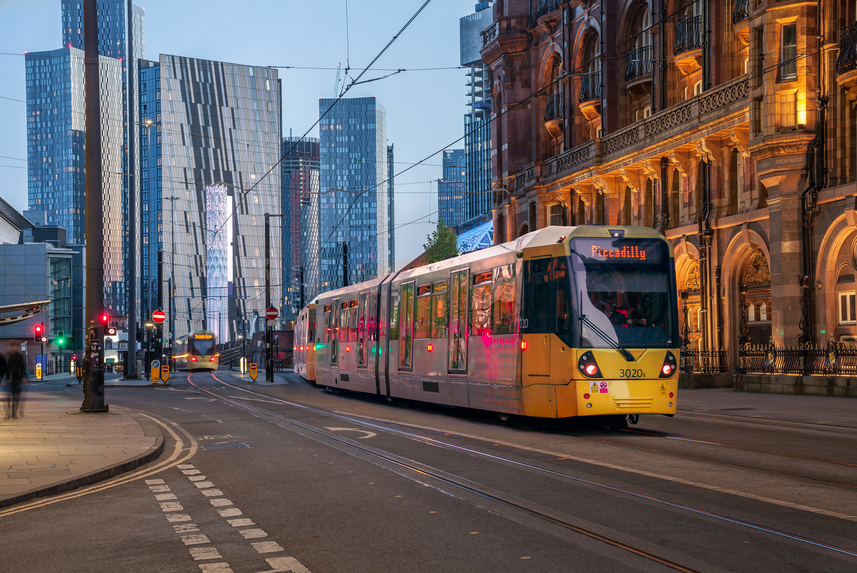
2.6.3
HORIZONTAL AND VERTICAL ALIGNMENTS
  Changes in the horizontal alignment and vertical alignment were limited because the target streets are operating roads.
  The alignments were kept in the same situation.

Slide 27
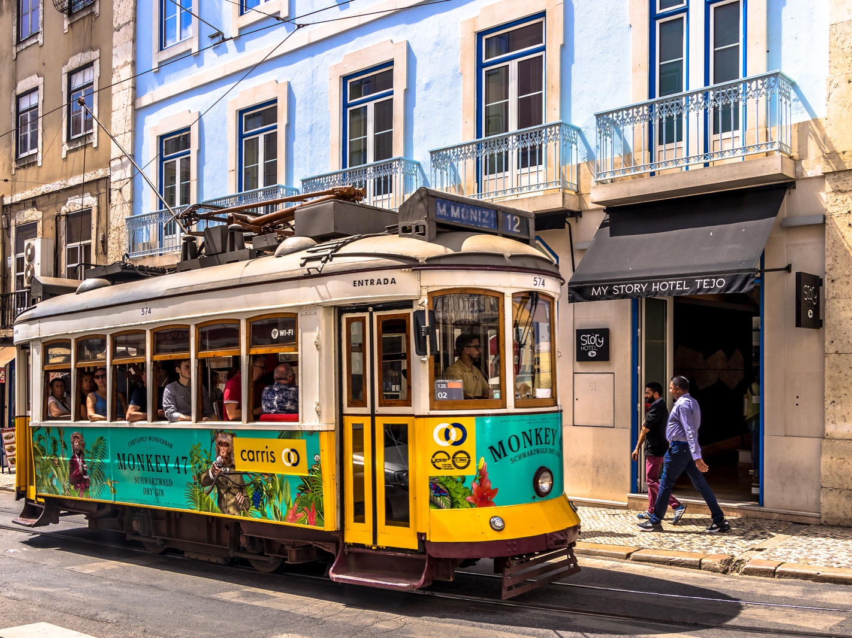
2.6.3
HORIZONTAL AND VERTICAL ALIGNMENTS
  Origin-Destinatio trunout were used in this project at 3 stations (Eastern terminal, Western terminal and An-Najah New Campus).
  Emergency turnout were used each 2-3 stations for any unexpected situation.

Slide 28
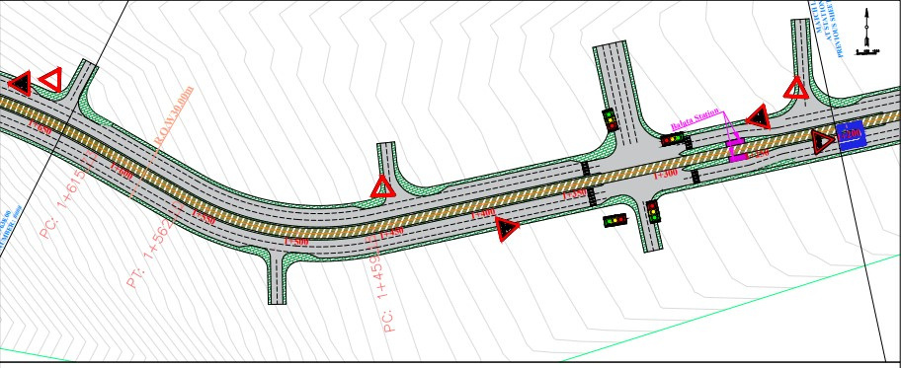
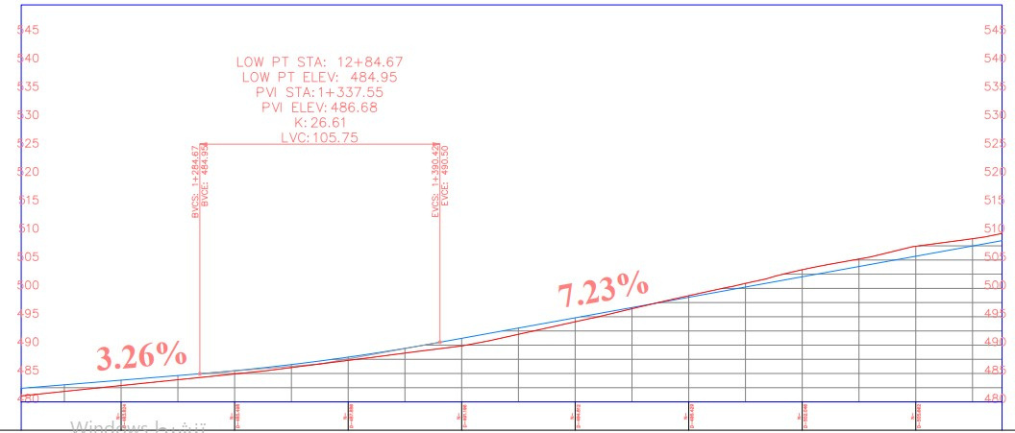

Slide 29
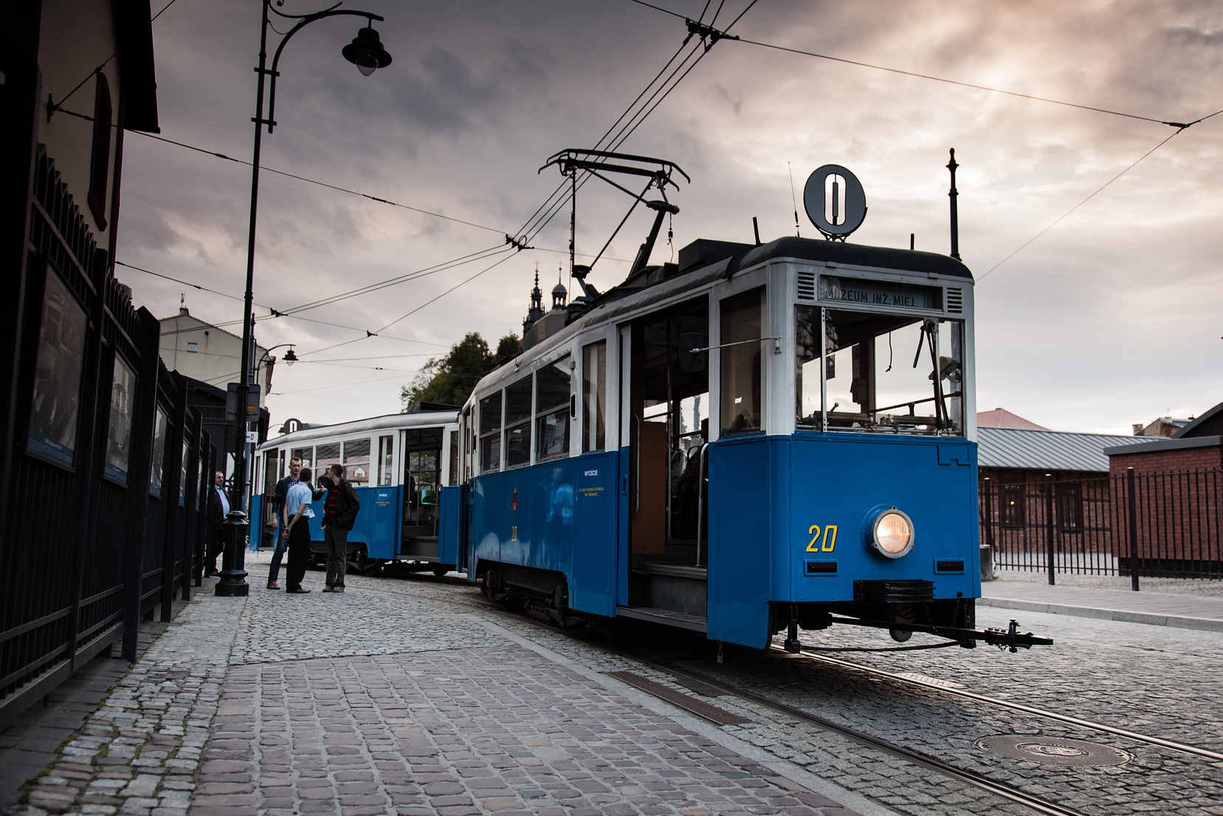
2.6.4 System Schedule
In order to schedule the tram system, some assumptions were made:
  Maximum value between morning and afternoon volume was used in scheduling at peak and off-peak periods.
  Tram service time is from 6:00 am to 10:00 pm.

Slide 30
2.6.4 System Schedule
3. The number of doors for each trolley is 2 doors.
4. Waiting or resting time at the main stations is assumed to be 90 seconds, and it’s added to total dwell time.
Total travel time = Running time + Total Dwell Time
5. Each station needs a specific percentage of the total dwell time value. This percentage is estimated according to the passenger load.

Slide 32
03
RESULTS
6.1 Before and After Analysis for Critical Intersections.
6.2 Cost Estimation.

Slide 33
3.1 Before and After Analysis for Critical Intersections
specific proposals were prepared to better control these intersections. These include are:
  For the Al-Quds-Balata intersection, the intersection is designed to be a signalized intersection with all-red intervals when the tram passes through the intersection.
  For the Al-Salam intersection, due to adding the tram lanes with the limitation in R.O.W at Haifa Street on the section from this intersection to Al-Kindy intersection.
  This section is designed to be one way (from east to west) and transferred the other direction will be to the parallel Ma’zouz Almasri Street

Slide 34
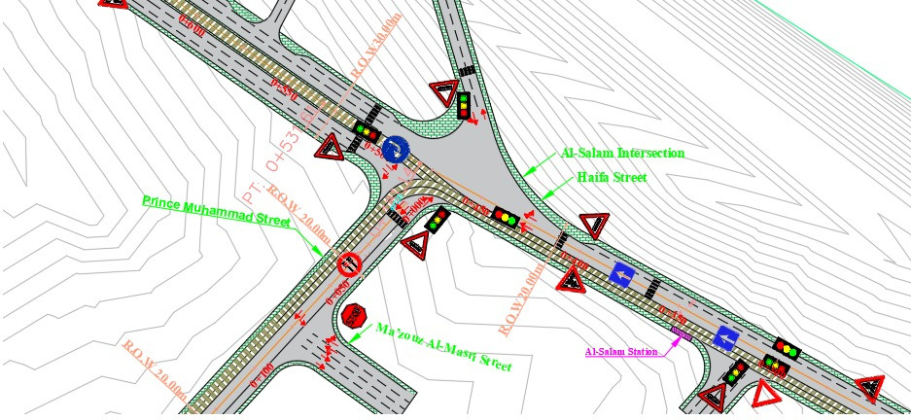

Slide 35
L.O.S of The Key Intersections
To assess the tram influence on traffic operation, the LOS is found considering the ICU method using the Synchro10 program.
In calculations, some proposals were used:
  The LOS was checked and calculated in 2025 (tram operating time) and 2030 (after 5 years from operation).
  The annual growth rate of vehicles in Nablus City before operating tram is 2.8%.
  The annual growth rate of vehicles in Nablus City after operating tram is 1.6%, which the percentage of reduction in vehicles after opertating the tram is 48%.

Slide 36
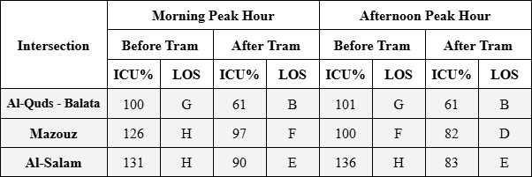
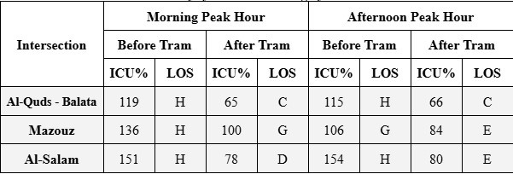
The values of LOS and ICU% for each intersection before and after adding the tramway system in 2025 using Synchro10
The values of LOS and ICU% for each intersection before and after adding the tramway system in 2030 using Synchro10

Slide 37
3.2 Cost Estimation
To estimate the cost of the project, some assumptions were used:
  The area needed for each tram trolley to maneuver and maintain is assumed to be 250 m2.
  Tram depot area = number of trolleys * 250 = 40 * 250 = 10,000 m2.
  Asphalt is measured in square meters m2.

Slide 38
3.2 Cost Estimation
  Curbstone, signalization, power system and tram rail has been measured in meter length.
  Traffic signs are the signs that will be added to the traffic system.
  Traffic signal that is calculated in the cost estimation is the signals that are added at the entrance of Balata camp.

Slide 39
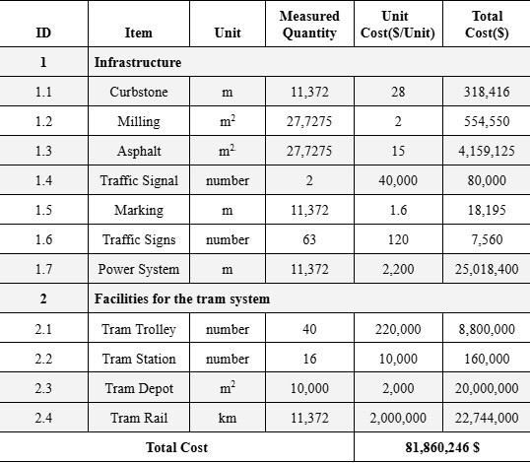

Slide 40
04
Conclusions, Limitations and Recommendations.

Slide 41
4.1 Conclusions
  The tramway system is one of the modes that could be more efficient and more environmentally friendly than other existing public transportation modes.
  This study will help the decision maker to choose the most appropriate solution.
  The current traffic system problems in Nablus are increasing considerably with time
  A large number of passengers use the terminals of the city during the morning and afternoon peak periods, which makes it necessary to provide an effective way to transport them
  A public transportation system with high efficiency is needed to meet the current and future demand.
  The results show that implementing the tramway system would enhance the LOS at the intersections.

Slide 42
4.2 Limitations
  Collecting the necessary information for critical intersections. Due to the political situation.
  The percentages of travelers that were interviewed using the questionnaire was limited.
  It was difficult to convince drivers of the public transportation vehicles who were interviewed to disclose the real number of trips.
  Lack of expertise in estimating costs related to the railway sector in Palestine.

Slide 43
4.3 Recommendations
  To conduct practical and more field-based data collection to obtain more accurate data.
  To consider expanding the routes of the tramway system to serve additional key districts in the city.
  Consider employing the current drivers in tramway facilities and redistributing the service taxis.
  To reuse the current transportation modes.
  Reuse part of the area of the current terminals for parking space.

Slide 44
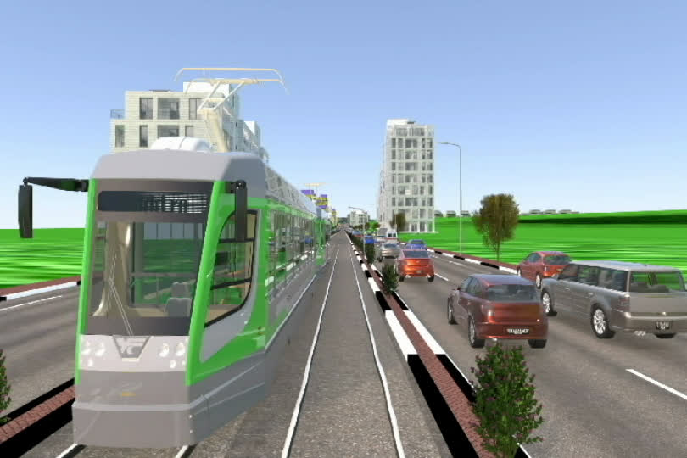

Slide 45
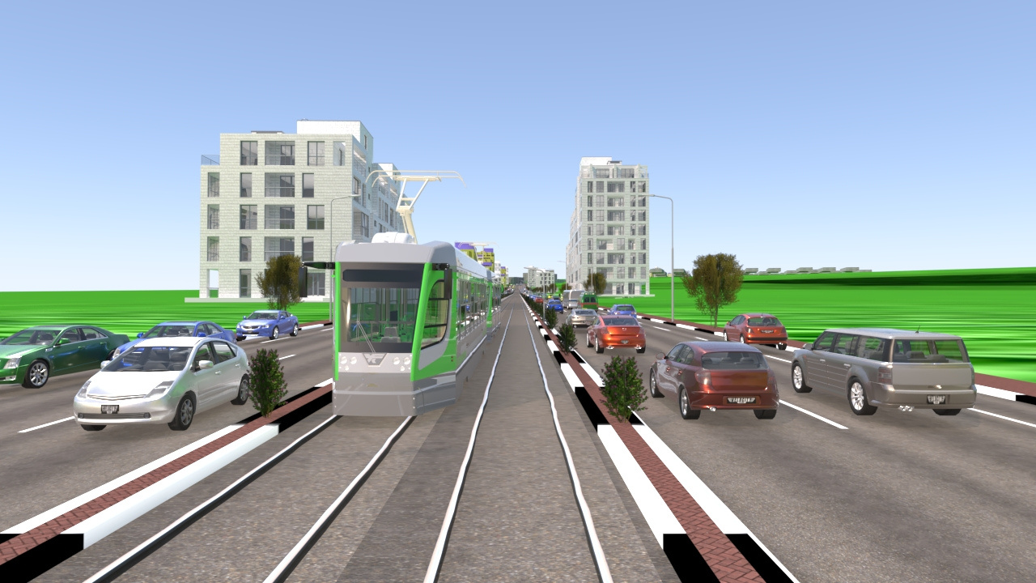
THANK YOU
Any questions ?

