Slide 1
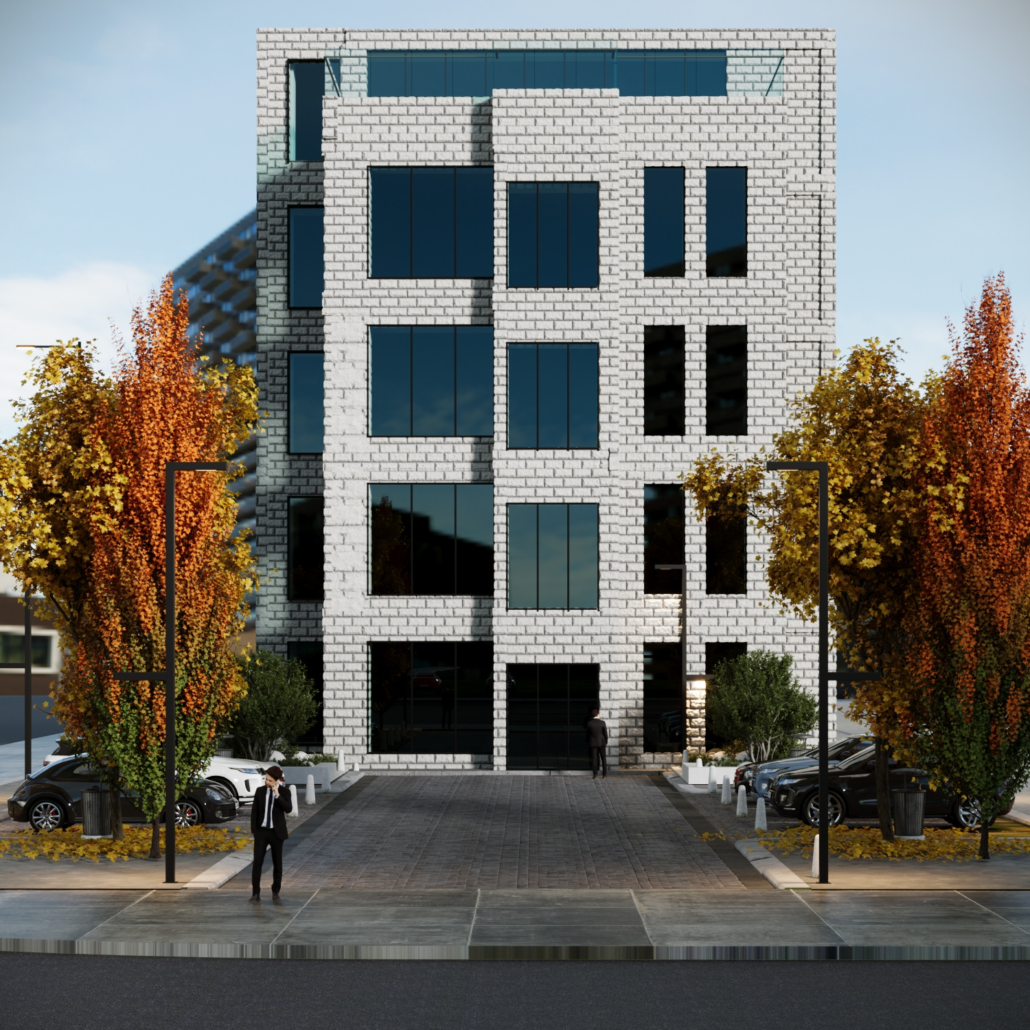

An-Najah National University
Faculty of Engineering and Information Technology
Building Engineering Department
Graduation project I I
Integrated redesign of the Ministry of Education
Prepared By:
Sojood Tayseer
Noor Daraghmeh
Yasmeen Rawajbeh
Under the Supervisor :
Eng. Nermeen Al-Barq

Slide 2
Outline
Introduction
Architectural Aspects
Environmental Aspects
Structural Aspects
Electro-Mechanical Aspects
Quantity Surveying & Cost Estimate

Slide 3
1.
Introduction

Slide 4
Noise Analysis
Site Layout
Site And Climate Analysis
Sun Path
Analysis
Location
Wind Analaysis

Slide 5
2.
Architectural Aspects

Slide 6
Standard
Old Plans
Architectural Aspect
Modified
Plans
Case Studies
Questionnaire

Slide 7
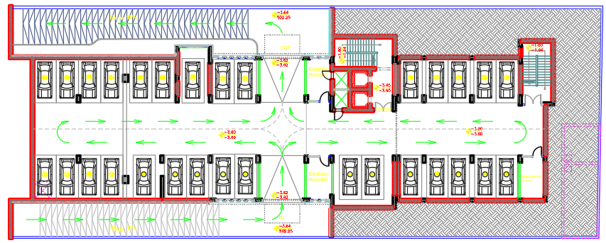
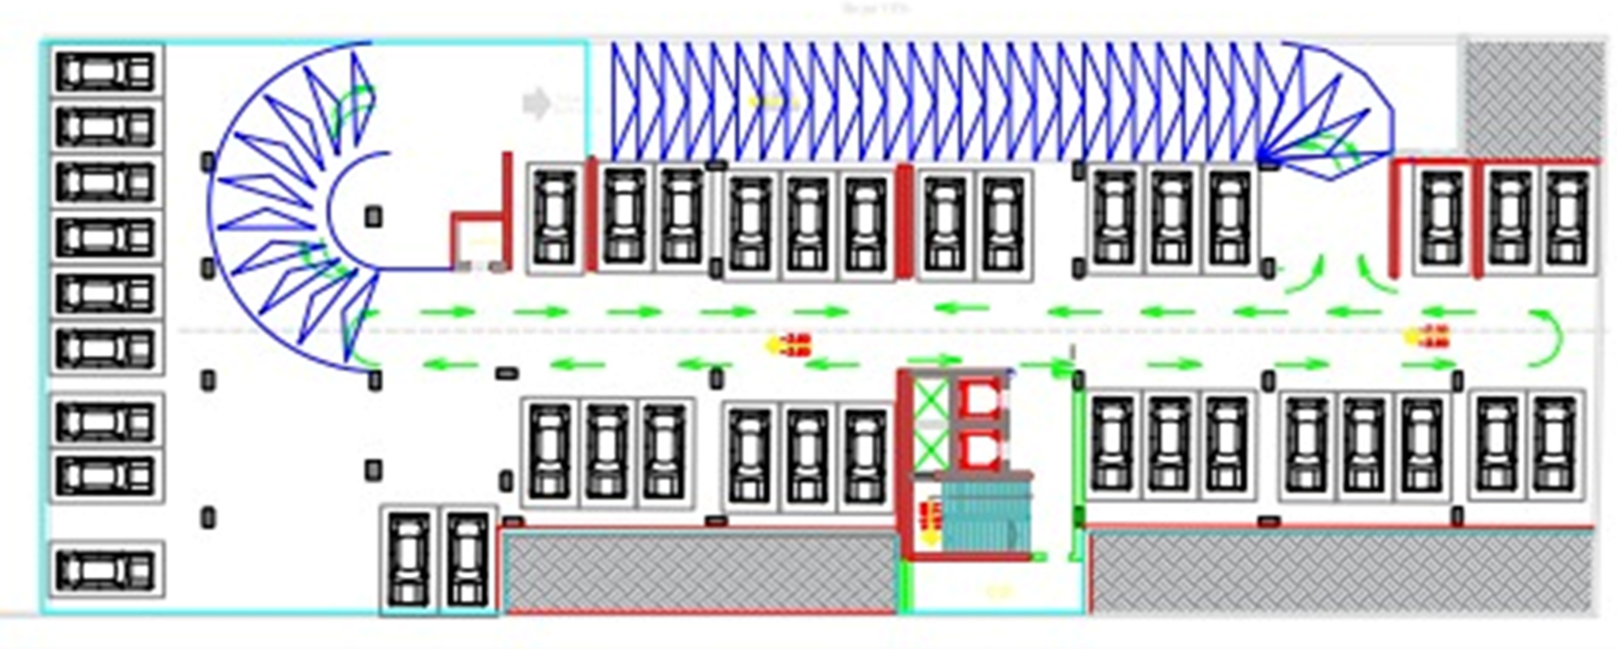
Architectural Aspect
Basement Plans
Before Modification
After Modification
N

Slide 8
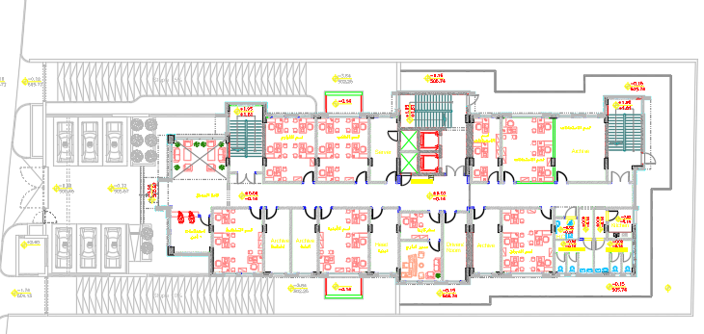
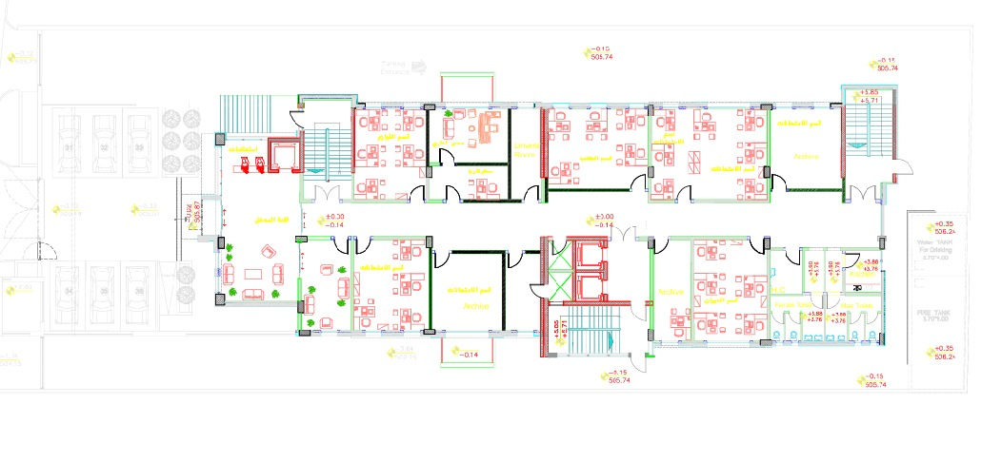
Architectural Aspect
Ground Plans
Before Modification
After Modification
N

Slide 9
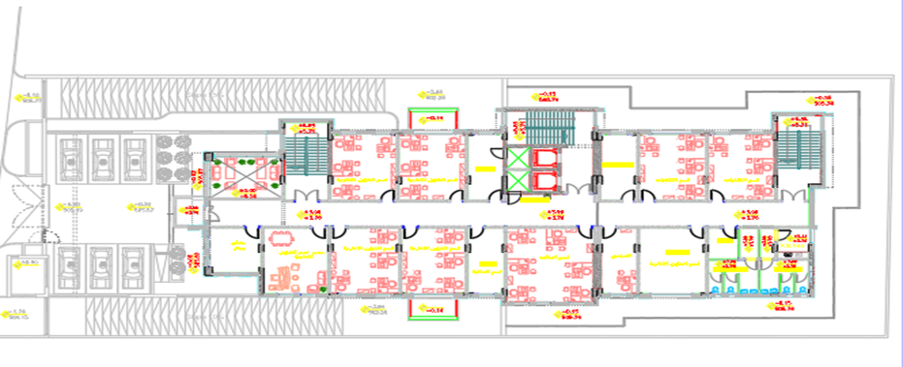
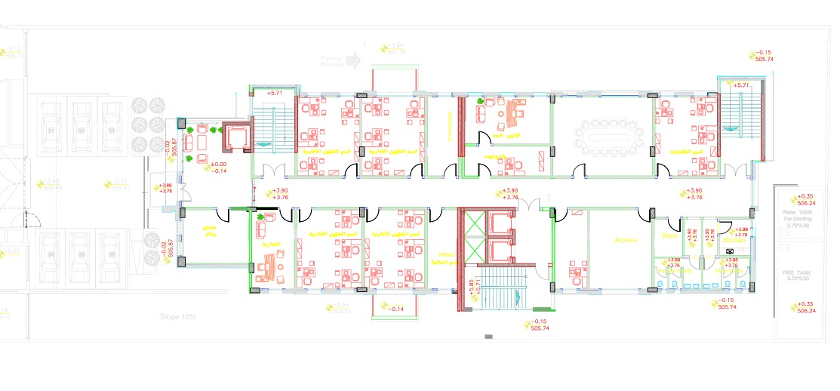
Architectural Aspect
First Plans
Before Modification
After Modification
N

Slide 10
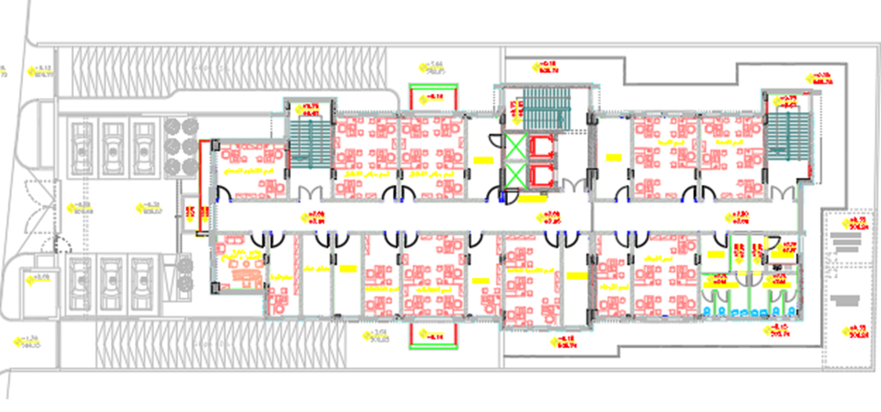
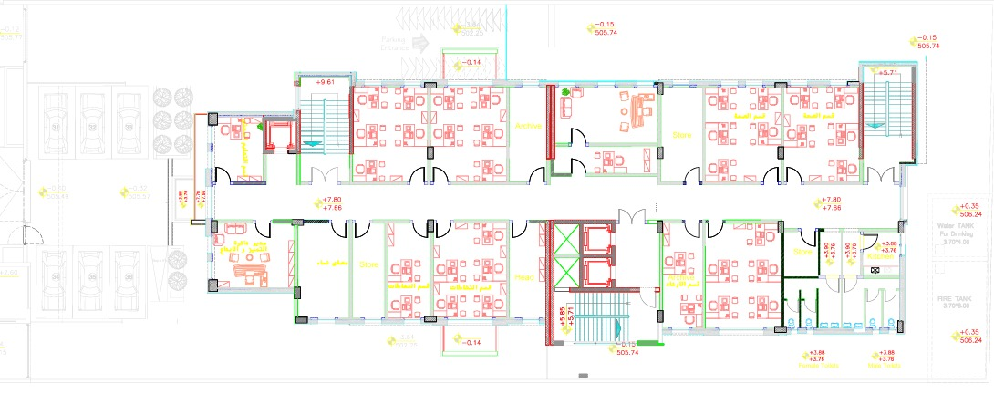
Architectural Aspect
Second Plans
Before Modification
After Modification
N

Slide 11
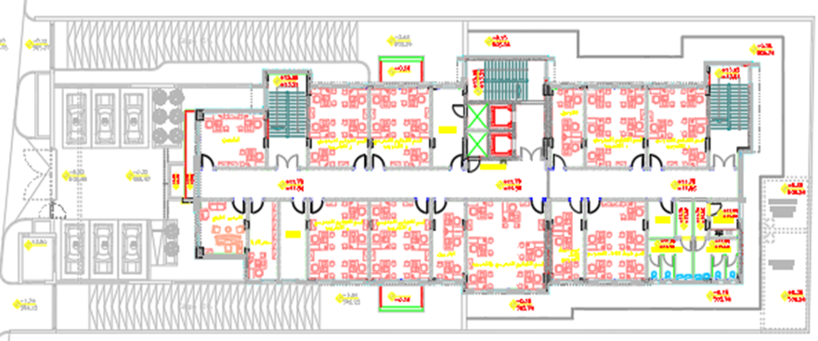
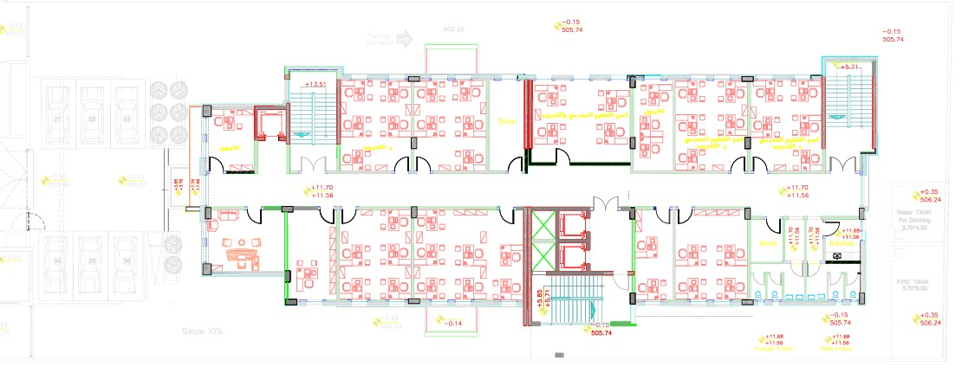
Architectural Aspect
Third Plans
Before Modification
After Modification
N

Slide 12
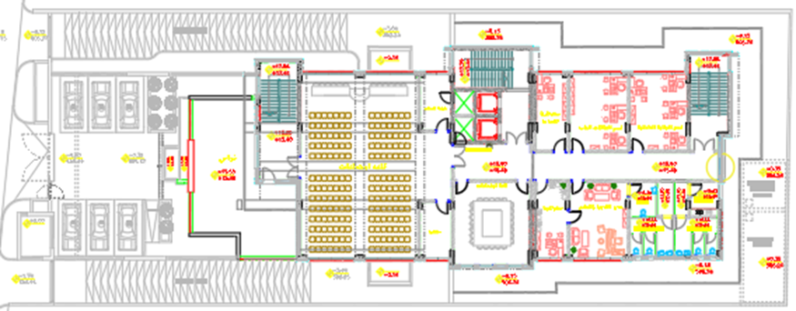
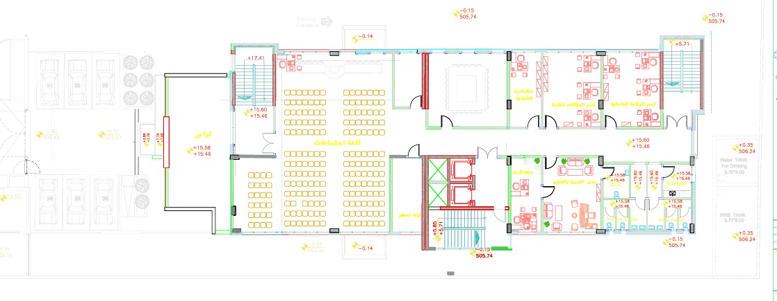
Architectural Aspect
Fourth Plans
Before Modification
After Modification
N

Slide 13
3.
Environmental Aspects

Slide 14
Thermal Analysis
And Comfort
Daylight Factor
Environmental Aspects
Over Shadowing
And Solar Radiation
CDF Analysis
And Design
Design Builder
Analysis

Slide 15
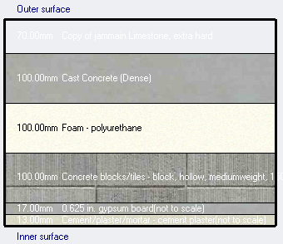
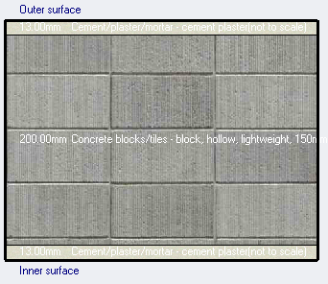
Design Builder data
External wall
internal wall
U-value = 4.192 w\m2.k
U-value = 4.882 w\m2.k

Slide 16
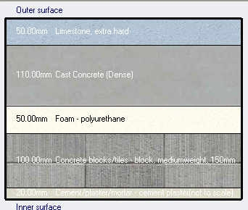
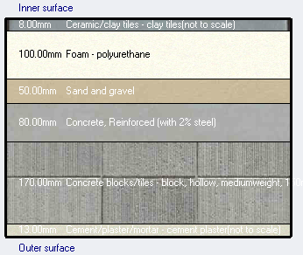
Design Builder data
External wall
internal wall
U-value = 0.452 w\m2.k
U-value = 0.245 w\m2.k

Slide 17
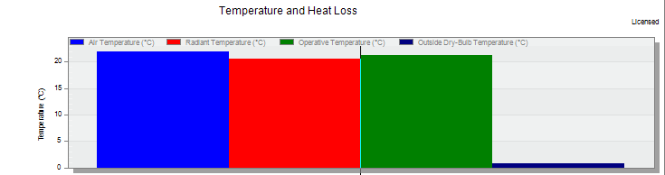
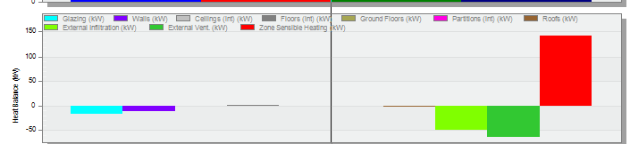
Design Builder data
Heating load
Temperature
Heat losses
Total heating load = 170.176 KW

Slide 18
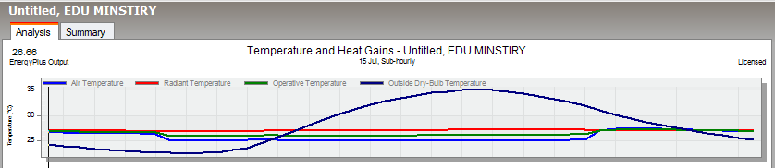

Design Builder data
Cooling load
Temperature
Heat gain
Total cooling load = 102.17 KW

Slide 19
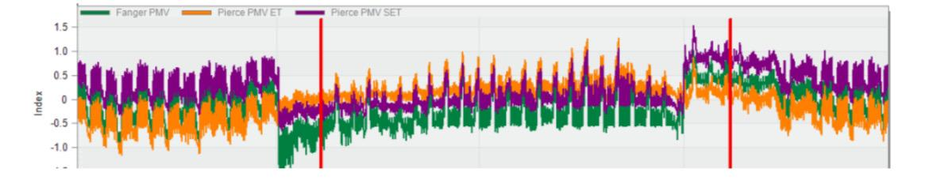
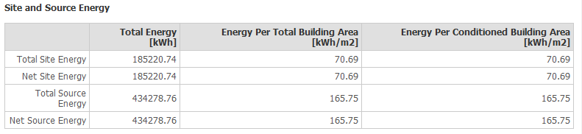
Design Builder data
Thermal comfort
PMV index value
The site and source energy
Building hours = 400 hr
Final total consumption= 165.75 kw/m2

Slide 20
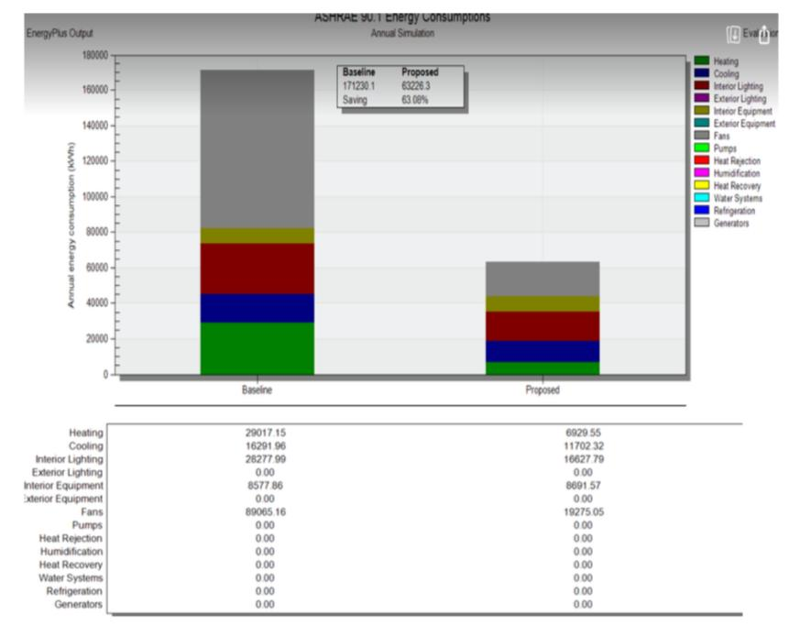
Design Builder data
the conservation ratio between the building after insulation and the baseline is 63.06%

Slide 21
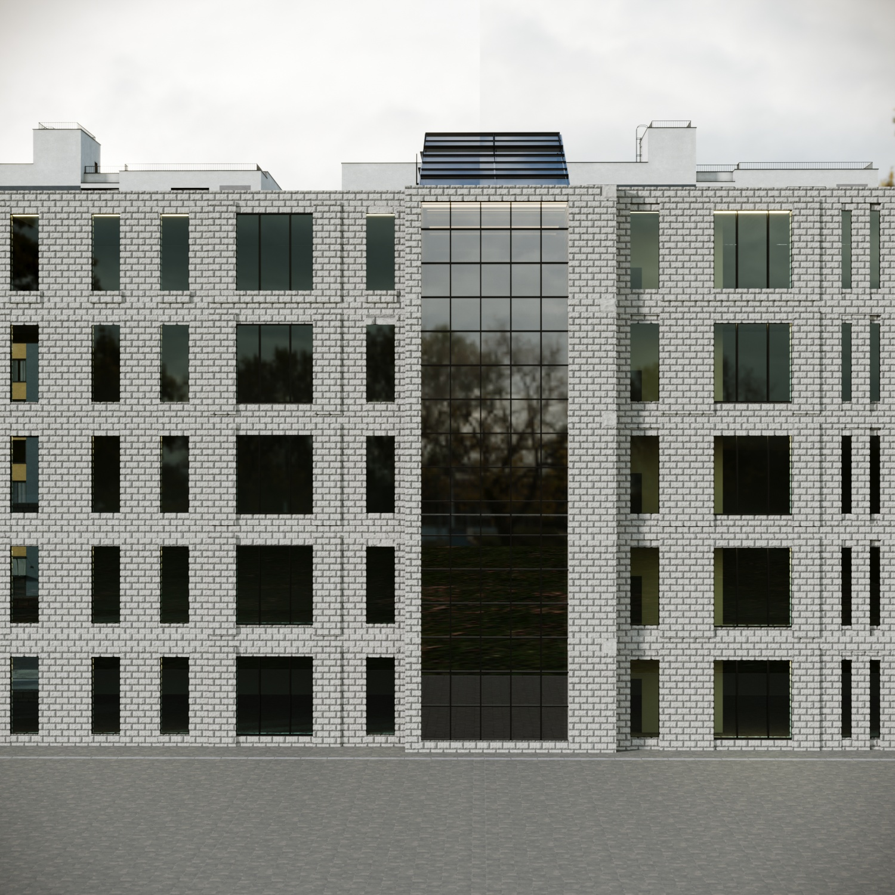
Daylight Factor modifications action:
To solve the problem
Enlarged the windows
Using double low e glass
Using thermal insulation in walls and roof to enhance cooling load
Solar chimney

Slide 22
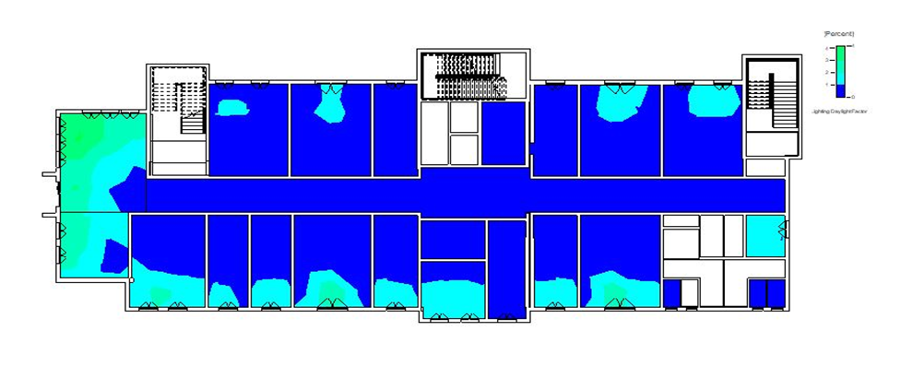
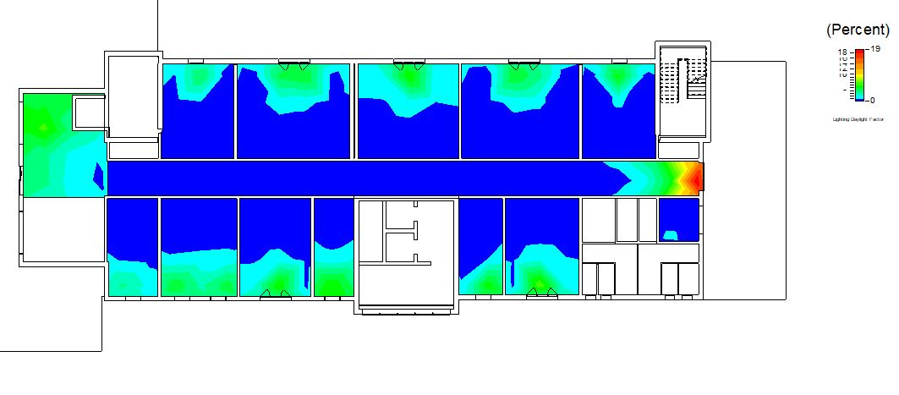
Daylight Factor
Ground floor
Before Modification
After Modification

Slide 23
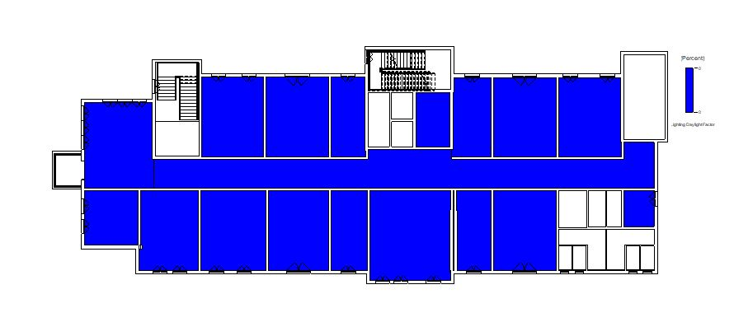
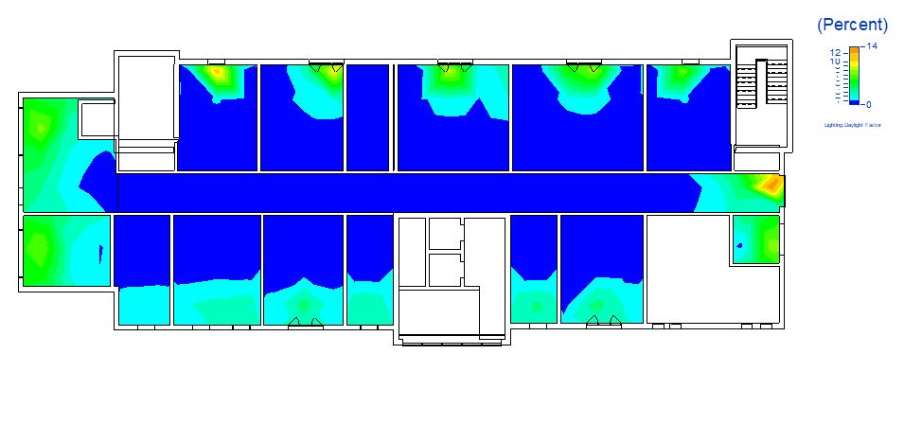
Daylight Factor
First floor
Before Modification
After Modification

Slide 24
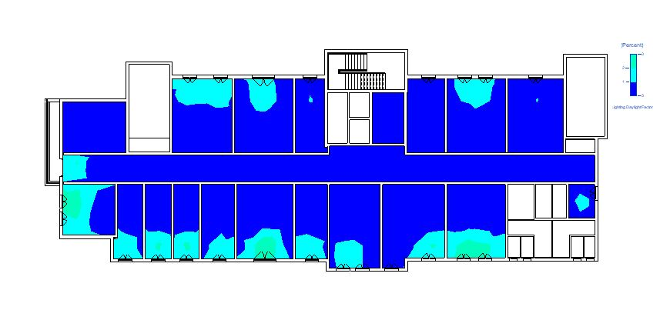
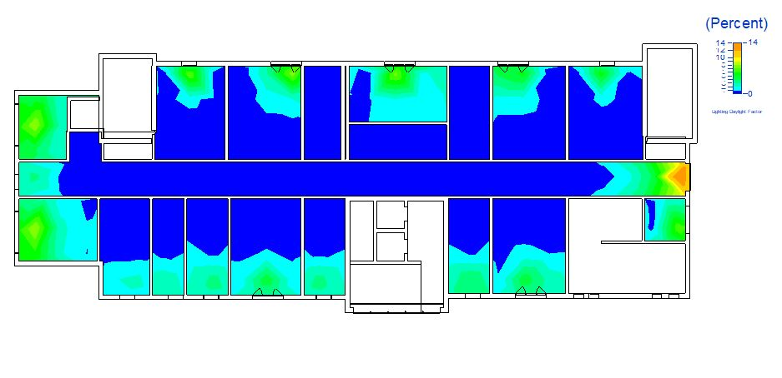
Daylight Factor
Second floor
Before Modification
After Modification

Slide 25
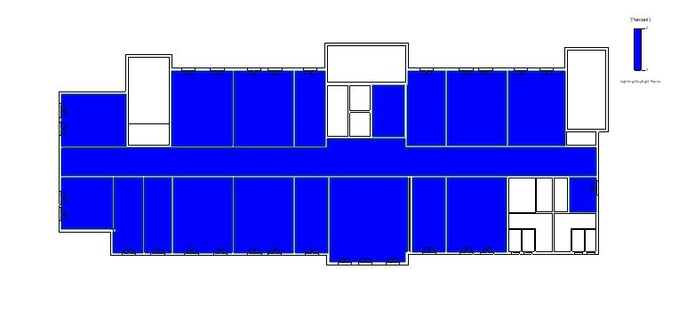
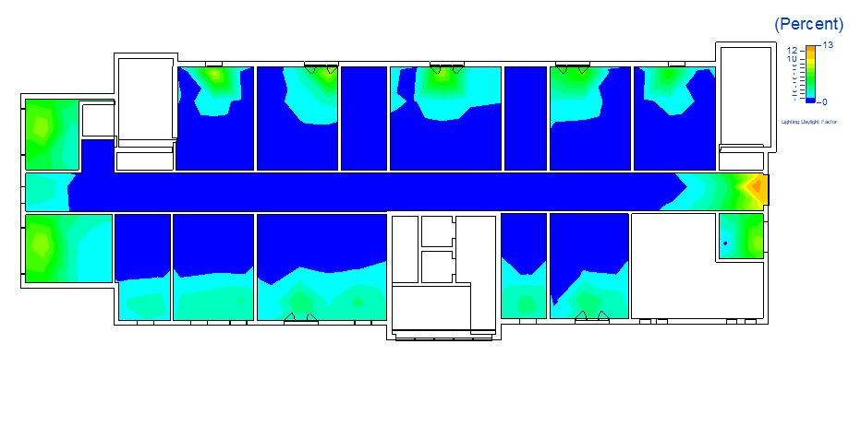
Daylight Factor
Third floor
Before Modification
After Modification

Slide 26
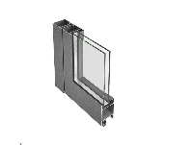
Solar chimney
Double glass

Slide 27
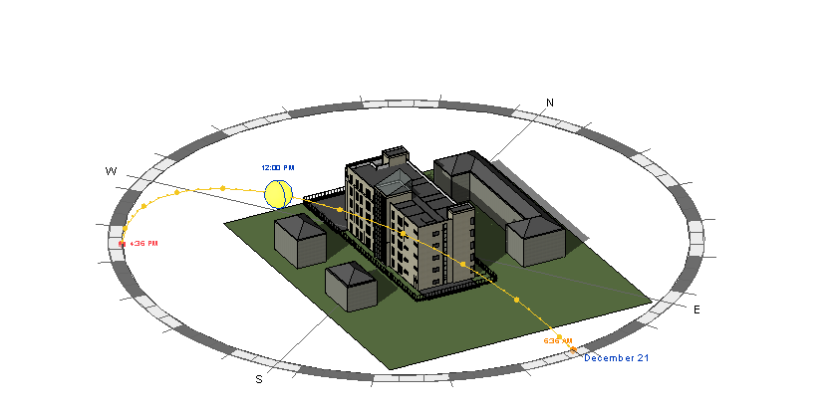
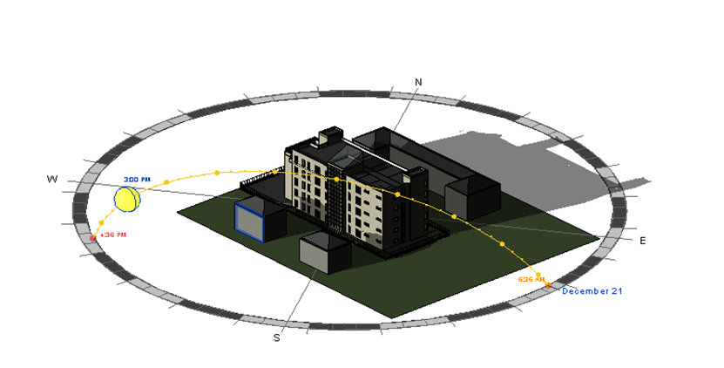
Shadowing and overshadowing
Winter (21-12)

Slide 28
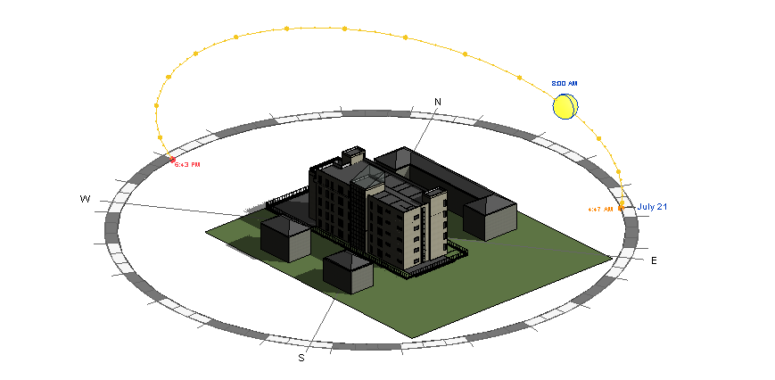
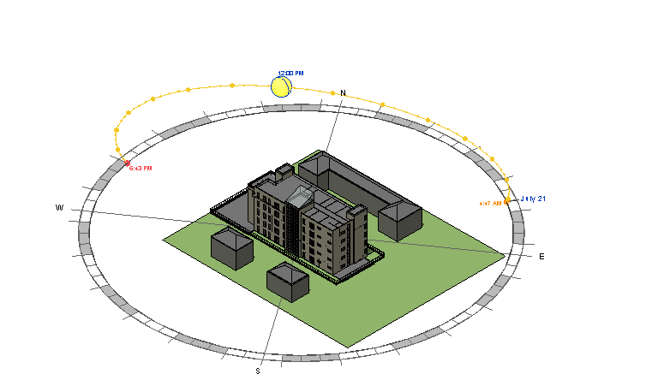
Shadowing and overshadowing
Summer (21- 07)

Slide 29
4.
structural Aspects

Slide 30
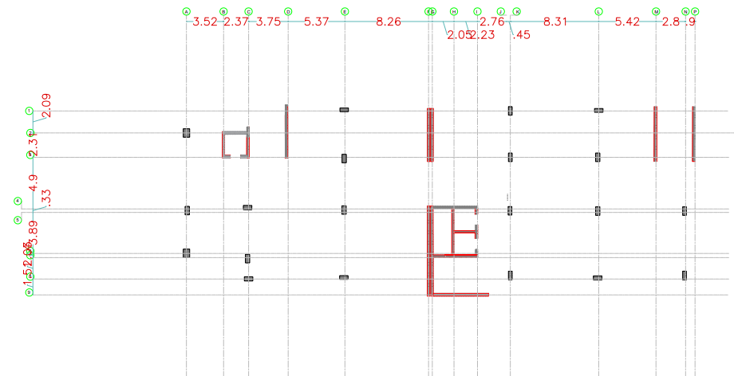
Column Distribution

Slide 31
ASSUMPTIONS:
The following codes were used in the structural design:
¬ ACI 318- 2014. Code
¬ Uniform Building Code (UBC 97).
¬ American Society of Civil Engineers (ASCE)

Slide 32
Load effect
 | Etabs kN/m2 | Manuel kN/m2 | % Error
Live Load | 15915 | 15941 | 0.16
SID Load | 16783.8 | 16811.2 | 0.16
Dead Load | 30135.7 | 28757.37 | 4.79

Slide 33
Designing Data:
Structural Component | Compressive Strength (f’c) | Unit Weight (ɣ)
Columns and Shear Walls | 28 MPa | 25 KN/m³
Slabs and Beams | 24 MPa | 25 KN/m³
Specifications | Yield Stress (Fy) | Modulus of Elasticity (E) | Unit Weight
Reinforcement Steel | 420 MPa | 200GPa | 78.5 KN/m³

Slide 34
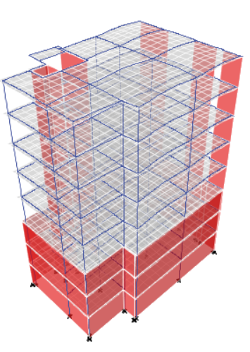
Structural model

Slide 35
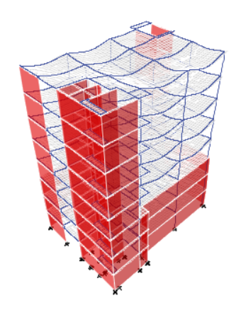
Compatibility Check for the first part of the building
 | Etabs | Manuel | % Error
Live Load | 15915 | 15941 | 0.16
SID Load | 16783.8 | 16811.2 | 0.16
Dead Load | 30135.7 | 28757.37 | 4.79
Compatibility check for the first part of the building

Slide 36
Compatibility Check for the second part of the building
 | Etabs | Manuel | % Error
Live Load | 14710 | 14766.4 | 0.38
SID Load | 15513 | 15572.48 | 0.38
Dead Load | 26470 | 25172.31 | 5.16

Slide 37
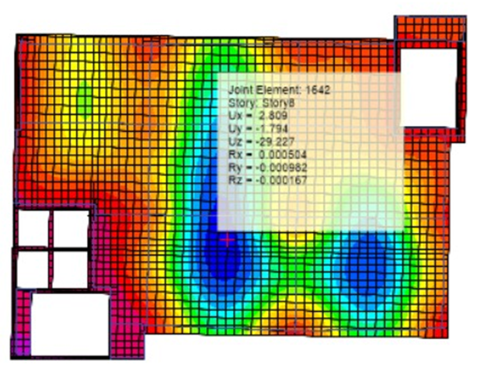
Deflection check part 1
Etabs result = 0.029 m … deflection check passed

Slide 38
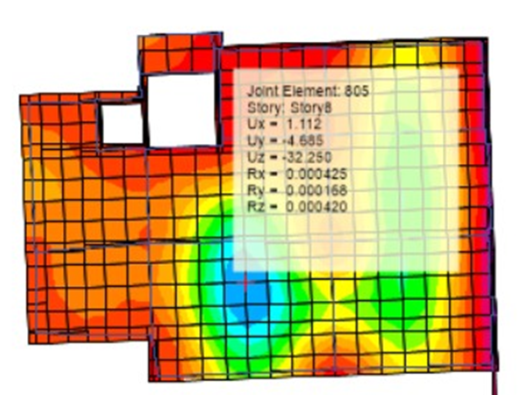
Deflection check part 2
Etabs result = 0.032 m … deflection check passed

Slide 39
Internal forces checks
Stress-Strain Check
beam
Negative moment for beam = 352 KN
Positive moment for beam = 196 KN
• Percentage of error
Negative moment for beam = 15%
Positive moment for beam =5%
column
Etabs= 2835.55
Manuel= 2561.93
% Error = 10.6

Slide 40
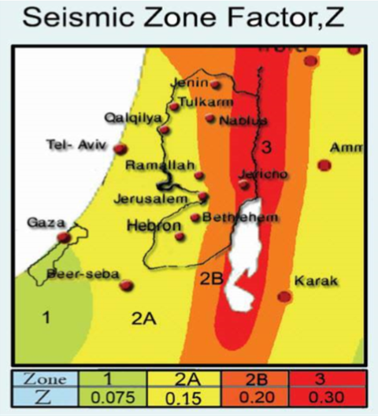
Seismic Design
Seismic zone : The faculty is located in Nablus city Therefore, the seismic zone is 2B and the Z value is equal to 0.20.
Soil profile: The soil type is rock so the soil profile is SB
Force Reduction Factor R = 5.5 (Building Frame System - shear wall)
Importance Factor I = 1.25
Acceleration-Dependent Seismic Coefficient Ca = 0.2
Velocity-Dependent Seismic Coefficient Cv = 0.2

Slide 41
Seismic checks
1. Period Check
T=0.76 sec.
(Tx) = 0.65 sec < 0.76sec, the check is ok
(Ty) = 0.43 sec < 0.76 sec, the check is ok.

Slide 42
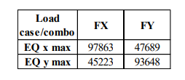
2. Base-shear check
Etabs
Manual
W = 87729kN
Fx = 8503 kN
Fy = 5221 kN
Base shear results from ETABS are more than manual calculations, so check is ok.

Slide 43
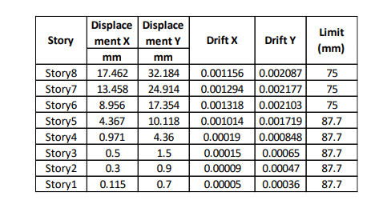
Drift check
All drifts in floors < limit, so the check is ok

Slide 44
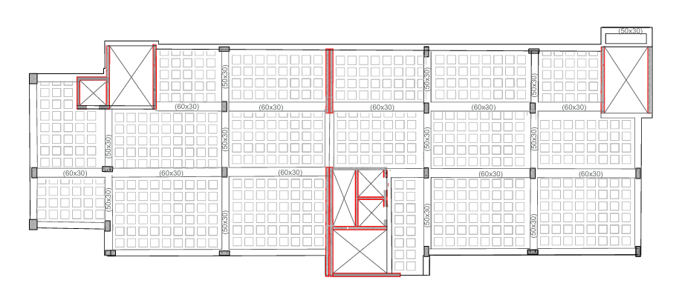
Design of structural elements
Slabs
Ribbed distribution

Slide 45
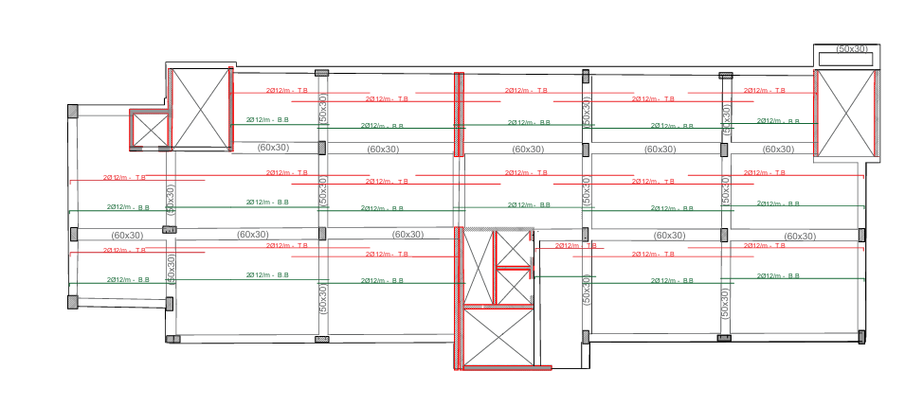
Reinforcement for floors

Slide 46
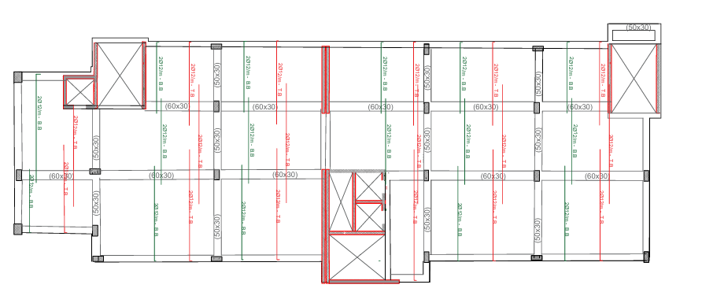

Slide 47
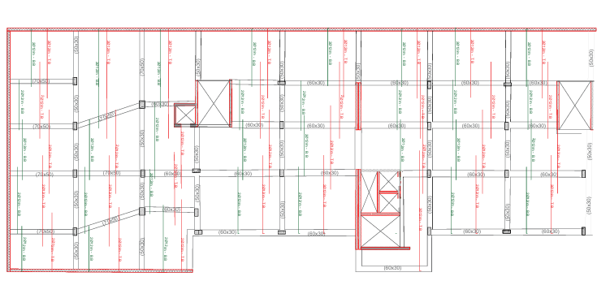
Reinforcement for basement

Slide 48
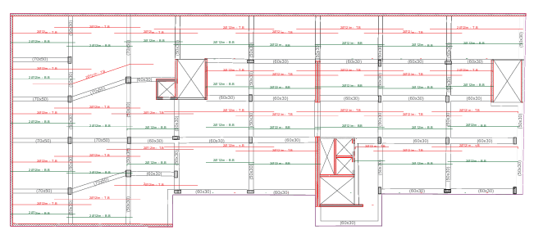

Slide 49


Slide 50

Footing Rainforcment

Slide 51


Slide 52


Slide 53

Shear wall details

Slide 54


Slide 55

Beam Details

Slide 56

Stairs

Slide 57
Water supply
Fire alarm an
Firefighting systems
Artificial
lighting
Acoustical
design
Electro-mechanical Aspect
HVAC
design
Drainage system
Power
design

Slide 58
5.
Electro-mechanical
Aspects

Slide 59

Artificial Lighting
Space Analysis and Design have both been done with DIALux evo
Employees Office

Slide 60

Meeting room:

Slide 61

Manager room

Slide 62

Archive room

Slide 63

Multipurpose room

Slide 64

Reception + waiting room

Slide 65

Corridor

Slide 66


Bathroom & W.C

Slide 67

Garage

Slide 68

Artificial plan for the first basement.

Slide 69

Artificial plan for ground floor

Slide 70

Artificial plan for first floor

Slide 71

Artificial plan for second floor

Slide 72



Electro-mechanical Aspect
HVAC Design
The system used for HVAC is Variable Refrigerant Flow (VRF) system with casset unit.
Out Door Unit
Indoor Unit
Casset Unit

Slide 73

HVAC Design
VRV System Concept

Slide 74
Acoustical design
Standards:
Reverberation time
Office: 0.40-0.70 sec (Recommended reverberation times for 7 key spaces 2020)
Meeting hall: 0.80-1.90 Sec (Target Reverberation Time - Commercial Acoustics® 2020)
Meeting room: 0.60-1.20 Sec. (The Reverb Problem – Scale and Context 2021)
Noise criteria
Noise criteria (NC) is: NC35-NC40 (Noise Criteria For Rooms, 2020).
Sound transmission index (STI)

Slide 75

As shown in Table, STC will be design at 50 dB.

Slide 76


Slide 77

External wall

Slide 78





Smoke dedicators
Fire fighting system
sprinklers
fire alarm
fire extinguishers
fire hoes

Slide 79
Fire fighting system
In our building we have meeting hall, offices , kitchen, praying rooms, waiting areas and parking so we used:-
Type of spaces | Used fire suppression system | Fire detector system
Meeting hall | Fire extinguisher (class A, C) , water sprinkler | Smoke detector
Offices | Fire extinguisher (class A) , water sprinkler | Smoke detector
Kitchen | Fire extinguisher (class K) , water sprinkler | Flame detector
Praying rooms | Fire extinguisher (class A) , water sprinkler | Smoke detector
Waiting areas | Fire extinguisher (class A) , water sprinkler | Smoke detector
Parking | Fire extinguisher (class B) , water sprinkler | Flame detector

Slide 80

Fire fighting system
Vertical system

Slide 81

Quantity Surveying & Cost Estimations

