Slide 1


Operations Improvement At Aziza Company – Cows
An-Najah National University
Faculty of Engineering and Information Technology
Industrial Engineering Department
Graduation Project ( 2 )
Supervisor Name: Eng. Suleiman Dafi

Slide 2




The teamwork
Ahmad Tayseer
Omar Abdi
Mohammed Jaffar
Fuad Fattoh

Slide 3



Outline
Review of the first graduation project
Documentation of procedures
Development
Organizational structure
Job descriptions
Conclusion
Recommendation

Slide 4
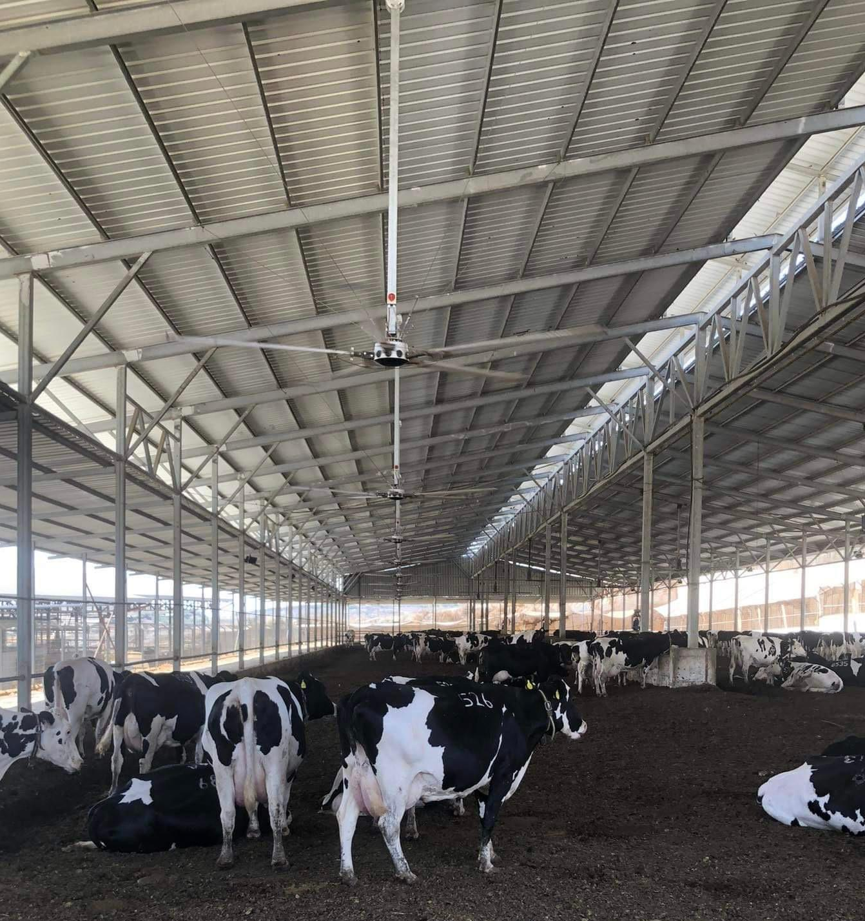
Introduction
Aziza Dairy Farm was established in 2018. The farm was mainly inaugurated by the main company “PADICO” for internal trade between Aziza Company and Pinar Company. The farm is located in Kour District, Qalqilya. Its area is 20,000 square meters and it consists of 6 hangars, a main building for workers, a laboratory and an automatic milking parlour. There are between 6-9 workers working on the farm around 24 hours. The average farm yield is 26 liters of milk per cow.

Slide 5
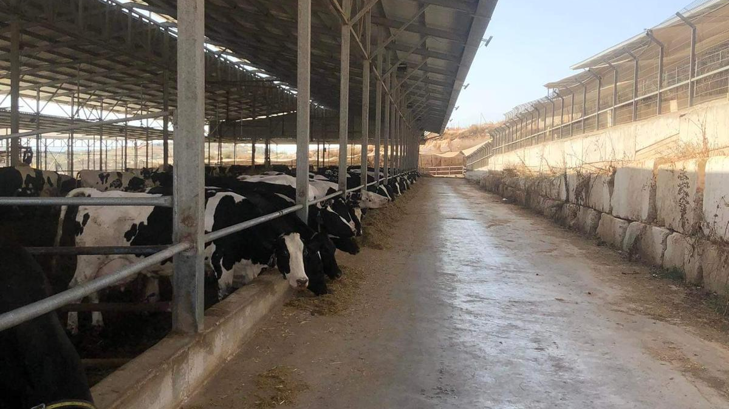
Problem Statement
The main problem is Confronting farm procedures and traditional practices that prevented them from increasing the productivity of cows' milk and which found problems in engineering methods for managing work and dealing with cows,
Wrong planning and implementation of work procedures and cows exposed to many diseases that affect their production and lack of safety.

Slide 6

Objectives
Raising the level of productivity on the farm
Developing a farm organizing system
Developing farm-specific technological and engineering solutions
Creating a farm management system from an administrative and technical standpoint
Attention to maintenance operations on the farm

Slide 7
Methodology
Data collection and studying the current situation
Identify the main problem
Search on theoretical back & Previous work
Identify Constrains
Apply what we have studied in previous courses to solve AZIZA farm problems

Slide 8

Documentation of procedures

Slide 9
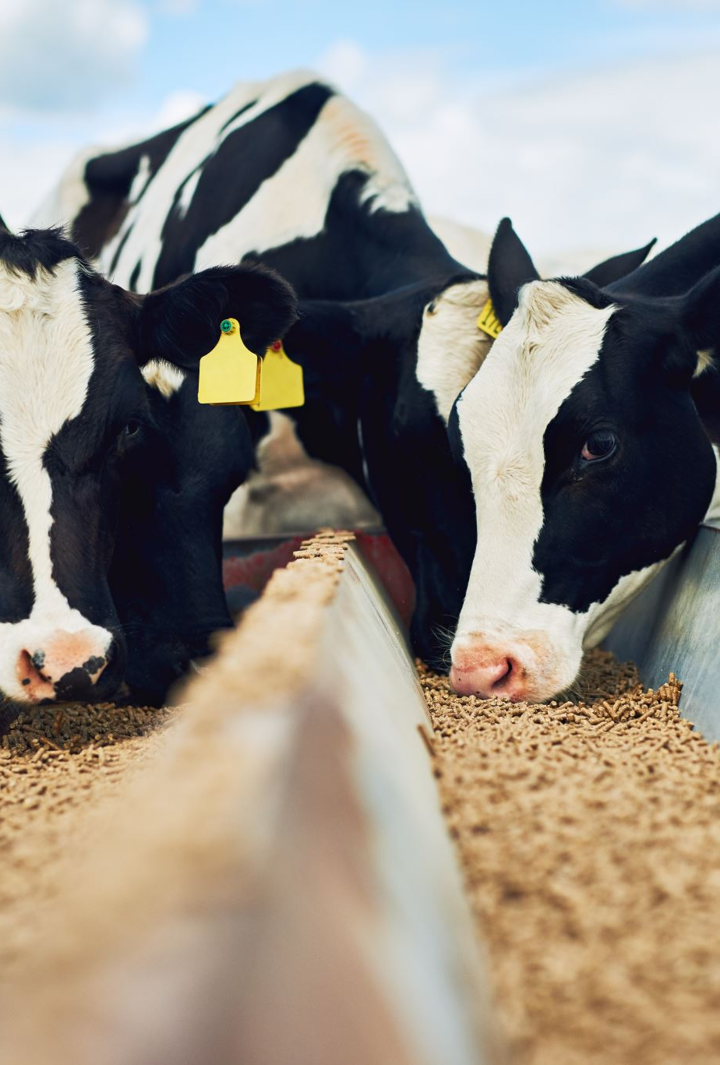
Cow vaccination operations management
Cows' data is recorded on the system
The vaccine and the appropriate time are determined
Cows are assembled and installed
Cows are vaccinated
They are returned to the barn

Slide 10
تطعيم الأبقار
البداية
الدخول للمبنى الاداري
تطعيم العجول (كلاستريدم)
تسجيل بيانات الابقار
اختيار الطعومات المناسبة لحالة الابقار
تحديد مواعيد الطعومات
التوجه للمزرعة
تنظيف المشارب
تجميع الابقار
ميكانيكيا
تثبيت الابقار
يدويا
تثبيته بالممر الاوتامتيكي
تثبيته بالحبال
تطعيم البقرة
النهاية

Slide 12

Maintenance operations management
Go to the problem place.
Evaluate the problem.
Fill out a maintenance request form.
Work to fix the problem

Slide 13
البداية
الصيانة :
الذهاب الى موقع المشكلة
يتم فحص المشكلة
لا
تقييم ما إذا كان يمكن حل المشكلة داخليًا
نعم
يتم إرسال نموذج طلب طاقم خارجي إلى المدير مع التفاصيل
عاجلة
تقييم ما إذا كانت المشكلة عاجلة
غير عاجلة
يتم إرسال الموافقة و إجراء الطلب
يتم حل المشكلة بسرعة
يتم حل المشكلة
يتم تعبئة استمارة طلب للمواد المطلوبة لحل المشكلة
يتم ملئ نموذج صيانة بجميع التفاصيل
الانتظار على الموافقة على الطلب
يتم حل المشكلة
النهاية

Slide 15
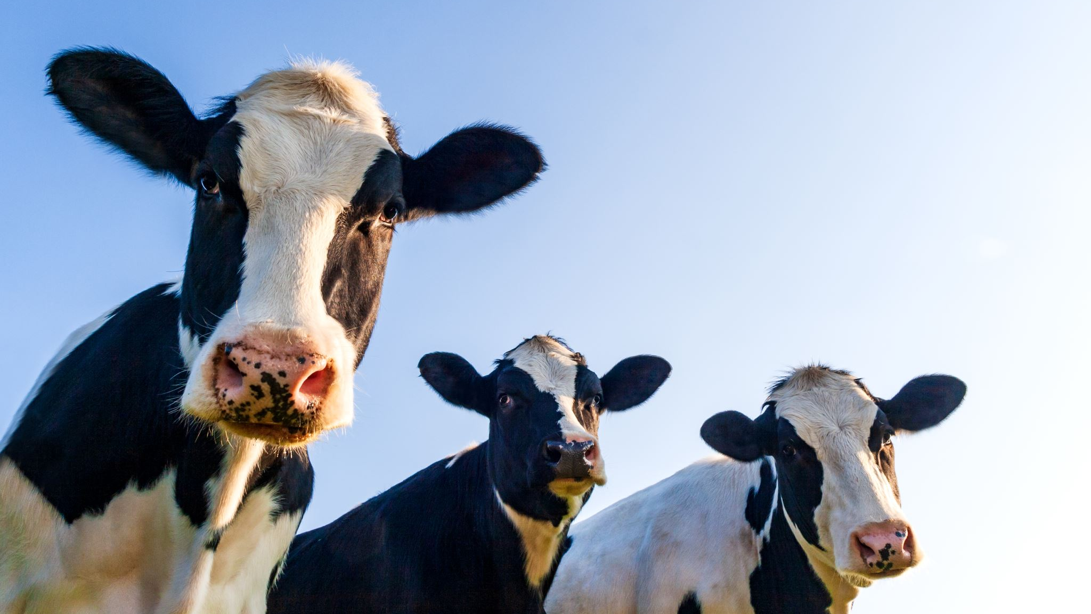
Milking operations management
Cows are grouped
They are taken to the parlour
They are cooled before entering the milking parlour
They are sterilized before milking
Milking them
Sterilize them after milking
Bring them back to the barn

Slide 16
البداية
الحلب :
تجميع الابقار عند مدخل الحظيرة
انتقال الابقار من الحظيرة الى المحلب
تبريد الابقار قبل الدخول الى المحلب باستدام المراوح و المياه
ادخال الدفعة الاولى من الابقار والتي تشمل 32 بقرة الى المكان المخصص في المحلب
تبدا عملية التعقيم للابقار باستخدام اليود
تجيهز المحلب ومعداته استعداد لبداية الحلب
تبدا عملية التخزين وترحيله الى المحلب
بدأ مرحلة الحلب
تستمر عملية الحلب من 10- الى15 دقيقة
عند انتهاء الحلب تبدا عملية التعقيم الثانية للابقار
تجهيز الابقار للخروج من المحلب وبداية الخروج
فحص اللحليب الناتج
مقبول
تجهيز الدفعة الثانية من الابقار الى الدخول ال المحلب
مرفوض
عودة الدفعة الاولى من الابقار الى الحظيرة وبداية المرحلة الثانية من الحلب
اتلاف الحليب
النهاية

Slide 18
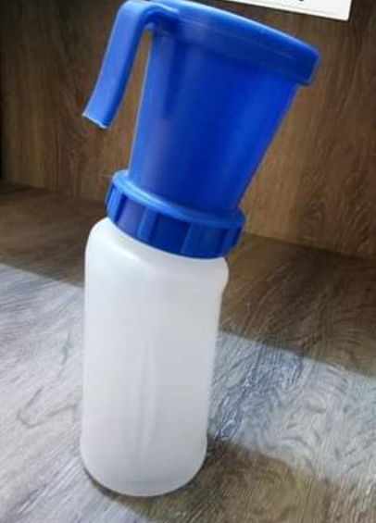
Development
Accelerate the sterilization process with better efficiency.
Reducing the use of external maintenance.

Slide 19
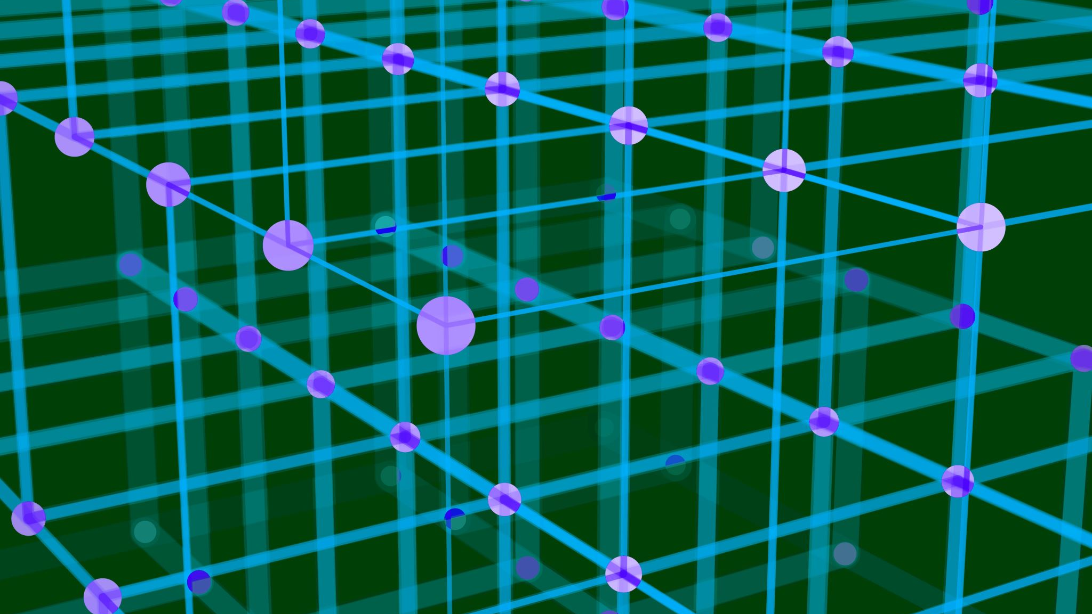
Organizational structure

Slide 20
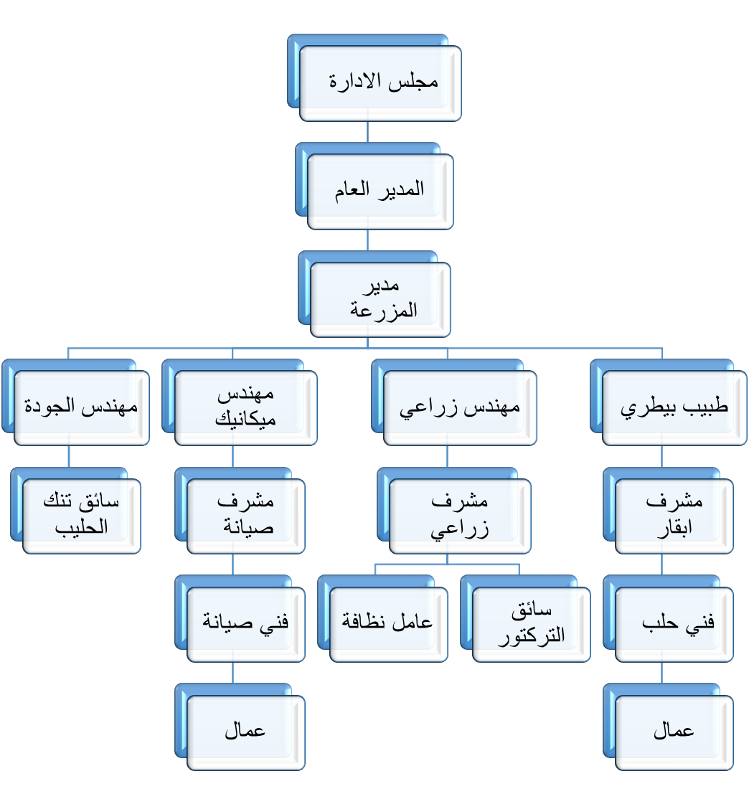

Slide 21


Slide 22
Job descriptions
General Director
vice president
Vet
The engineer
The Worker

Slide 24
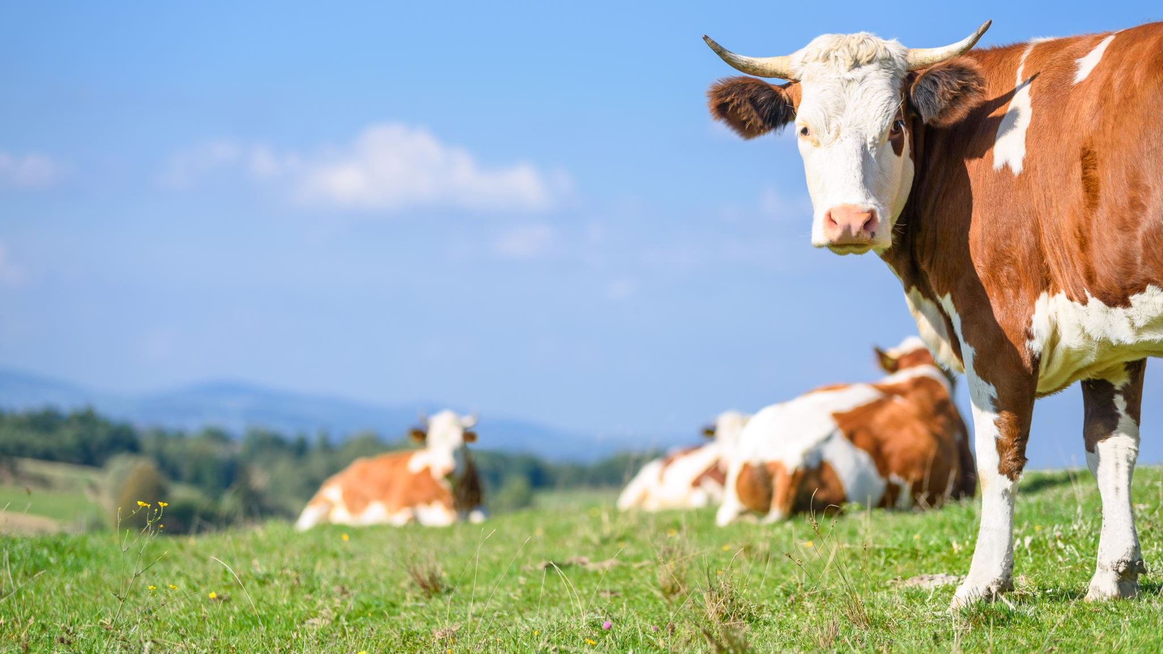
Conclusion
In the end, we conclude that the farm suffers from several problems, and the administration is interested in overcoming them. Therefore, in this project, most of the problems facing the farm were solved by:
Document all procedures and operations inside the farm.
Develop an organizational structure.
Work job descriptions.

Slide 25

Recommendation
Create the organizational structure proposed in this project with the specified job description.
Applying the proposed scheme in this project, which will increase the efficiency of the farm.
Approval of the procedures manual that was carried out in this project, and the commitment of all employees to it.
Equipping sprinklers in the barns to help the cows cool down and reduce humidity.
Giving bonuses to employees and motivating them to stay and work harder.
Obtaining better tools and more experienced maintenance personnel to reduce external maintenance expenses.

Slide 26


