Slide 1
Coin Recognition Using MATLAB
- Emad Zaben
- Bakir Hasanein
- Mohammed Omar

Slide 2
Introduction
There are several methods in recognize coins:
1. Mechanical method based systems;
2. Electromagnetic method based systems;
3. Neural networks and digital image processing based systems.

Slide 3
Introduction
Using digital image processing it’s possible to obtain the most accurate method by reading the details of an obtained photo to compare it with the properties of another standard photo.

Slide 4
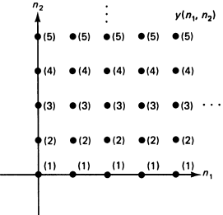
Digital Image Processing
Digital image processing method depends on two dimensional Fourier transform so the obtained samples of the photo would be formed in a two dimensional array as in the following:

Slide 5
Digital Image Processing
The method of digital image processing done by taking a finite number of samples whatever the scale of the photo so it’s possible to control the accuracy of a digital image by increasing or decreasing the number of samples (pixels).

Slide 6
Digital Image Processing
Each pixel would has two properties:
The intensity: which relates to the amount of light or the numerical value of a pixel;
Location address: the location of a pixel within the array of pixels (samples).

Slide 7
Edge Detection
There are many algorithms to process a photo, edge detection is one of simplest methods which depends on significant changes like color or some physical aspects.

Slide 8
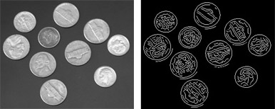
Edge Detection
The simple meaning of edge detection is to transform a photo into set of curves; the curves are the boundaries which split the significant changes so some properties of the photo could be treated.

Slide 9
Neural Networks
- Neural network is a method to learn a system to deal with new changes which are not seen before by it, so it looks like a system learns from the experience;
- Neural network could be seen as a method to produce an approximation functions that would be used to predict the output; these approximations would be done using a stored data.

Slide 10
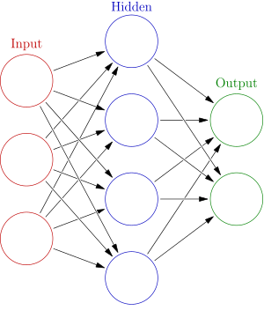
Neural Networks
The neural network consists of three parts:
1. Input;
2. Hidden;
3. Output.
Each part consists of neurons (nodes).

Slide 11
Neural Networks
Input nodes represent the stored data within the network which would be used to give the network the experience;
Output nodes which would be used to give the output (result);
Hidden nodes which could be used to map the input to output but indirectly to increase the experience of the network.

Slide 12
Neural Networks
- Hidden nodes could be used or not, if they are not used (single-layer network), the input data should match one of stored data within input nodes to give a correct output.
- If hidden nodes are used (double-layer network), the network would give a correct output when the input is close to or match the stored data within input nodes.

Slide 13
Methodology
To use neural networks, input nodes should be used with different images for the same coin (rotation of the coin is considered) so a 36 images was taken.
the input photo into the system should be converted to black and white scale (binary) to extract the features then to compare it with the futures of the images that stored within the neural network.

Slide 14
Coin identifier using Digital image processing using MATLAB
Image processing: is a method to perform some operations on an image, in order to get an enhanced image or to extract some useful information from it.
Objective: The main purpose of this project is to apply computer vision techniques to develop a program which should recognize coins in an image by two ways ( will discussed during the presentation) .
Note: Commands used in the Program will discussed every step .

Slide 15
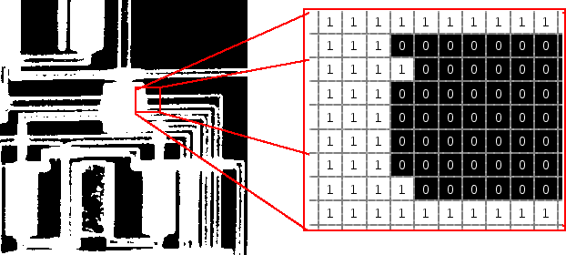
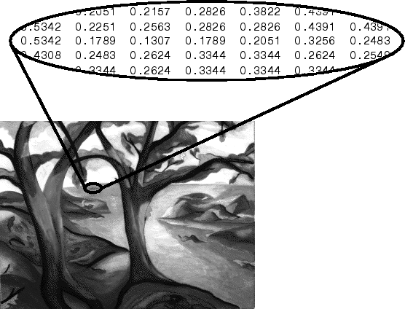
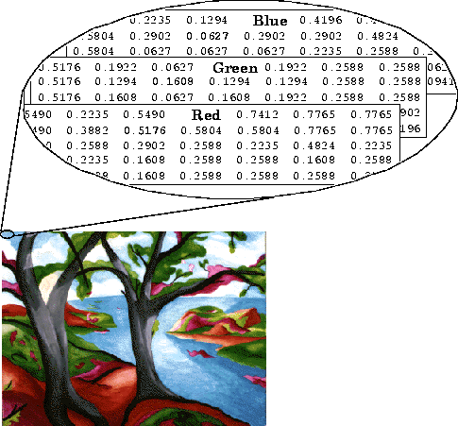
Types of Digital Images:
Binary:
Each pixel is just black or white.
Gray scale:
Each pixel is a shade of gray.
True Color, or RGB:
Each pixel has a particular color.
This color is described by the amount of red, green and blue in it.
Each has range of (0-255)
IMGPROinmatlab.m
Notes:
Binary (0 black 1 white) Gray ( from0 black to 255 white) RGB (this gives a total of 2563 different possible colors. ) Such an image is a “stack” of three matrices

Slide 16
Main commands used in the Program:
imread: reads an image in a certain directory .
Imshow(name.format): shows the loaded image ex:imshow('img1.png').
B=im2bw (A): convert the image to binary.
D=imfill(C,'holes'): fill the shapes after converting to binary to get full empty shape.
[centers, radii] = imfindcircles(D,[20 200],'ObjectPolarity','bright'):
this command used to determine the Centers and radius of each coin ( Filled holes).
h = viscircles(centers,radii) : this command to make circle just on the borders of the converted image.

Slide 17
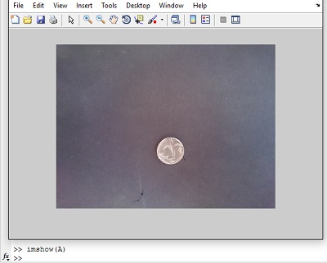
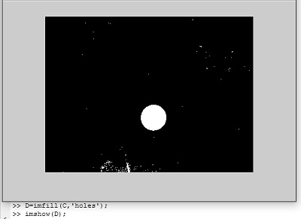
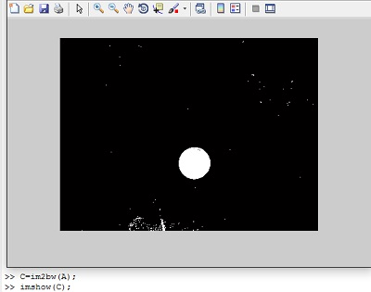
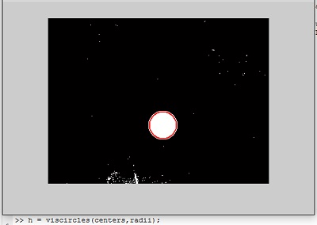

Slide 18
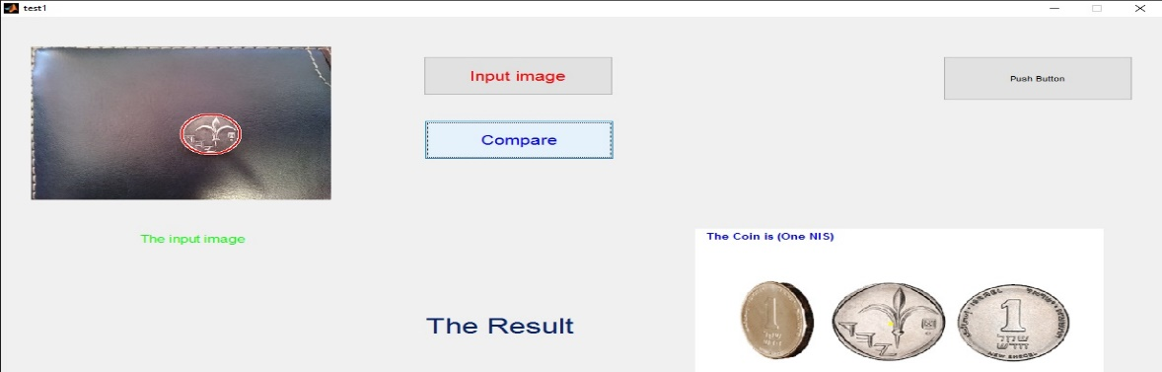
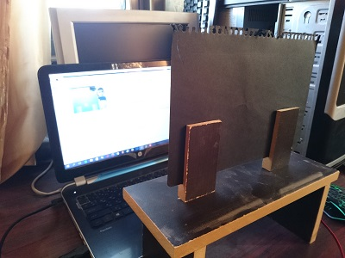
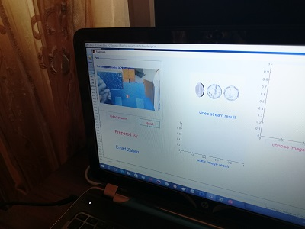
Methodology:
Two methods used to get to the main objective :
Static Image method:
Video Streaming method.

Slide 19
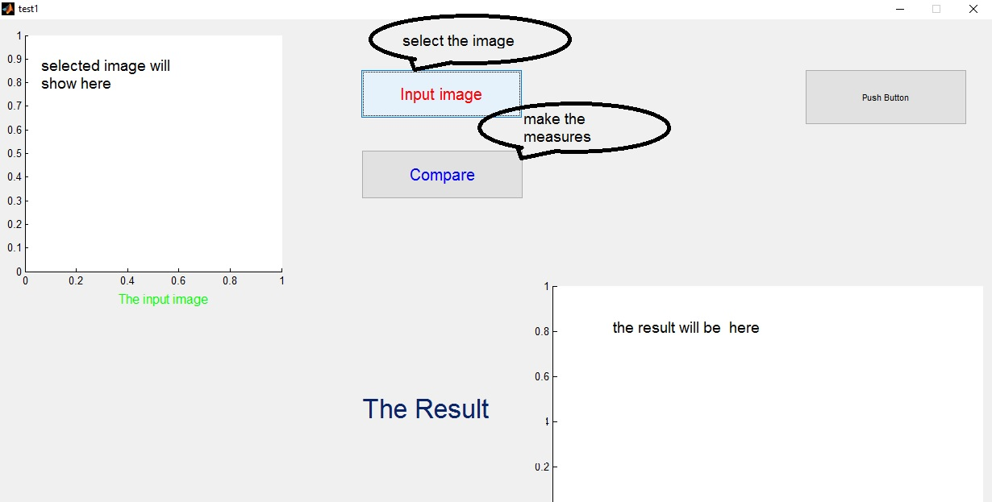
Static Image method:
First step : image selection.
Second step : the image converted to the different types.
Final step : take measurements and display the result.
Notes:
the image with the coin selected and read it by MATLAB, a good camera///////measurements will based on the converted image

Slide 20
Video Streaming method:
First step: a laptop camera will be running .
Second step: each simple time a screen shot
will be made and converted to the other
types of digital images using commands.
Third step :the measurements compared with the data stored previously .
final step: the result will be shown.
FinalDesign.m

Slide 21
Important notes a bout the process:
the distance for the taken photos and the data base photos MUST be the same.( constant distance here I take the photos from 20 cm)
The angle of shooting have to be constant.
For video stream the holder should placed at the same distance when the data stored taken.

