Slide 1

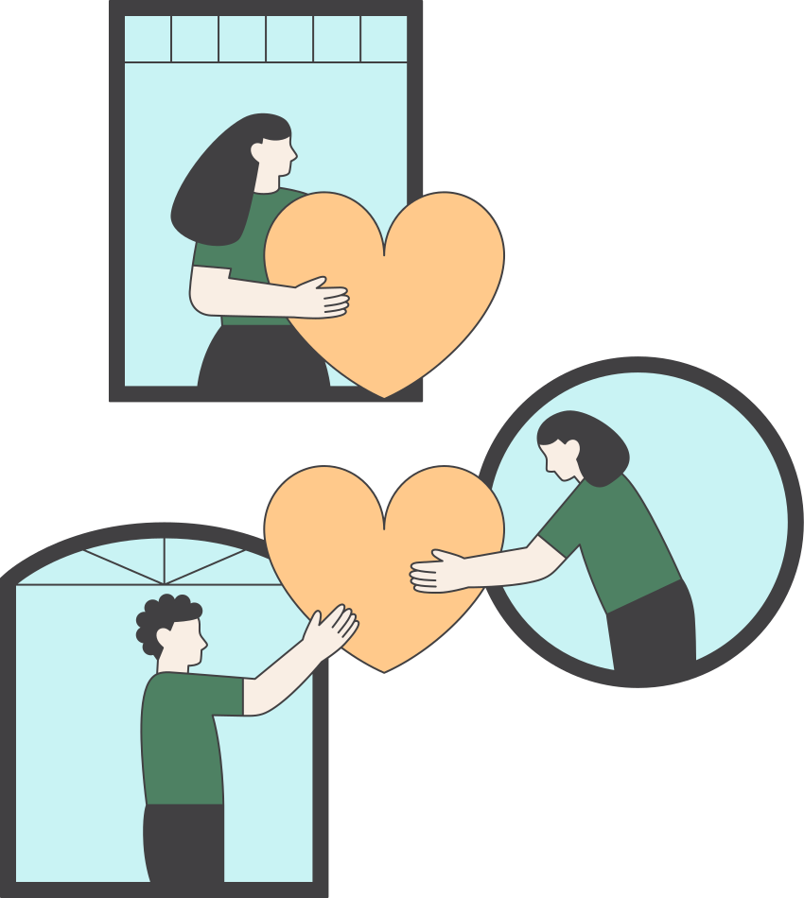




CHARITY
SINCE 2005
IDEAL CHARITABLE CHARITY

Slide 2

01.introduction
02.objectives
03.tools,method,
language programming
04.future work
05.conclusion

Slide 3

introduction

Slide 4
The ideal Charitable Association is an association founded in 2005 and located in the eastern region of Nablus.
The association provides various assistance, such as clothes, food parcels, money, and health tools, to different types of needy people, such as orphans, low-income families, people with special needs, and others.
After studying the association’s situation, it became clear that its mother was still practicing paperwork until now, so we created a complete system consisting of a website and an application.

Slide 5



4 types of user
Admin
Doner
client
volunteer

Slide 6
objective

Slide 7
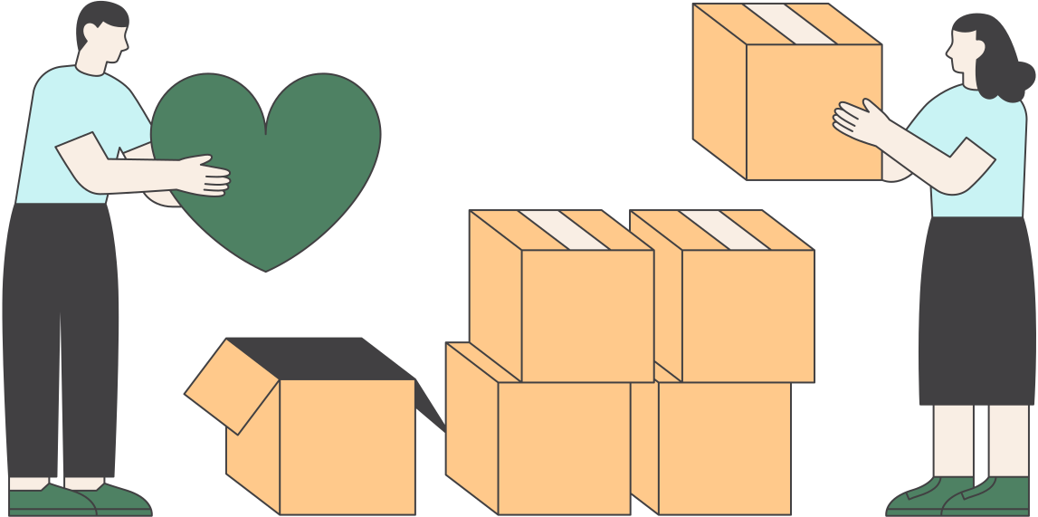
Admin
1. Admin (Association Manager): He has full control and access to the site. He can add users, donors, or volunteers, in addition to distributing the donated aid to those in need and add task to the volunteer
Doner
Donate various types of donations, specifying their type and number, and adding pictures of them
client
Those in need receive aid through manual distribution from the admin or automatically from the site
volunteer
Volunteers for the association to complete the requirements of specific courses or purely volunteer work. They receive assignments from the admin and implement them.

Slide 8
Tools, Methods and Programming
Languages

Slide 9






Slide 10
Future work

Slide 11
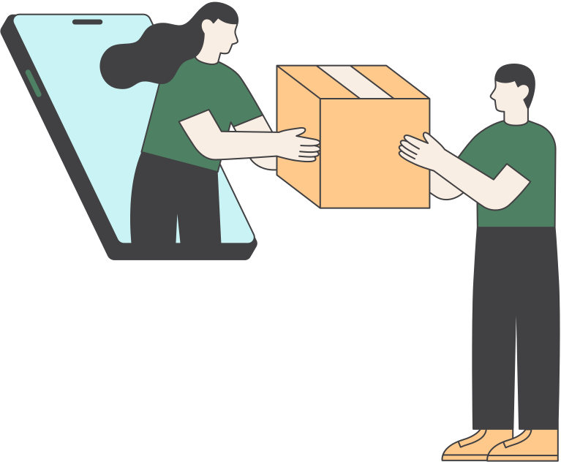
1. Developing the website to provide media scanning techniques to ensure its authenticity
2. Providing a feature to print certificates for volunteers.

Slide 12
conclusion

Slide 13
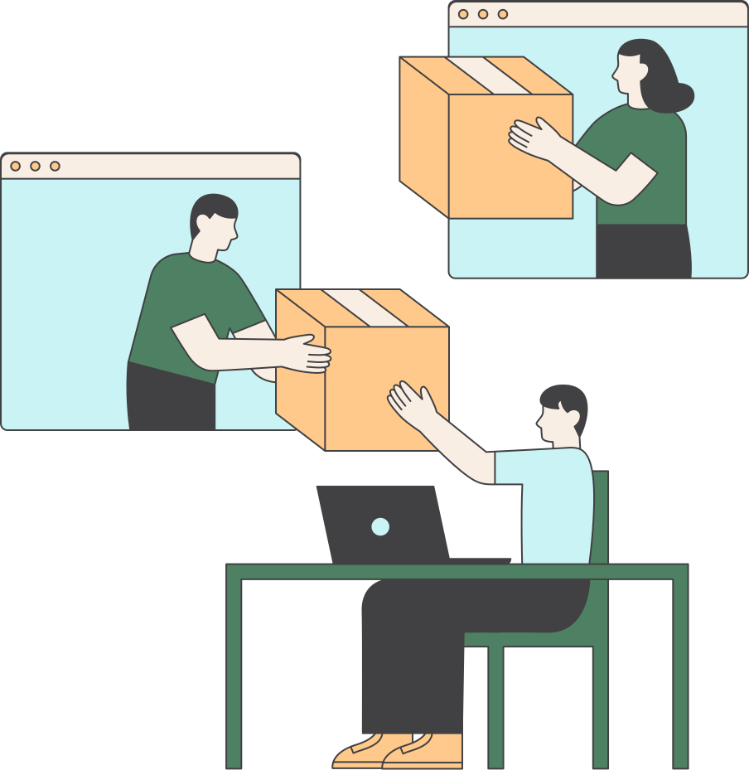
A software project supports the work of a charitable association that provides aid and services to different groups of society, whether low-income, orphans, or people with special needs. This system targets the association’s director, donors to the association, the people who benefit from it, and also its volunteers. We have proven that the computerized system facilitates transactions and also organizes The association's resources greatly increase the efficiency of its work

