Slide 1
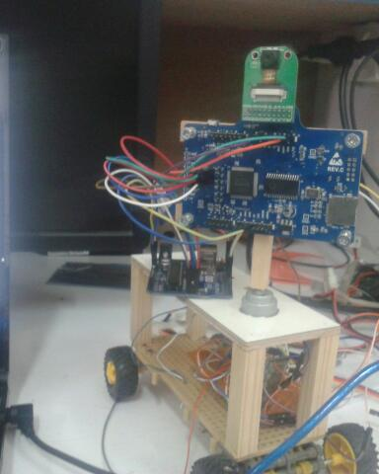
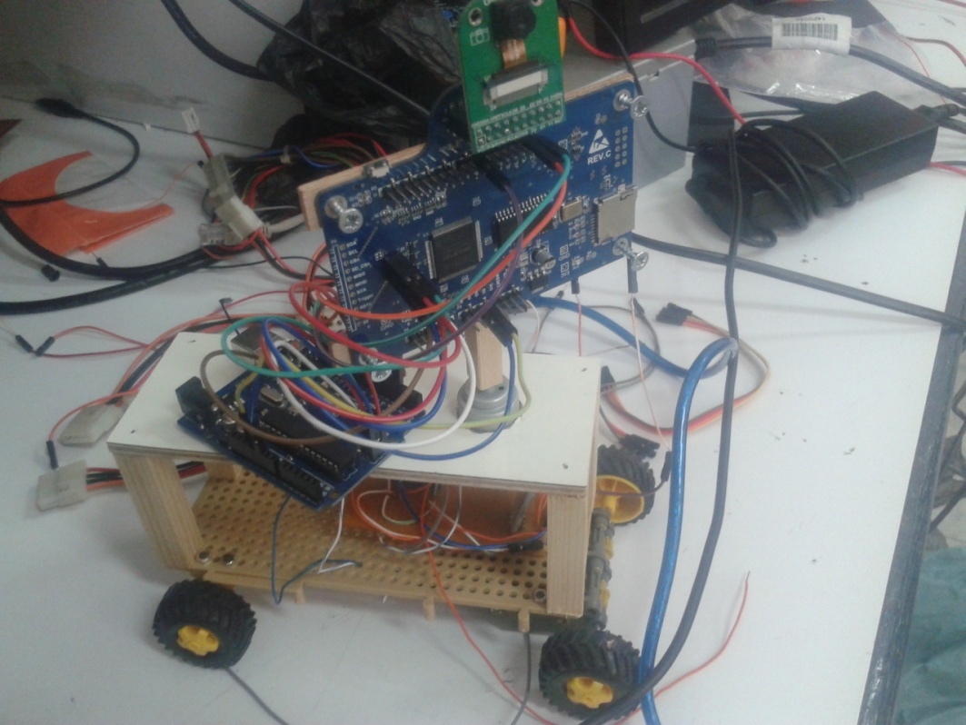
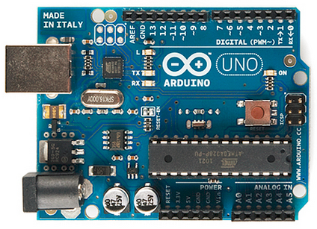
Monitoring Robot
Prepared by: Hanin Mizyed ,Abdalla Melhem
Supervisor: Dr. Sufyan Samara

Slide 2
Content Out line
Project Overview
Project Features
Motivation
Project Implementation.
Difficulties and challenges.
Conclusion and Future Work

Slide 3
Overview
What is Monitoring Robot?
  Vehicle which can be controlled
  remotely by an Android device

Slide 4
Overview
How ?
  Write an Android app which allows the user to steering the robot.
  The app sends commands to the microcontroller via Bluetooth.
  Microcontroller controls the motors.
  Microcontroller sends signal to camera module to capture images, and transmit images back to the android app

Slide 5
Project Features
Applicable project.
User friendly just control the car using android application
Reasonable cost device
Can stream live video
Used for multi purposes

Slide 6
Motivation
Exploring risky locations, caves and areas that cannot be reached by humans.

Slide 7
Operating Environment
Software
  Java Development Kit v1.7.0
  Android SDK v22.0.5
  Eclipse IDE v4.2.1
  Arduino IDE v1.0.5
Hardware
  Android Device: Android 2.3 or later
  Arduino Board
  Bluetooth Module
  2 DC Motors
  ArduCam shield

Slide 8
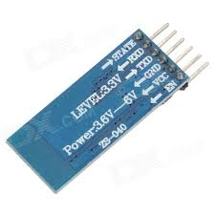
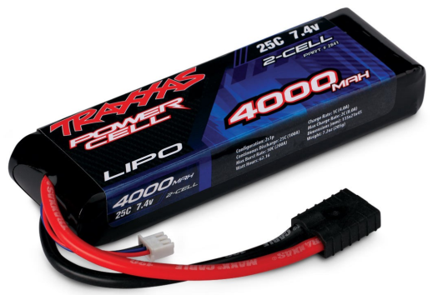
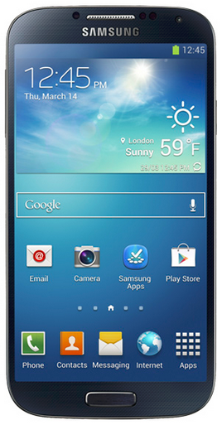
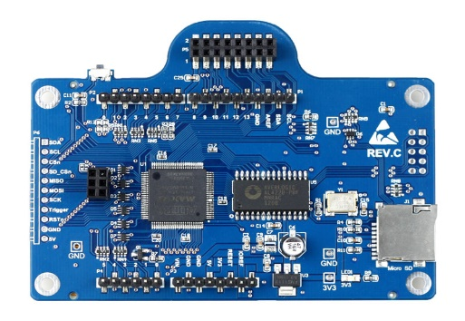
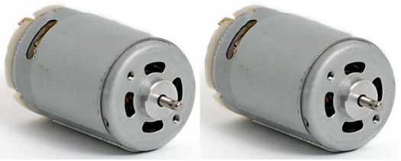
Project Implementation
Bluetooth module
Power source
Microcontroller
Android app
Camera Module
DC motors

Slide 9
Microcontroller
The Brain Of The Project
Microcontroller | Arduino UNO
Operating Voltage | 4V
Digital I/O Pins | 14 (of which 6 provide PWM output

Slide 10
Microcontroller
Bluetooth module
Power source
Microcontroller
Android app
Camera Module
DC motors

Slide 11
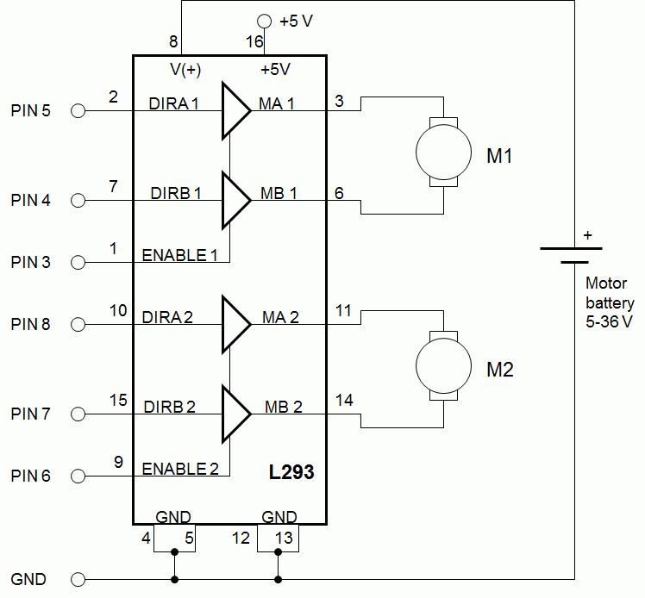
H-Bridge
The most common method to drive DC motors in two directions under control of a microcontroller

Slide 12
Bluetooth Module
Bluetooth module
Power source
Microcontroller
Android app
Camera Module
DC motors

Slide 13
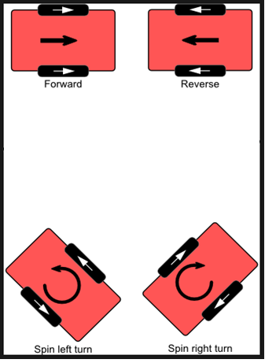
DC Motors
The vehicle is controlled by two DC motors.
Each Motor controls a single wheel.

Slide 14
Bluetooth Module
  Used to transfer data between mobile and Arduino.
Features: simple to program, low power.
Class 1 Bluetooth for long range (~100m)
  Chosen model: (HC-06) Bluetooth Module

Slide 15
Bluetooth Module
Essentially implements a wireless serial stream
  When module receives a message via Bluetooth,
  it sends that message via serial
  When modem receives a message via serial, it sends that message via Bluetooth
Has static network address which Android controller uses to establish a connection

Slide 16
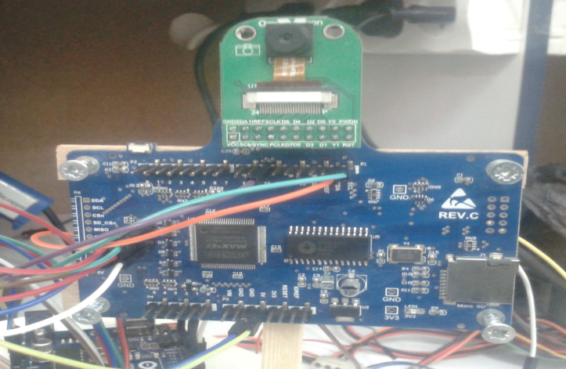
ArduCam Sheild
Arduino based open source camera platform , well mated to Arduino boards.
connect it with OV2640 camera module.
  Used to capture images and transmit it back
  To the arduino

Slide 17

Android Application

Slide 18
Android Part
Sleek, simple and powerful design.
Creates socket for communicating with Bluetooth module , using its known address
Android Bluetooth API
Notes:
Provides APIs to build apps that take full advantage of device hardware, connected accessory devices, the Internet, software features, and more.

Slide 19
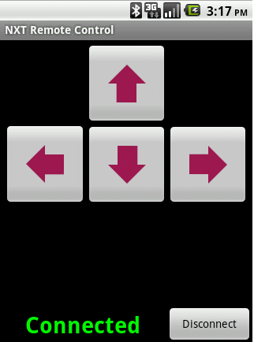
Android
Creates a socket for communication purposes with Bluetooth module.
Read the user command and transmit it to the microcontroller via the Bluetooth communication link.
The commands can vary between controlling the vehicle moving directions and turning the stream on and off.

Slide 20
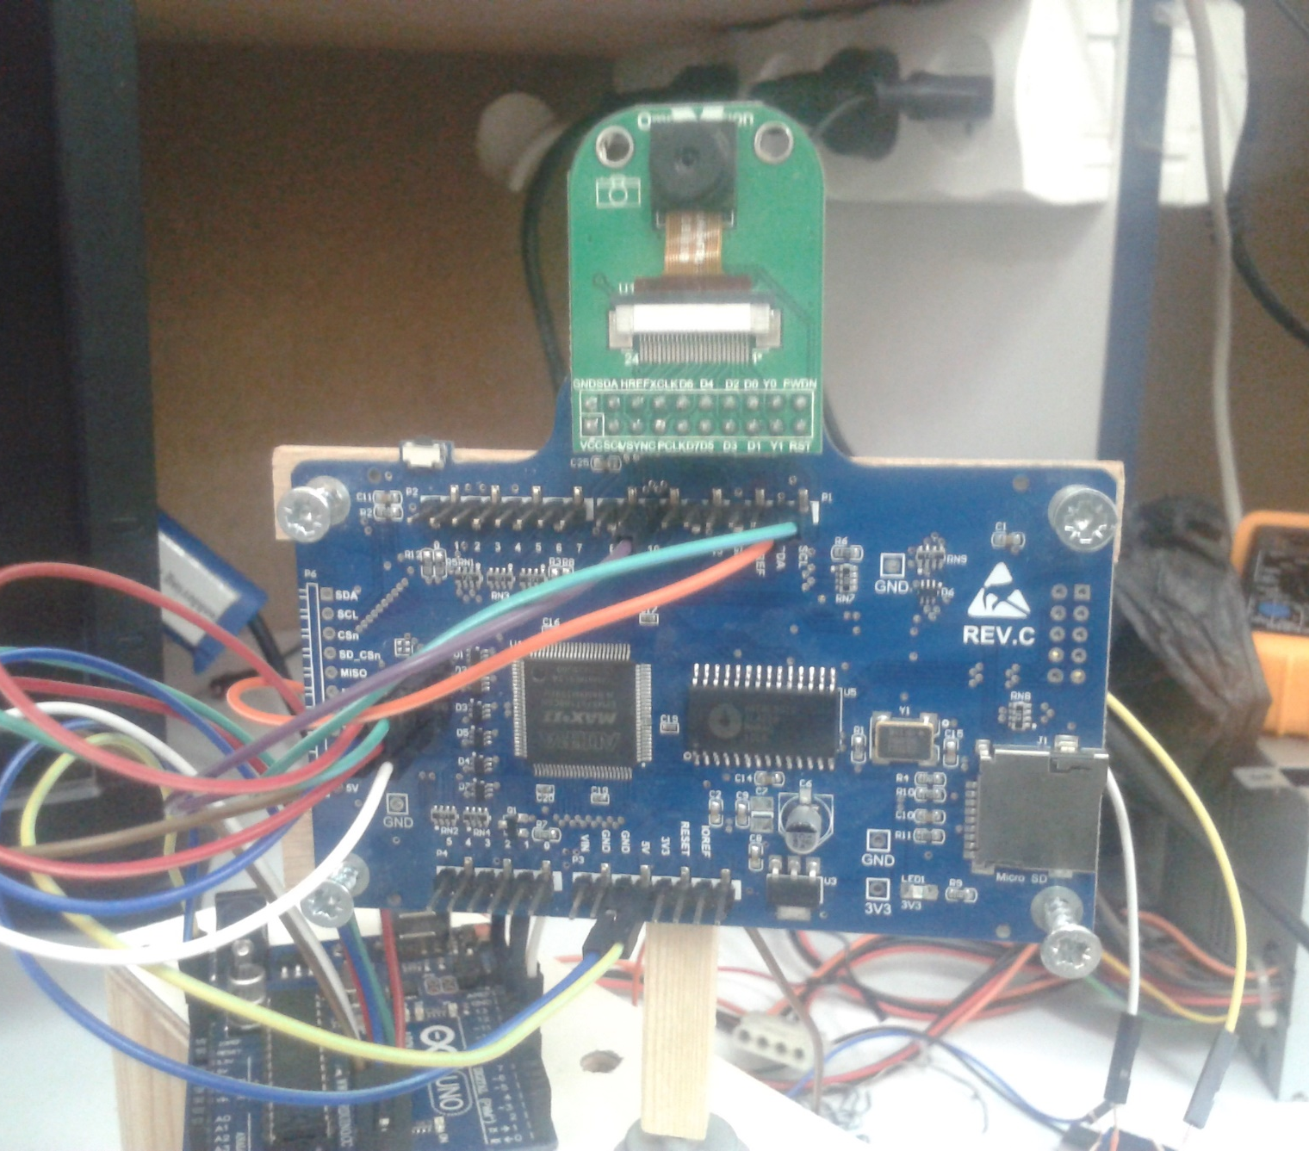
Video streaming

Slide 21
Video Streaming
Android will send a signal to the Microcontroller
Microcontroller send a signal to the Camera Module to capture an image
stores it in a memory inside the ArduCam Shield called “FIFO”.
the Arduino reads the image and sends it to the Android Application through the Bluetooth Module

Slide 22
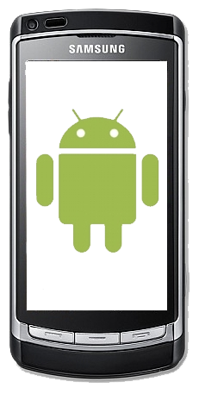
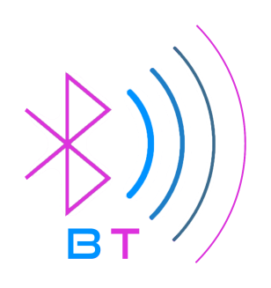
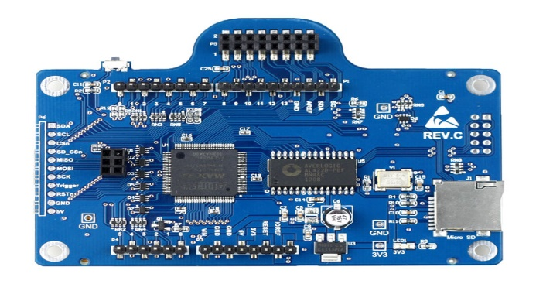
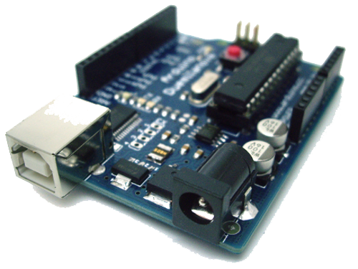
Video Streaming Architecture
Android App
Micro Controller

Slide 23
Video streaming
Android receives the image through the Bluetooth connection as an array of bytes.
Android Application decodes the byte array as a JPEG object.
JPEG object is displayed on an image view as an image.

Slide 24
Difficulties and challenges
The limited bandwidth provided by the Arduino Uno (maximum 115200 bit/s) forced us to transmit pictures at a resolution of 320x240 to provide an acceptable frame rate.
The power consumption through the motors was high enough to force us into using a static power supply instead of normal batteries for testing.
In order to make available for the Android to send other commands, we had to add a delay between each capture command.
Bluetooth limited range.
The design of the robot, must be small with a light weight.

Slide 25
Conclusions and future work
  Android app development (Java, XML)
  Selecting parts based on datasheets
  It is feasible to implement Bluetooth communication between Android device and microcontroller

Slide 26
Conclusions and future work
  We learned how to program Arduino Uno microcontroller,
  and how to hook it up with ZS-040 Bluetooth Module and an Ardu-Cam Shield,
  we learn how to capture images using the ArduCam and sending it to arduino.
  Bringing a design from concept to implementation

Slide 27
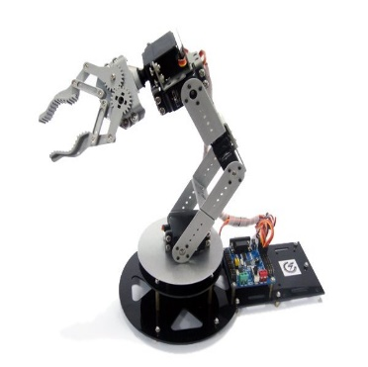
Future work
Adding sensors to the robot such as Gas sensor, Temperature sensor and others.
  Bluetooth too low-bandwidth; switch to WiFi
. robot arm controlled by servo motor.

Slide 28
Thank you for your kindly attention

