Slide 1
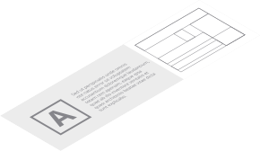
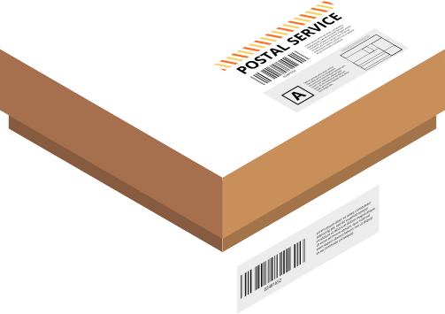
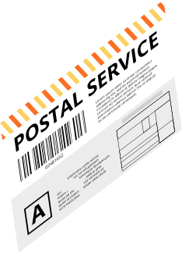
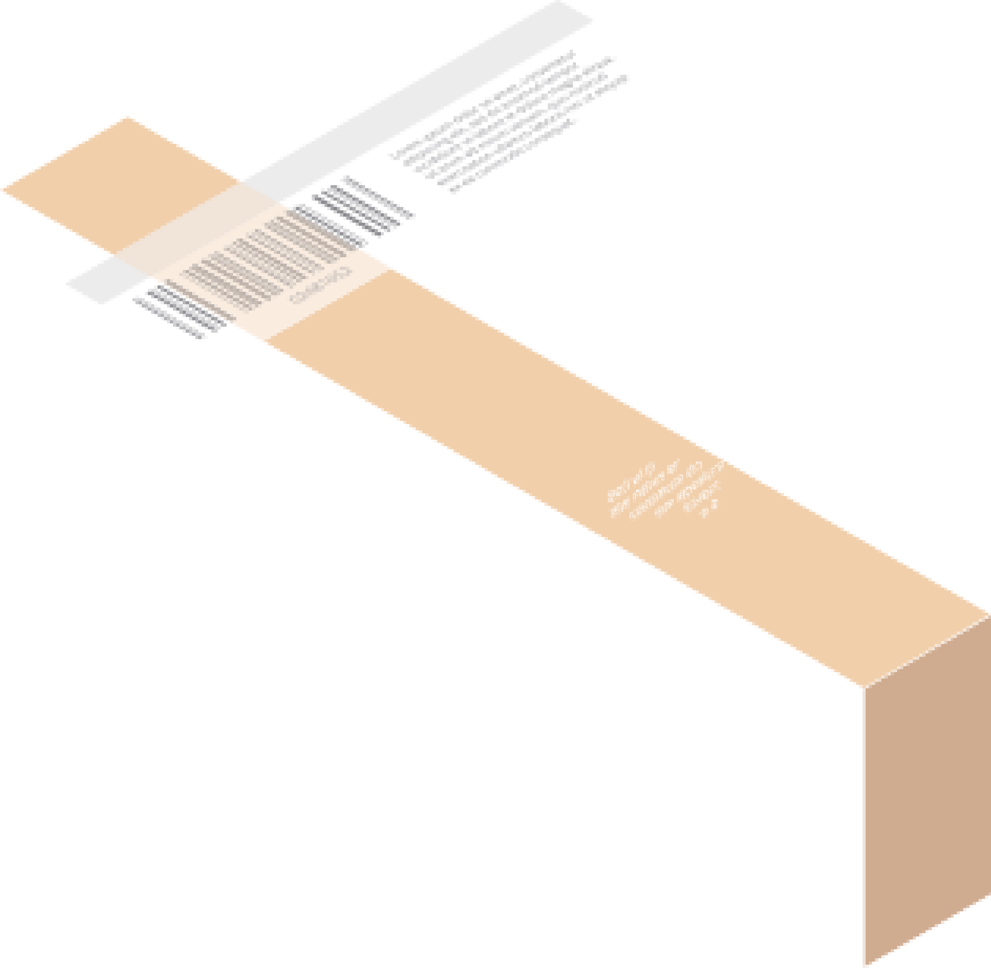





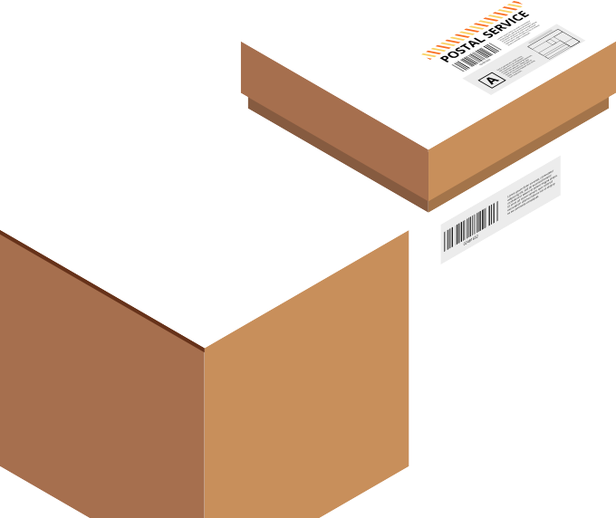



PARCEL STORAGE AND RETRIEVAL SYSTEM
PRESENTED BY
Oday yamak Ahmad Awad
SUPERVISED
Dr.Raed Qadi Dr.Samer Arandi

Slide 2





LIST OF CONTENTS
Introduction
Components
Constraints
Future Work
Features
Any Questions?

Slide 3
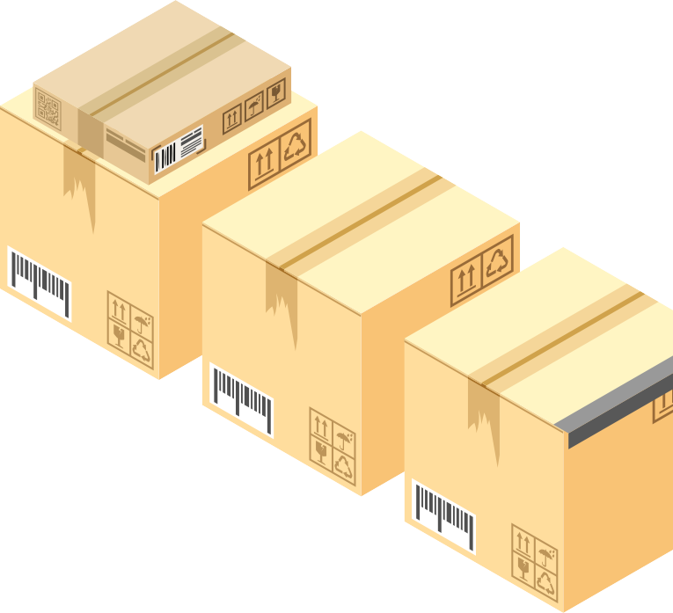

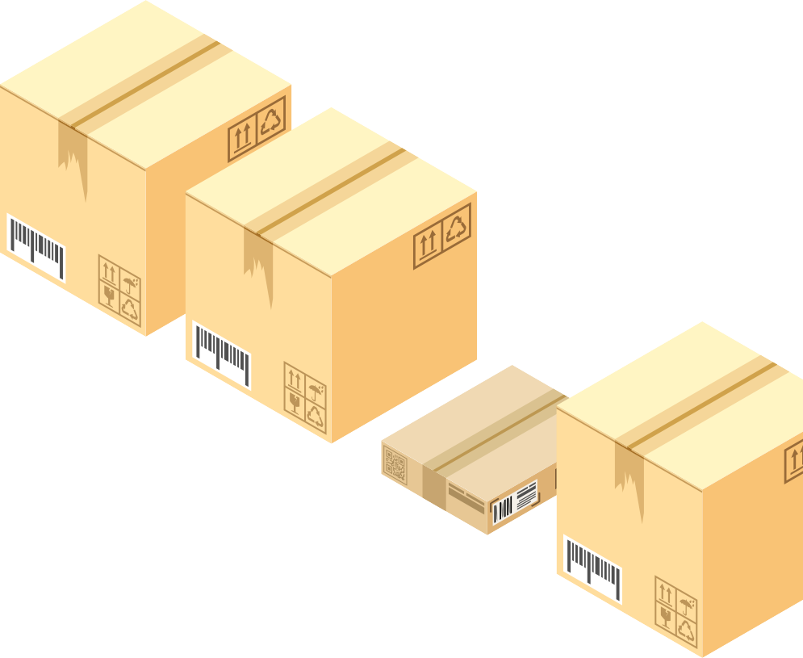


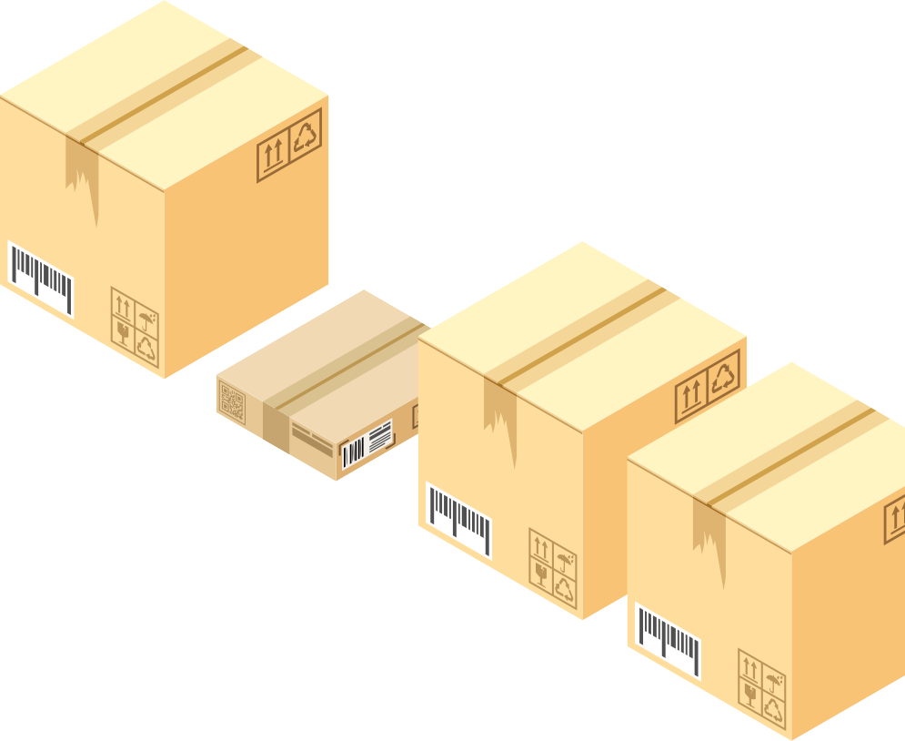








Introduction
"With the growth of e-commerce, last-mile delivery faces challenges such as theft, delays, and inefficiency. Automated parcel lockers provide a secure and reliable solution for both delivery services and customers.

Slide 4

CONSTRAINS
Limited time for development and testing
Difficulty in obtaining and transporting some parts Challenges in handling certain electronic components
Finding a suitable mechanism using simple and available components

Slide 5
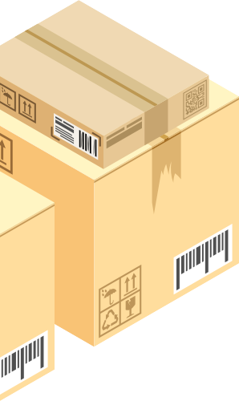
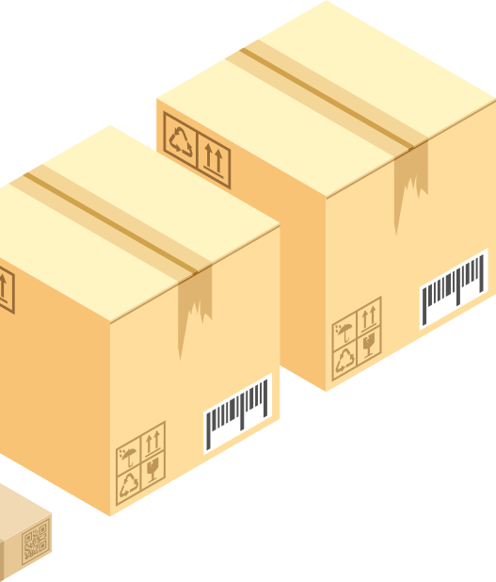
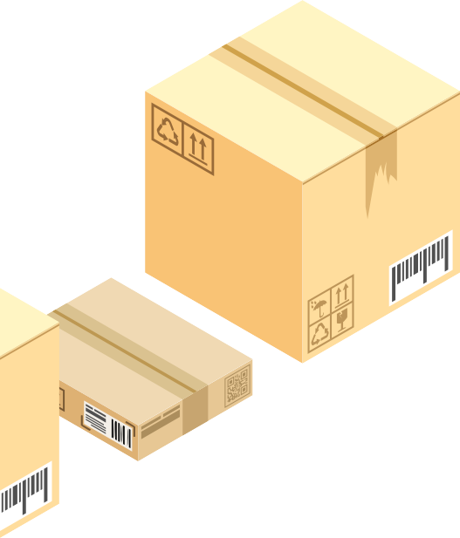
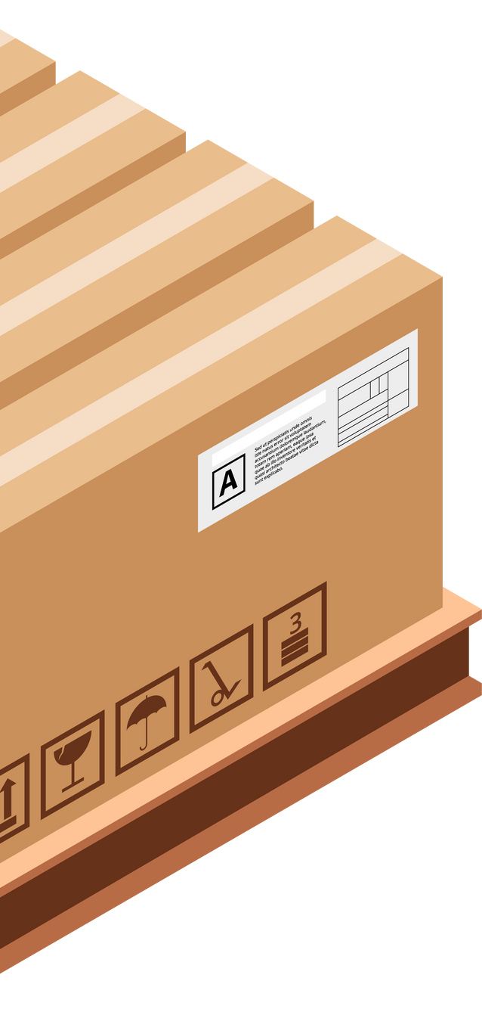
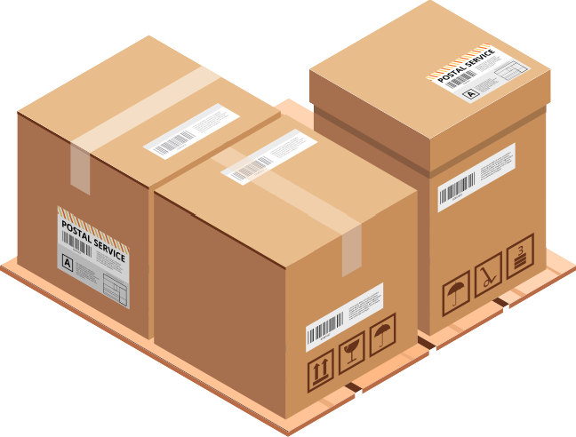





FEATURES
Secure storage for products
Payment
Mobile application for enhanced user experience
Safety sensors for smoke, fire, and gas detection
Cooling system

Slide 6
HARDWARE PART
The methodology focuses on developing a smart parcel storage and receiving system that integrates mechanical , electronic , and software components . It includes a CNC robotic mechanism, servo-controlled lockers, and a user authentication system, all managed by an Arduino Mega.

Slide 7
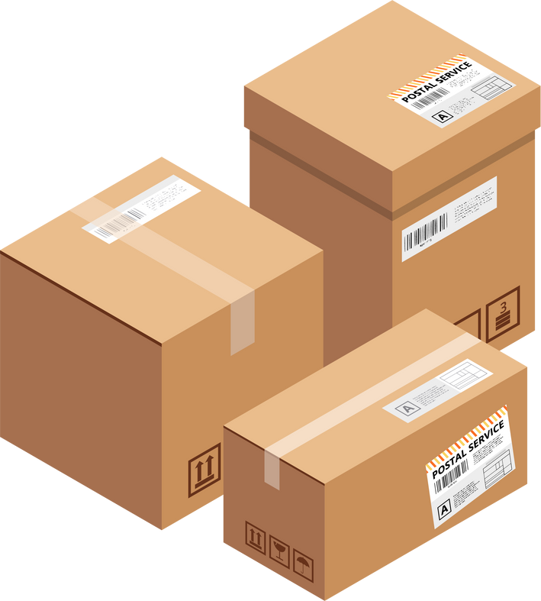
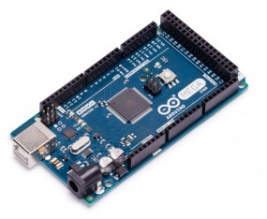
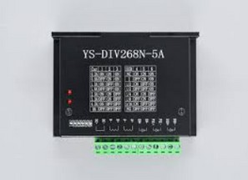
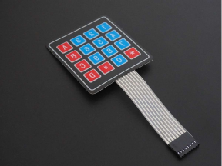
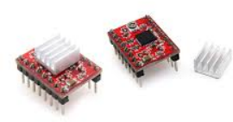
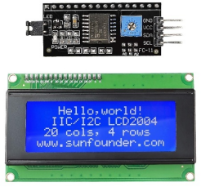
HARDWARE PART
Arduino Mega
A4988/Div268n stepper drivers
Keypad
I2C 20*4 lcd

Slide 8

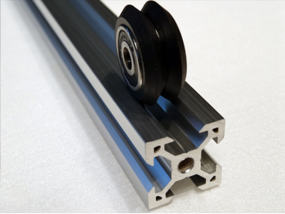
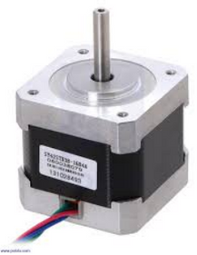
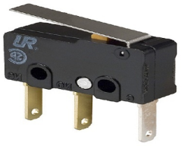
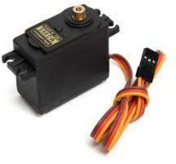
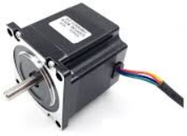
HARDWARE PART
V-SLOT
Nema 17/23 stepper motors
Limit Switch
Servo Motor

Slide 9
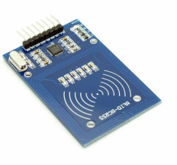
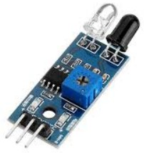
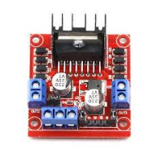
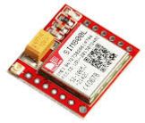
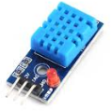
HARDWARE PART
RFID
SIM800L
IR sensor
DHT/ H-bridge

Slide 10
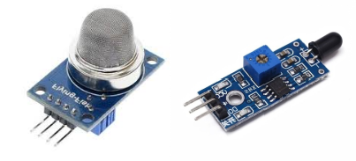
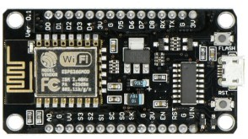
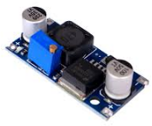
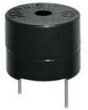
HARDWARE PART
MQ2/Flame Sensors
Buzzer
ESP8266
Buck Converter

Slide 11
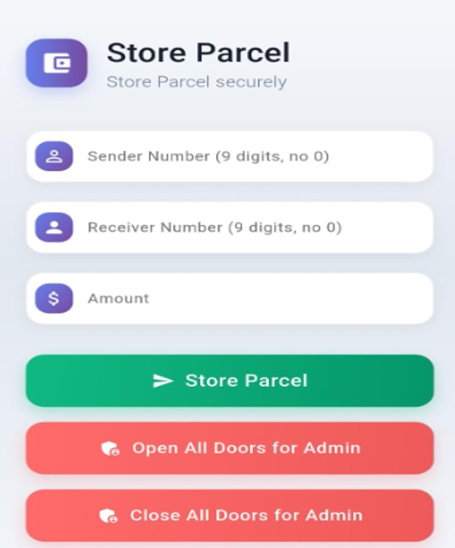
Mobile Application
A user-friendly mobile app to control and manage parcel storage securely

Slide 12
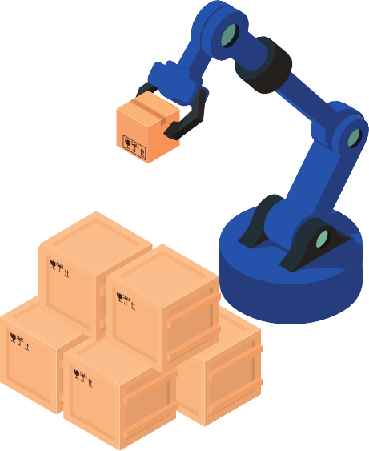










FUTURE WORK
Enable users to operate the system through voice commands
Voice Control
^{Additional Mobile} Expand the mobile app with more options and
Features
flexible controls
AI Parcel Scanning
Integrate AI to analyze parcel content and detect prohibited or harmful items

Slide 13
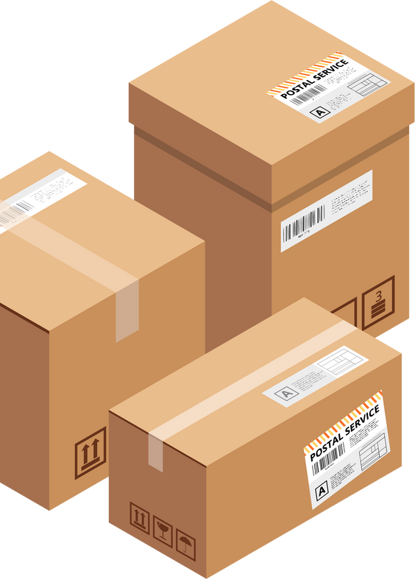











Thank You
Thank you for your time and attention.

Slide 14
Any Question ?

