Slide 1

LAQEENE social app
Done by :
Deyar Idhilie
Supervised by :
Dr. Sufyan Samarah
Here is where your presentation begins

Slide 2
Motivations
Here’s what you’ll find in tplate:
There is a huge demand in the newer generation for this kind of social apps this could be seen from the facebook groups . In addition to the fact that our lives are more virtual than ever , especially after the 2020-2021 quarantine took a place , more and more area of lives became “online”

Slide 3
The Idea
Mercury is the closest planet to the Sun and the smallest one in the Solar System—it’s only a bit larger than the Moon

Slide 4
Problem vs Solution

Slide 5
Software Development Process :
1
2
3
4
Requirementsame
Design
Implementation
Testing
Mercury
Venus
Neptune
Saturn
Mercury is the smallest planet
Neptune is the farthest planet
Saturn is the
ringed planet

Slide 6
Frontend :
Mobile
App
Web
Flutter ,Dart language
Backend :
Neptune
Node
js & express
Venus is the second planet from the Sun
Venus is the second planet from the Sun
Neptune is the farthest planet from the Sun
Mongo
DB
POSTMAN
Stream Api
Messaging
Database
Test Endpoitns and Rest Api response

Slide 7
Customer Journey
Mercury
Saturn
01
rcury is the smallest planet
04
03
Register/Login
04
Create a date
Saturn is the
ringed planet
Venus
Neptune
02
Create profile
05
Accept/Decline requests
Venus has a beautiful name
03
Neptune is the farthest planet
Mars
Jupiter
03
06
Chatting
03
View DATES AROUND
03
Jupiter is the biggest planet

Slide 8
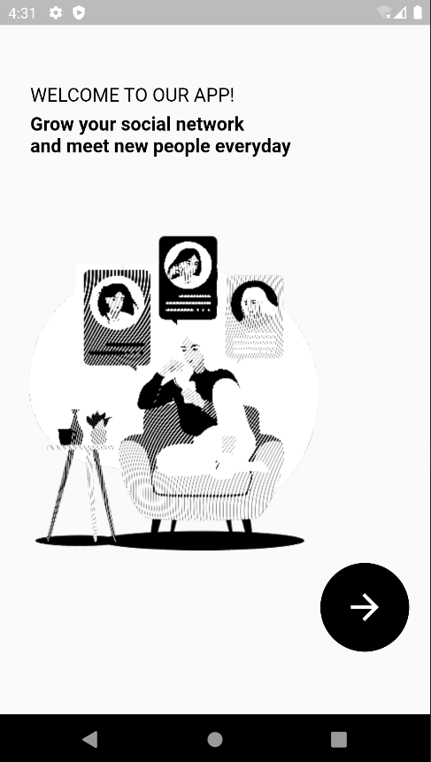
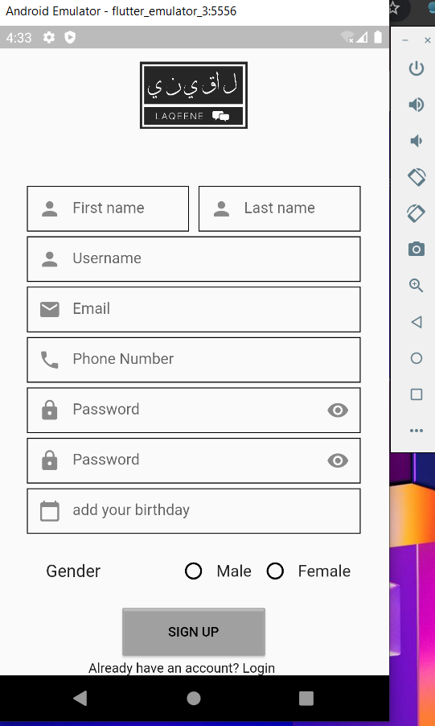
You can replace the image on the screen with your own work. Right-click on it and then choose "Replace image" (in Google Slides) or "Change Picture" (in PPT) so you can add yours

Slide 9
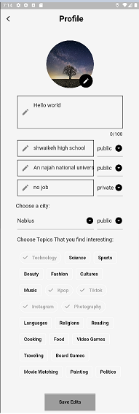
Control Your information privacy
You can replace the image on the screen with your own work. Right-click on it and then choose "Replace image" (in Google Slides) or "Change Picture" (in PPT) so you can add yours

Slide 10
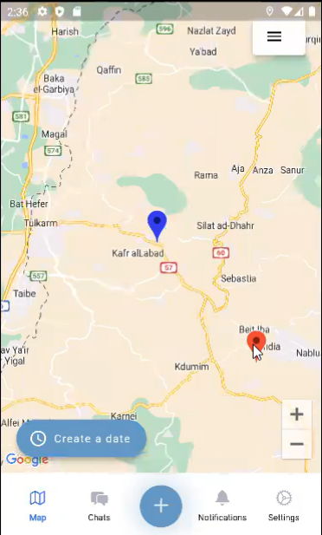
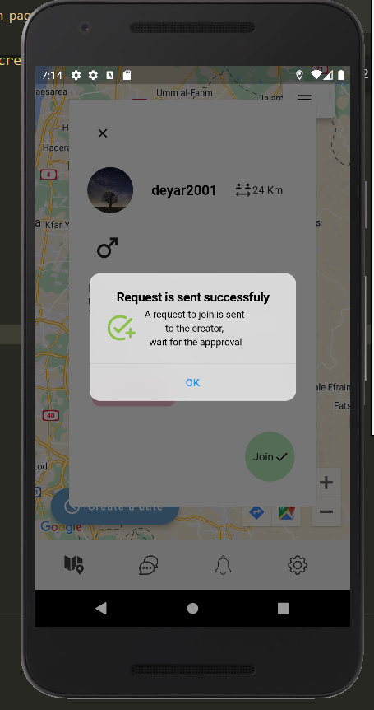
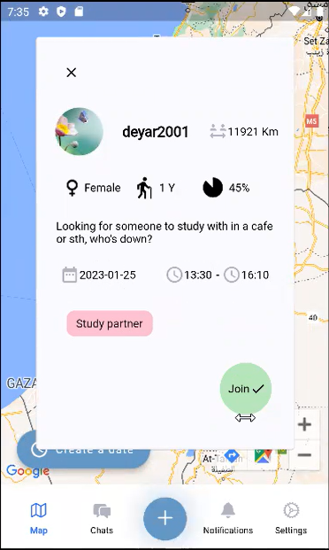
View Dates around
You can replace the image on the screen with your own work. Right-click on it and then choose "Replace image" (in Google Slides) or "Change Picture" (in PPT) so you can add yours

Slide 11
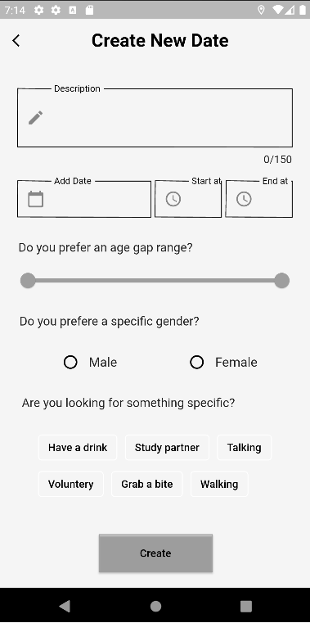

Seect Day And Time
You can replace the image on the screen with your own work. Right-click on it and then choose "Replace image" (in Google Slides) or "Change Picture" (in PPT) so you can add yours

Slide 12
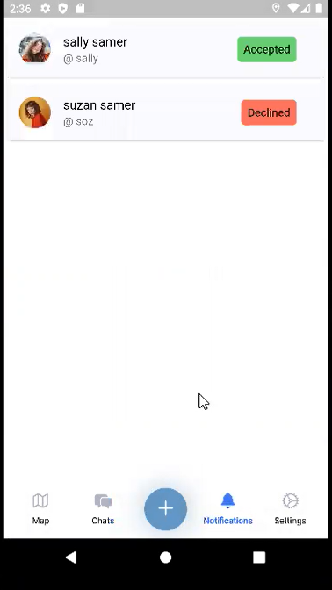
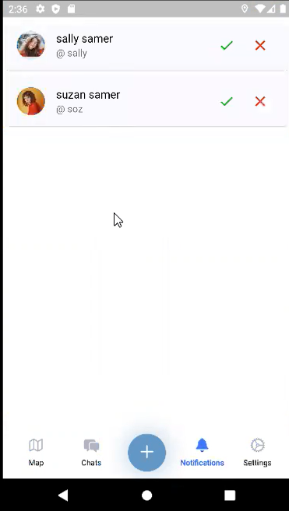
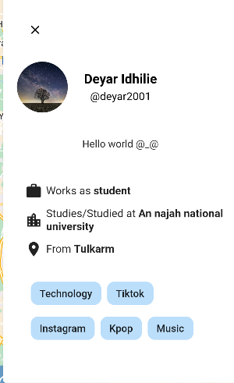
You can replace the image on the screen with your own work. Right-click on it and then choose "Replace image" (in Google Slides) or "Change Picture" (in PPT) so you can add yours

Slide 13
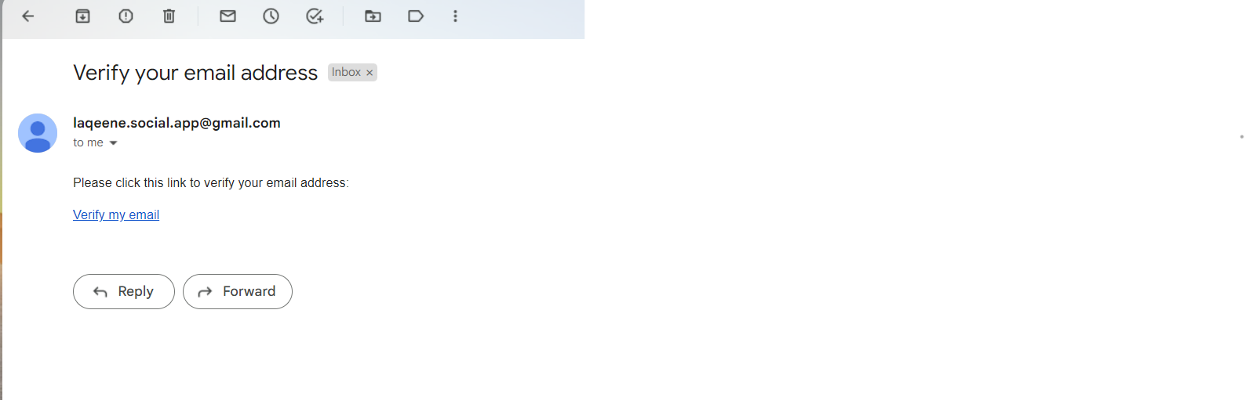

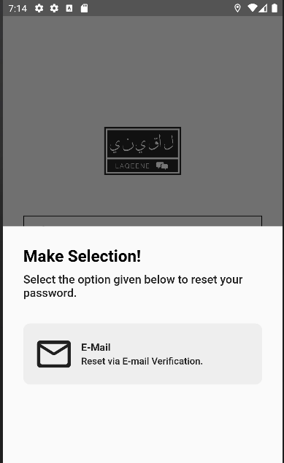
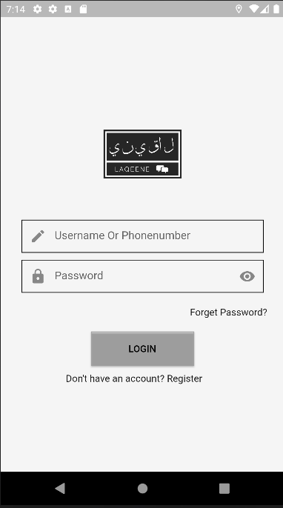
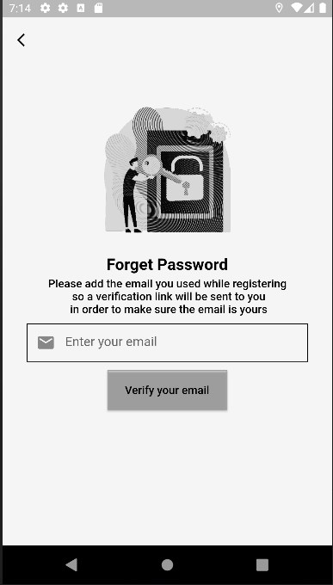

Slide 14
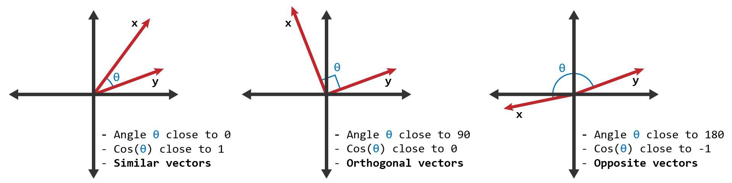
Machine Learning:
Cosine Similarity

Slide 15
Chats

Slide 16
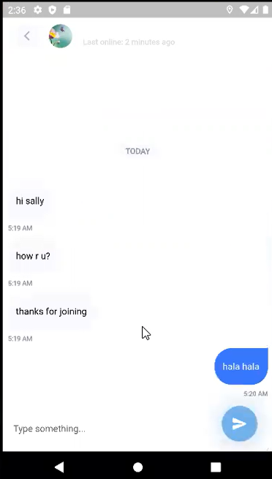
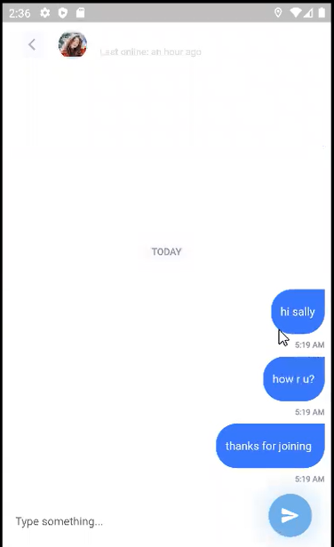

Slide 17
Future View
Venus
Jupiter
Venus has a pretty name
To improve our app and make it profitable, it need to be released to the market and user activity need to be studied in order to add the right features
Jupiter is the biggest planet
Neptune
Mercury
Neptune is the farthest planet
Mercury is a small planet

Slide 18
Mercury is the closest planet to the Sun
Thanks for listening <3
Despite being red, Mars is actually a cold place

