Slide 1

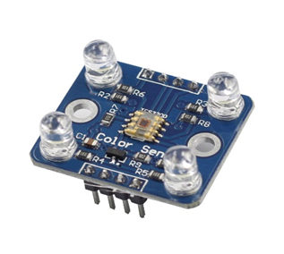
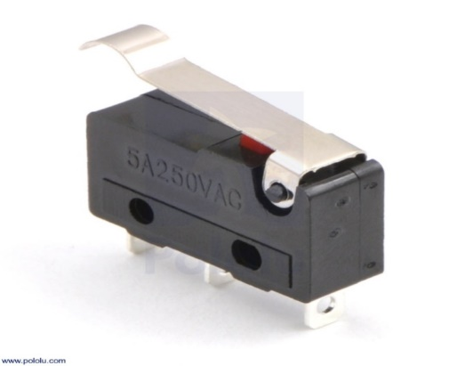
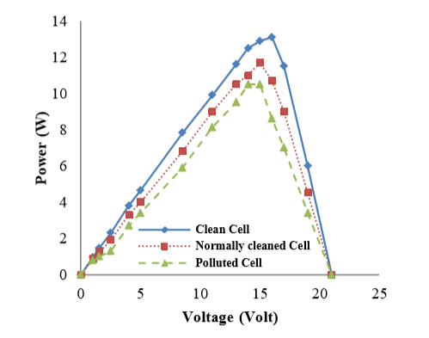
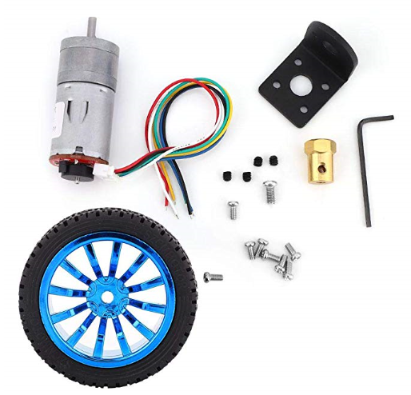
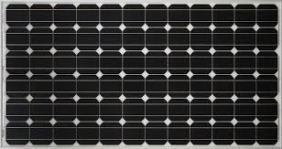
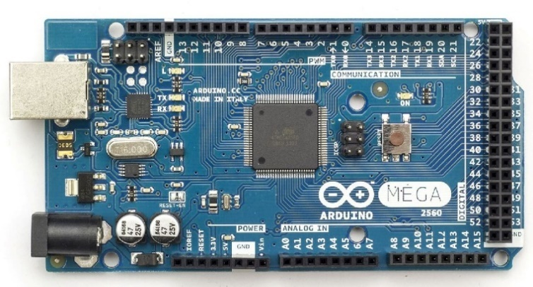
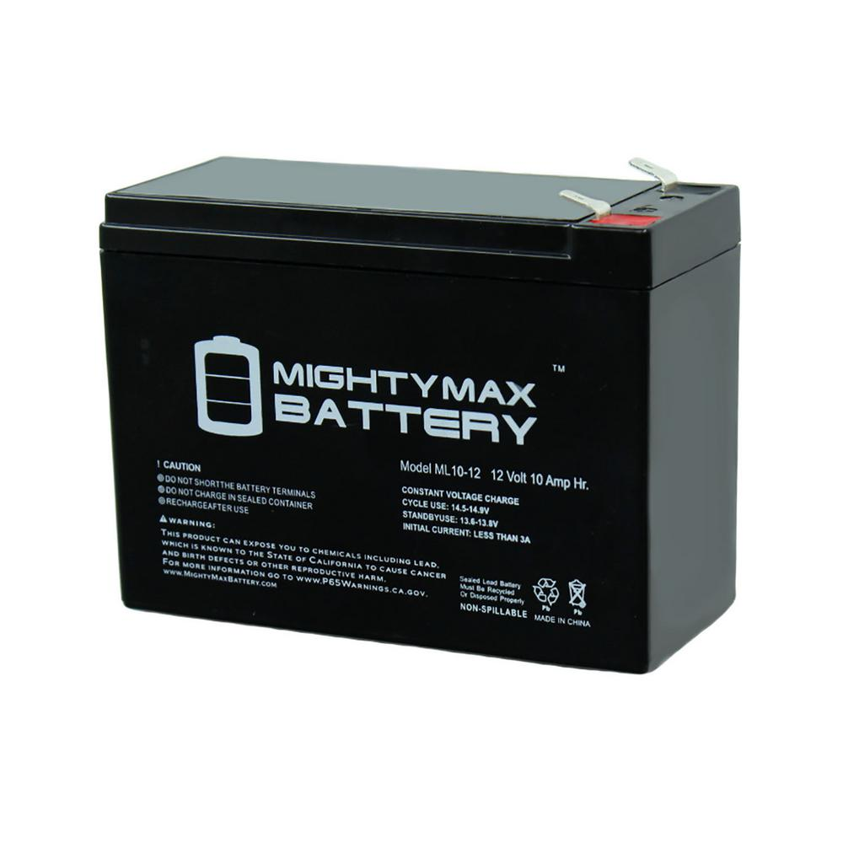
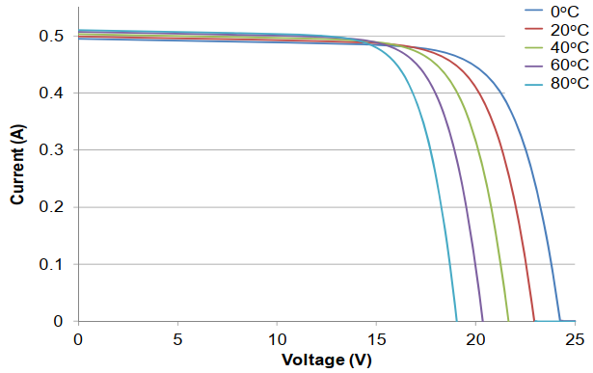
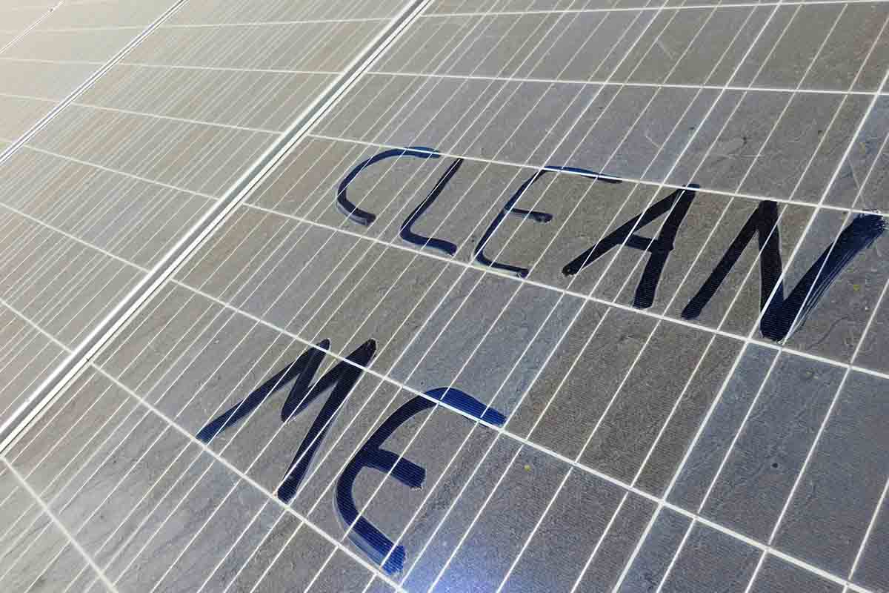
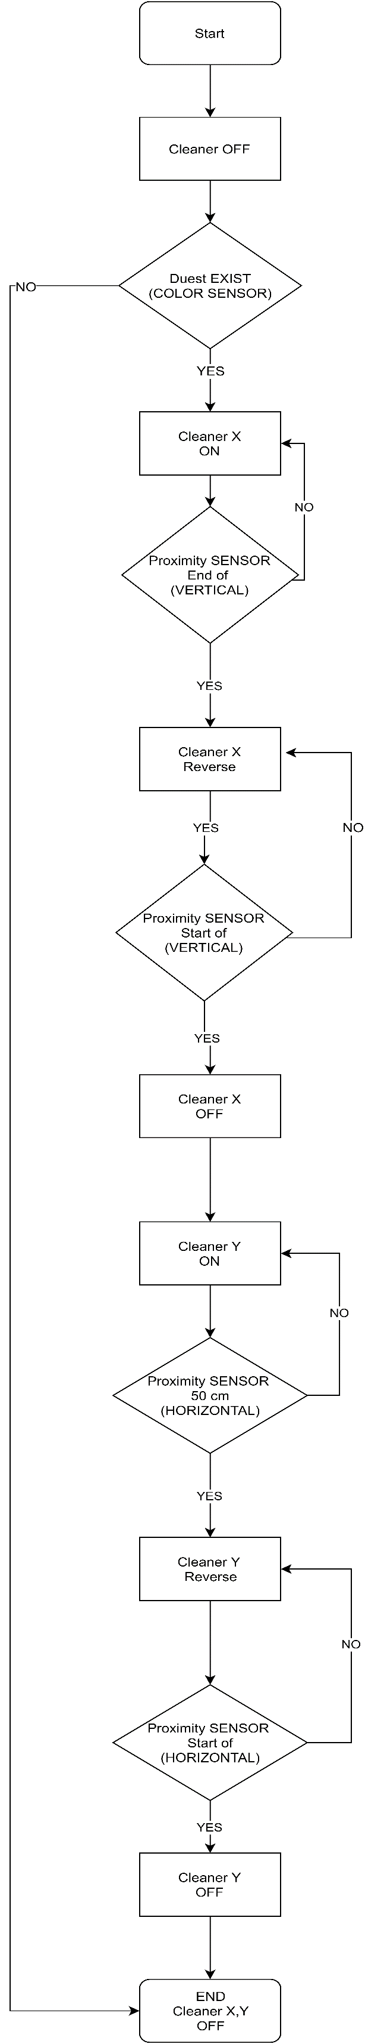
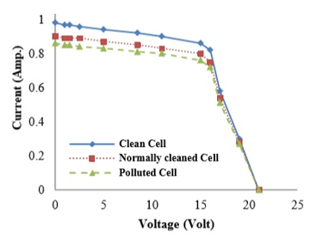
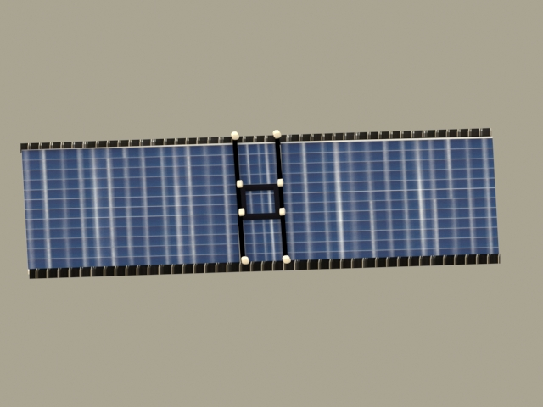
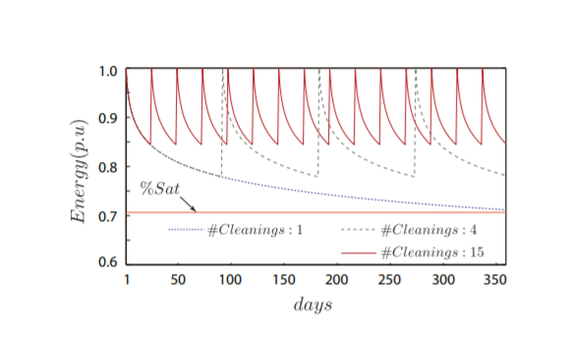
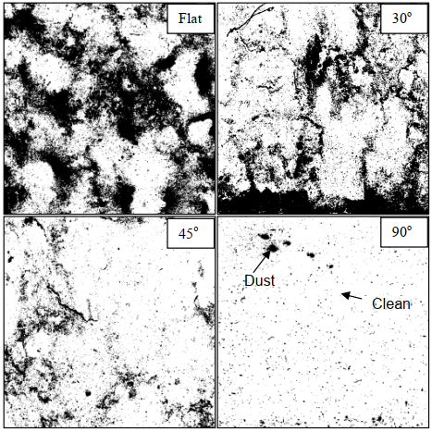
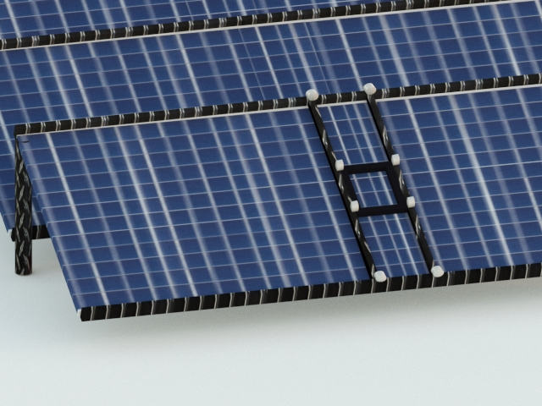
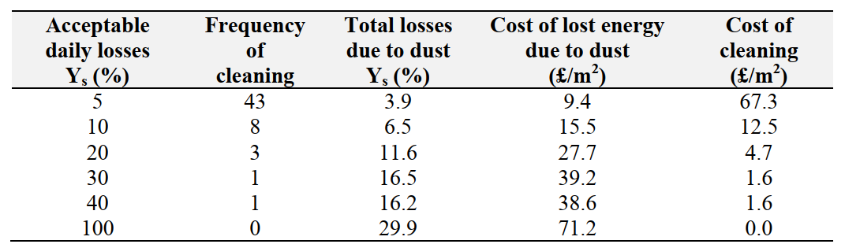
An-Najah National University
Electrical Engineering Department
PV PANELS CLEANING ROBOTICS SEYSTEM
AL-NAJAH-NATIONAL-UNIVERSITY
Faculty of Engineering
Electricals Engineering Department
AL-NAJAH-NATIONAL-UNIVERSITY
Faculty of Engineering
Electricals Engineering Department
Mostafa Ahmad Alawneh
Bara Horani
Mohammad Abu Hania, Rafeef Durgham Jian
Abstract
Materials
Background
future work
Nowadays, the use of solar cells has increased dramatically and clearly in our time to produce electricity, and many projects today use thousands of solar cells to sell electricity and profit from it, One of the biggest and common problems affecting solar cells is the dirt and dust accumulated on them, which weakens the access of light to cells and thus reduces the efficiency of the production of these cells for electricity.
To reduce the dirt accumulated on these cells, we need a system that will clean these cells by itself, there are certainly solutions to this problem, and at a lower cost than other systems used to clean solar panels.
Compared to existing solar cell cleaning systems, the cost of this system is lower, and it does not consume much energy, moreover its maintenance is low.
This table shows cost of the system
Switch Sensor
Color sensor
Encoder Gear Motor, with Mounting Bracket 65mm Wheel
Tool | Number (#) | Price
Arduino Mega | 1 | $14.99
Switch sensor | 4 | $11.00
Color sensor | 1 | $9.89
Dc motor | 1 | $5.99
Wheels | 8 | $40.00
Others |  | $50.00
Total | _ | $131.87
P-V characteristics of the cells
Pvs Module
Arduino
12V-dc battery
right work need hard work-right work need hard work-right work need hard work-right work need hard work-right work need hard work-right work need hard work-right work need hard work-right work need hard work-right work need hard work-right work need hard work-right work need hard work
Cost of the system
right work need hard work-right work need hard work-right work need hard work-right work need hard work-right work need hard work-right work need hard work-right work need hard work-right work need hard work-right work need hard work-right work need hard work-right work need hard work
Methodology
the effect of temperature on pv module
When there is a change in the color of the cells due to the dirt accumulated on them, the controller gives an order to the motors to move the frames of the secondary tire as well as the brush begins to move to clean and when the cleaning process is finished the color of the solar cells is checked again and then the mainframe moves to complete the process Cleaning.
Conclusion
Introduction
With the growth and development of solar systems in Palestine and the start of investment with the construction of large solar stations, the need to design a system for washing solar cells and providing continuous cleanliness and high efficiency of the system has entered.
Solar cells provide human effort, especially with systems installed on rooftops that are difficult to clean for their location.
The Productivity of solar panels can be reduced 20 percent due to dust, pollen, grime and other particulates that accumulate on the solar panel. For high dust, pollen or desert areas, a dirty solar panel can reduce its power capabilities by up to 30 percent, this means the percent of produced electricity will be reduced.
It can be said that we can remove dust and dirt from solar cells by using dust sensing, thereby increasing electricity production, reducing cleaning costs, and increasing the economic return on projects that produce solar energy by solar panels.
.
the effect of temperature on pv module
Recommendations
There are several ways to improve our project, for instance:
1.Increase cleaning speed.
2. Make the system's energy derived from solar cells.
3. Develop the system to move from one row to another.
Energy produced with different number of cleanings in the year
System design 1
Acknowledgements
Cost of lost energy in one year generated from CdTe PV module due to dust
We would like to express deep gratitude to our supervisor Dr. Moien Omar for inspiring us to conceive this project, for this guidance, and his gracious support throughout the course of our work, that motivated us to work in this area and for his faith in us for every stage of his project.
A special thanks and appreciation for all staff ,our Parents, colleagues for supporting us and providing any assistance requested.
Inverted images of non-graded dust samples on a glass collected naturally, 0°, 30°, 45° and 90° tilt.
System design 2
Algorithm design

