Slide 1
Cultivation of Calendula Herb and Formulation of Calendula Products
Prepared by:
Amani “Haj Yousef”
Azeeza Saleem
Muna Alhamad
Supervised By:
Dr. Husni Odeh

Slide 2
Outlines
Background of Calendula.
Objectives of the project.
Methodology
Cream improvements
Cream tests
Results
Safety and precautions
Recommendation

Slide 3
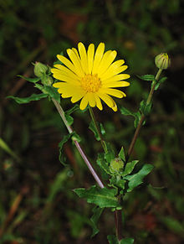
Calendula Flower
Calendula flower petals’ extract contains a large number of anti-inflammatory and oxidative organic compounds like polysaccharides, flavanoids, triterpene alcohols, phenol acids, tannins, glycosides, sterols, carotenoids, saponosides while “the most impressive health benefits of calendula extracts include its ability to rapid healing, protect oral health, improve the appearance of the skin, heal burns, scars, acne, varicose veins, skin cracks, joints pains, lower inflammation, reduce the risk of certain cancers, and eliminate cramps.

Slide 4
Objectives of the project
The aim of this project is to produce effective cream containing calendula extracts.
This study will focus on calendula petals; which are the richest part of nutrients and healing medicines.
The products will be tested on many specific cases such as burns, scars, acne, varicose veins, skin cracks and joints pains. to assembly data on these products for developments.

Slide 5
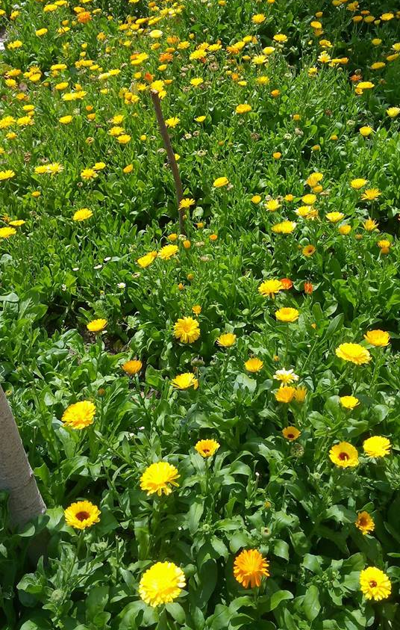
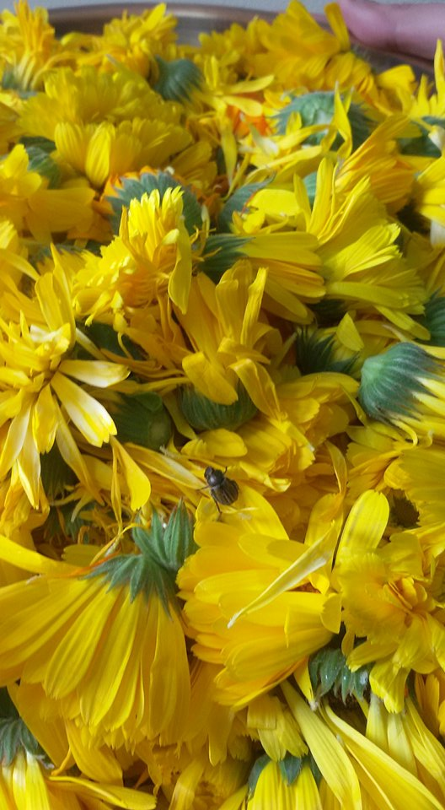
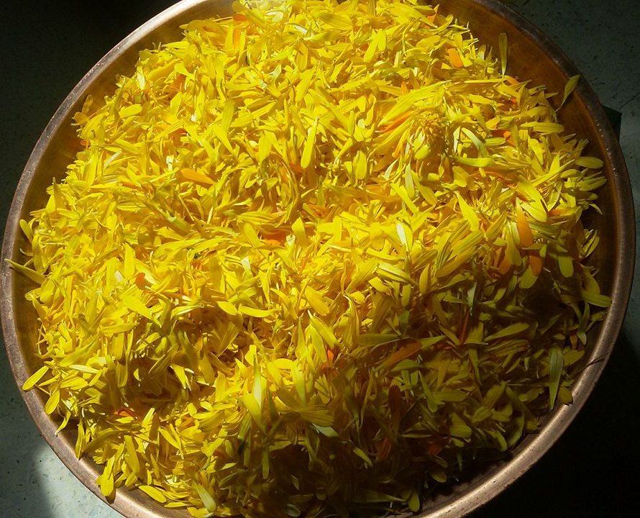
Methodology
Cultivation
Separating

Slide 6
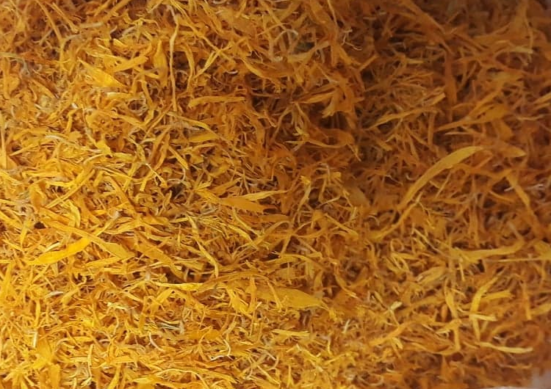
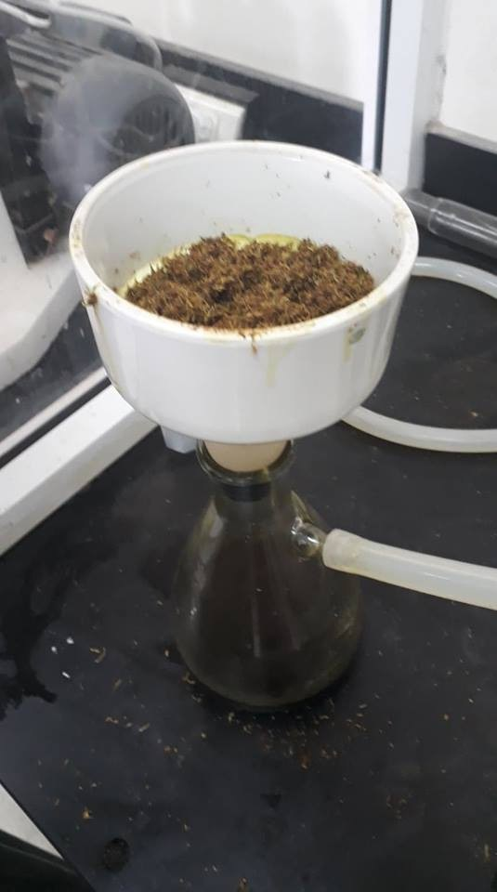
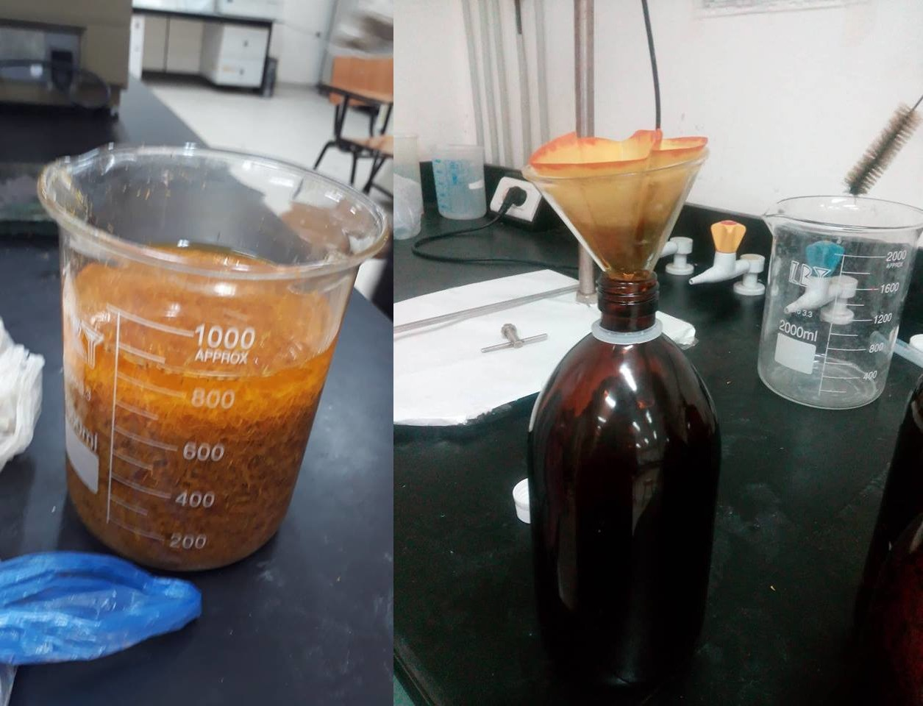
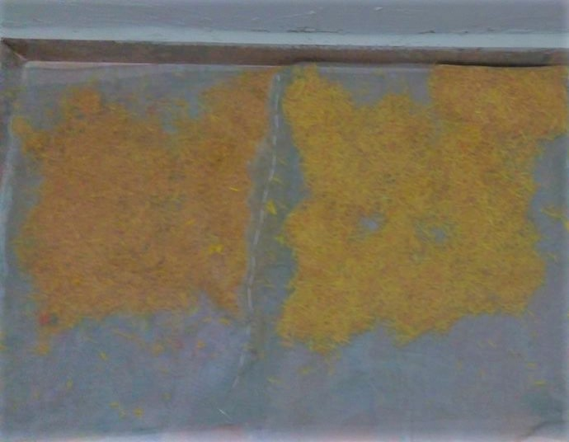
Extraction by Ethanol
Suction filtration
Drying and milling

Slide 7
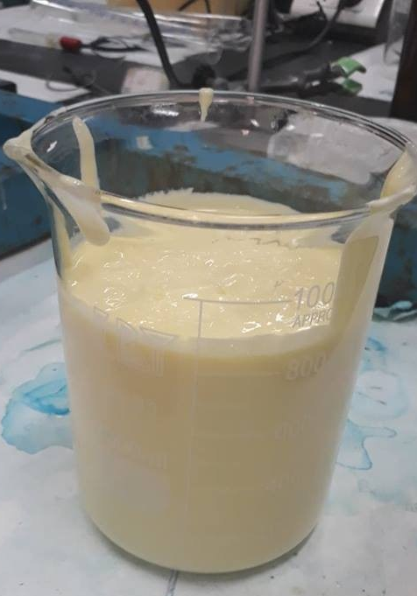
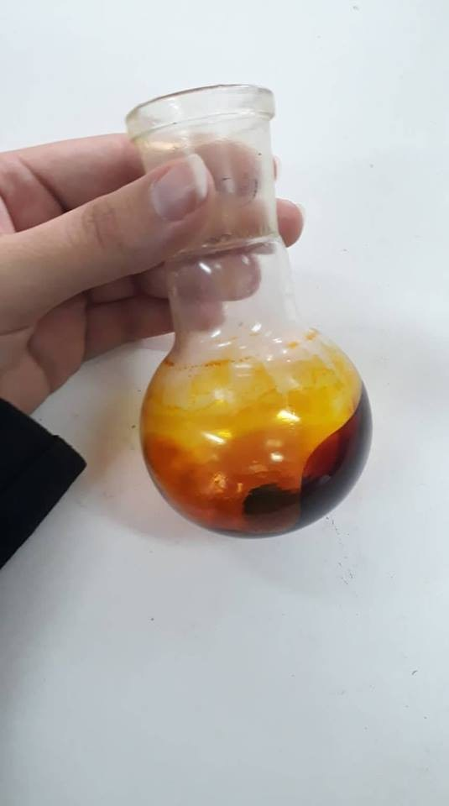
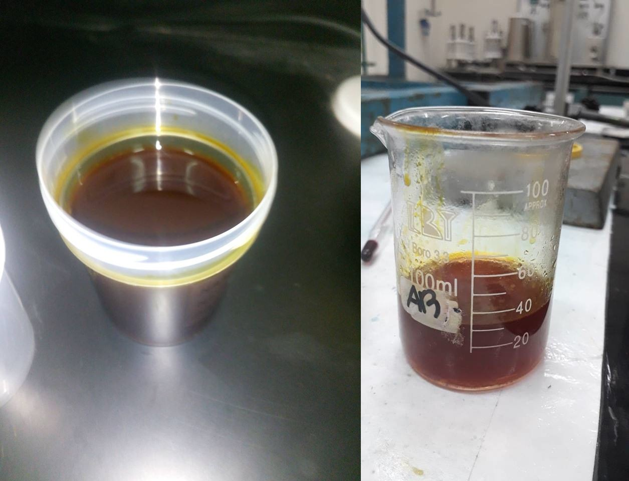
Calendula extract and ethanol solvent solution.
Calendula extract After rotary evaporator.
Final Cream

Slide 8
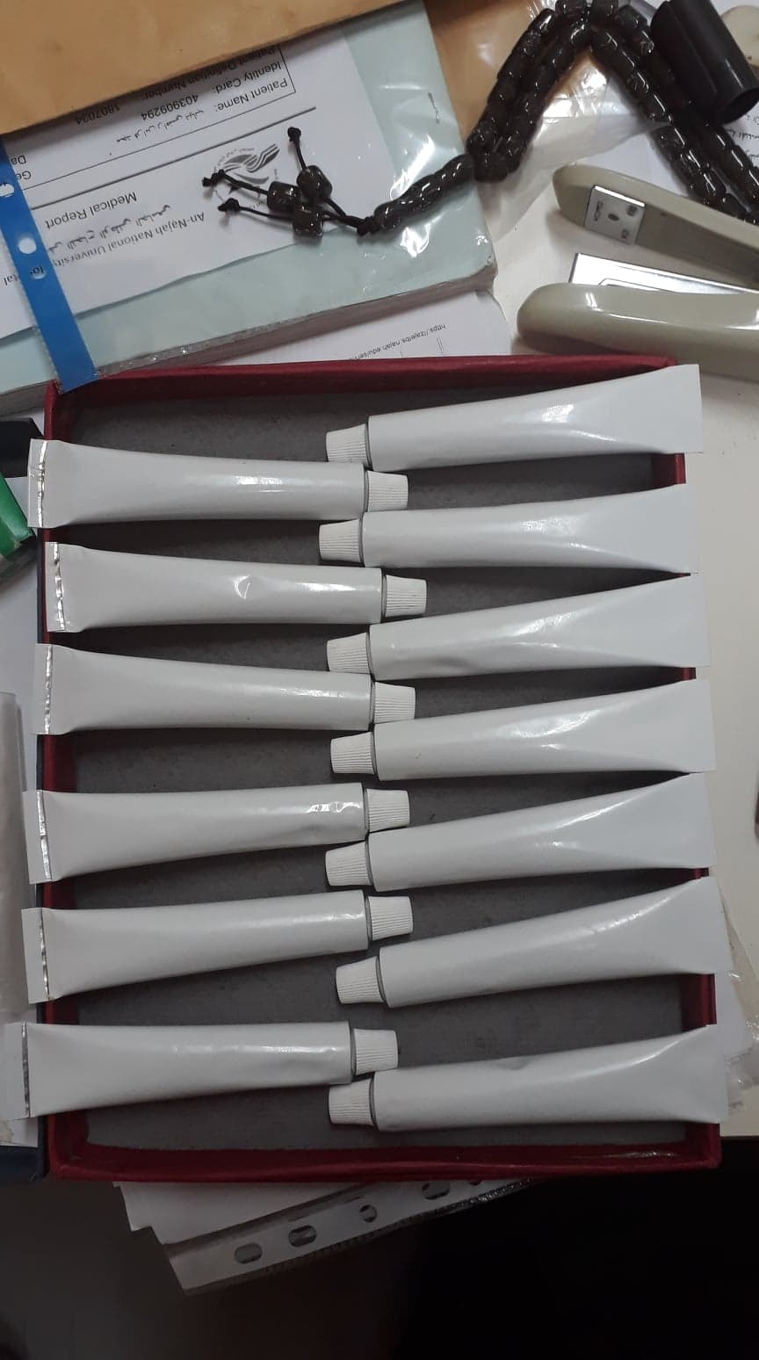
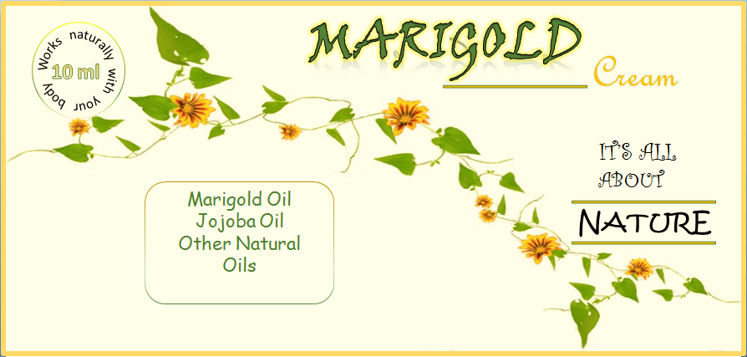
Filling
Labeling

Slide 9
Ingredients of Cream
Stearic acid
Wax
Jojoba oil
Almond oil
Glycerin
Calendula oil
Rosemary
Aloe Vera oil
TEA
Distilled water
Perfume

Slide 10
Developments on Cream Formulae.
Four different formulae have been prepared as presented in table 1. The fourth formula is the approved formulae of the project.
Trial | F1 | F2 | F3 | F4
Ingredient
Stearic acid (gm) | 101 | 101 | 101 | 101
Emulsifier (gm) | 70 | 75 | 65 | 75
Calendula Extract (gm) | 1.5 | 1.5 | 1.5 | 2.0
Jojoba oil (gm) | 17.36 | 26.04 | 17.36 | 21.7
Almond oil (gm) | 27 | 27 | 36 | 32
Glycerin (gm) | 50 | 50 | 50 | 50
perfume(gm) | - | 0.1 | 0.1 | 0.1
Aloe Vera l (gm) | - | - | - | 50
Rosmary Oil (gm) | - | - | - | 1.5
TEA (gm) | - | 0.1 | 0.1 | 0.1
Distill water (gm) | 598 | 598 | 598 | 550
Total (gm) | 866 | 880 | 870 | 884

Slide 11
Evaluation of Formulae.
Physical and biological tests were occurred for forth formula.
1. Physical Evaluations.
PH | 5.2
Viscosity (Cp) | 788
Appearance | Its creamy appearance is homogeneous yellow with acceptable viscosity.
Separation | No Separation during period of month
Homogeneity | Good
Color | stable yellow
odor | Aromatic substances were added
content of active ingredient | 6.70%
Average filling weight | 10ml &15ml filling tubes

Slide 12
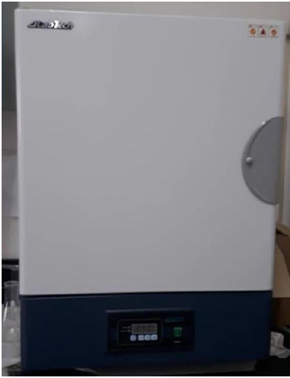
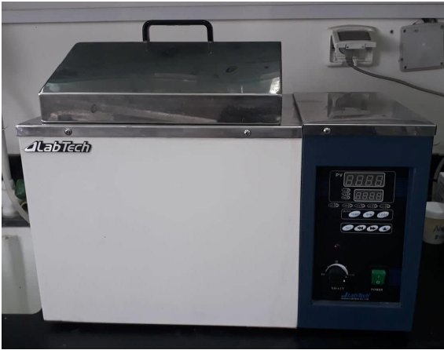
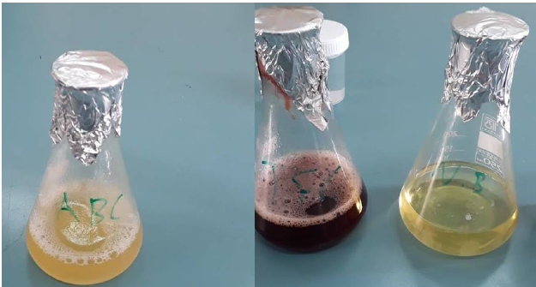
2. Biological Screening.
Total aerobic bacteria (APC) and E. Coli bacteria Tests were occurred using specific media and microbial incubator.
Microbial incubator
Water Bath device
Broth, E. Coli and APC media

Slide 13
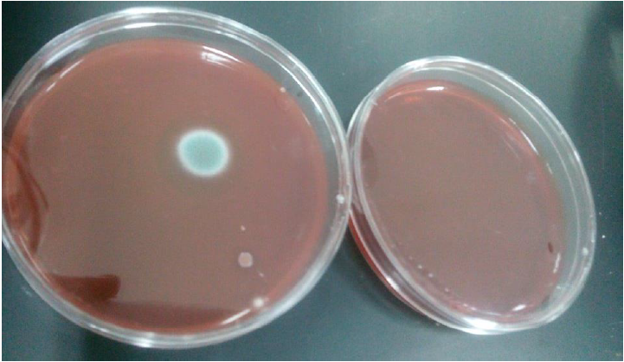
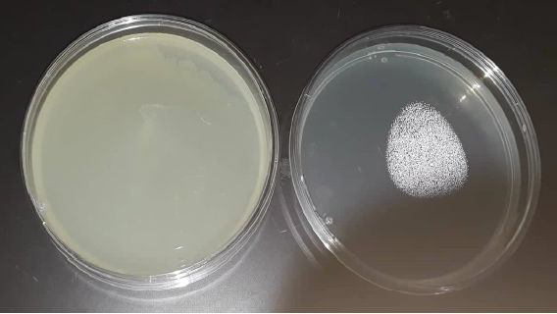
Biological tests
Microbial Test | No. Bacteria | Acceptable limit
APC | 170 | < 15000
E. Coil bacteria | 7 | < 10
E. Coli Result test
APC result test

Slide 14
PH of four formulae
Acceptable Range of PH is 4.5 – 5.5 for all formulas of cream.

Slide 15
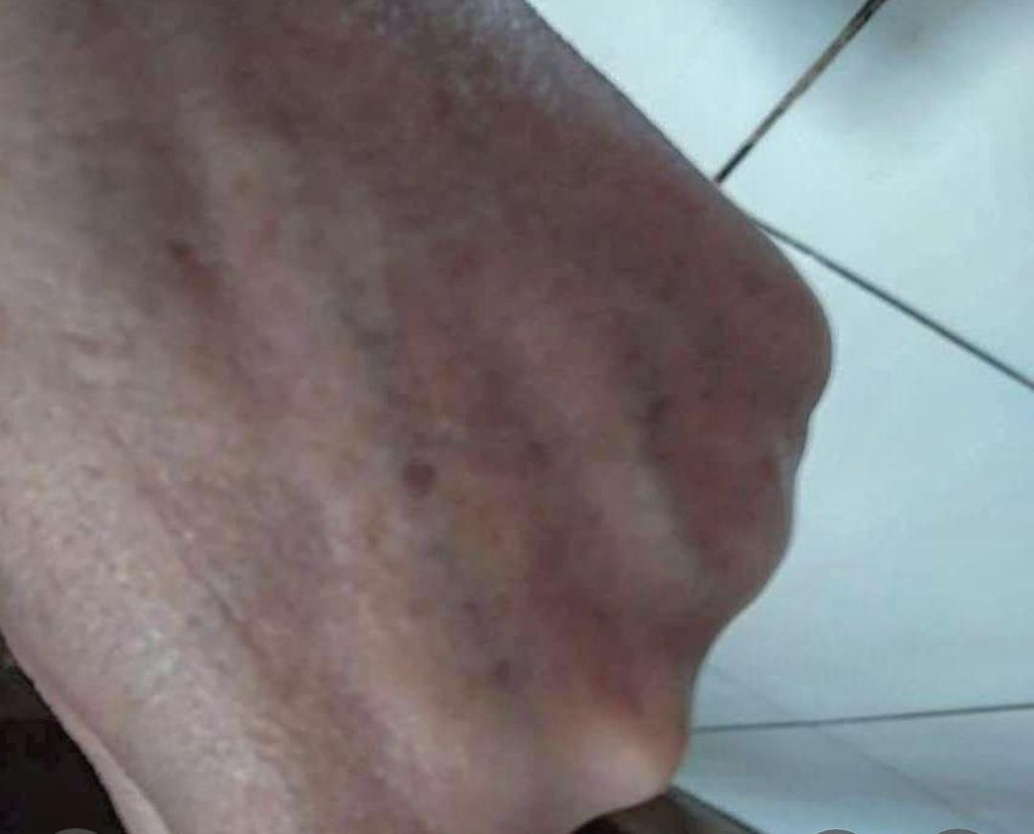
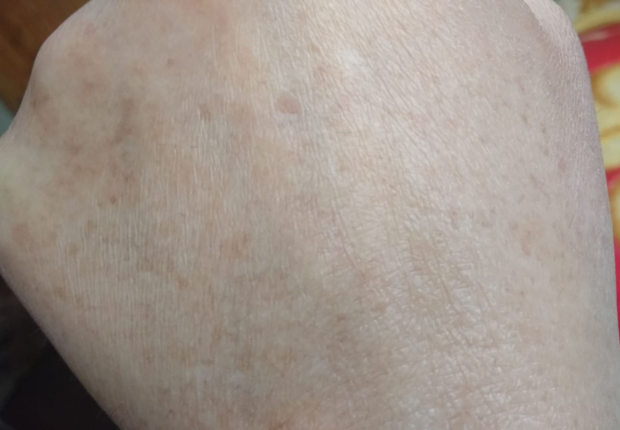
Results
The following figures are before and after the usage of the cream; for several dermatological diseases:
Sunburns
Before
After

Slide 16
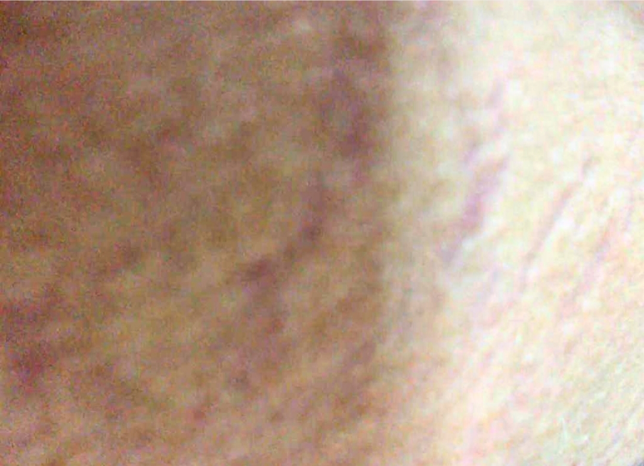
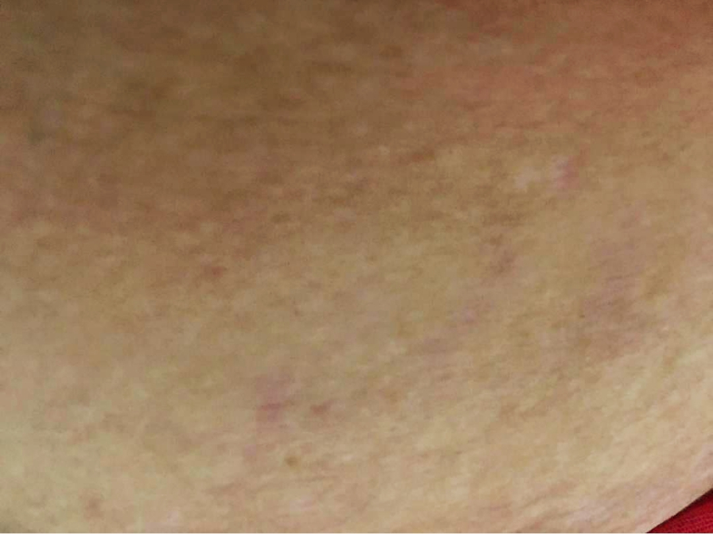
leather cracks
Before
After

Slide 17
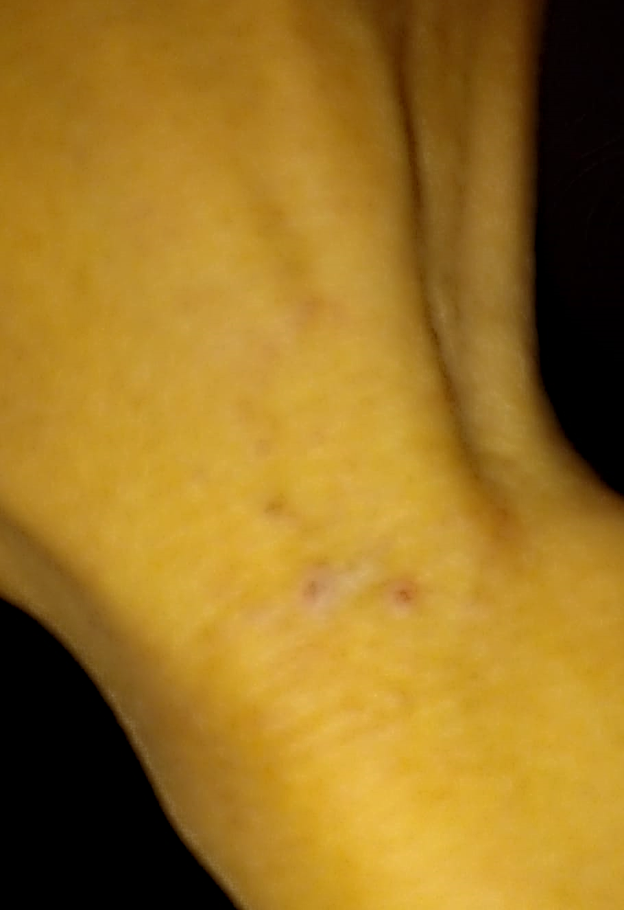
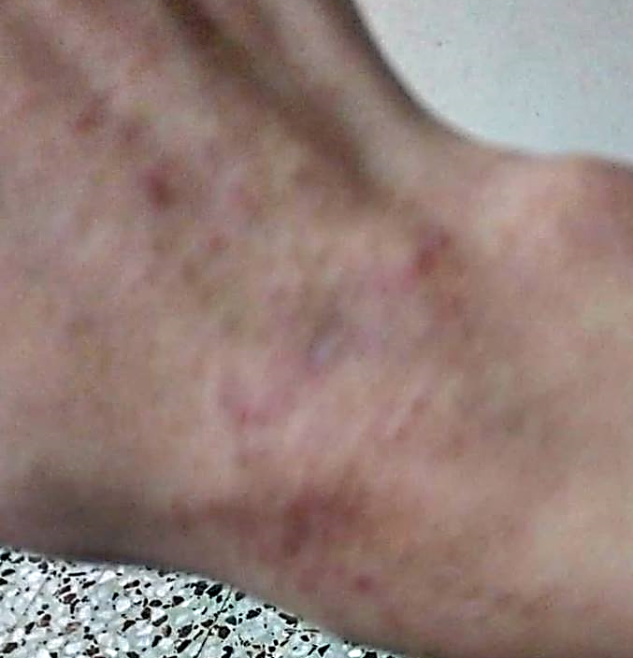
allergy pills
Before
After

Slide 18
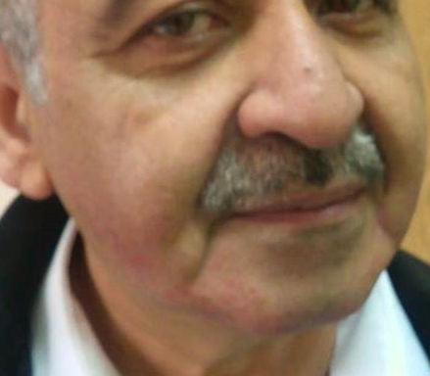
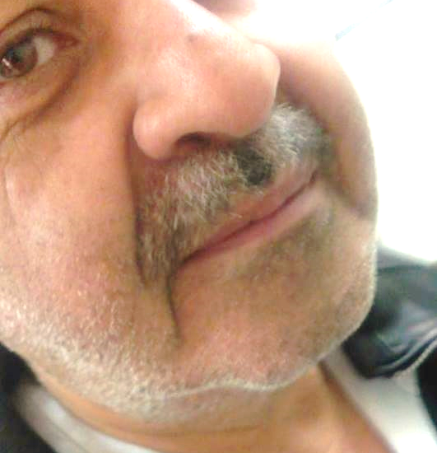
allergy

Slide 19
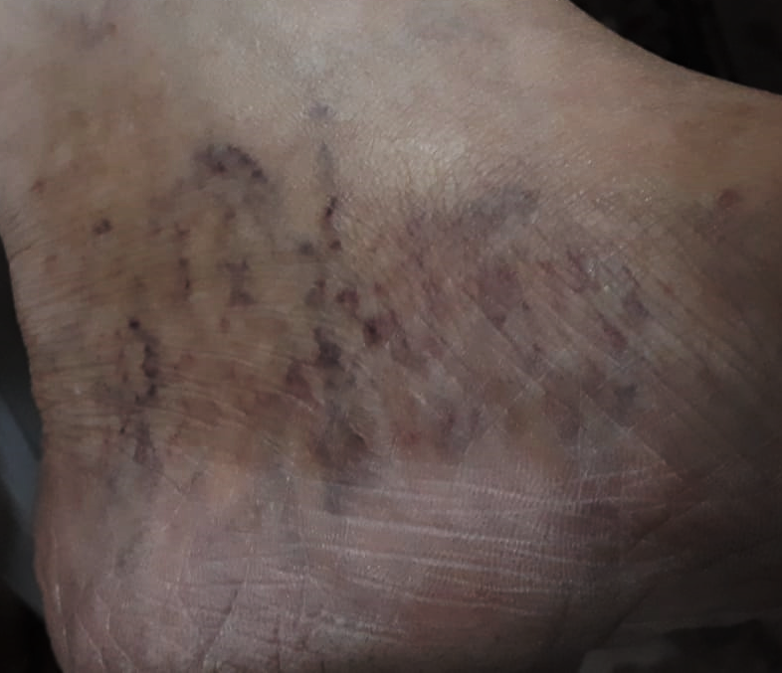
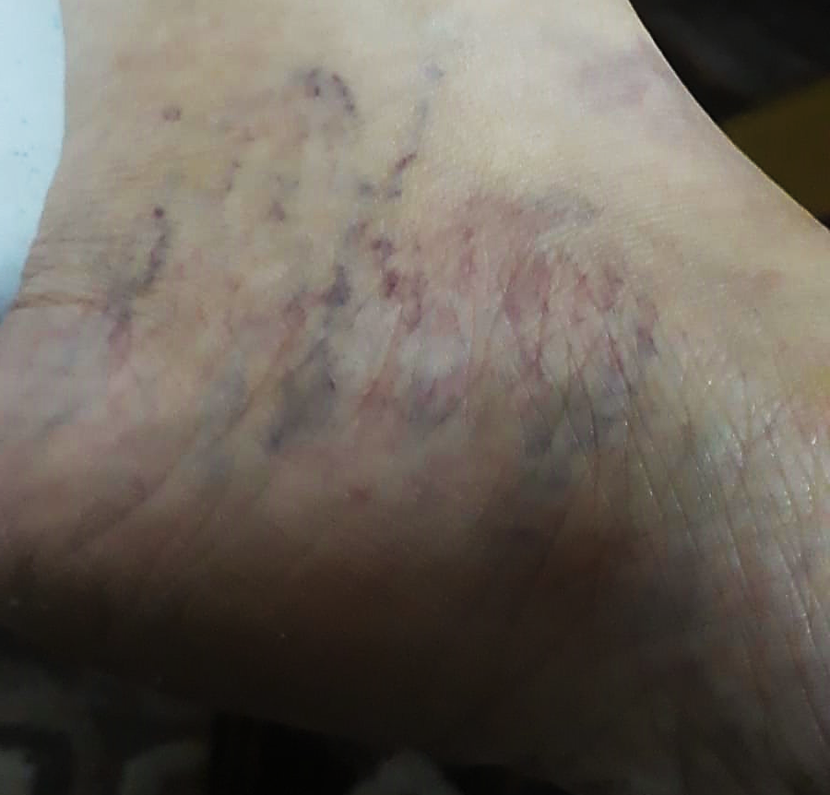
skin dryness and sunburns
Before
After

Slide 20
Rosacea

Slide 21
Safety and Precautions
Calendula is generally considered safe to use on the skin. However, it must not apply to an open wound without a doctor's supervision.
the conventional concentrations of topical calendula formulations, including the flower extract ranging from concentrations of 0.0001% to 0.8% is safe for use.
The concentration of the extract in all formulae were within the safe limit:
 | F1 | F2 | F3 | F4
Calendula Extract % | 0.0017 | 0.0017 | 0.0017 | 0.0023

Slide 22
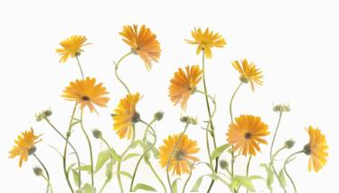
Recommendations
Cultivate larger amount of seeds to extract a greater proportion of the active ingredient to ensure more effective cream.
This project should be continued to study the effect on varicose veins and eczema since there are many variables need to be studied.
Ensure a longer period of study of the healing process.

Slide 23
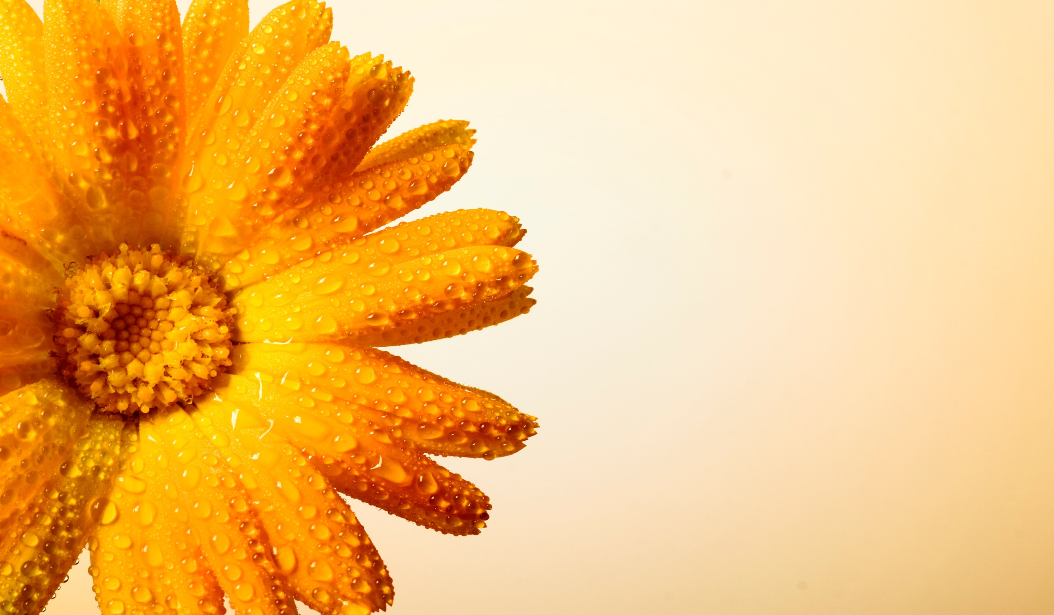
Thanks for Listening

