Slide 1

Filling Machine
Prepared by: Supervisor:
Talal Dweikat Dr. Kamel Saleh
Jafar Qadi
Hosny Saleh

Slide 2
Outline.
Introduction.
Design of filling machine.
Objectives.
Hardware & Software components.
Benefits.

Slide 3
Introduction
Our project is a filling machine used to fill certain type of pharmaceutical alcohol which was filled manually.

Slide 4
Objectives
Local manufacturing and maintenance solution.
Automatically filled bottles at the same level.
Increase the number of bottles filled per hour.

Slide 5
Benefits
High-precision filling.
User-friendly.
Flexibility for the future.

Slide 6
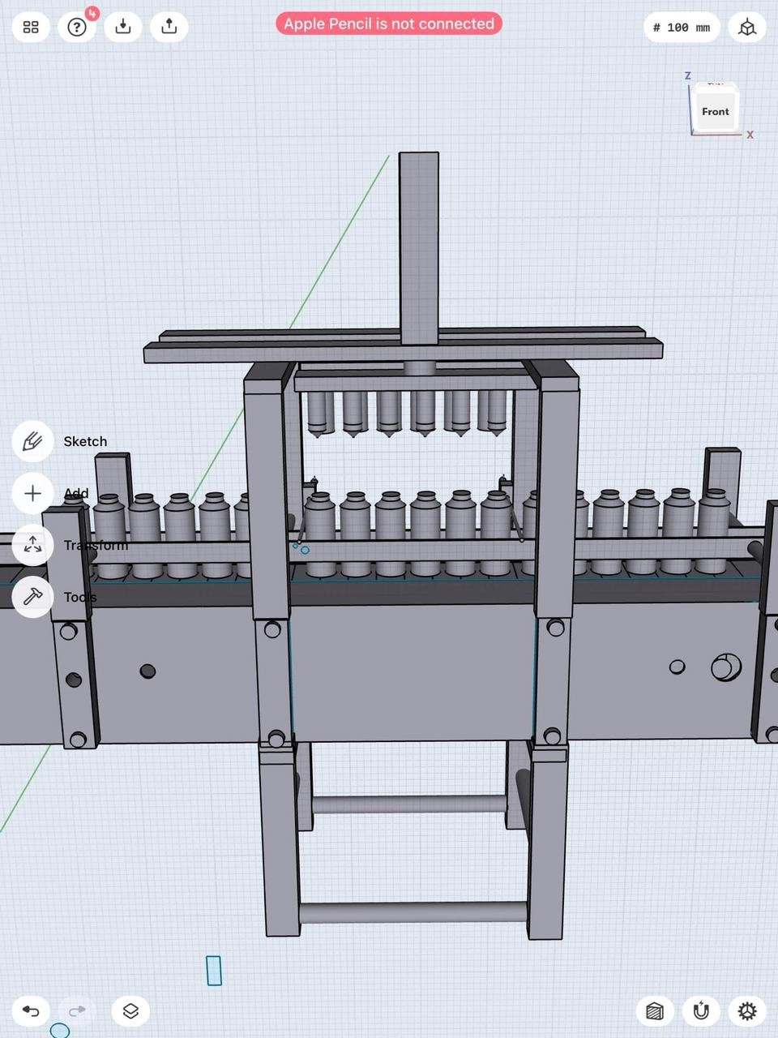
Design of Filling Machine

Slide 7
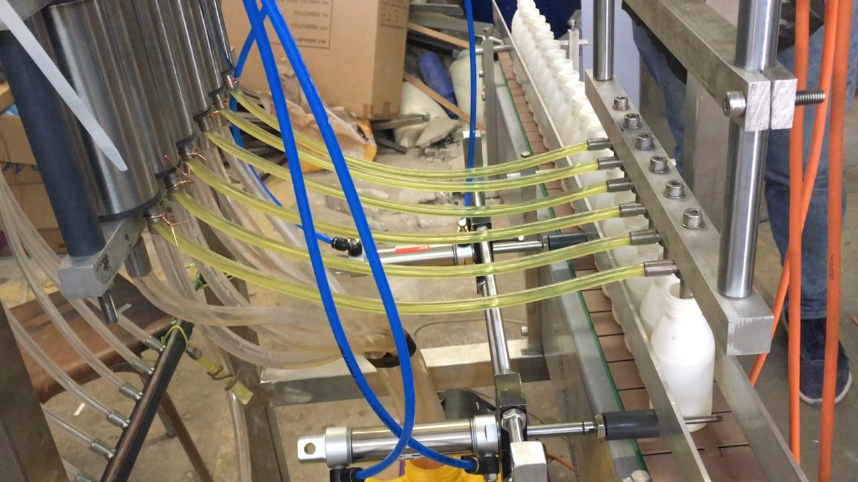
Design of Filling Machine

Slide 8
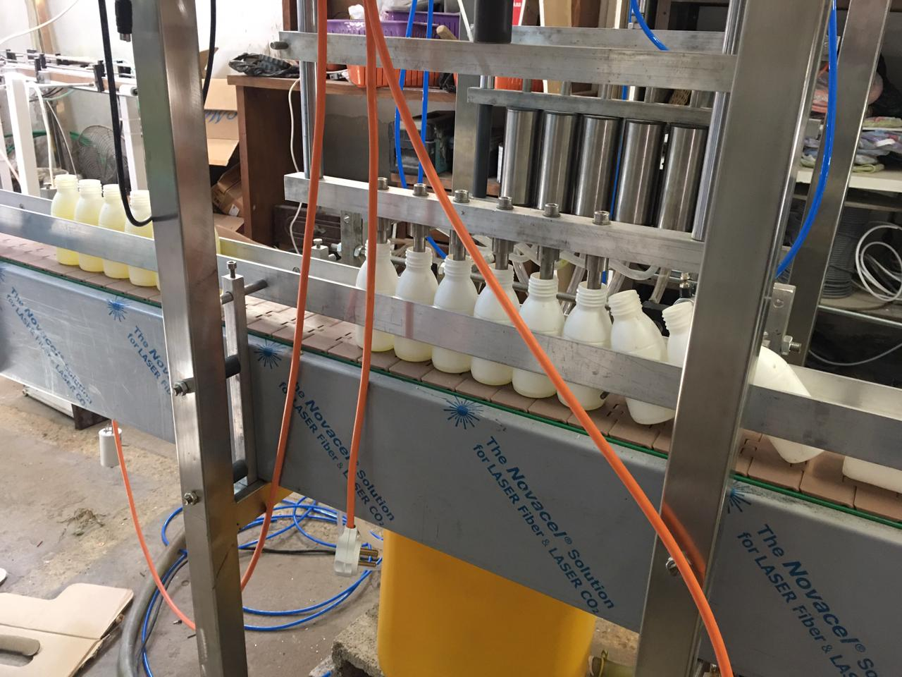
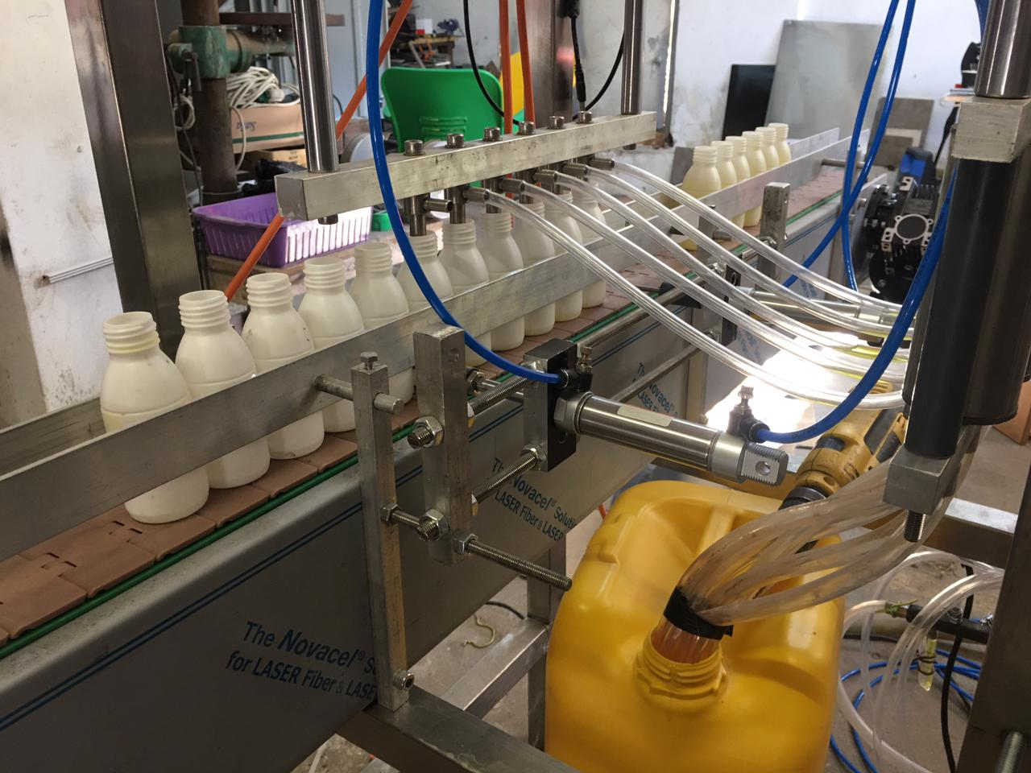
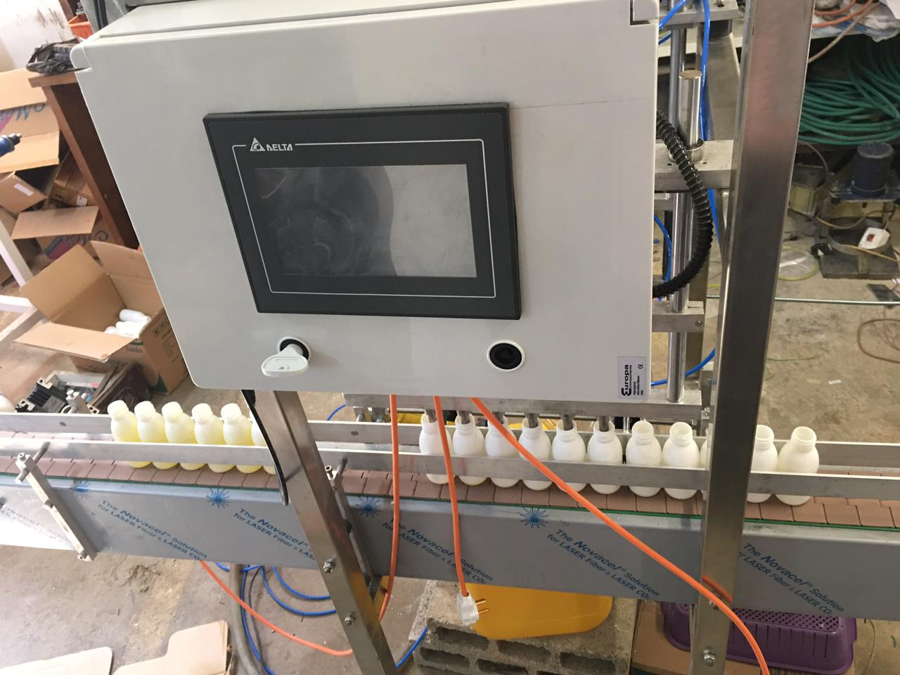
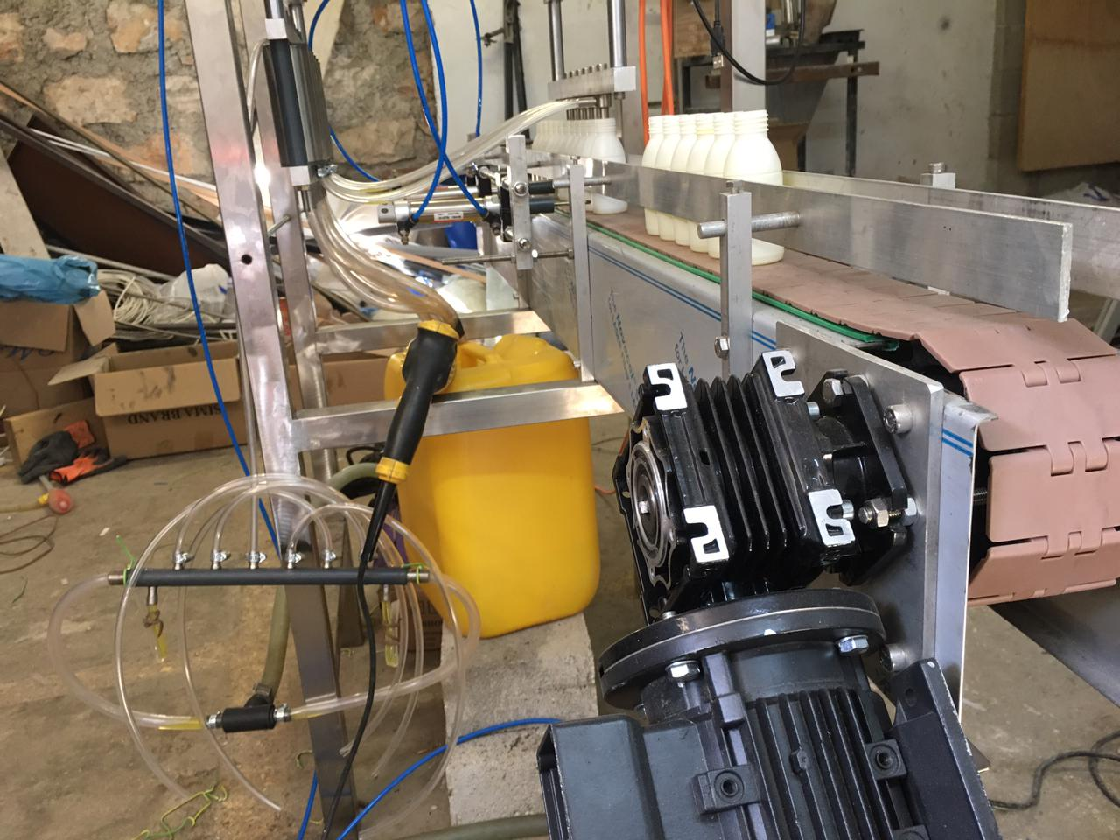

Slide 9
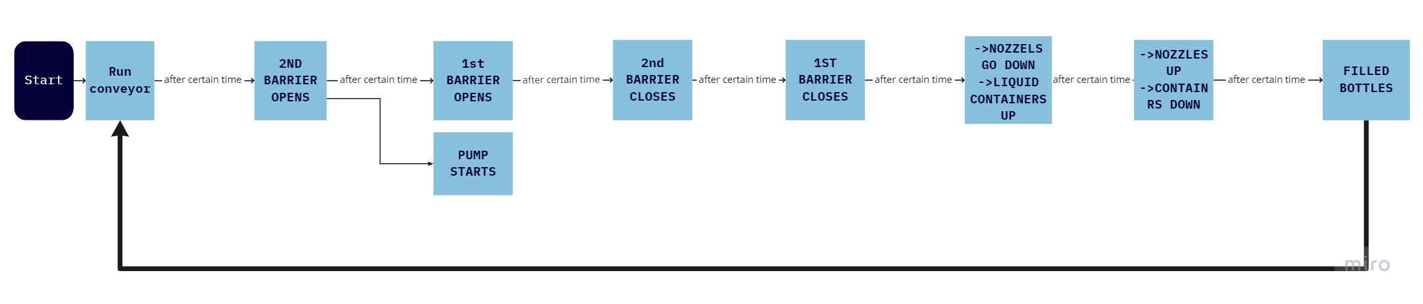
Filling Operation Flow Chart

Slide 10
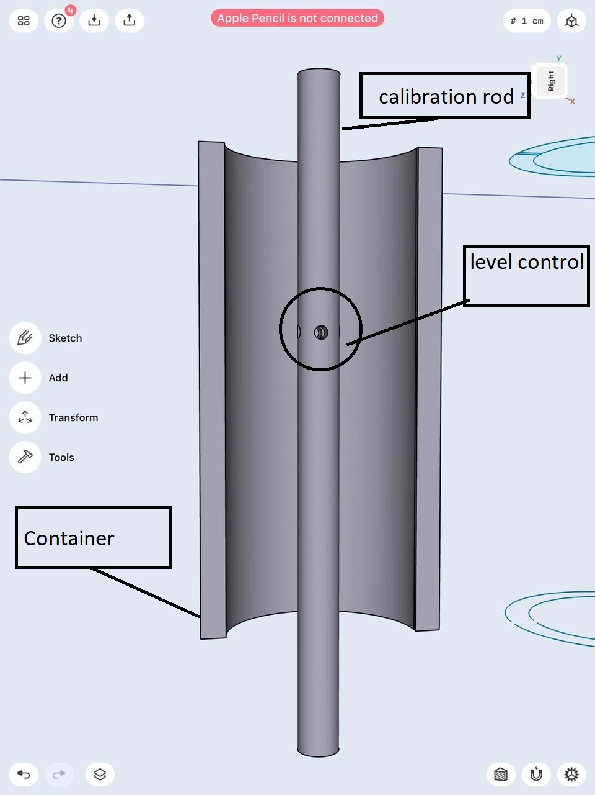
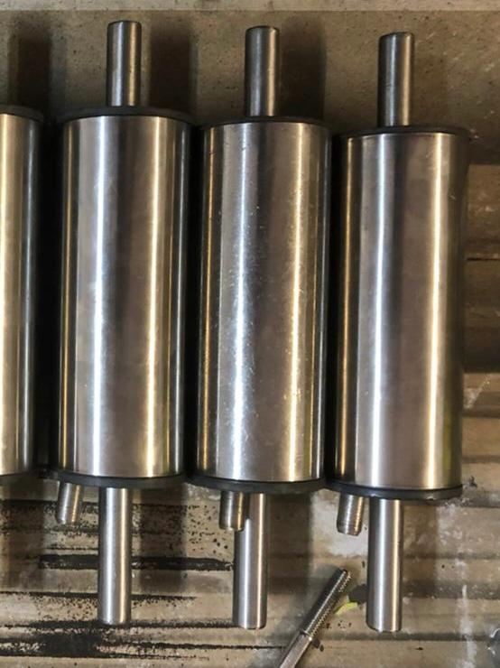
Hardware components
Liquid container design

Slide 11
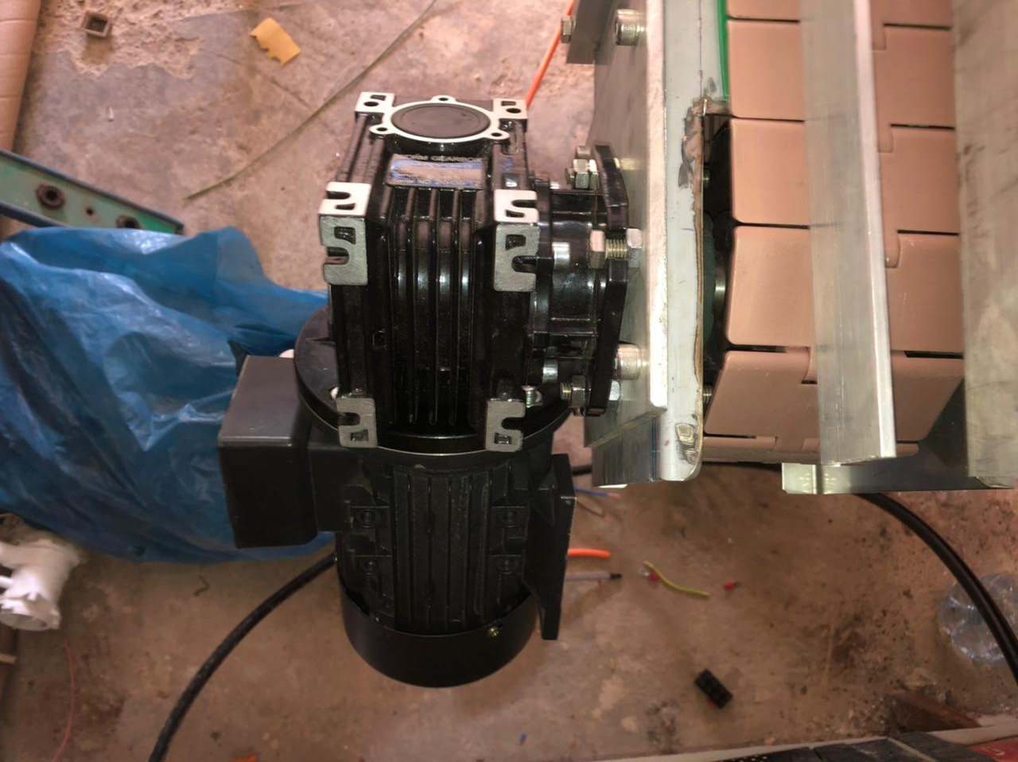
Hardware components
AC Motor with gearbox.

Slide 12
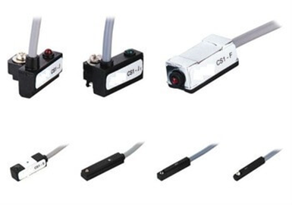
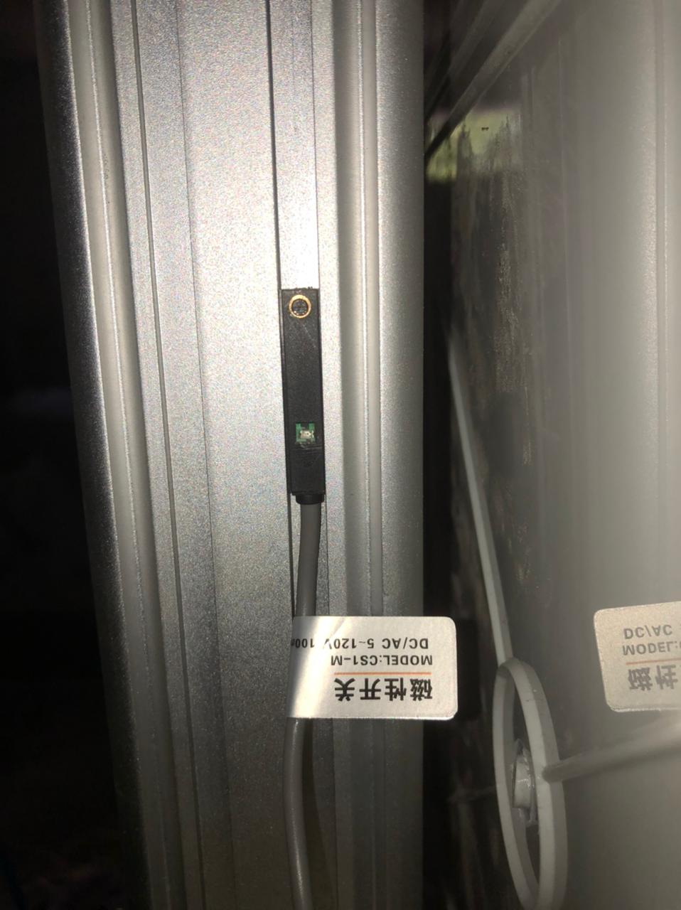
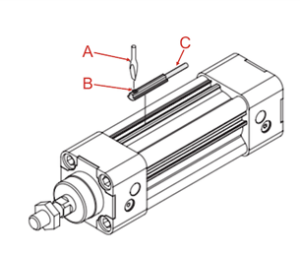
Hardware components
Proximity sensors.

Slide 13
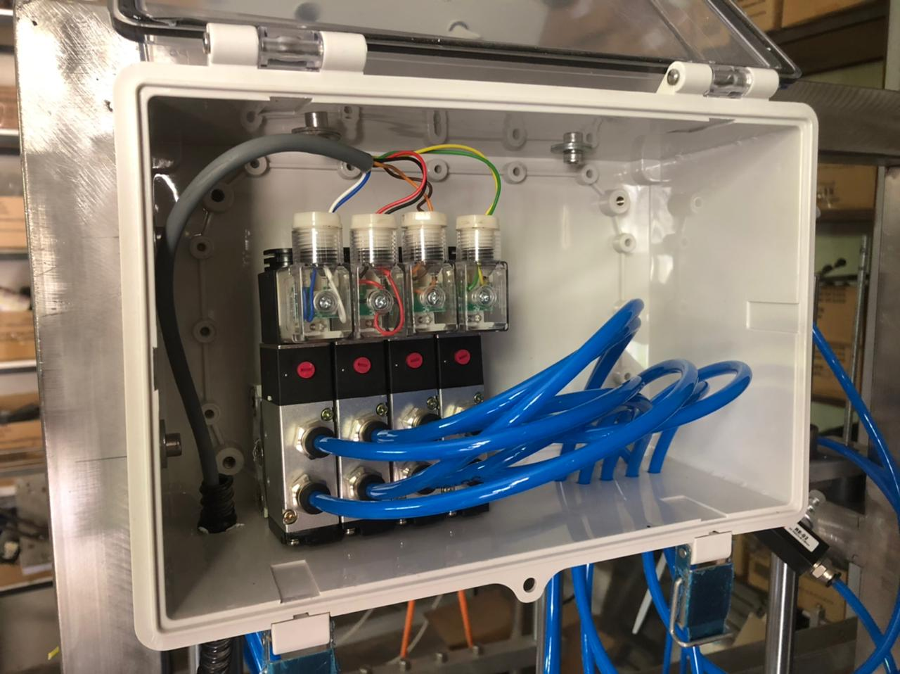
Hardware components
Selector switches for pneumatic cylinders.

Slide 14
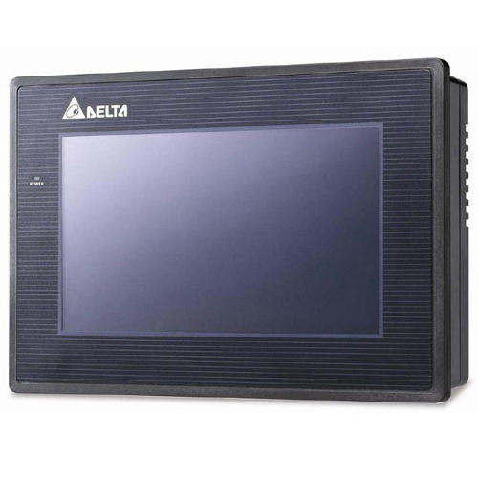
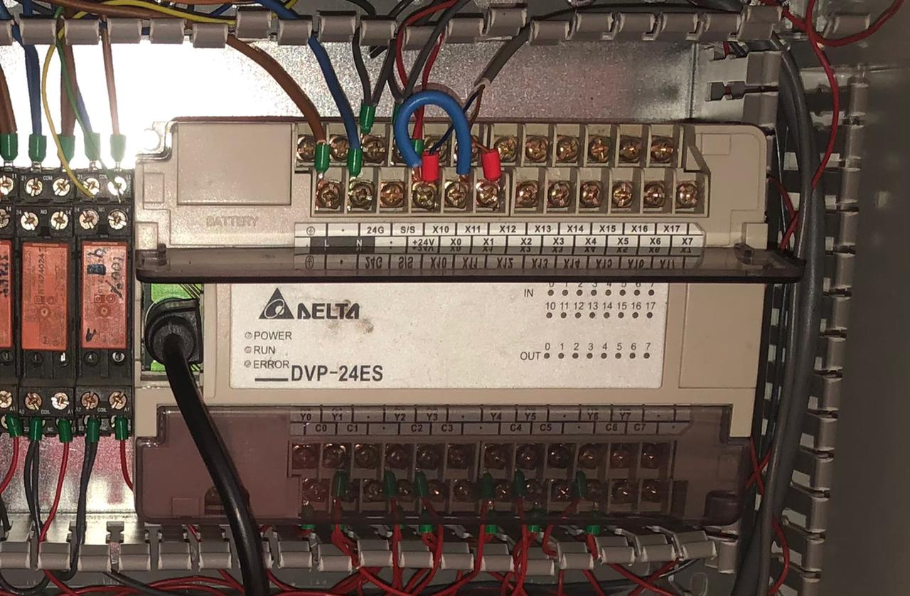
Software components
Controller and HMI.

Slide 15
Thanks for your attention

