Slide 1
Mechanical system for Al-asria college in ramallah
بسم الله الرحمن الرحيم
Prepared by :
Hashem Ihasn Janajreh 10611602
Mohammad Abu Sarah 10613862
Sari Khaled Sobeh 10507861
Ahmad Medhat Attiyah 10614151
Supervisor :
Dr. Iyad Assaf
May-2011

Slide 2
Presentation out line
- Building Description.
- Heating load calculation.
- Cooling load calculation.
- Duct Design.
- Plumbing System.
-fire fitting system
- Equipment Selection.
- Summary

Slide 3
Building Description
Building Location :
Country: Palestine.
City: Ramallah
Elevation: 840 m above sea level
Latitude: 32˚.
Building face sits at the south orientation.
The wind speed in Ramallah above 5 m/s.

Slide 4
Building details
used | Floor number
Garage | Basement -2
Operation theater major, Anesthetists, DR.s room | Basement -1
Clinics , book store, printing room ,coffee shop | Ground floor
Lecture rooms,library study | First floor
Lecture rooms,computer lab | Second floor
Simulation labs , teachers rooms , meeting room | Third floor
offices | Fourth floor
offices | Fifth floor
offices | Roof floor

Slide 5
Heating load
Outside design condition | Inside design condition | Parameters
4 °C | 22 °C | T: temperature
62 % | 50 % | Φ : relative humidity
3 g of water/kg of dry air | 8.3 g of water/kg of dry air | W : moisture content
9 °C |  | Tun: unconditioned temperature
7 °C |  | Tg : ground temperature
    The heat loss is calculated by this equation :
Q=U*A*∆T

Slide 6
Summary for heating load
Heating load (ton) | Heating load (kw) | FLOOR
8.45 | 29.59 | Basement (-1)
7.87 | 27.53 | Ground floor
23.48 | 82.18 | First floor
34.86 | 122.02 | Second floor
17.12 | 59.90 | Third floor
16.12 | 56.45 | Fourth floor
22.13 | 77.46 | Fifth floor
10.9 | 38.38 | Roof floor
141.01 | 493.54 | TOTAL

Slide 7
Cooling Load
Outside design condition | Inside design condition | Parameters
32 °C | 24 °C | T: temperature
57 % | 50 % | Φ : relative humidity
17.4 g of water/kg of dry air | 9.6 g of water/kg of dry air | W : moisture content
29.4 °C |  | Tun: unconditioned temperature
7 °C |  | Tg : ground temperature
    The general conduction equation in cooling calculation is:
Q=UA(CLTD)corr
For transmitted through glass:
For convection through glass:
Q=A(SHG)(SC)(CLF)
Q=UA(CLTD)corr
CLTD correction=(CLTD+LM)K+(25.5-Ti)+(To-29.4)

Slide 8
Summary of cooling load
Cooling load (ton) | Cooling load (kw) | Floor
10.18 | 35.62 | Basement (– 1)
12.88 | 45.1 | Ground floor
33.14 | 115.99 | First floor
45.48 | 159.18 | Second floor
19.69 | 68.90 | Third floor
22.30 | 78.06 | Fourth floor
26.37 | 92.30 | Fifth floor
13.65 | 47.76 | Roof floor
183.69 | 642.92 | Total

Slide 9
Duct Design
Design procedures
* Number of grills and diffusers are calculated and distributed uniformly.
* The total sensible heat of floor is calculated.
* The V_{circulation} of floor is calculated.
* The initial velocity for the main duct must ≤ 5 m/s.
* The pressure drop (∆P/L)=0.4 Pa/m
* The main diameter is calculated .
* The height and width of the rectangular ducts are determined from software program .

Slide 10

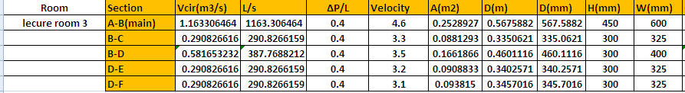
Sample calculation For Design duct :
Example: first floor we choose lecture room(3)

Slide 11
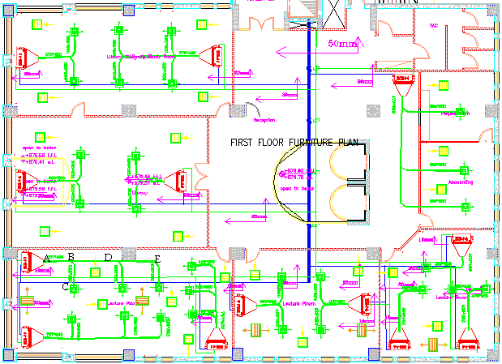

Slide 12
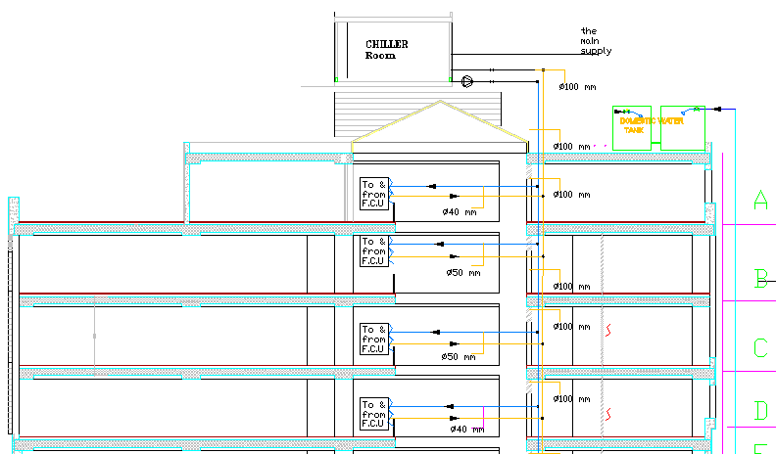
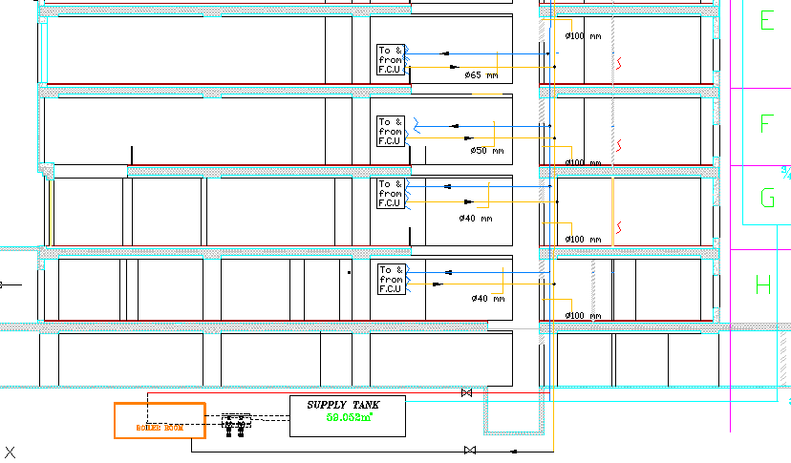

Slide 13
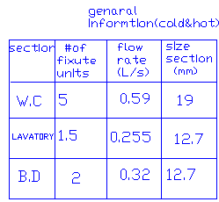
Plumbing System(potable and dranige systems)
General information:
From the table of potable water we can find the number of fixture units, the flow rate and the size as in below table :

Slide 14
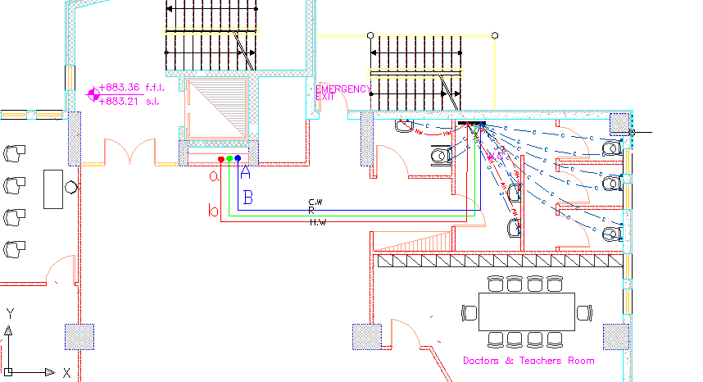
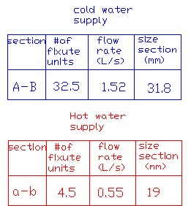
Then we can connect the water to the fixture as in the figure(example second floor):

Slide 15
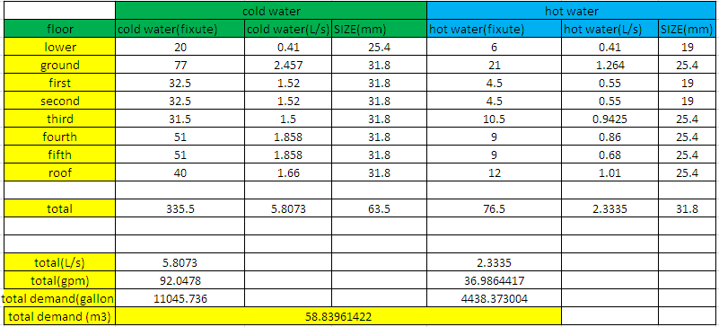
Then we calculated the number of fixture unit for all floors in the building to determined the demand of water which needed as in table:

Slide 16
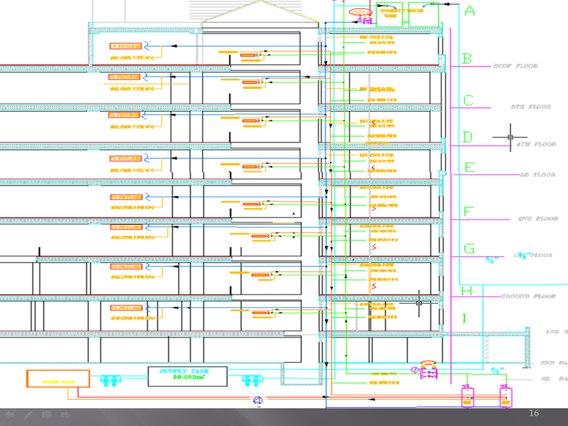

Slide 17
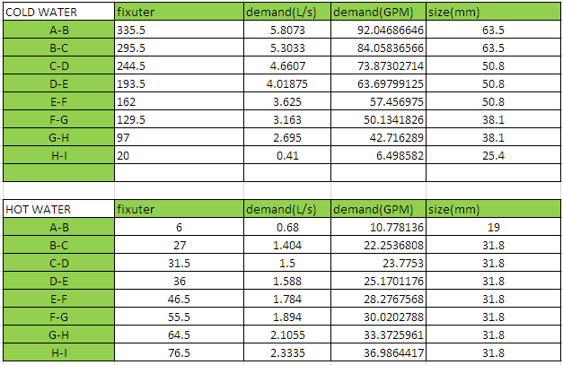
Total demand water, size for the building riser:

Slide 18
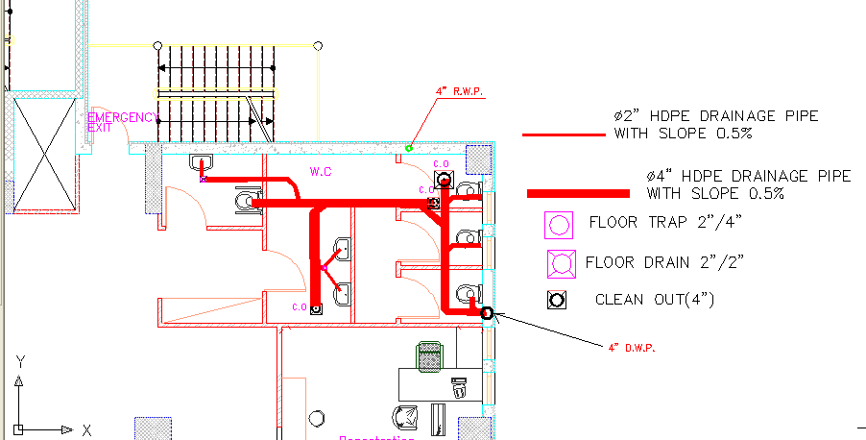
Drainage system
As in the below figure ,we can see how can draw the drainage system on AutoCAD(Example third floor):

Slide 19
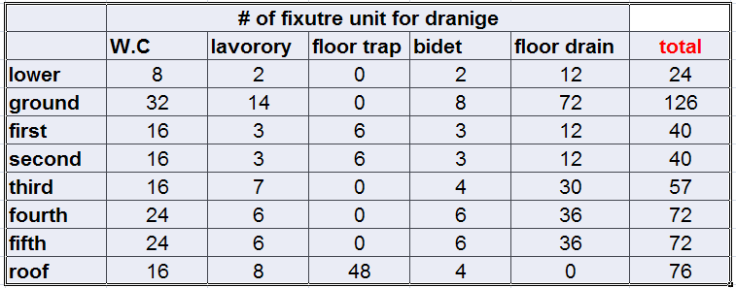
Drainage system
We can calculated the number of fixture unit but we don’t need for a pipe of vent because the drainage pipe descent on wall and it can use a vent
The table show the number of fixture units:

Slide 20
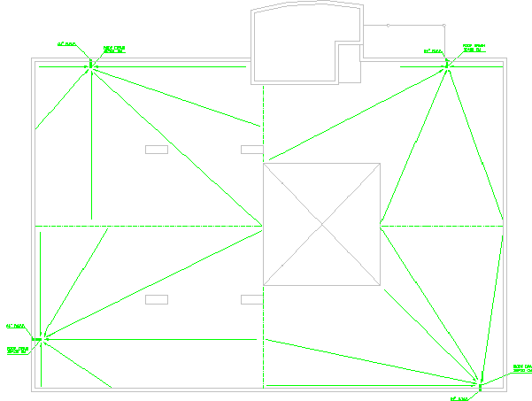
Drainage for rain water

Slide 21
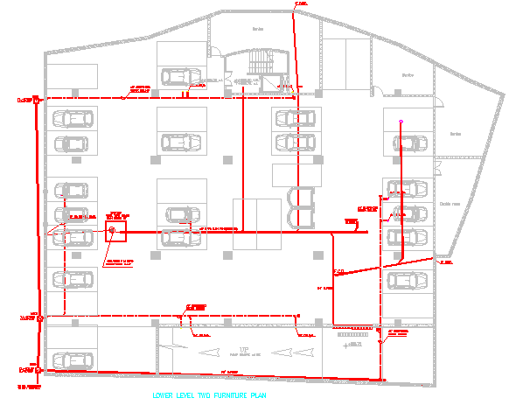
Drainage system
After that ,we should combine all exist drainage and going it to the manhole outside of building as in the figure:

Slide 22
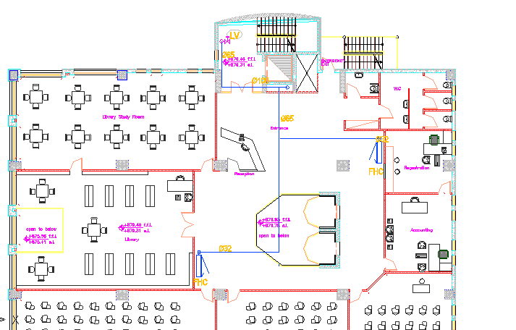
Fire fighting system
In the college we have 9 floor ,one of them is a garage which location is (second lower floor) and the 8 floor is studying floors. So we will use three systems of fire fitting which combined of them( landing valve , F.B.C, sprinklers(for garage)).
Example: third floor we use (L.v(2.5’’) , F.B.C(1.25’’)):

Slide 23
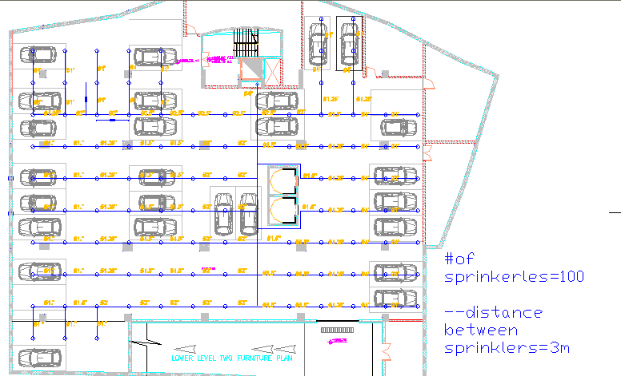
Fire fighting
But we use the sprinkler(4’’) in garage as in the figure :

Slide 24
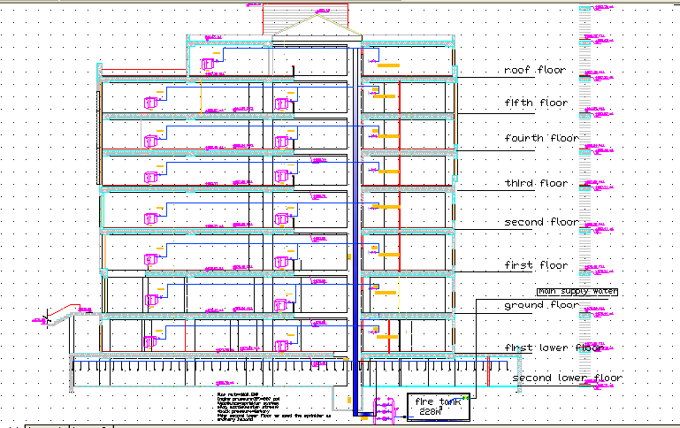
Fire fighting(riser(6 in))

Slide 25
Equipment Selection
Boiler :
From mansour catalog of steam boiler is
720 kw. MS-20 which has capacity is
Chiller :
From Petra catalog we select a model
Which has capacity is 707 kw. A P S 150 2S AC
Fan coil :
RAC 4 H/C CBP 3
400 cfm

Slide 26
Equipment selection cont.
Exhaust fans:
From ROSENBERG program we select a fan according to total CFM for example.,
DH 355-4 D EX
PUMPS:
From LOWARA company we select
1. Circulation pump for boiler GM GS20/SV330F5T
2. Centrifugal pump for potable water GXS20-GMD20
3.Transfer pump GENYO 2HMS4/F15
4.Drainge pump DOC7VX

Slide 27
SUMMARY
*All steps of design and plans of HVAC system are done.
*All steps of design and plans of plumping system and fire fitting system are done.
*we select a suitable equipment for the system which satisfied the required conditions.

Slide 28
The End

