Slide 1


Slide 2
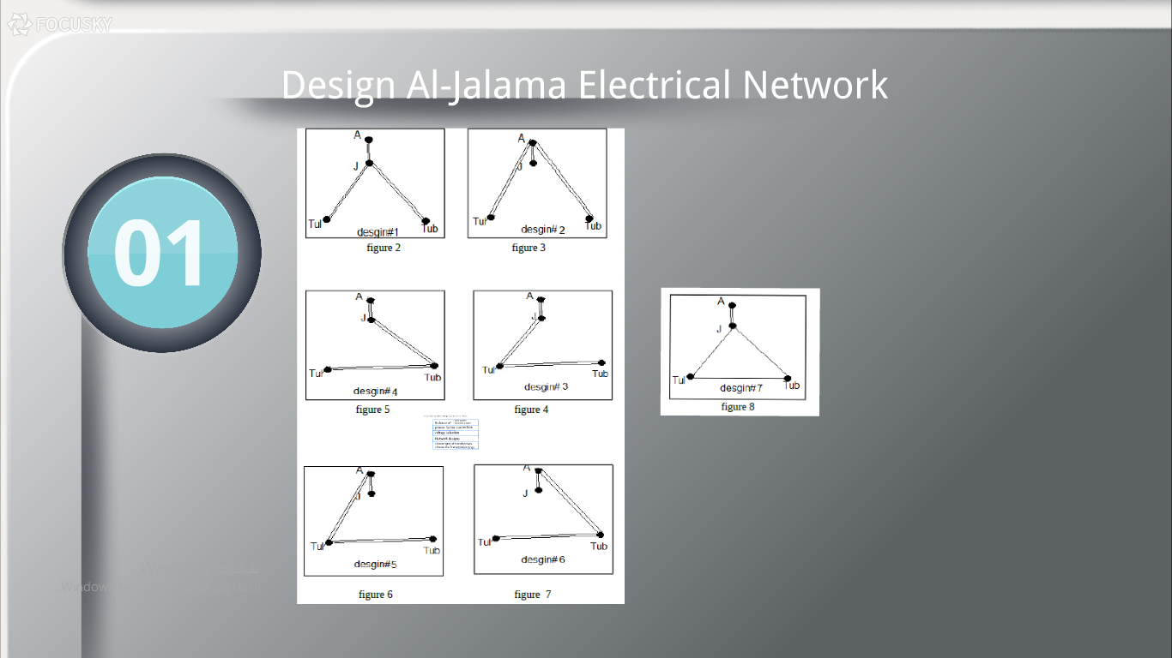

Slide 3
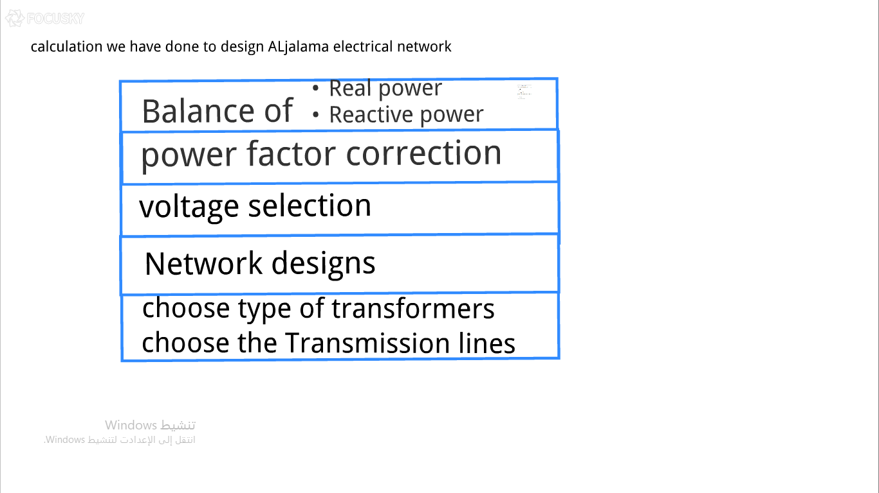

Slide 4
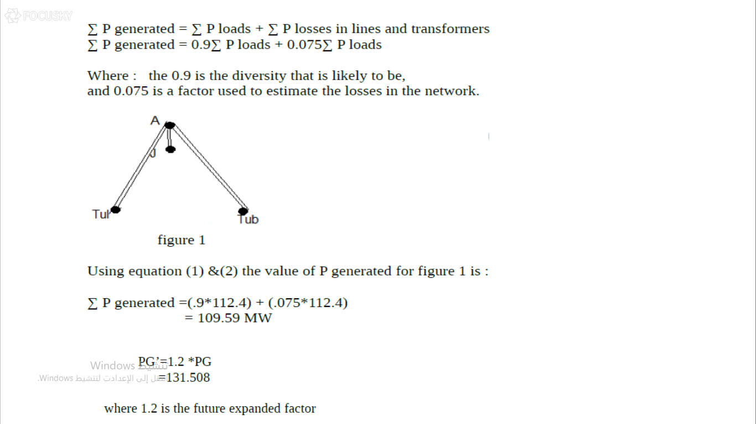

Slide 5
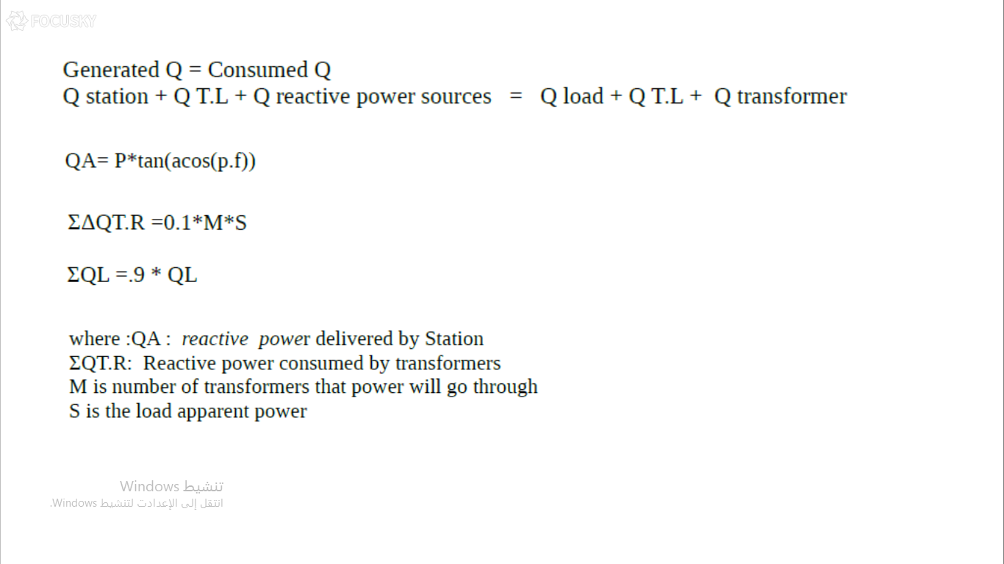

Slide 6
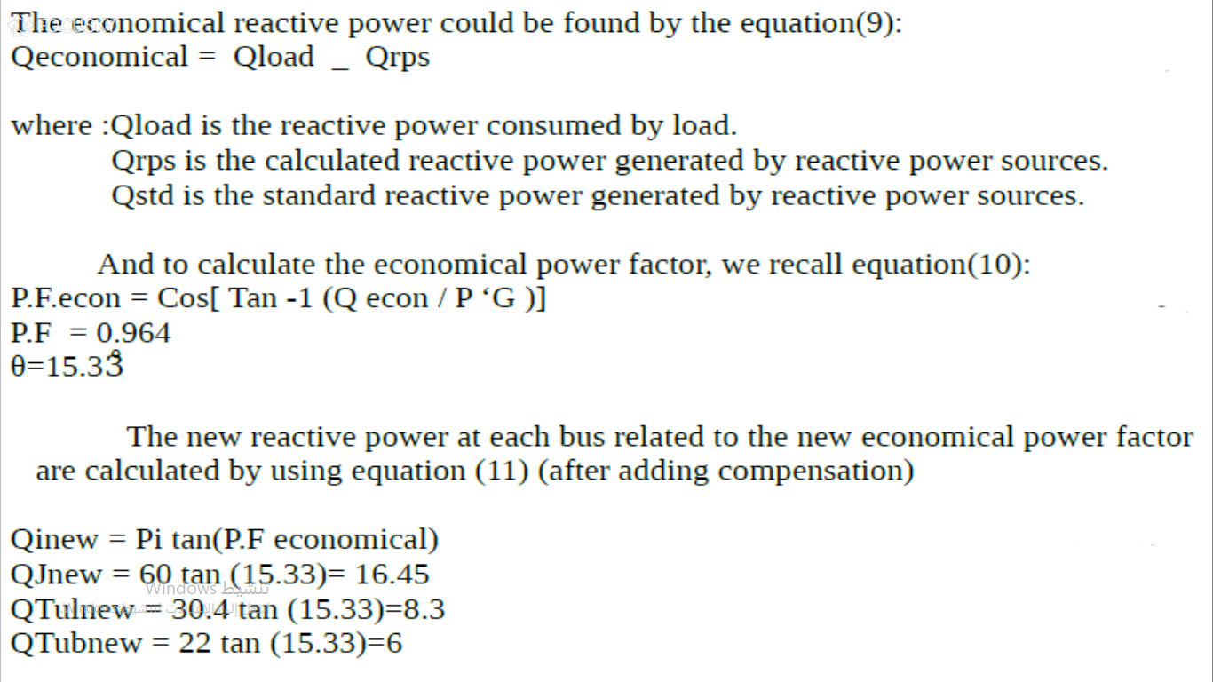

Slide 7
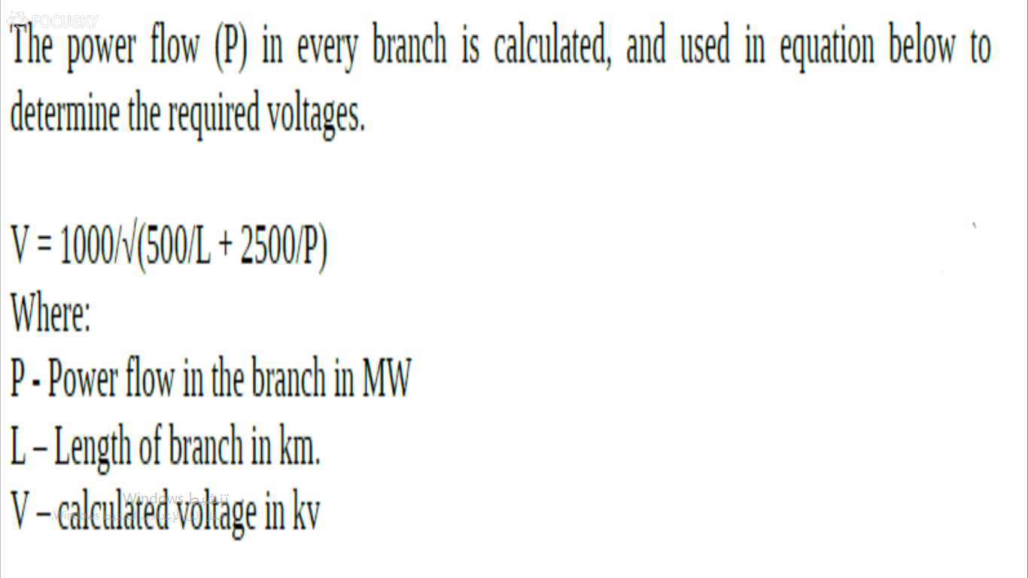

Slide 8
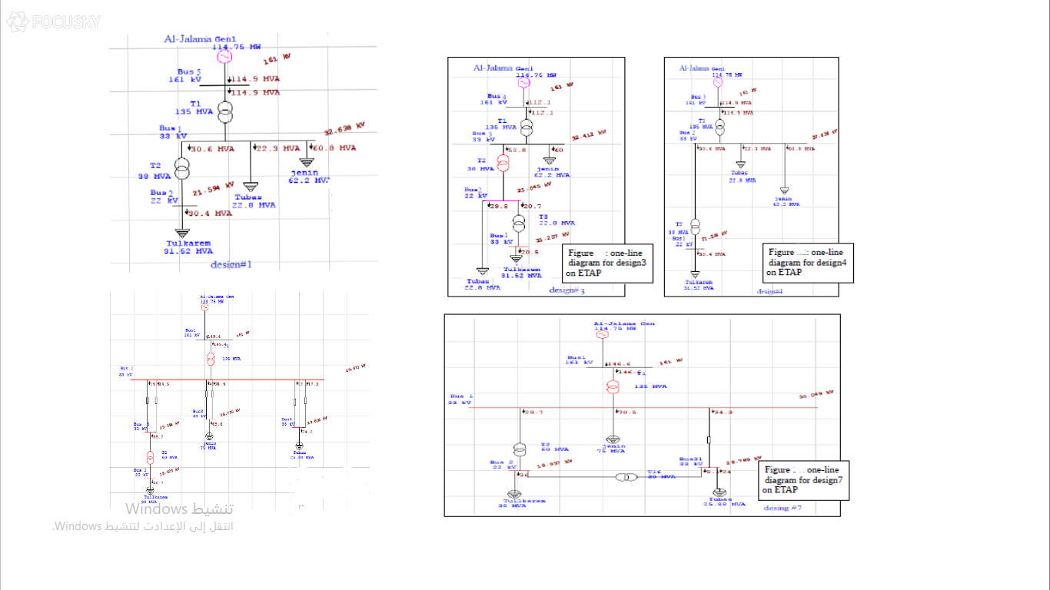

Slide 9
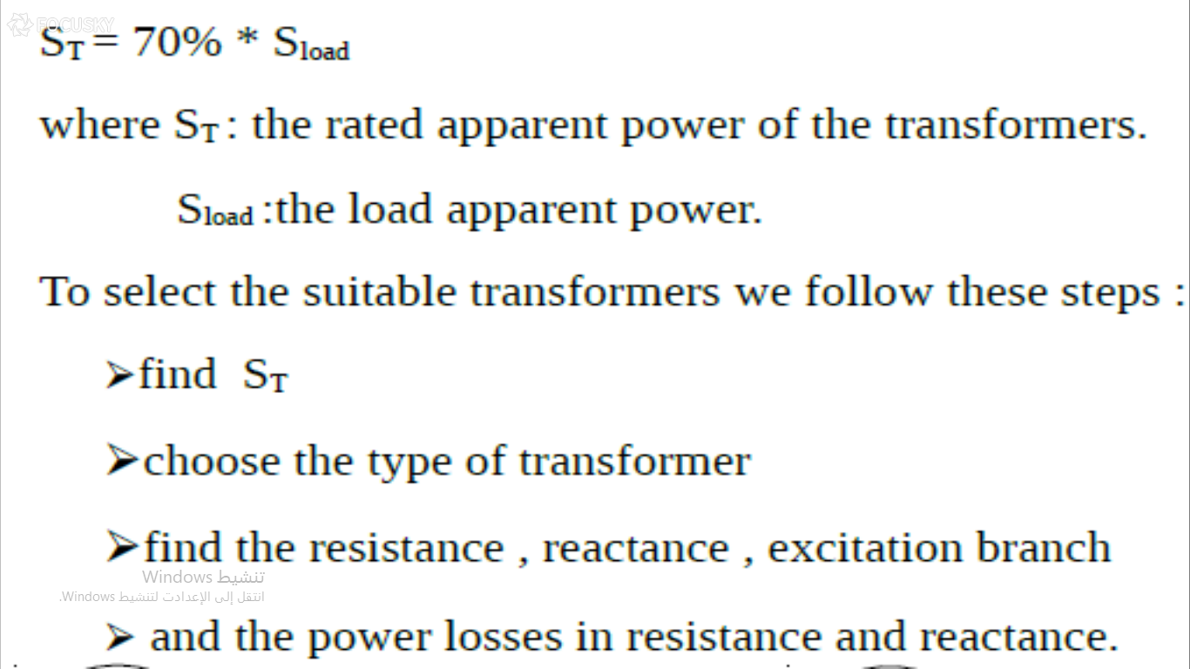

Slide 10
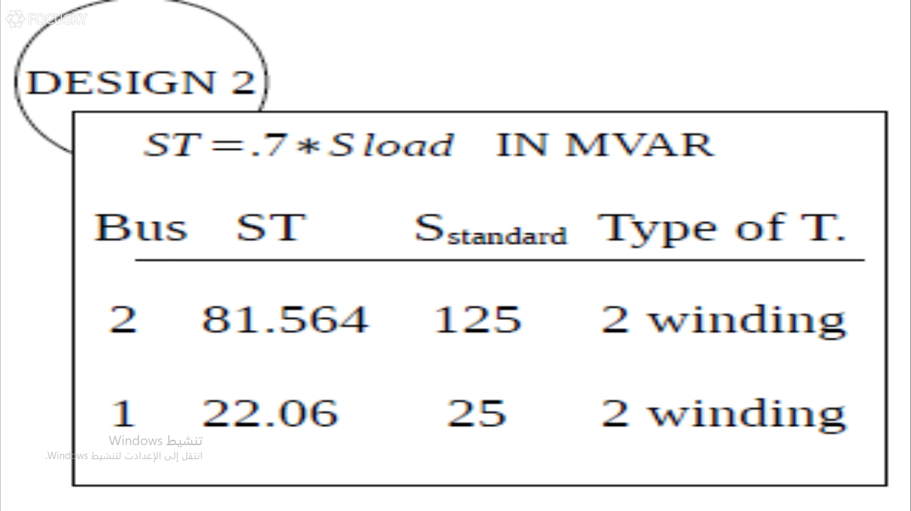

Slide 11
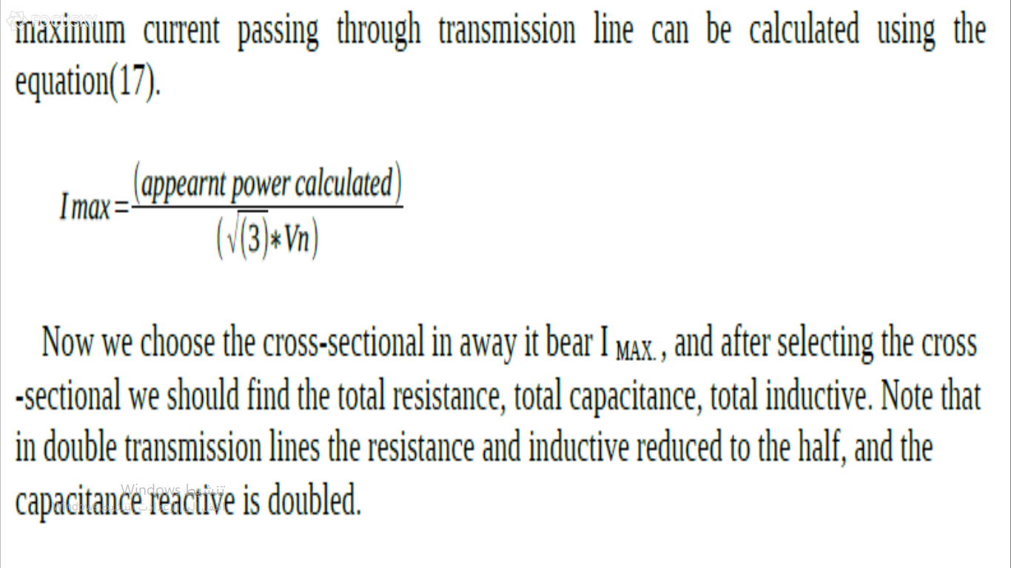

Slide 12
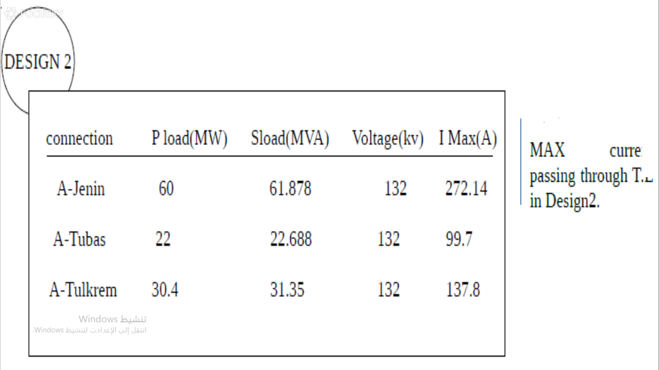

Slide 13
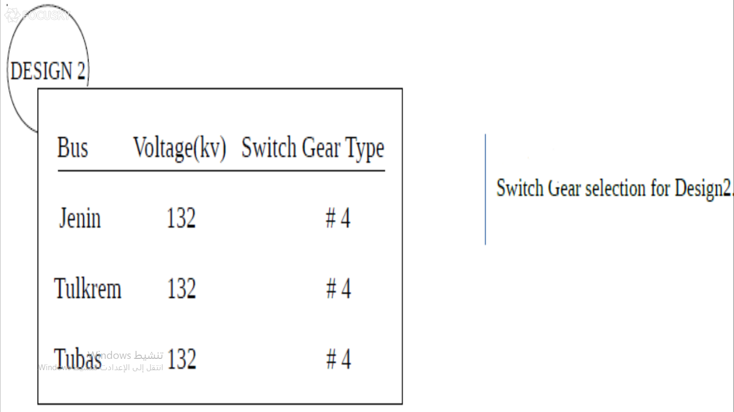

Slide 14
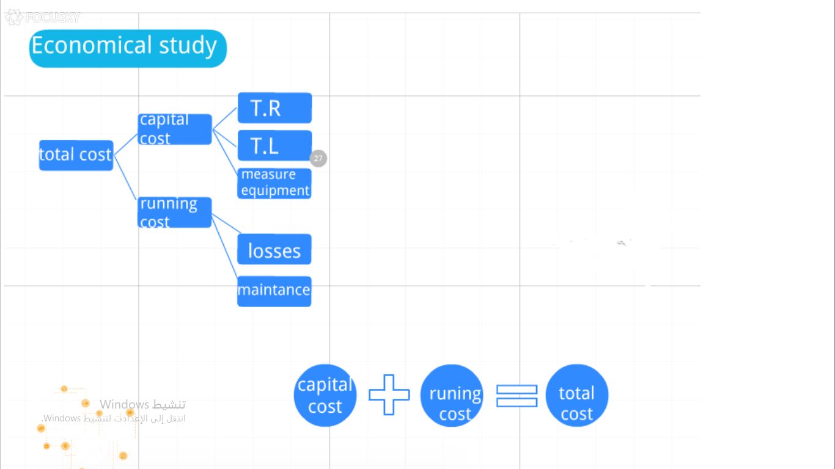

Slide 15
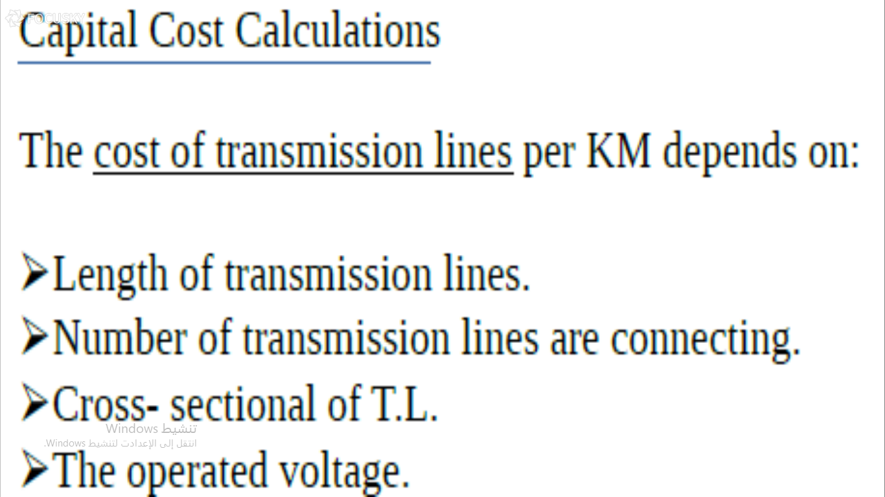

Slide 16
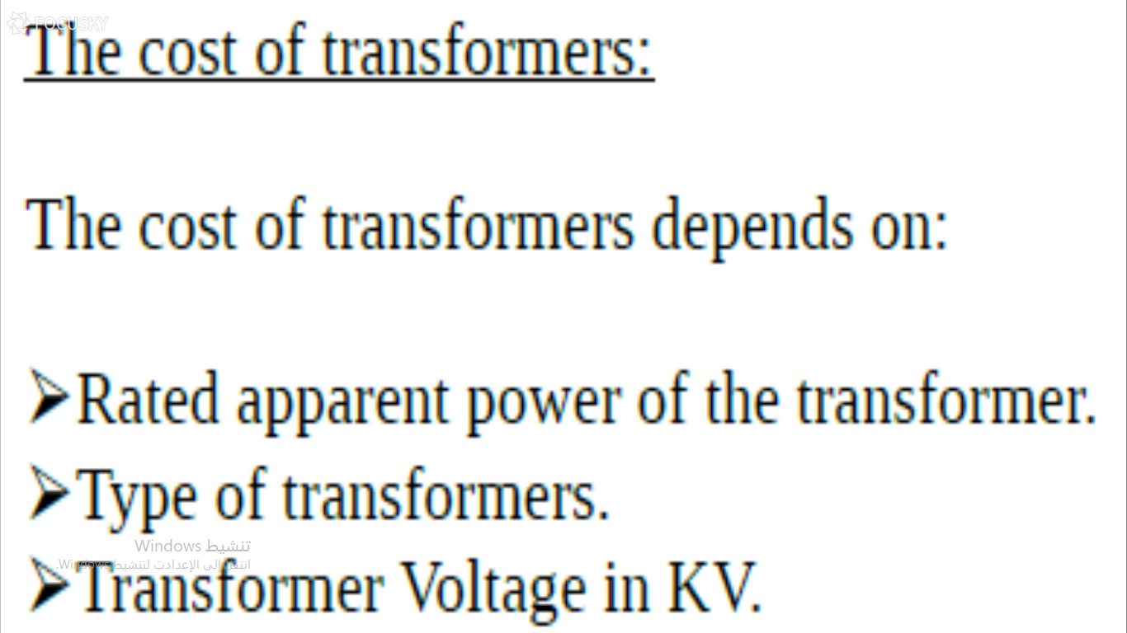

Slide 17
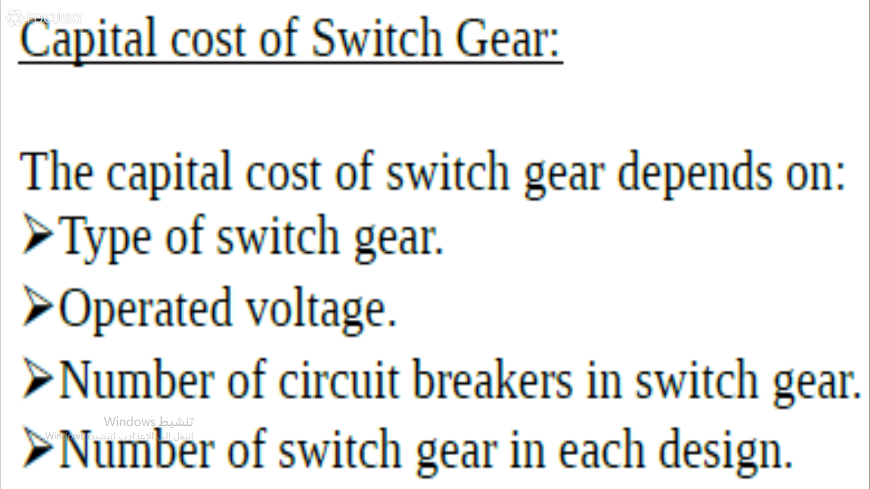

Slide 18
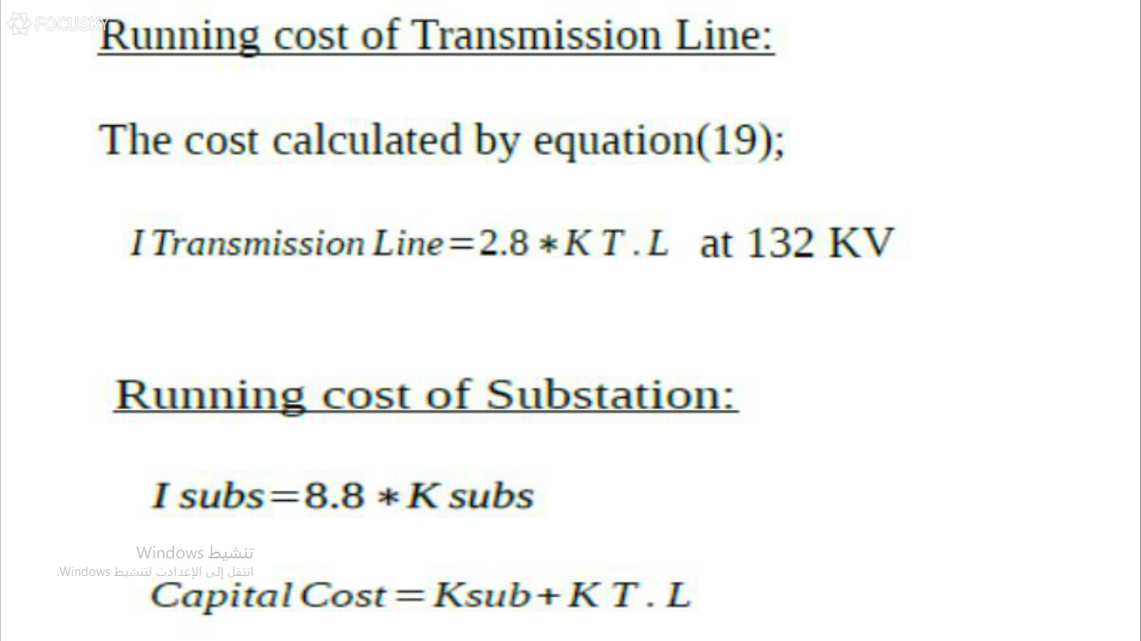

Slide 19
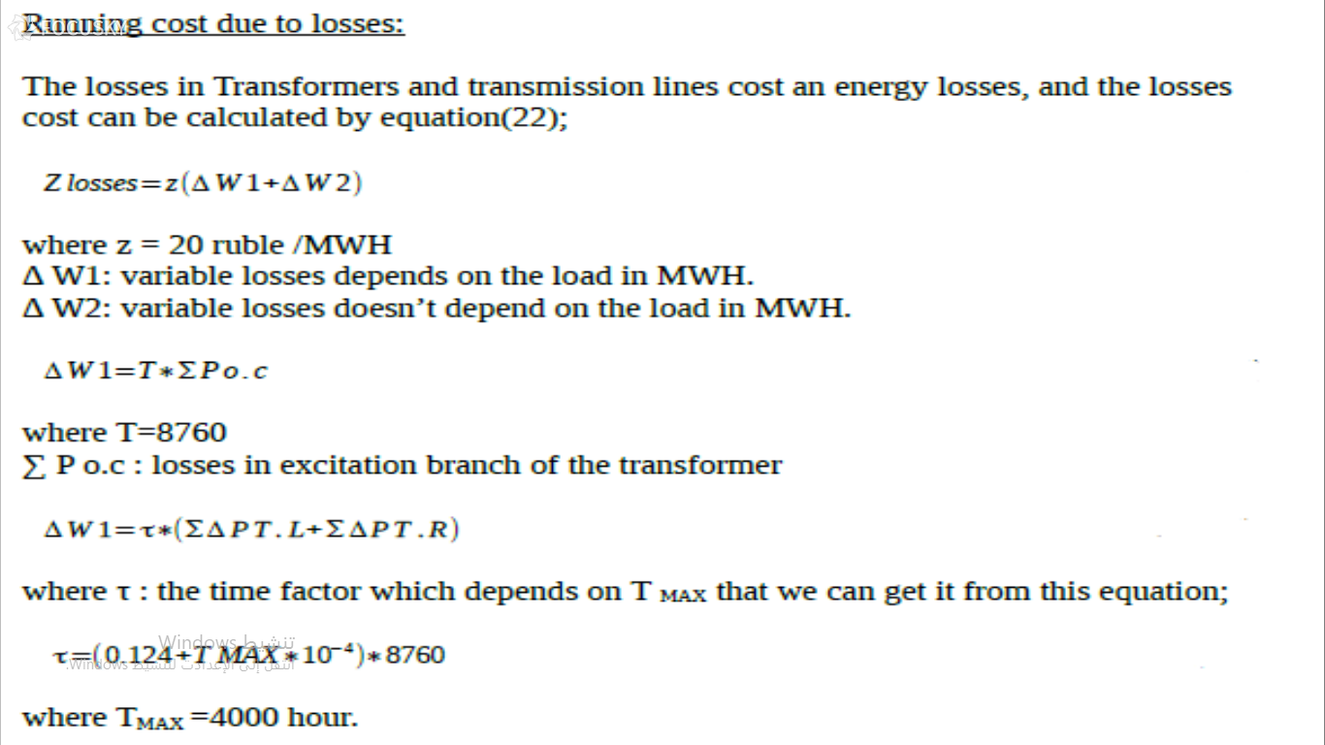

Slide 20
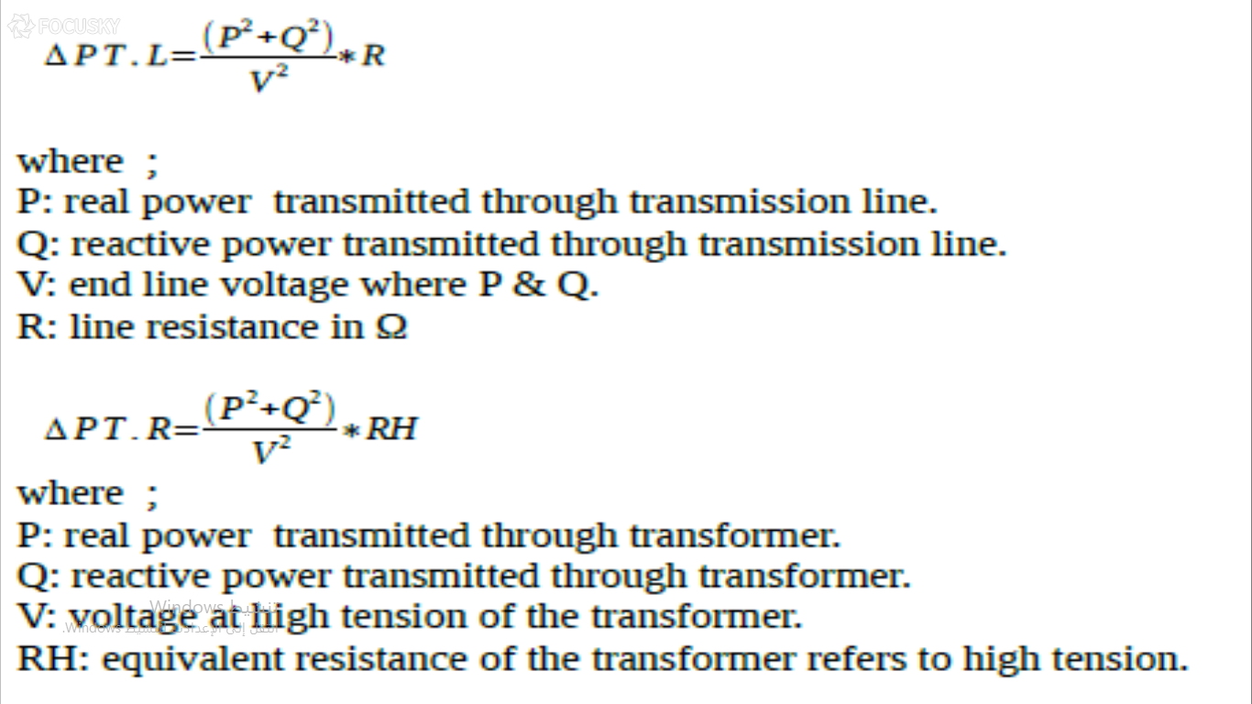

Slide 21
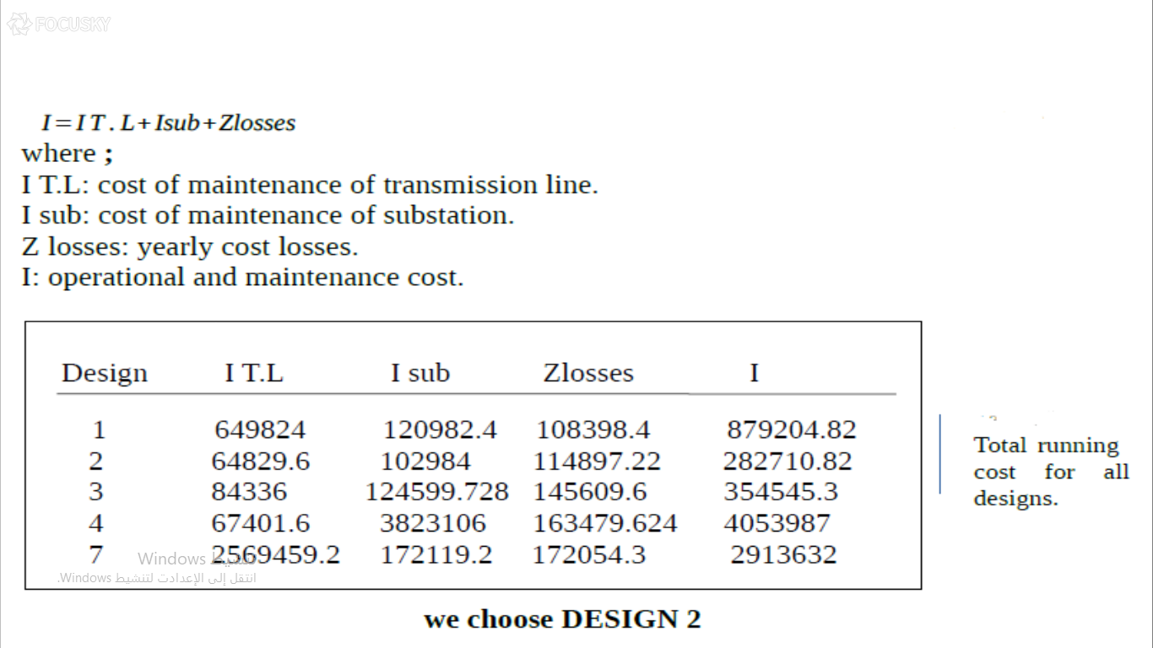

Slide 22
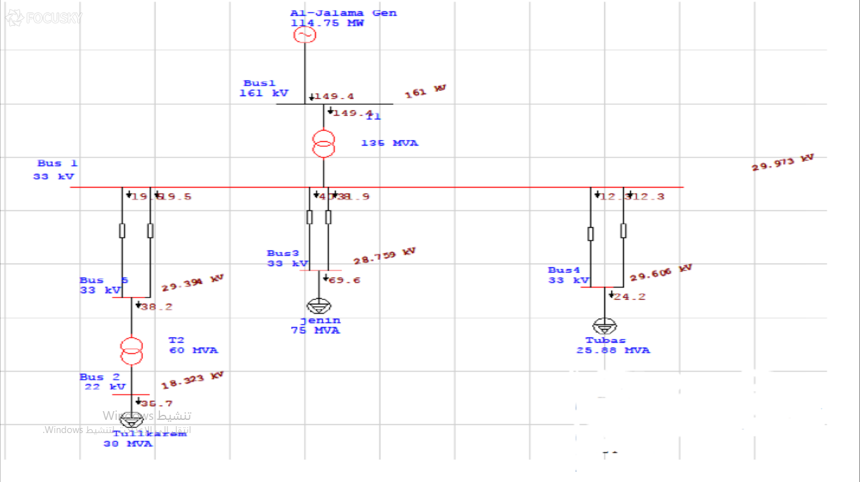

Slide 23
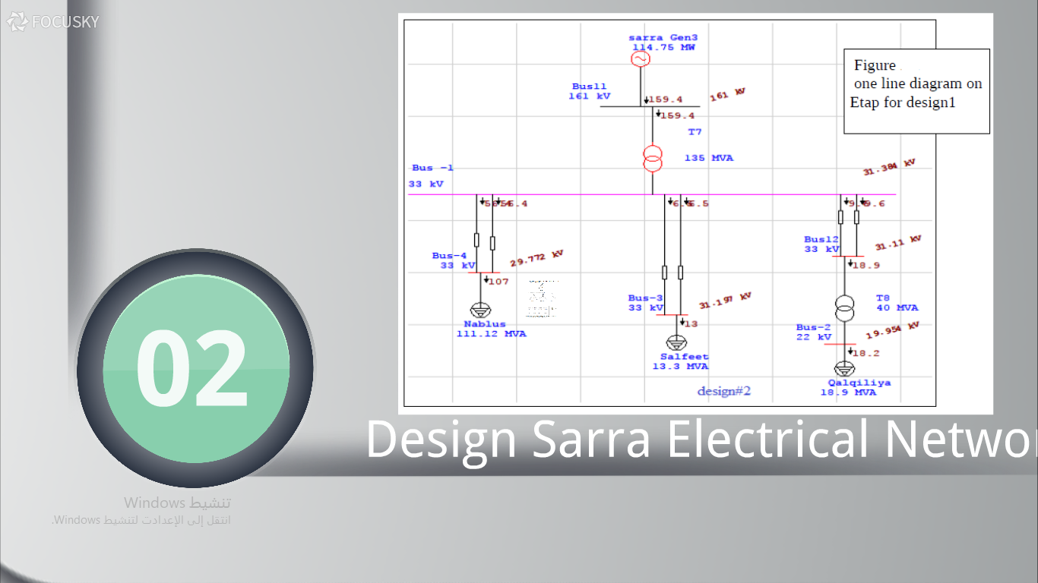

Slide 24
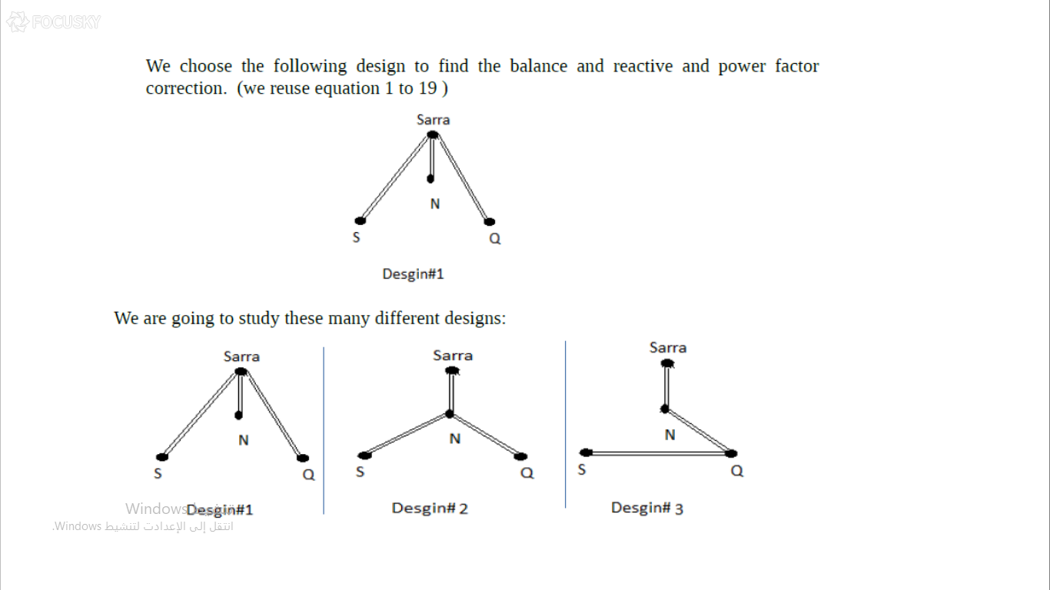

Slide 25
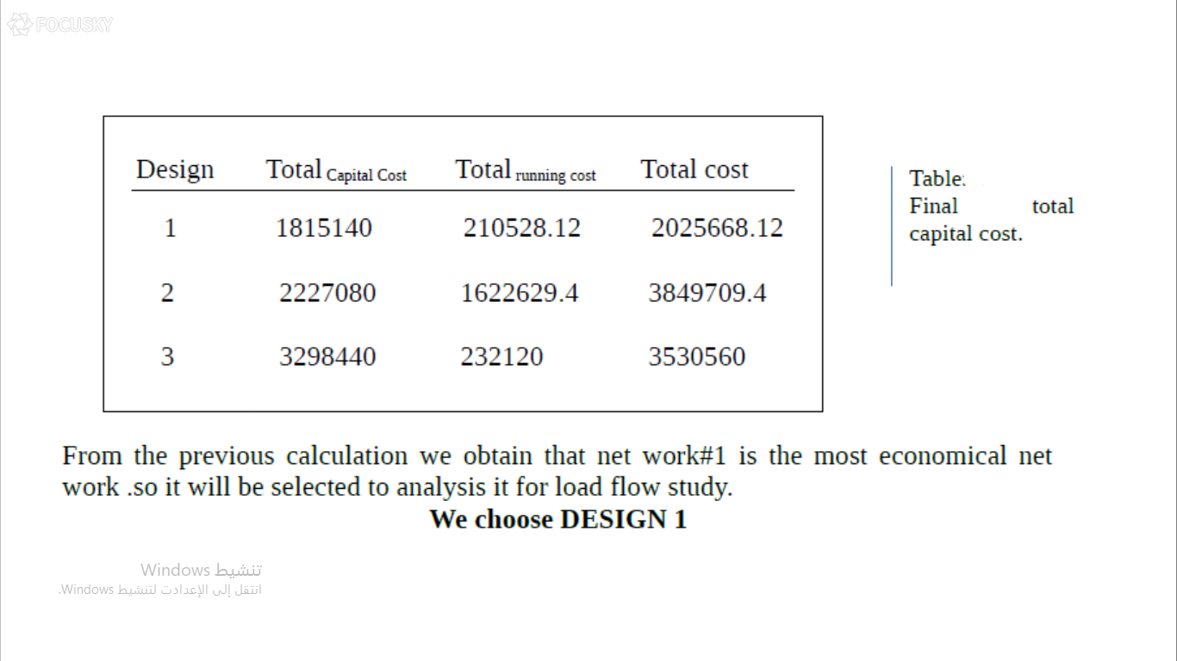

Slide 26
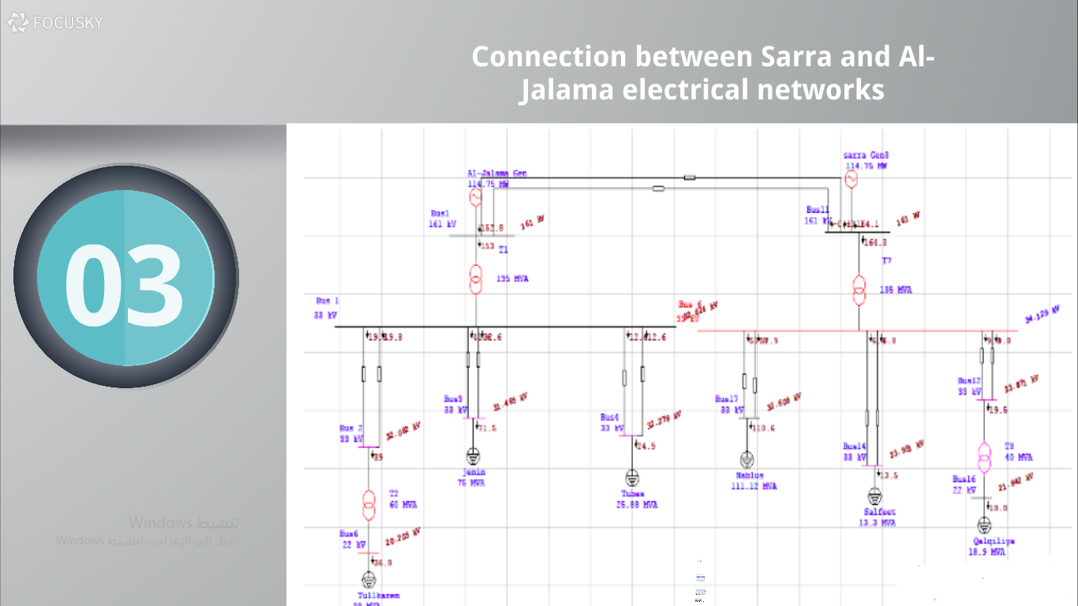

Slide 27
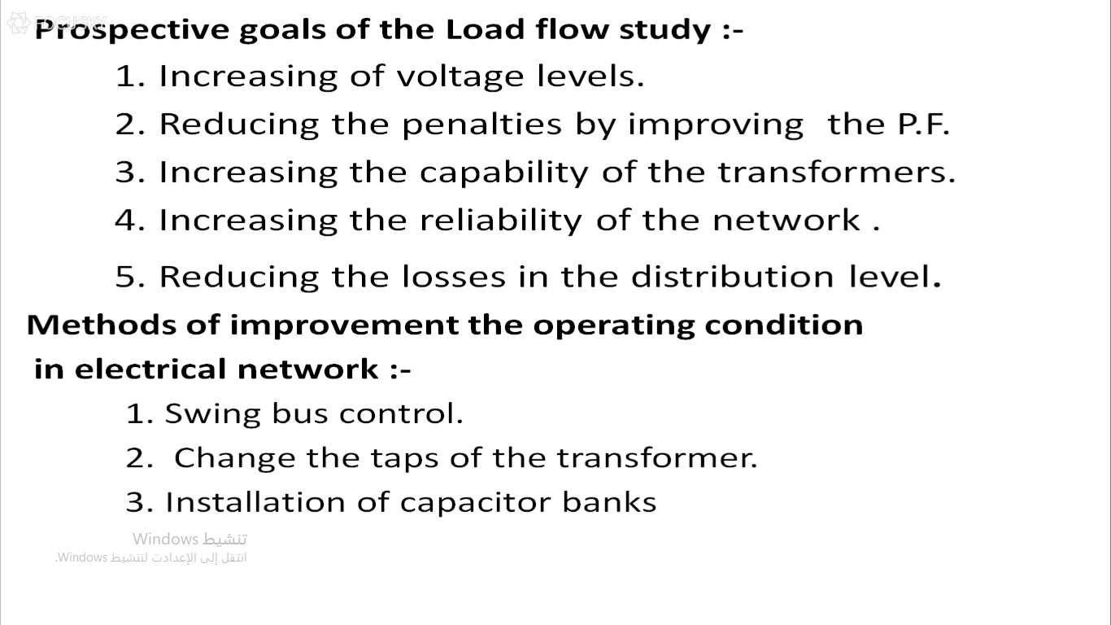

Slide 28
Load flow study
Maximum load flow study
Minimum load flow study
The economical study

Slide 29
Maximum Case Improvement
1.05 Vnominal< V < 1.1 Vnominal
pf (load &capacitor) < 0.96 lag
The total power losses must decrease

Slide 30
The Result Of Load Flow:
The following table shows the results after adding capacitors in order to improve the voltage levels .
Voltage after adding the capacitors | voltage after changing the tap | Voltage after improving the generators | Nominal voltage (KV) | #of Bus
33.848 | 32.365 | 31.73 | 33 | Bus#1
33.411 | 31.819 | 31.167 | 33 | Bus#2
32.968 | 31.184 | 30.522 | 33 | Bus#3
33.499 | 32.007 | 31.357 | 33 | Bus#4
21.891 | 20.212 | 19.566 | 22 | Bus#5
33.58 | 33.023 | 31.902 | 33 | Bus#6
33.317 | 32.842 | 31.632 | 33 | Bus#7
33.401 | 32.757 | 31.717 | 33 | Bus#8
22.061 | 21.669 | 20.312 | 22 | Bus#9
32.18 | 31.468 | 30.309 | 33 | Bus#10

Slide 31
The swing bus result
PF% | MVA | Mvar | MW | Swing Bus
75.19 | 309151 | 203.828 | 232.441 | At beginning
75.96 | 311.192 | 202.411 | 236.369 | after improving the generators
76.29 | 312.912 | 202.295 | 238.728 | after changing the tap
90.01 | 273.387 | 130.615 | 239.163 | after adding the capacitors

Slide 32
The result of power losses
Power losses= Apparent Losses/(Total Motor Load+Total Static Load))*100
ΔP at beginning =4.495
ΔP after improving the generators =4.04
ΔP after Changing the turns ratio of the transformers =3.841
ΔP after adding the capacitors = 2.85

Slide 33
Minimum Case Improvement
1-Vact>Vnom at any Bus at low voltage side
2-Pf (Load &capacitor) <0.96 Lag at any Load Bus
3-the total power losses must decrease

Slide 34
The Result Of Load Flow:
The following table shows the results after adding capacitors in order to improve the voltage levels .
Voltage after adding the capacitors | voltage after changing the tap | Voltage after improving the generators | Nominal voltage (KV) | #of Bus
33.078 | 32.704 | 31.904 | 33 | Bus#1
32.914 | 32.492 | 31.69 | 33 | Bus#2
32.665 | 32.241 | 31.434 | 33 | Bus#3
32.937 | 32.562 | 31.76 | 33 | Bus#4
21.968 | 21.403 | 20.672 | 22 | Bus#5
32.955 | 32.773 | 31.975 | 33 | Bus#6
32.85 | 32.668 | 31.869 | 33 | Bus#7
32.883 | 32.701 | 31.975 | 33 | Bus#8
22.145 | 22.019 | 20.949 | 22 | Bus#9
32.389 | 3.16 | 31.352 | 33 | Bus#10

Slide 35
The swing bus result
PF% | MVA | Mvar | MW | Swing Bus
80.49 | 115.947 | 68.809 | 93.322 | after improving the generators
80.60 | 116.954 | 69.228 | 94.262 | after changing the tap
89.15 | 107.156 | 50.604 | 94.455 | after adding the capacitors

Slide 36
Benefits of Improving Power Factor:
1. Lower Apparent Power
2.Reduces losses in the transmission line
3. Improves voltage drop.
4. Avoiding the penalties
The following table shows the system of the penalties in our companies:
Power Factor | P.F Penalties
P.F≥ 0.92 | No Penalties.
0.92>P.F ≥0.8 | 1% of total bill for each one under 0.92
0.8>P.F≥0.7 | 1.25%of total bill for each one under 0.92
P.F <0.7 | 1.5%of total bill for each one under 0.92

Slide 37
The result of power losses
ΔP after improving the generators =1.53
ΔP after Changing the turns ratio of the transformers =1.469
ΔP after adding the capacitors = 1.23

Slide 38
Economical study
This table shows the fixed capacitors and the regulated capacitors which used in minimum and maximum Load
regulated cap QcMVAR | fixed cap. Qc MVAR | Min case Qc MVAR | Max case Qc MVAR | Bus
9 | 6 | 6 | 15 | Jenin
12 | 6 | 6 | 18 | Nabluse
6 | 6 | 6 | 12 | Tulkarm
Sum of fixed cap =18 MVAR
Sum of regulated cap =27 MVAR

Slide 39
The cost of fixed capacitor C1=3500$/MVAR
The cost of regulated capacitor C2=7020$/MVAR
Time of max losses T=4500H
The cost of real power losses CΔp=120 $/MWH
Capital recover factor Eh=0.22
Capital cost Cc= fixed capacitor *C1+ regulated capacitor *C2
= 18*3500+ 27*7020
=252540$
After |  | Before
ΔQ(MVAR) | ΔP(MW) | ΔQ(MVAR) | ΔP(MW)
130.615 | 240.163 | 202.295 | 238.728

Slide 40
The equivalent annual cost of capacitor
EAC=0.22*Cc =0.22*252540
=55558.8($/year)
Percentage of the total reduced power losses
ΔP%=P1%-P2%
P1% is the power Losses before any capacitors added
P1%=6.56/(187.376+42.52)
=3.841
P2%is the power losses after the capacitors added
P2%=8.86/(187.376+46.041)
=2.85
ΔP%=3.841-2.85
=0.9

Slide 41
The total reduced power losses ΔP = ΔP%*Total power load after capacity
=0.9* (187.376+46.041)/100
=2.1MW
The total reduced energy losses ΔΔP= ΔP*T
2.1*4500=9453.388MW.H
The annual cost of total reduced energy losses Z= ΔΔP*Cp
9453.388*120 =1134406.62$/year
The total saving amount S=Z-EAC
= 1134406.62 -55558.8
=1078847.82
Pay pack period PP=CC/S
=252540/ 1078847.82
=0.23 year
0.23*12 =2.8 month

