Slide 1
Smart Piano
to Play Your Songs without a Teacher

Slide 2
Requirements
Piano or ORG
indicators tell the user which keys must press to play a song .
indicators tell the controller that the key has been pressed.
A display screen shows the notes
mobile application play/add/edit/remove new songs.
Controller controls the two types of indicators, the display screen and receives data from the application through a Bluetooth component

Slide 3
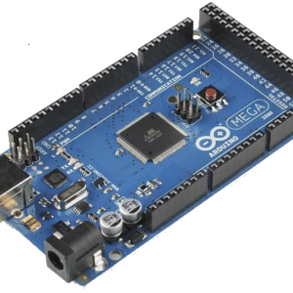
Which component we used for controlling to achieve our idea ??
it is Capable to achieve our idea

Slide 4
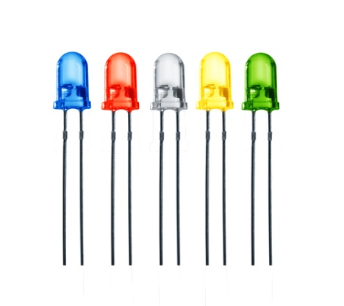
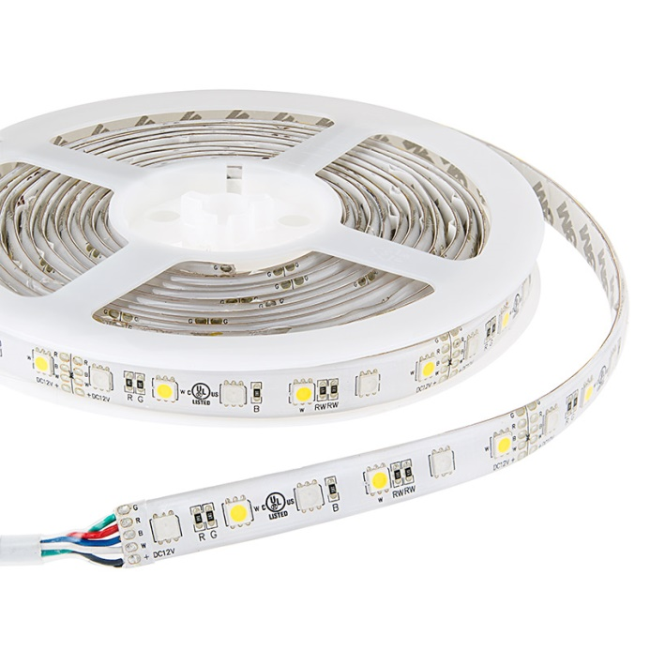
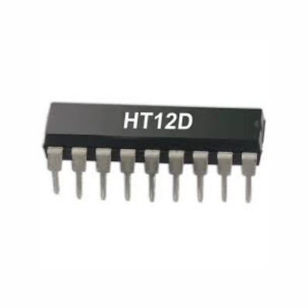
Which keys must I press to play my song ???
LEDs + multi decoders OR RGB LED strip ? ?
OR
+

Slide 5
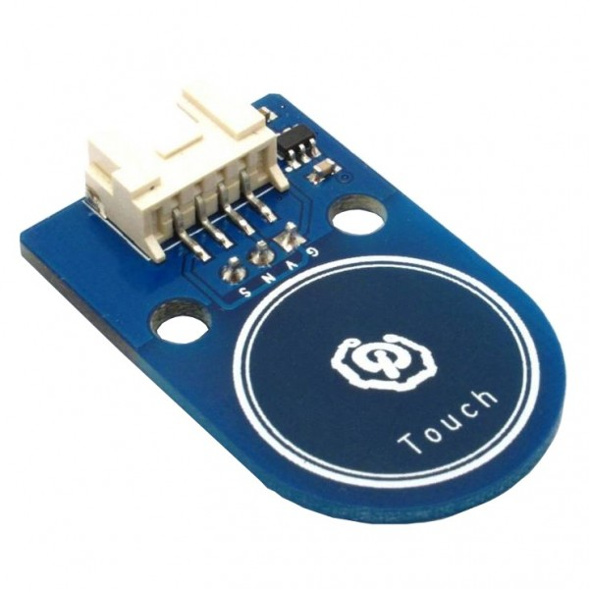
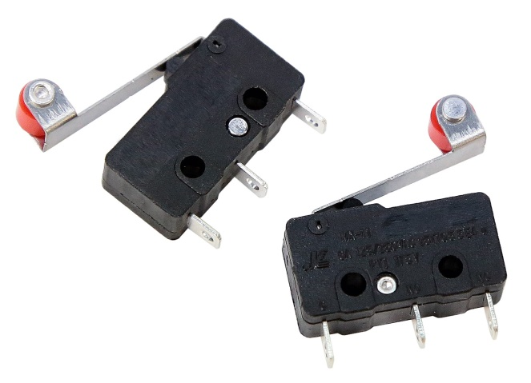
How will the Arduino controller know that you have pressed the key to move to the next note ??
Touch sensors OR limit Switches ??
OR

Slide 6
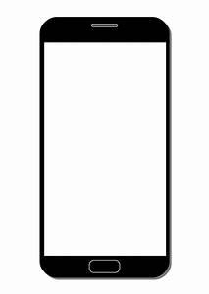
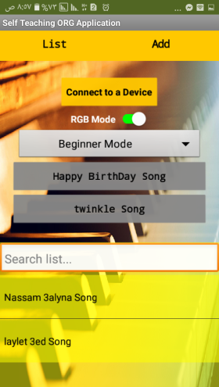
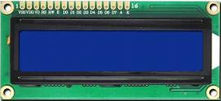
How can I know which note I have played ???
Mobile application OR LCD display screen ??
OR

Slide 7
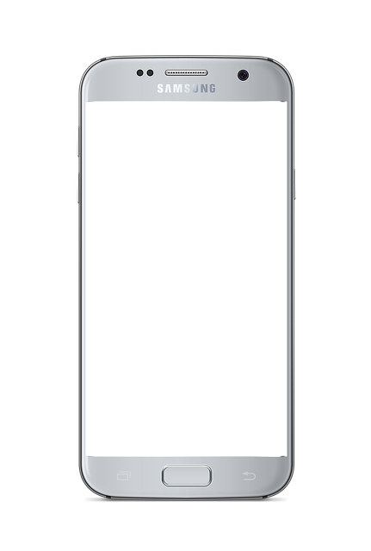

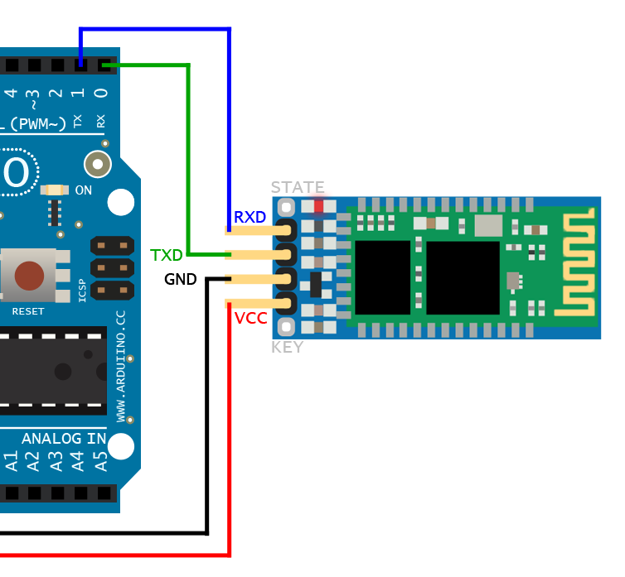
How can I add my songs, edit them and play them ??
You can add a song , edit it and play it by the mobile application connected to the controller by Bluetooth component

Slide 8
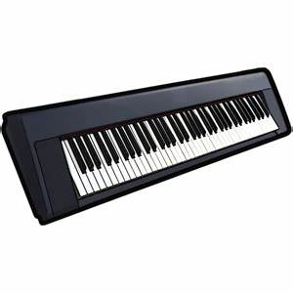

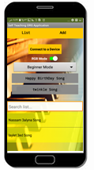
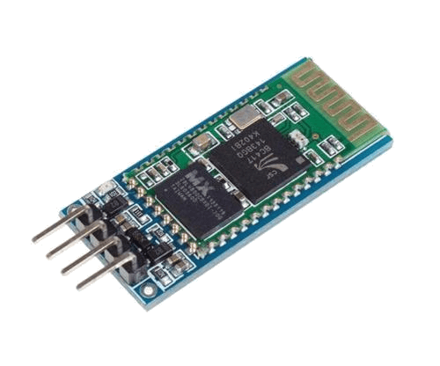

Final project components :
+
+
+
LED strip for note-key indication
49 –key ORG
Arduino Mega for control
+
+
+
+
Bluetooth for communication with mobile app.
Limit switches to do the next note
LCD to show notes
Mobile app. To play songs

Slide 9
  adding new songs in midi files format instead of entering notes manually
  adding next levels of playing piano like using chords(using multiple keys to make one sound) instead of one key for note

