Slide 1

Shop Assistant Robot
PREPARED By:
Mahmoud Arafat
Ahmad Ashayer
SUPERVISED By:
Dr. Luai Malhis

Slide 2






Table of Content
INTRODUCTION
MOTIVATIONS
CHALLENGES
APP
HARDWARE STAGES
FUTURE WORK

Slide 3
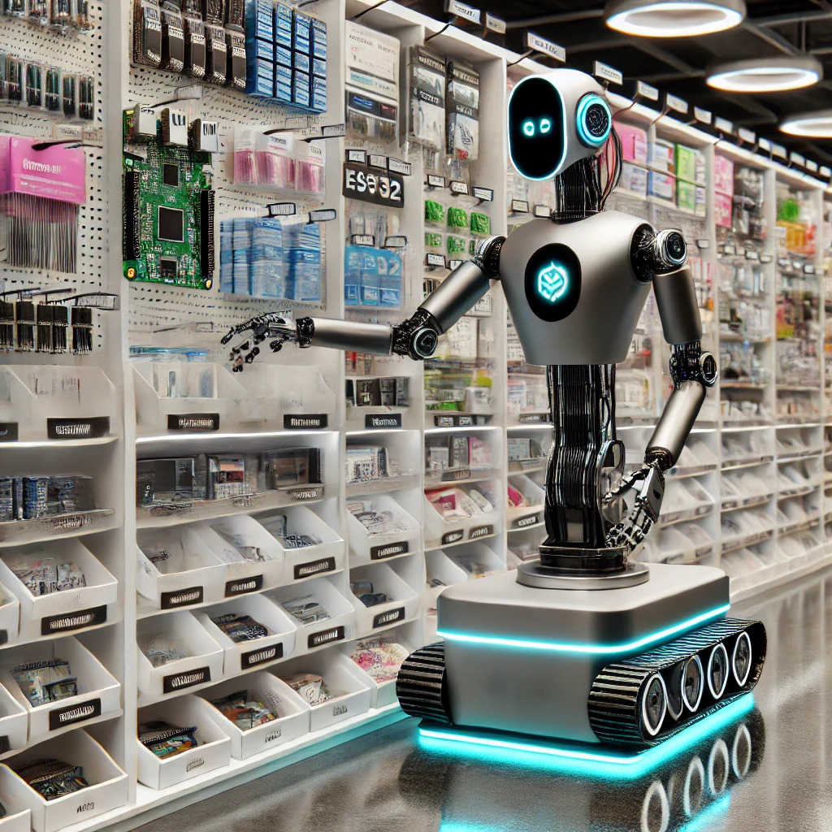
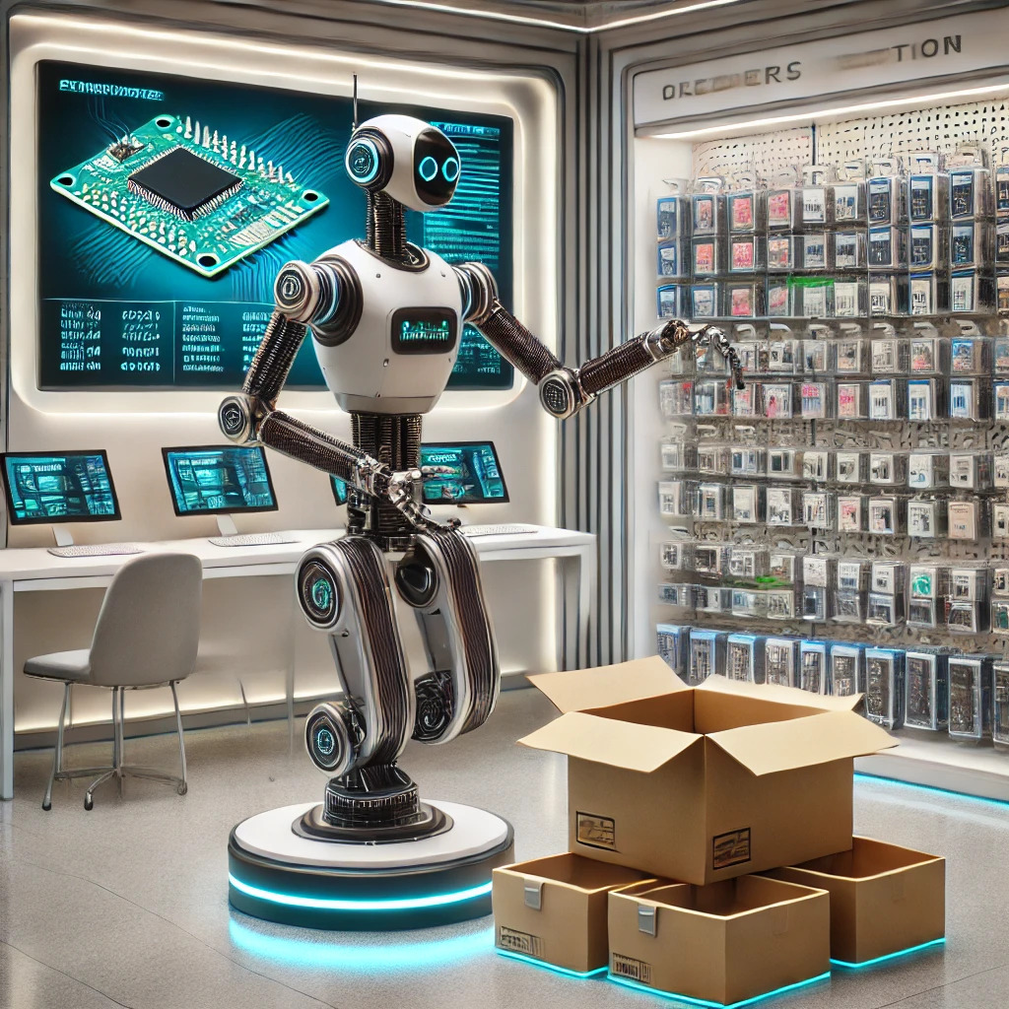
Introduction
Shop Assistant Robot is a robot that prepares and packs customer orders from A to Z.
Preparing an order
Stocking the shelves

Slide 4


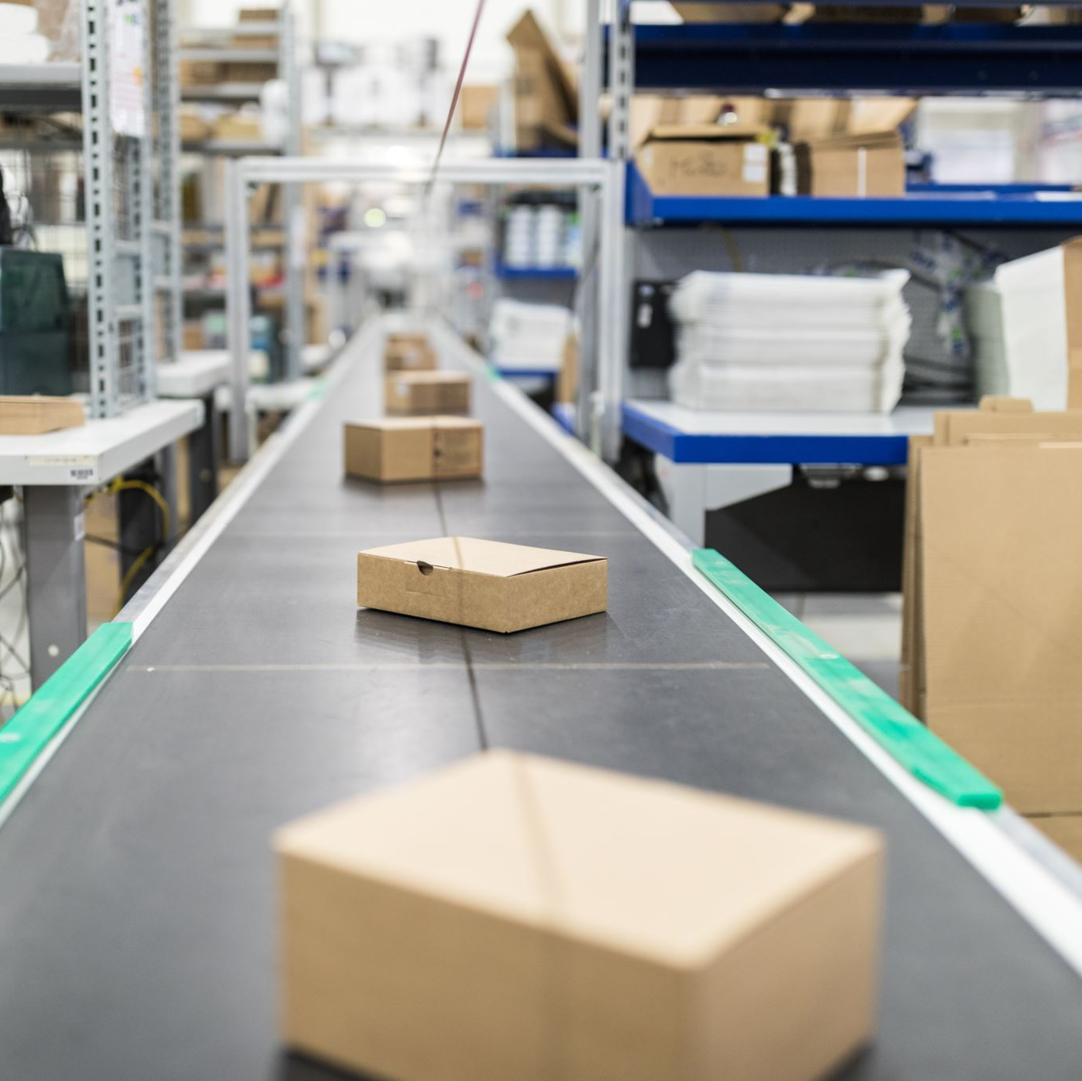

Preparing an order
1- Take the item from the shelves and put it on the production line
2- Filter the item if the customer does not want it
1
2
3- Pack the box that the item is in

Slide 5

Stocking the shelves
1 The robot goes to a mini-store or a sample from a store and takes the item
1
2 And fills the item that has been sold out from the shelves

Slide 6



MOTIVATIONS
IMPROVE CUSTOMER SERVICE
INCREASE EFFICIENCY
SPEED OF ORDER FULFILLMENT

Slide 7




Challenges
The size of the project is large.
The cost.
There is a lack of all the components we need.
The lack of the tools we need to speed up the project creation process.

Slide 8
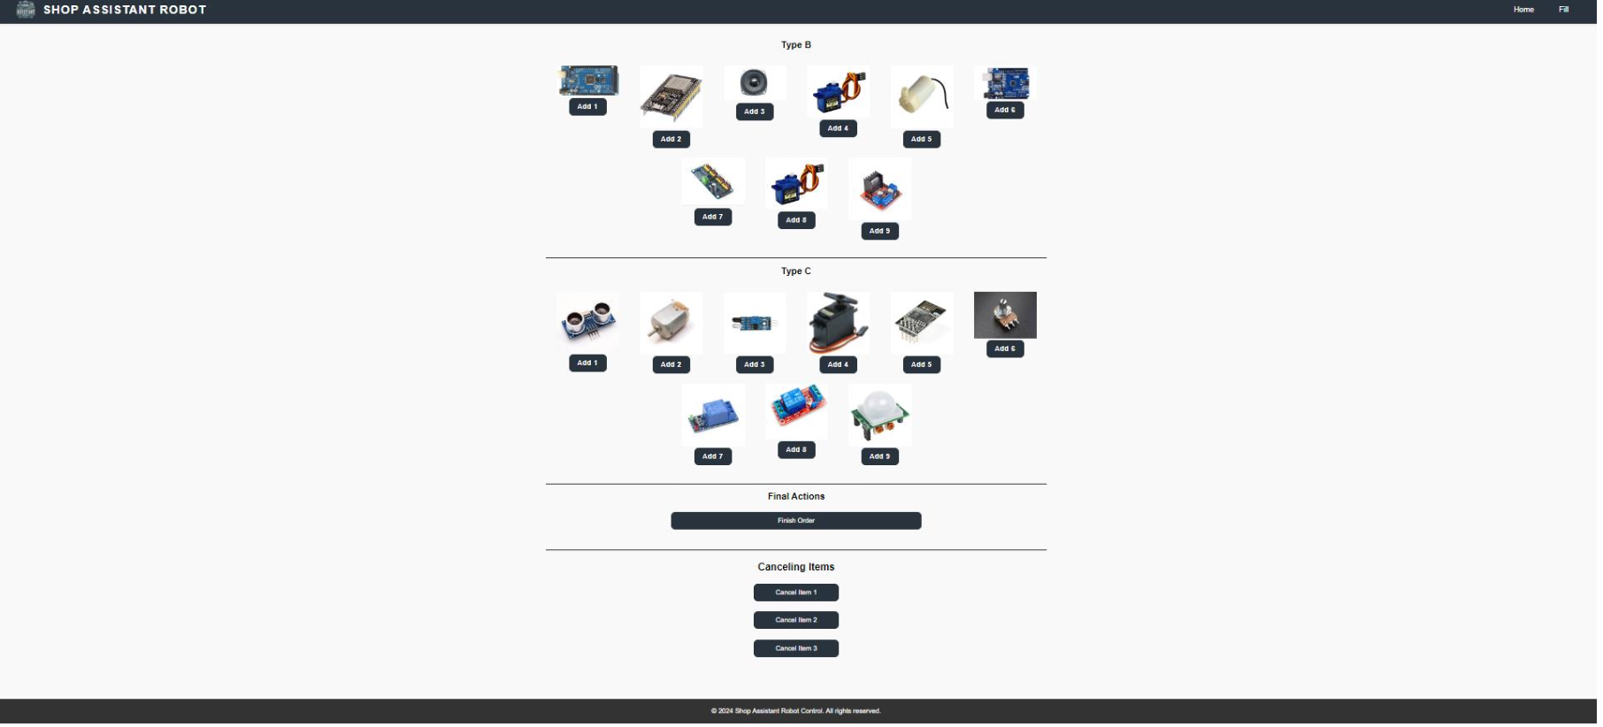
App
Getting Items Page:

Slide 9
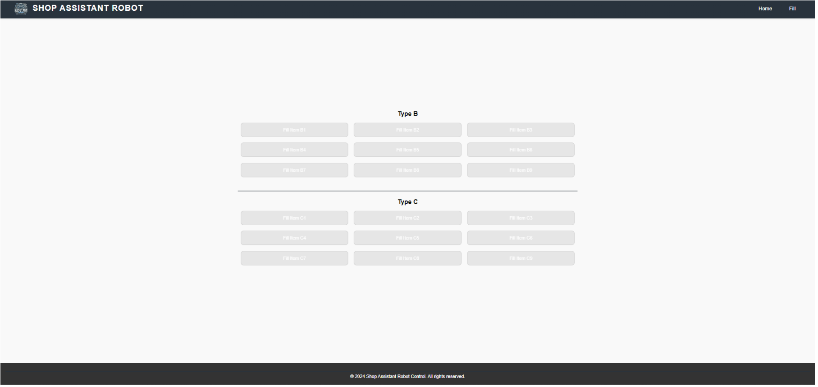
App
Filling Items Page :

Slide 10
Hardware stages
Robot movement stage
Crane stage
Production line stage
Packaging stage

Slide 11
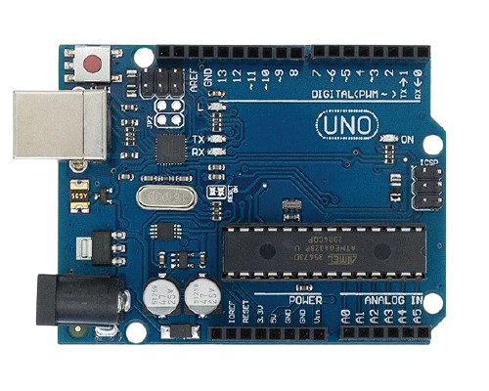
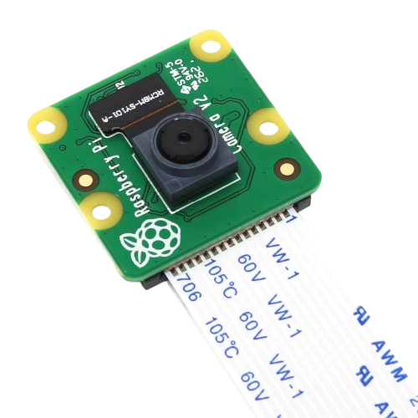
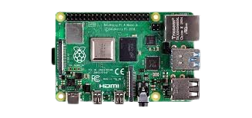
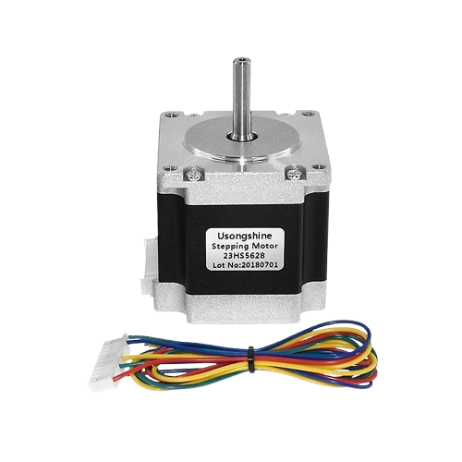
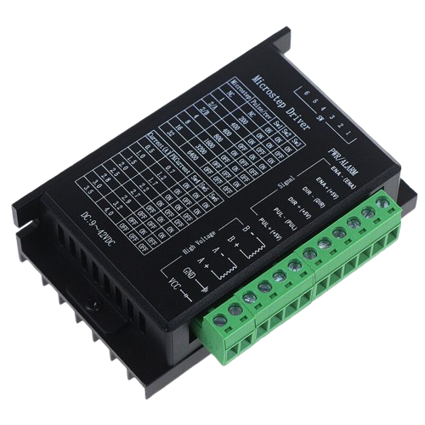
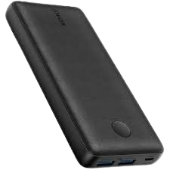
Robot movement stage
Raspberry pi 4
Arduino uno
Raspberry pi camera module v2
Nema23 - Stepper Motor
TB6600 Stepper Motor Driver
Power bank 20000mah

Slide 12
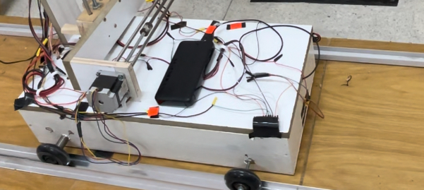
The Result

Slide 13
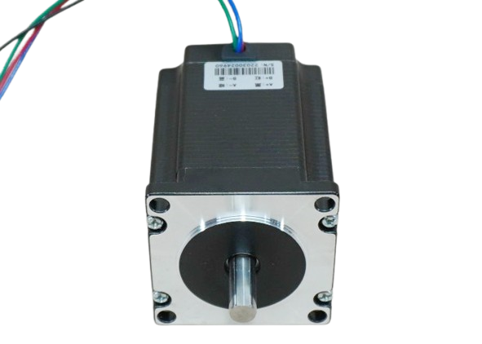
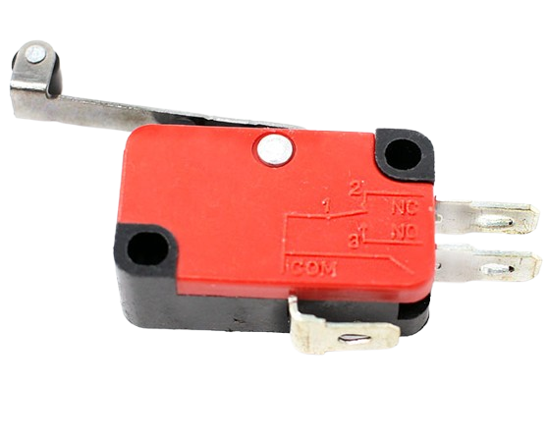
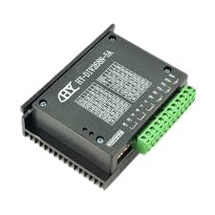
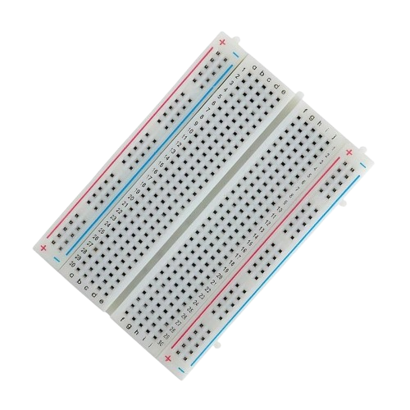
Crane stage
stepper motor j-5718hb3401
Nema23 - Stepper Motor
limit switch
YS-DIV268N-5A Stepper Motor Driver
TB6600 Stepper Motor Driver
Breadboard

Slide 14
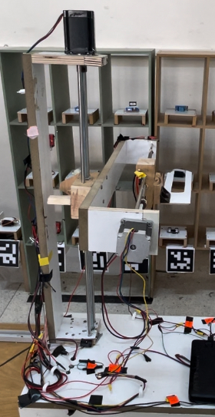
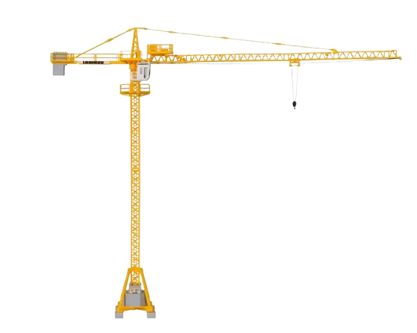
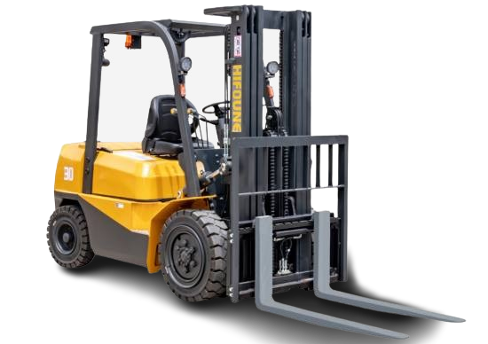


The Result

Slide 15
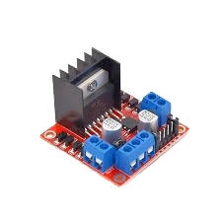
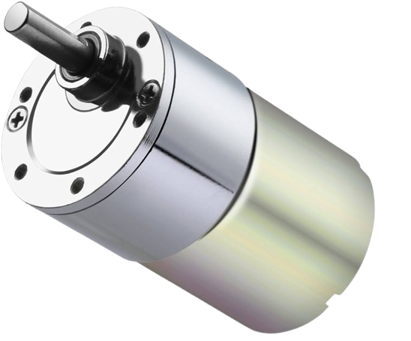
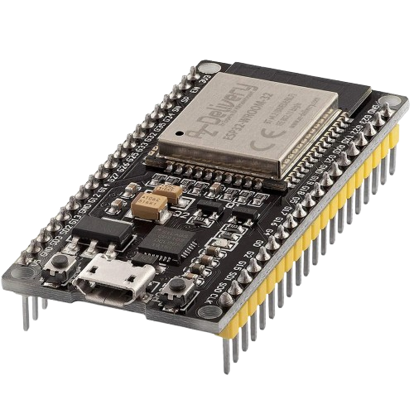
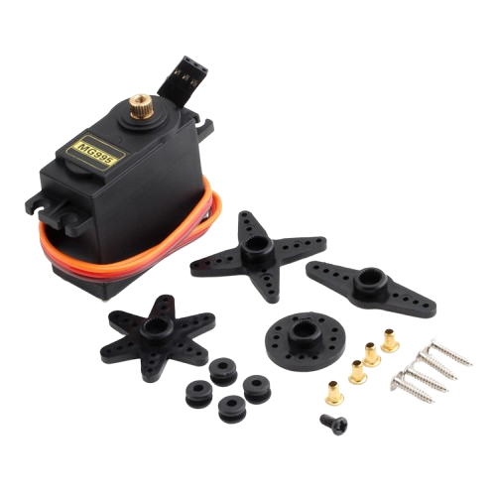
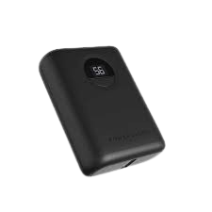
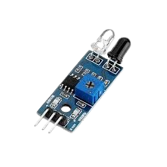

Production line stage​
Esp32
Arduino uno
DC motor
H-bridge
Power bank 10000mah​
MG995 Servo motor
Ir sensor
Battery 12v 7ah

Slide 16
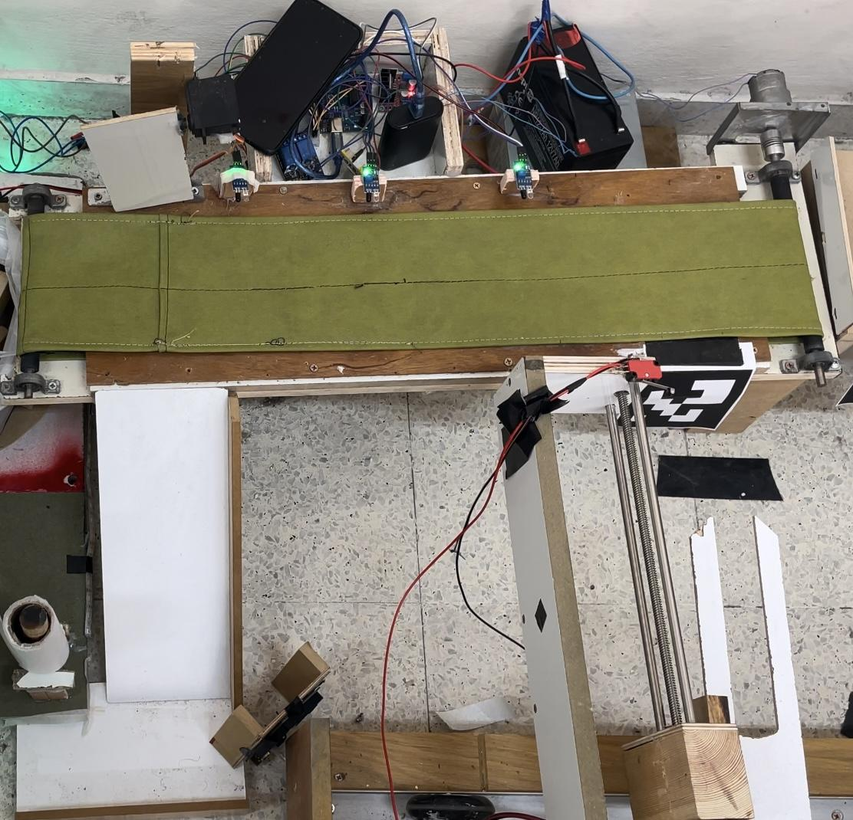
The Result

Slide 17
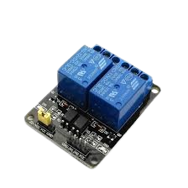
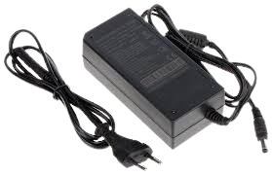

Packaging stage​
Rgb led
Relay module 2 channel
Power supply 12v 4a
DC motor​

Slide 18
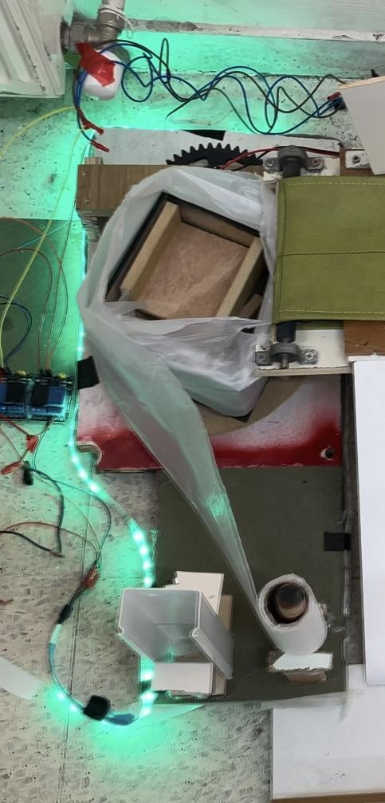
The Result

Slide 19
Future work:
1
2
3
4
1- Make the robot multi-path to save a lot of space.
2- Add an arm to move the canceled orders to a place that makes it easy for the robot to take them and return them to the shelves.
3- Add a tracking sensor to enable the supervisor to know the location of the robot in the store.
4- Increase the speed of the crane, but to increase the speed of the crane we must change the T8 lead screw, but it is not available in our country with the length we want.

Slide 20
Thank you very much

