Slide 1

Graduation Project
Faculty of Engineering & Information Technology Management information systems Department
Yasmeen
SALON
By : Aya Salman
Hala Halboni
Supervised by : Ahmad shraidah

Slide 2
Graduation Project
Faculty of Engineering & Information Technology Management information systems Department
Yasmeen
SALON
By : Aya Salman
Hala Halboni
Supervised by : Ahmad shraidah

Slide 3
Table of
CONTENT
Introduction
Modules
Current state
Reports
Solutions & Added value
Future developments

Slide 4
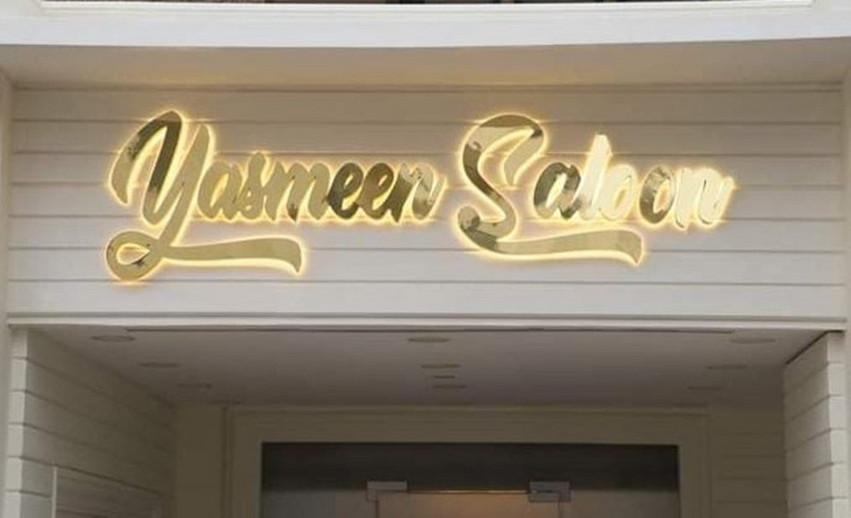

I^{T}NºT^{p}R^{ic}O^{:1} DUCTION
yasmeen Salon consists of 3 sections:
Yasmeen Beauty salon Yasmine Couture For Dresses Yasmeen Garden For photography

Slide 5
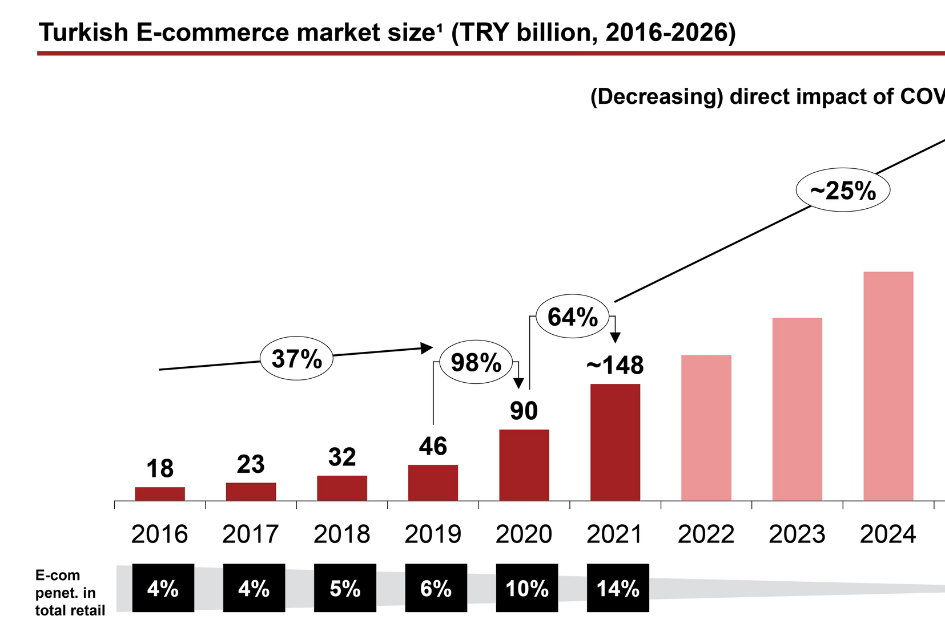
I^{T}NºT^{p}R^{ic}O^{:1} DUCTION
More people use websites:
Since the Covid-19 pandemic.
Easier and simpler
Comfort and less effort. Occupation, which sometimes impedes movement.

Slide 6


Topic:2
CURRENT STATE
Paper based system.
"Recently they started using Excel"
The reservation process is done manually by phone. No reporting.

Slide 7

01 Online Marketing.
Online Booking System
Consultation and Suggestions.
Generate customized and ad-hoc reports.
05 Build Customer Database For
^{Top}S^{ic}O^{:4}LUTION
Marketing.

Slide 8

MODULES IN
Topic:5
Website. Calendar. Inventory. Rental.
Employee.
Sales. Events.
Email marketing. Dashboard.
Contacts.

Slide 9
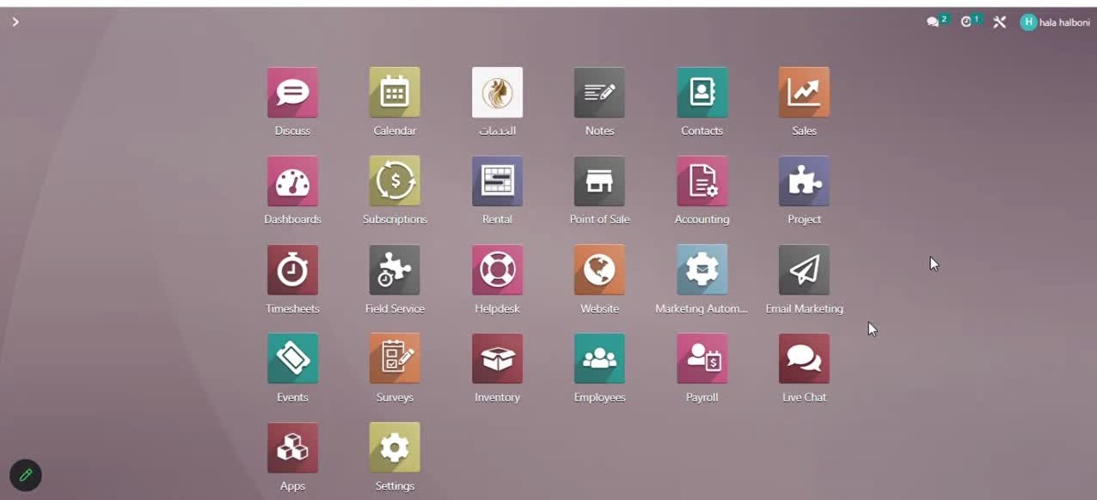
Email Marketing

Slide 10
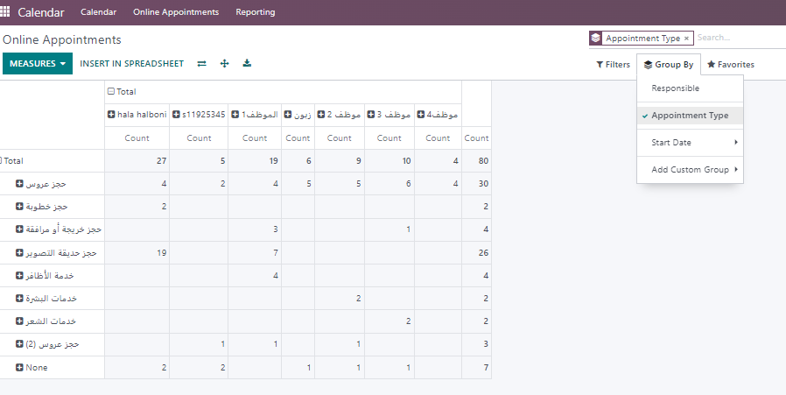
Topic:5 Reports

Slide 11
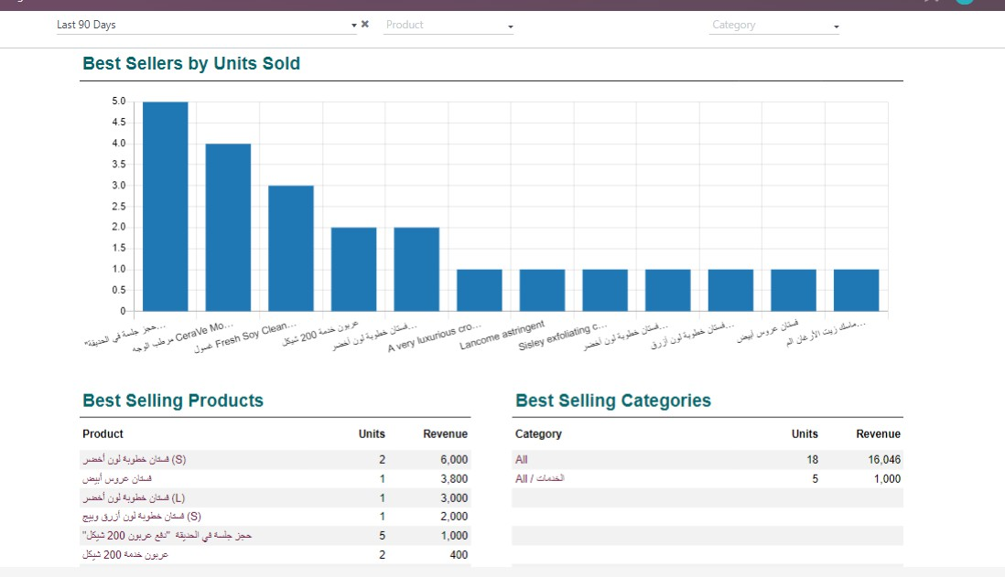

Slide 12
Topic:6
Future developments
Domain publishing & Search engine optimaization.
SMS Marketing.
CRM.

Slide 13
FINALLY, WE ARE SO GRATEFUL TO D.AHMAD SHRAIDEH FOR
HIS SUPPORT

Slide 14
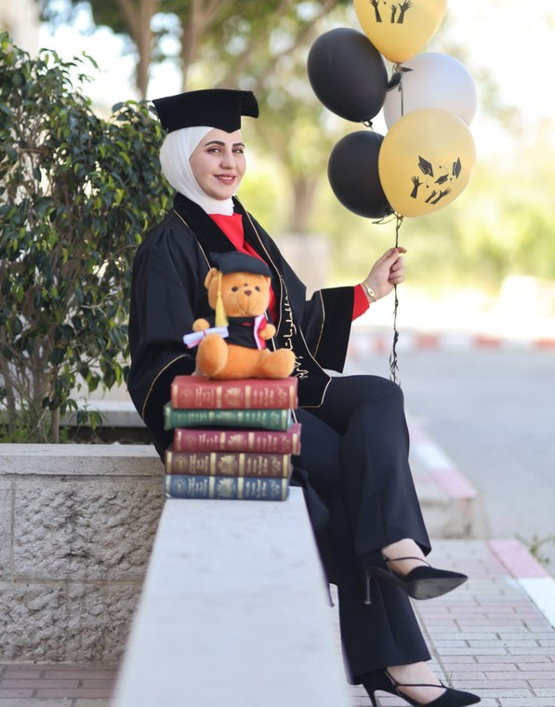
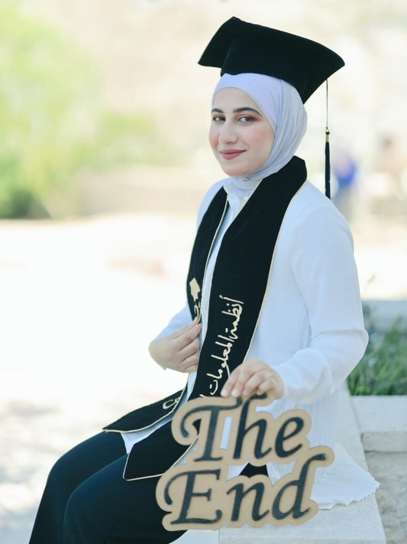
Thank You

