Slide 1
BEYOND CELIAC
By:
Noor Sadaqa
Alia Tuqan
Supervisor:
Dr Mona Demaidi

Slide 2
Outlines:
Introduction.
Motivation.
Features.
Methods and techniques.
Tools and technologies.
Future work.

Slide 3
What is Beyond Celiac?
It is a mobile application built using React-Native, which mainly helps users who suffer with celiac disease and users who want to know more about the disease because they have some Celiac patients in their surroundings.

Slide 4
Motivation

Slide 5
Celiac disease patients face many difficulties especially when they are diagnosed for the first time, they don’t have enough knowledge and experience to live and adapt with Celiac.

Slide 6
Features

Slide 7
Basic and simple information for defining Celiac.
An appointment calendar to keep track with dates and set appointments if there’s any.
A Map to help patients find the nearest supermarkets which provide gluten-free products.
Map to help patients find near healthcare places.
Daily tips and advice.

Slide 8
Simple chatbot.
Food Recipes that are suitable for Celiac patients.
Diagnosis test.

Slide 9
Tools and Technologies

Slide 10


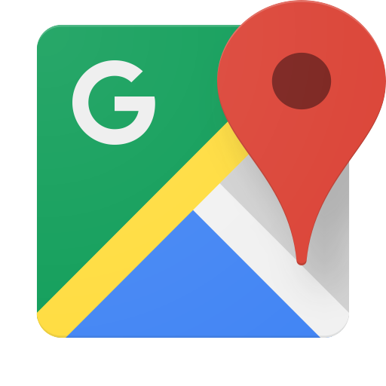

Slide 11


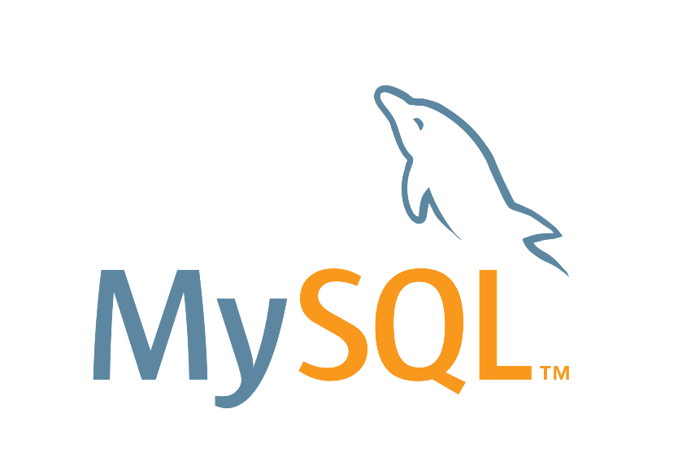


Slide 12
Methods and techniques

Slide 13
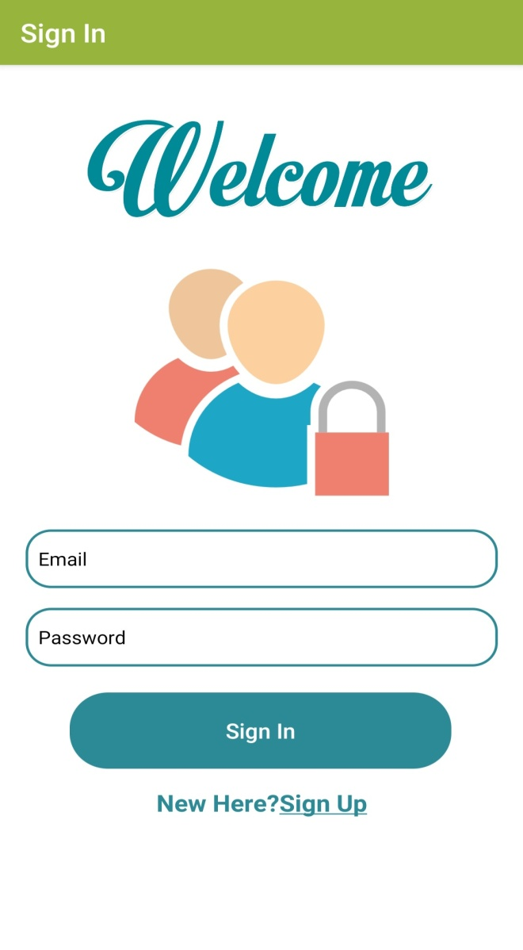

SignIn
Splash Screen

Slide 14
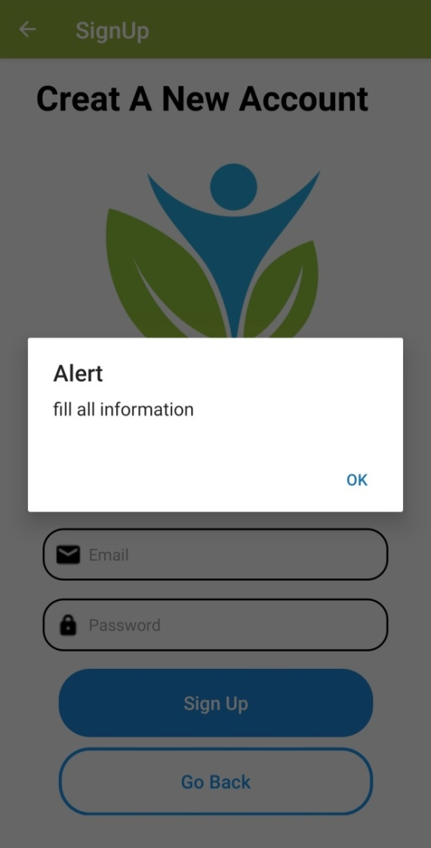
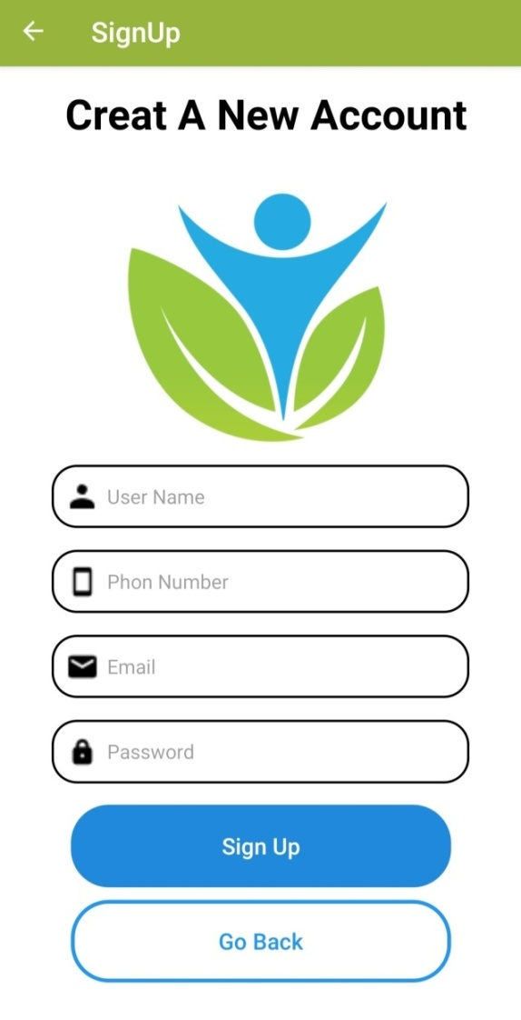
Sign Up

Slide 15
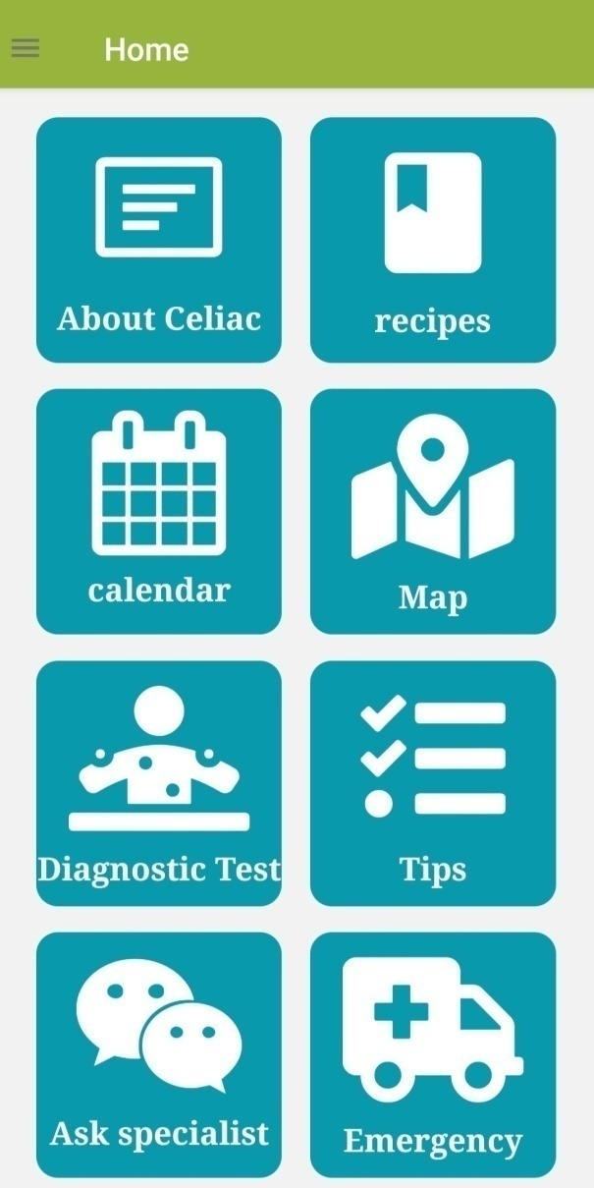
Home Screen
Home Screen contain all feature.
From Home screen user can go to any feature.

Slide 16
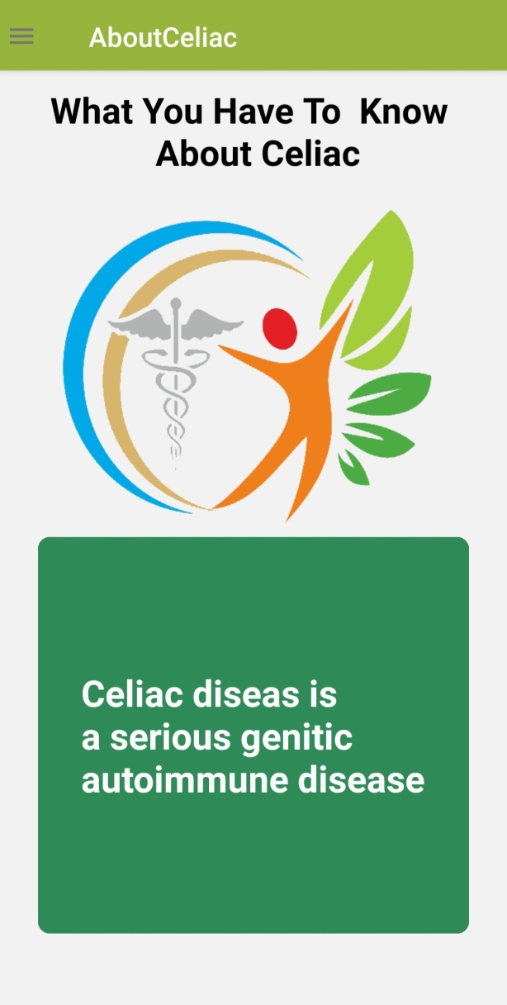
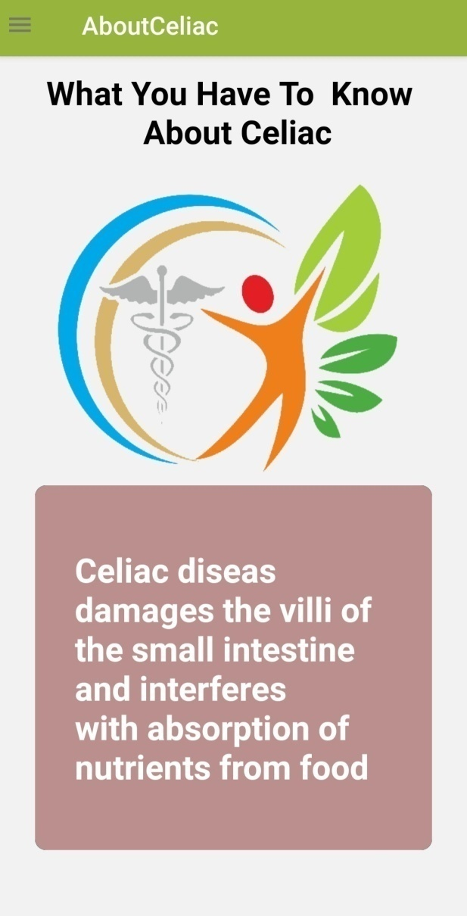
About Celiac

Slide 17
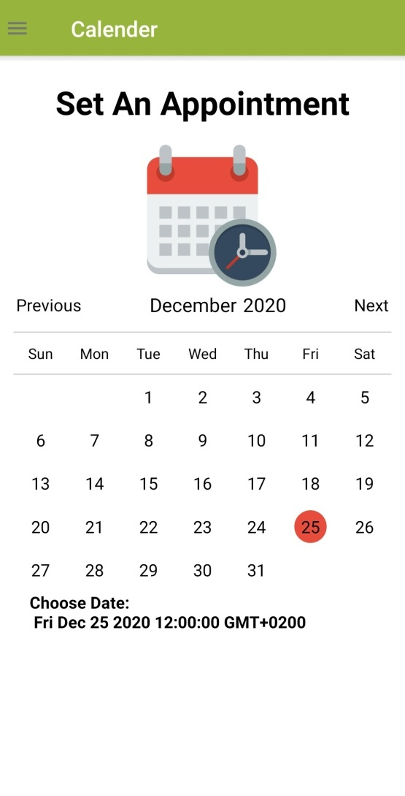
Calendar
Calendar which helps the user keep track of dates, appointments and events that were entered previously.

Slide 18
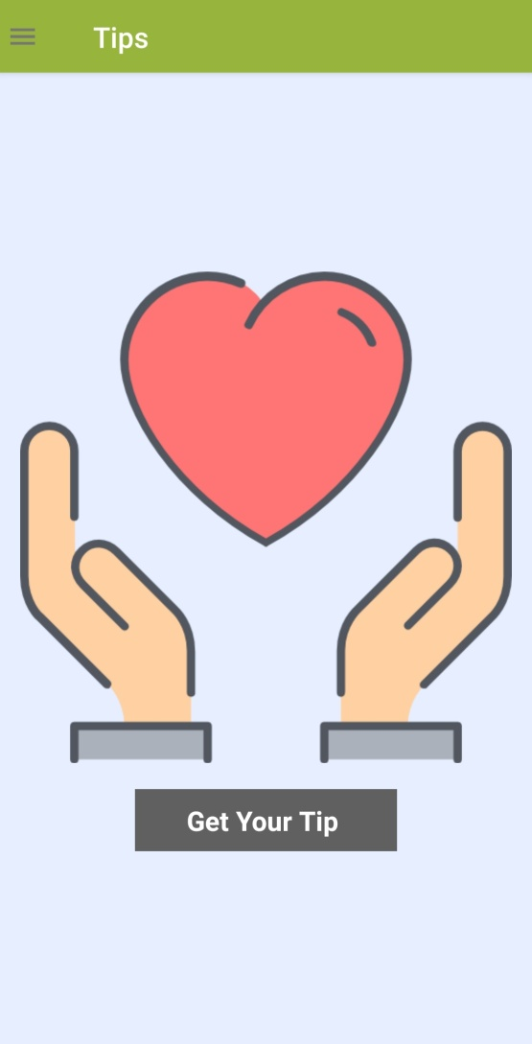
Tips
It is a tips system which provides users with various daily life advice in different fields as health, nutrition, sport … etc.

Slide 19
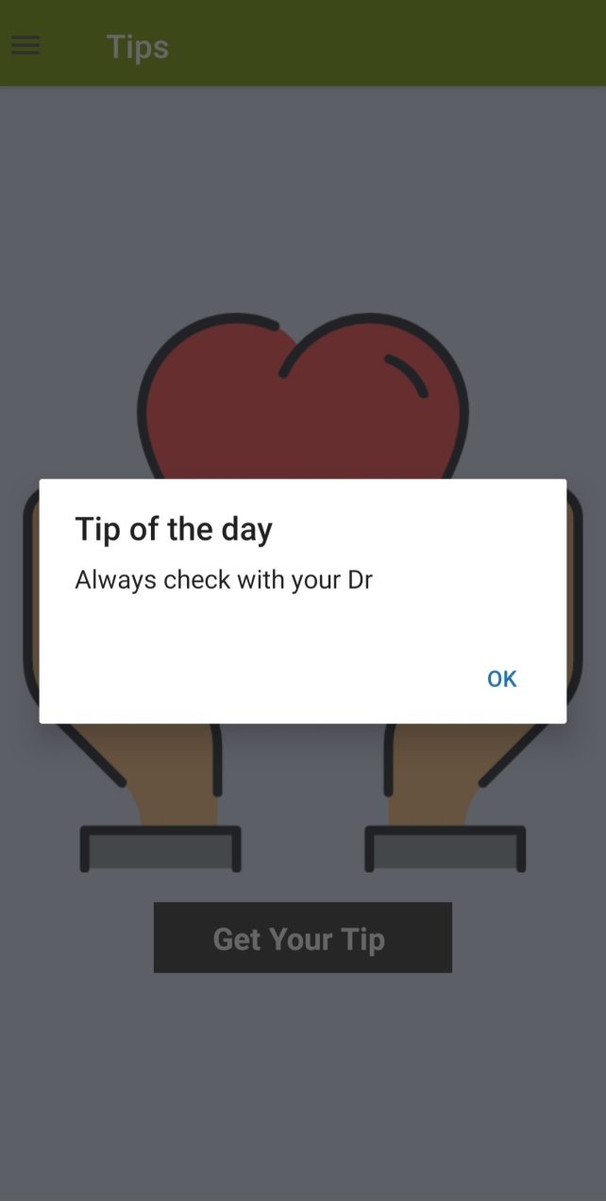
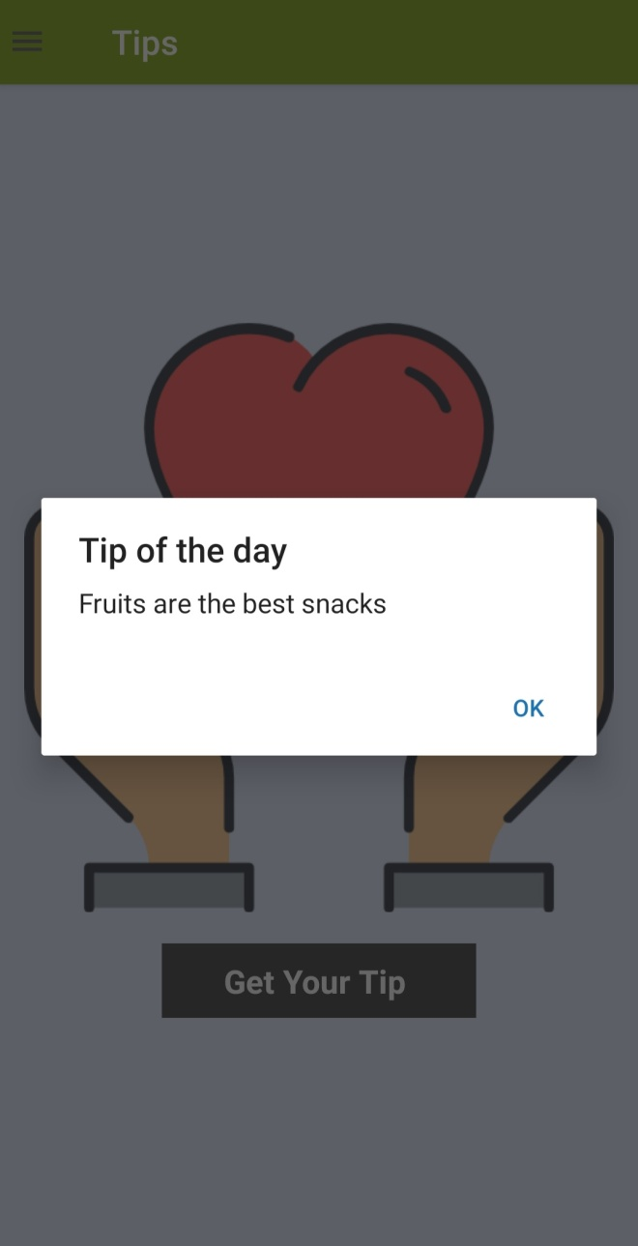
Tips

Slide 20
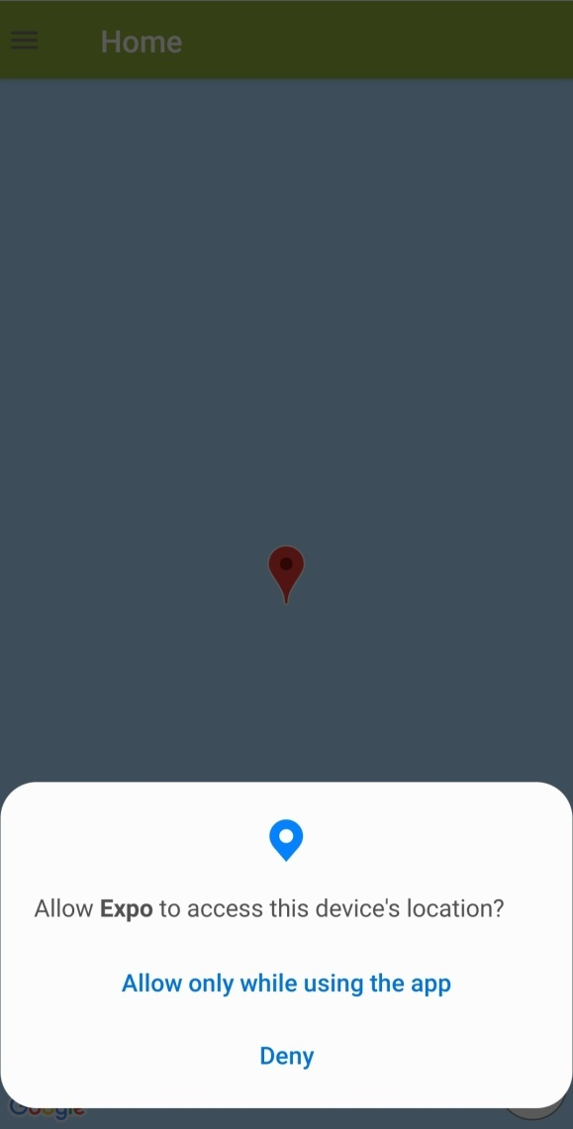
Emergency and Map
These two features use Google maps.
The map displays the current user’s location.
The user can move the map to see the places around him.

Slide 21
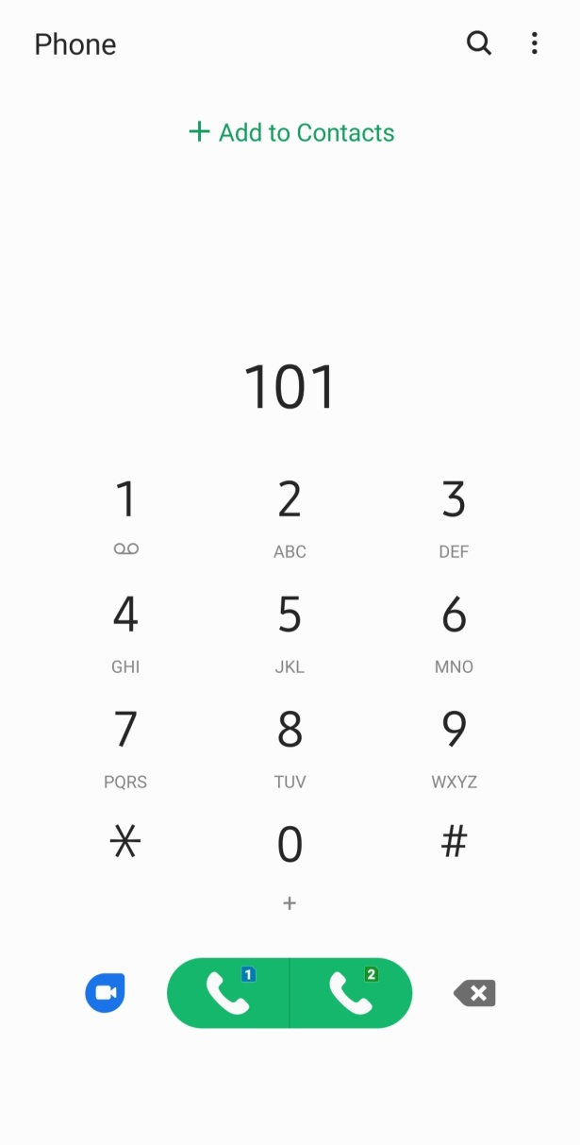
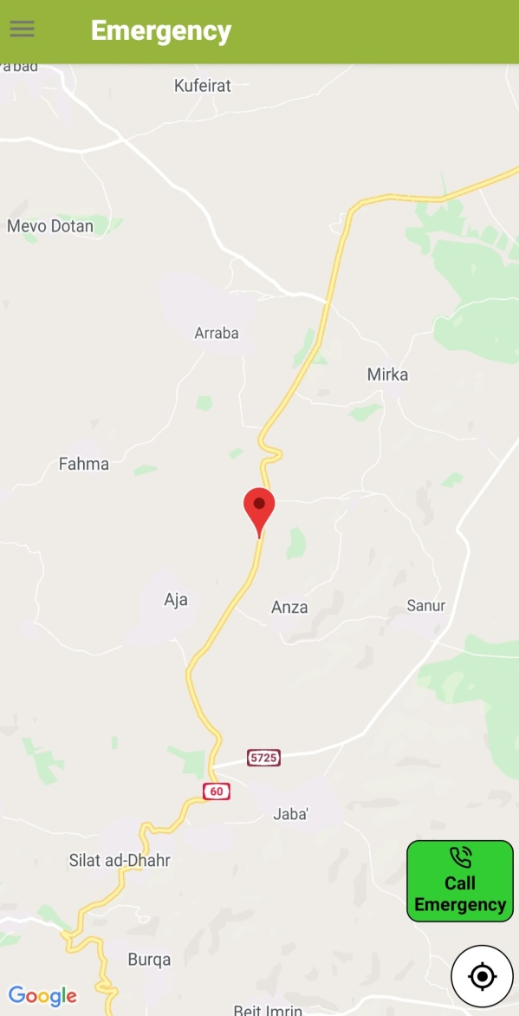
Emergency

Slide 22
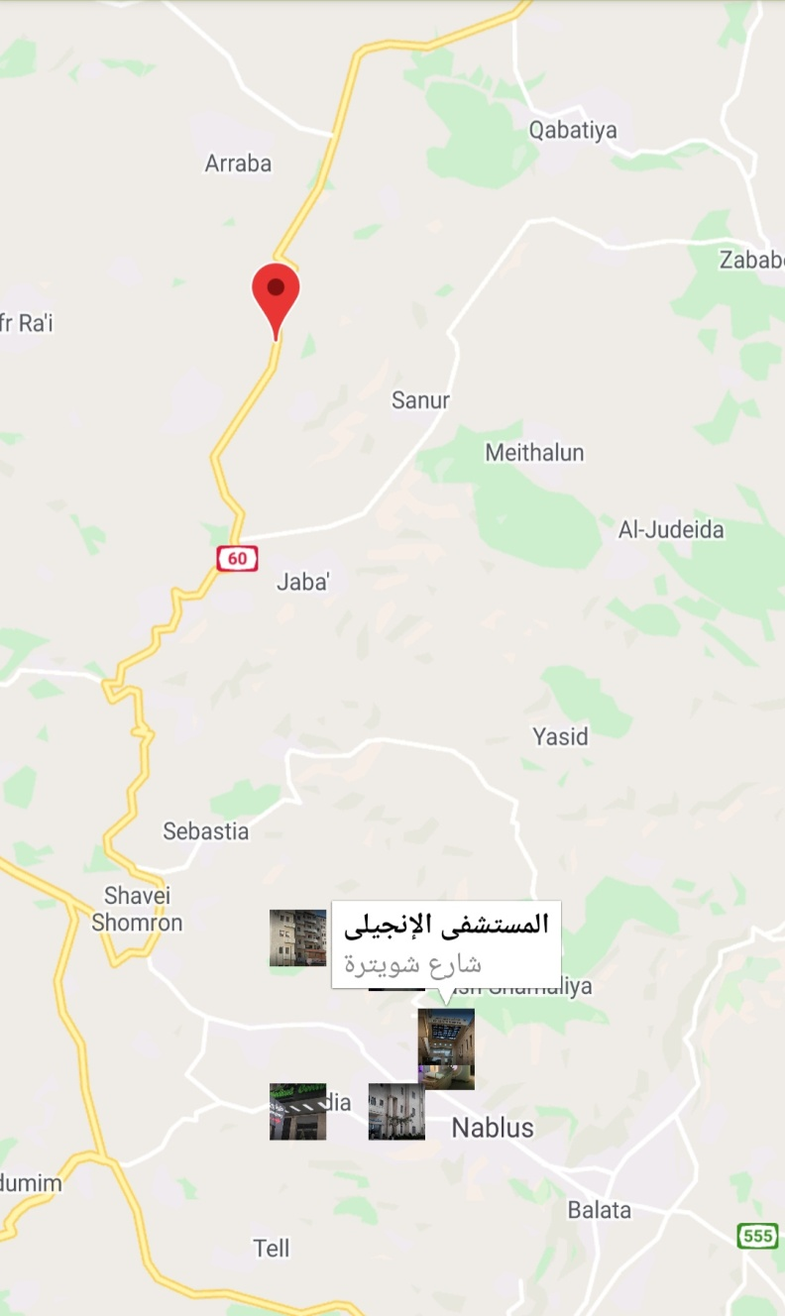
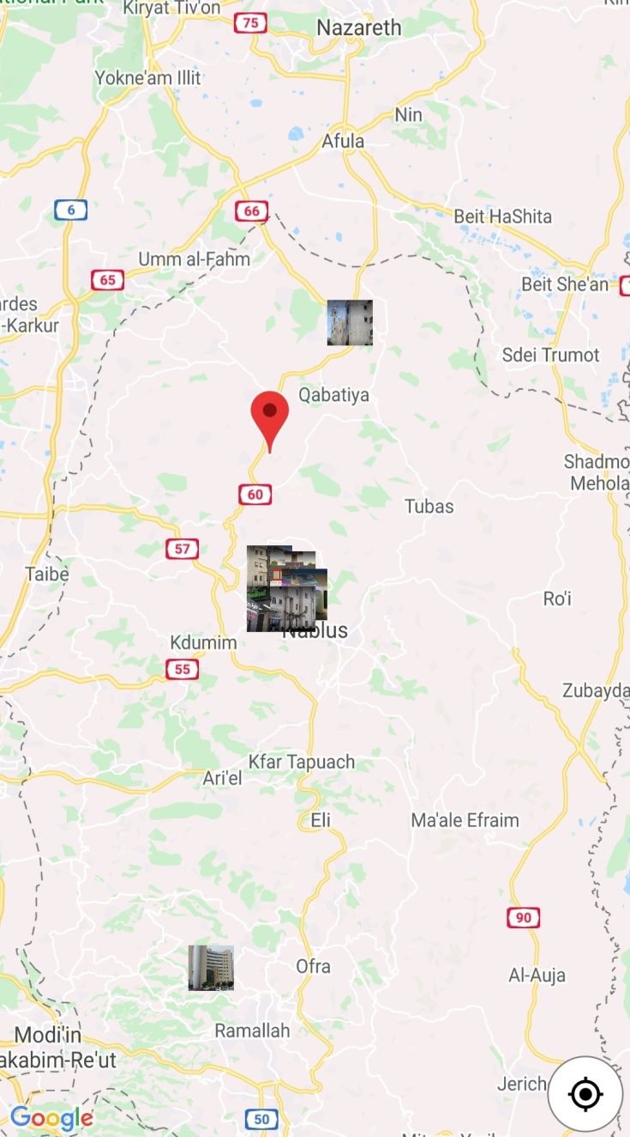
Places in map

Slide 23
Limitations

Slide 24
Difficulties in collecting data and information about the disease.
Some places do not exist on Google Map.
Since it is a complex disease, there were difficulties in creating features that are suitable and provide as much help as possible to patients.

Slide 25
Future Work

Slide 26
A professional chatbot that would answer the user’s questions instead of simple chatbot.
Provide OCR to know if a specific product contains gluten or not.
Provide Barcode checking to know if a specific product contains gluten or not.

Slide 27
Thank You For Listening

