Slide 1
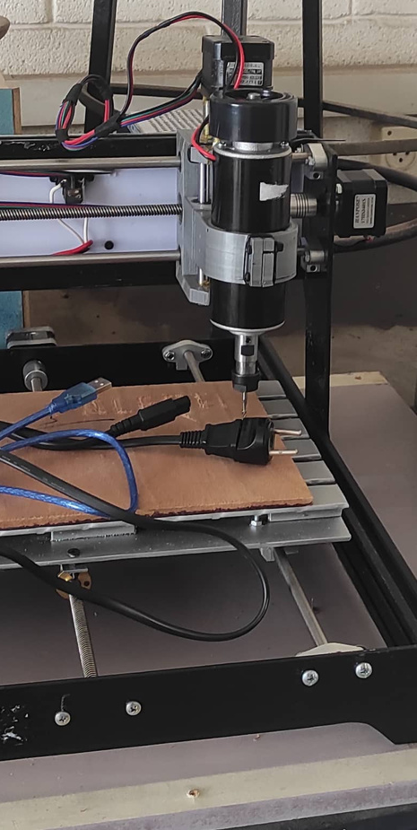
THREE AXIS CNC MACHINE
Nidal Al-Dari
Ameer Odeh
Sadele Rabaya
Supervisor:
Dr. Bashir Nouri
May 2022

Slide 2
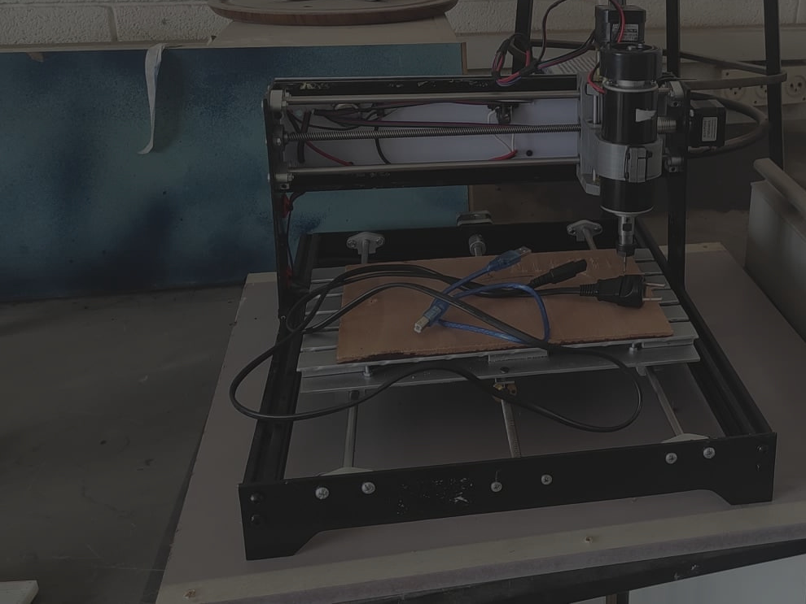
Overview
  Introduction
  Mechanical Components
  Electrical Components
  Software
  Limitations
  Conclusion

Slide 3
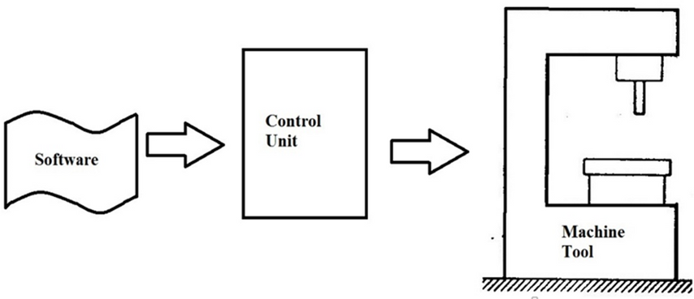
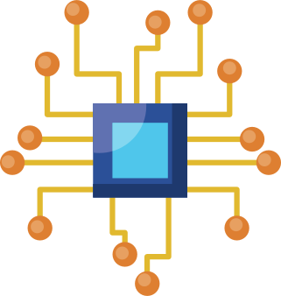
Introduction
WHAT IS COMPUTER NUMERIC CONTROL?
Figure 1.1: CNC Operation Components

Slide 4
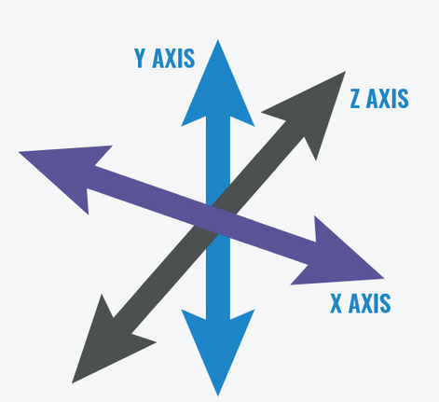

DEGREES OF FREEDOM
Figure 1.2: Three Axis Motion

Slide 5
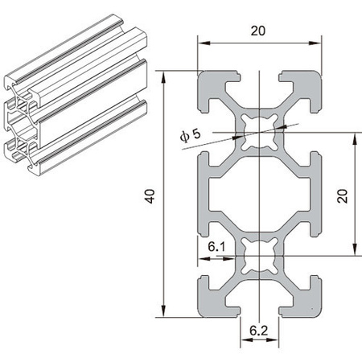
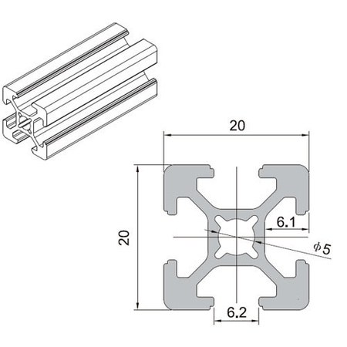

Mechanical Components
MACHINE STRUCTURE
Figure 2.1: 2040 And 2020 Aluminum Profiles

Slide 6
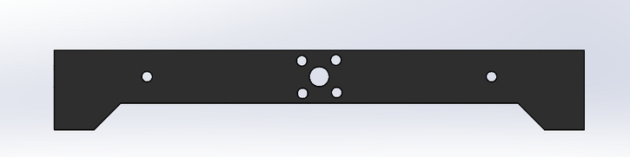
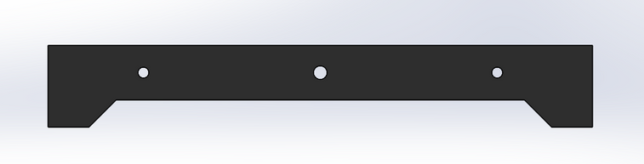

MACHINE STRUCTURE
Figure 2.2: Front And Back Panels

Slide 7
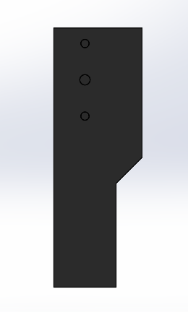
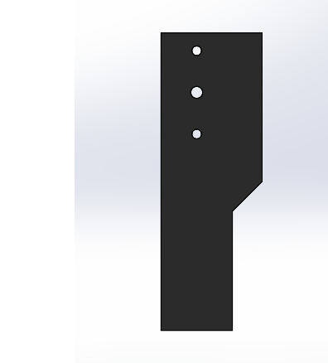

MACHINE STRUCTURE
Figure 2.3: Side Panels

Slide 8
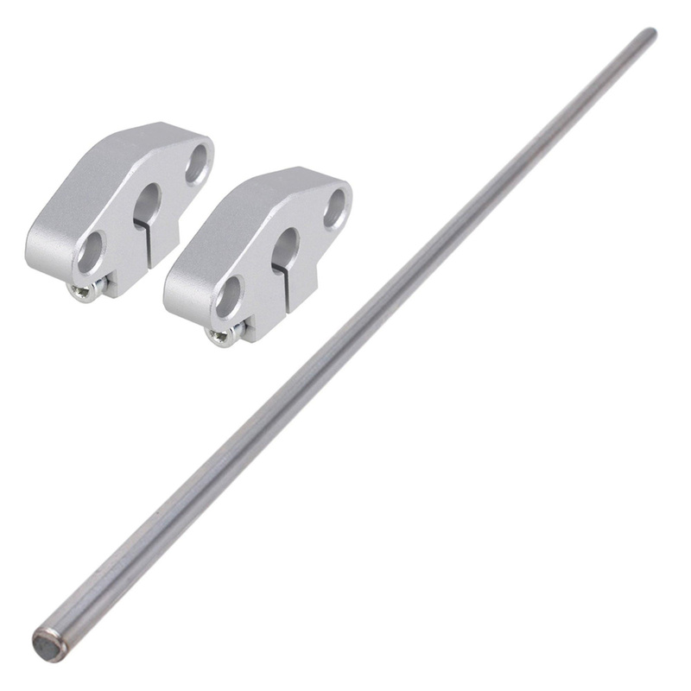
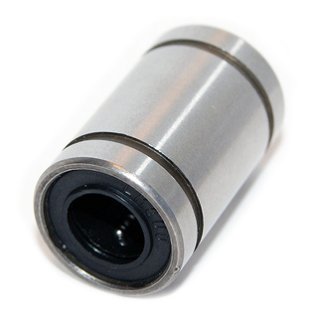
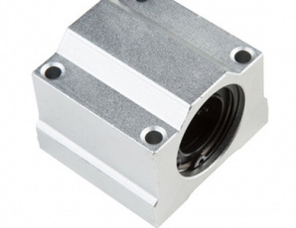
MACHINE STRUCTURE
Figure 2.4: Support And Guidance For Each Axis
8MM

Slide 9

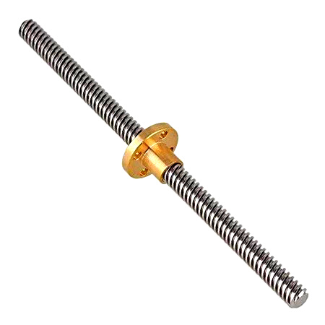
CONVERTING MOTOR OUTPUT TO LINEAR MOTION
8 MM
LEAD
4
START
2 MM
PITCH
Figure 2.5: ACME Lead Screw

Slide 10
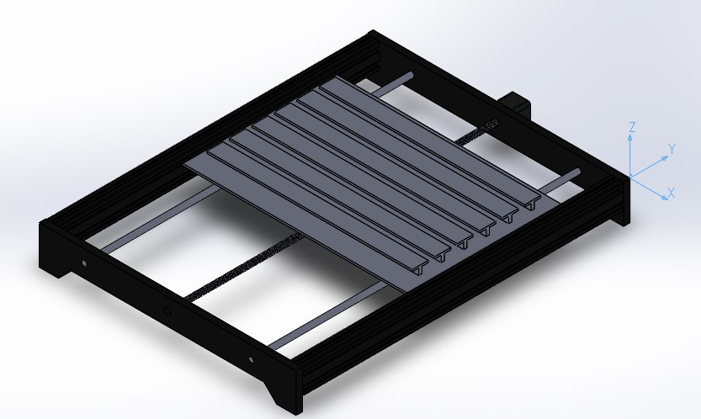
MACHINE STRUCTURE
MOVING TABLE (Y-AXIS)
Figure 2.6: Moving Table (Y-Axis)

Slide 11
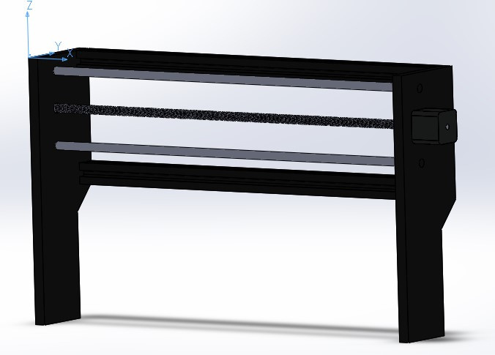
MACHINE STRUCTURE
X-AXIS
Figure 2.7: X-Axis

Slide 12
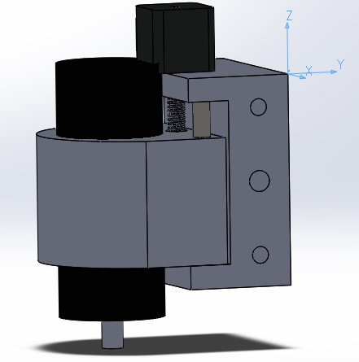
MACHINE STRUCTURE
Z-AXIS WITH SPINDLE
Figure 2.8: Z-Axis With Spindle

Slide 13
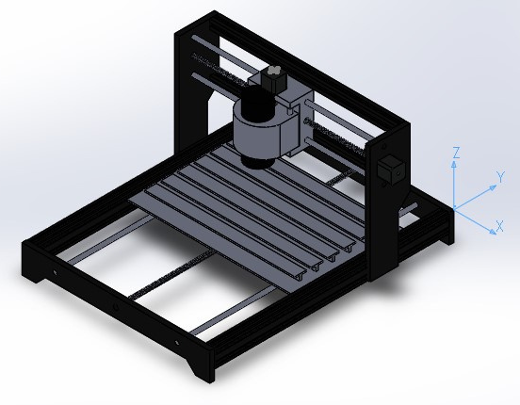
MACHINE STRUCTURE
FINAL DESIGN OF THE MACHINE
Figure 2.9: Final Design

Slide 14
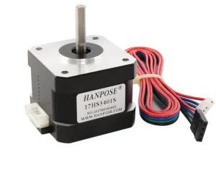
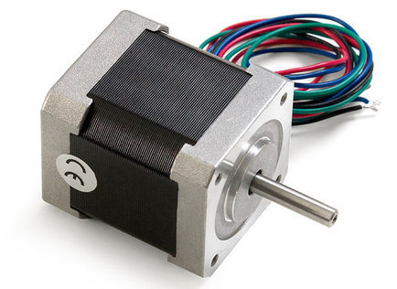
ELECTRICAL COMPONENTS
STEPPER MOTORS
X-AXIS
NEMA 17 34MM
1.3A
28 N.CM
Y AND Z-AXIS
NEMA 17 42MM
1.68A
36 N.CM
Figure 3.1: X-Axis Stepper
Figure 3.2: Y And Z-Axis Stepper

Slide 15
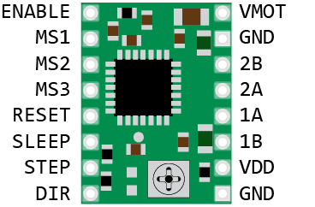
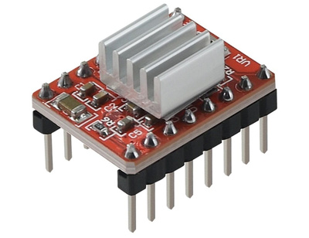
CONTROLLING THE STEPPERS
A-4988 PINOUT
A-4988 WITH HEATSINK
Figure 3.3: A-4988 Stepper Driver
Figure 3.4: A-4988 With Heatsink

Slide 16
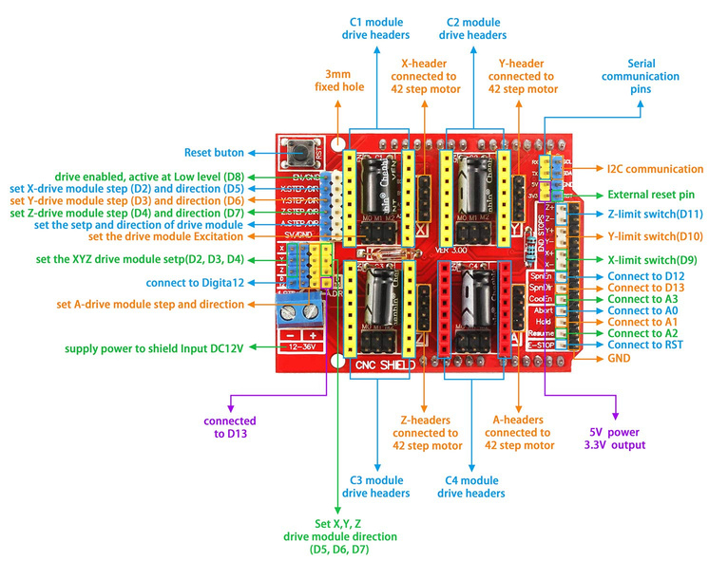
CONTROLLING THE STEPPERS
CNC SHIELD PINOUT
MOTOR VOLTAGE: 8 V TO 35 V.
LOGIC CIRCUITS VOLTAGE: 3 V TO 5.5 V.
CURRENT: 2 A (MAX).
FIVE STEP RESOLUTIONS: FULL, 1/2, 1/4, 1/8 AND 1/16.
PROTECTION: UNDER-VOLTAGE, OVER-CURRENT AND OVER-TEMPERATURE.
Figure 3.5: CNC Shield Pinout

Slide 17
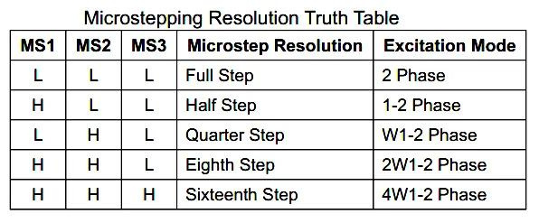
CONTROLLING THE STEPPERS
CNC SHIELD MICROSTEPPING
THE USED STEPPER MOTORS HAVE A RESOLUTION OF 200 STEPS / REV
USING 1/16 MICROSTEPPING WE GET:
200*16 = 3200 STEPS = 1 REV = 8MM
3200/8 = 400 STEPS/MM

Slide 18
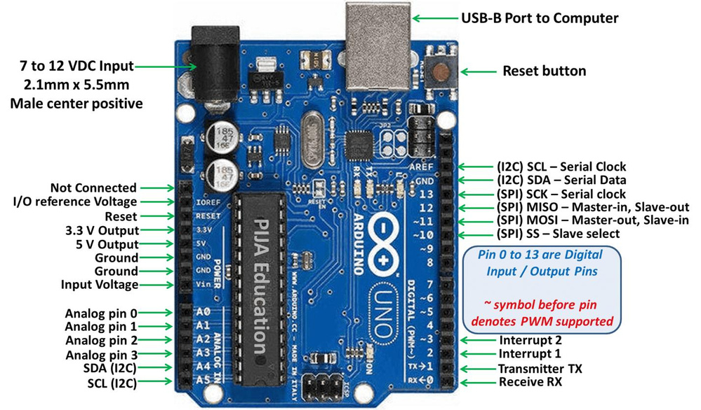
CONTROLLING THE STEPPERS
ARDUINO UNO PINOUT
Figure 3.6: Arduino Uno Pinout

Slide 19
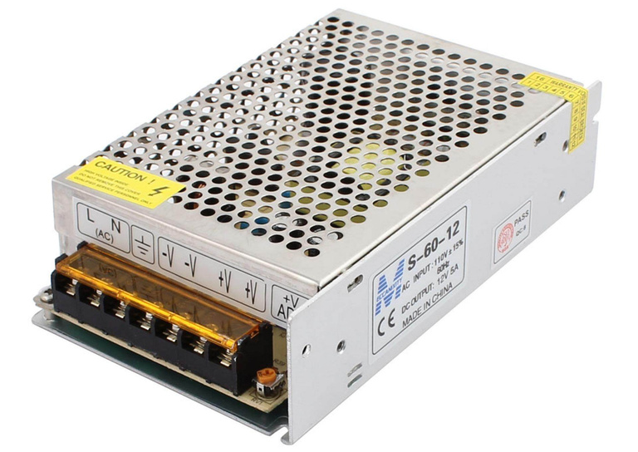
POWER SUPPLY
AC SUPPLY: 110-240 VAC 50-60HZ
OUTPUT VOLTAGE: 12 VDC
MAX. OUTPUT CURRENT: 5A
HIGH EFFICIENCY AND LOW WORKING TEMPERATURE
SHORT-CIRCUIT PROTECTION ,OVER-CURRENT PROTECTION, OVERLOAD PROTECTION
Figure 3.7: 12V Power Supply

Slide 20
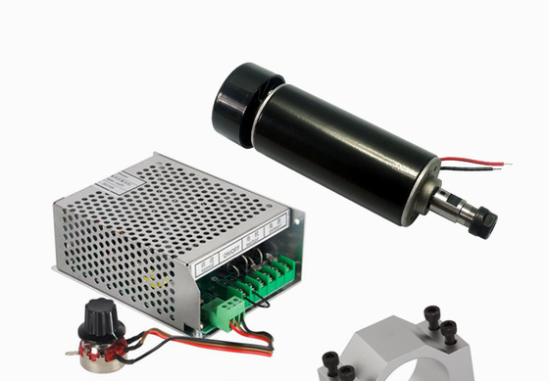

SPINDLE AND POWER SUPPLY
INPUT VOLTAGE: AC110V/220V 50/60HZ
OUTPUT CURRENT PEAK: 5A
OUTPUT VOLTAGE: DC0-100V
POWER: 500W
TORQUE: 50 N.CM
Figure 3.8: 500W Spindle With Power Supply

Slide 21
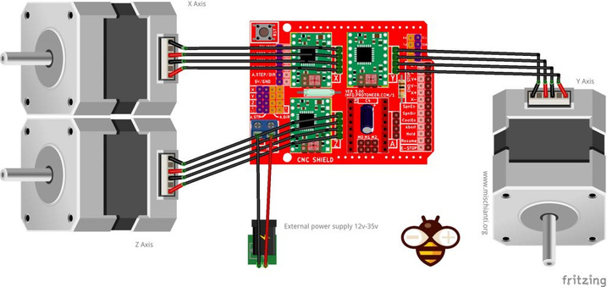
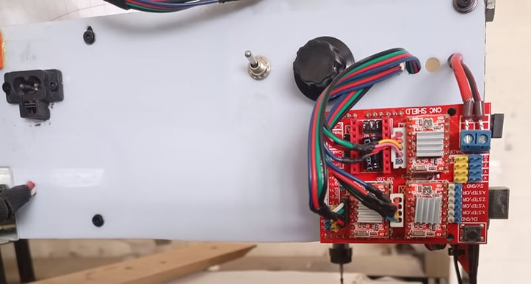
ACTUAL CONNECTION
Figure 3.9: Actual Connection

Slide 22
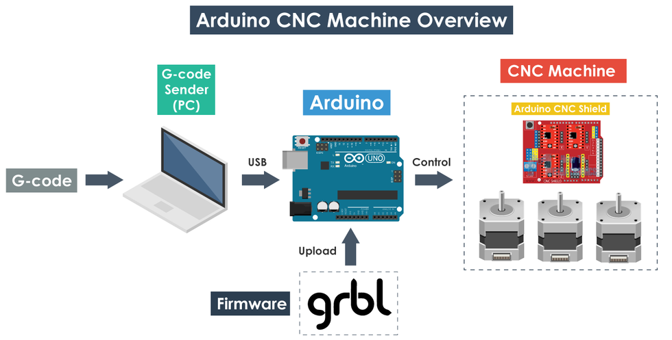

SOFTWARE
OPERATION OVERVIEW
Figure 4.1: Operation Overview

Slide 23
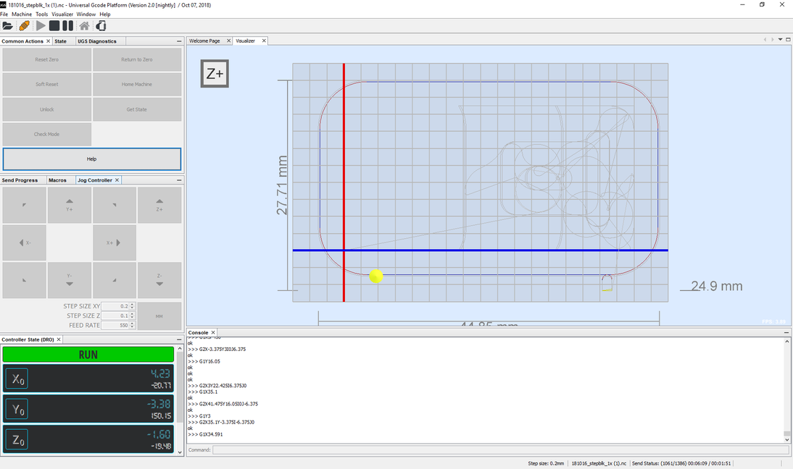
UNIVERSAL G-CODE SENDER
Figure 4.2: UGS User Interface

Slide 24
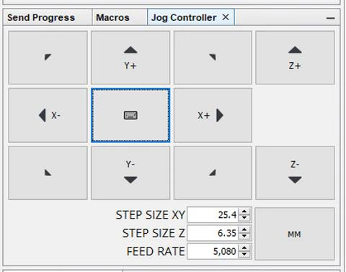
JOG CONTROLLER
Figure 4.3: Jog Controller

Slide 25
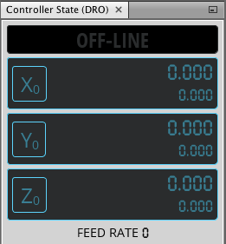
CONTROLLER STATE MONITOR
Figure 4.4: Controller State Monitoring

Slide 26
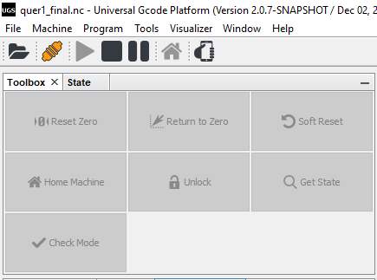
TOOLBOX AND STATE
Figure 4.5: Toolbox and state

Slide 27
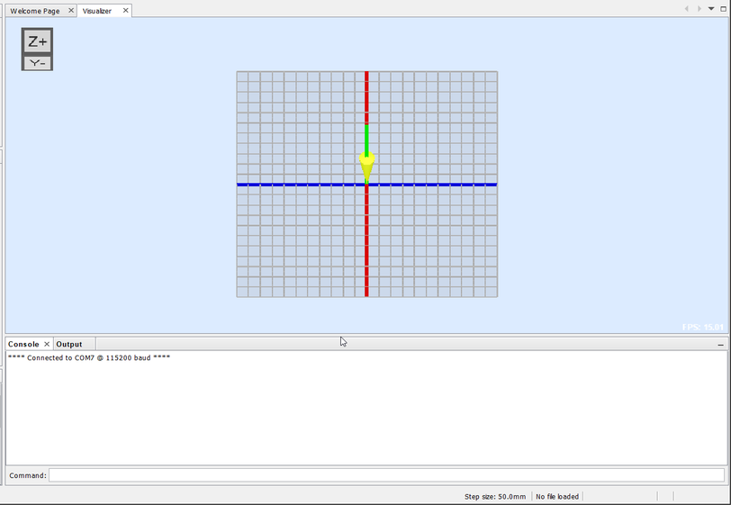
COMMAND BOX AND VISUALIZATION
Figure 4.6: Command Box And Visualization

Slide 28
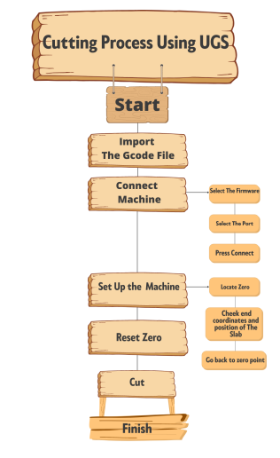
FLOW CHART OF MACHINING WITH UGS
Figure 4.7: Flow Chart Of Using UGS

Slide 29
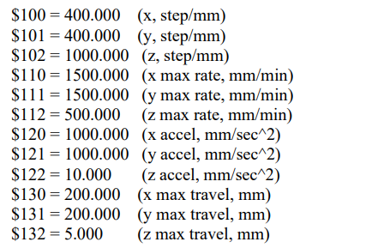

RECOMMENDED SETTINGS
Figure 4.8: Recommended settings

Slide 30
DEMO

Slide 31
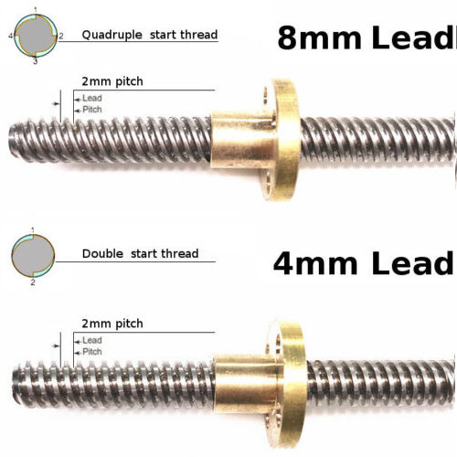

LIMITATIONS
LEAD AND RESOLUTION
Figure 5.1: Lead And Resolution

Slide 32
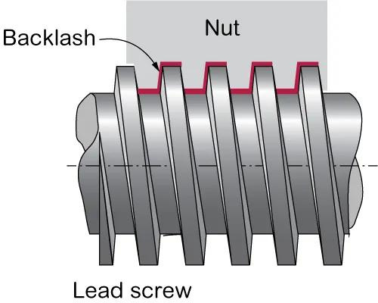
LIMITATIONS
BACKLASH
Figure 5.2: Backlash

Slide 33
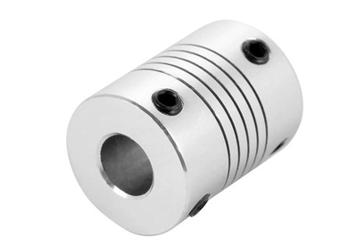
LIMITATIONS
LOOSE COUPLING IN THE Y-AXIS
Figure 5.3: Loose Coupling

Slide 34
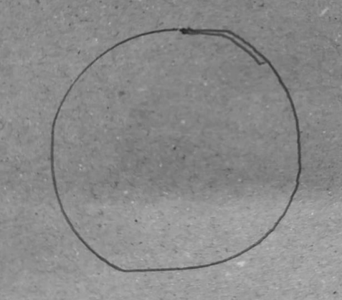
DELAY IN THE Y-AXIS MOVEMENT
Figure 5.4: Delay in the Y-axis movement

Slide 35
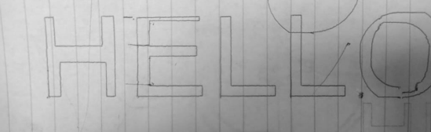
DELAY IN THE Y-AXIS MOVEMENT
Figure 5.5: Delay in the Y-axis movement

Slide 36
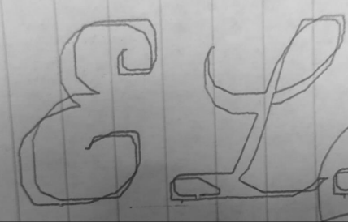
SMALL ARCS AND CIRCLES
Figure 5.6: Machine Struggling to make small arcs

Slide 37
CONCLUSION
OVERALL PERFORMANCE

Slide 38
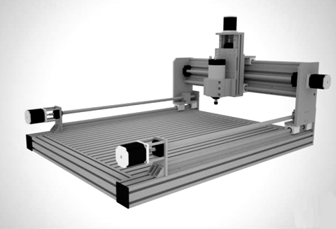
DESIGN MODIFICATIONS
Figure 6.1: Moving Table Vs Moving Gantry

Slide 39
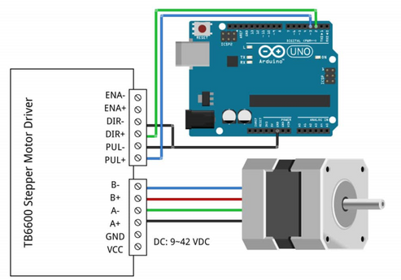
DESIGN MODIFICATIONS
Figure 6.2: A4988 Vs TB6600

Slide 40
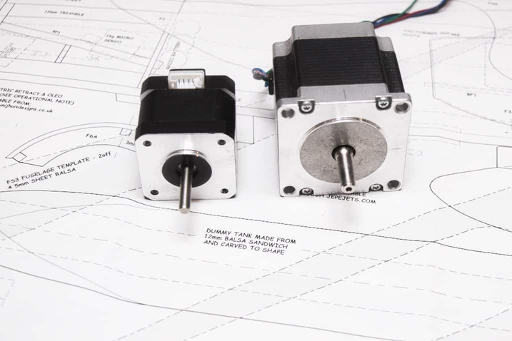
DESIGN MODIFICATIONS
Figure 6.3: NEMA 17 Vs NEMA 23

Slide 41
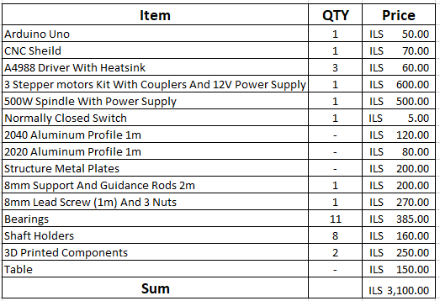
BILL OF MATERIALS

