Slide 1

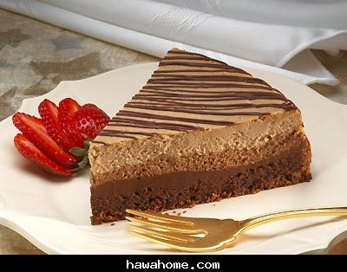
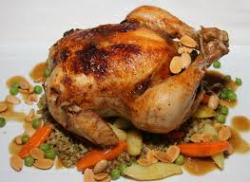

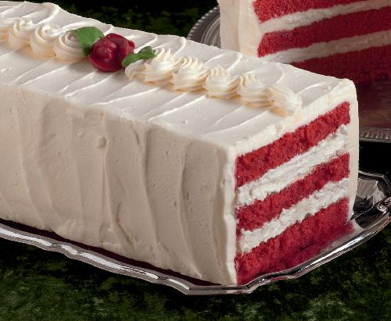
An-Najah National University
Faculty of Engineering
Building Engineering Department
Design a Restaurant
Graduation project
Prepared By:
Abeer Abu Rwees
Layal Tayem
Rawan Droubi
Supervisor Name: Dr. Feda'a Yaseen

Slide 2

Project contents:
Architectural Design
Structural Design
Electrical Design
Mechanical Design
Environmental Design
Quantity Surveying.

Slide 3
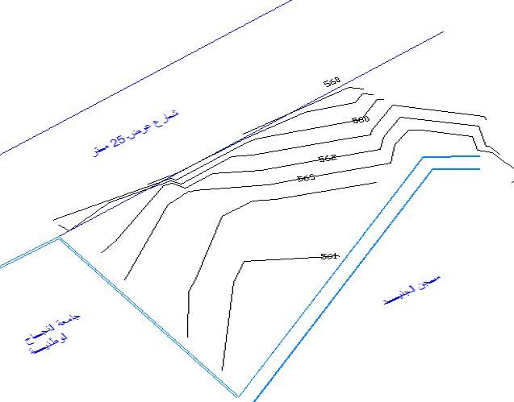
Architectural Design
A strategic location of the restaurant was selected it lies on the new main road that connect An-Najah university from the west gate to Nablus city ,it lies between An-Najah university and AL-Junaid Prison

Slide 4
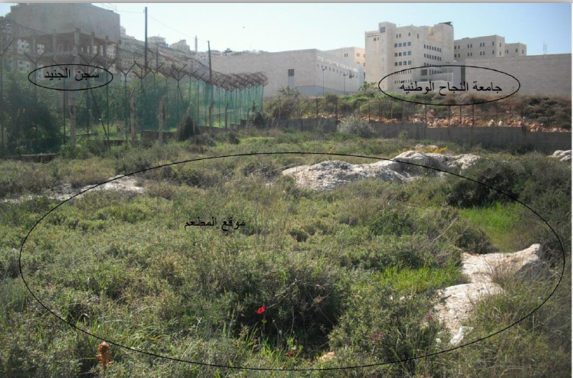

Slide 5
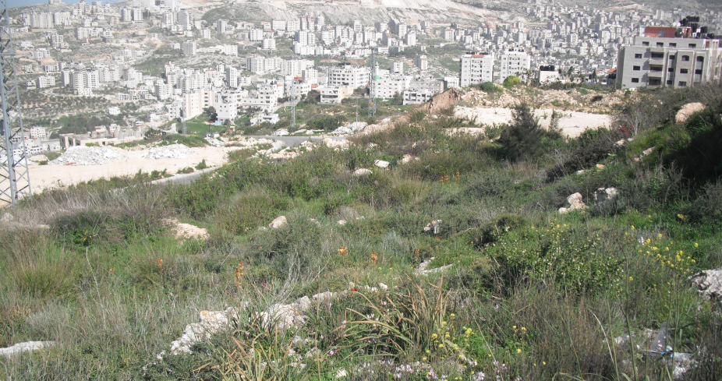

Slide 6
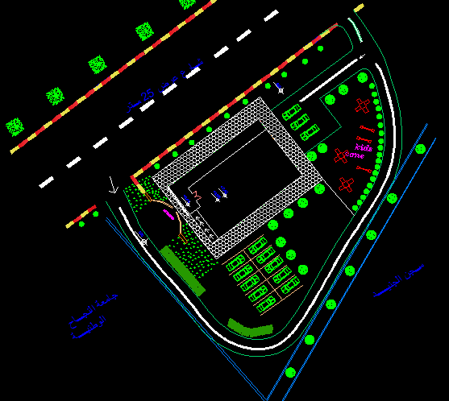

Slide 7
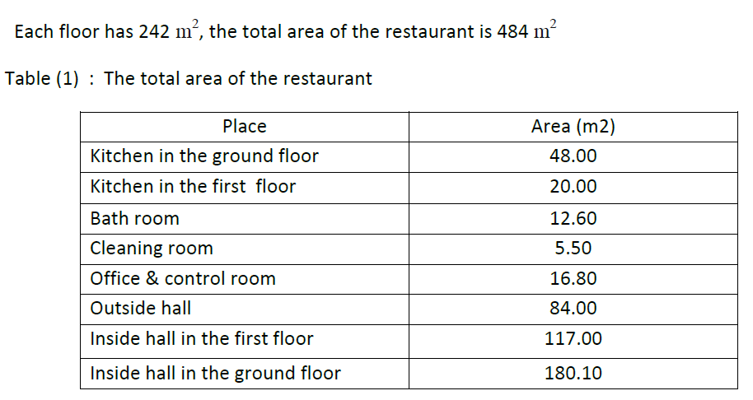

Slide 8
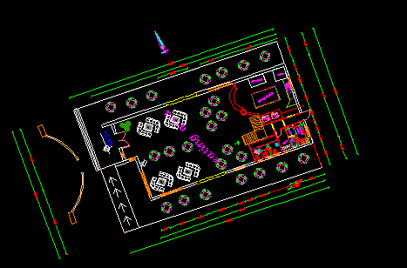

Slide 9
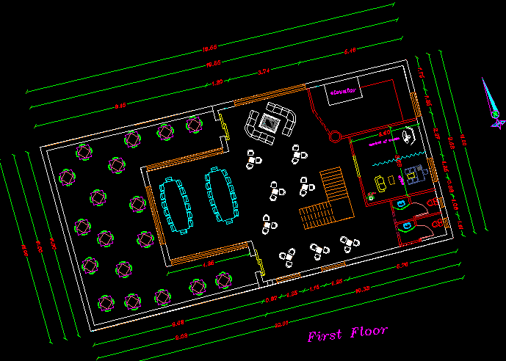

Slide 10
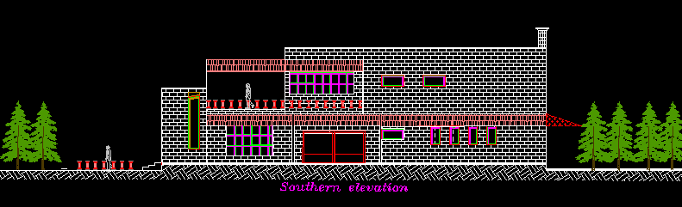
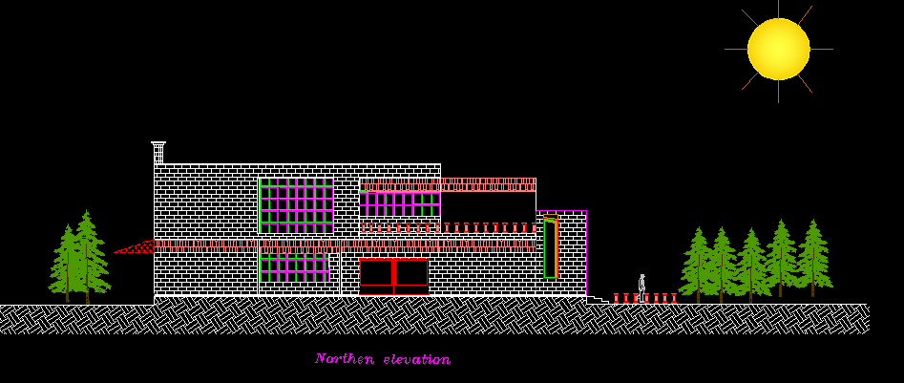

Slide 11
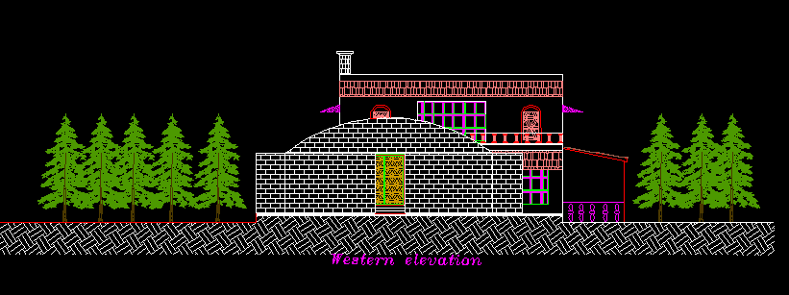
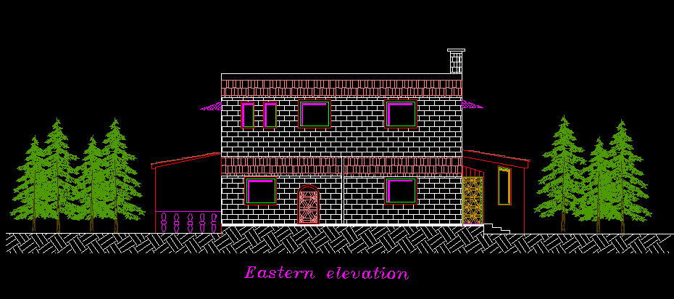

Slide 12
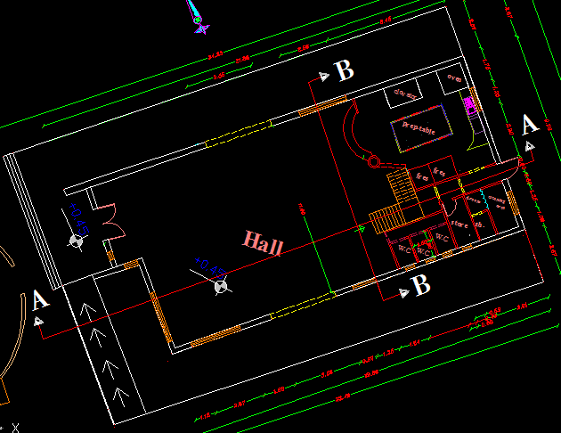

Slide 13
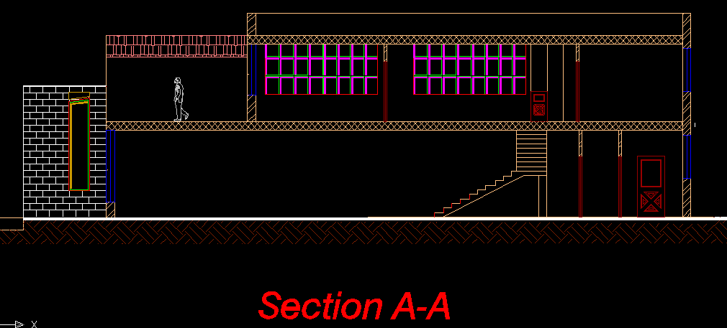
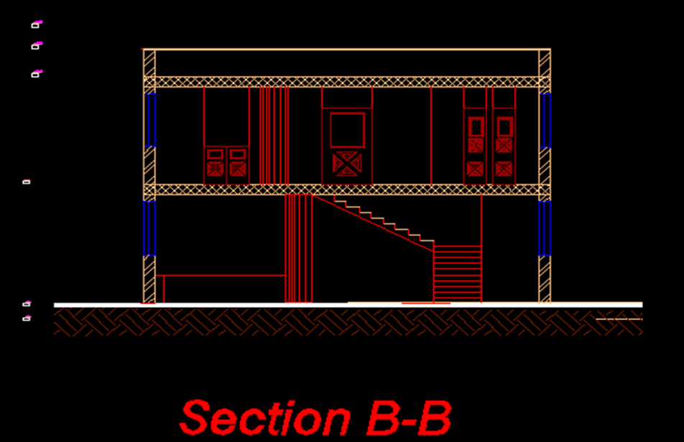

Slide 14
Structural Design
Design Data:
▪ Compressive strength of concrete (fc) = 28 MPa
▪ Yielding strength of steel (fy) = 420 MPa.
▪ Units : (meter-kilogram)
▪ E=280449639
▪ Story height= 3.5m
▪ Live load = 5 kN/m² (According to ASCE Code Table 4.1)
▪ Dead load ( slab weight) = 5 kN/m² (by calculation )
▪ Super imposed dead load =4 kN/m² (by calculation )
▪ Masonry external walls are used with wall thickness of 300 mm and unit weight of 22 kN/m³.

Slide 15
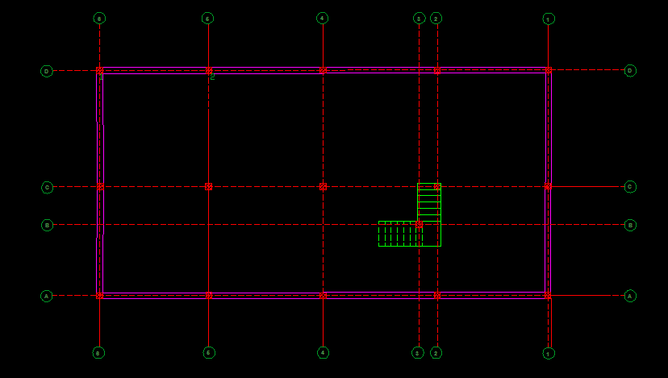

Slide 16
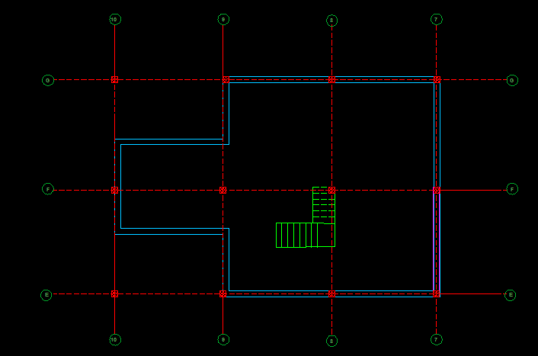

Slide 17
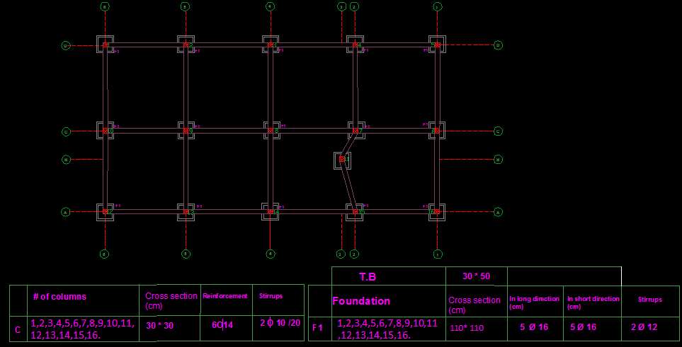

Slide 18
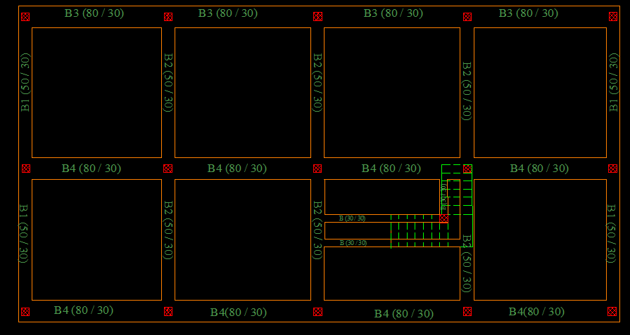
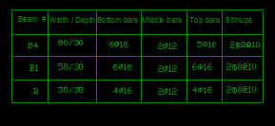

Slide 19
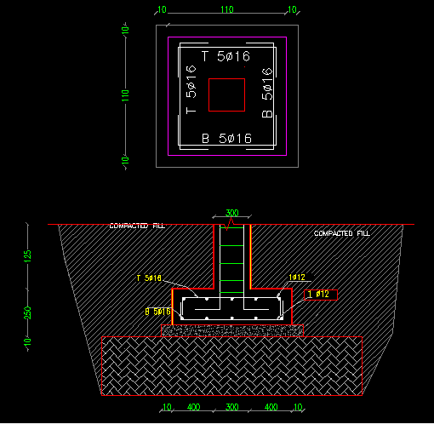

Slide 20
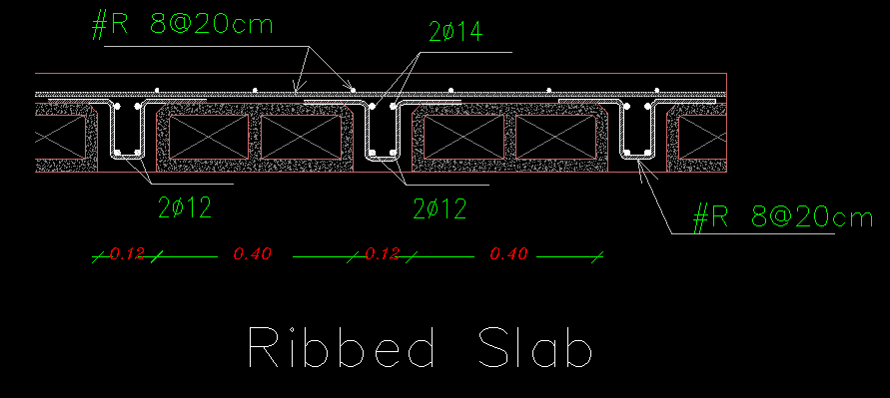

Slide 21
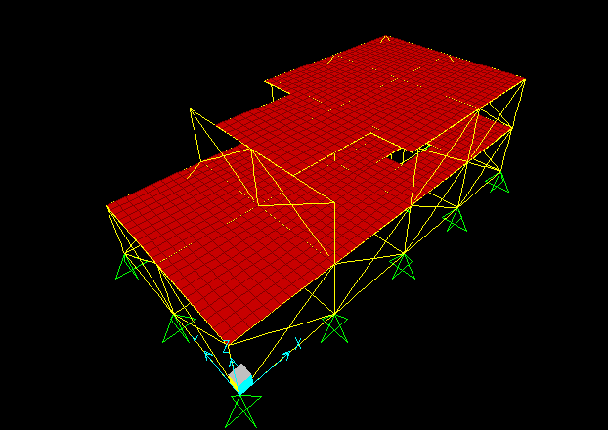
Compatibility check:

Slide 22
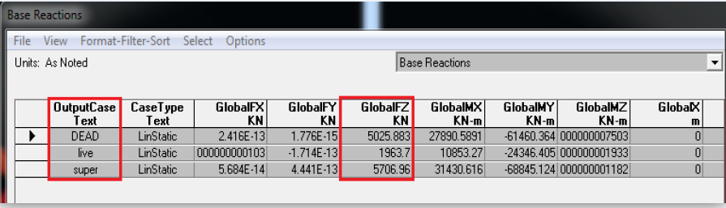
Equilibrium check:
Dead load:
From calculations=(1342+23+499+2940)= 4804 KN
From SAP= 5025 KN
% error= 4.6 %
4.6 % < 5% ………… Acceptable
Live load:
From calculations=(402*5)= 2010 KN
From SAP= 1963 KN
% error= 2.4 %
2.4 % < 5% ………… Acceptable
Super load:
From calculations=(1600+1806+1766)= 5970 KN
From SAP= 5707 KN
% error= 4%
4 % < 5% ………… Acceptable

Slide 23
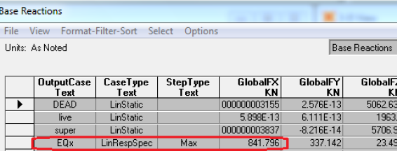
Earthquake check:
• Buildings in "Nablus" city, (Zone 2B→ Z= 0.20)
• Number of stories = 2 stories, Soil type is SB.
• Concrete compressive strength, fc= 280 kg/cmˆ2
• Yield strength of steel, fy = 4200 kg/c mˆ2
• Height of each story is 3.5 m.
Shear (V) for the Building:
Total weight = 4804 KN.
CV = 0.20 I = 1 R = 5.5
T = Ct * (hn) ^ (3/4) =0.0488 (7) ^ (3/4) = 0.21 s
T sap = 0.26 s
V = {(Cv)*(I)/(R*T)} * W
V calculated = {(0.2)*(1)/ (5.5*0.21)} * 4804
V calculated = 0.173*4804=831 KN

Slide 24
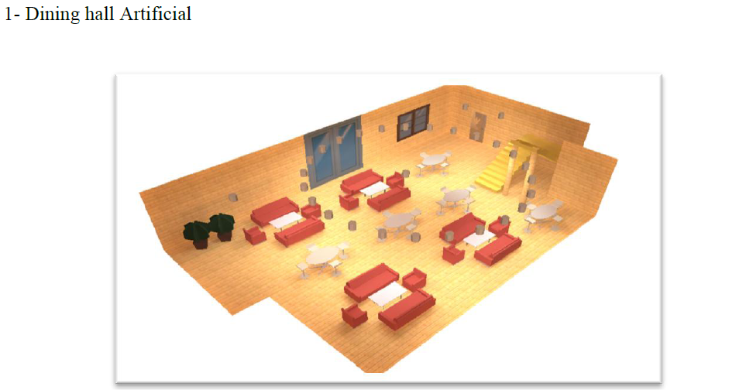
Electrical System:

Slide 25
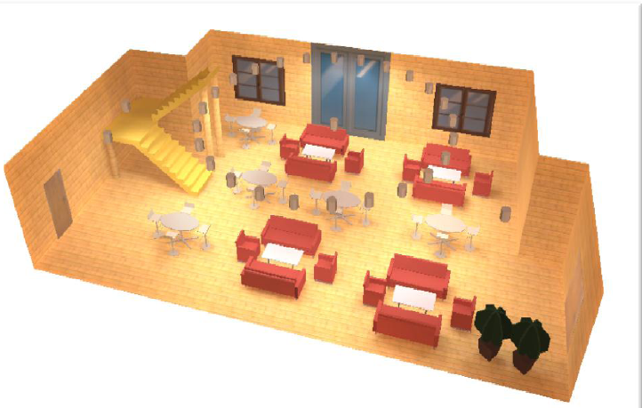
E=250 lux

Slide 26
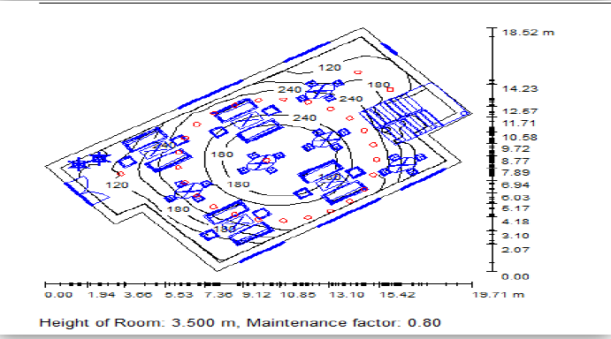

Slide 27
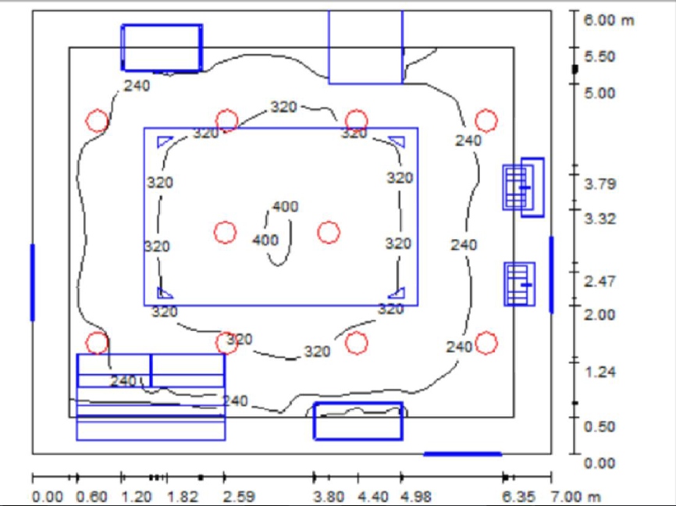
Kitchen Artificial:
E=350 lux

Slide 28
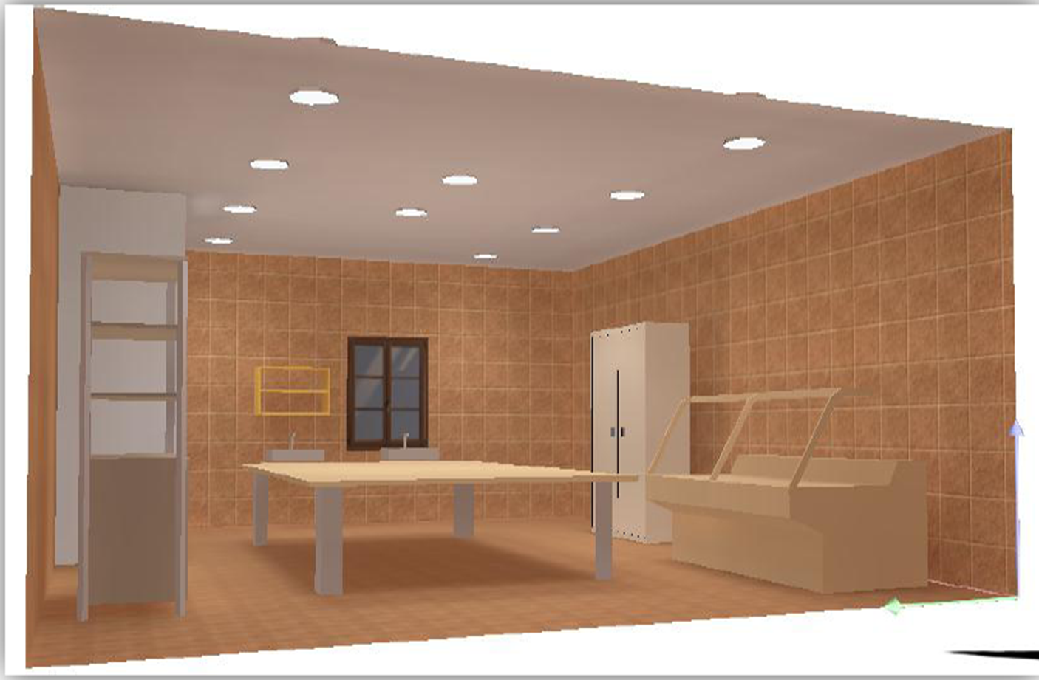

Slide 29
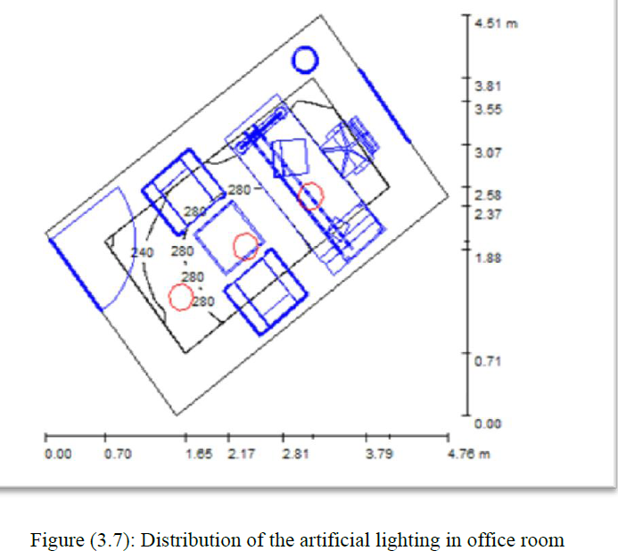
Administration room Artificial:
E=250 lux

Slide 30
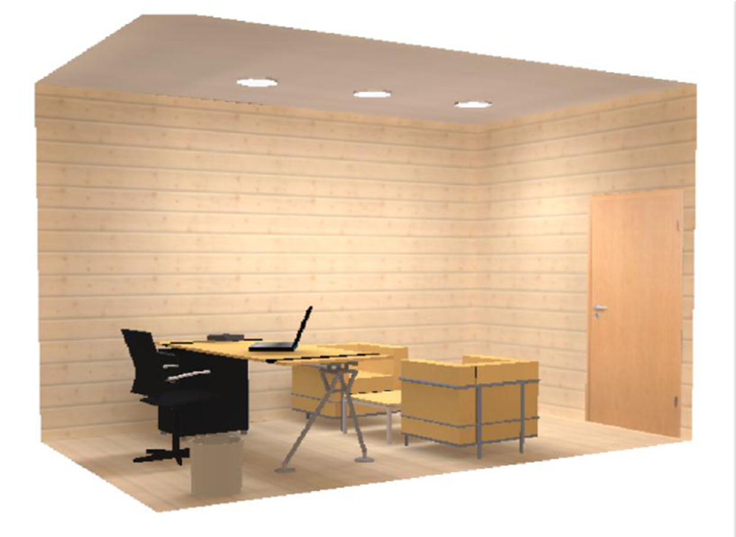
Administration room Artificial:

Slide 31
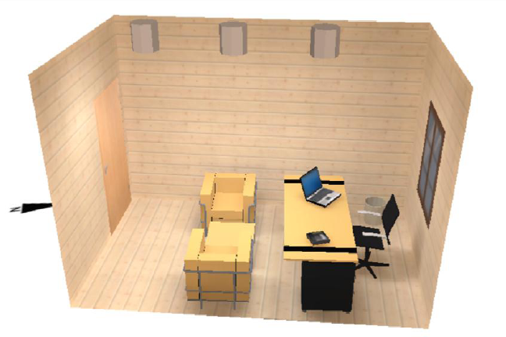
Administration room Artificial:

Slide 32
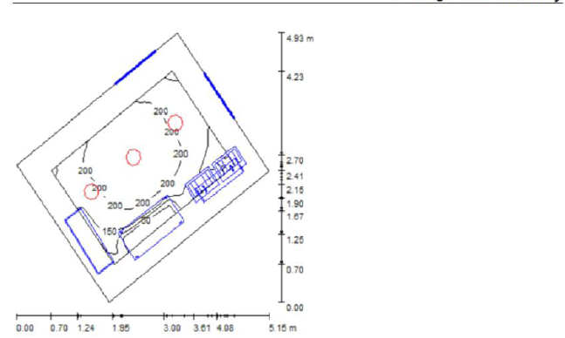
Cleaning Room:
E=200 lux

Slide 33
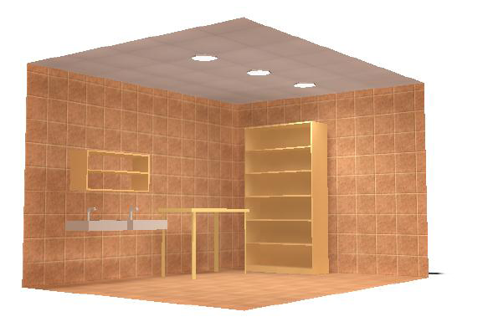
Cleaning room :

Slide 34
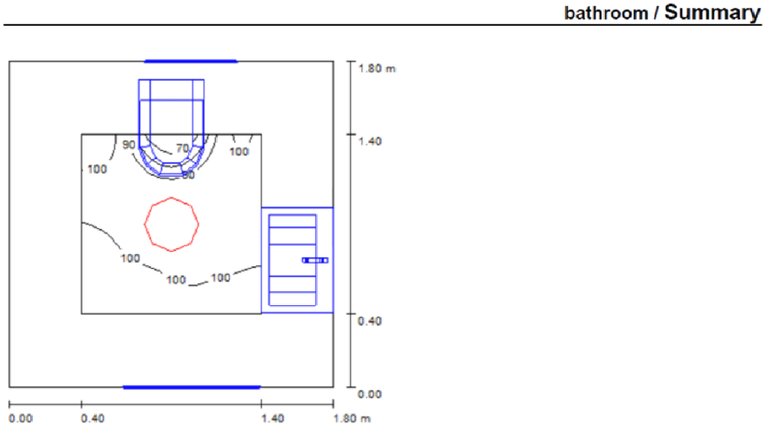
Bathroom
E=100 lux

Slide 35
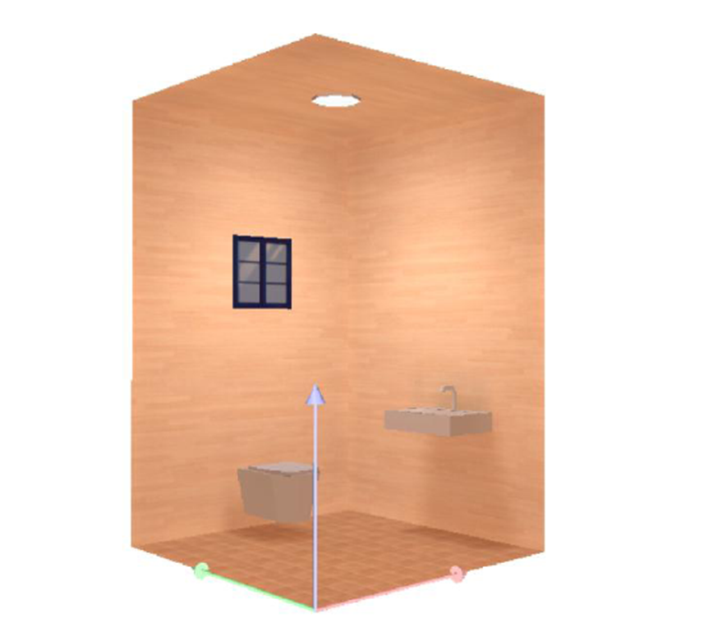
Bath room Artificial:

Slide 36
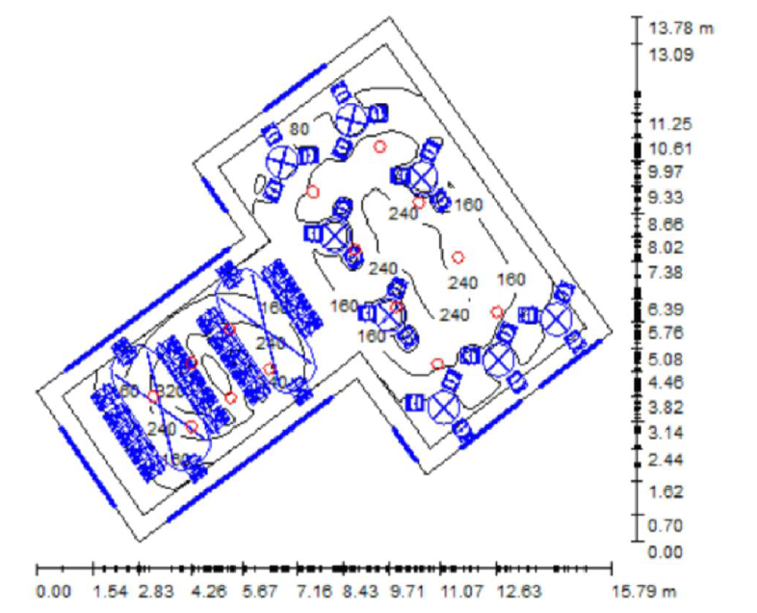
First Floor Artificial:
E=250 lux

Slide 37
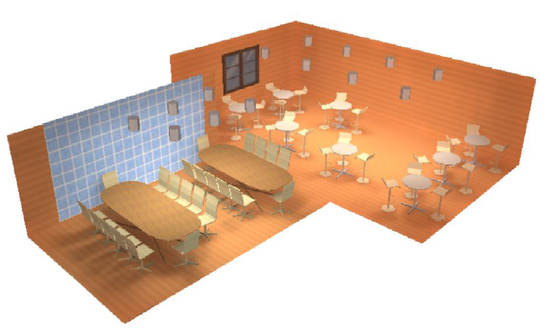
First Floor Artificial:

Slide 38
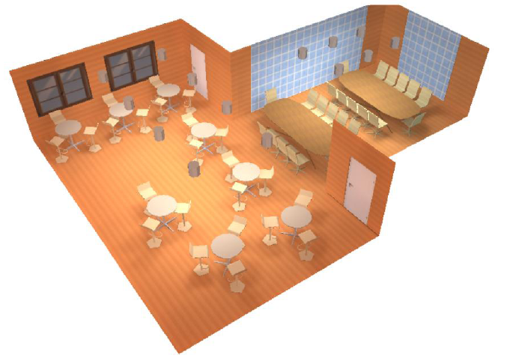
First Floor Artificial:

Slide 39
Circuit Breaker:
Total WATT of Lighting = 2200 Watt
# of branches of lighting:
(2200 × 1.10) / (220 ×10) = 2 C.B for Lighting
For (2Ampair) (4 to 5) outlet can be connected to one circuit breaker
We have (40) Outlet 40/5 = 8 C.B
Main Circuit Breaker:
I (M.C.B) = {{(power lighting × D.f) + (outlet × D.f)}/220} ×S.f
I (M.C.B) = {{(220 × 0.85) + (40 × 0.25)}/220} ×1.12 = 32 Ampair
We need main C.B with (3 phase) 35) A)
Cables of lighting diameter = 1.5 mm ²
Cables of outlets = 2.5 mm ²

Slide 40
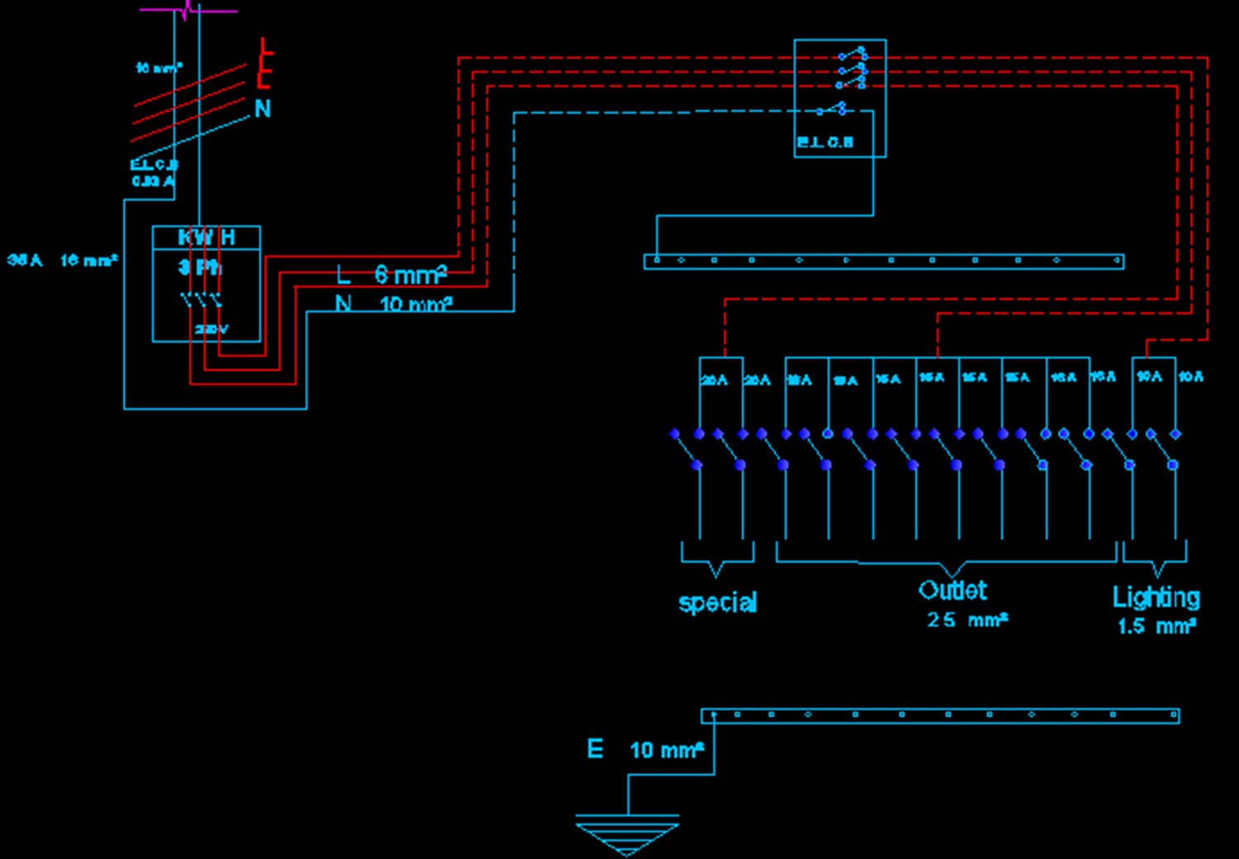

Slide 41
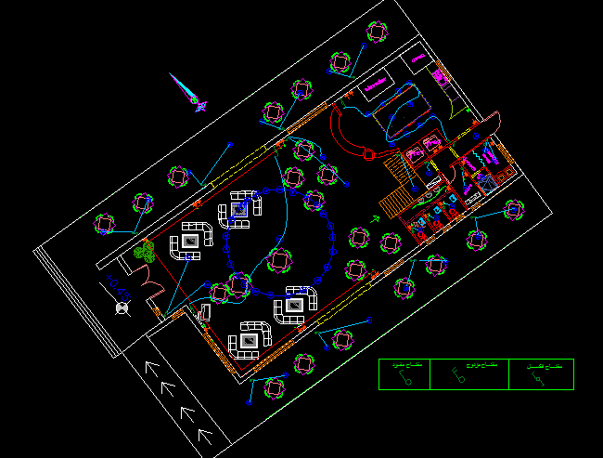

Slide 42
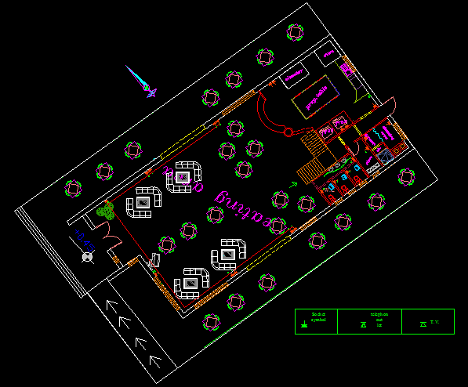

Slide 43
ميكانيك

Slide 44
ميكانيك

Slide 45
ميكانيك

Slide 46
ميكانيك

Slide 47
ميكانيك

Slide 48
ميكانيك

Slide 49
Environmental Design
Acoustics
1-interior sources: the kitchen, customers, HVAK system.
2-exterior source: traffic and adjacent occupancies.
So in this project some solutions were performed to minimize the noise:
• To minimize the exterior noise:
A wall of trees and shrubs were planted on the street side, which purifies the air also.
The sitting area in the dining hall was designed to be far from the street, the entrance and bathroom were put near the noise source.

Slide 50
Environmental Design
To minimize the interior noise:
Acoustical tiles from fiberglass were used at the false ceiling
Curtain and cloth covers for tables were used, with high sound absorption coefficients.
Ornamental plants were used.
The partition between the kitchen and the dining hall (parquet, gypsum board) is good in reduce the noise from kitchen.
HVAC system was insulating. Acoustic insulated flexible duct made of, steel wire and glass fiber was used. It can absorb the noise from the shaking when ventilated; it's also good in fire resistance and heat insulation.
Loud speaker system was used to give music.

Slide 51
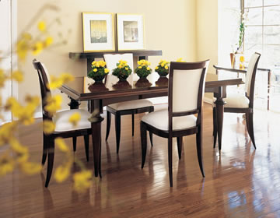
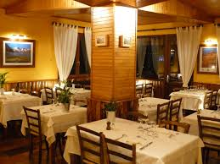
Environmental Design

Slide 52
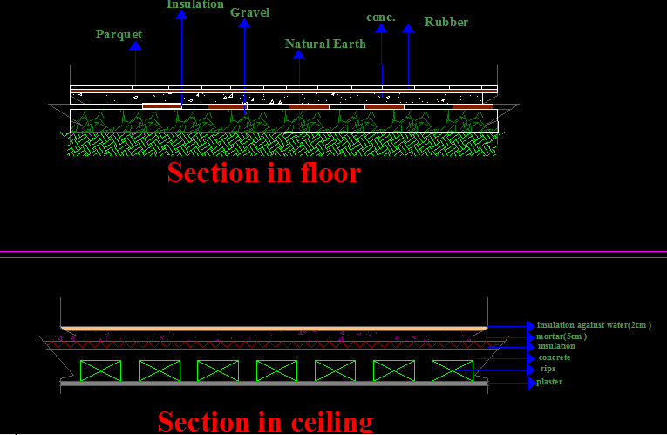
Environmental Design

Slide 53
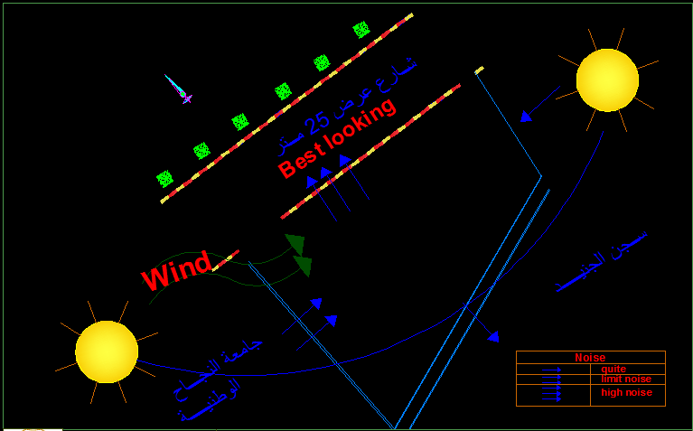
Solar Design:

Slide 54
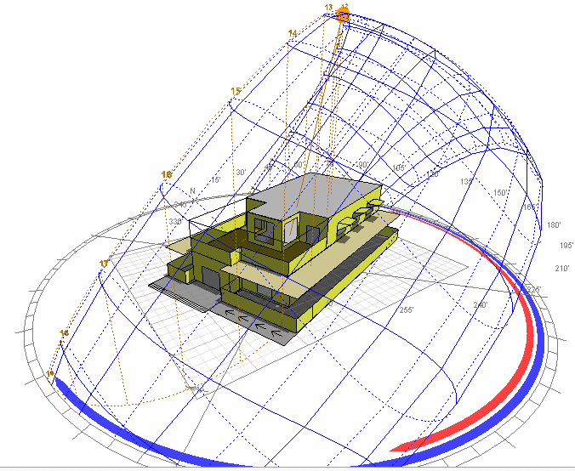
Environmental Design
Summer sun

Slide 55

Environmental Design
Winter sun

Slide 56

Environmental Design
Southern elevation

Slide 57



Slide 58

Environmental Design

Slide 59


Environmental Design

Slide 60

Hydraulic Elevator:
The advantages of hydraulic elevator:
• No overhead machine room needed.
• Its dimension is optimized.
• Loads are distributed to load bearing walls-there are no overhead structural requirement.
• Machine room can be located remotely
• Installation costs are generally less than other types.

Slide 61


Environmental Design
saving energy:
Restaurant use about 2.5 times more energy per square foot than other commercial buildings . For the reason eco-friendly equipment's were used, less energy, save money and helped protect the environment.

Slide 62
المواصفااااااات

