Slide 1
Developing and Improving the Management System at Languages and Capacity Building Academy ( LCB Academy )
Prepared by:
Haneen Dawood
Lama Bostami
Sima Masri
Yasmine Tibi
Submitted to:
Dr. Yahya Saleh
Saturday
5-5-2014

Slide 2
Agenda
Introduction : Languages and Capacity Building Academy
Problem Statement
Objectives
Mission and Vision
Goals
Policies
Organizational Structure
Job Description
Work Procedures
Conclusion and Recommendation

Slide 3
Introduction
Languages and Capacity Building Academy “LCB” is profit organization , in Tubas
provide programs for training languages , capacity building and help students to discover themselves and improve them
There are two different department in LCB Academy : languages unit include two languages English and Hebrew , and capacity building like Preparing university students for the job market and mat Mathematics courses for different levels.
They also provide students services (audit services, linguistic revision for theses and graduation project, copy and print services),And also provides translation services such as translation of legal documents , with a Staff off one Senior Manager , two Consultants to put Strategy and structure of the courses and four Trainers ,I n summer -2013 with 105 trainees joined the languages course.

Slide 4

Problem Statement
the absence of complete and comprehensive administrative system which leads to many problems and difficulty in dealing with the information whether they belong to the customer, or to the staff

Slide 5
Objective
The Aim
The Benefits behind our aim:
It will increase the efficiency of the service.
as well as in terms of human resources how to organize and employ them properly.
also finances follow-up from the start without any difficulties and reduce the costs.
Reduce the time.

Slide 6
Methodology
1- collecting data: we visited the academy location in tubas –Nablus, to make an overview about the capacity of the building and the layout of department
2- data analysis: studying the current situation of the center set the main problem facing it and check the weakness point and any gaps in it to find the best solution
3- tools and procedures : the ISO standard

Slide 7
Mission and Vision
The Mission Statement
"To build capacity and plant confidence in student's self, and to enable him/her to use languages effectively by applying the four skills as a second language".
The Vision
“LCB Academy aims to be the most greenish fertile and fruitful land in Tubas Province and most surrounding areas”
The Slogan
"Make your step two steps"

Slide 8
Goals
First: According to the standard measurement of the target
1.Quantitative goals:
Increasing the number of students applying various sessions.
2.Descriptive goals:
To remain on the reputation of academic and popular competition between institutions.
The declaration of the name and mental image of the institution and its services at all graduate and trainers.

Slide 9
Goals (continued)
Second: According to the objectives of the standard time and the administrative level:
1.Long-Term Goals:
Achieve the name is unique in the level of courses and educational services provided on a large scale (Tubas and then the West Bank).
2.Medium-Term Goals:
An increase in the number of applicants registered students annually .
3.Short-Term Goals:
Increase the number of students in current cycles through the declaration of good sessions provide access for students of the institution easiest ways.

Slide 10
Policies
It is a set of work rules and manners that workers must do in achievement of tasks to go forward organization goals.
Why the policies is required?
Simplify and clarify the goals.
Decentralization of power.

Slide 11
Policies
Managerial Policies:
1. Basic Policies
The policy of maximizing profits received by the academy
2. Functional Policies
The policy of attracting trainers from the local market
3. Operational Policies
Training policy for trainers to achieve good performance

Slide 12
organizational structure
Organizational structure is the skeleton of an organization. It is an expression of who is performing the various functions and tasks of a company and how these people relate to one another.

Slide 13
Organization Structure Types
Functional Structure
Divisional Structure
Matrix Structure
Other Organizational Structures

Slide 14
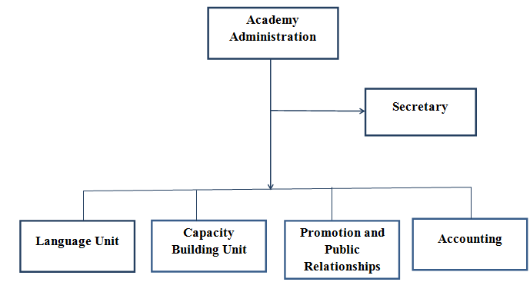
LCB-Academy’s Structure

Slide 15
Job Description
Job analysis plays a key role in providing a functional work environment functional in all its dimensions, it helps to choose the proper organizational structure, and to undertake well administrative decisions and sound choose of the workforce.
Stages of job description and analysis:
First: jobs design phase.
Determine the content and level of work and the nature of matter leads to knewledgement of functions and activities that is unnecessary or essential to the organization.

Slide 16
Job Description
Stages of job description and analysis:
Second: job analysis phase.
Data collection
Information collection selection method
Third: job description phase.
Writing and full description of the processes, tasks responsibilities, and qualifications required.

Slide 17
Job Discription
Manager
Trainer

Slide 18
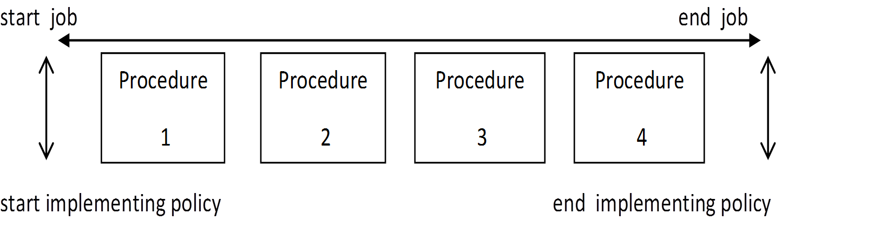
Work Procedure
Managerial procedures comes in the form of a detailed series of steps that reflect the progress and implementation of the policy.

Slide 19
Requirement of effective procedural system
The desired targets must be achieved.
Excluding procedures that could be merged or deleted .

Slide 20
Work Procedure
Types of procedures:
Moving procedures.
Storing procedures.
Waiting procedure.
Controlling procedures.

Slide 21
Some of procedures:
Capacity building
Reception of trainee
Languages

Slide 22
Capacity building trainee
submit request for training course
Reject the request
accept the request
Payment of training course fees
Proof of payment
Documentation (computerized system)
Continue until the end of the training course
undo the training course for some reasons

Slide 23
Languages trainee
submit request for specific level
do the test
confirm with the required of the level?
no
yes
suggest the appropriate level
Payment of training course fees
Proof of payment
Documentation (computerized system)
undo the training course for some reasons
Continue until the end of the training course

Slide 24
The Procedures
Capacity building trainee
Languages trainee
Form 1
Form 2

Slide 25
Some of procedures:
Courses advertising
Flow Chart
The procedure

Slide 26
Conclusion
selecting the goals and policies of the Academy
and painted the Mission and vision that aspires
to achieve them always.
organizational structure which was built in a
logical manner commensurate with the size of the
Academy as it will fit more advanced situation.
many relations of job Titles was explained , as well
as the relationship between the staff and the
Director setting the responsibilities, procedures
which is extracted from the organizational
structure

Slide 27
Recommendation
adoption and implementation of the project in the LCB Academy
transform our work into computerized system
develop and expand our project
Activation of the units in the proposed organizational structure

Slide 28
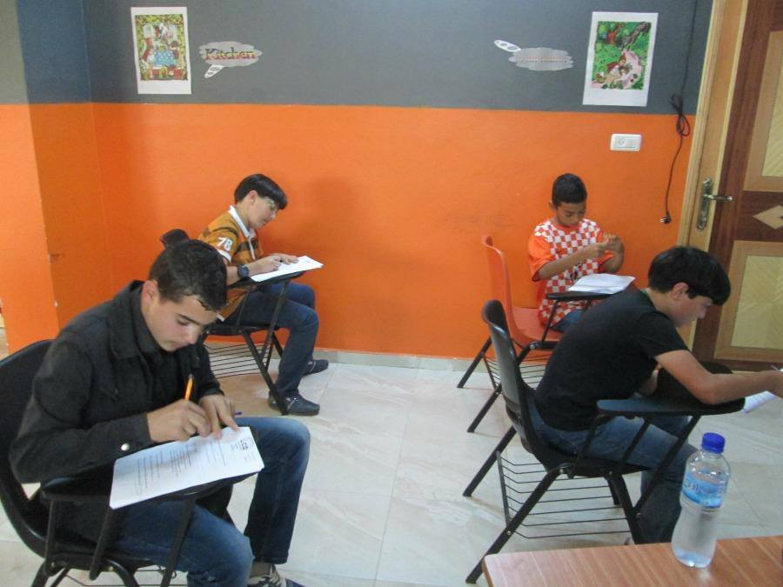
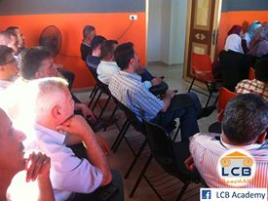
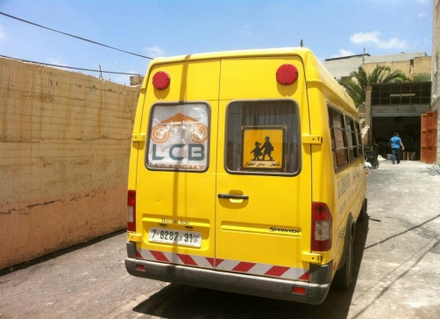
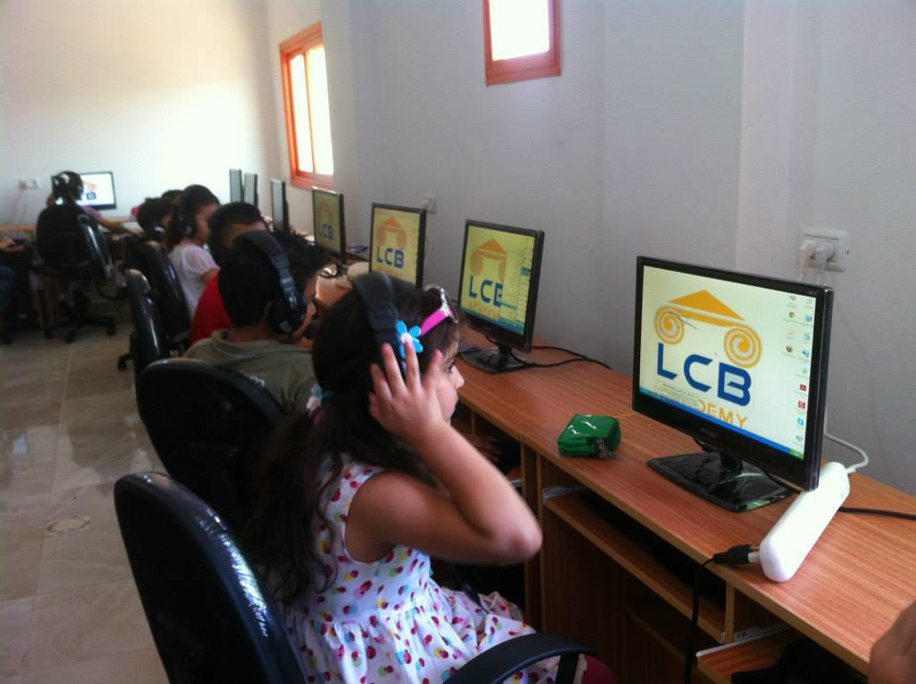

THANK YOU FOR YOUR ATTENTION

