Slide 1



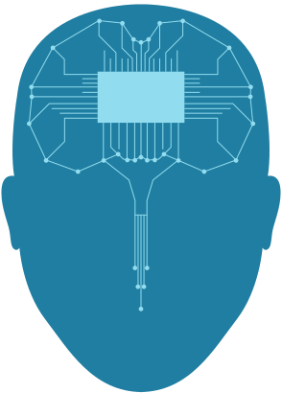




GRADUATION PROJECT 2:
boxing Robot
Supervisors
Dr. Saad Tarabiya
Dr. Anas tomah

Slide 2
TABLE OF CONTENT
Introduction
01
Overview
02
Features
03
Tools
04
Limitations
05
Future Work

Slide 3


INTRODUCTION
The boxing robot is an innovative training tool designed to enhance the boxing experience and provide aspiring users with valuable feedback. It is equipped with artificial intelligence and computer vision technologies that enable it to detect punches in real-time. What sets the boxing robot apart is its ability to provide immediate feedback on punches allowing users to improve their skills and track their progress over time. With its precise punch detection capabilities and interactive training modes that helps boxers refine their technique, and ultimately elevate their performance

Slide 4

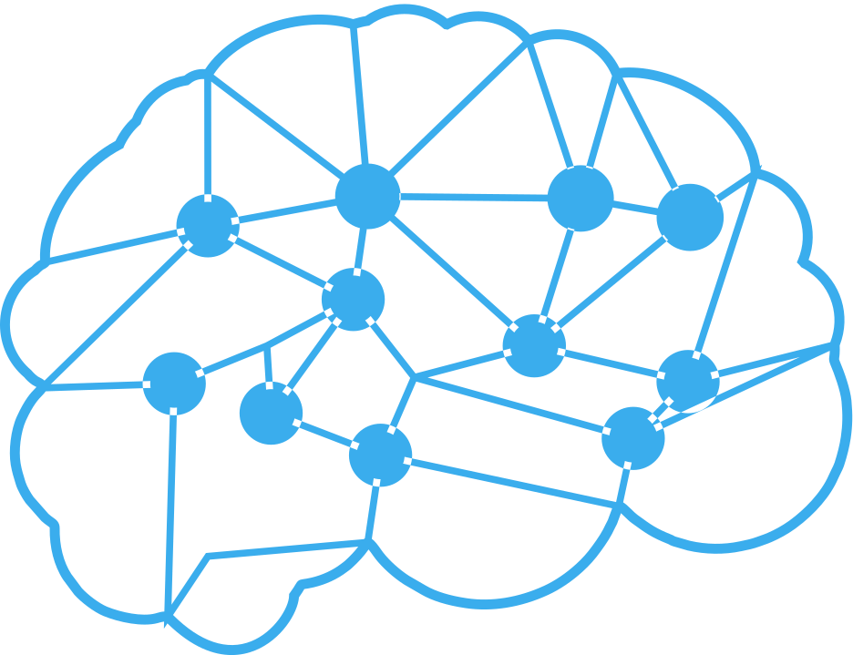


OVERVIEW
1
Our Project is simply a Boxing Training robot that enables potential users to practice the basic boxing techniques which include throwing punches and taking punches and also stances like the guard position. the system includes two modes:
  training mode: where the user can freely practice their boxing technique and a
  Vision mode: that detects the user behavior and throws punches accordingly

Slide 5




2
FEATURES
REAL-TIME MOTION DETECTION
INTERACTIVE MODES
APPLICATION
user-friendly application that serves as a control center and feedback platform. Through the application, users can effortlessly control the robot's training modes, The application also provides real-time feedback
The boxing training robot utilizes advanced computer vision algorithms to analyze and detect punches in real-time
The boxing robot offers two interactive training modes. the Training Mode and Vision mode

Slide 6



3
TOOLS
ARDUINO MEGA
PYTHON
Acted as an interface between the raspberry pi and the hardware components and also controlled specific hardware functions
We used python as our artificial intelligence language where we used libraries like OpenCV and mediapipe for punch and gesture detection

Slide 7


3
TOOLS
RASPBERRY PI
OPENCV AI KIT
The Raspberry Pi 3 micro-controller serves as the main control unit, coordinating the operations of various hardware components and running the necessary software algorithms like punch detection and guard detection.
The OpenCV AI KIT camera is employed for capturing video footage of the user's movements, which is essential for analyzing and detecting punches during training sessions.

Slide 8
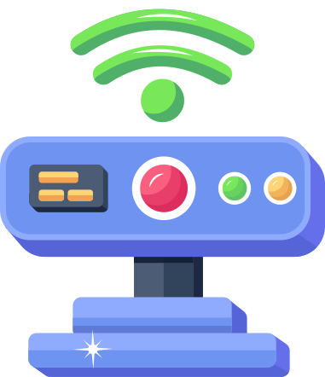
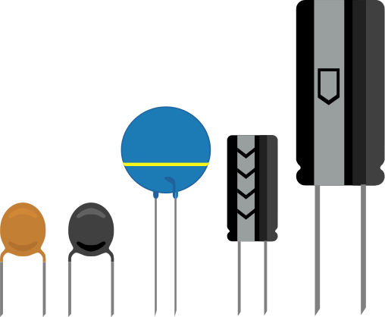
3
TOOLS
INFRARED SENSOR
OTHER HARDWARE
MH sensor series: F249 4 PIN Infrared Speed Sensor is utilized to detect the Punches from the user to the pad installed on the wooden frame
Servo motors to control the robot's arms movements, a wooden frame to mount all these components on and other components like wires and cables..etc

Slide 9

4
LIMITATIONS
AVAILABILITY
COMPATIBILITY
Some of the hardware components arrived late which hindered the development process of the project
Some libraries that were used in the python computer vision code were incompatible with the raspberry pi

Slide 10

5
FUTURE WORK
1
2
3
Enhanced Training Programs:
incorporate advanced machine learining algorithms to analyze the user's punching technique and provide personalized feedback for improvement
Advanced Sensing Technology:
integrating advanced sensing technologies. This can involve the use of force sensors or pressure-sensitive materials on the robot's surface to measure the impact and force of punches
Scoring system and challenges:
The scoring system would introduce a competitive element to the training sessions, allowing users to track their performance and compare it to predefined benchmarks or other users' scores.

Slide 11


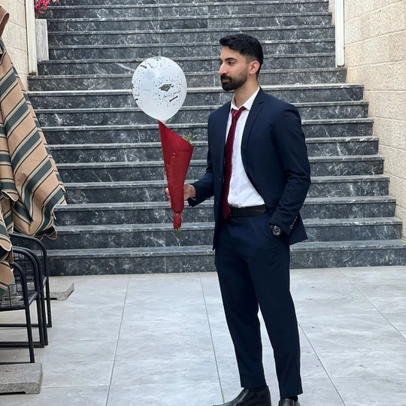
PROJECT BY
AHMED NABHAN
AHMED JALAMNEH

Slide 12
Thanks!
Do you have questions?

