Slide 1
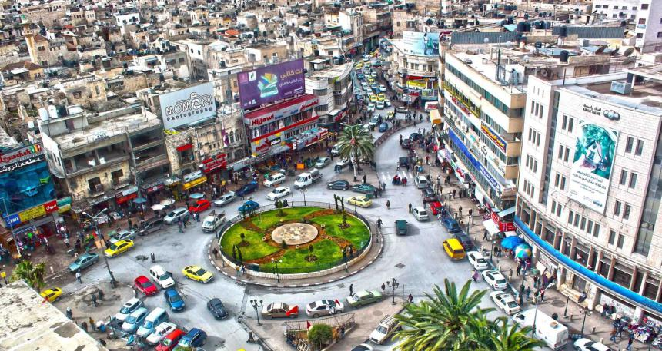
Analysis and Redesign for Major Intersections in Nablus City

Slide 2
Outline
Introduction
Methodology
Data collection
Traffic analysis
Geometric design
Conclusions and recommendations

Slide 3
Introduction
Intersections are argued to be the main cause of congestion and accidents in the city of Nablus.
It’s important to study the major intersections and assess them accordingly.

Slide 4
Methodology
Visit the intersections in the study area.
Collect data, which include PHV, accidents, and drawings from municipality.
Data was analyzed by SYNCHRO program.
Intersections was improved in terms of LOS, geometry, and accidents
Recommendation will be suggested to municipality of Nablus city.

Slide 5
Data collection
Traffic volume
Inventory study
Current geometry
Accidents

Slide 6
Accidents data

Slide 7
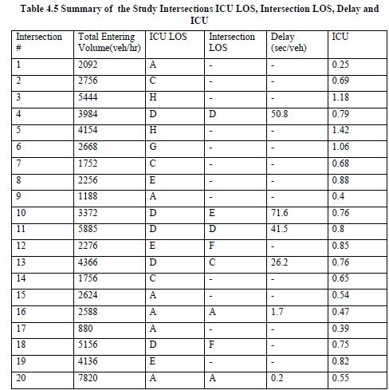
Traffic analysis
The intersections were analyzed using SYNCHRO program.

Slide 8
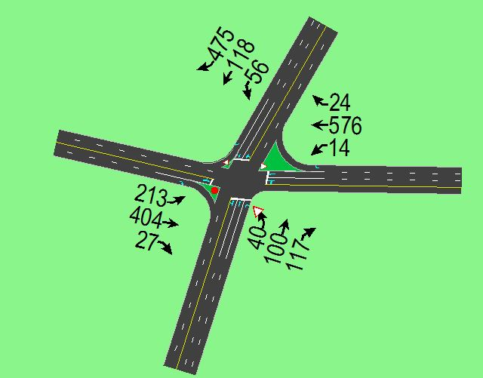
Sample of traffic analysis
Al- Ghawi intersection

Slide 9
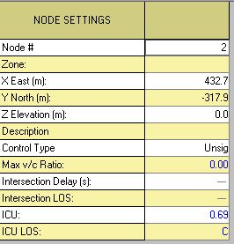
Sample of traffic analysis
LOS for Al- Ghawi intersection using SYNCHRO program

Slide 10
Warrants
Some intersections are warranted using SYNCHRO, which include :
Al-Ghawi, Al-Quds –Balata, Asira, Tell- Al-
Makhfia, Tunis-Yaffa, Rafedia-ALMolouk Halls, Om-Salama.

Slide 11
Geometric design
Based on :
LOS
Accidents
Pavement conditions
Conditions of the intersections

Slide 12
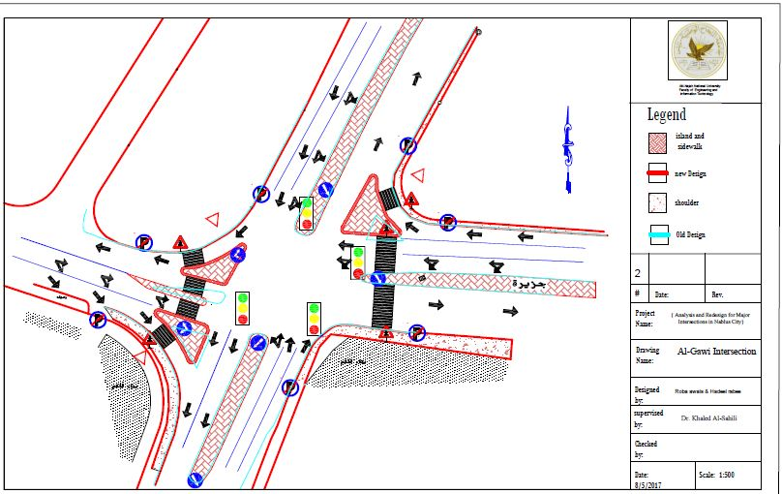
Al-Ghawi intersection

Slide 13
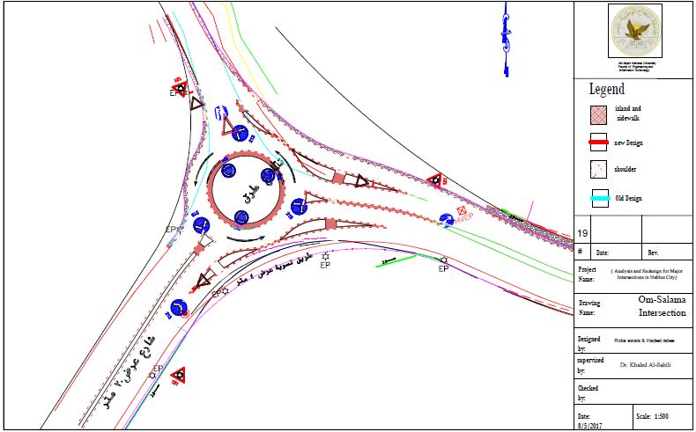
Om-Salama intersection

Slide 14
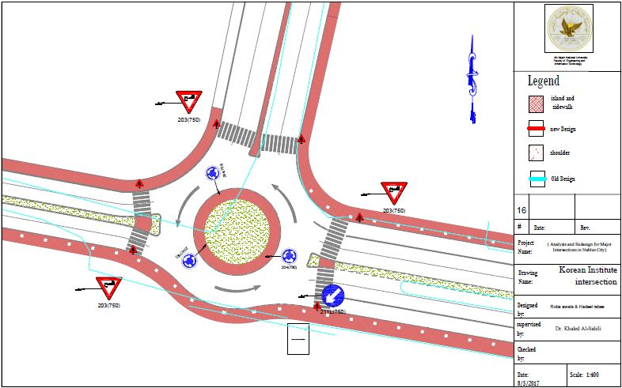
Korean Institute intersection

Slide 15
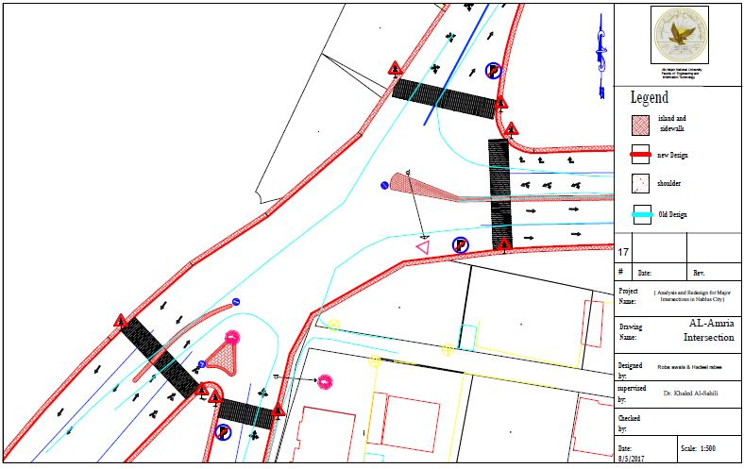
AL-Amria Intersection

Slide 16
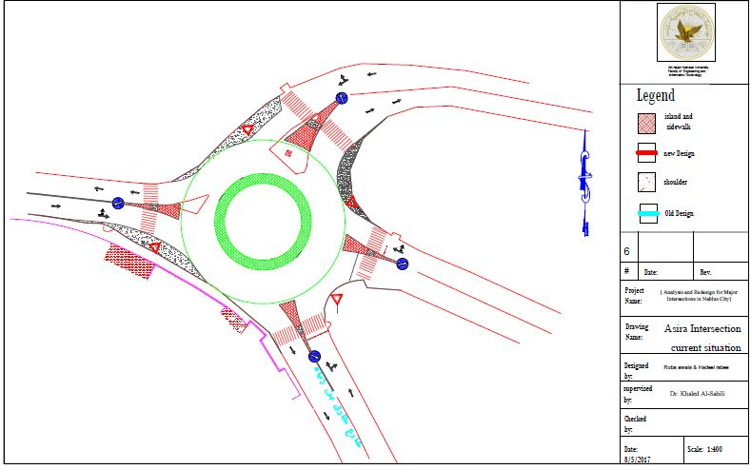
Asira interection (Alternative 1)

Slide 17
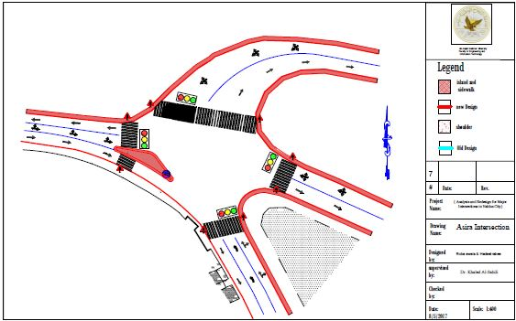
Asira interection (Alternative 2)

Slide 18
Conclusions
The study area was defined the major intersections distributed throughout Nablus City.
This was done through field survey and in coordination of Nablus Municipality.
Required data was collected .
These conditions were evaluated using SYNCHRO for traffic operating conditions at these intersections.
Geometric and pavement conditions were evaluated.
The required geometric, traffic, and pavement improvements were prepared in the form of traffic and design plans.
The expected outcomes to be suggested to Nablus Municipality and will taken into their consideration.

Slide 19
Recommendations
Adding lanes and islands were needed.
Preventing parking at some intersections.
Improving islands and right turn movement.
Changing the radius of curvature.
improving pavement marking.
Adding traffic control device, adjusting traffic signals.
Adding roundabouts.

Slide 20
Prepared by :
Roba Fawzy Awias
Hadeel Adnan Rabee
Supervised by :
Dr. Khaled Al-Sahili

Slide 21

Thanks for your attention
Any questions?

