Slide 1
Complaint management system
An-Najah National University
Faculty of Engineering & Information Technology
Computer Engineering Department

Slide 2
Outline
Introduction
Solution
Final Outcome
1
3
5
2
4
6
Problem system
Technologies
Future Planes

Slide 3
1.
Introduction
Let’s start with introduction

Slide 4
Introduction
To deal with customer-related difficulties, the Consumer Protection Association (CPA) has a number of measures in place. A complaint system is a set of procedures used by businesses to address complaints and resolve disputes. In addition, there is a considerable necessity to collect, investigate, and appreciate the nature of the CPA's conflict resolution and complaint systems. CMS (Complaint Management System) intends to provide an effective software gateway for handling customer needs and complaints

Slide 5
2.
Problem
Let’s start with problem

Slide 6



Problem
Not dealing with huge amount of complaints:
There is no system capable of categorizing these complaints, so that I would be able to work with it
Multiple ways to complain
Where complaints reach an association from a wide variety of social media
Neglect of the complaint
It is possible that the complaint may be lost or neglected due to a malfunction in the social media applications
CPA

Slide 7
3.
Solution
Let’s start with problem

Slide 8
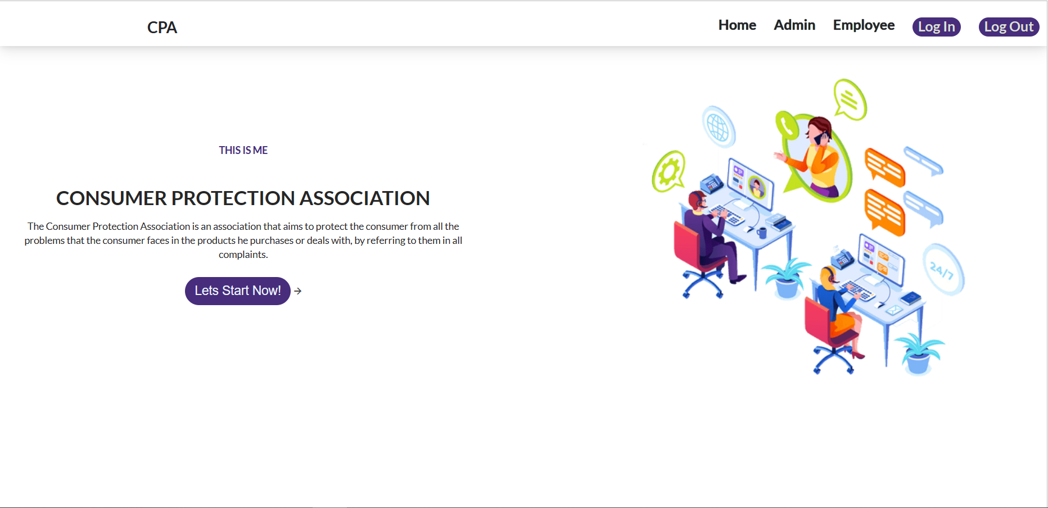
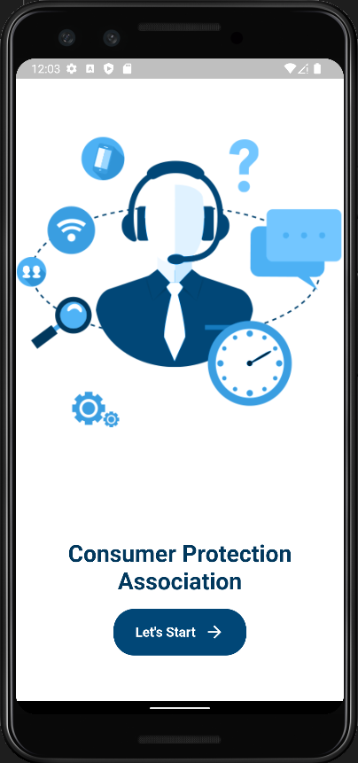
Building a cross platform mobile and website Complaint management system mobile for consumer to make any complaint and website for CPS to dealing with this complaints.

Slide 9
4.
Technologies
Let’s start with Technologies

Slide 10


Frontend Technologies website!
React js:
Bootstrap and Ant library and else .
One of the most recent libraries used .
Easy to learn and used .
Easy to understand and edit code .
Great documentation .

Slide 11

Frontend Technologies Mobile!
Flutter:
Same UI and Business Logic in All Platforms
Reduced Code Development Time
Custom, Animated UI of Any Complexity Available

Slide 12

Backend Technologies!
Spring boot:
The core of the system.
Responsible for communication between server and application
Responsible For The Business Logic

Slide 13
5.
Final Outcome
Let’s start with final outcome.

Slide 14
Outcome
A person is able to make any complaint against any company through a telephone completely freely.
The person is also able to view the companies added by the organization and view their rating.
The organization has become able to organize and review the complaints received.
The organization became able to organize the companies and their employees.

Slide 15
6.
Future Work
Let’s start with final future work.

Slide 16
Future work
Create a Notification system for any change in his complaint
Applying the system to all organizations in all cities as a comprehensive system
Create a map showing the percentage of complaints in each city

Slide 17
Thanks!
Any questions?

Slide 18


Team Presentation
Hosny ishtaya
Hamza khaleel

