Slide 1

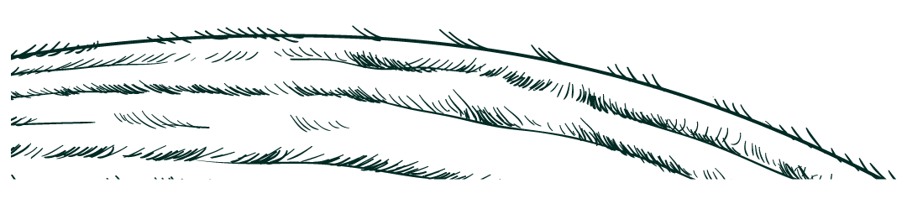
GrowBot Pro
Done By : Shahd Hamad & Raia Ishtaya
Supervised By : Haya Samaana

Slide 2
Table of contents:
01
Main Idea
06
Constraints
02
Features
07
Future Work
03
Control Mechanisms of a Robot
04
External Robot Structure
05
Hardware Modules

Slide 3

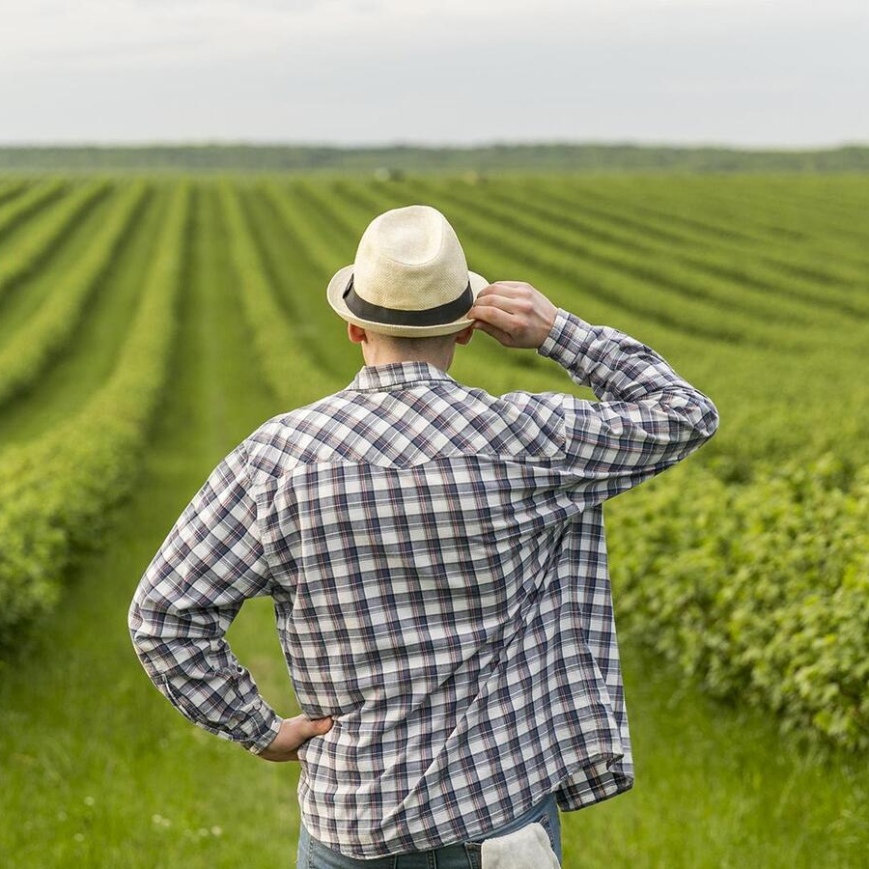
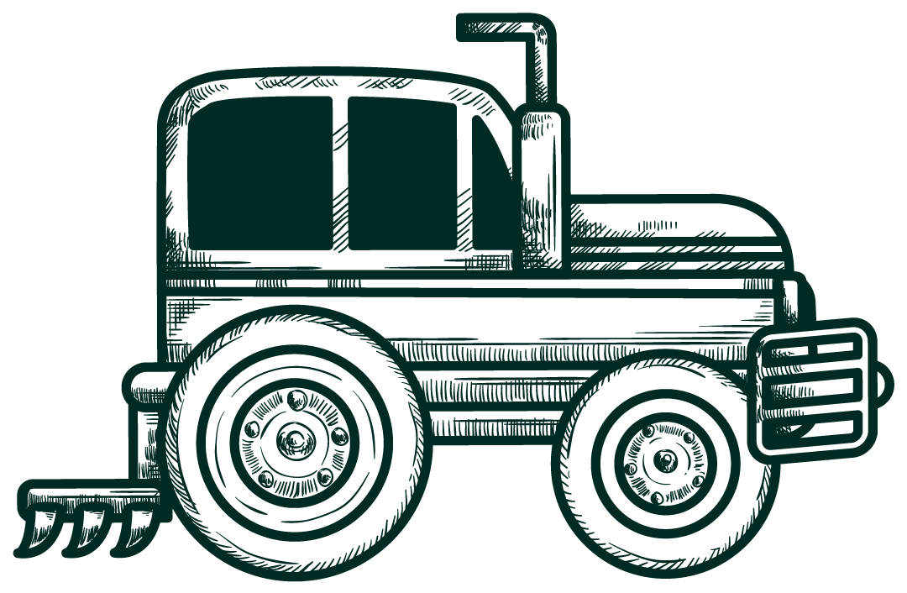
Main Idea
The core objective of this project is to develop an agricultural robot that can navigate and perform farming tasks .
The robot is designed with a robust structure to ensure it can operate effectively in real-world environments and handle a variety of tasks.

Slide 4
Features:
1) Robot movement in all directions.
2) Ability to clear and clean the ground before starting the planting process.
3) Detection of any obstacles.
4) Digging holes for planting seeds and watering them.

Slide 5
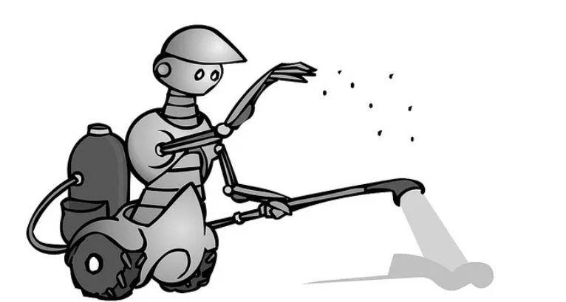
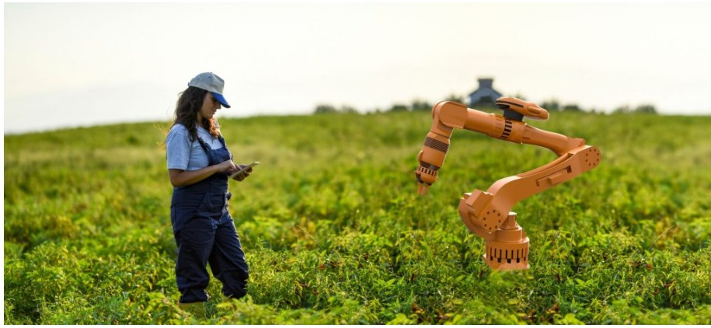
Control Mechanisms of a Robot:
Auto Mode
Static Mode

Slide 6
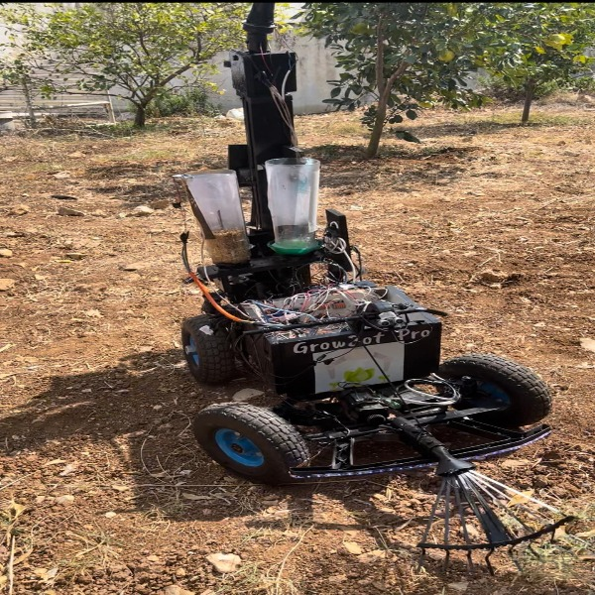
External Robot Structure :

Slide 7
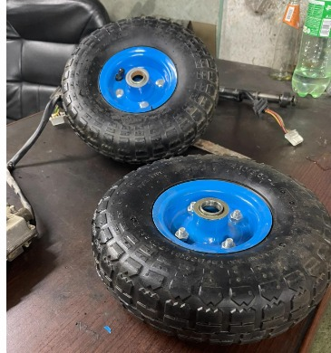
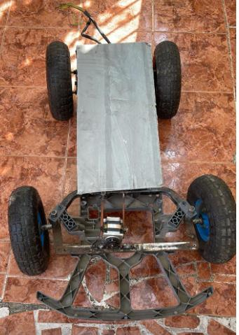
Hardware Modules :

Slide 8
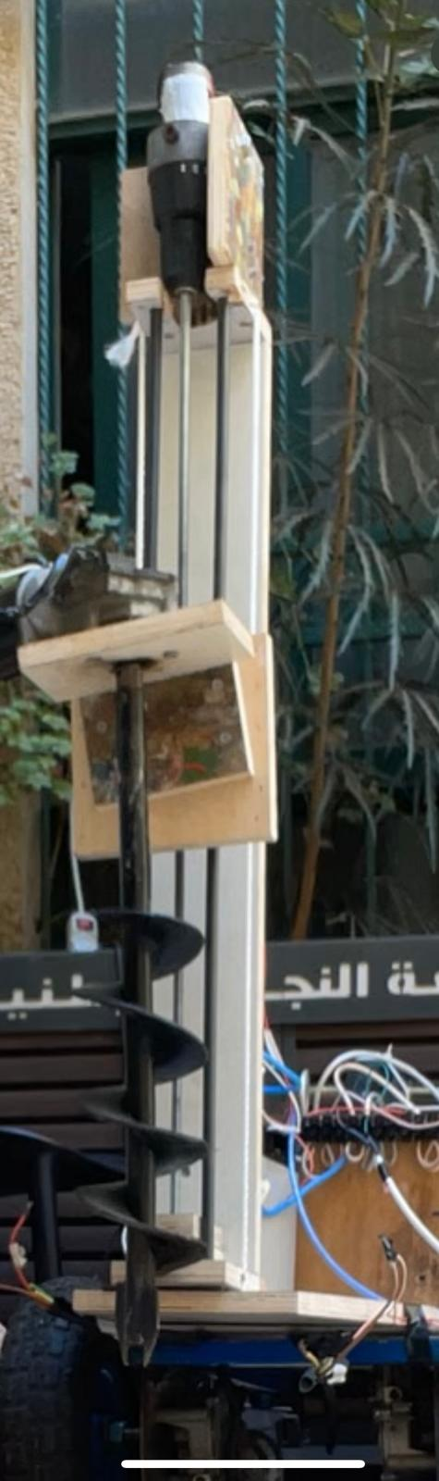
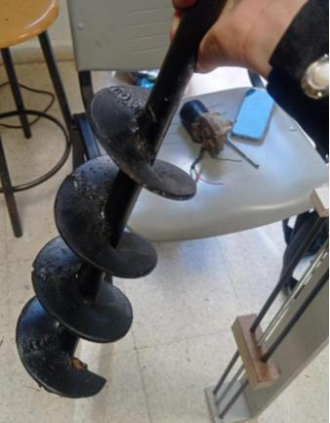
Hardware Modules :

Slide 9
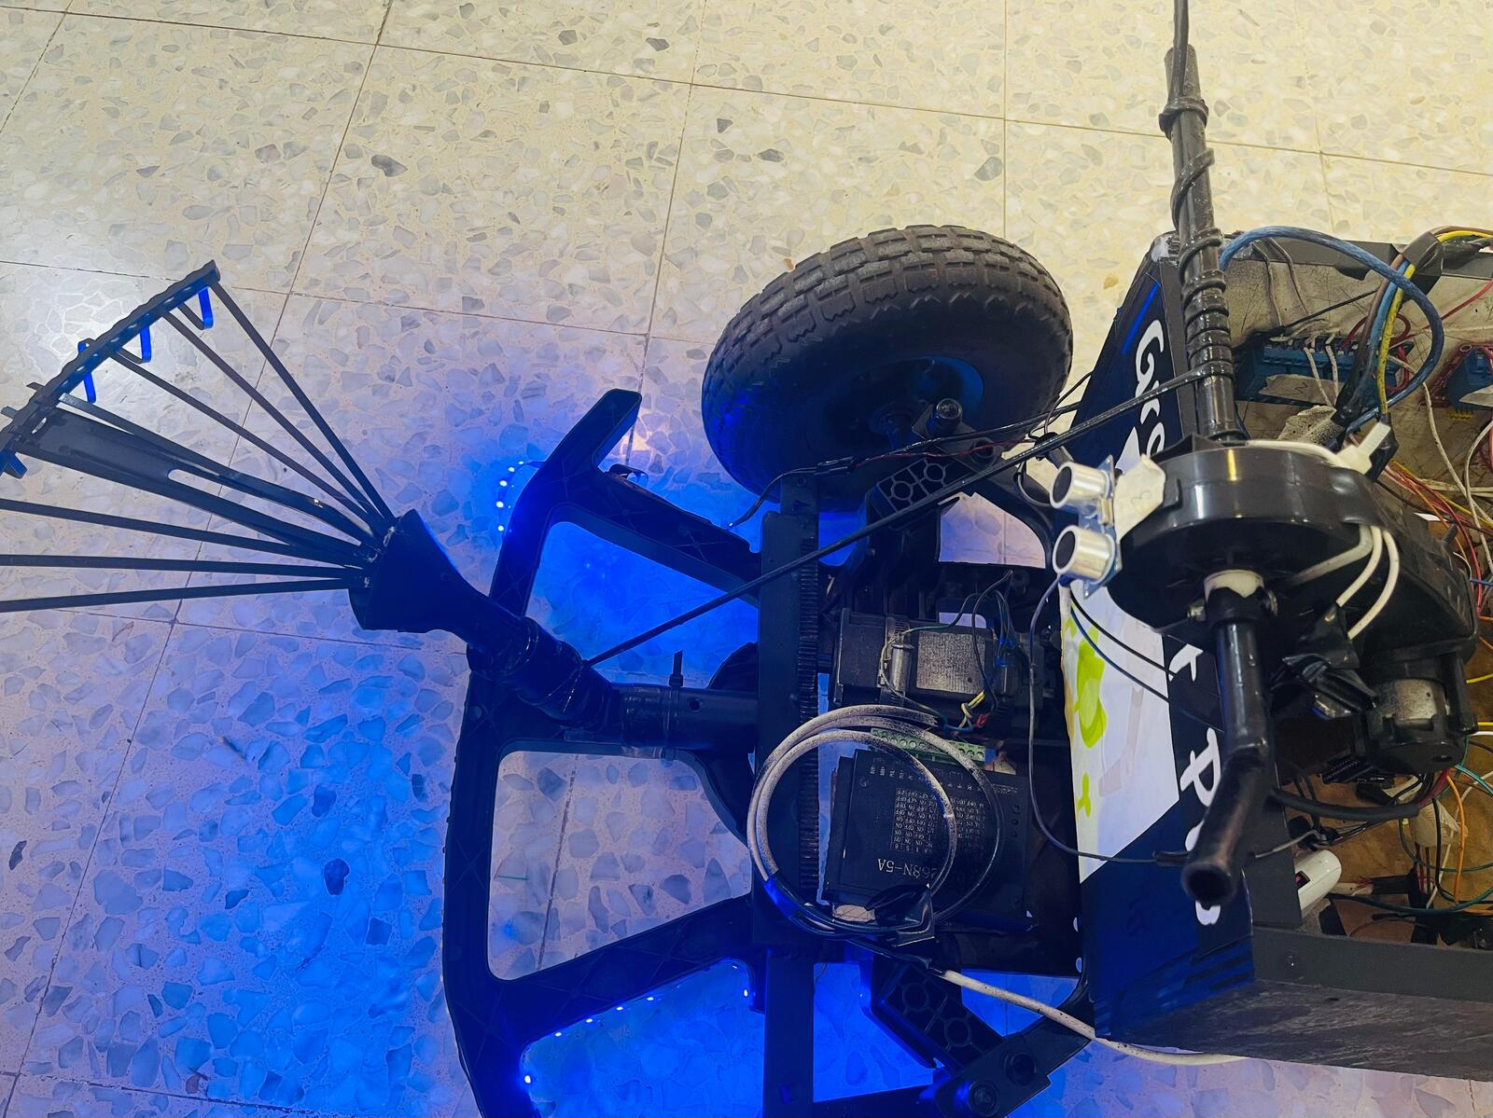
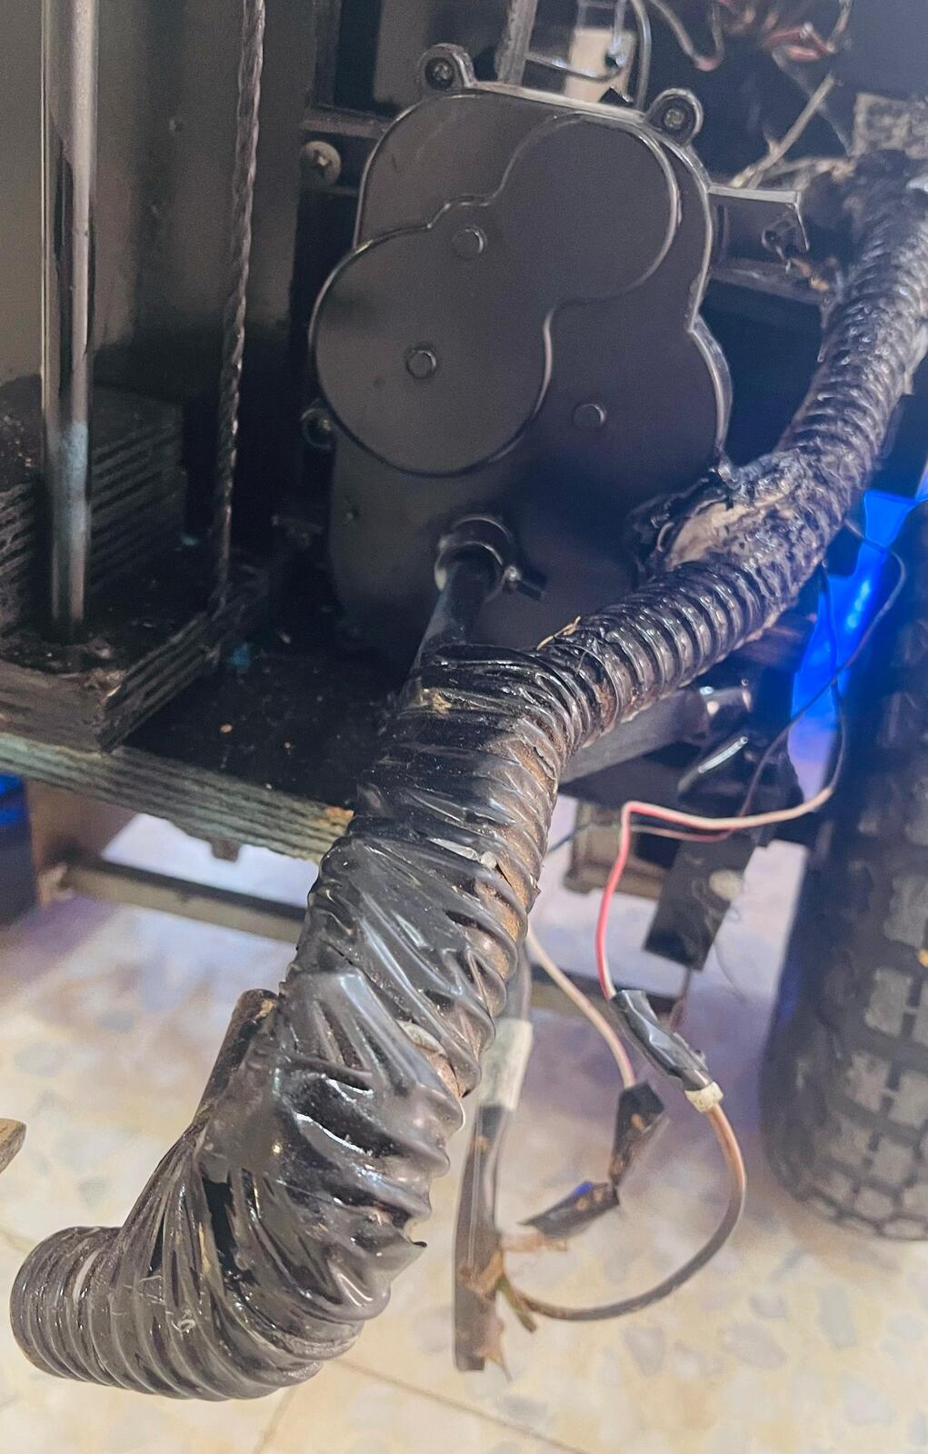
Hardware Modules :

Slide 10
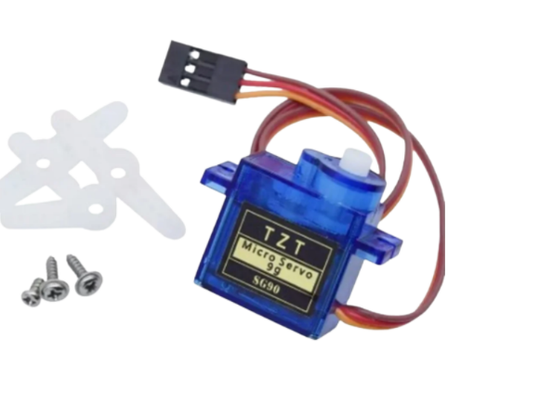
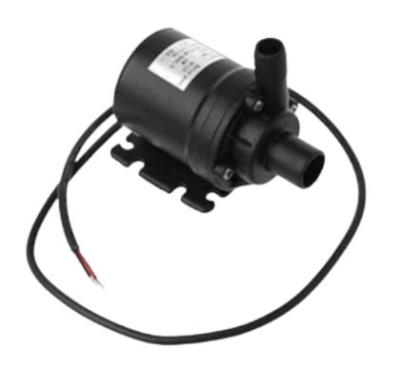
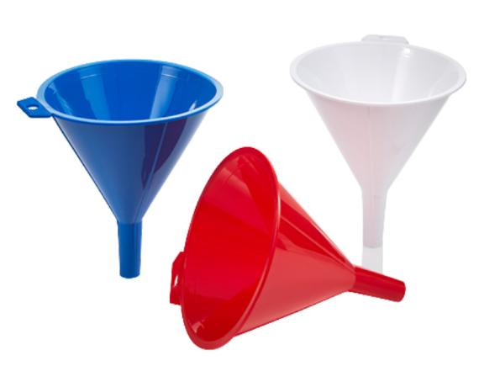
Hardware Modules :

Slide 11
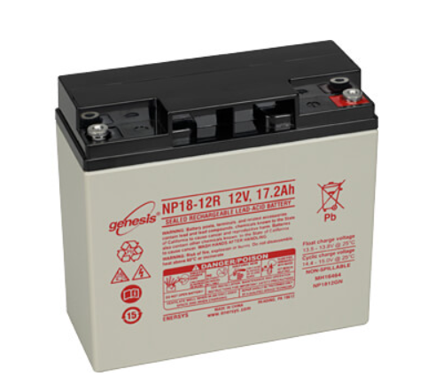
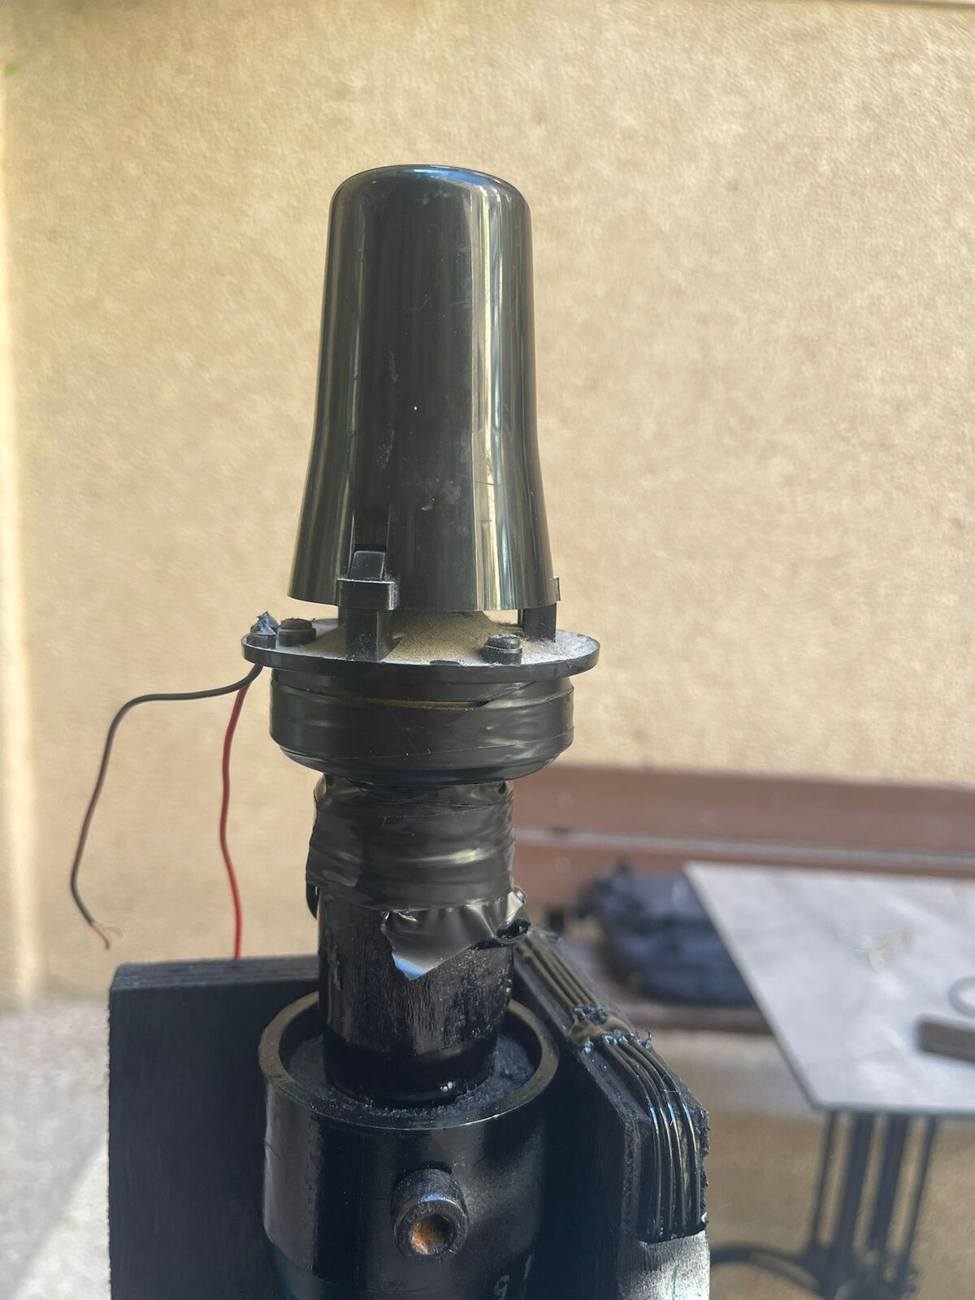

Hardware Modules :

Slide 12
Constraints :
Time
Large Size and Weight of the Robot
Vehicle Stability
Structural Load Capacity
Lack of Experience in Mechanics
Electrical Issues
Budgetary Limitations
Hardware Available

Slide 13
Future Work
GPS
Increased Autonomy
Advanced Sensor Integration
Improved Load Capacity and Durability
Efficient Energy Management
User-Friendly Interface

Slide 14



Thanks
Any Question ??

