Slide 1
HVAC SYSTEM DESIGN ALMAQASED HOSPITAL
The students:
Mohammad Shabaro (10611393)
Mahmoud Mousa (10612458)
Yosri Asfour (10508901)
Supervisor:
Dr. Iyad Assaf

Slide 2
Presentation out line
- Hospital Description.
- Heating load calculation.
- Cooling load calculation.
- Duct Design.
- Pipe Design.
- Riser and Boiler Room.
- Plumping system.
- Equipment Selection.
- Summary

Slide 3
HOSPITAL DESCRIPTION
Hospital location
Country: Palestine
City :Jerusalem
Basement floor | Emergency room & X-ray & labs & Nursery Unit& restaurant & kitchen & laundry & Blood Bank &Mortuary
Ground floor | Patient Room & Library & mosque & offices & Equipment Storage
First floor | Theater & ICU & Patient Room & pharmacy
Second floor | Histology & Microbiology & Patient Room & Endoscopy

Slide 4
HEATING LOAD
-Inside and out side design condition:
Outside design condition | Inside design condition | Parameters
4.7 °C | 23 °C | T: temperature
71.7 % | 50 % | Φ : relative humidity
3.7 g of water/kg of dry air | 8.8 g of water/kg of dry air | W : moisture content
9.15 °C |  | Tun: unconditioned temperature
12 °C |  | Tg : ground temperature

Slide 5
HEATING LOAD SUMMARY
 | Q sensible (KW) | Qlatent (KW) | Q total (KW)
Basement floor | 185 | 43 | 228
Ground floor | 204 | 52 | 256
First floor | 206 | 80 | 286
Second floor | 220 | 27 | 247
Total | 815 | 202 | 1017

Slide 6
COOLING LOAD
-Inside and out side design condition:
Outside design condition | Inside design condition | Parameters
30°C | 23 °C | T: temperature
50 % | 50 % | Φ : relative humidity
13.2 g of water/kg of dry air | 8.8 g of water/kg of dry air | W : moisture content
4.7 °C |  | Tun: unconditioned temperature
12 °C |  | Tg : ground temperature

Slide 7
COOLING LOAD SUMMARY
 | Q sensible (KW) | Qlatent (KW) | Q total (KW) | Qtotal (ton)
Basement floor | 220 | 54 | 274 | 78
Ground floor | 267 | 64 | 331 | 95
First floor | 271 | 87 | 358 | 102
Second floor | 292 | 67 | 359 | 102
Total | 1050 | 272 | 1322 | 377

Slide 8
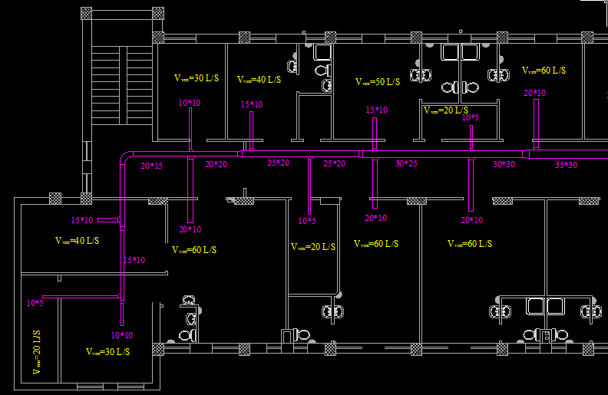
FRESH AIR DUCT
Section from second floor

Slide 9
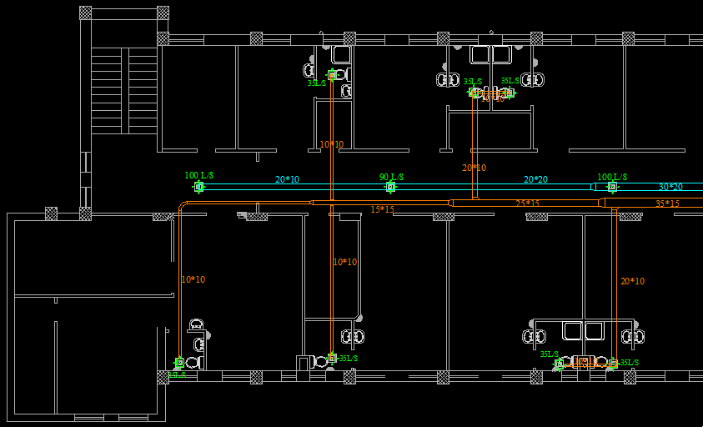
EXHAUST DUCT
Section from second floor

Slide 10
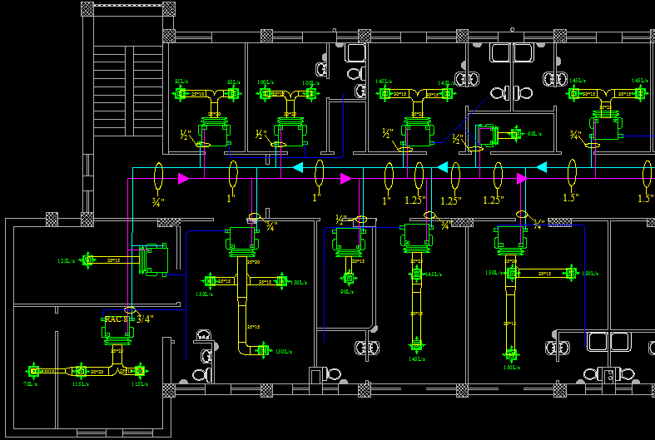
Fancoil , pipe and diffuser
Section from second floor
Section from second floor

Slide 11
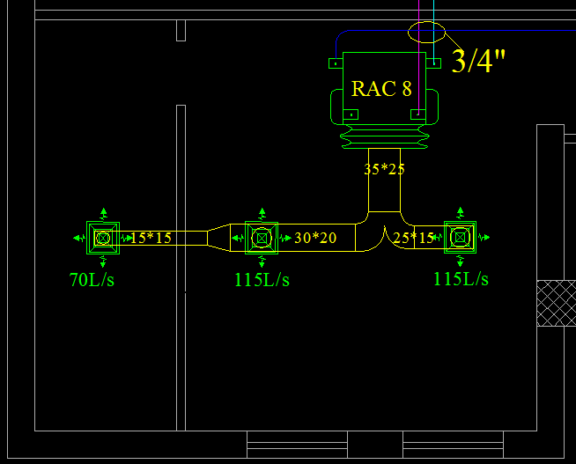
This plan illustrate how the FCU, Diffuser and Ducts are distributed in the room
Room area=25m²
Qsinsible = 4.5 KW
Qlatent=0.5 KW
Vven = 50(L/S)
Vcir = 335(L/s)
Vcir = 704(cfm)
FCU model:
RAC 8 CB H/C 4

Slide 12
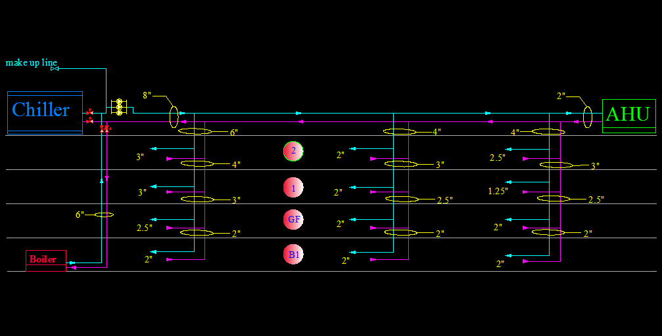
RISER

Slide 13
Plumping system
Potable Water:
Collector system is used to regulate the distribution of the water, this collector are Distributed near the bathrooms and all Pipes are sized depend on fixture unit.
Fixture | Number of Fixture unit
lavatory | 0.5
shower | 1
Water closet | 2
Total Cold Water Fixture Unit is 380 F.U & Total Hot Water Fixture Unit is 140 F.U
Domestic hot water boiler is 293 KW
Domestic water storage tank is 150 m³

Slide 14
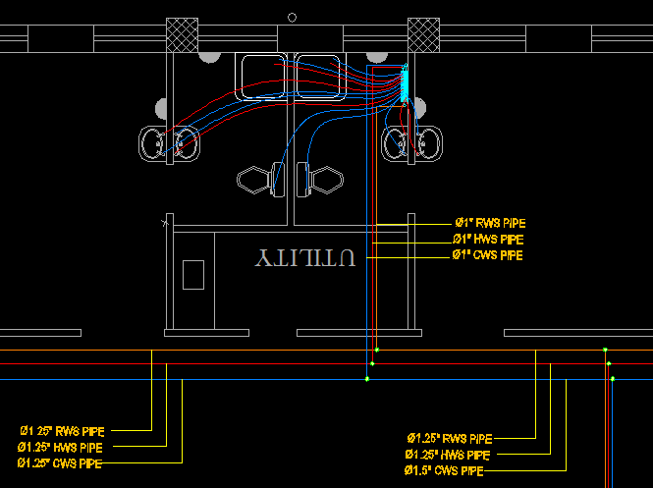
Water distribution

Slide 15
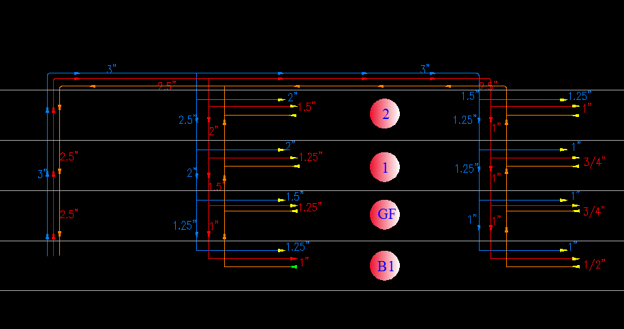
Potable water RISER

Slide 16
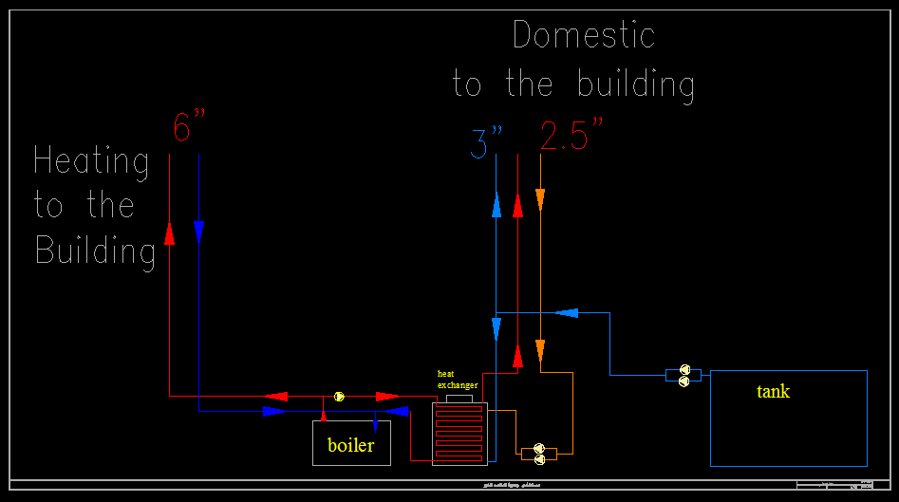
BOILER ROOM

Slide 17
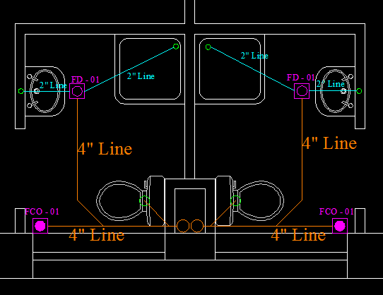
Drainage system:
Any horizontal branch must be sloped in range (1-1.5)cm for every 100 cm.
Every stack size is 4”
Every stack contain vent that’s size is 4”
Building drains are connected by horizontal branches in size 8 inch

Slide 18
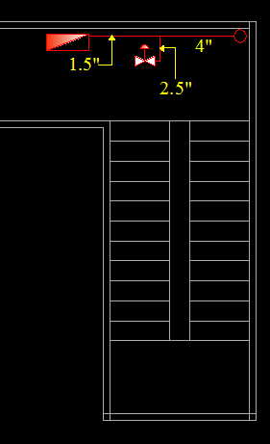
Fire fighting system:
In Almaqased Hospital there is 20 landing valve and 20 fire cabinet Distributors in the building , in each floor there is five landing and five fire cabinet
Pump is selected to provide 1000 gpm and 130 psi, the water must be provide the further landing valve by 250 gpm and 100 psi
Storage tank capacity is 450 m³

Slide 19
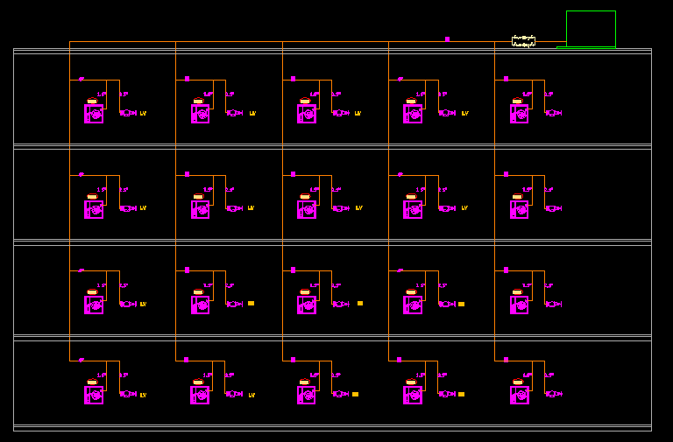
Fire fighting RISER

Slide 20
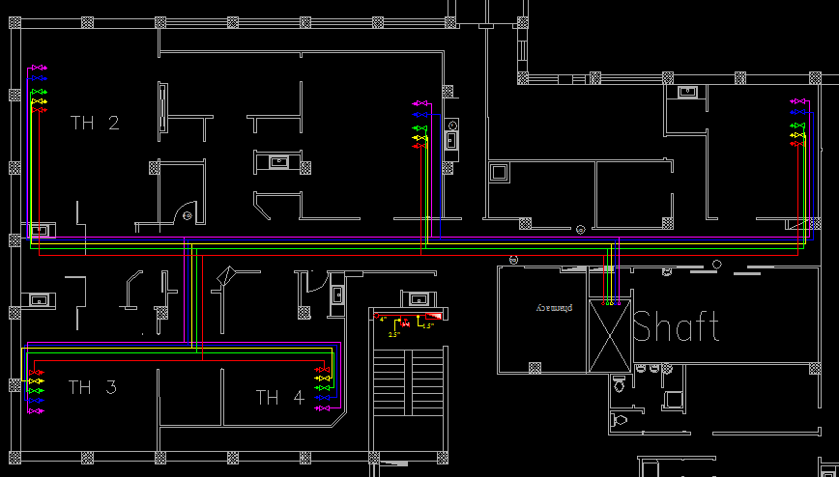
Medical gases system:

Slide 21
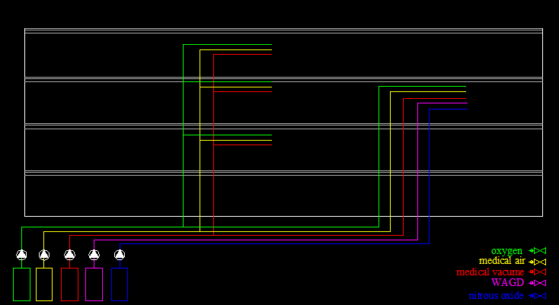
Medical gases RISER

Slide 22
equipments selection
Boiler: It is selected from De Dietrich Company
Boiler load = 1220 KW
Boiler Model No. :GT530 DIEMATIC-m3
Chiller: It is selected from Petra Company
Chiller load = 413.5 Ton
Chiller Model No. :W P S a 435 2S

Slide 23
Supply fan : It is selected from Greenheck Company
There is three supply fan are selected depend on flow rate and static pressure
And this supply fan no.1
Supply Fan Model No. : RSF-200
Exhaust fan : It is selected from Petra Company
There is nine exhaust fan are selected depend on flow rate and static pressure
And this exhaust fan no.1
Exhaust Fan Model No. : P-EX-T-640

Slide 24
Air Hander Unit(AHU): It is selected from Petra Company
In this project there is three (AHU) are selected for theaters.
This (AHU) model no. that supply theater 1 & 2
(AHU) Model No. : PAH H C 40 C 5 H 4 X 5
Fan Coil Unit(FCU): It Is Selected From Petra Company
In each room there is Fancoil that’s Compatible with its needs
Chimney:
Chimney is designed to exhaust gases from boiler and its
diameter is 50 cm

Slide 25
Pumps:
Chilled pump: The pump is selected from Sealed Motor Construction (SMC) depending on the total flow rate
Pump Model No. : SMC680-15
Hot water pump:
Flow rate = 1.35 L/S
Pump model: SMC270-5.5
Cold water pump:
Flow rate = 2.31 L/S
Pump model: SMC270-5.5

Slide 26
summary
*All steps of design and plans of HVAC system are done.
*All steps of design and plans of plumping system are done.
*we select a suitable equipment for the system which satisfied the required conditions.

Slide 27
Thank you for your
attention
Any question??

