Slide 1

04
Structural Aspect
Assumptions
Design
Structure Model
Seismic Checks
Structural Details

Slide 2
Structural Aspect
Assumptions
Codes Used
American Concrete Institute ACI 318- 2014.
Uniform Building Code (UBC 97).
Minimum Design Loads for Buildings and Other Structures (ASCE 7-16).
Soil used for filling | γ_{soil} = 20KN/m³
 | Փ = 30º
N. of floors | 5
Floor Height | H = 3.5m
Concrete b400 | F’c = 32 MPa
Steel bars | Fy = 420MPa
General Notes

Slide 3
Structural Aspect
Assumptions
Load Type | KN/m²
Dead Load | As Calculated in ETAB
Super Dead Load | 5.1
Live Load | 5
Loads
Factor | Value
Seismic Zone Factor “Z” | 0.2
Importance Factor | 1
Numerical Coefficient “R” | 5.5
Soil Profile | S_{B}
Acceleration Seismic Coefficient “Ca” | 0.2
Velocity Seismic coefficient “Cv” | 0.2
Structure Period “t” | 0.417 second
Seismic Factors

Slide 4
Structural Aspect
Design
Columns Grid :

Slide 5
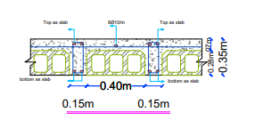
Structural Aspect
Design
Slab System
Longest span length equal about 6.2 m.
The used structural system is one way rib slab
With 35cm thickness

Slide 6
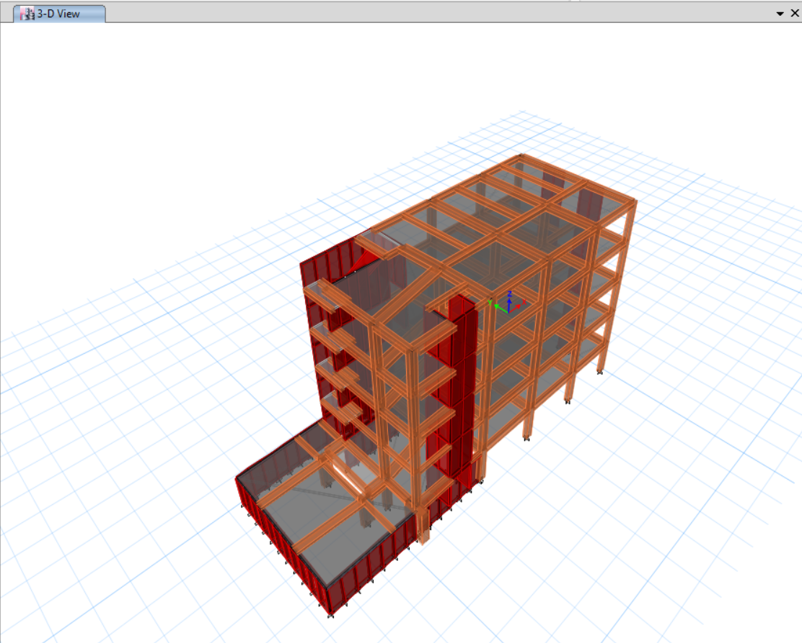
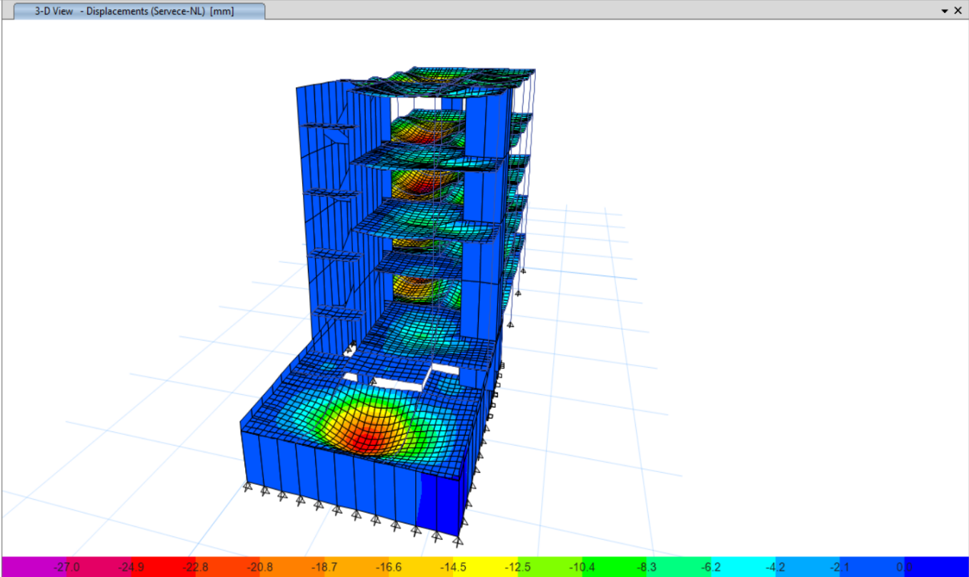
Structural Aspect
Design
Structural Model
Model Check
    Compatibility check

Slide 7
Structural Aspect
Design
Model Check
    2. Deflection check
    a. Live Term Deflection Check
    The Service combination deflection. ➔∆ = 24.07mm
Longest slab length = 5.8m
Therefore the maximum allowed deflection = 5.8/360 = 16.1mm
Δlive = ΔD+L - ΔD
= 24.07 – 16.32
➔ 7.75 mm < 16.1 mm Thus, live load deflection is acceptable.
    While the Dead combination deflection.
    ➔ ∆ = 16.32mm

Slide 8
Structural Aspect
Design
Model Check
    2. Deflection check
    b. long term deflection Check
    Is the deflection came from the service load:
Longest slab length = 5.8m
Therefore the maximum allowed deflection = 5.8/240 = 24.16 mm
➔ 24.07< Maximum allowable

Slide 9


Structural Aspect
Design
Model Check
    3. Equilibrium check
    4. Stress strain check
    Columns
    Beams

Slide 10
Structural Aspect
Design
Case | Mode | Period sec | Sum UX | Sum UY
Modal | 1 | 0.574 | 0.0662 | 0.4809
Modal | 2 | 0.48 | 0.1451 | 0.6683
Modal | 3 | 0.302 | 0.6251 | 0.677
Modal | 4 | 0.157 | 0.6485 | 0.779
Modal | 5 | 0.118 | 0.6573 | 0.8413
Modal | 6 | 0.098 | 0.6635 | 0.8413
Modal | 7 | 0.093 | 0.672 | 0.854
Modal | 8 | 0.089 | 0.672 | 0.8543
Modal | 9 | 0.089 | 0.672 | 0.8548
Modal | 10 | 0.082 | 0.6808 | 0.883
Modal | 11 | 0.082 | 0.8447 | 0.8841
Modal | 12 | 0.082 | 0.8453 | 0.9103
Modal | 13 | 0.082 | 0.8453 | 0.9156
Modal | 14 | 0.071 | 0.8472 | 0.9279
Modal | 15 | 0.068 | 0.8473 | 0.928
Modal | 16 | 0.066 | 0.8571 | 0.9324
Modal | 17 | 0.05 | 0.8578 | 0.9324
Modal | 18 | 0.048 | 0.8895 | 0.9388
Modal | 19 | 0.045 | 0.9066 | 0.9483
Seismic Check
1. Model participant mass ratio check

Slide 11
Structural Aspect
Design
Seismic Check
2. Period Time check
Load Case/Combo | FX kN | FY kN | FZ kN
Dead | -2.57E-06 | 0 | 12925.83
Live | -1349.02 | -2211.94 | 6586.12
sid | -1.98E-06 | 0 | 12821.03
EQx Max | 2487.43 | 1304.62 | 1.02E-06
EQy Max | 1181.76 | 3096.66 | 1.99E-06
Hand Calculated period time t = 0.417s,
while in Etab as shown in the figure t = 0.574
As method A in ubc97 code Etab should be less than 1.4 T_{Method A} (hand calculated period time)
T Etab < (1.4Tmethod A = 0.583s)
3. Base shear force check
Building weight | 2.5Cv | Cv/t | Manual V
27417.66 | 0.5 | 0.416 | 2077

Slide 12
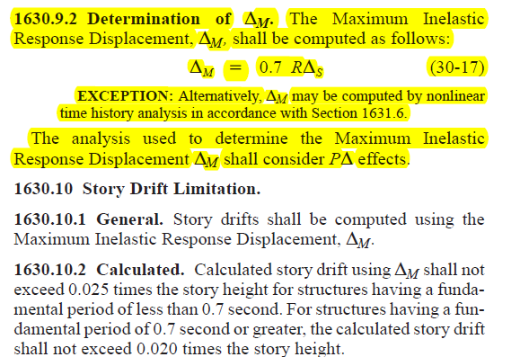
Structural Aspect
Design
Seismic Check
4. Drift Check
Story | height | Dis X | Dis Y | Drift X | Drift Y | Delta X | Delta Y | Delta limit
Base |  | 0.00 | 0.00
1.00 | 3.00 | 0.10 | 0.15 | 0.10 | 0.15 | 0.40 | 0.59 | 75.00
11.00 | 3.50 | 0.32 | 1.28 | 0.22 | 1.12 | 0.83 | 4.33 | 87.50
2.00 | 3.50 | 5.05 | 17.55 | 4.73 | 16.27 | 18.22 | 62.65 | 87.50
3.00 | 3.50 | 2.99 | 8.63 | 2.06 | 8.92 | 7.93 | 34.34 | 87.50
4.00 | 3.50 | 5.61 | 12.84 | 2.62 | 4.21 | 10.08 | 16.20 | 87.50
5.00 | 3.50 | 7.42 | 16.95 | 1.81 | 4.11 | 6.96 | 15.84 | 87.50

Slide 13
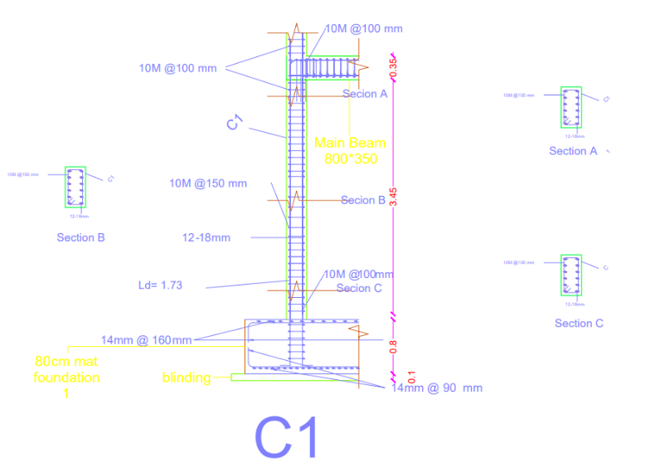
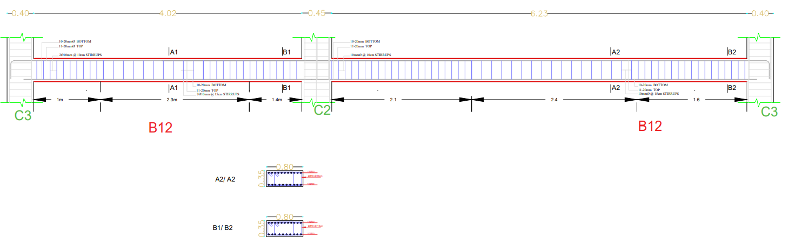
Structural Aspect
Design
Structural details
Column
Beam

Slide 14
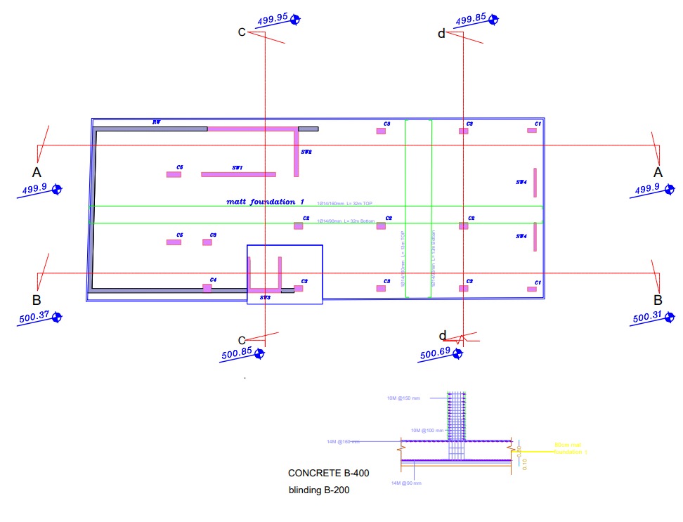
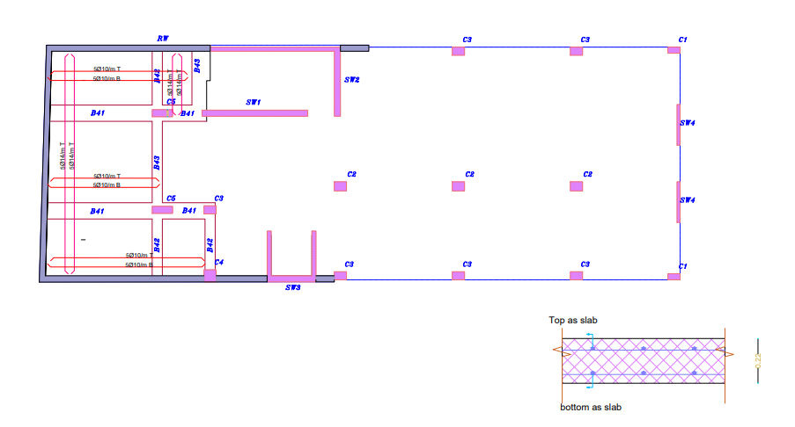
Structural Aspect
Design
Structural details
Slab
Ground Floor P1
Mat Footing

Slide 15
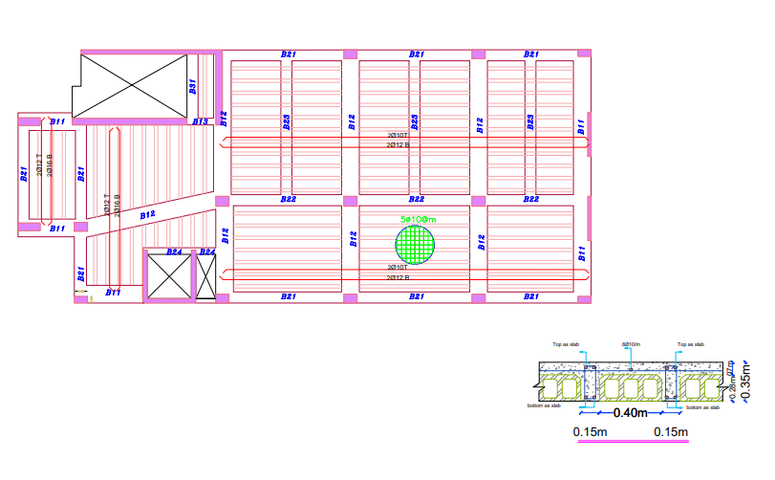
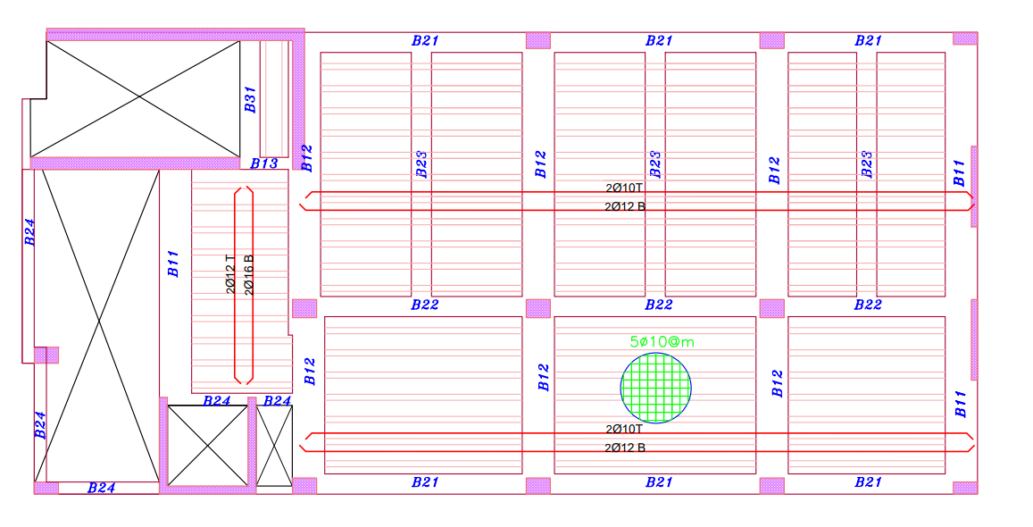
Structural Aspect
Design
Structural details
Slab
Ground Floor P2
First Floor

Slide 16
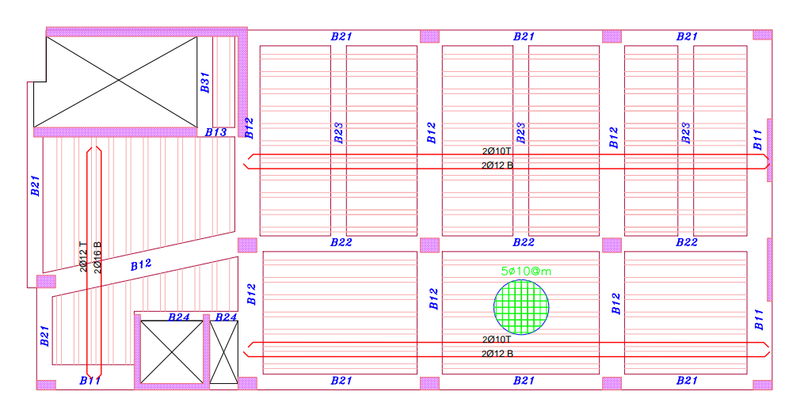
Structural Aspect
Design
Structural details
Slab
Second Floor
Third Floor
Fourth Floor

Slide 17
04
Accoustical Aspect

Slide 18
Acoustical Aspect
Room Acoustics Design
Rooms materials as show in table
Surface | Class Room | Prayer Hall
Floor | Tiles | Moquette
Ceiling | gypsum | gypsum
Walls | plaster | plaster
Windows | glass | glass
Doors | Wood | Wood
Emergency exit Door | ---- | Steel

Slide 19
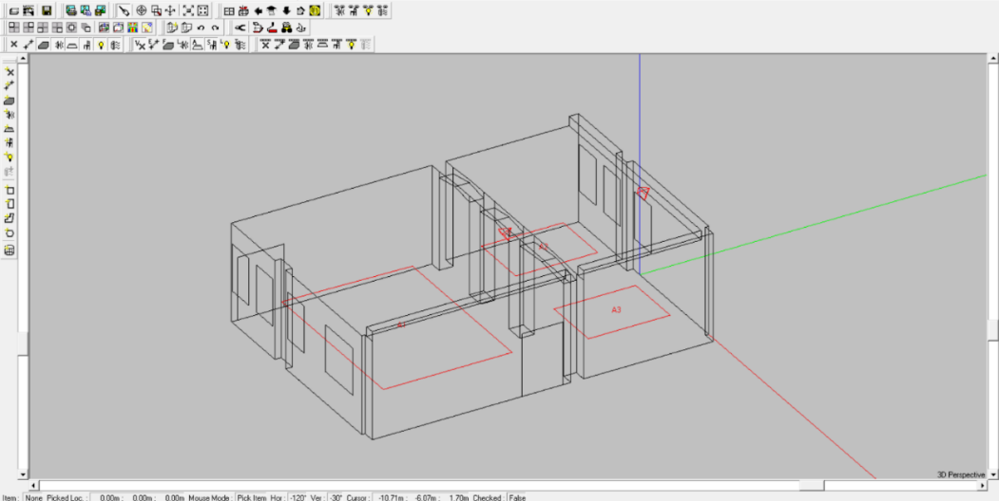
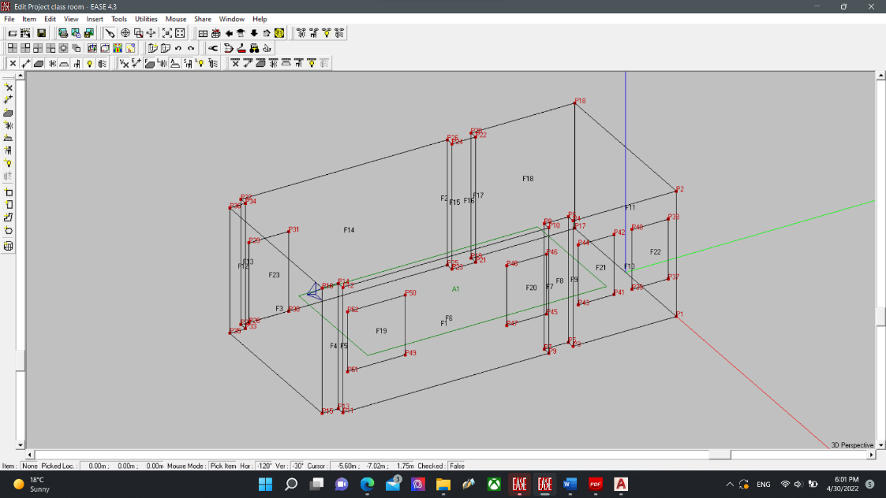
Acoustical Aspect
Room Acoustics Design
Rooms Ease Model
Prayer Hall
Class Room

Slide 20
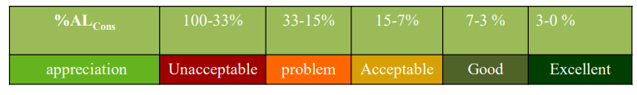
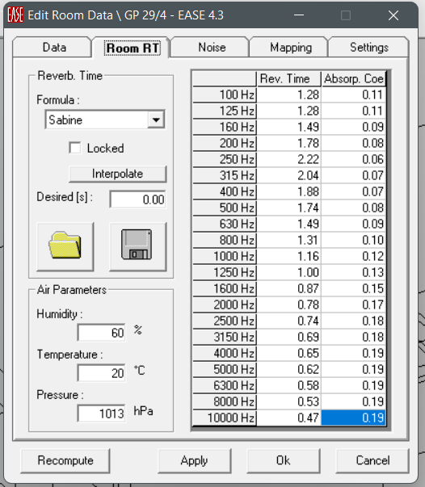
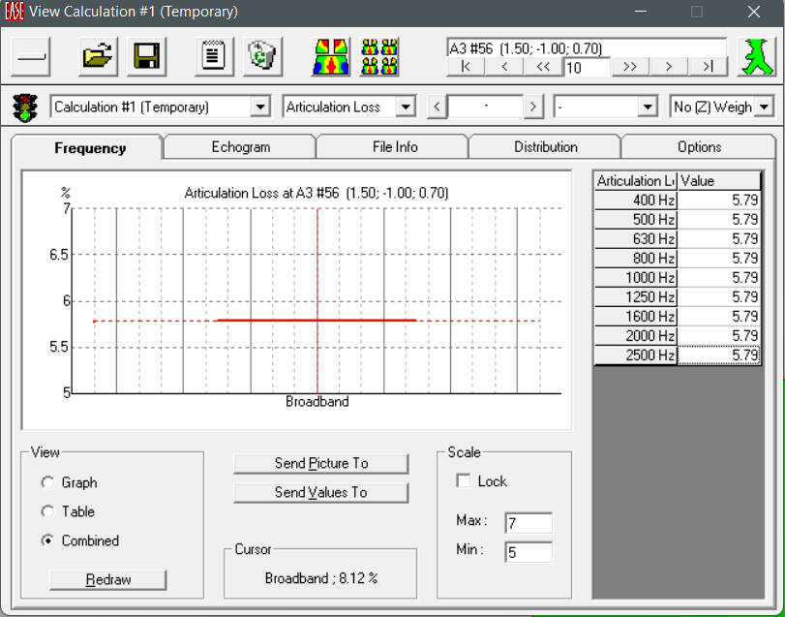
Acoustical Aspect
Room Acoustics Design
Reverberation Time & Articulation Loss
Prayer Hall
The recommended RT from 1.4 to 2.6 second
With acceptable minimum value reach to 0.8 second on the required frequency.
Also The articulation loss values is less than 7% which is within the recommendation for prayer hall that shown in the sections above.

Slide 21
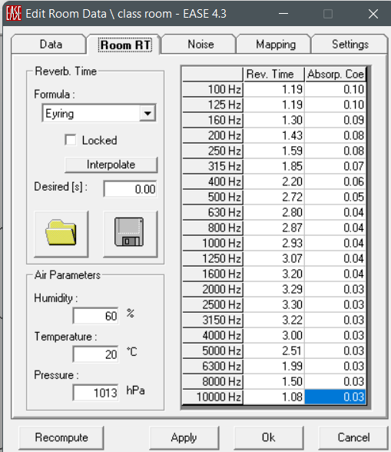
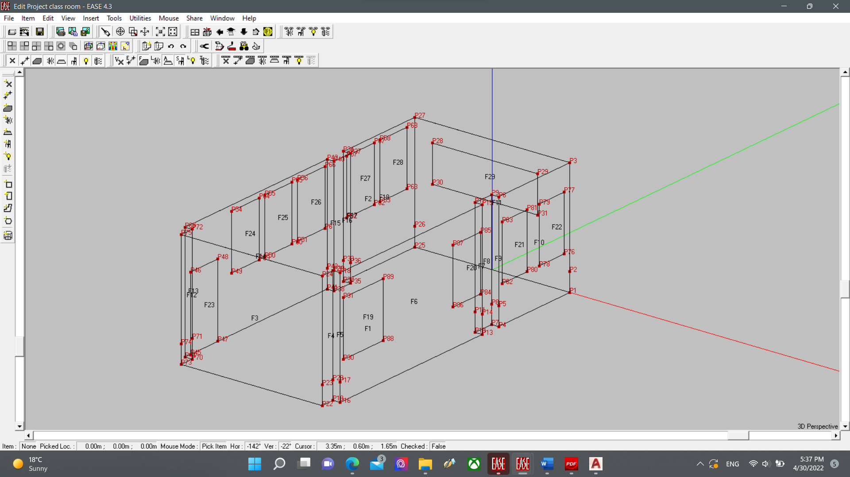
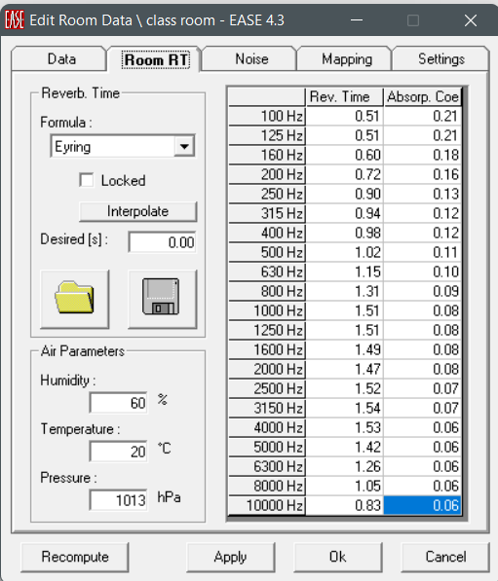
Acoustical Aspect
Room Acoustics Design
Reverberation Time
RT Before Modification
Class Room
In order to reach the standard range from 0.5 to 0.9 second at 85Hz to 255Hz, panels F24 – F29 had been added.
RT After Modification

Slide 22
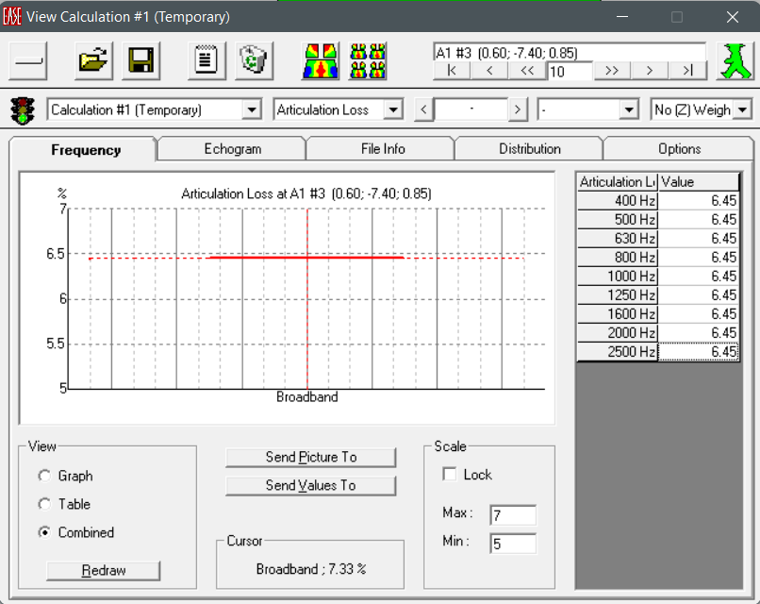
Acoustical Aspect
Room Acoustics Design
Articulation Loss
Class Room
The articulation loss is less than 7% , which give
A good appreciation, as tables show.

Slide 23
04
Electrical

Slide 24
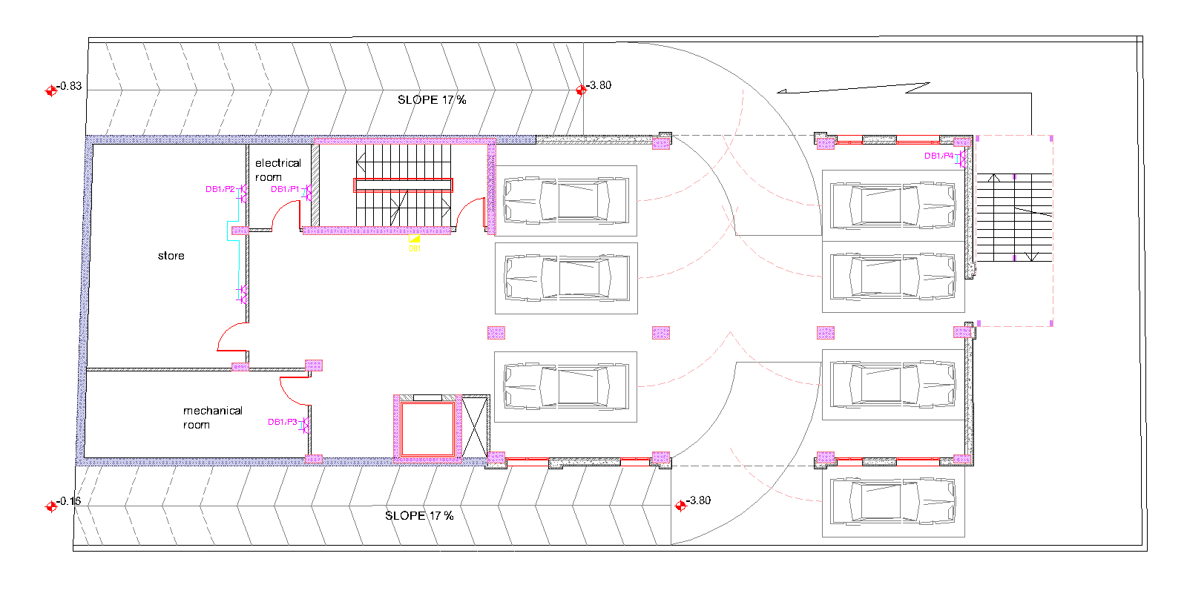
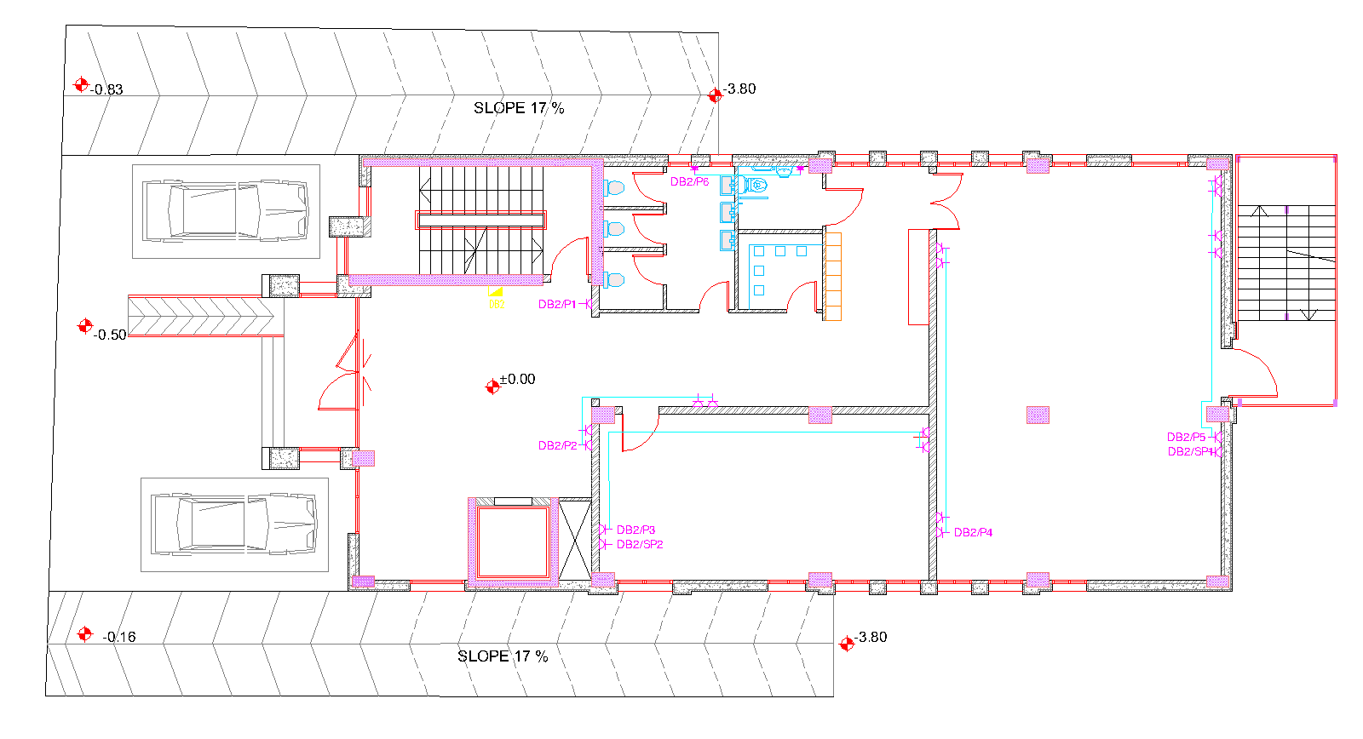
The suggested electrical plans.
Basement Floor
Ground Floor

Slide 25
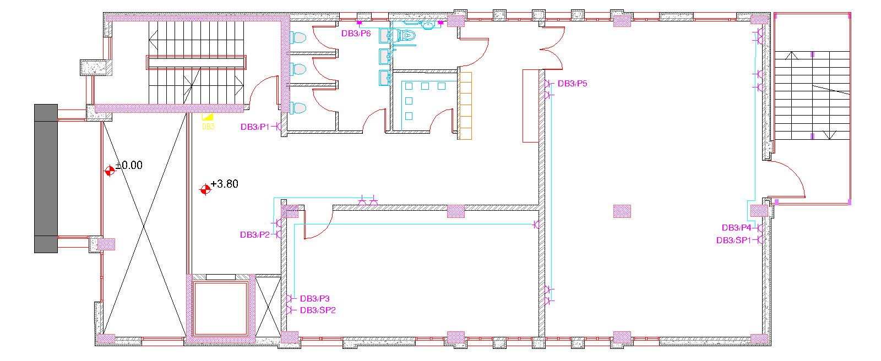
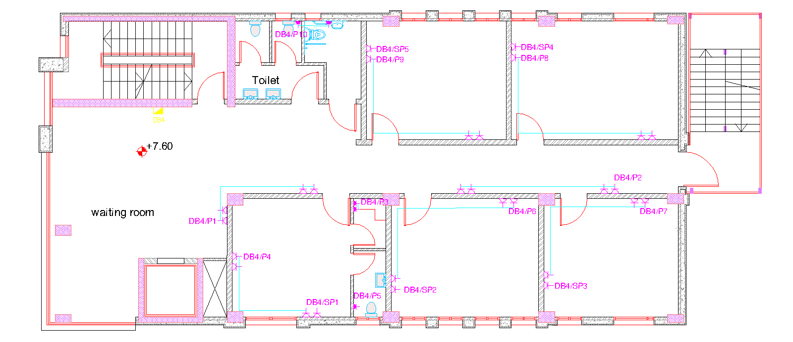
First Floor
Second and Third Floor

Slide 26
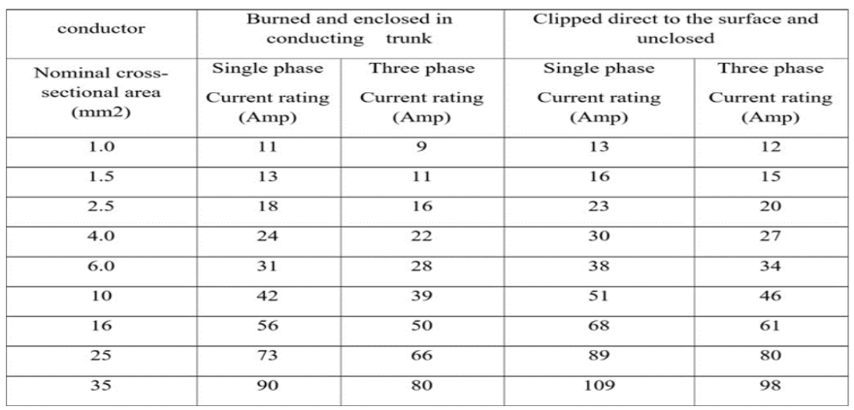

the electrical current for branches will be calculated as the following equation:
$$Load Current = \frac{power\left(watt\right)}{voltage∗power factor}$$
The power factor equal 0.85
Then a suitable circuit beaker will be chosen
I_{c.b} > 1.15 load current

Slide 27
The following table show the calculation summary for Basement floor sockets
brunch No. | No of Sockets | Power per socket | Brunch total Power | Voltage | L wire | I load (Amp) | R wire | V drop | V drop % | I C.B | I cable | Cable Area | C.B
P1 | 1 | 250 | 250 | 220 | 4.50 | 0.40 | 0.03 | 219.9 | 0.01 | 0.46 | 0.53 | 2.5 | 16
P2 | 4 | 250 | 1000 | 220 | 13.30 | 1.60 | 0.09 | 219.8 | 0.07 | 1.84 | 2.12 | 2.5 | 16
P3 | 2 | 250 | 500 | 220 | 10.30 | 0.80 | 0.07 | 219.9 | 0.03 | 0.92 | 1.06 | 2.5 | 16
P4 | 2 | 250 | 500 | 220 | 23.80 | 0.80 | 0.16 | 219.8 | 0.06 | 0.92 | 1.06 | 2.5 | 16

Slide 28
The following table show the calculation summary for Basement floor lighting
brunch No. | total Light Power for brunch | Voltage | L wire | I load (Amp) | R wire | V drop | V drop % | I C.B | I cable | Cable Area | C.B
L1 | 117.6 | 220 | 27.80 | 0.57 | 0.32 | 219.82 | 0.08 | 0.65 | 0.75 | 1.5 | 13
L2 | 80 | 220 | 7.30 | 0.39 | 0.08 | 219.97 | 0.01 | 0.44 | 0.51 | 1.5 | 13
L3 | 108 | 220 | 15.50 | 0.52 | 0.18 | 219.91 | 0.04 | 0.6 | 0.69 | 1.5 | 13
L4 | 108 | 220 | 21.40 | 0.52 | 0.25 | 219.87 | 0.06 | 0.6 | 0.69 | 1.5 | 13
L5 | 108 | 220 | 19.10 | 0.52 | 0.22 | 219.89 | 0.05 | 0.6 | 0.69 | 1.5 | 13
L6 | 108 | 220 | 19.40 | 0.52 | 0.22 | 219.88 | 0.05 | 0.6 | 0.69 | 1.5 | 13
L7 | 160 | 220 | 14.40 | 0.77 | 0.17 | 219.87 | 0.06 | 0.89 | 1.02 | 1.5 | 13
L8 | 700 | 220 | 177.30 | 3.37 | 0.51 | 218.29 | 0.78 | 3.87 | 4.46 | 1.5 | 13
L9 | 454 | 220 | 60.50 | 2.19 | 0.69 | 218.48 | 0.69 | 2.51 | 2.89 | 1.5 | 13

Slide 29
The following table show the calculation summary for
Power distribution boards
DB | Total Power | Voltage | I load | I C.B | I cable | C.B | Cable Area(mm2)
DB1 | 2250 | 220 | 12.03 | 13.84 | 15.91 | 15 | 3
DB2 | 4750 | 220 | 25.40 | 29.21 | 33.59 | 30 | 10
DB3 | 4750 | 220 | 25.40 | 29.21 | 33.59 | 30 | 10
DB4 | 7750 | 220 | 41.44 | 47.66 | 54.81 | 50 | 16
DB5 | 7750 | 220 | 41.44 | 47.66 | 54.81 | 50 | 16

Slide 30
The following table show the calculation summary for
Lighting distribution boards
DB | Total Power | Voltage | I load | I C.B | I cable | C.B | Cable Area(mm2)
DB1 | 1944 | 220 | 10.39 | 11.95 | 13.75 | 15 | 2.5
DB2 | 1672 | 220 | 8.94 | 10.28 | 11.82 | 15 | 1.5
DB3 | 1426 | 220 | 7.62 | 8.77 | 10.08 | 10 | 1.5
DB4 | 1674 | 220 | 8.95 | 10.30 | 11.84 | 15 | 1.5
DB5 | 1674 | 220 | 8.95 | 10.30 | 11.84 | 15 | 1.5

Slide 31
The following table show the calculation summary for
Total distribution boards and Main Distribution Board
DB | Total Power | Voltage | I load | I C.B | I cable | C.B | Cable Area(mm2)
DB1 | 4193.6 | 220 | 22.426 | 25.79 | 29.66 | 30 | 6
DB2 | 6421.82 | 220 | 34.341 | 39.49 | 45.42 | 40 | 16
DB3 | 8425.82 | 220 | 45.058 | 51.82 | 59.59 | 55 | 25
DB4 | 9424.2 | 220 | 50.397 | 57.96 | 66.65 | 60 | 25
DB5 | 9424.2 | 220 | 50.397 | 57.96 | 66.65 | 60 | 25
MDB | 37889.64 | 220 | 202.62 | 233 | 268 | 235 | 120

Slide 32
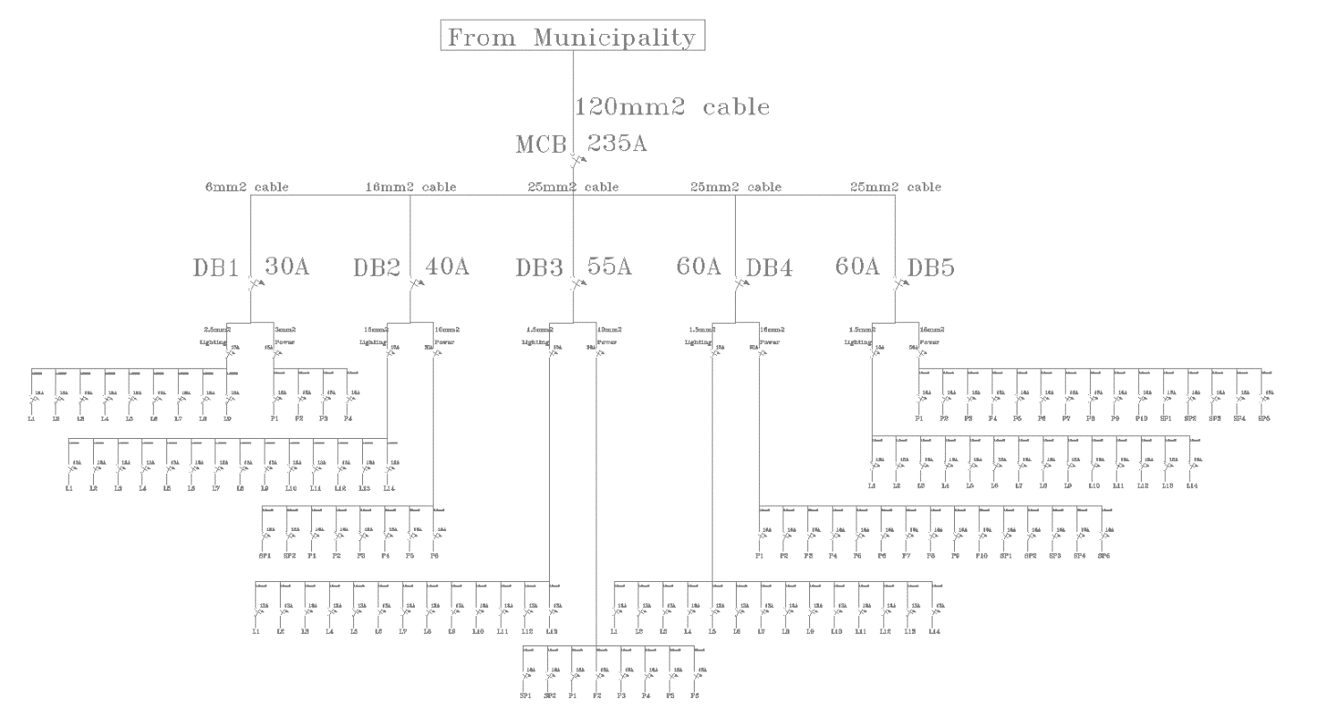
The following Figure Show the electrical distribution Board

