Slide 1




Made by:
Rayhan Shhadeh
Tala Zayed
Supervisor:
Dr. Emad Natsha

Slide 2


Rayhan Shhadeh
Tala Zayed

Slide 3
Table of contents
01
02
03
Introduction
Components
Process
04
05
06
Difficulties
Results
Future work

Slide 4

01
Introduction

Slide 5
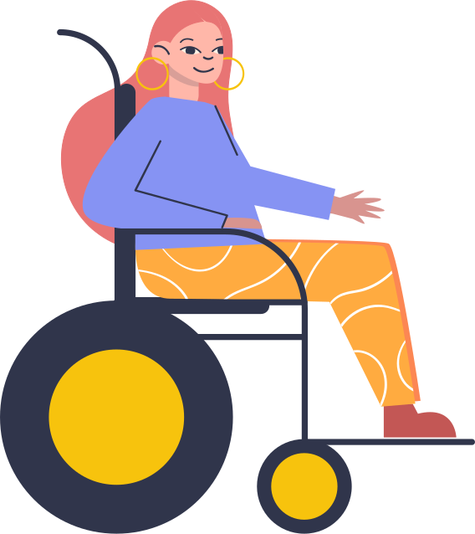

Project Idea
Our idea came from the thoughts of creating an impactful graduation project, a product that helps people, by making an electrical wheelchair that controls the home devices

Slide 6
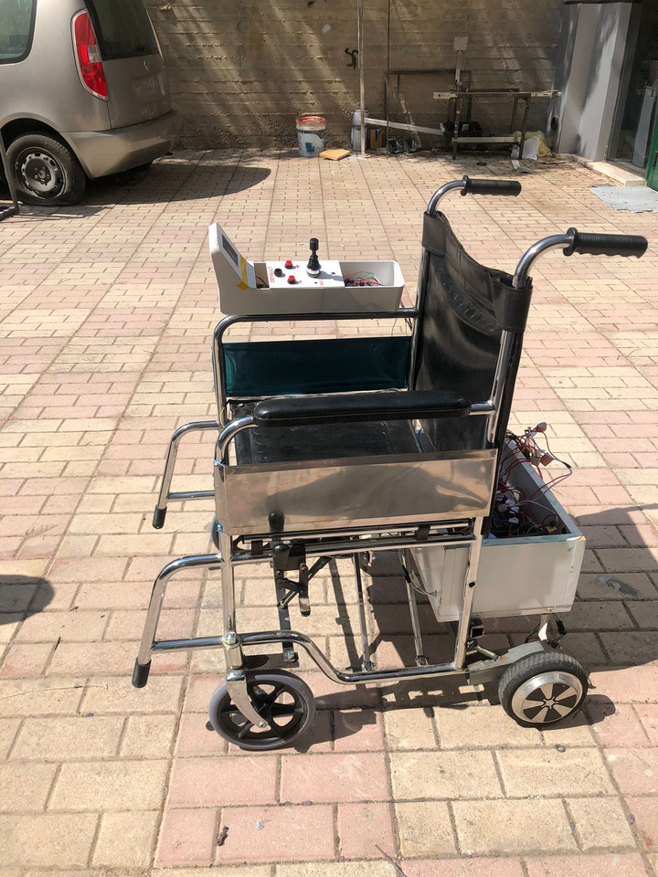
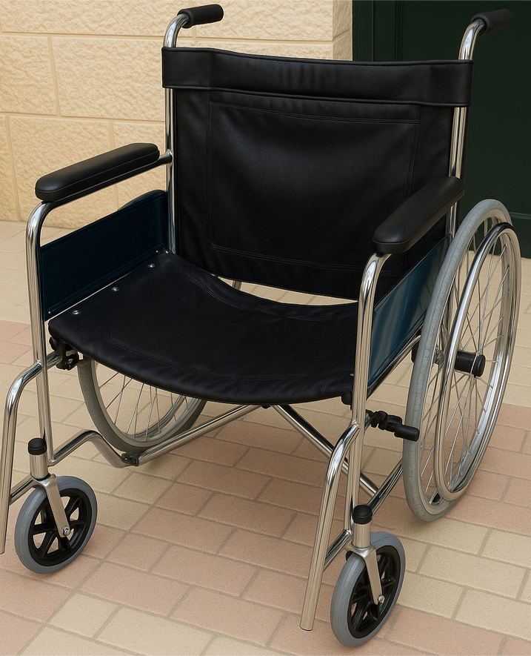

System Overview

Slide 7



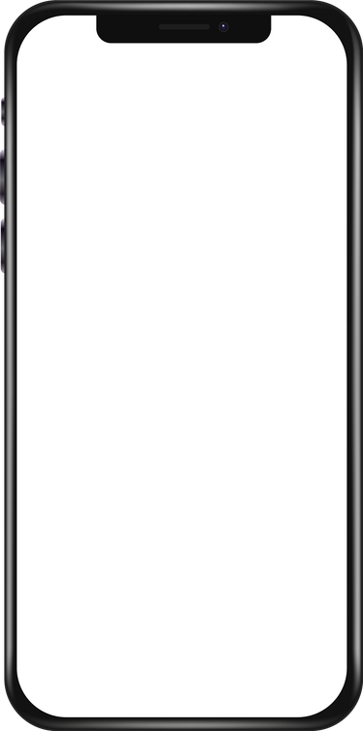


System Features
1
2
3
Wheelchair
Smart Home
Mobile Application
  Joystick for full-direction.
  Multiple speeds.
  Obstacle detection for safety.
Control AC 220V devices by
  Touch Screen
  Voice Commands
  Voice commands.
  Manage devices

Slide 8
02
Components

Slide 9
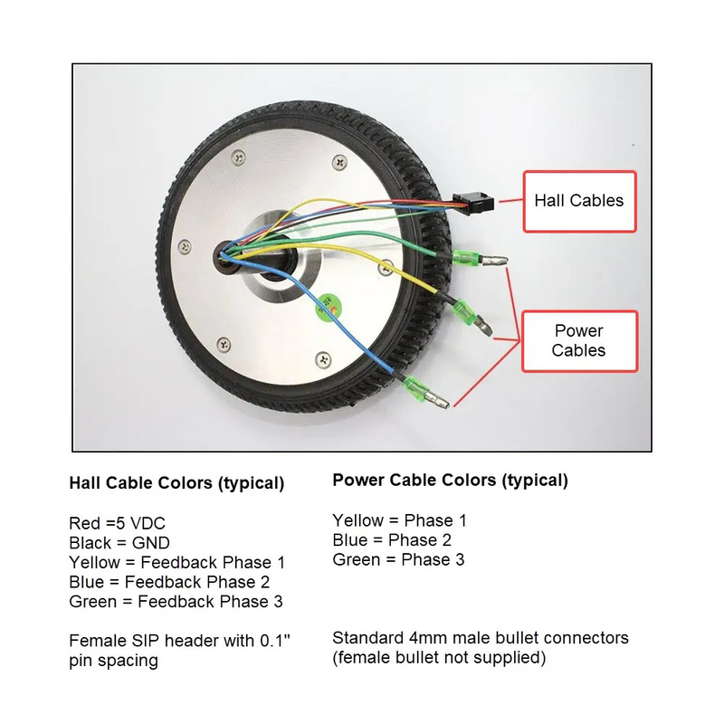
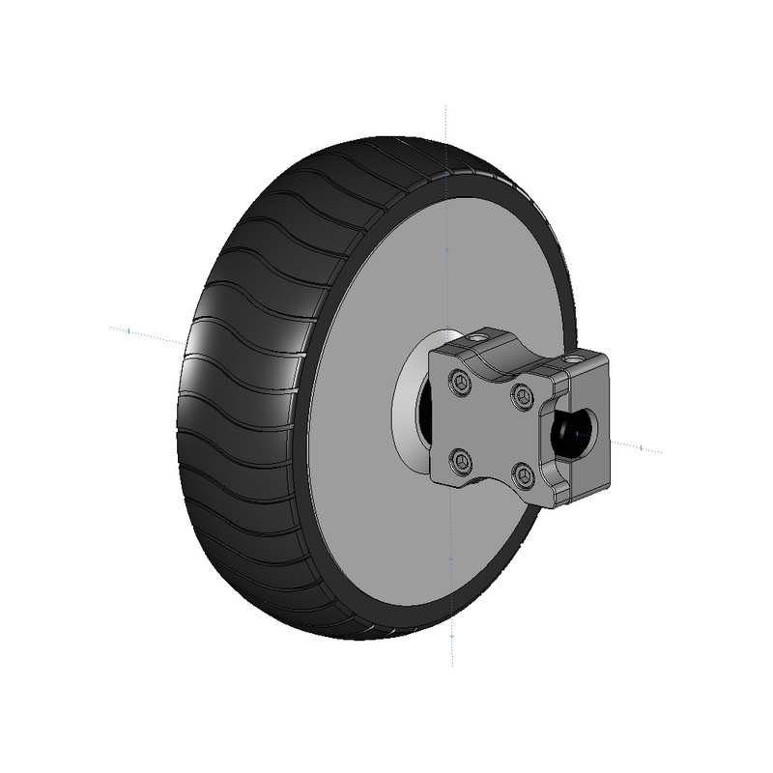
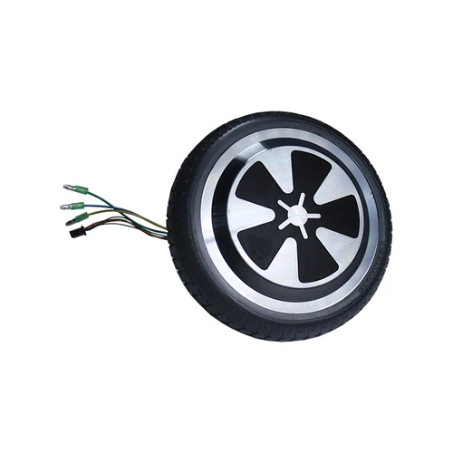
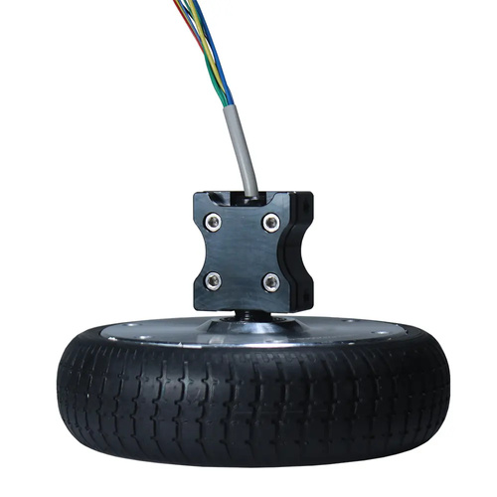
Hardware Components
Hoverboard 3 phase motor wheels

Slide 10
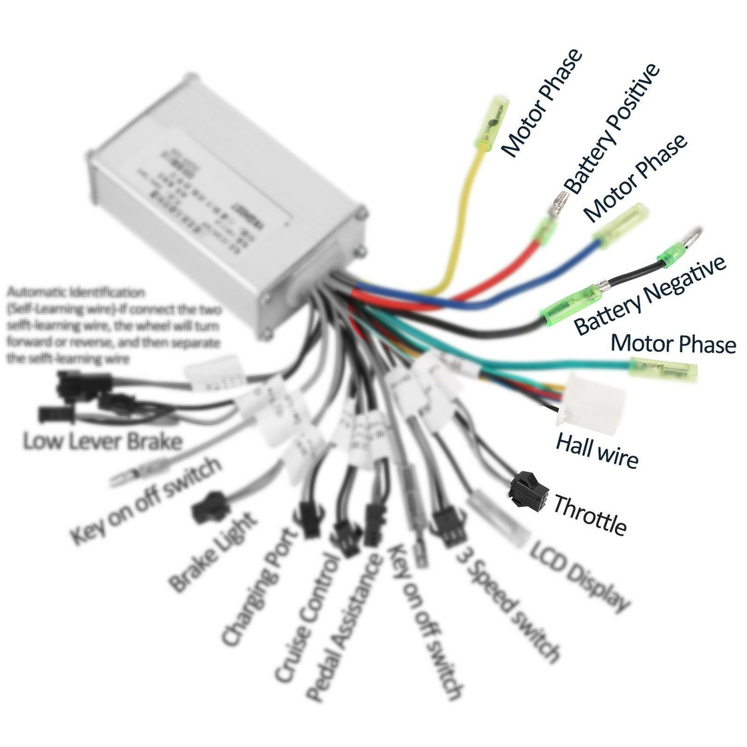
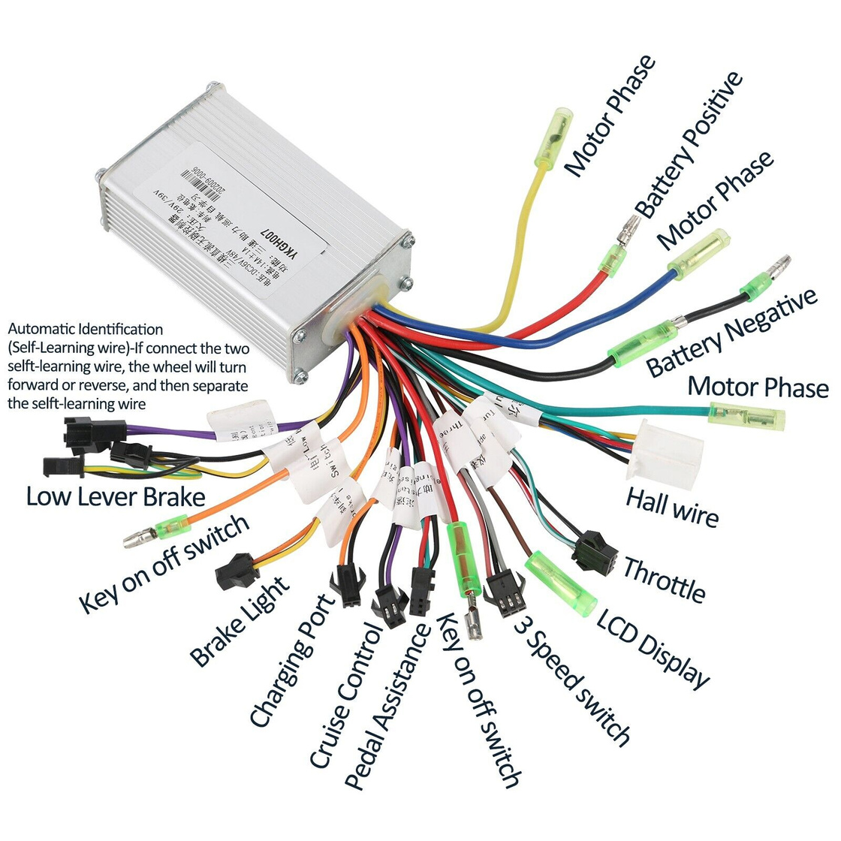
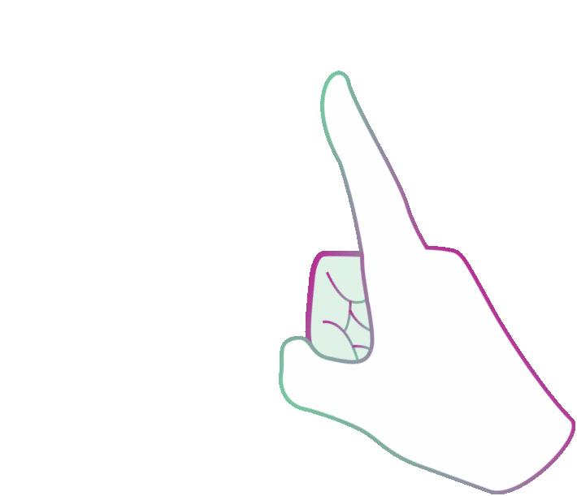
Hardware Components
E- bike controller
What we used
VS
What we bought

Slide 11
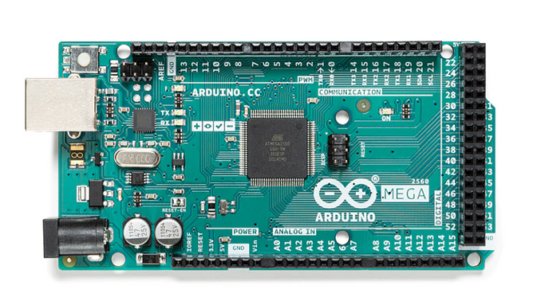
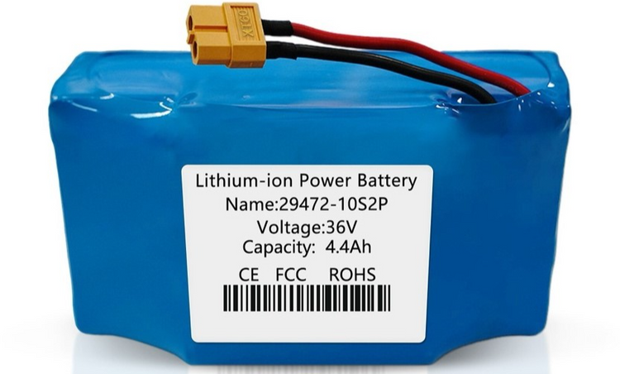
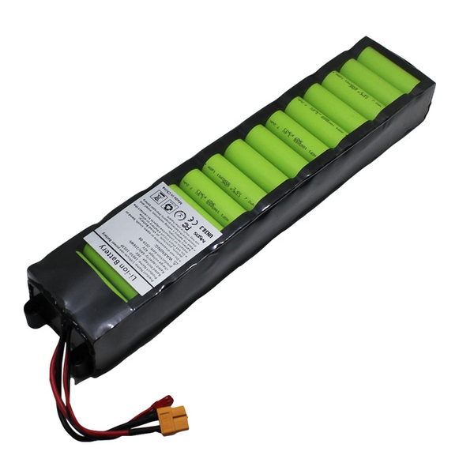
Hardware Components
36v li-on battery
Arduino Mega

Slide 12
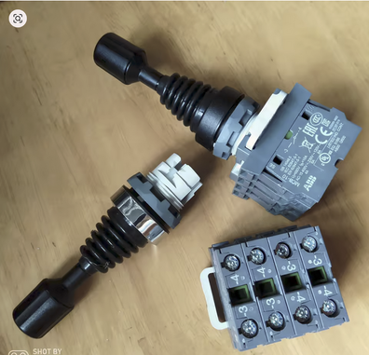
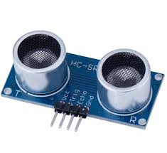
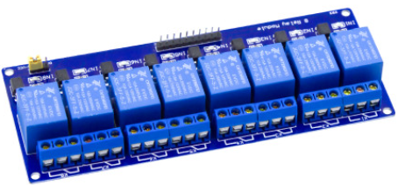
Hardware Components
Mechanical Joystick
Ultrasonic sensor
Relay 8-channel

Slide 13
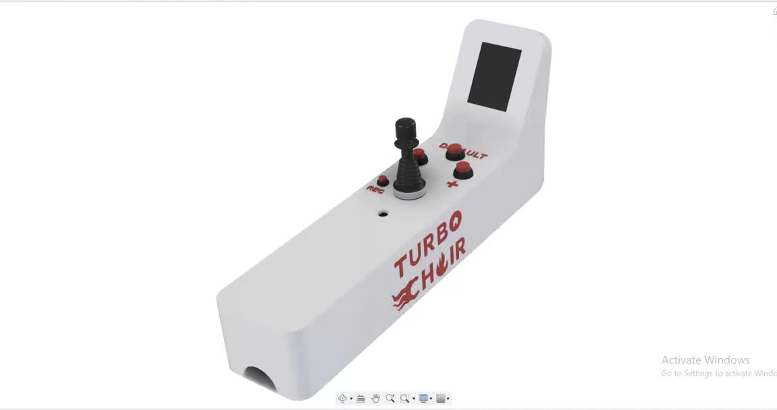
Hardware Components

Slide 14
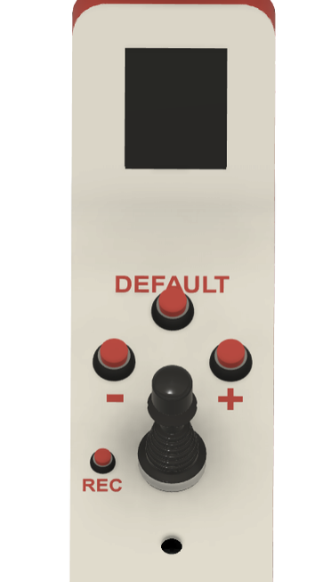
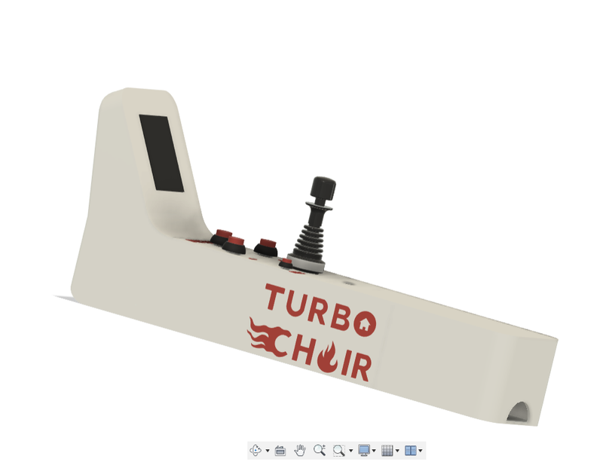
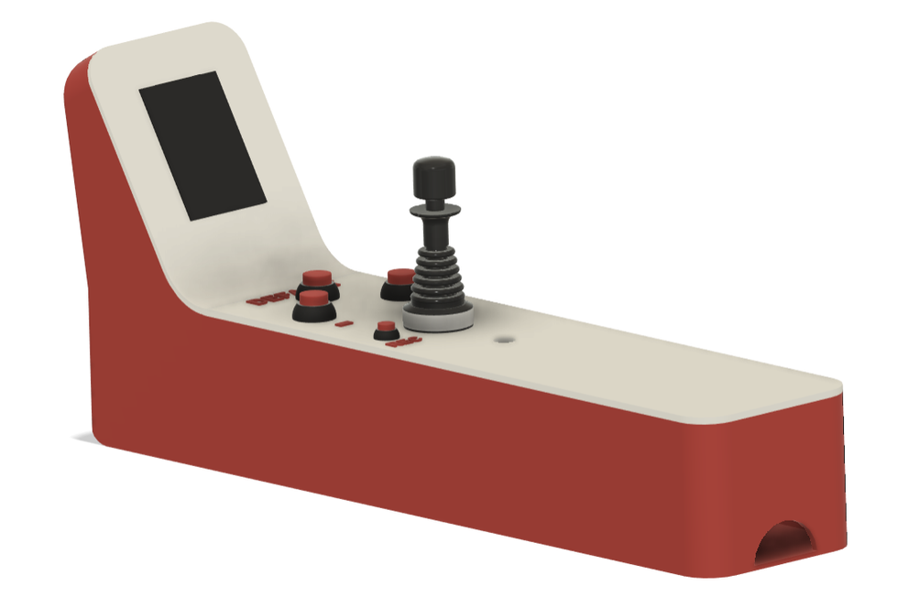
Hardware Components
3D Printed Arm

Slide 15
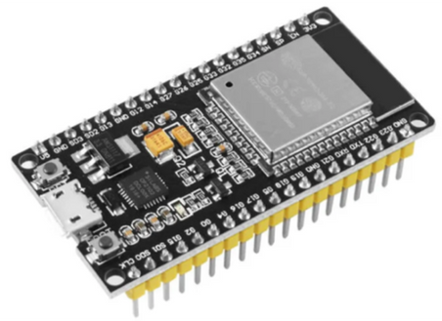
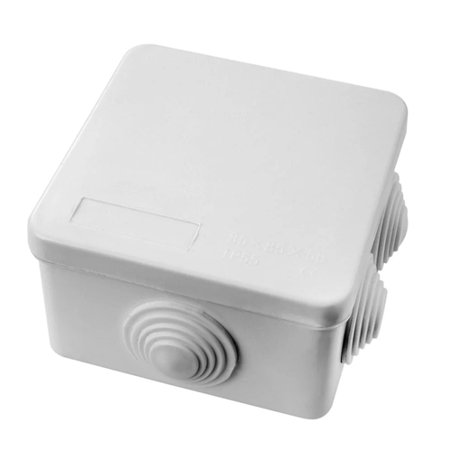
Hardware Components
ESP32
  Wireless communication in smart home
  1 Publisher ESP32
  3 Subscriber ESP32s
Subscriber Box
  Used to put subscriber ESP32 and another related components in subscriber side,

Slide 16
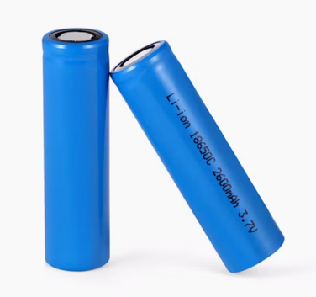
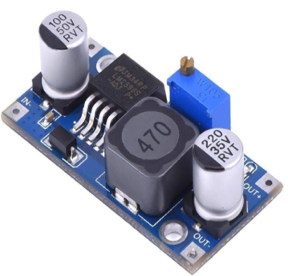
Hardware Components
18650 Li Ion Battery 3.7V
  Used for powering the ESP32 in subscriber side
LM2596 voltage regulator
  Used to convert 7.4v from li-on batteries to 5v as input to ESP32

Slide 17
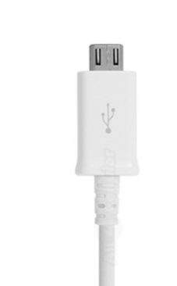
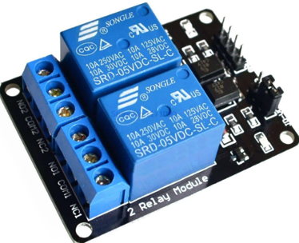
Hardware Components
cable
  Connected with 2 out wires from voltage regulator to power the ESP32
2-ch relay
  Used to to tae the command from ESP as ON,OFF and control 220v AC device.

Slide 18
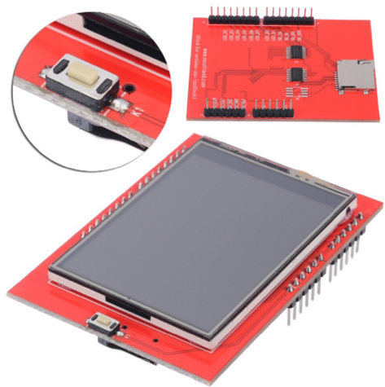
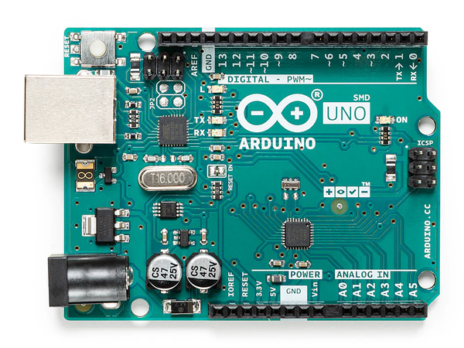
Hardware Components
2.4 TFT Touch Screen
  Used to display the devices from database with ON/OFF buttons for each added device.
Arduino uno
  Used to display content on touch screen and to handle serial communication with publisher ESP

Slide 19
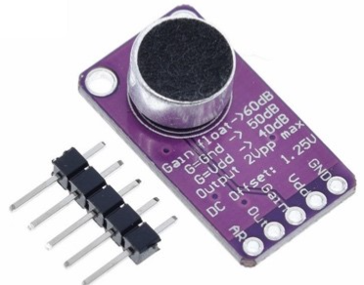
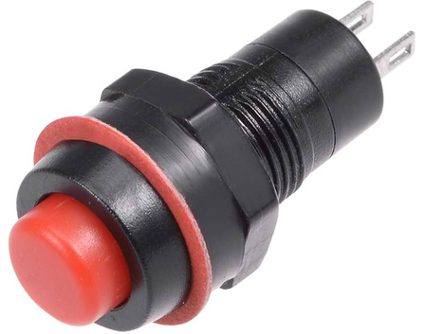
Hardware Components
Max9814 microphone module
  Used to take voice command from the user to control the devices.
Momentary push button
  Used as a record button and it will be pressed if the user want to say some commands.

Slide 20
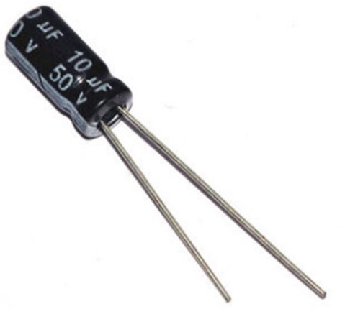
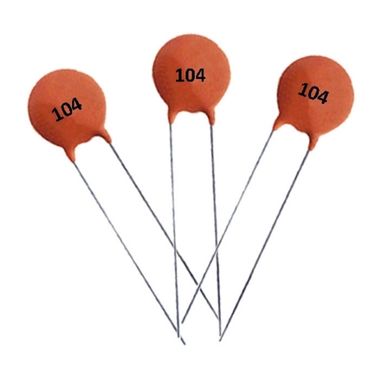
Hardware Components
Electrolytic capacitor
  Used with Max9814 microphone module between GND,VDD and another one on output to prevent unwanted low-frequency noise.
Ceramic capacitor
  Used with Max9814 microphone module between GND,VDD for filtering and decoupling purposes

Slide 21
03
Process

Slide 22

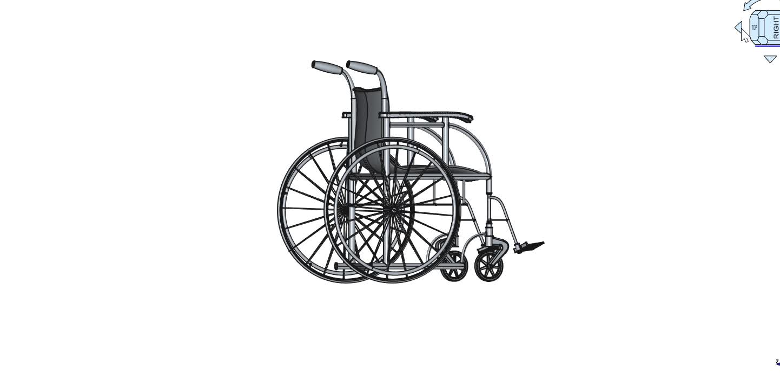
WheelChair

Slide 24
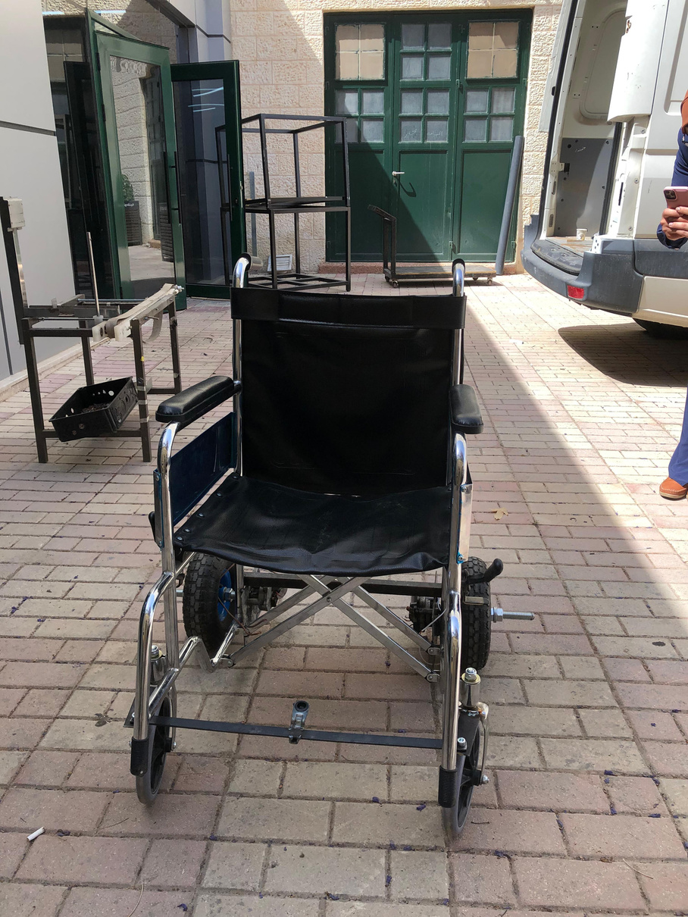
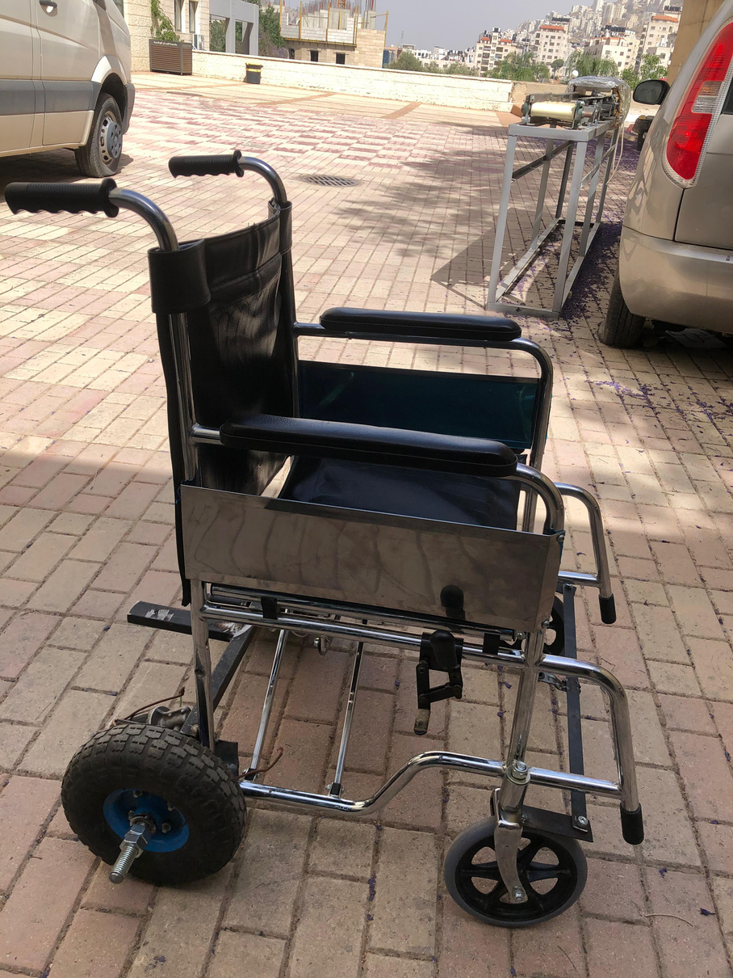
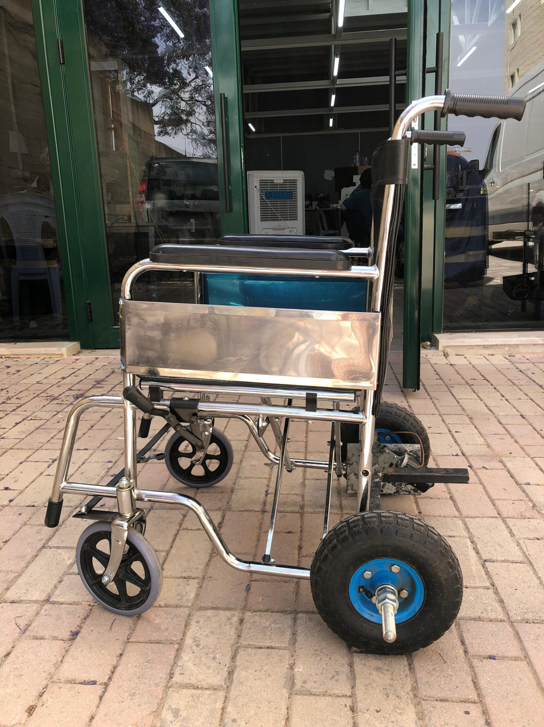
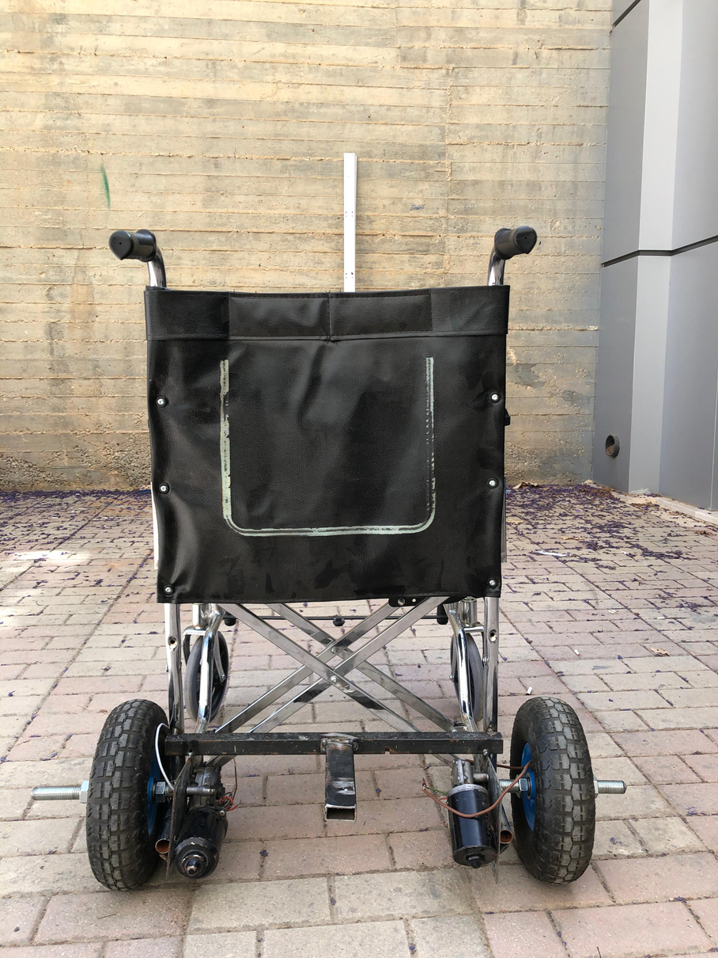
First Stage
Wheelchair before using BLDC motors

Slide 25
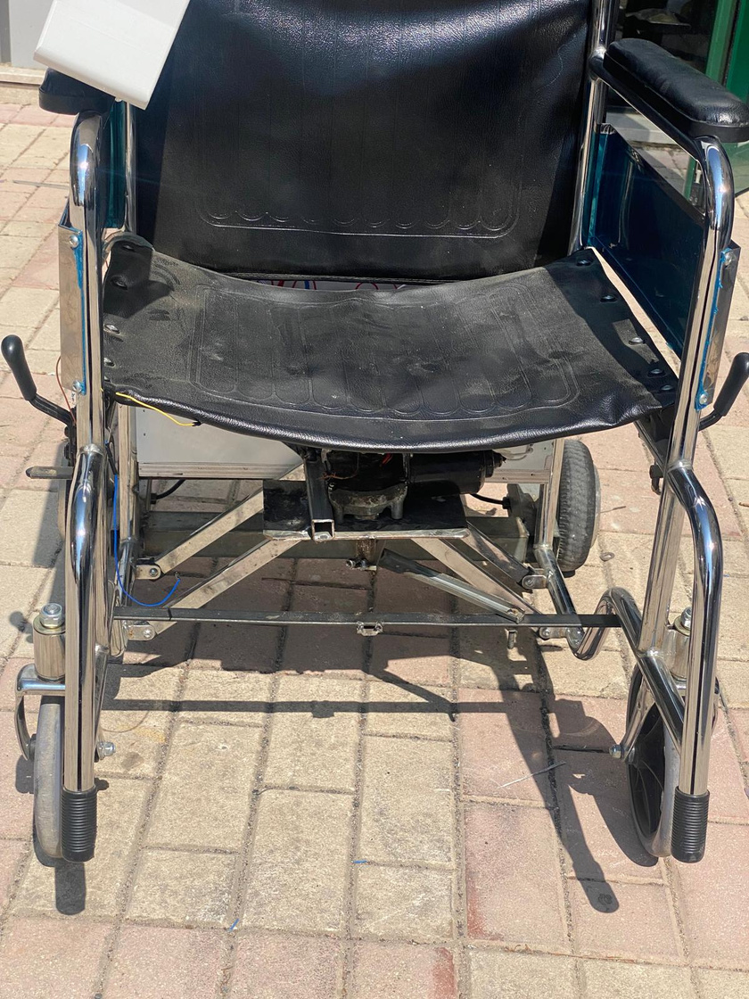
Second Stage
using a rod to control Left and Right

Slide 26
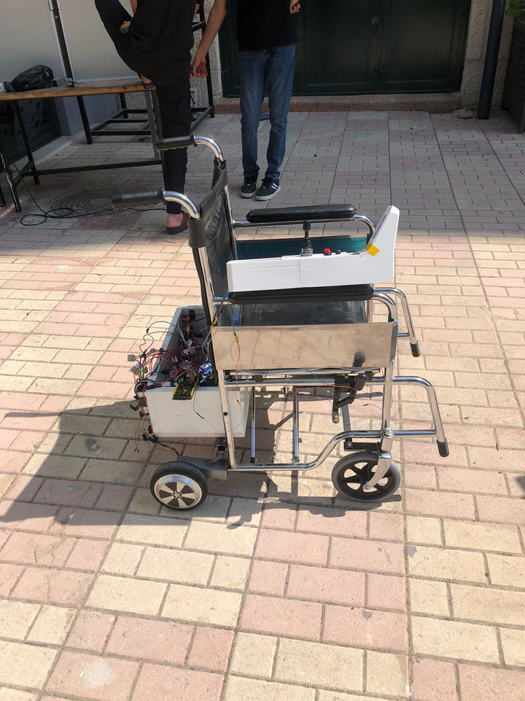
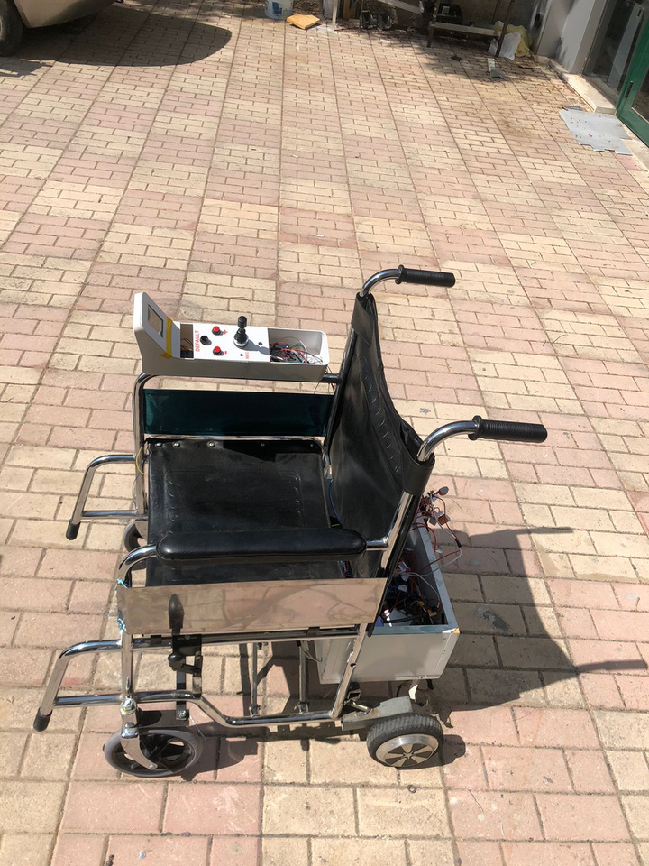
Third Stage
Replacing the DC motors to BLDC 3 phase Motors

Slide 27
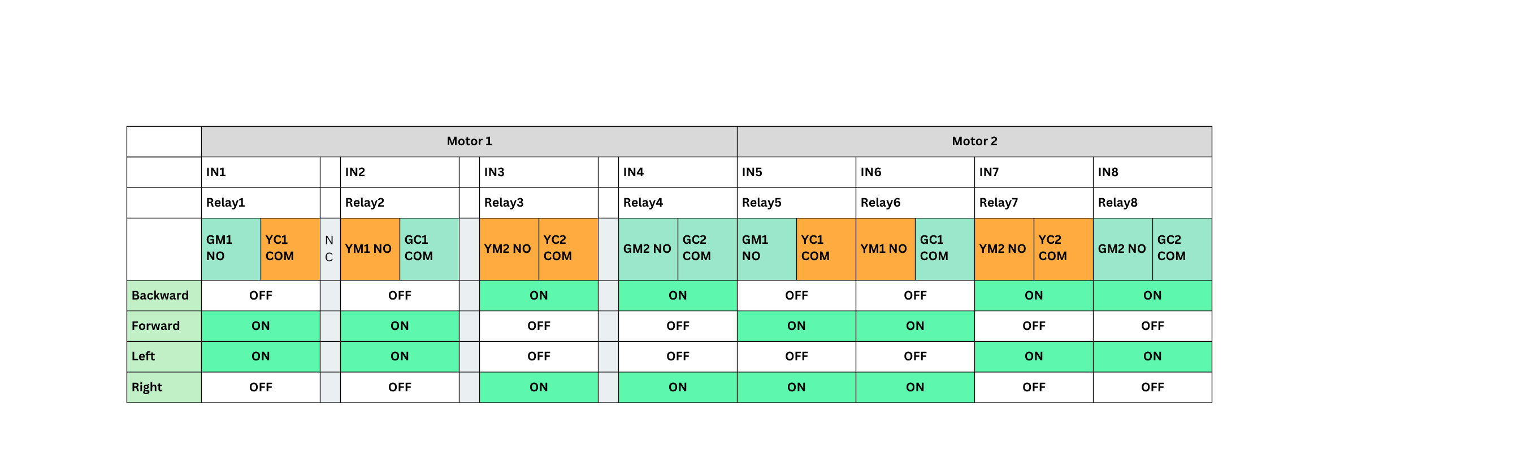
How did we control the motor?
How did we control the hall sensors??

Slide 28
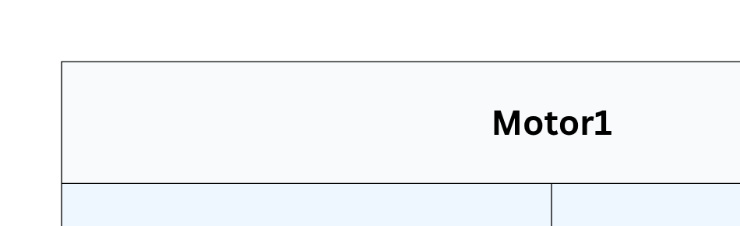

Slide 29
Smart Home

Slide 30
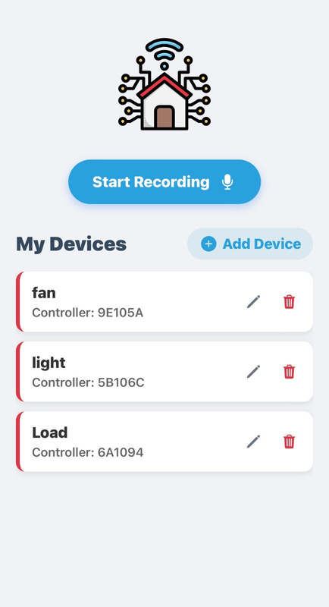
How Can the User control (ON/OFF) devices?
Touch Screen
Microhrophone
Mobile Appliction

Slide 31
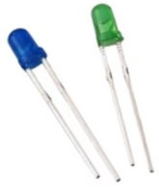
Publisher Side
Subscriber Side
Publisher ESP32
Subscriber ESP32

Slide 32


Wireless Communication
Communication Protocol
MQTT broker (cloud)
  Real-time communication
  Efficient communication
  Secure communication
  Scalability (new devices)

Slide 33
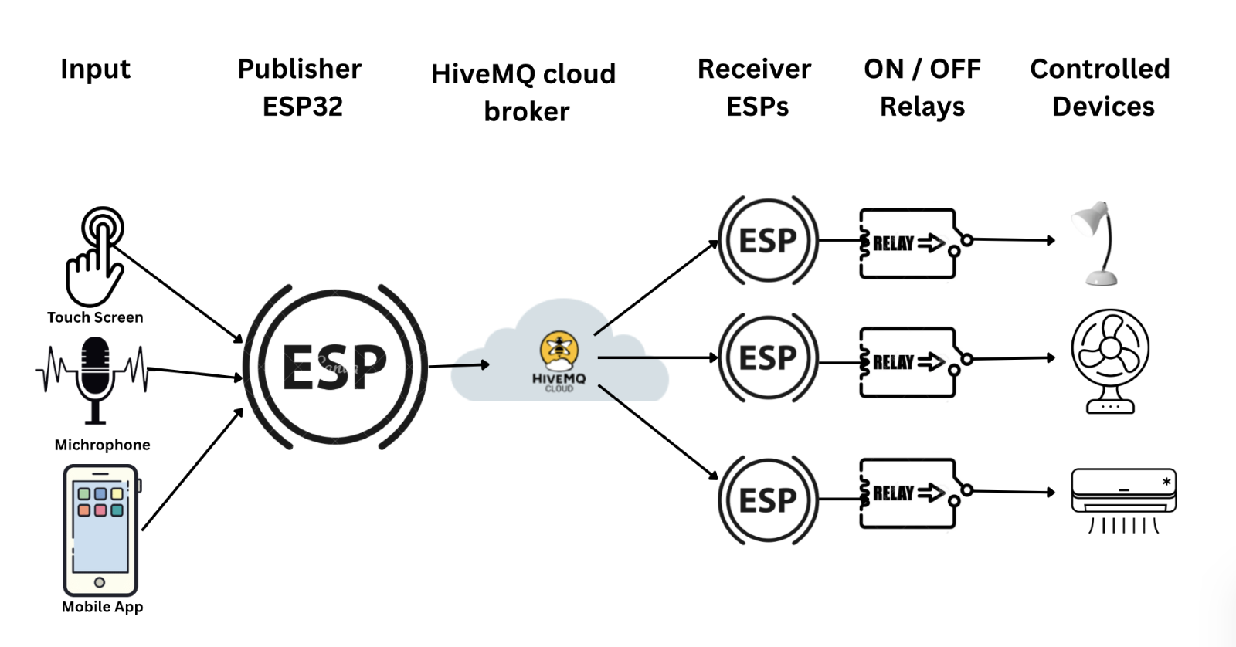
System Flow

Slide 34
Mobile Application

Slide 35





Technologies
React Native

Slide 36


Welcome Screen
Main Screen

Slide 37
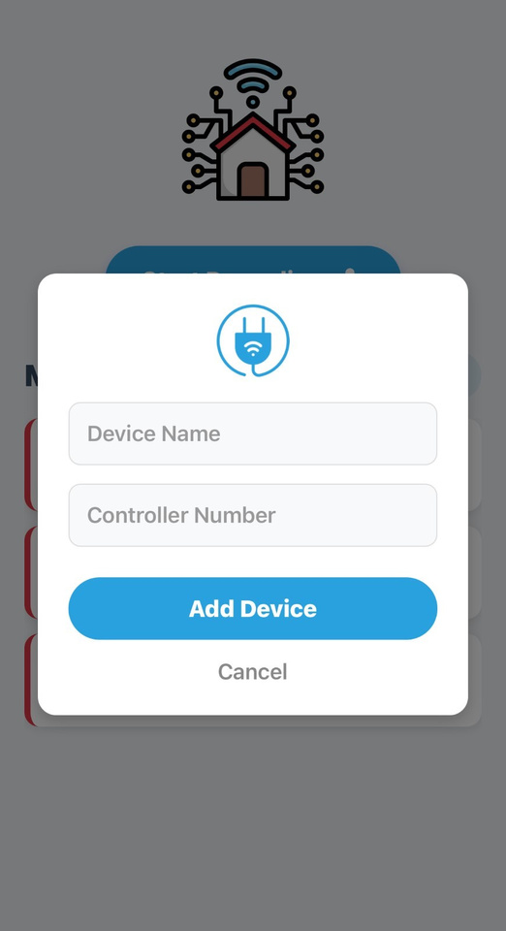
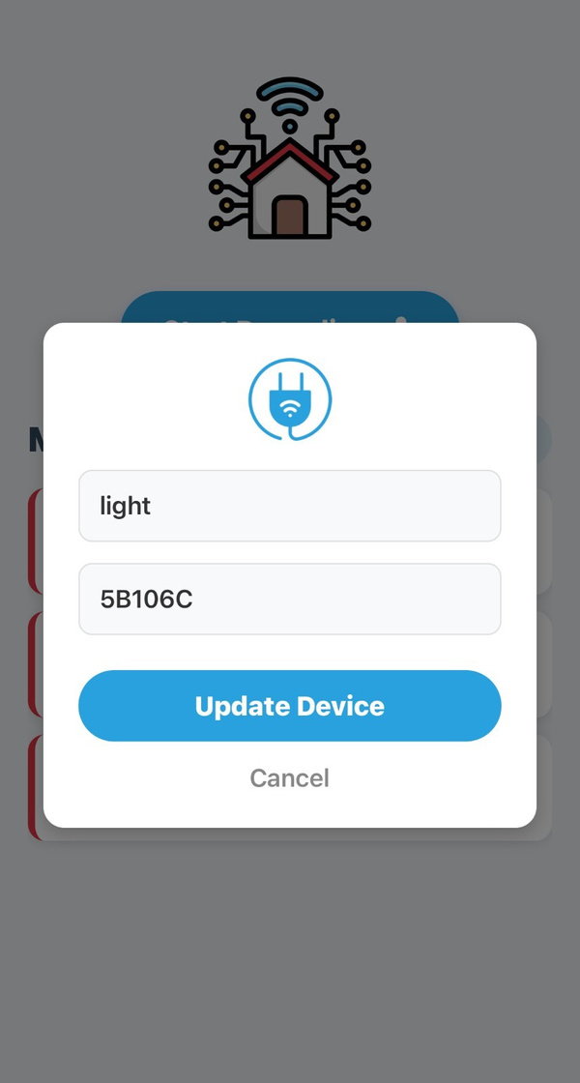
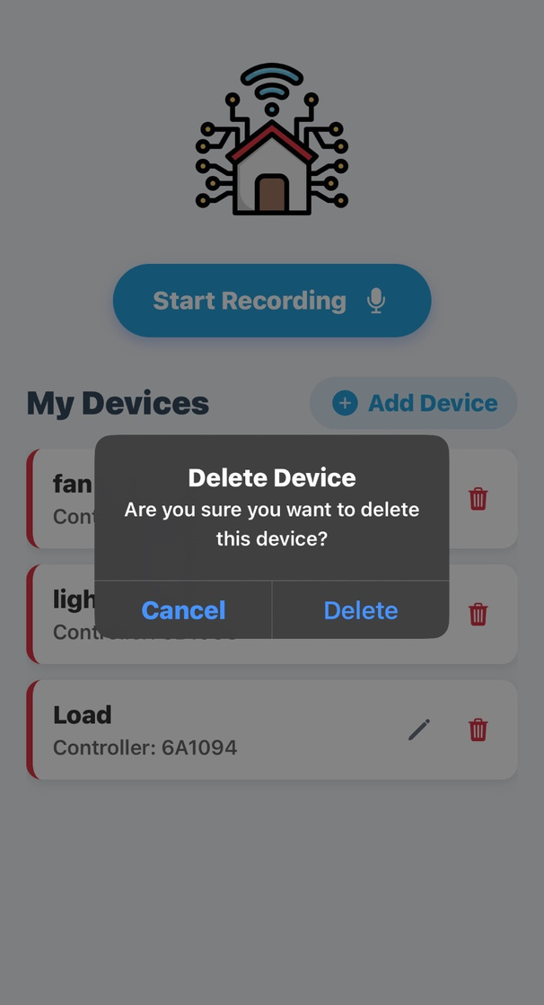
Device Managment

Slide 38
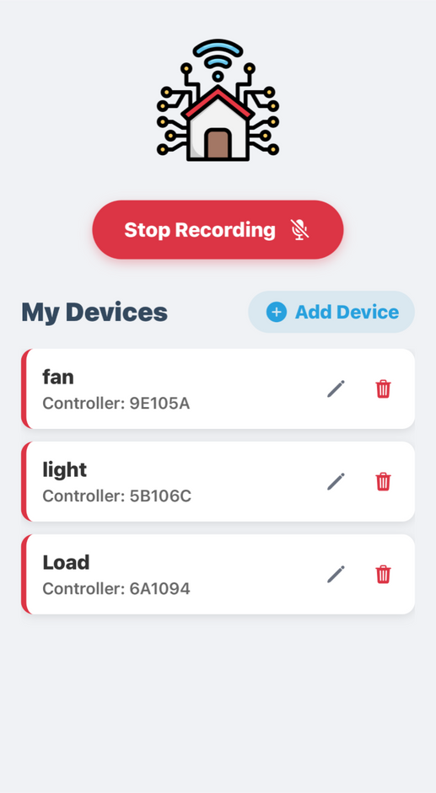

Record command

Slide 39


Whisper Transcription API
turn on the fan
Chat Completions API
turn on the fan
device : “fan”
command : “on”
TTS (Text-to-Speech) API
device : “fan”
command : “on”
the fan is turned on (feedback)

Slide 40
04
Difficulties

Slide 41
WheelChair

Slide 42


Problems with the first DC motors

Slide 43

Problem vs. solution
Problem
Solution
  Different motors speed
  Can’t control each motors to run the right clockwise and the left counterclockwise due to the wiping motors popular issue (Ground connected to chassis)
  controlling 3 phase motor
  left and right functionality
Tried solutions:
Software delay, potentometer, limit the voltage that the fastest motor helds
Real and Last Solution:
Change the motors from 2 phases DC to 3 phases DC motors

Slide 44
Obstacles

Slide 45
Smart Home

Slide 46

1
Limitation of nRF Module
Problem (nRF)
Solution (ESP32)
  Limited range
  Stable connection
  Not support Wifi
  Better range
  Packet loss
  Reliable data transfer

Slide 47


2
Internet issue
Problem (najahWifi)
Solution (Hotspot )
  WiFi.h library dose not support networks with username and passwor credentials.
  WiFi.h supports mobile hotspot as any WiFi network with ssid and password.

Slide 48

3
Optocoupler vs Relay
Problem (Optocoupler)
Solution (Relay)
  It was unable to handle the high voltage and current requirements of AC loads
  Used to the command from ESP as ON,OFF and control 220v AC device.

Slide 49
05
Results

Slide 50
WheelChair Demo

Slide 51
Smart Home Demo

Slide 52


System setup
(suscriber boxes)

Slide 53


Touch Screen Input

Slide 54


Michrophone Input

Slide 55

Mobile
Application

Slide 56
06
Future Work

Slide 57
Future Work
01
Add camera-based vision for advanced obstacle detection.
Support for Arabic language voice recognition.
Optimize the batteries connection to not cut off
Reduce the delay in the motors when it stops
02
03
04

Slide 58


Thanks!
Do you have any questions?

Slide 59
Text & Contrast (
Dark Grey/Black)
Smart Home Accent
(Cool Blue)
Secondary Accent
/ Highlight
Primary color
Neutral

Slide 60



Thank you!

