Slide 1

An-Najah National University
Faculty of Engineering
Building Engineering Department
Graduation Project II
Analysis & Redesigning Of The Faculty Of Fine Art
Prepared By:
Karam Bassalat
Umaier Najjar
Omar Sabbah
Project supervisor:
Eng. Abd El-Hakeem Al-Jawhari

Slide 2
CONTENTS:
Introduction
Site
Architectural Design
Structural Design
Environmental Design
Electrical Design
Mechanical Design
Safety Design
Estimated Cost

Slide 3
INTRODUCTION
The main concept of our project was to redesign the building from different aspects such as architectural, structural and environmental.

Slide 4
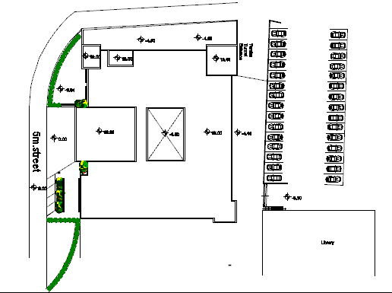
Site
N

Slide 5
Architectural Design
Existing building:
5 floors, 1 basement
New building:
6 floors, 2 basements

Slide 6
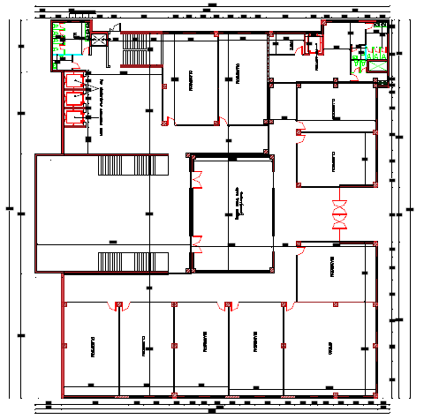
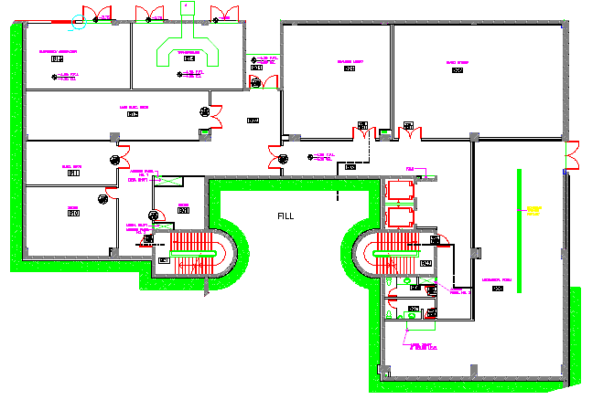
Architectural Design
Basement new design
Existing basement

Slide 7
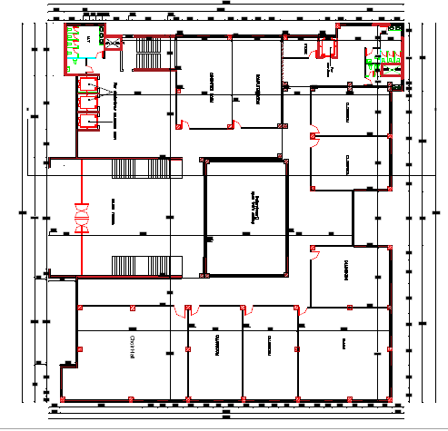
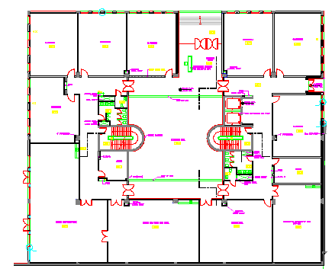
Architectural Design
Ground floor new design
Existing Ground floor

Slide 8
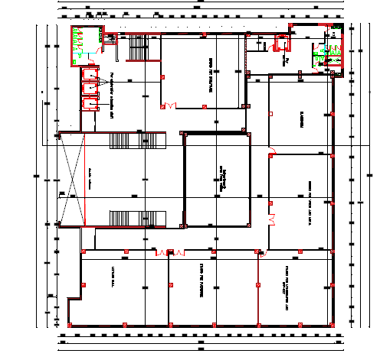
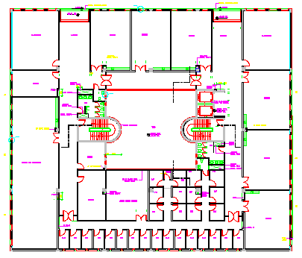
Architectural Design
First floor new design
Existing first floor

Slide 9
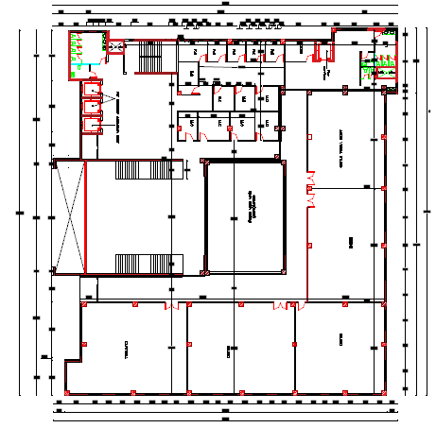
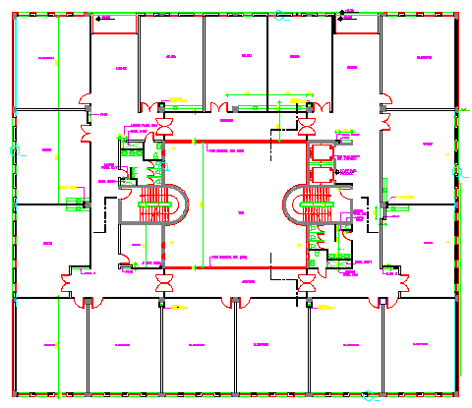
Architectural Design
Second floor new design
Existing second floor

Slide 10
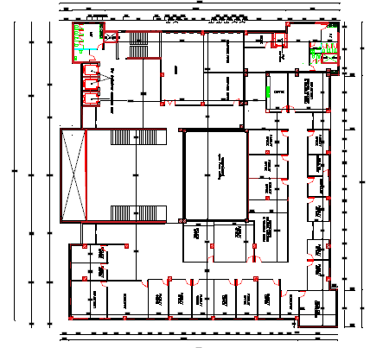
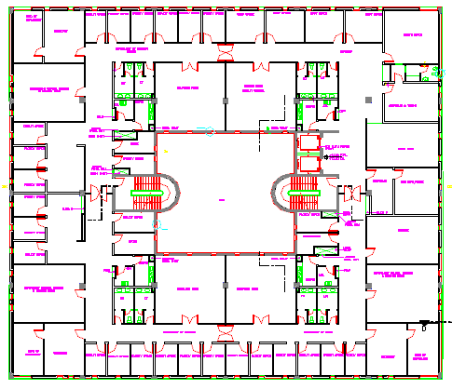
Architectural Design
Third floor new design
Existing third floor

Slide 11
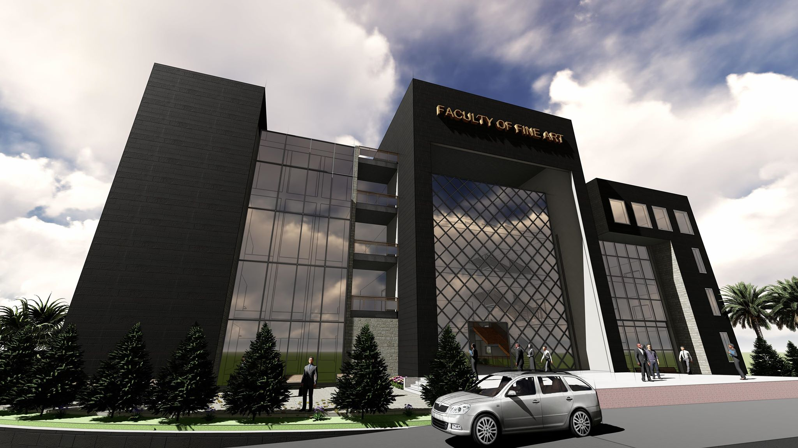
Architectural Design
South elevation in new design

Slide 12
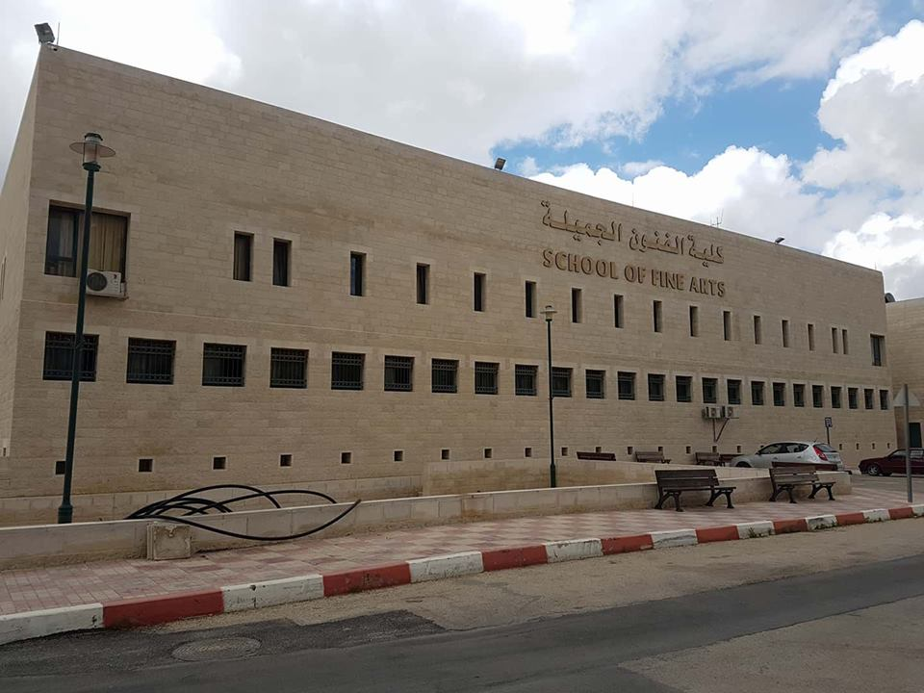
Architectural Design
South elevation in existing building

Slide 13
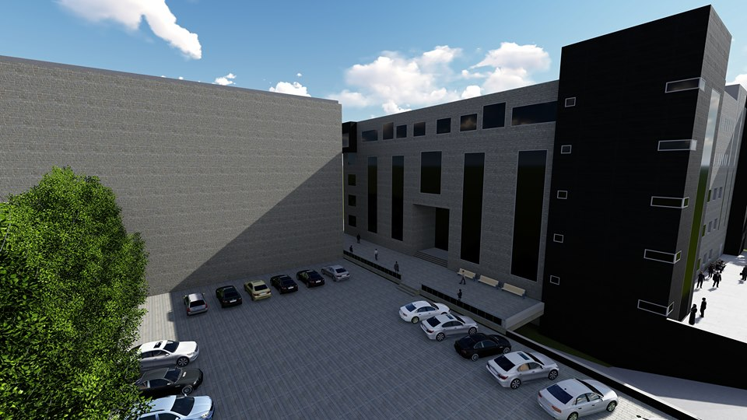
Architectural Design
North elevation in new design

Slide 14
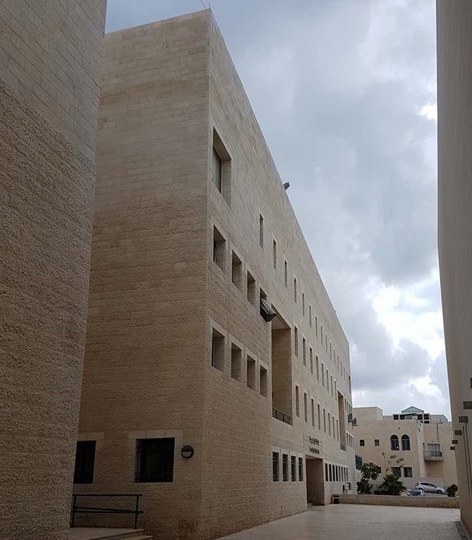
Architectural Design
North elevation in existing building

Slide 15
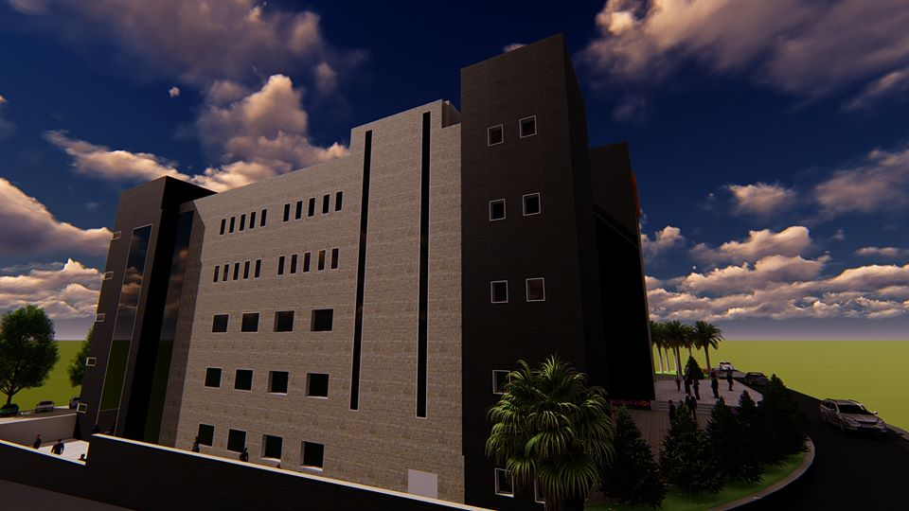
Architectural Design
West elevation in new design

Slide 16
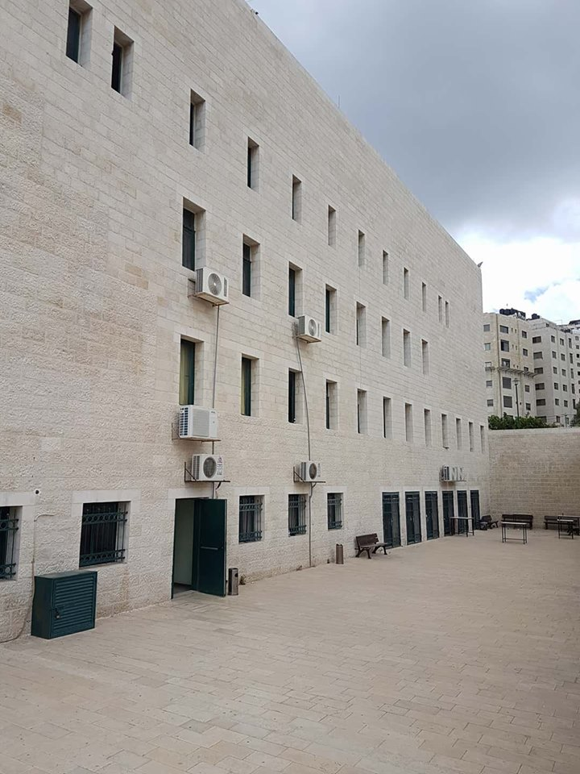
Architectural Design
West elevation in existing building

Slide 17
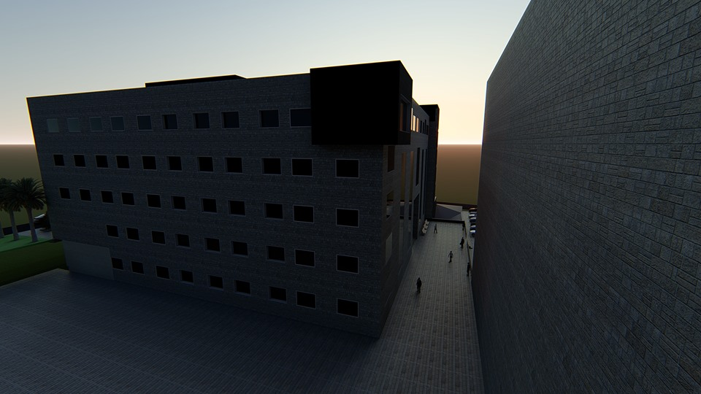
Architectural Design
East elevation in new design

Slide 18
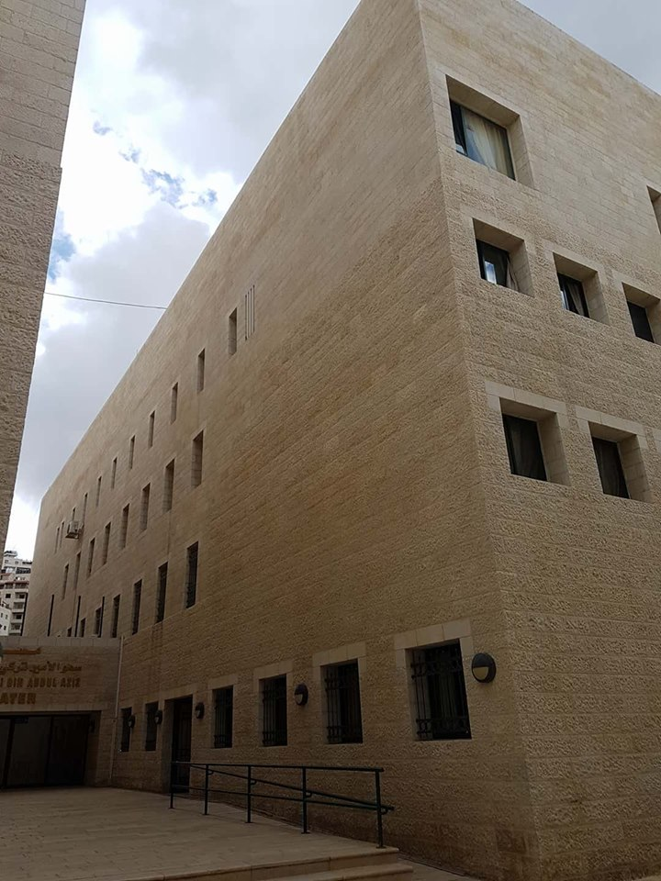
Architectural Design
East elevation in existing building

Slide 19
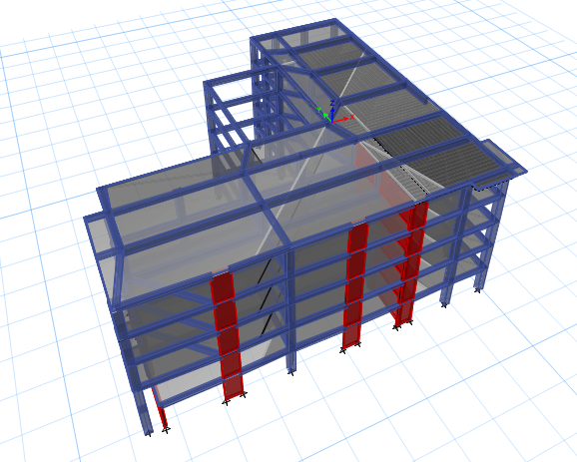
Structural Design

Slide 20
Structural Design
Codes:
ACI 318-11 (American Concrete Institute): building code requirements of structural concrete and commentary.
ASCE-2010 (American Society of Civil Engineers).
UBC 97 (Uniform Building Code).
Material Property:
Compressive strength of Concrete “f′c”.
    For columns, beams and shear walls f′c = 32 Mpa
    For all other elements f′c = 24 MPa
Yielding strength of steel fy = 420 MPa.

Slide 21
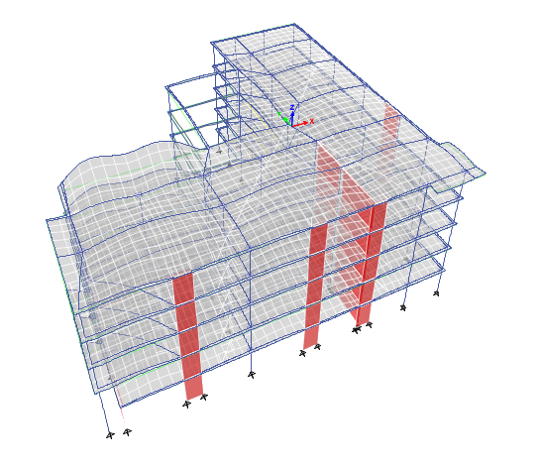

Structural Design
Model Checks:
Compatibility
Equilibrium
Drift

Slide 22
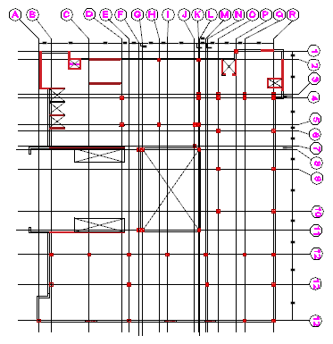
Structural Design
Columns center lines

Slide 23
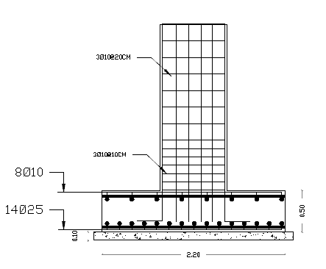
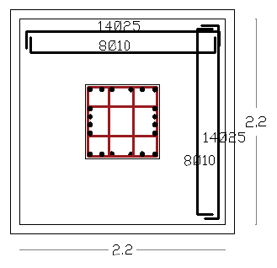
Structural Design
Footing Reinforcement Details:
Single footing

Slide 24
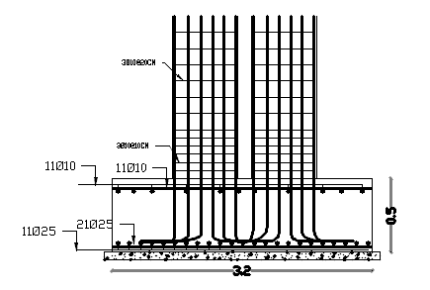
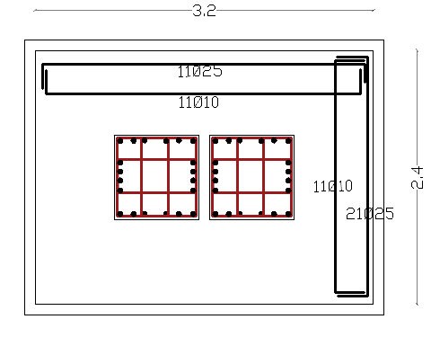
Structural Design
Footing Reinforcement Details:
combined footing

Slide 25
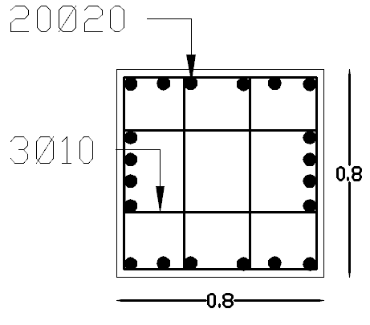
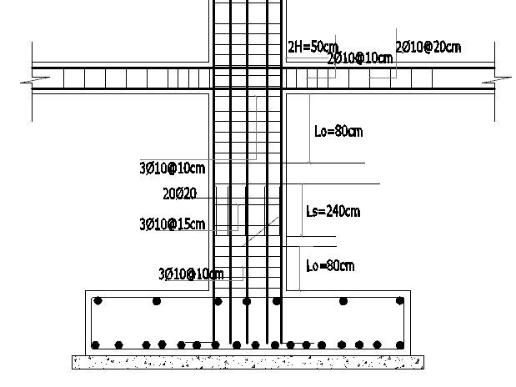
Structural Design
Column Reinforcement Details:
column section

Slide 26
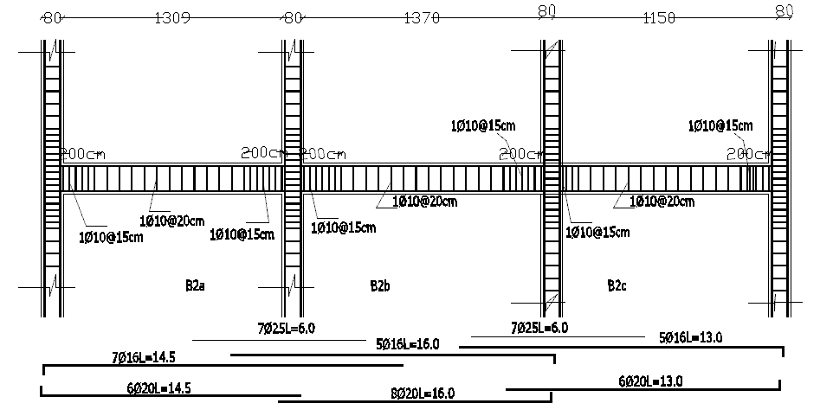
Structural Design
Beam Reinforcement Details:

Slide 27
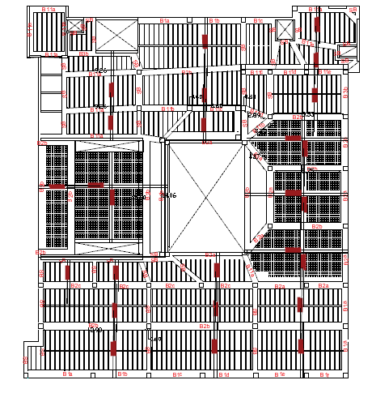
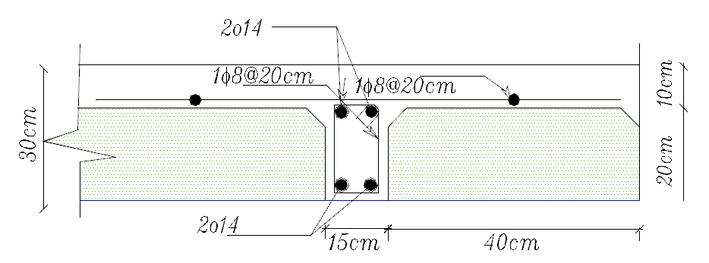
Structural Design
Slab details:

Slide 28
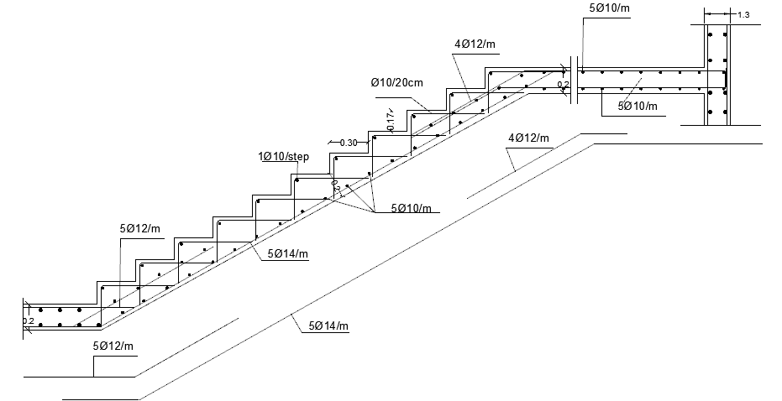
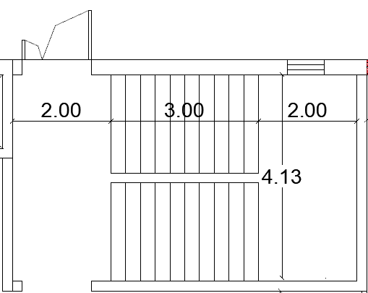
Structural Design
Slab details:
Stair reinforcement details
Stair plan

Slide 29
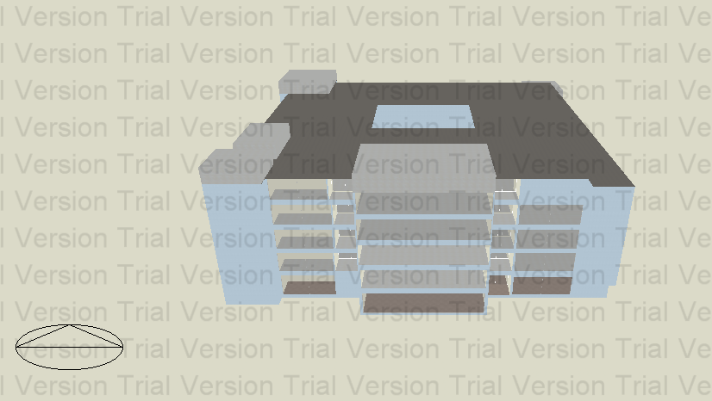
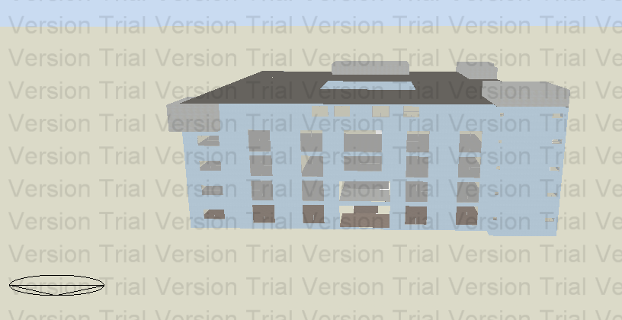
Environmental Design.
Design Builder program ( 3D Model ):

Slide 30
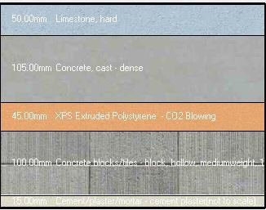
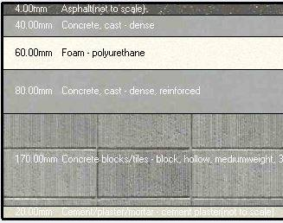
Environmental Design.
External wall Layer :
Roof Layer :
U-value = 0.445 W/ m^2.k
U-value = 0.314 W/ m^2.k

Slide 31
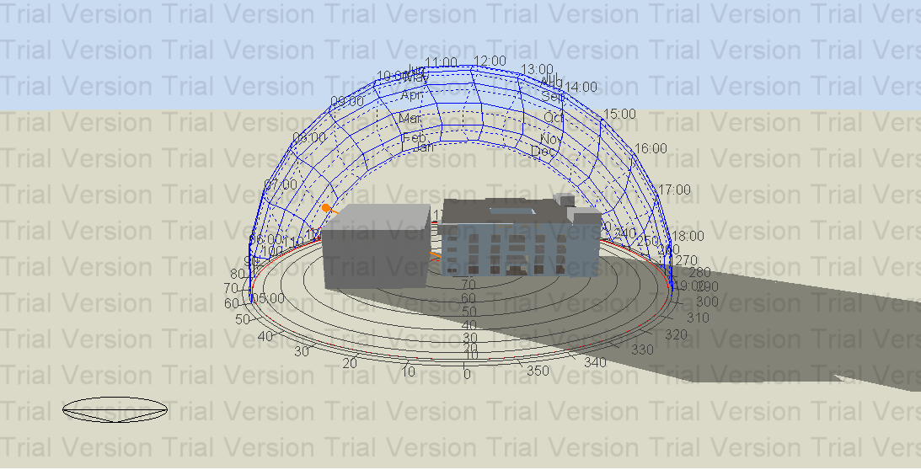
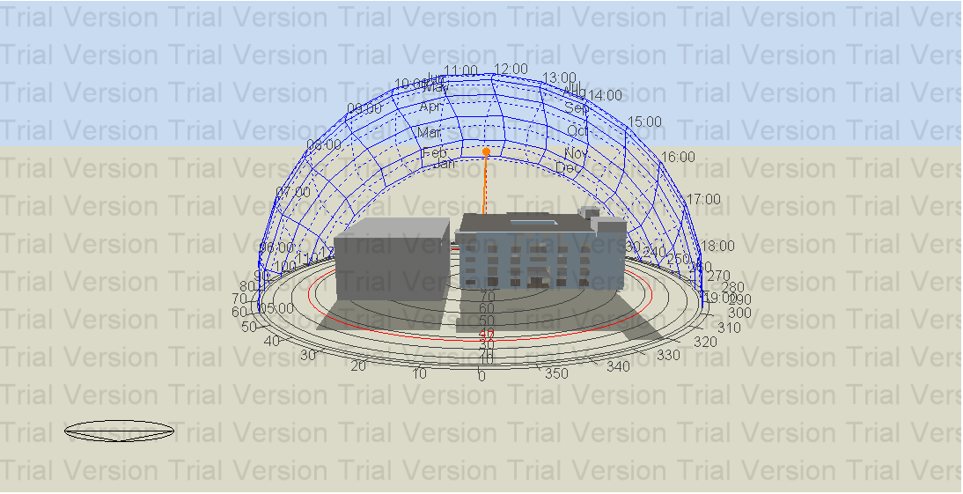
Environmental Design.
Shading:
Shading in winter (21St/January) :
At 8:00 AM. At 12:00 PM.

Slide 32
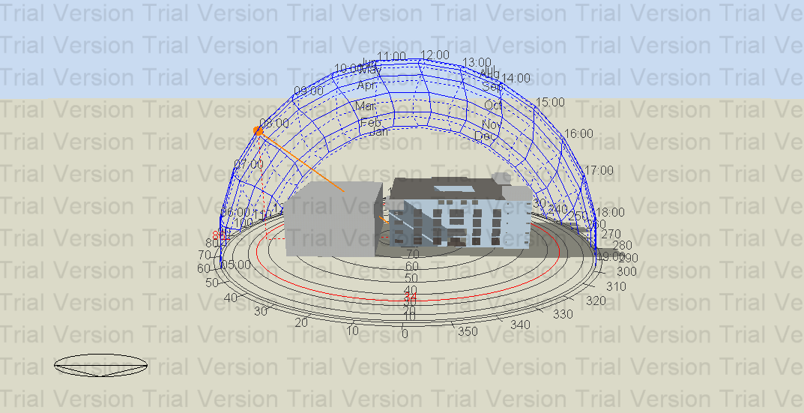
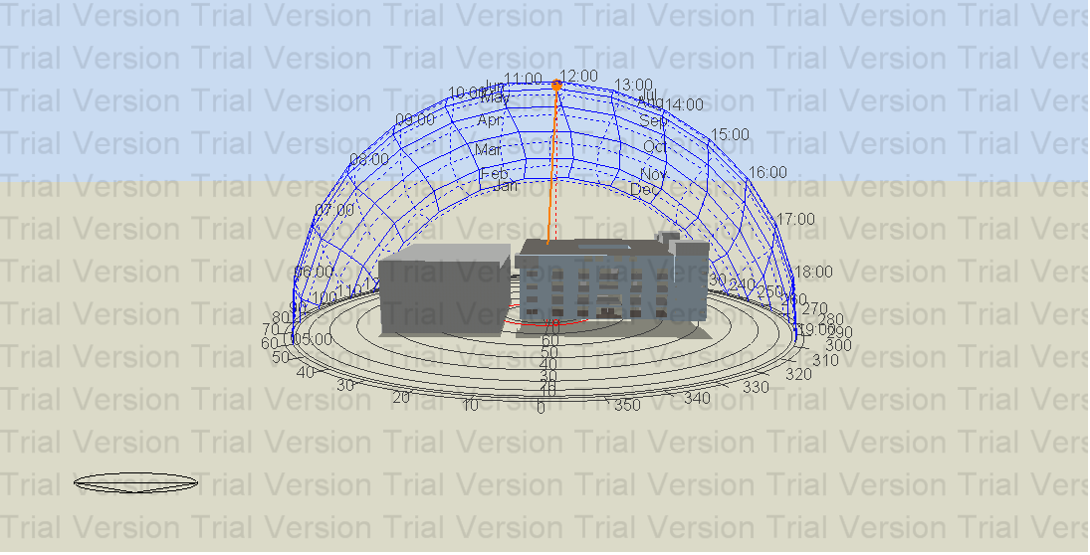
Environmental Design.
Shading:
Shading in Summer(21St/July) :
At 8:00 AM. At 12:00 PM.

Slide 33
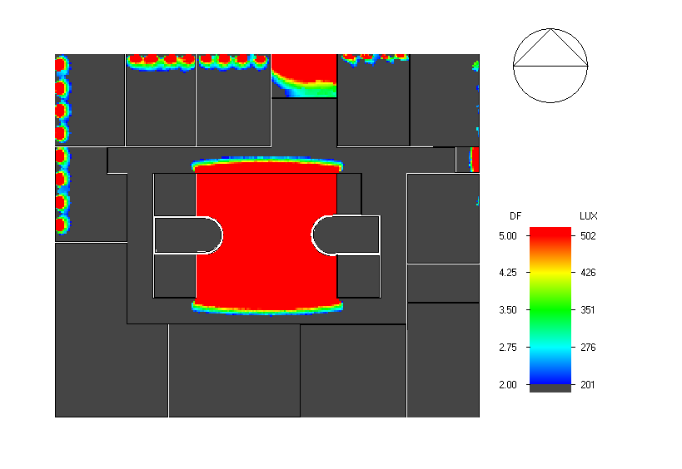
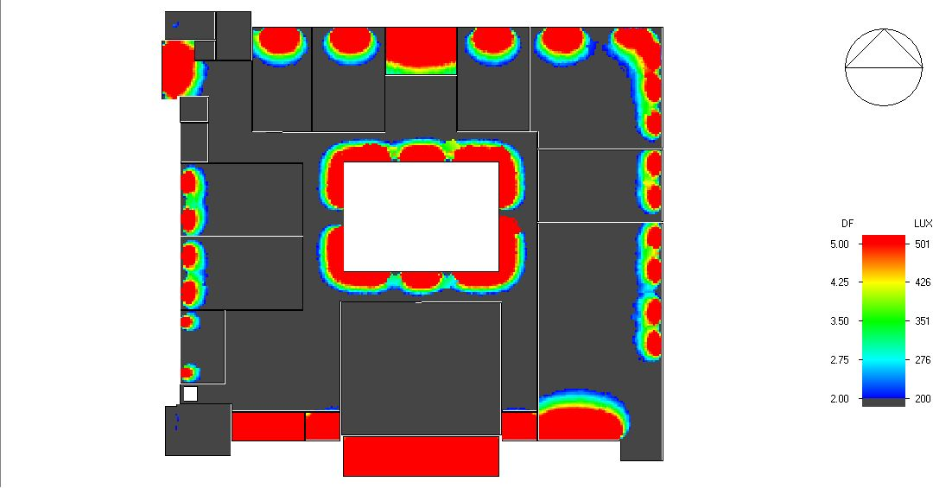
Environmental Design.
Natural daylight analysis.
Existing building G.F
New design building G.F

Slide 34
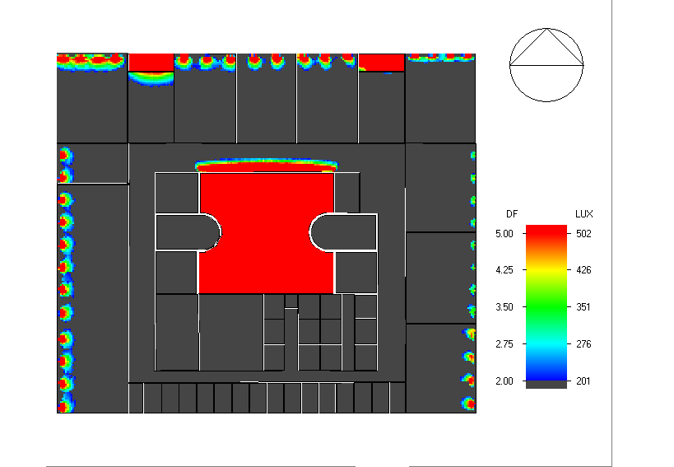
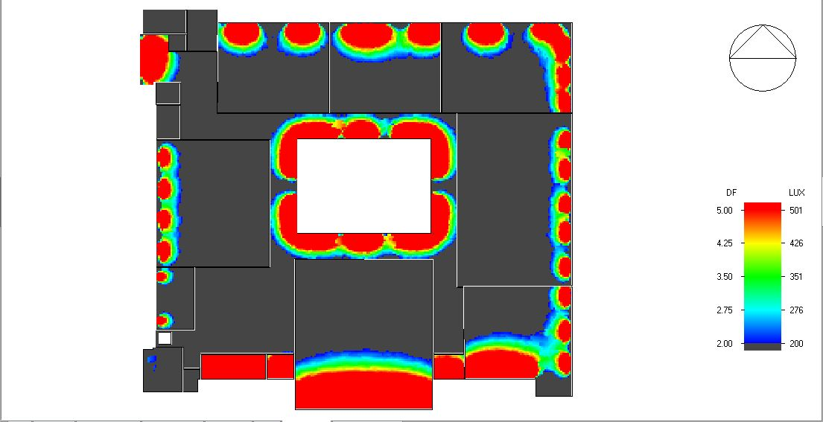
Environmental Design.
Natural daylight analysis.
Existing building F.F
New design building F.F

Slide 35
Environmental Design.
Simulation results were :
Compare building | Heating design KW | Cooling design KW | Intensity KWh\m^2
Existing | 293.39 | 351.52 | 205.01
New design | 220.51 | 500.5 | 127.94

Slide 36
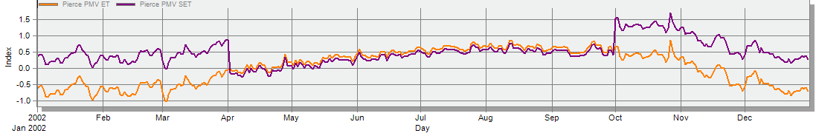
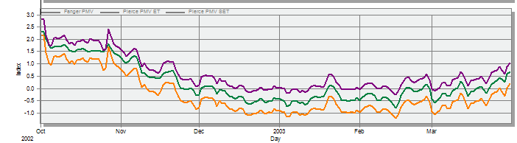
Environmental Design.
Comfort :
New design Building :
Existing Building :

Slide 37
Solar Cells Design:
We used PVsyts software in order to have appropriate solar cells design.
Use Hanwha. With capacity has 330 WP
The module for design Pv cell is (1.68×1) m
174 Modules were used.
Size of system = 57.5 Kwp.
Initial cost of the system = 69240 $
Operation Cost = 1038.6 $/year.
Electricity Production = 106000 KWh/yr.
Annual Saving = 106000* 0.17 = 18020 $/yr.
Payback Period = 70278.6/18020 = 4. 67 years

Slide 38
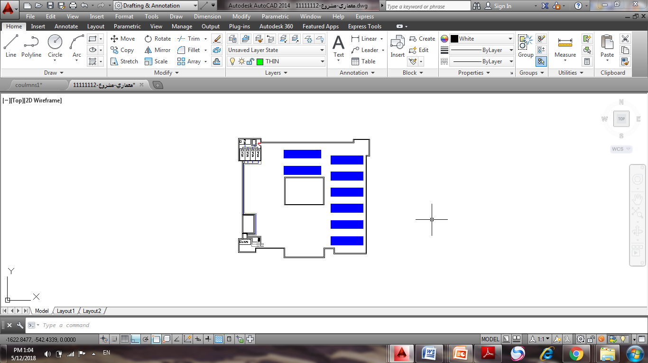
Solar Cells Design:
Modules Distribution:

Slide 39
Electrical
DESIGN

Slide 40
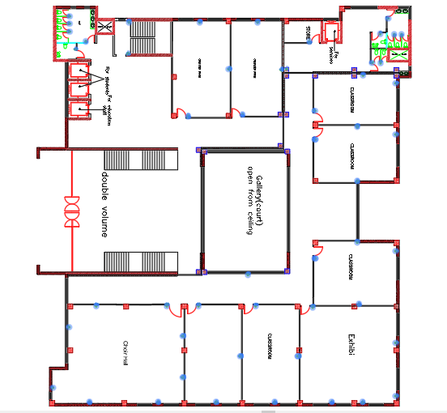
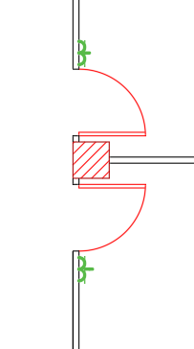
    Sockets Arrangement

Slide 41


    Lighting arrangement

Slide 42







    Artificial Lighting
    Computer lab:
    New Design Existing computer lab
surface | Result | Min | Max | Threshold value
Computer user plane | UGR | 11.5 | 25.4 | 19

Slide 43


Artificial Lighting
Computer lab:
New Design Existing computer lab

Slide 44





Artificial Lighting
Exhibition:
New Design Existing computer lap.

Slide 45



Artificial Lighting
Chorus Hall:

Slide 46
Total power in G.F = 19088.09 Watt
Artificial Lighting
Space name | Lamps names | Number of luminaries | Total power (W) | Total Load (Amp)
All classroom | Flores(RC125B W60L60 1xflor34S/680 NOC) | 53 | 6172 | 10
Computer lap | Flores +Led (RC148B W60L60 1xLED34S/840 NOC) | 32 | 3588 | 10
Corridors | led ( Rc123 | 25 | 2468.8 | 10
Exhibit | led+ Flore | 30 | 2489 | 10
Chorus Hall | led Flores | 35 | 2930.7 | 12
Total power in building = 97440.45 KW

Slide 47

Mechanical DESIGN

Slide 48


5 water tanks is used, each one has a volume of 9 m² as shown:
Mechanical DESIGN
  Water Supply System:
water supply tank for the faculty
Water supply tank volume = 45*1000 = 45000 L/d, which is equivalent to 45m³.
The available water supply tank on the existing faculty as mentioned earlier is 40m³ which is less than the required volume (45 m³).

Slide 49


Mechanical DESIGN
Water Supply System
New Design
Existing building

Slide 50




Mechanical DESIGN
Water Supply System

Slide 51


Mechanical DESIGN
Drainage system:
Grey water
The required pipe diameter and slope = 2’’and 2% slope

Slide 52


Mechanical DESIGN
Drainage system:
Grey water

Slide 53


Mechanical DESIGN
Drainage system:
Black water

Slide 54
Mechanical Design:
HVAC Design:
Multi split unit system ( Casttet ) was used for all buildings rooms
The system was selected from a DAIKIN’s company
Main component of Multi split unit system is:
1- Outdoor unit.
2- Controller.
3- Indoor units.
4- Pipes.

Slide 55

Mechanical Design:
HVAC Distribution:

Slide 56

Mechanical Design:

Slide 57




Safety Design:
Automatic sprinkler system.
ExtinguisherFM200
Hose station.
Warning signs.
Smoke detectors

Slide 58

Distribution of fire suppression system in ground floor:

Slide 59

Distribution of fire suppression system in ground floor:

Slide 60

Distribution of Escape Route system in ground floor:

Slide 61

Reflected Celling

Slide 62

Reflected Celling

Slide 63
Total cost
The total cost of the building = 10,052,190.3 LIS
The Unit cost = 916 LIS/m^2

