Slide 1
raduation Project 2
An experimental investigation of the impact of the dust deposition on the performance of the PV systems at different tilt angles in Palestine conditions
G
Students: Supervisor:
Mohammad Khader Dr. Remez Khaldi
Khalil Daraghmeh
Karam Ali
Abdullah Mansour

Slide 2
Overview
Introduction
Methodology
Challenges
Results & Discussion
Conclusions
Recommendations

Slide 3
Introduction
Energy types , renewable or non-renewable.
Palestine is 100% dependent on neighboring countries for fuel , and 87% for electricity.
Palestine is exposed to approximately 3,000 hours of solar radiation annually .

Slide 4
Factors affecting efficiency
Orientation
Tilt Angle
Cleaning
Temperature
Shading

Slide 5
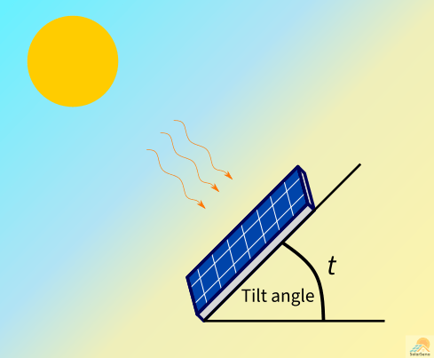

Optimum tilt angle in palestine is 29°.
The standard temperature for panels in is 25°.
The power generation factor
in Palestine is around
5.5 kWh/$m^{2}$/day.
= 29 °

Slide 6
Sources of dust particles
Activities of people in the area.
The smoke of factories.
Salts resulting from the evaporation of sea water.
Desert sands.
Pollutants and dust from the environment.

Slide 7
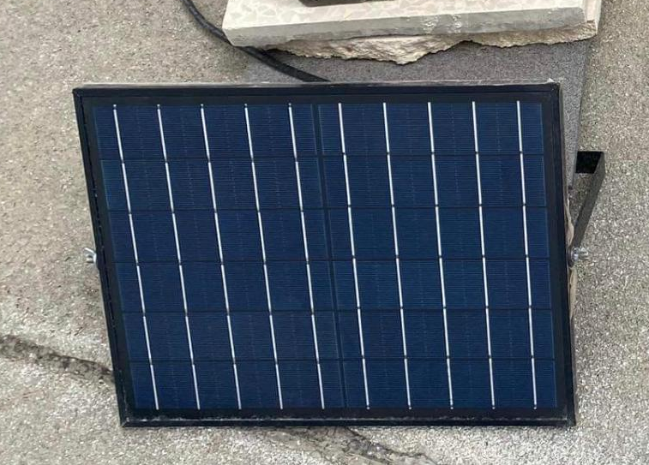
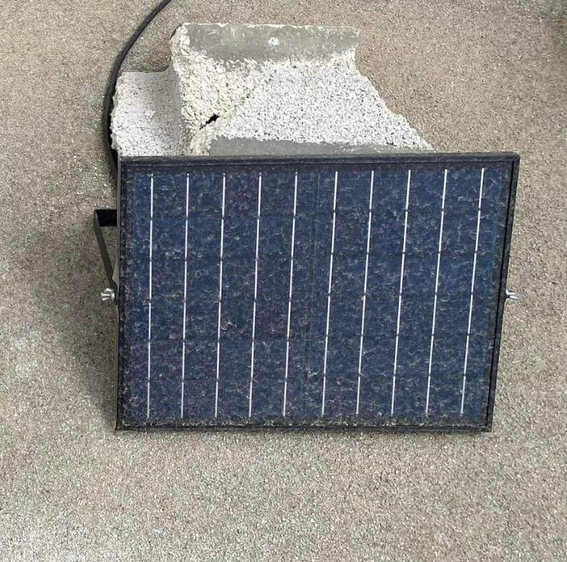
We will collect the tilt angle and dust accumulation in one study to find out the relationship between them.

Slide 8
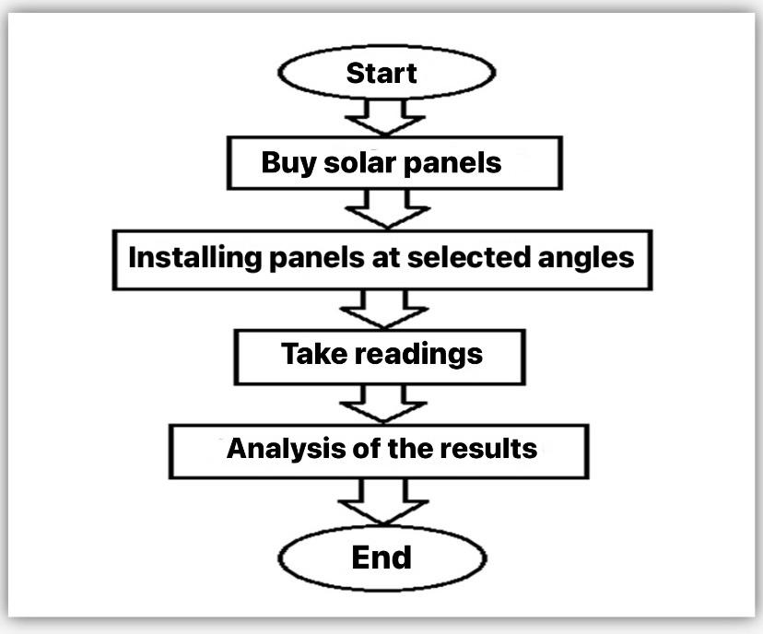
Methodology
The work plan

Slide 9
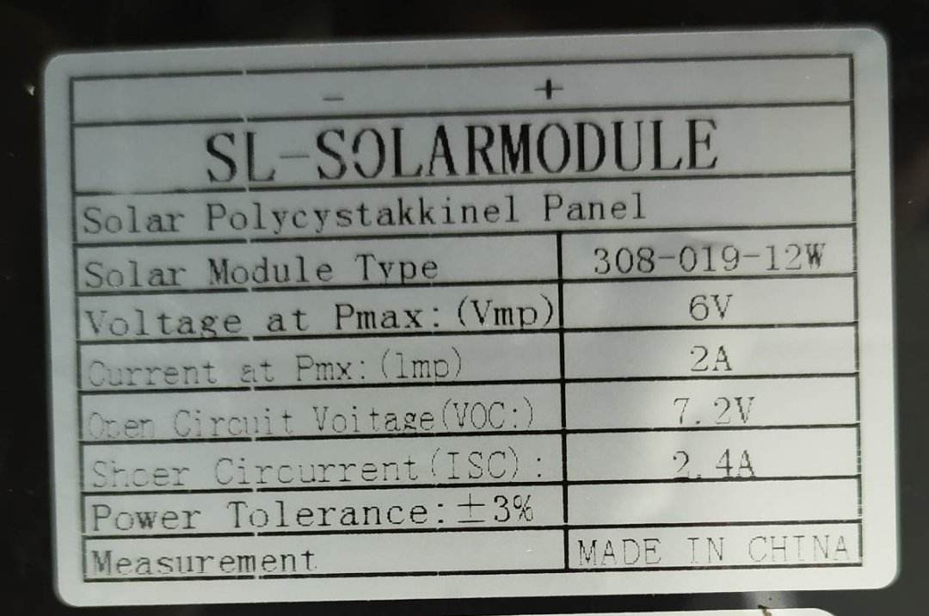
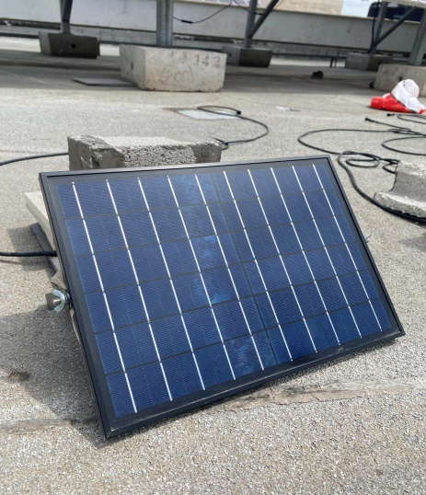
Selected PV module was from module type of 308-019-12W

Slide 10
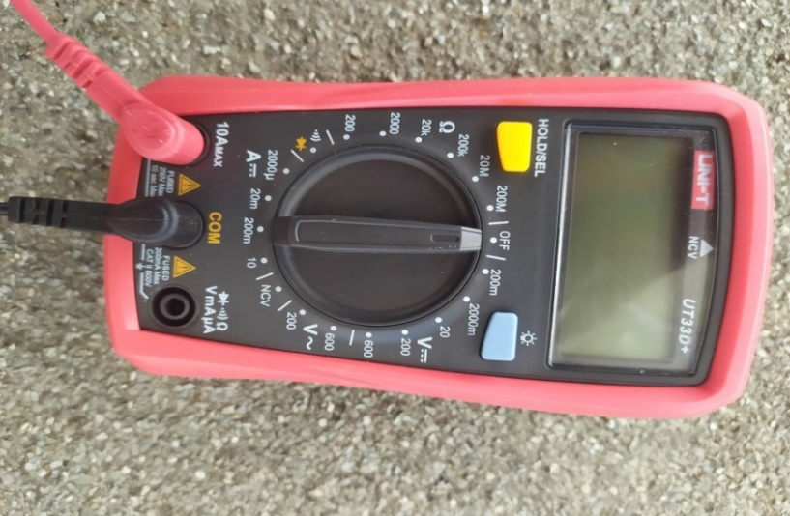
Measurement Equipment:
Current & Voltage Measurements by Using multi-meter
UT33D+

Slide 11
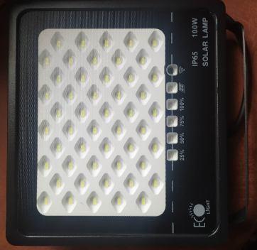
Light will be connected as load
Module T001E 100watt

Slide 12
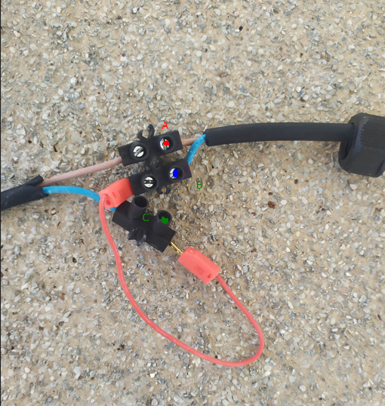
Measurement Process
1- Voltage measurement:
• Multi-meter wires on A and B in
Volt-meter mode on the right scale.
2- Current measurement:
• Remove red wire.
• Multi-meter on A and C in Ammeter mode on the right scale.
3- Power Measurment:
• Using power equation.

Slide 13

Soiling effect calculation :
The equation will be used to calculate the power efficiency in our project:
$$⧍P=\frac{Pd – Pc}{Pd}x100\%$$
Pd : Power of the uncleaned/dusted panels.
Pc: Power of the cleaned panels.
⧍P: Power difference between the cleaned and uncleaned/dusted or soiling loss percentages.

Slide 14
Results and discussion
The energy produced for the same angle at the same time for both the clean and .dirty plates was calculated
Weather conditions were taken into account while taking the readings, as the weather was not stable during the project period.

Slide 15
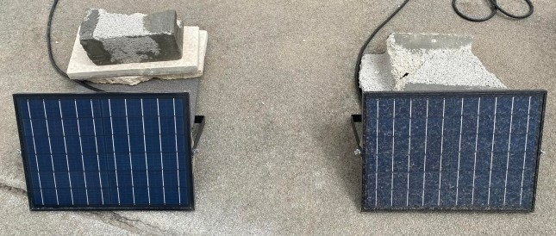
The dust was formed was decent enough to show power loss. in the images below
the PV panels has reached the peak of accumulated dust:
panel angle 0°.
panel angle 30°.
panel angle 15°
panel angle 45°

Slide 16
Average soiling loss per day
Days | Soiling Loss table
 | 0° | 15° | 30° | 45°
03-May | 3.86% | 3.05% | 3.46% | 0.58%
07-May | 2.43% | 1.81% | 1.37% | 0.89%
09-May | 5.55% | 5.05% | 4.88% | 3.86%
14-May | 5.34% | 3.52% | 3.09% | 2.04%
21-May | 9.07% | 3.74% | 3.33% | 0.68%
24-May | 9.59% | 4.45% | 3.98% | 1.39%
31-May | 16.52% | 15.12% | 10.85% | 1.69%
01-June | 18.89% | 15.29% | 12.10% | 3.53%
03-June | 20.59% | 19.41% | 13.95% | 8.11%

Slide 17
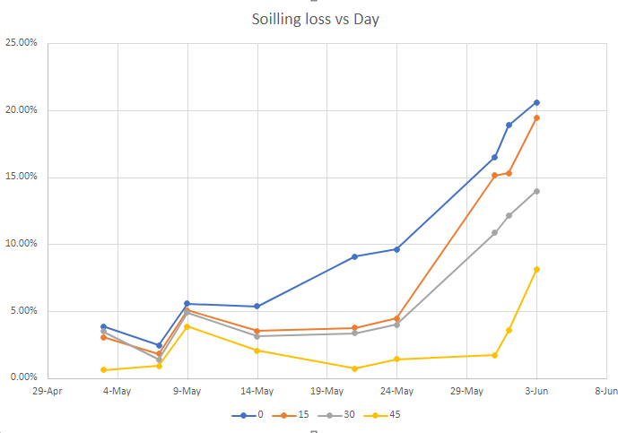

Slide 18
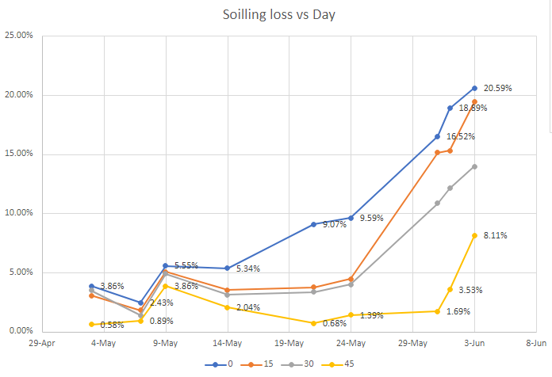
This graph above shows the soiling loss between the lowest soiling scenario and highest soiling scenario, for angles 0 & 45.

Slide 19
Average soiling loss per Weekly
Period | 0° | 15° | 30° | 45°
First week 3-May to 9-May (6d) | 3.95% | 3.30% | 3.24% | 1.77%
Second week 9-May to 14-May (5d) | 5.45% | 4.29% | 3.99% | 2.95%
Third week 14-May to 21-May (7d) | 7.21% | 3.63% | 3.21% | 1.36%
Fourth week 21-May to 31-May (10d) | 11.73% | 7.77% | 6.05% | 1.25%
Fifth week 31-May to 3-Jun (4d) | 18.67% | 16.61% | 12.30% | 4.44%

Slide 20
Average soiling loss per 2 weeks.
Period | 0° | 15° | 30° | 45°
First two weeks 3-May to 14-May (11d) | 4.29% | 3.36% | 3.20% | 1.84%
Second two weeks 14-May to 24-May (10d) | 8.00% | 3.90% | 3.47% | 1.37%
Third two weeks 24-May to 3-Jun (11) | 16.40% | 13.57% | 10.22% | 3.68%

Slide 21
Average soiling loss Monthly
Period | 0° | 15° | 30° | 45°
Monthly Average | 10.20% | 7.94% | 6.33% | 2.53%

Slide 22

Sample of Calculations :
For day of 9-May three readings was taken:
For First reading: Cleaned panel ( I = 1.65A, V= 3.23 V) and Dusted panel (I = 1.56 A , V = 3.22 V ).
.For cleaned panel of 0° tilt angle: P = I x V = $1.65×3.23= 5.3295 watt$
.For dusted panel of 0° tilt angle: P = I x V = $1. 56×3.22 = 5.0232 watt$
$$⧍P=\frac{5.0232 – 5.3295}{5.0232}x100\%= −6.10\%$$
One of the readings was excluded because it is abnormal , so we have 2 readings now 5.00% and 6.10%, taken the average of them
$$\frac{5\%+ 6.10\%}{2}=5.55\%$$

Slide 23
Breaking point.

Slide 24
Challenges
- The weather, from rain to clouds.
Adjust the panels to the best orientation.
Find the right measuring device.
The strikes & inability to reach the project.

Slide 25
Conclusion:
The more the angle increased the lesser the dust affect.
The dust requires time until it forms decent impact on the generated power.
There was rainy days that surely caused the dust to be reduced.
it took more time for the dusted panels to show degradation in performance.

Slide 26
Recommendations:
More PV panels should be taken to guard against inaccuracy factors.
PV analyzer is a superior device in comparison with Multi-meter.
Taking readings for tilt angle of 55° or 60° to observe more knowledge of higher angles soiling loss reduction.
Expanding the period of study.

Slide 27
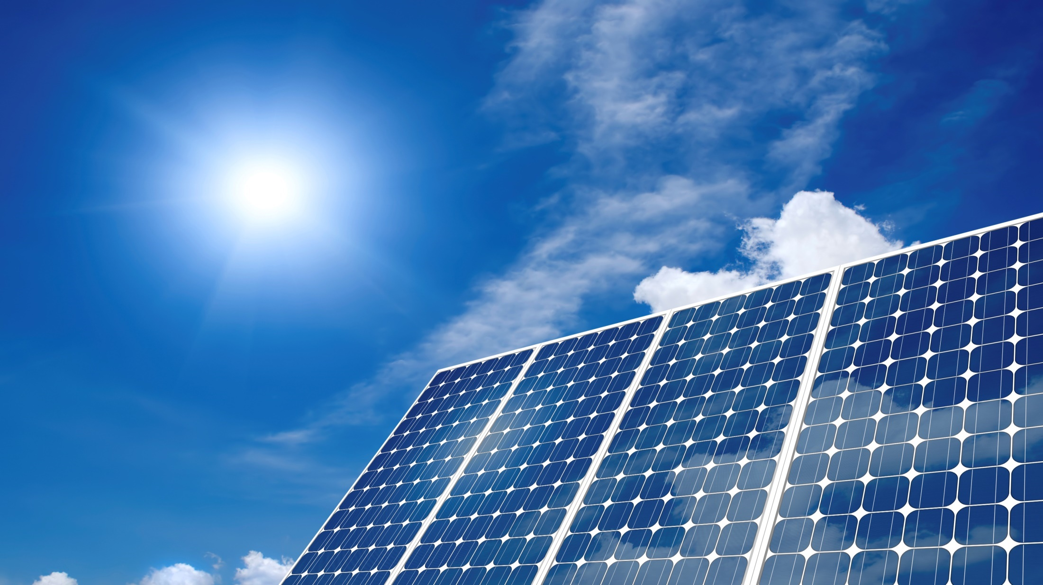
thanks!
Any Questions ?

