Slide 1

An-najah National University
Friendly Student Hostel
Presented by:
Ahmad Amudi
Hiba Abbas
Ruba Tumeh
Samah Tayy Abdelqader
Supervisor:
Eng. Moayad Salhab
18.5.2016

Slide 2
Outline
Introduction
Site Analysis
Architectural Design
Environmental Design
Structural Design
Electrical Design
Mechanical Design
Safety

Slide 3
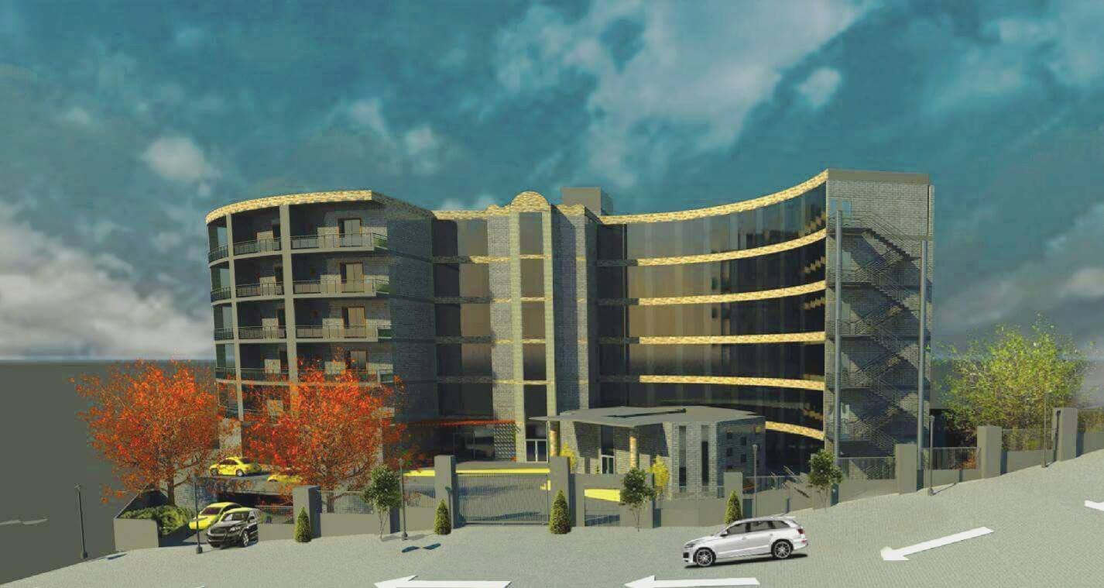
Introduction

Slide 4
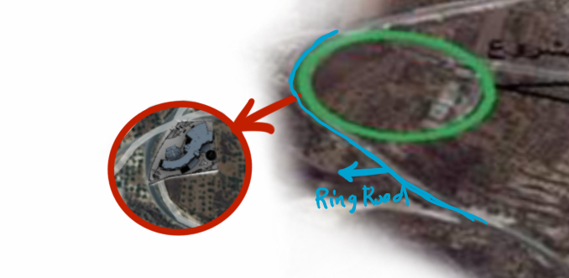
Location
The site of the project is located in Nablus City.
The land of the project:

Slide 5
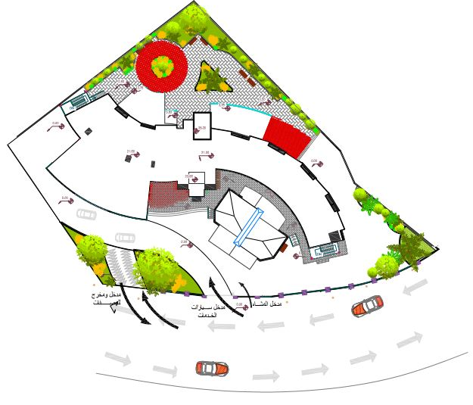
Architectural Design
Site Plan

Slide 6
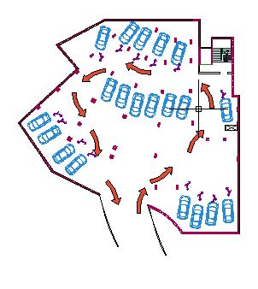
Architectural Design

Slide 7
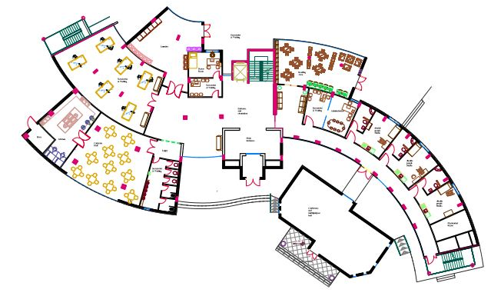
Architectural Design
Ground Floor

Slide 8
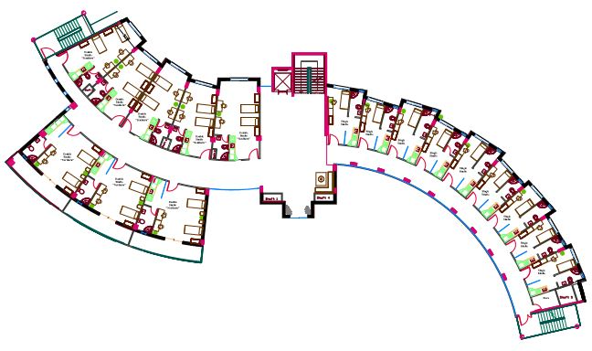
Architectural Design
First Floor

Slide 9
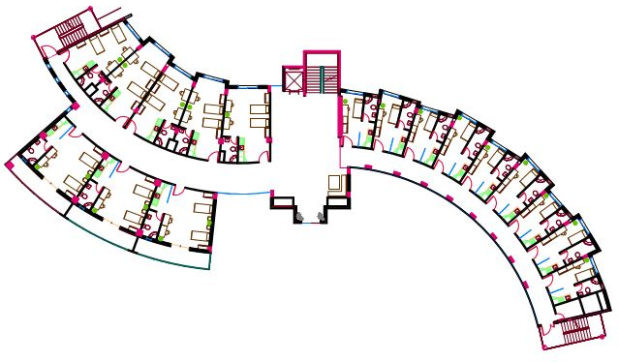
Architectural Design
Second Floor

Slide 10
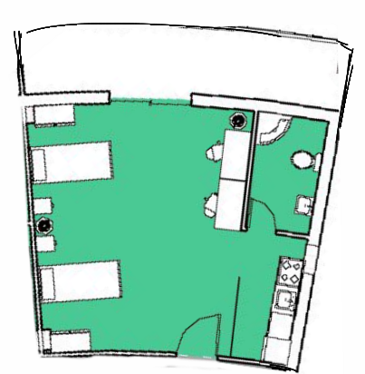
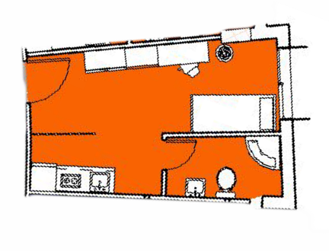
Architectural Design
Functions Areas
Single Studio
Double Studio

Slide 11
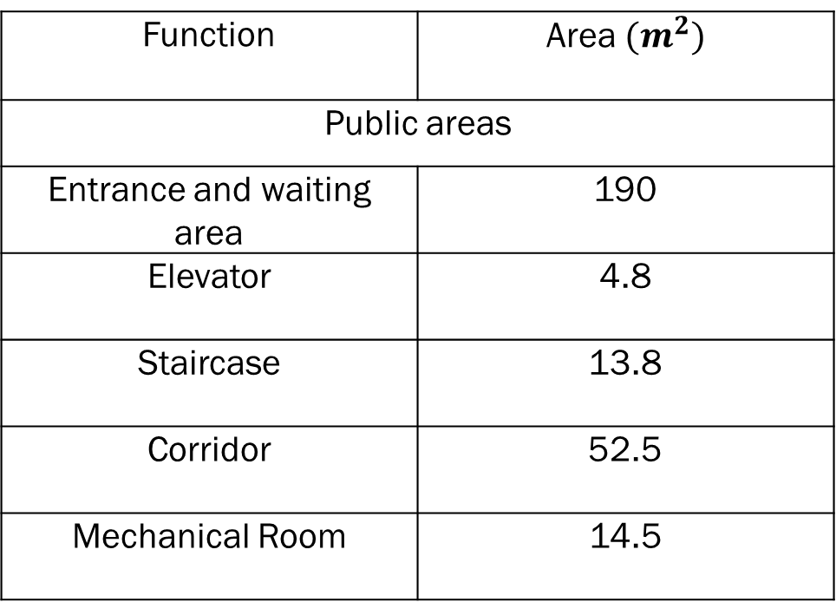
Architectural Design
Functions Areas
Function | Area ${(m}^{2})$
Public areas
Entrance and waiting area | 190
Elevator | 4.8
Staircase | 13.8
Corridor | 52.5
Mechanical Room | 14.5

Slide 12
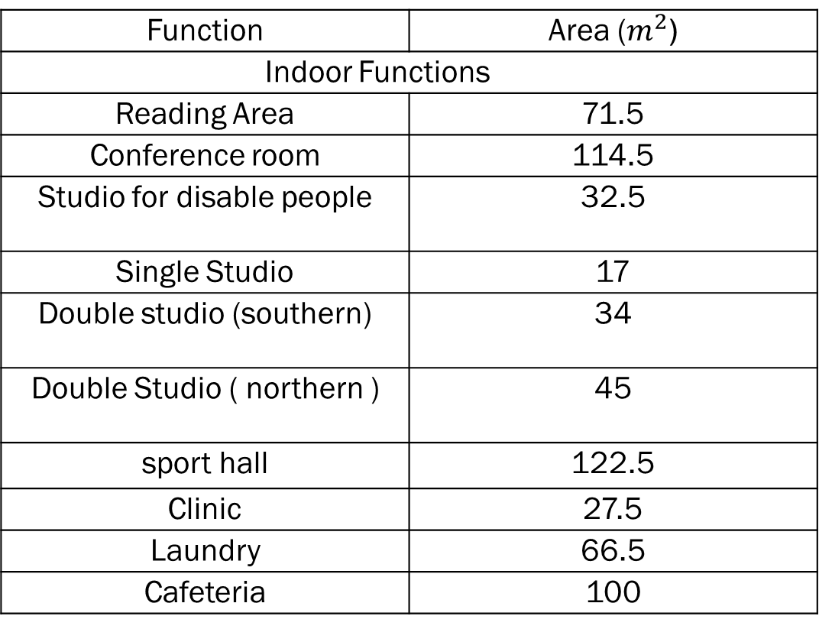
Architectural Design
Functions Areas
Function | Area ($m^{2}$)
Indoor Functions
Reading Area | 71.5
Conference room | 114.5
Studio for disable people | 32.5
Single Studio | 17
Double studio (southern) | 34
Double Studio ( northern ) | 45
sport hall | 122.5
Clinic | 27.5
Laundry | 66.5
Cafeteria | 100

Slide 13
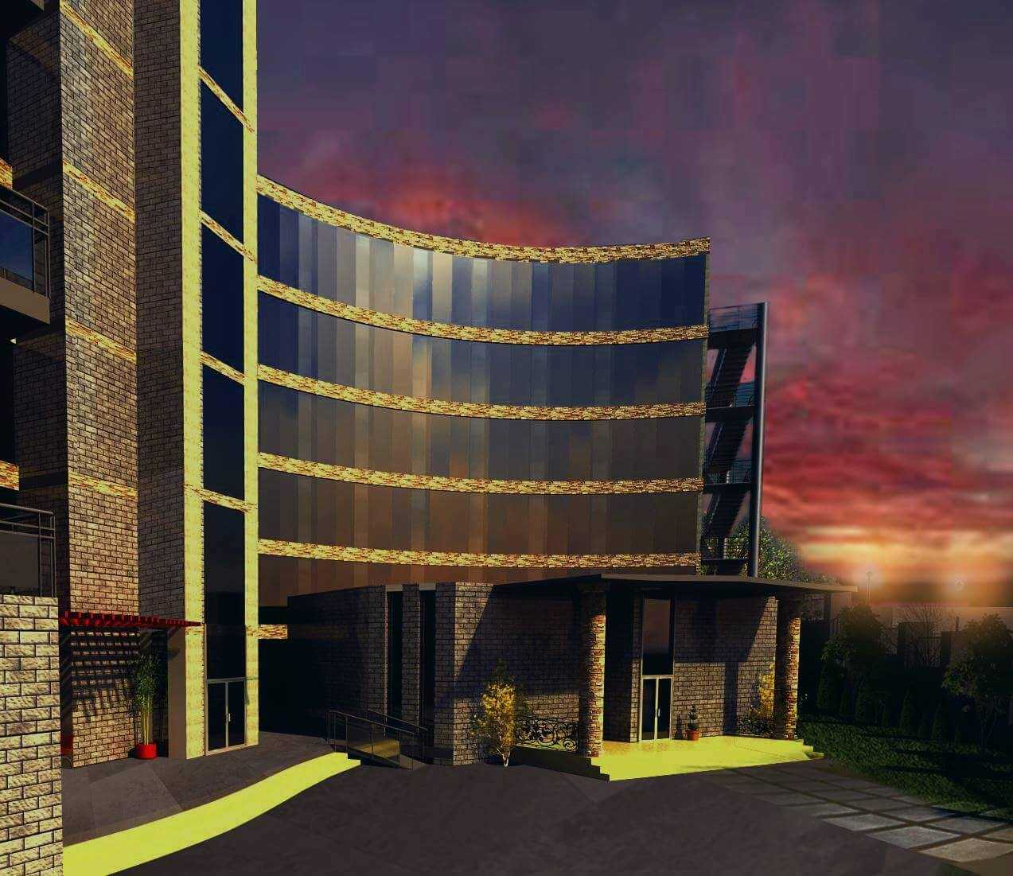
Architectural Design

Slide 14
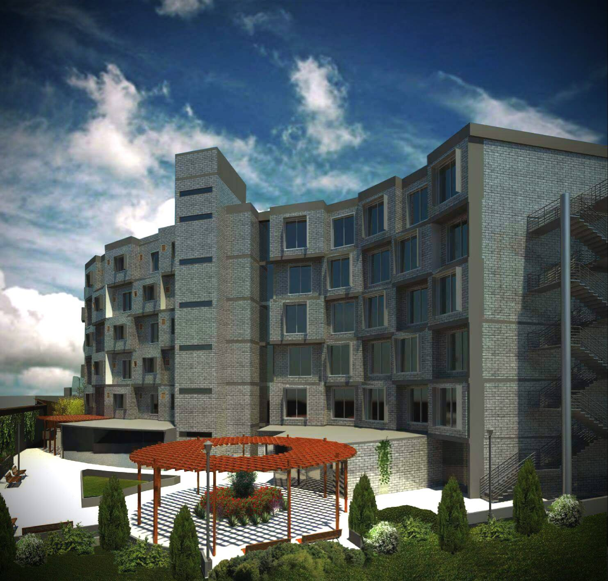
Architectural Design

Slide 15
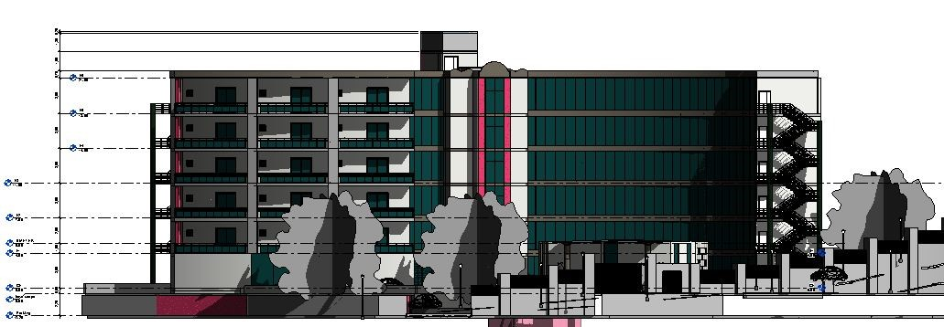
Architectural design
Elevations
North Elevation

Slide 16
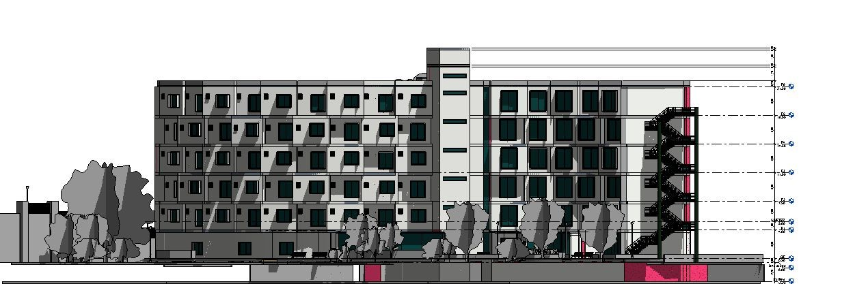
Architectural design
Elevations
South Elevation

Slide 17
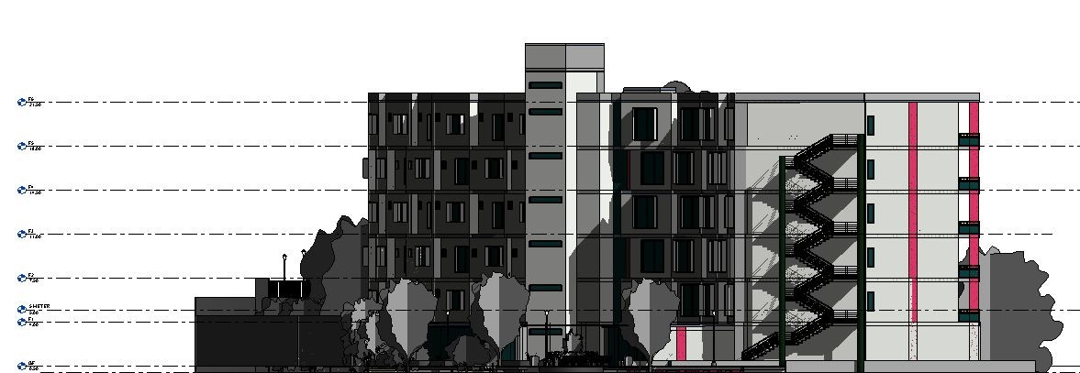
Architectural design
Elevations
East Elevation

Slide 18
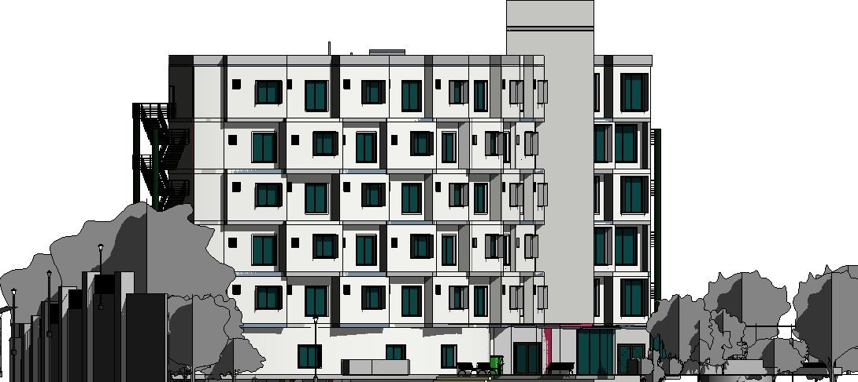
Architectural design
Elevations
West Elevation

Slide 19
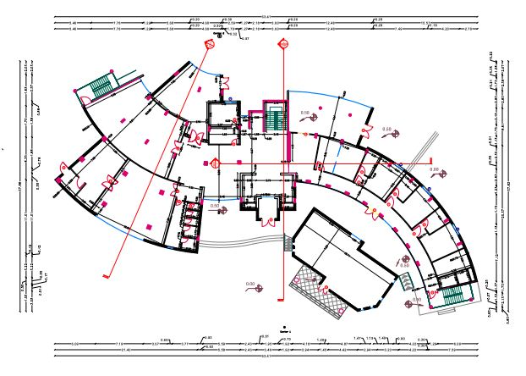
Architectural design
Ground Floor

Slide 20
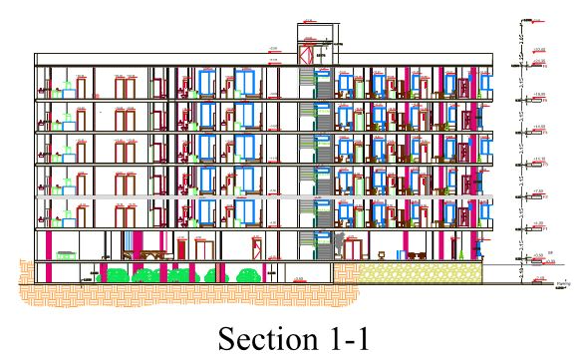
Architectural design
Sections

Slide 21
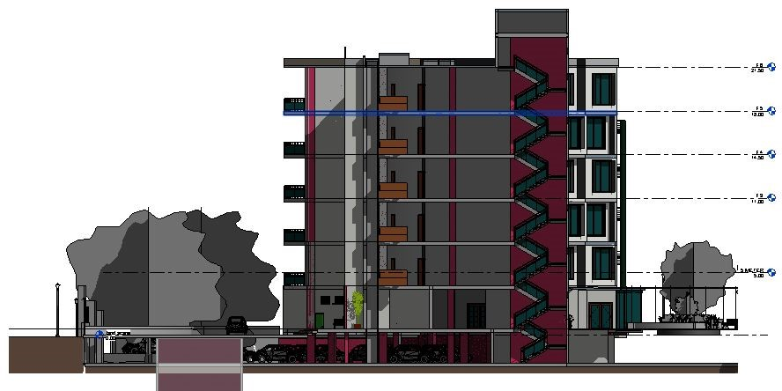
Architectural design
Sections
Section 2-2

Slide 22
Environmental Design:

Slide 23
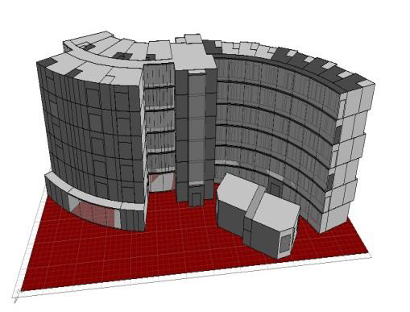
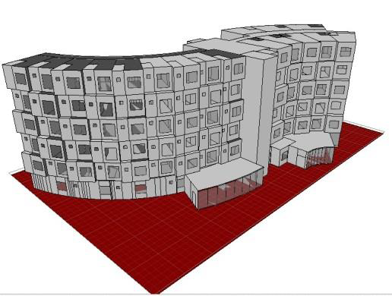
Building the Project in Ecotect

Slide 24
Shading Devices

Slide 25
Aspects taken in consideration in Environmental Design
Architectural Design
Surrounding Buildings

Slide 26

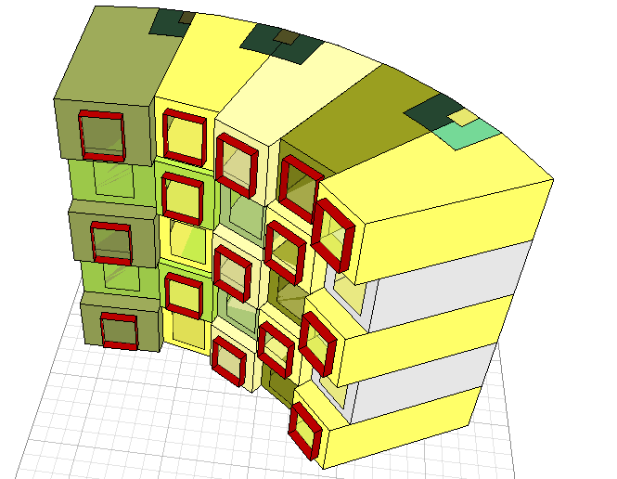
Studios

Slide 27
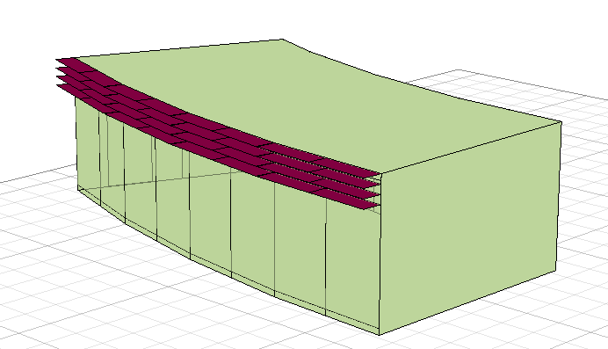
Reading area

Slide 28
Daylight Factor (DF%)

Slide 29
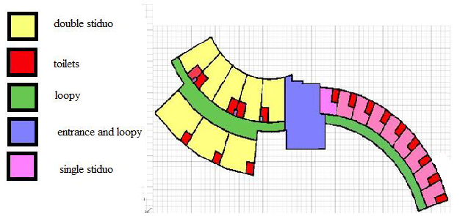
DF%
Single Studio #1
Recommended DF (%) | Achieved DF (%) | Recommended Illuminance (Lux) | Achieved Illuminance (Lux)
2.9-5.8 | 3.76 | 250-750 | 320
Double Studio #2 (South)
Recommended DF (%) | Achieved DF (%) | Recommended Illuminance (Lux) | Achieved Illuminance (Lux)
2.9-5.8 | 3.33 | 250-750 | 283

Slide 30
Thermal Analysis

Slide 31
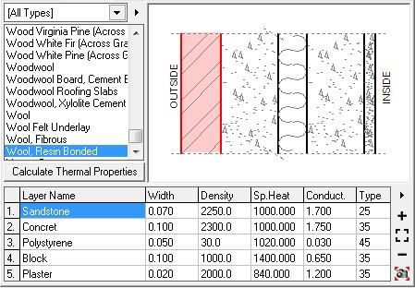
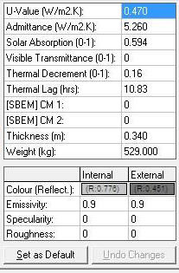
Properties of External Wall Layers

Slide 32
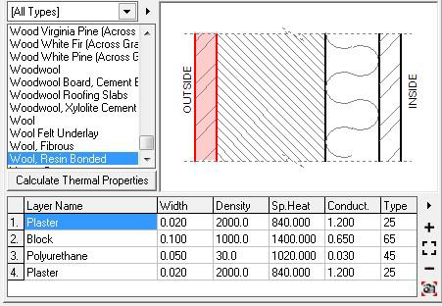
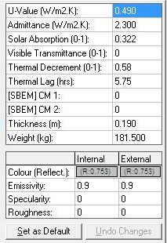
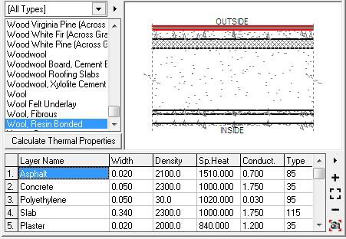
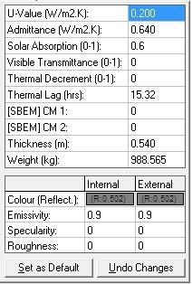
Partition layers and properties
Roof layers ) and properties

Slide 33
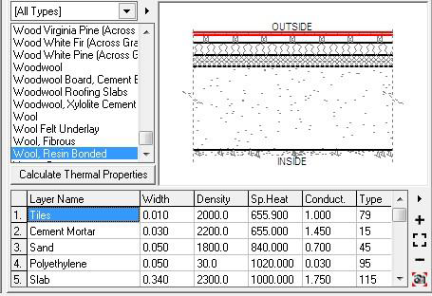
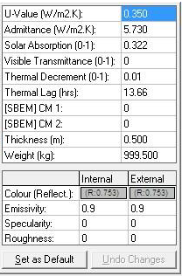
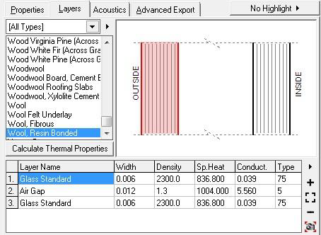
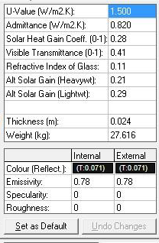
Floor-Ceiling layers
and properties
Glass layers and properties

Slide 34
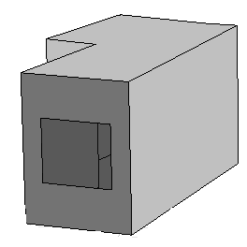
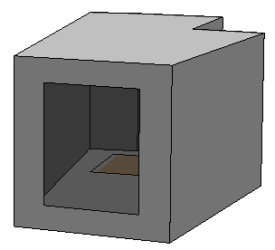
Monthly heating and cooling loads:
Mixed mode system Vs. full air conditioning system:
 |  | Mixed Mode Ventilation System |  | Full Air Conditioning System
Single Studio | Total per m² (Wh) | 16477 |  | 40017
 | Floor Area (m²) | 19.243
Double Studio | Total per m² (Wh) | 19870 |  | 31753
 | Floor Area (m²) | 33.371
Reading Area | Total per m² (Wh) | 35106 | 97858
 | Floor Area (m²) | 69.644

Slide 35
Acoustical Analysis

Slide 36
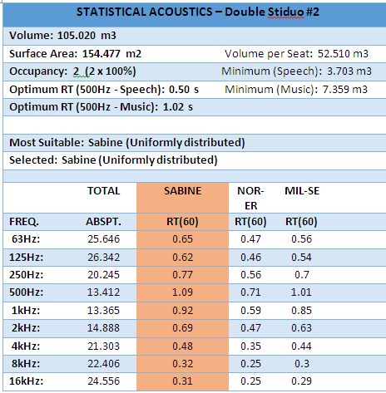
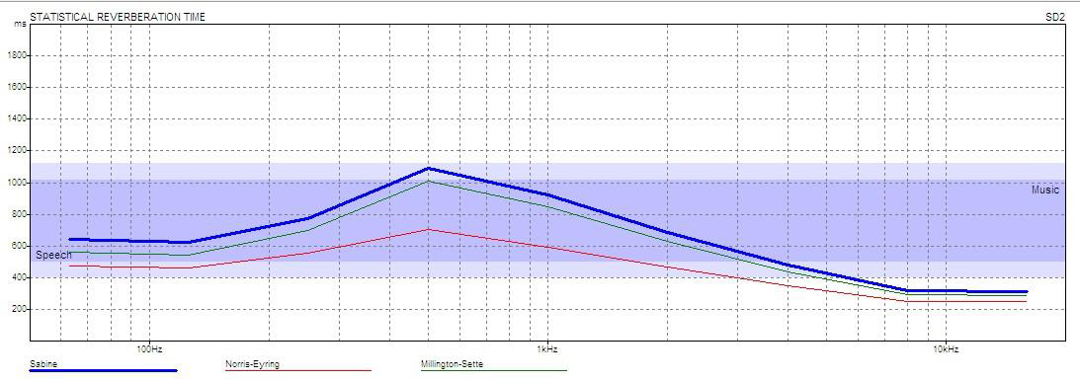
RT60 (double studio)

Slide 37
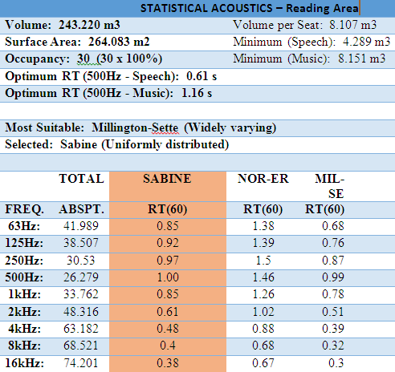
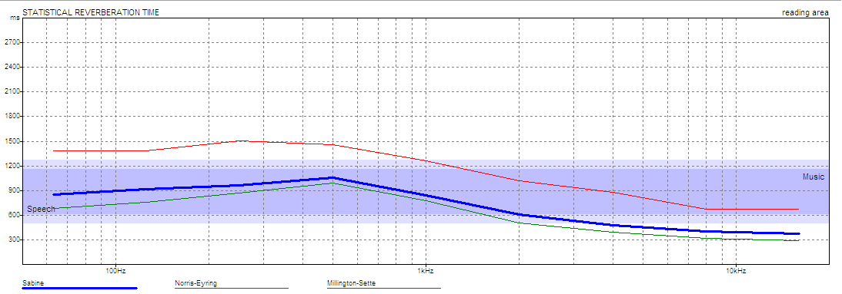
RT60 (Reading Area)

Slide 38
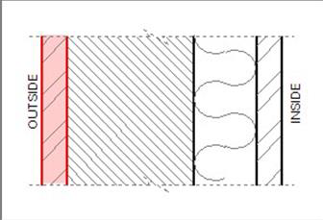
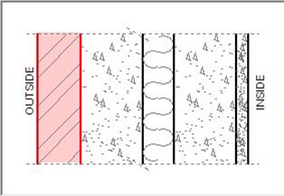
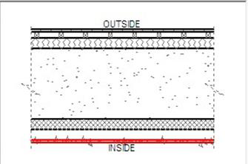
STC and IIC:
STC for Partition STC for walls
STC =57 dB | STC =56 dB
IIC for Ceiling IIC=70dB

Slide 39
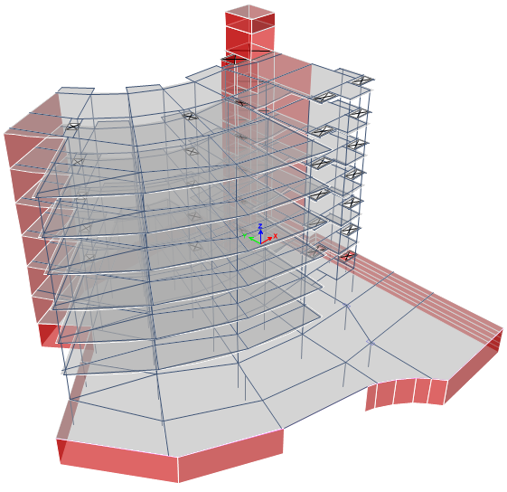
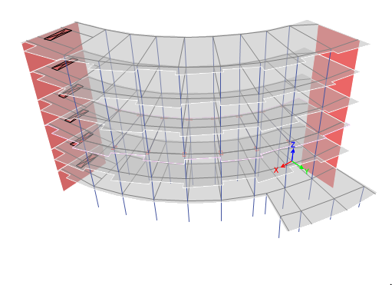
Structural Design

Slide 40
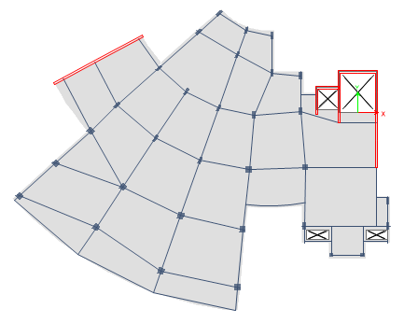
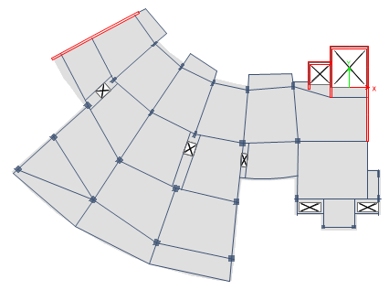
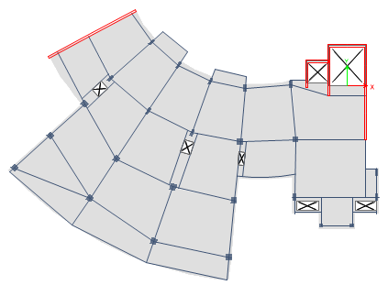
Structural Design
Block 1 :

Slide 41
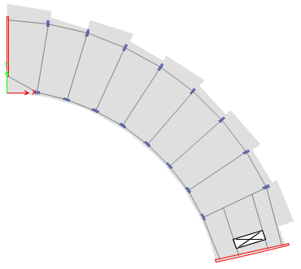


Structural Design
Block 2 :

Slide 42

Structural Design
Seismic Data:
Zone : 2B
Cv | 0.2
Ca | 0.2
Importance factor (I) | 1
Reduction factor R | 5.5
Ground acceleration | 9.81
Scale Factor | 1783

Slide 43
Structural Design
The two blocks are valid for :
1- Compatibility check.
2- Equilibrium check.
3- Stress strain relationship (local check).
4- Deflection check.

Slide 44


Structural Design

Slide 45
Structural Design
Dynamic design for block 1
Period Check :
T_{standard} = 0.781 sec
From ETABs:
T_{ETABs} =0.592 sec

Slide 46

Structural Design
Drift Check

Slide 47
Structural Design
Slab:
Thickness of the slab is 35 cm
Beams:
1. Drop
2. Hidden

Slide 48

Structural Design
Column Reinforcement:

Slide 49
Structural Design
Isolated
Combined
Mat
Footing Designed Result:

Slide 50

Structural Design
Water tank:

Slide 51

Structural Design
Shear Wall:

Slide 52
Electrical Design
1. Artificial Lighting
Dialux Evo was used to obtain the best lighting design
Factors taken into consideration during the design:
Standard required illuminance
Glare
2. Circuit Breakers

Slide 53

Electrical Design
Artificial Lighting Design Results
(Single Studios)
Disable People Studio
Height of Room
3.5m
Reflection factors
Ceiling | 84.4%
Walls | 57.3%
Floor | 82.4%
Maintenance Factor
0.8

Slide 54
Electrical Design
Artificial Lighting Design Results
(Single Studio)
Work Plan Results
Targeted Illumination (Lux) | Minimum Illumination (Lux) | Maximum Illumination (Lux) | Mean Illumination (Lux) | Uniformity
500 | 324 | 920 | 501 | 0.65
UGR
Minimum UGR | Maximum UGR | Threshold Value
<10 | 16.9 | 19.0

Slide 55


Electrical Design
Artificial Lighting Design Results
Luminaires Used in Single Studios
Lamp Type | Luminaire Luminous Flux (Lm) | Power (Watt) | Color Temperature (Kelvin) | Color Rendering index (CRI)
LED5 | 370 | 8.0 | 3,000 | 100
TCS 2$×$TL | 6490 | 110.0 | 3,000 | 100

Slide 56


Electrical Design
Artificial Lighting Design Results
Single Studio Views

Slide 57

Electrical Design
Circuit Breakers
Rated current for circuit breaker for lighting: 10 Amp
Rated current for circuit breaker for sockets: 16 Amp
Lighting branches: for 50$m^{2}$ area we can use 1 branch
Sockets branches: for 4 sockets we use 1 branch
Special Loads: for each special load we use 1 branch

Slide 58


Electrical Design
Circuit Breakers for Typical floor
Function | No. L.C.B | No. S.C.B | No. S.L.C.B
Single Studios | 4 | 9 | 0
Double studios (North) | 2 | 6 | 0
Double Studios (South) | 3 | 10 | 0
Common Areas | 4 | 2 | 0
Item | Diameter $({mm}^{2})$
Lighting | 1.5
Sockets | 2.5
Circuit Breaker | Diameter $({mm}^{2})$
Typical Floor | 10

Slide 59
Mechanical Design
Water Supply System
Drainage System
HVAC System

Slide 60
Water Supply System
3 Shafts were used in water supply system.
First Floor | Vertical pipe diameter(inches) Main FW |  | Horizontal pipe diameter(inches) Main FW |  | Branch pipe diameter(inches) Main FW |  | Meter diameter(inches) Main FW
Shaft 1 | 3 | 2 ½ | 1 1/4 | 1 | ¾ | ¾ | 1 1/4 | -
Shaft 2 | 2 ½ | 2 | 1 | ¾ | ¾ | ¾ | 1 | -
Shaft 3 | 3 | 2 ½ | 1 | ¾ | ¾ | ¾ | 1 | -

Slide 61

Drainage System
Ground Floor

Slide 62

HVAC System
VRF System
VRF is Variable Refrigerant Flow system, it was adopted in our design
Several Internal Units can be connected to one external unit

Slide 63
HVAC System
VRF System
Single Studio
Max Heating: 1174 W at 01:00 on 18th January
Max Cooling: 1316 W at 08:00 on 22nd July

Slide 64

HVAC System
VRF System
Wall Mounted-GEN4 indoor unit was selected to be used in studios.
Selected Indoor Unit
Type | Wall Mounted-GEN4
Cooling Capacity | 5500 BTU/hr. (1.6 KW)
Heating Capacity | 6100 BTU/hr. (1.8 KW)
Power Supply | 208-230V/ 60Hz/ 1_{ᶲ}
Model Number | ARNUO53SBL4

Slide 65

HVAC System
VRF System
Multi VIV Heat Recovery 208-230V outdoor unit was selected to be used.
Selected Outdoor Unit
Type | Multi VIV Heat Recovery 208-230V
Frame Series | Triple Frame
Cooling Capacity | 408000 BTU/hr. (119.5KW)
Heating Capacity | 459000 BTU/hr. (134.5KW)
Power Supply | 208-230V/ 60Hz/ 3_{ᶲ}
Model Number | ARUB408BTE4

Slide 66

Safety Design

Slide 67



Safety Design
Fire Fighting System
Fire extinguishers
Sprinklers
Detection& Alarms

Slide 68
Ask me No Questions, Tell You No Lies!

