Slide 1
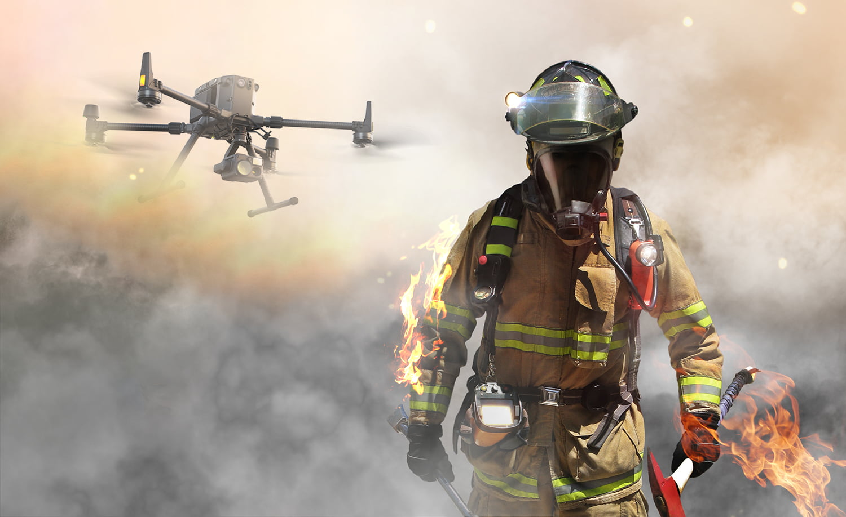

Fire-Fighter Drone
Done By:
Jaad Hussien
Mazen Quzmar
Laith Ishtaya
Department of Electrical Engineering
Supervisor:
DR. Falah Hasan & DR.Raed Jabr
5-2-2024
Notes:
https://unsplash.com/photos/m5P0c6ABWDs

Slide 2
Introduction
PROJECT OPJECTIVE
Electrical Components
Software and Programming
Conclusion
Outline

Slide 3
Introduction

Slide 4
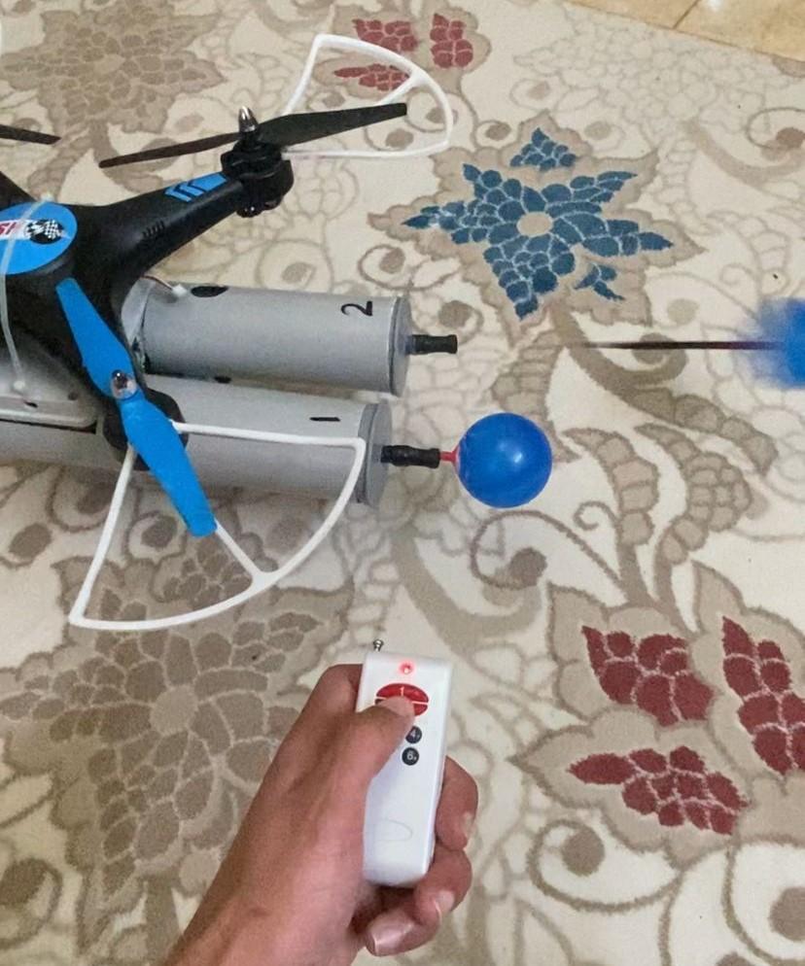
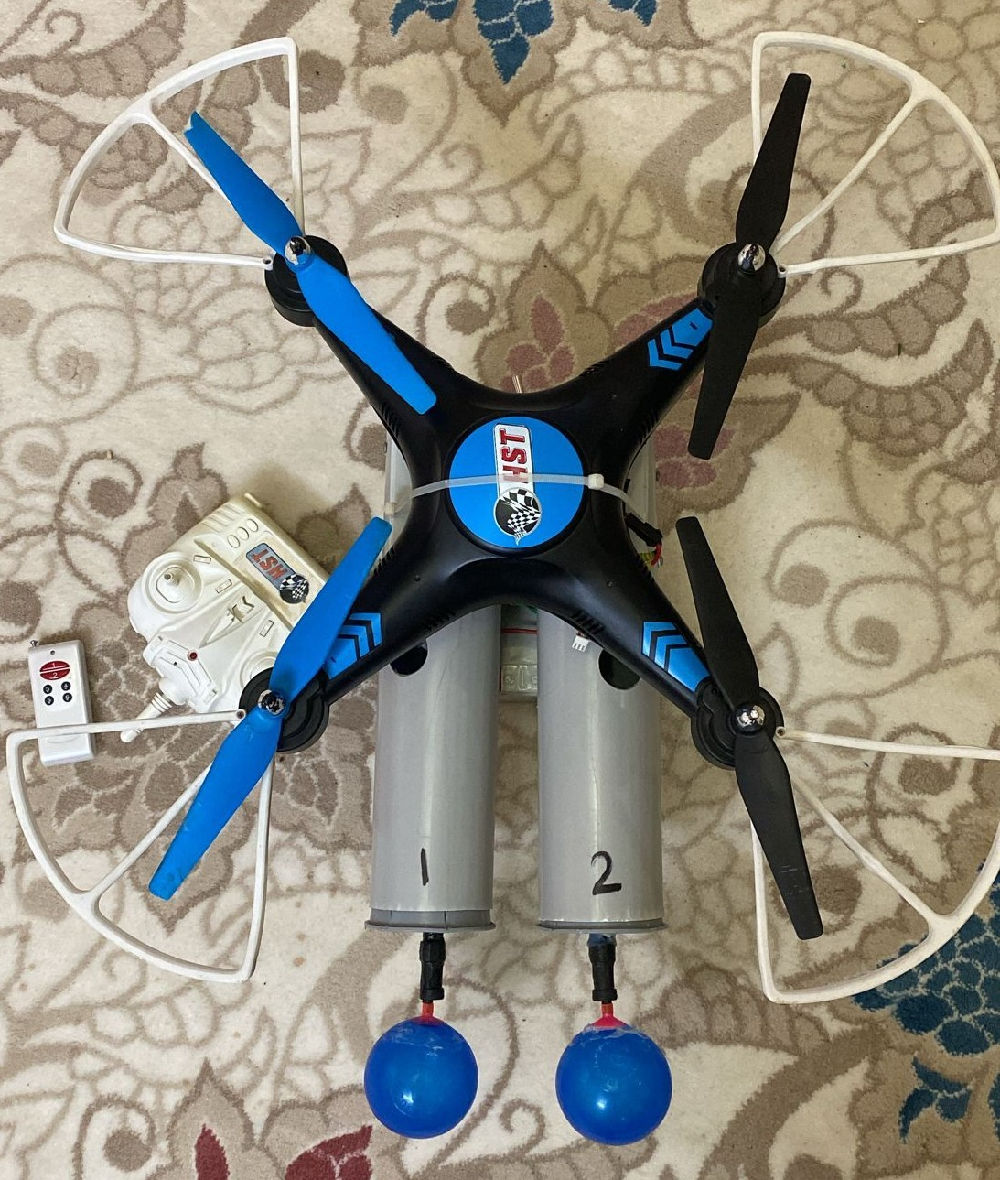
A firefighter drone, is an unmanned aerial vehicle designed specifically for firefighting
operations. These drones are equipped with specialized technology and tools to assist in
extinguishing fires, gathering data, and aiding firefighters in their tasks.

Slide 5
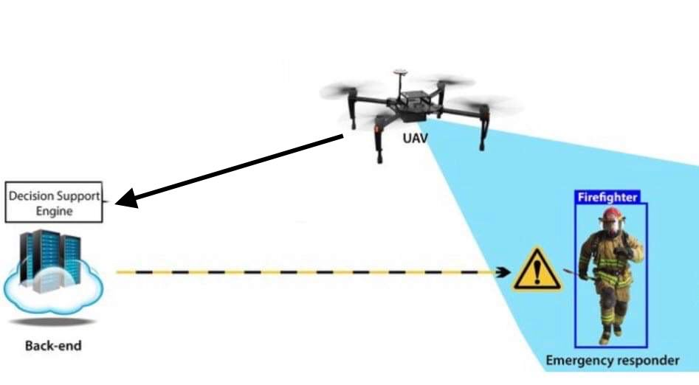
PROJECT OPJECTIVE
Firefighter drones can target various areas and perform specific tasks to assist in extinguishing fires. Here are some common drone targets for fire suppression:
Inaccessible Areas .
Support for Firefighters .
Economic benefit .

Slide 6
Electrical Components

Slide 7
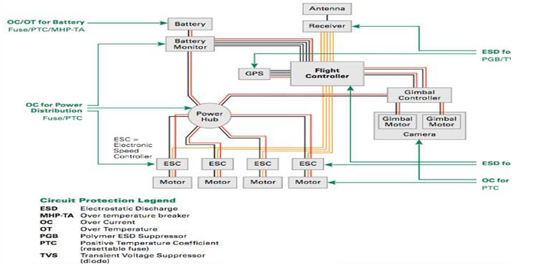
ELECTRICAL CIRCUIT DESIGN
This circuit shows the mechanism of installing the drone in general.

Slide 8
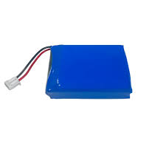
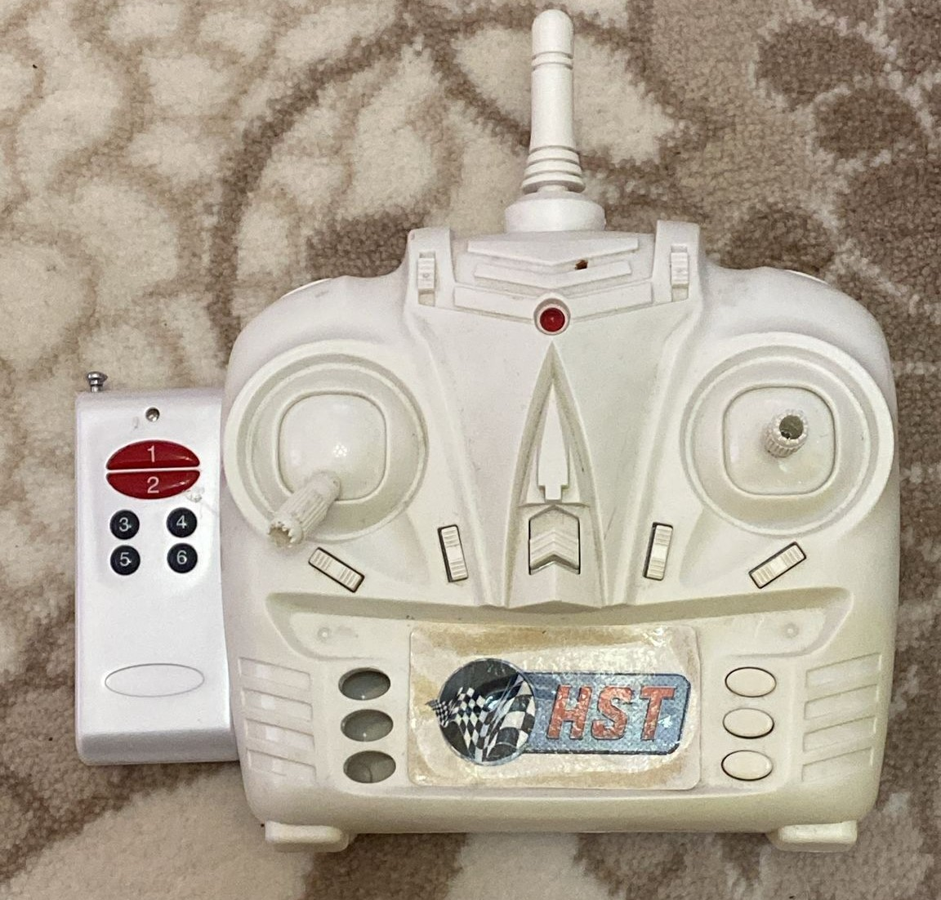
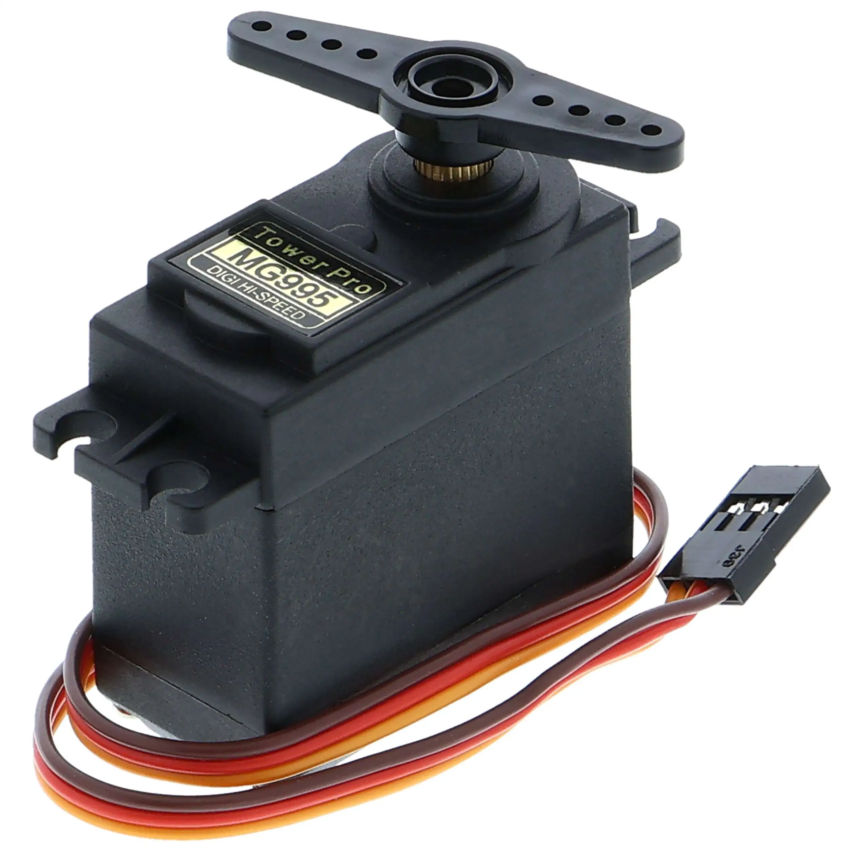
Electrical components
Battery (LIPO) Wifi controller servo motor

Slide 9
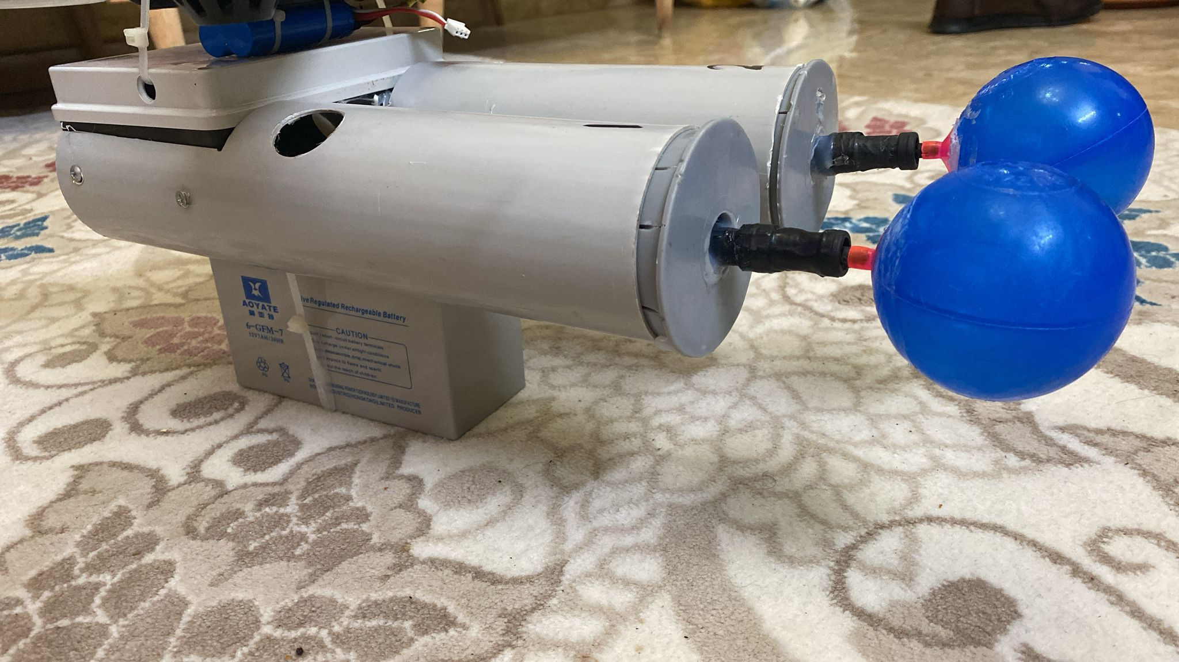
Ball launcher
Here are some key features and capabilities of a ball launcher firefighting drone:
Rapid response.
Safety.
Efficiency.
Remote Operation.

Slide 10
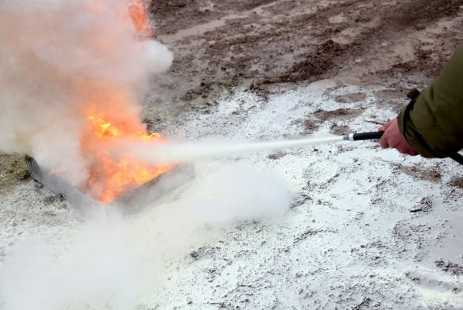
Fire extinguisher balls are small shaped automatic fire extinguishers that can be thrown to the fire and dispense fire-fighting substances within 3 seconds. The ball that will be launched from the drone contains the main fire extinguishing agent, which is ammonium phosphate
Monoammonium phosphate (MAP) is a widely used fire extinguishing agent, particularly in dry chemical fire extinguishers. It consists of ammonium dihydrogen phosphate (NH₄H₂PO₄) and is effective against Class A, B, and C fires. Class A fires involve ordinary combustibles like wood and paper, Class B fires involve flammable liquids, and Class C fires involve energized electrical equipment.
Fire Extinguisher ball

Slide 11
Software and Programming

Slide 12
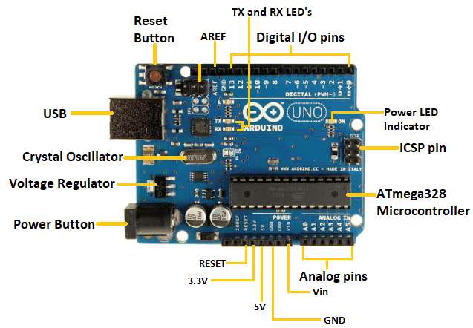
Arduino
The Arduino board will be Arduino Uno Rev3

Slide 13
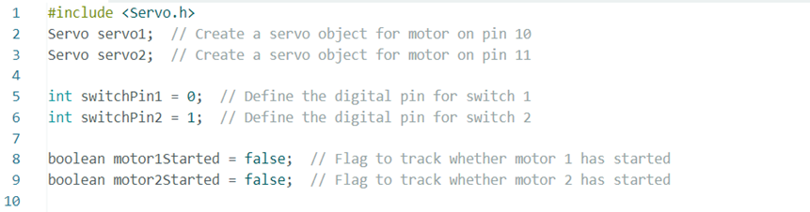
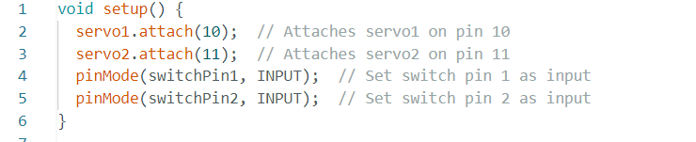
Arduino Code

Slide 14
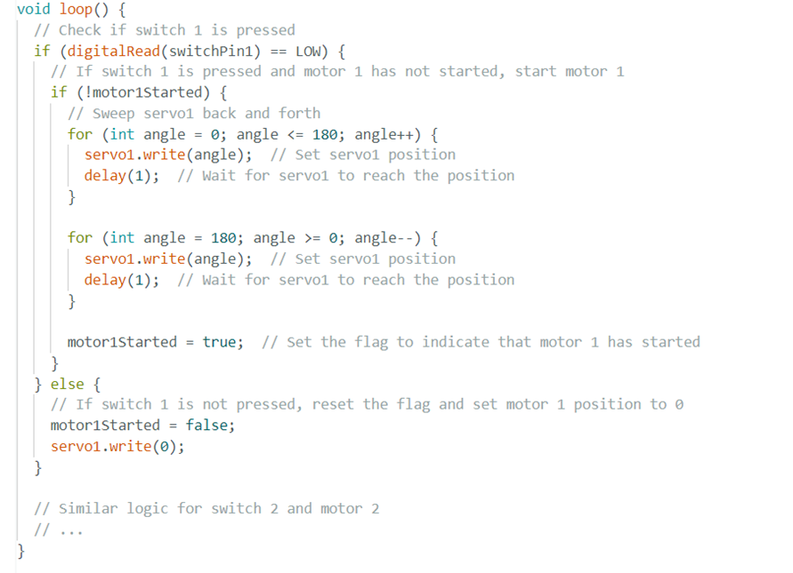

Slide 15
Economic analysis of project

Slide 16
component prices
Flight Controller : From 100nis to 200nis.
Motors: From 50nis to 150nis .
Propellers : From 20nis to 50nis .
Battery : From 75nis to 200nis .
communication System : From 100nis to 200nis.

Slide 17
Firefighting drone Maintenance
Like any other aircraft, firefighting drones require regular maintenance to ensure their proper functioning and longevity.
The maintenance costs for firefighting drones can vary depending on the type of drone, its components, and the frequency of use. Here are some factors that can affect the maintenance costs for firefighting drones .
Flight Hours.
Components.
Environmental factors.
Emergency repairs.

Slide 18
Conclusion
General conclusion.

Slide 19
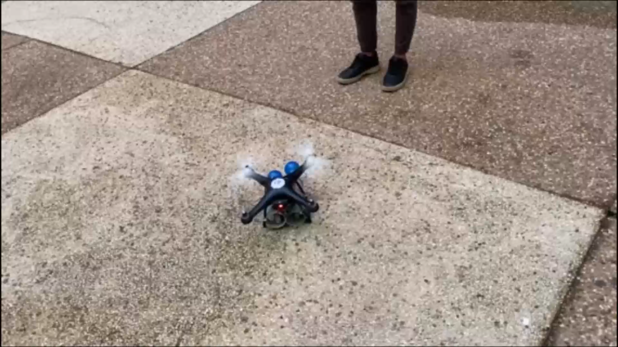

Slide 20
Thanks For Listening☺

