Slide 1

Foundation Design for A Multi-Story Residential Building
By
Firas Jaber– Reg. No: 11344722
Zeiad B3ara– Reg. No: 11344369
Omar Bishawi – Reg.No:11344594
Under supervision of: Dr. Mohamad Ghazal.

Slide 2
Outlines
Introduction
Type of Foundations
Site Description.
Structural System.
Analysis.
Methodology
Design& result

Slide 3
Introduction
Aim of the project :
This project aims to design a foundations for a residual building on three choices of footing design with variable values of bearing capacities for each choice.
1st option single footing
2nd option Raft(mat) foundation
3rd option piles.

Slide 4
Type of foundation
Pile
Type
Mat
Single

Slide 5
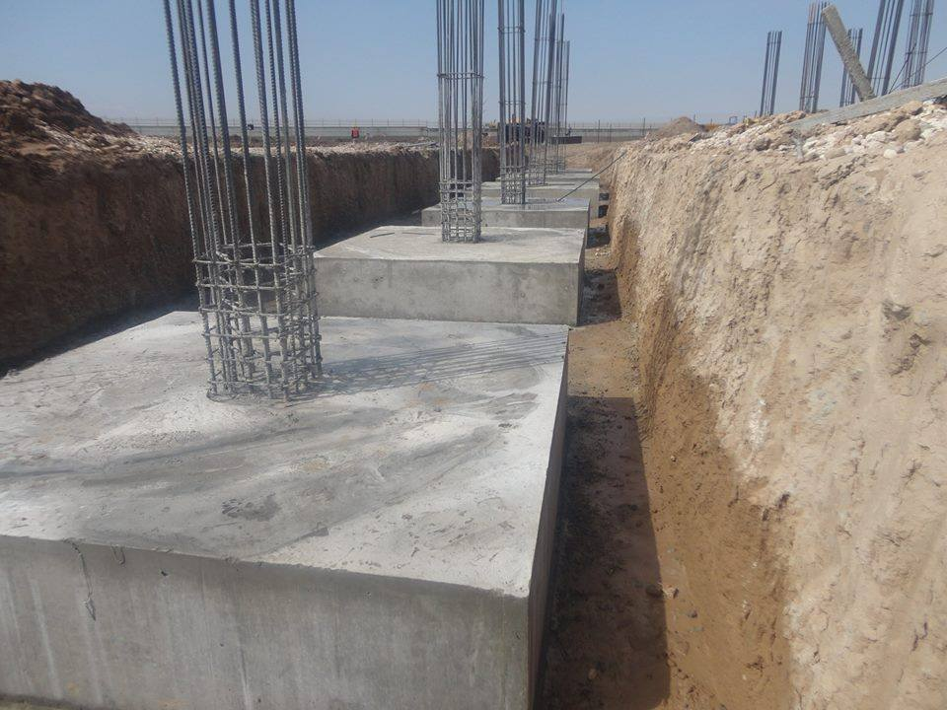
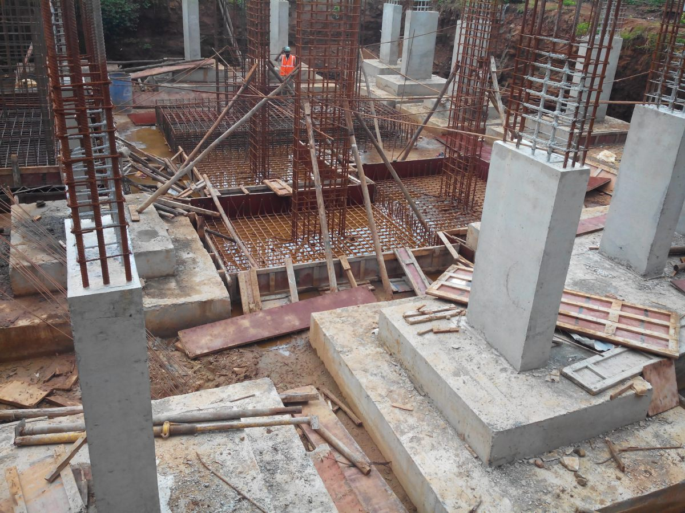
The shallow foundation
Single footing .
Raft(mat) foundation.
basement wall.

Slide 6
Deep foundation
Pile: is a deep foundation which is used since the upper part of the soil is week and the bearing capacity is small can’t carry the building.
Piles have two types:
1- End bearing pile.
2- Friction pile.

Slide 7
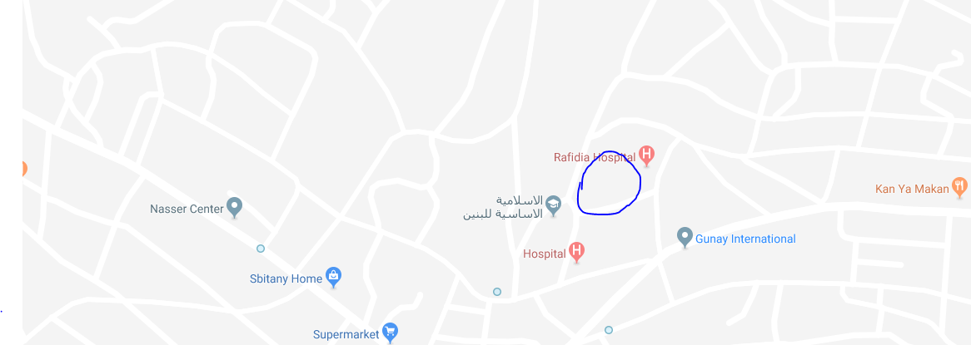
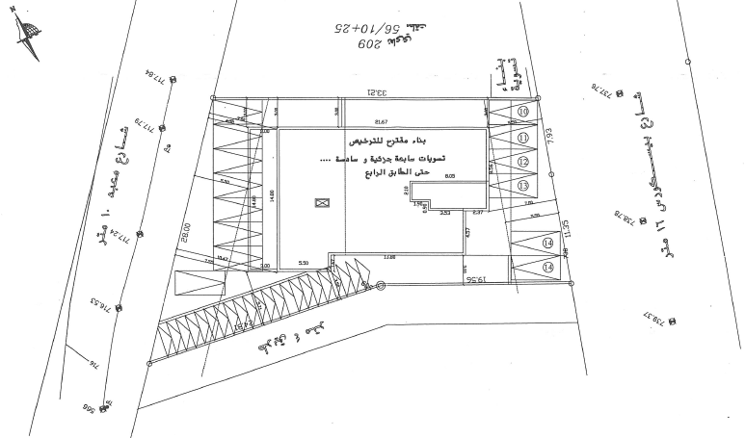
Site Description
Al-Dardouk residential building, this building consists of 10 stories.
It is bordered by a street of 16 m width from the east, a street of 10 m width from the west, a street of 4 m from the south and existing buildings from north and east.
plan area of 900 square meters , Nablus, Palestine,
Basin NO.7 Rafedia and Parcel NO. B 42.

Slide 8
Structural System.
Foundation design must support different kinds of loads. Such as dead load, live loads, snow loads, wind loads and seismic loads. Foundation should be design in the way which meets building requirements.
Loads
Gravity
Lateral
Dead
Live
Earthquake

Slide 9
Methodology
The structure is going to be modeled using ETABS 2016 program in order to analyze and design the basement wall and to get the reaction values to use it in the designing of foundations in different conditions, and then SAFE 2016 to analyze and design the different types of footings.

Slide 10
Codes and Standards
ACI 318-14 (American Concrete Institute): building code requirements of structural concrete and commentary.
ASCE7-2010 (American Society of Civil Engineers).
AutoCAD 2014.
ETABS 2016& then SAFE 2016 program.

Slide 11
Analysis
Loads and load combination:
Dead loads:
The dead load calculated by (ETABS).
Wall weight = 22 KN/m
Superimposed dead loads:
The superimposed dead load was 4.13 KN/m²
Live loads:
The live load was 3 KN/m²
.

Slide 12
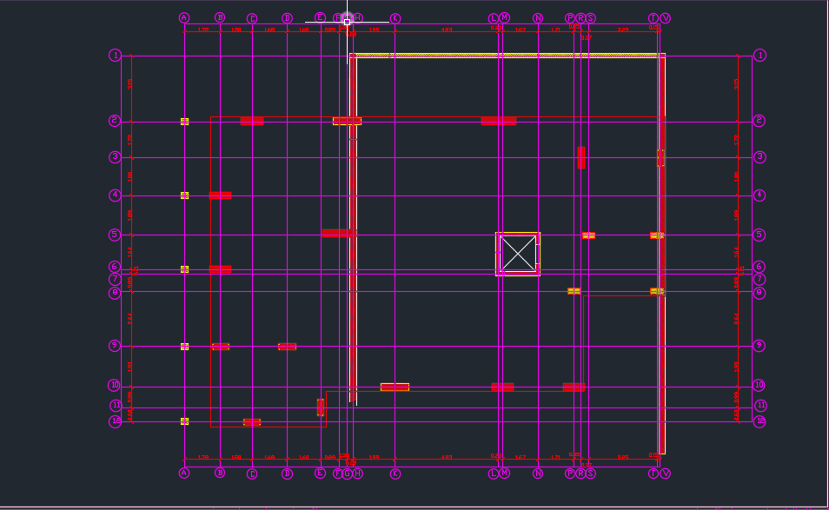
The Center lines of columns:

Slide 13
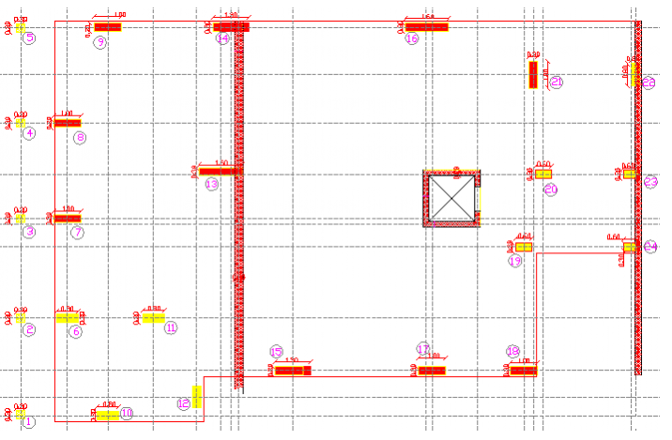
Columns layout of the structure

Slide 14
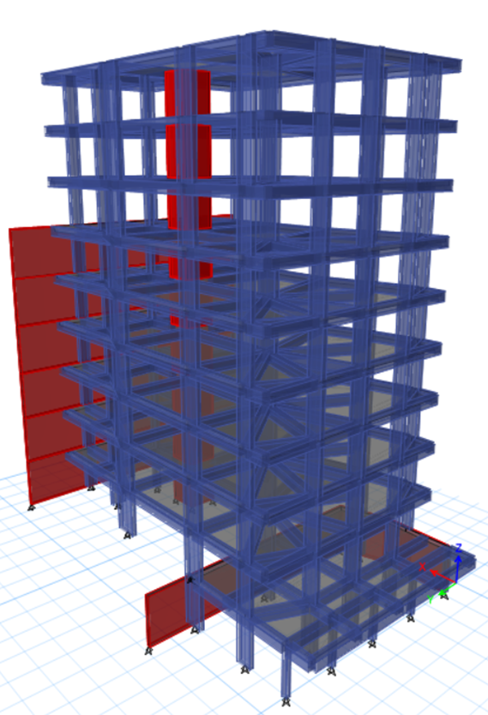
3D Modeling for building

Slide 15
Reactions on each column
Column # | Service Load (KN) | Ultimate load (KN)
C1 | 131 | 183.4
C2 | 348 | 487.2
C3 | 340 | 476
C4 | 350 | 490
C5 | 140 | 196
C6 | 2340 | 3276
C7 | 2550 | 3570
C8 | 2565 | 3591
C9 | 2100 | 2940
C10 | 1040 | 1456
C11 | 2400 | 3360
C12 | 725 | 1015
C13 | 5464 | 7649.6
C14 | 2542 | 3558.8
C15 | 3220 | 4508
C16 | 3300 | 4620
C17 | 1995 | 2793
C18 | 1455 | 2037
C19 | 1000 | 1400
C20 | 900 | 1260
C21 | 2070 | 2898
C22 | 330 | 462
C23 | 343 | 480.2
C24 | 250 | 350

Slide 16
Design of foundations
Our footing options | Assumed Bearing Capacity
1st Single footing | 300 KN/m²
2nd Mat foundation | 150 KN/m²
3rd Piles | 120 KN/m²

Slide 17
First design option (single footing )
Take single footing with bearing capacity 300 KN/m2 as a supporting foundation for design.
Since we have different values of reactions we are going to make grouping for footings:
Group1 {5464} KN for (C13)
Group2 {3300 – 3220} KN for (C16 and C15)
Group3 {2565 – 2340} KN for (C8, C7, C14, C11 and C6)
Group4 {2100 – 1455} KN for (C9, C21, C17 and C18)
Group5 {1040– 725} KN for (C10, C19, C20 and C12)
Group6 {350– 131} KN for (C4, C2, C23, C3, C22, C24, C5 and C1)

Slide 18
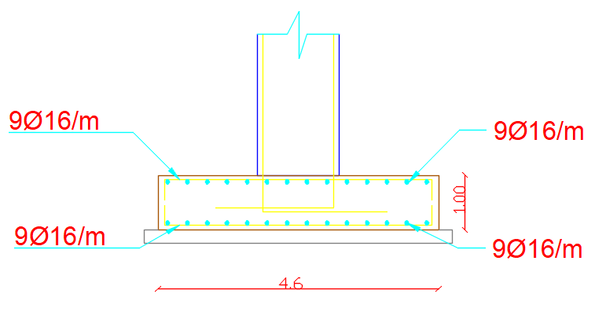
Figure ‎7‑3 section in Footing F1

Slide 19
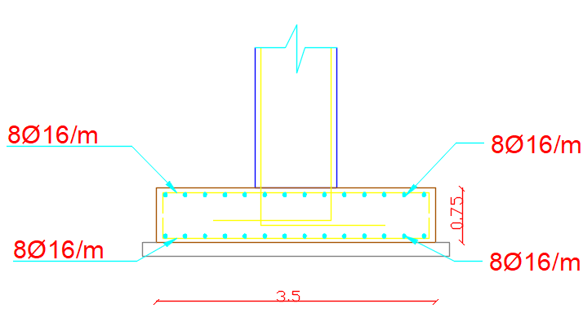
Figure ‎7‑5 Section in footing F2

Slide 20
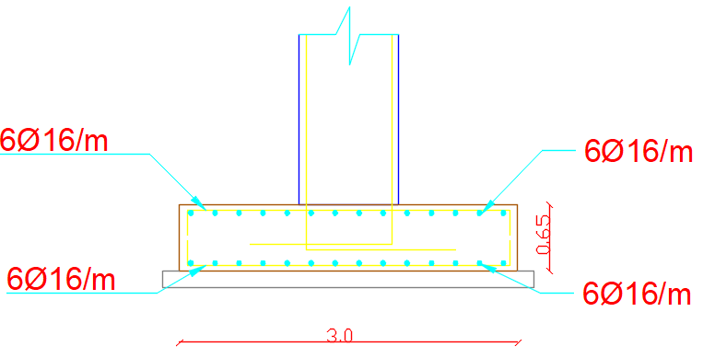
Figure ‎7‑7 Section in footing F3

Slide 21
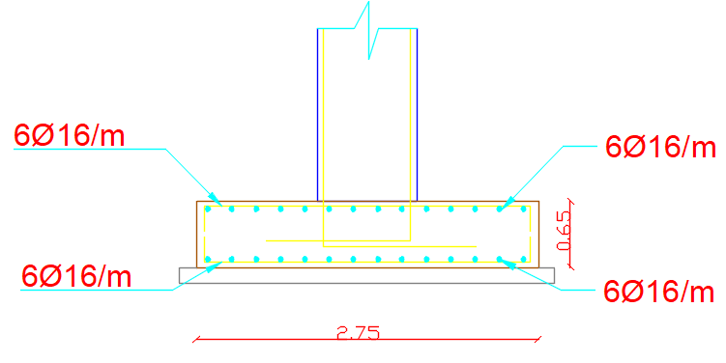
Figure ‎7‑9 Section in footing F4

Slide 22
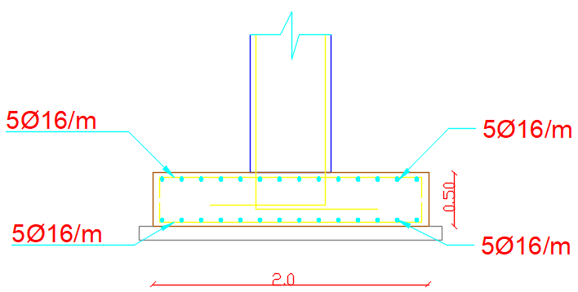
Figure ‎7‑11 Section in footing F5

Slide 23
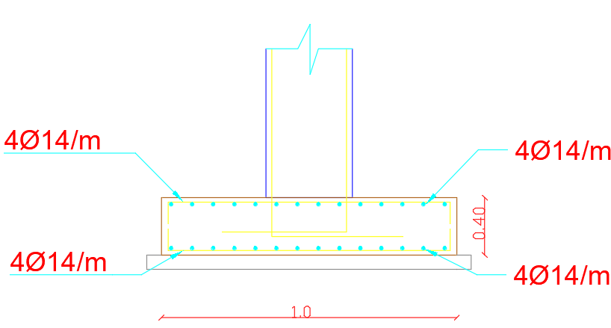
Figure ‎7‑13 Section in footing F6

Slide 24
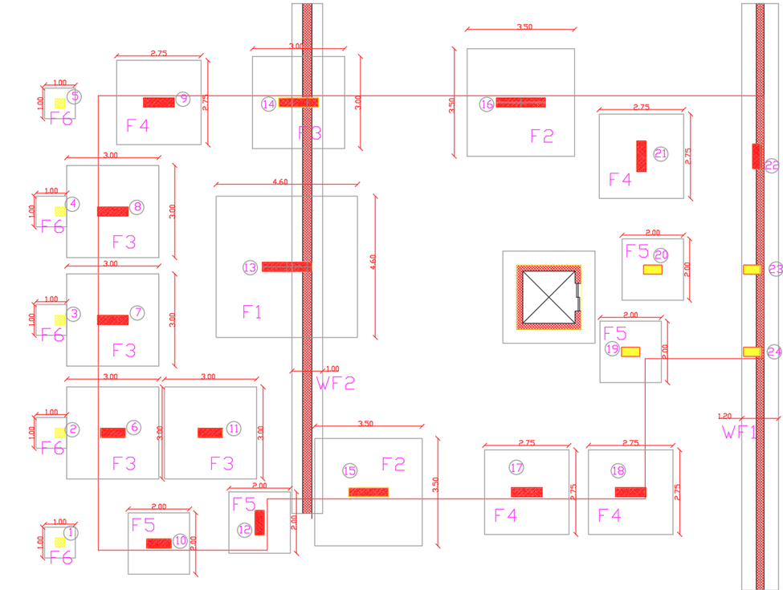
Figure 7-18 show the layout of footings for First Option

Slide 25
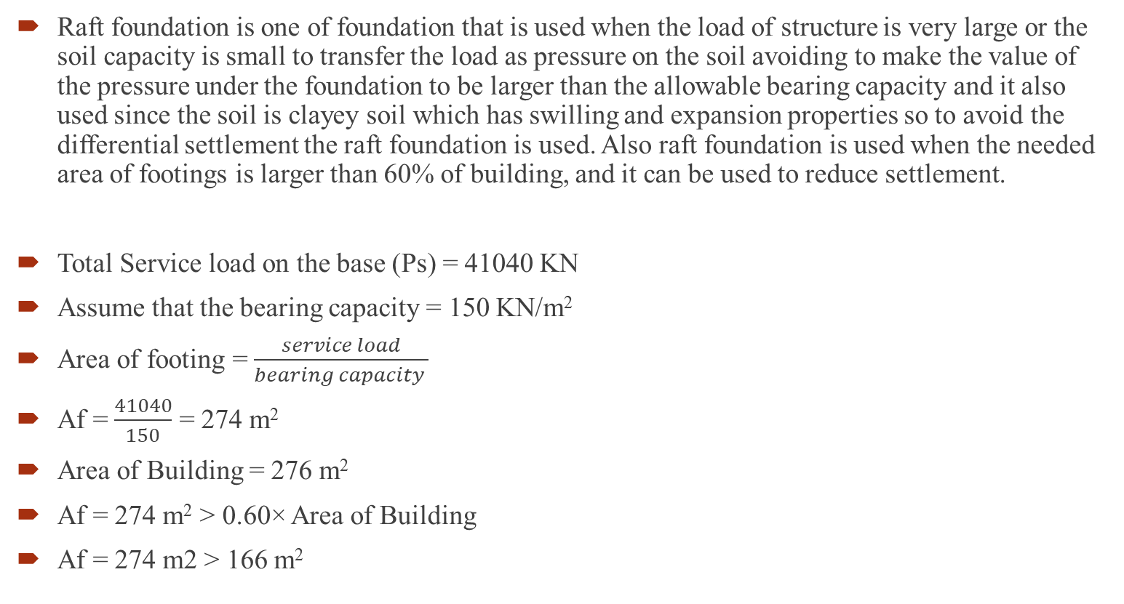
Second option Mat(Raft) foundation
Raft foundation is one of foundation that is used when the load of structure is very large or the soil capacity is small to transfer the load as pressure on the soil avoiding to make the value of the pressure under the foundation to be larger than the allowable bearing capacity and it also used since the soil is clayey soil which has swilling and expansion properties so to avoid the differential settlement the raft foundation is used. Also raft foundation is used when the needed area of footings is larger than 60% of building, and it can be used to reduce settlement.
Total Service load on the base (Ps) = 41040 KN
Assume that the bearing capacity = 150 KN/m²
Area of footing = $\frac{service load}{bearing capacity }$
Af = $\frac{41040}{150}$ = 274 m²
Area of Building = 276 m²
Af = 274 m² > 0.60× Area of Building
Af = 274 m2 > 166 m²

Slide 26
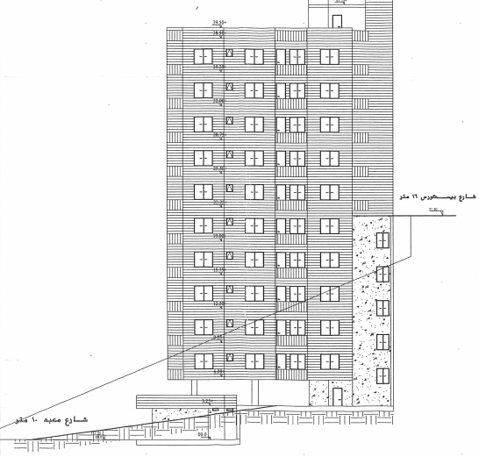
Mat or Raft Foundation
Area of foundation / Building area = more than 60 %.
Since there is two different level on the building, the raft foundation will be divided to two parts each one is on different level.

Slide 27
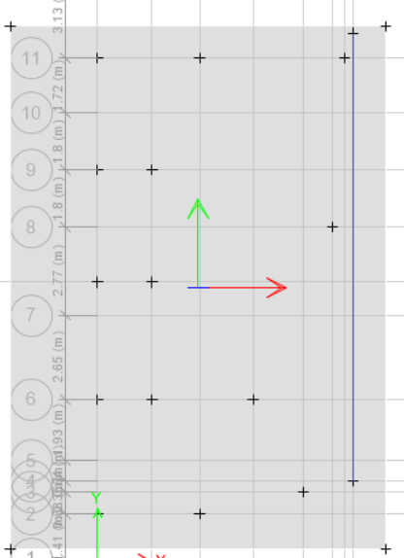
Design
We use SAFE program in order to design Mat foundation.
Extension in some corners is carried out in order to reduce punching shear and therefore reduce thickness of mat.

Slide 28
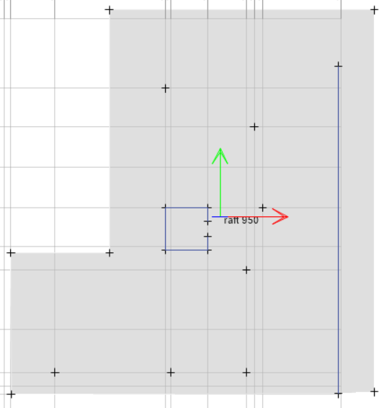
Design
This Figure ‎shows the model of part.1& part.2 of mat foundation.

Slide 29
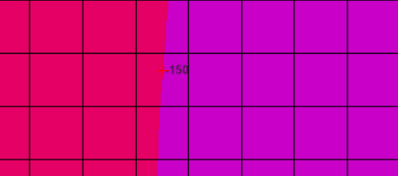
Design part.1 of mat foundation
Bearing Capacity Check
q = 150KN/m²
q_{all} = 150 KN/m²
q = q_{all} ………………… (OK)

Slide 30
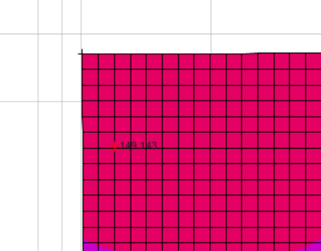
Design part.2 of mat foundation
Bearing Capacity Check
q = 149 KN/m2
qall = 150 KN/m2
q < qall ………………… (OK)

Slide 31
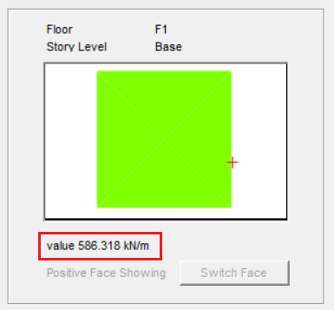

Design part.1 of mat foundation
Wide beam Shear Check
Vu = 586 KN/m
ØVc = $\frac{0.75}{6}$×$\sqrt{28}$×1000×$\frac{910}{1000}$
ØVc = 601 KN/m
ØVc > Vu ………………… (OK)

Slide 32
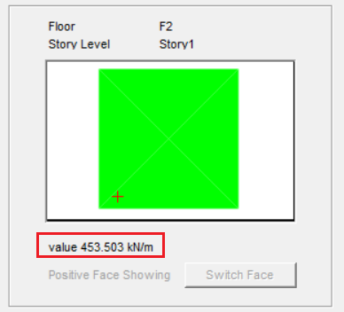

Design part.2 of mat foundation
Wide beam Shear Check
Vu = 453 KN/m
ØVc = $\frac{0.75}{6}$×$\sqrt{28}$×1000×$\frac{910}{1000}$
ØVc = 601 KN/m
ØVc > Vu …………………(OK)

Slide 33
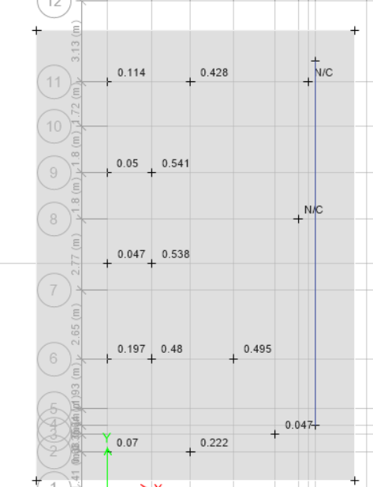
Design part.1 of mat foundation
We use thickness of mat foundation to be 1m then we check it by display punching on columns and all results found less than 1 and it is ok.
Since the Punching ratio less than 1
0.54<1 …………………(OK)

Slide 34
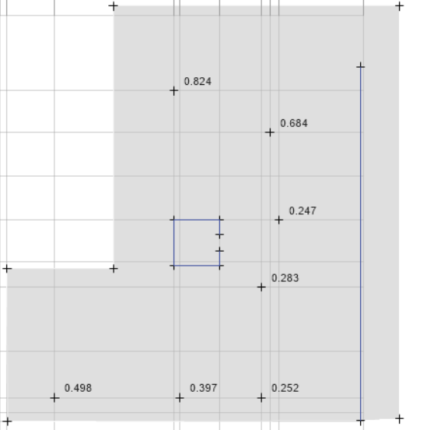
Design part.2 of mat foundation
We use thickness of mat foundation to be 1m then we check it by display punching on columns.
Since the Punching ratio less than 1
0.85<1 …………………(OK)

Slide 35
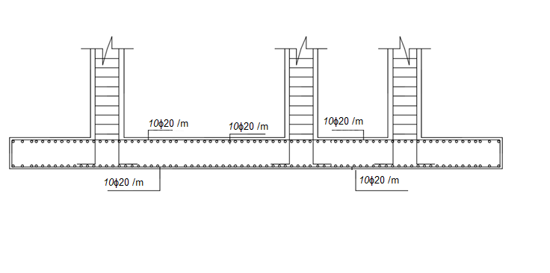
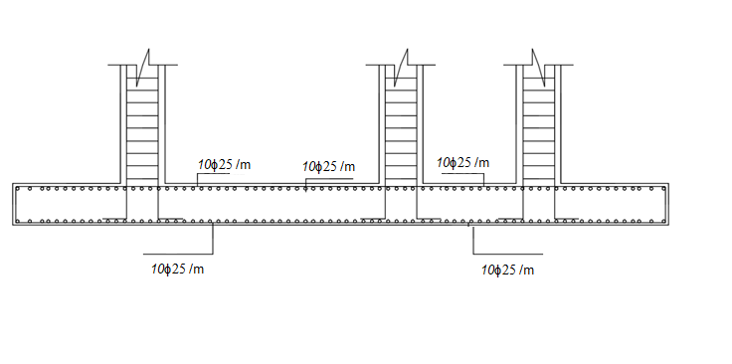
Mat foundation reinforcement :
The reinforcement for part 1
The reinforcement for part 2

Slide 36
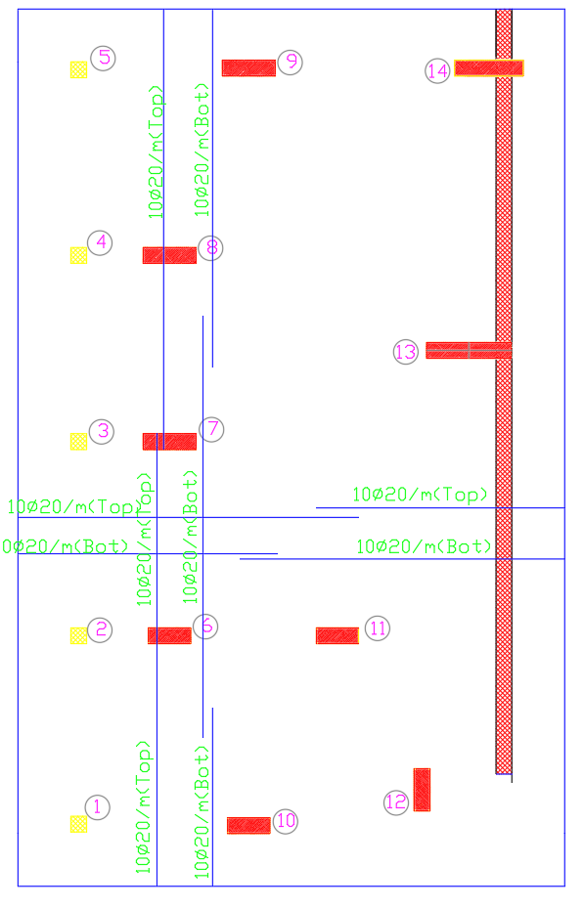
Mat foundation reinforcement :
Raft foundation Reinforcement part 1.

Slide 37
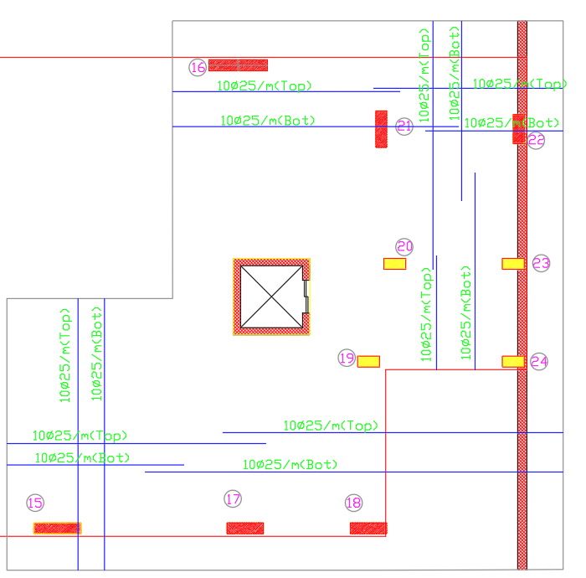
Mat foundation reinforcement :
Raft foundation Reinforcement part 2 .

Slide 38
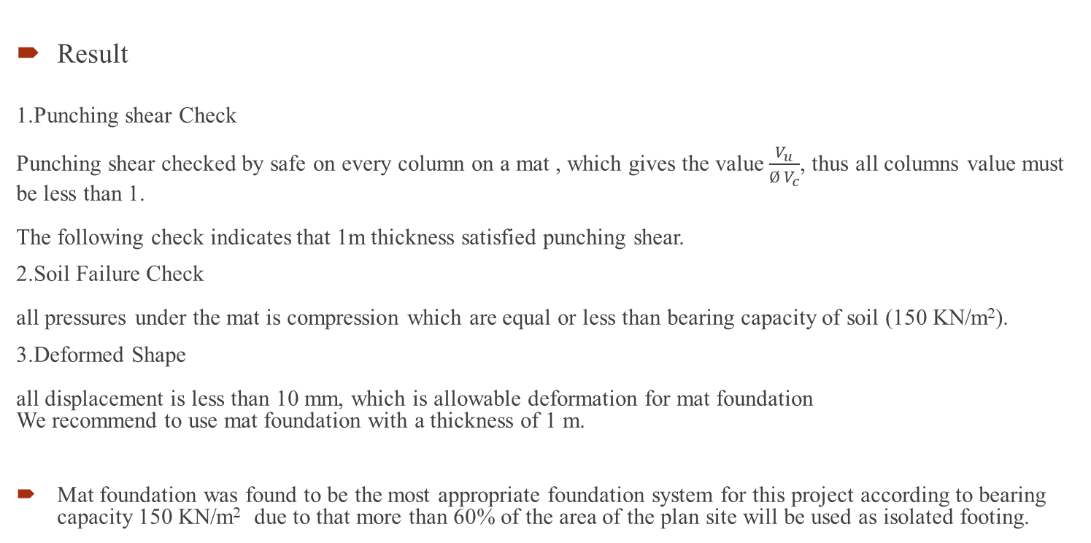
Summary
Result
1.Punching shear Check
Punching shear checked by safe on every column on a mat , which gives the value$\frac{V_{u}}{Ø V_{c}}$, thus all columns value must be less than 1.
The following check indicates that 1m thickness satisfied punching shear.
2.Soil Failure Check
all pressures under the mat is compression which are equal or less than bearing capacity of soil (150 KN/m²).
3.Deformed Shape
all displacement is less than 10 mm, which is allowable deformation for mat foundation
We recommend to use mat foundation with a thickness of 1 m.
Mat foundation was found to be the most appropriate foundation system for this project according to bearing capacity 150 KN/m² due to that more than 60% of the area of the plan site will be used as isolated footing.

Slide 39
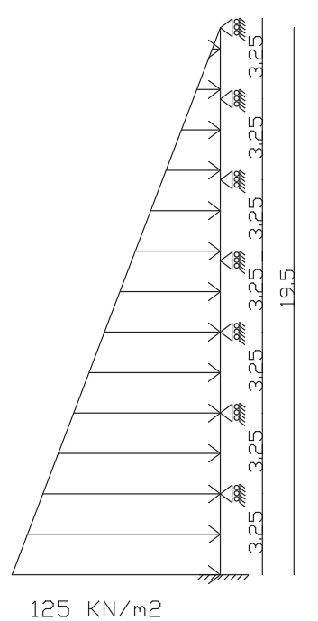
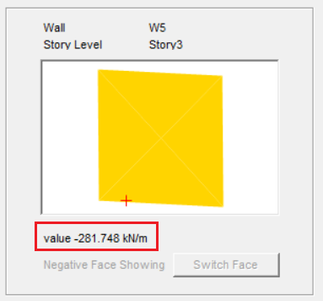

Design of basement wall.1:
Assume that wall thickness (h)= 50cm
Wide beam Shear Check
ØV_{c} = $\frac{0.75}{6}$×$\sqrt{28}$×1000×$\frac{460}{1000}$
ØV_{c} = 304 KN/m
ØV_{c} > V_{u} …………………(OK)

Slide 40
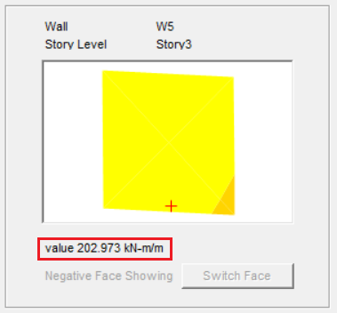

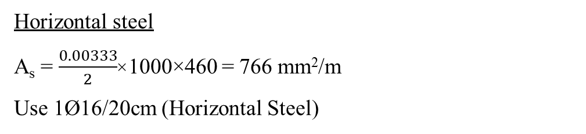
Design of basement wall.1:
Flexure design
M_{u} = 203KN.m/m
$ρ= \frac{0.85×f_{c}^{′}}{F_{y}}×$
$(1−\sqrt{1−\frac{2.61 ×M_{u}}{b×d^{2}×f_{c}^{′}}}$)
$ρ= \frac{0.85×28}{420}×(1−\sqrt{1−\frac{2.61 ×203×{10}^{6}}{1000×{460}^{2}×28}}$)
$ρ=0.0026$
$ρ$_{min} = 0.00333
$ρ<$ $ρ$_{min}
A_{s(min)} = 0.00333×1000×460
A_{s(min)} = 1532 mm²/m
A_{s} = 1195 mm²/m
Use A_{s(min)} = 1532 mm²/m
Use 6Ø18/m (Vertical Steel)
Horizontal steel
A_{s} = $\frac{0.00333}{2}$×1000×460 = 766 mm²/m
Use 1Ø16/20cm (Horizontal Steel)

Slide 41
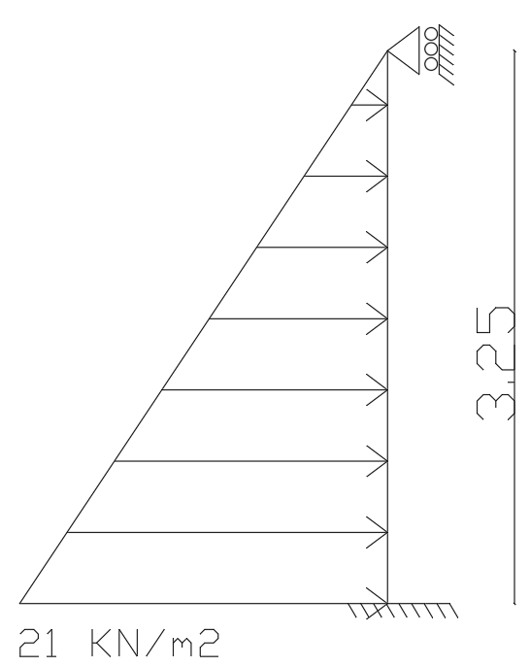
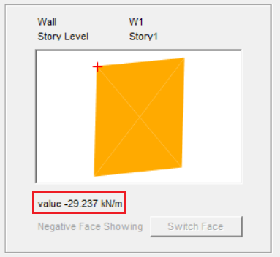

Design of basement wall.2:
Assume that wall thickness (h)= 30cm
V_{u} = 30 KN/m
ØV_{c} = $\frac{0.75}{6}$×$\sqrt{28}$×1000×$\frac{260}{1000}$
ØV_{c} = 172 KN/m
ØV_{c} > V_{u} …………………(OK)

Slide 42
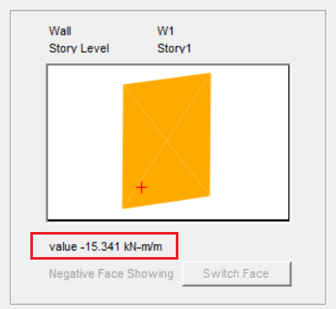


Design of basement wall.2:
Flexure design
M_{u} = 15KN.m/m
$ρ= \frac{0.85×f_{c}^{′}}{F_{y}}×(1−\sqrt{1−\frac{2.61 ×M_{u}}{b×d^{2}×f_{c}^{′}}}$)
$ρ= \frac{0.85×28}{420}×(1−\sqrt{1−\frac{2.61 ×15×{10}^{6}}{1000×{260}^{2}×28}}$)
$ρ=0.0006$
$ρ$_{min} = 0.00333
$ρ<$ $ρ$_{min}
A_{s(min)} = 0.00333×1000×260
A_{s(min)} = 866 mm²/m
A_{s} = 153 mm²/m
Use A_{s(min)} = 866 mm²/m
Use 1Ø16/20cm (Vertical Steel)
Horizontal steel
A_{s} = $\frac{0.00333}{2}$×1000×260 = 433 mm²/m
Use 1Ø12/25cm (Horizontal Steel)

Slide 43
Third design option (piles )
For soil with bearing capacity 120 KN/m2, each pile capacity was assumed to be 950 KN/m2 as a supporting foundation for design.
Since we have different values of reactions we are going to make grouping for piles.
  Group1 {5464} KN for (C13)
  Group2 {3300 – 3220} KN for (C16 and C15)
  Group3 {2565 – 2340} KN for (C8, C7, C14, C11 and C6)
  Group4 {2100 – 1455} KN for (C9, C21, C17 and C18)
  Group5 {1040– 725} KN for (C10, C19, C20 and C12)
  Group6 {350– 131} KN for (C4, C2, C23, C3, C22, C24, C5 and C1)

Slide 44
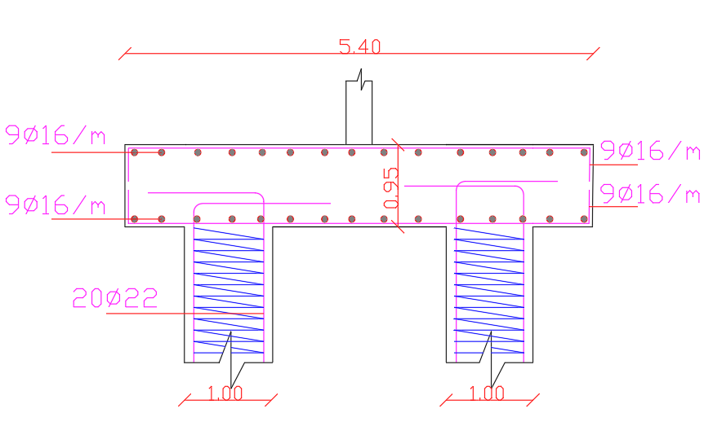
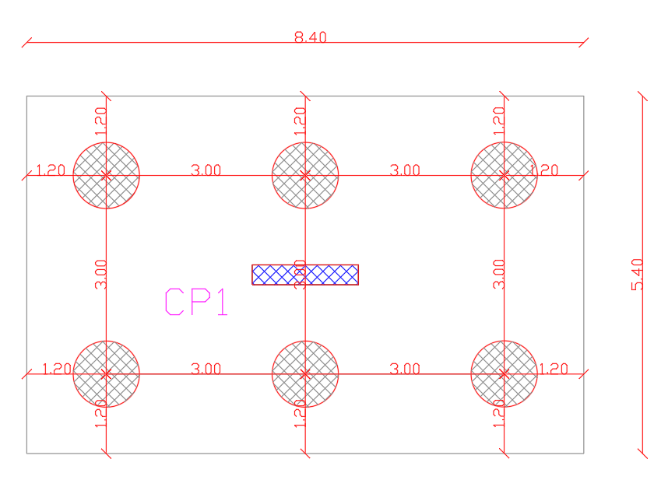
Figure ‎7‑27 section in Pile cap CP1, Figure ‎7‑25 CP1 layout
Figure ‎7‑25 CP1 layout
Figure ‎7-27 section in Pile cap CP1

Slide 45
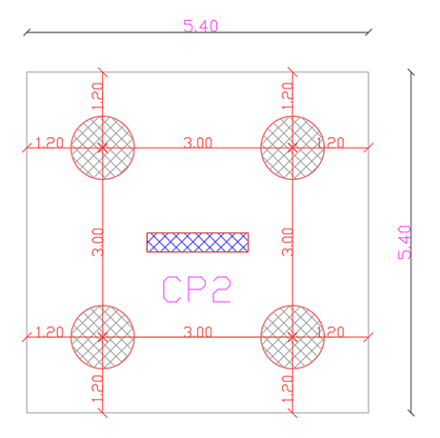
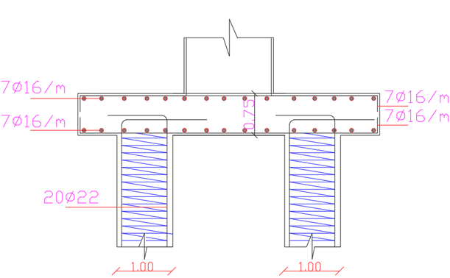
Figure ‎7 28 CP2 layout, Figure ‎7 30 Section in pile cap CP2
Figure ‎7 30 Section in pile cap CP2
Figure ‎7 28 CP2 layout,

Slide 46
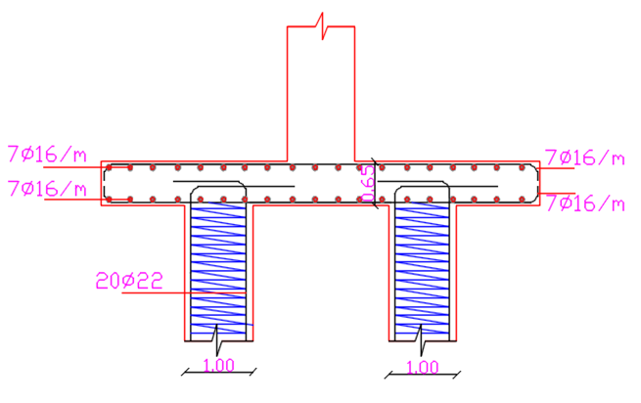
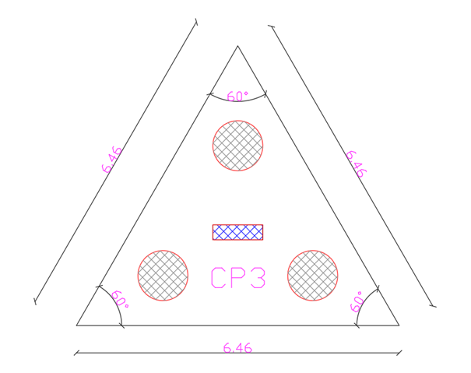
Figure ‎7-31 Shows CP3 layout, Figure ‎7 33 shows Section in pile cap CP3
Figure ‎7 33 shows Section in pile cap CP3
Figure ‎7-31 Shows CP3 layout,

Slide 47
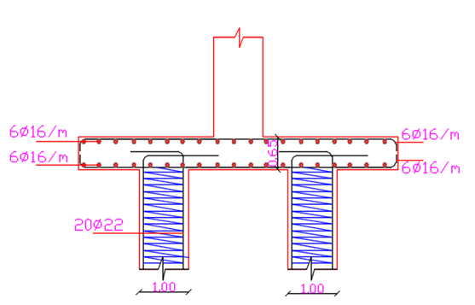
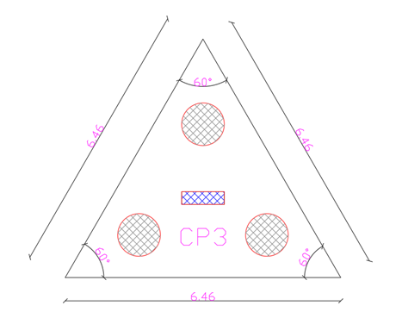
Figure ‎7-34 CP4 layout, Figure ‎7 36 Section in pile cap CP4
Figure ‎7 36 Section in pile cap CP4
Figure ‎7-34 CP4 layout,

Slide 48


Figure ‎7-37 CP5 layout, Figure ‎7-39 shows Section in pile cap CP5
Figure ‎7-39 shows Section in pile cap CP5
Figure ‎7-37 CP5 layout

Slide 49


Figure ‎7-40 CP6 layout, Figure ‎7-42 shows Section in pile cap CP6
Figure ‎7-42 shows Section in pile cap CP6
Figure ‎7-40 CP6 layout

Slide 50

Analysis result
Analysis result
Since the Service load combination has a compression reaction this means that the structure is impossible to overturn.

Slide 51
Recommendation
According to our project site ,which has a bearing capacity of soil =300 kn/m^2,we find that the best choice is to design it on single footings.

Slide 52

Thanks for being here

